Slide 1

Cars4U
Supervised Learning - Foundations
Renato Barroco

Slide 2

This is an exploratory data analysis and a supervised learning (regression) analysis using a dataset provided by great learning at the Post Graduate program of Data Science and Business Analytics.
The main objective is to apply supervised learning regression to arrive at statistically significant coefficients of linear regressions and to build a model for used car price predictions, generate a set of insights and recommendations that will help the business to grow.

Slide 3

Data Dictionary
1. S.No. : Serial Number
2. Name : Name of the car which includes Brand name and Model name
3. Location : The location in which the car is being sold or is available for purchase Cities
4. Year : Manufacturing year of the car
5. Kilometers_driven : The total kilometers driven in the car by the previous owner(s) in KM.
6. Fuel_Type : The type of fuel used by the car. (Petrol, Diesel, Electric, CNG, LPG)
7. Transmission : The type of transmission used by the car. (Automatic / Manual)
8. Owner : Type of ownership
9. Mileage : The standard mileage offered by the car company in kmpl or km/kg
10. Engine : The displacement volume of the engine in CC.
11. Power : The maximum power of the engine in bhp.
12. Seats : The number of seats in the car.
13. New_Price : The price of a new car of the same model in INR Lakhs.(1 Lakh = 100, 000)
14. Price : The price of the used car in INR Lakhs (1 Lakh = 100, 000)

Slide 4

Data description
Numerical:
Year
Kilometers_driven
Mileage
Engine
Power
Categorical:
Name
Location
Fuel_Type
Transmission
Owner_Type
Seats

Slide 5
1. Explore and visualize the dataset.

Slide 6
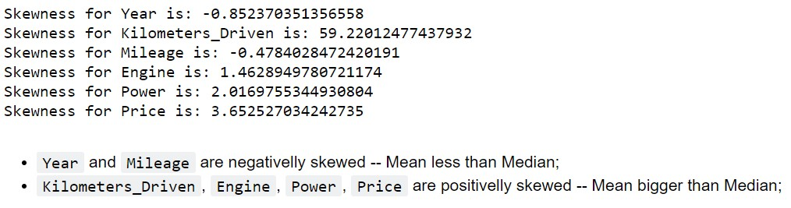
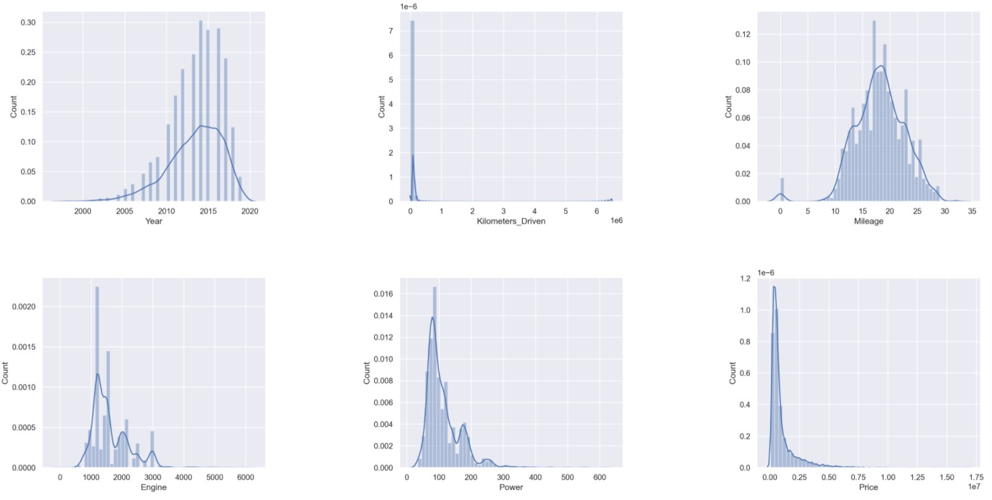
Univariate analysis

Slide 7
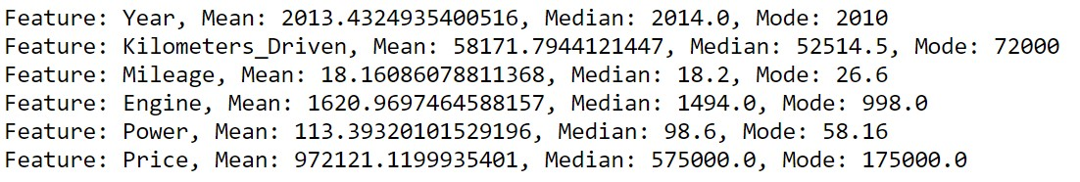
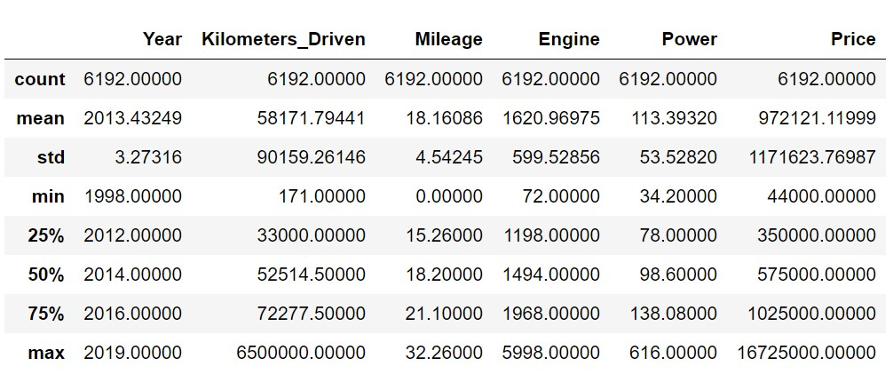
Univariate analysis

Slide 8
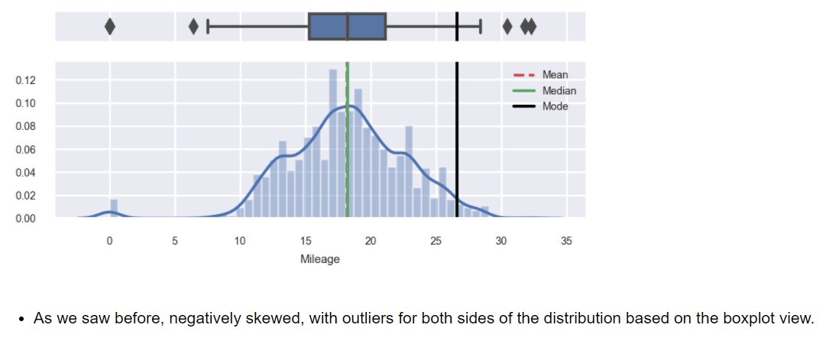
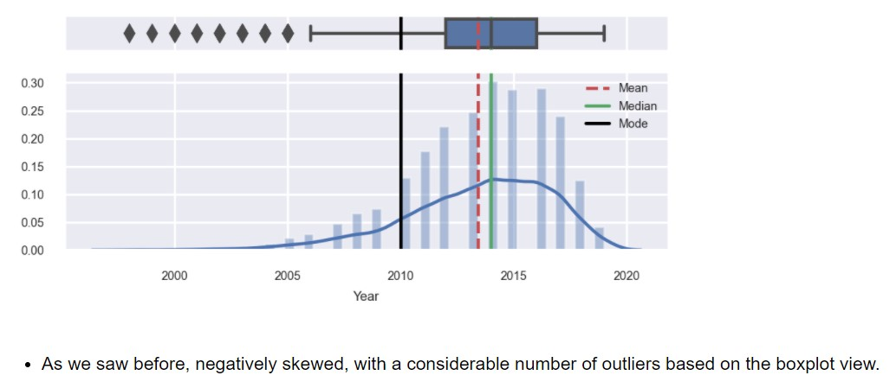
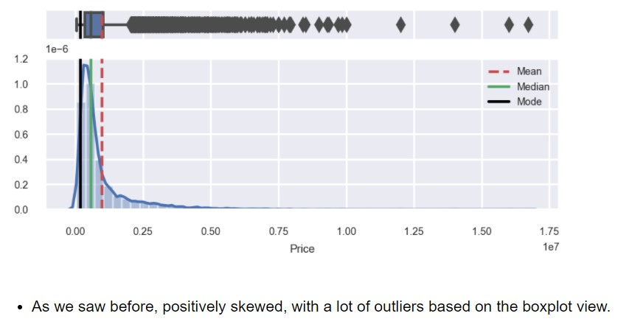
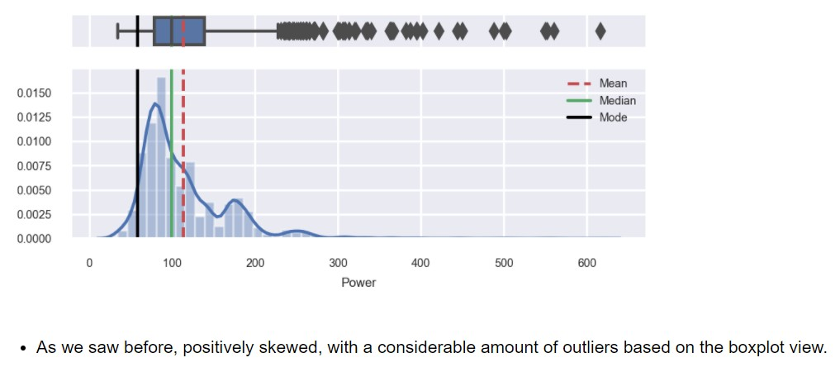
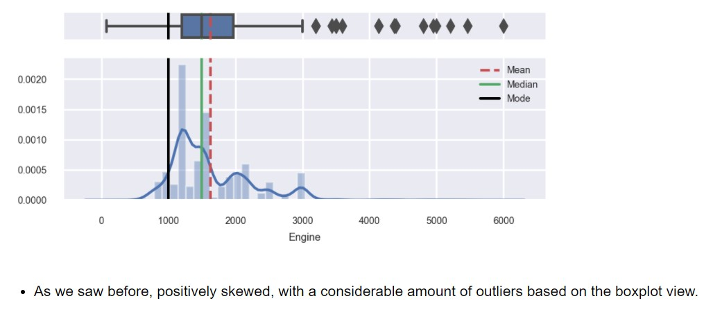
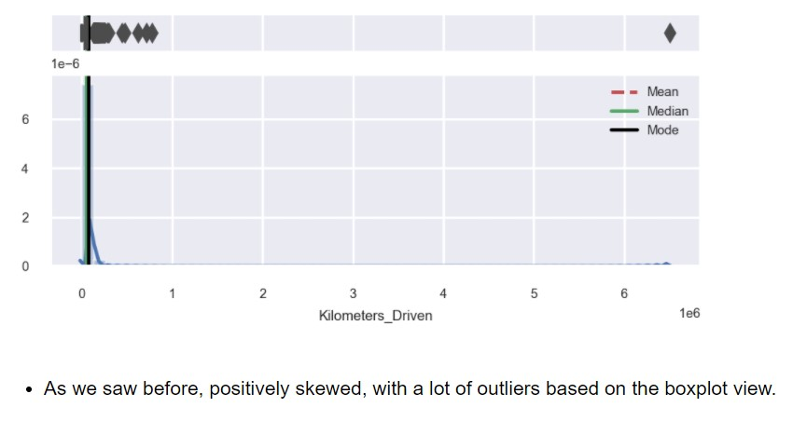

Slide 9
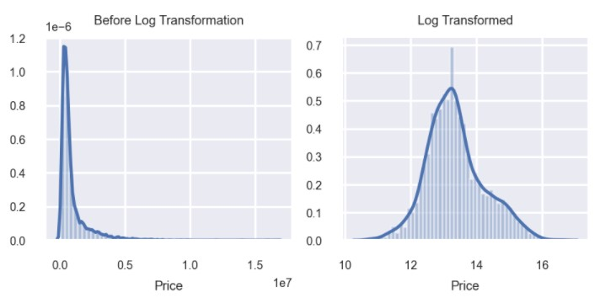
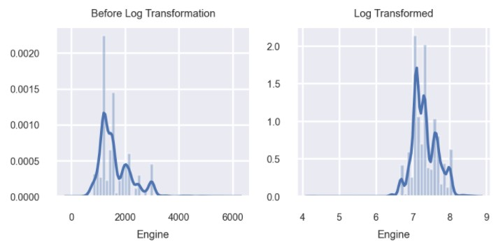
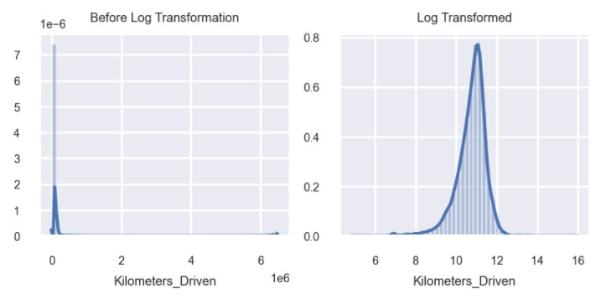
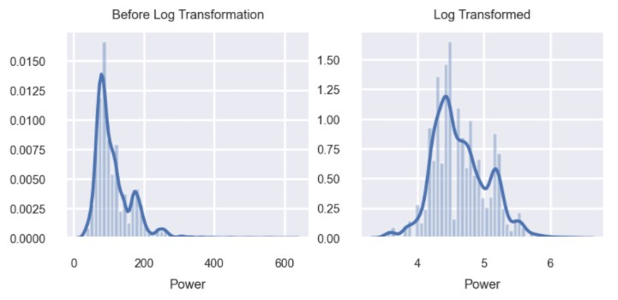

Slide 10
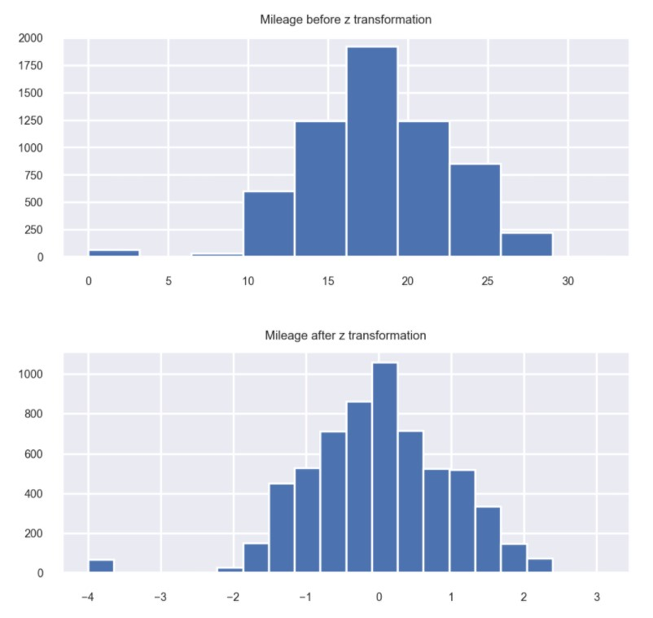

Slide 11
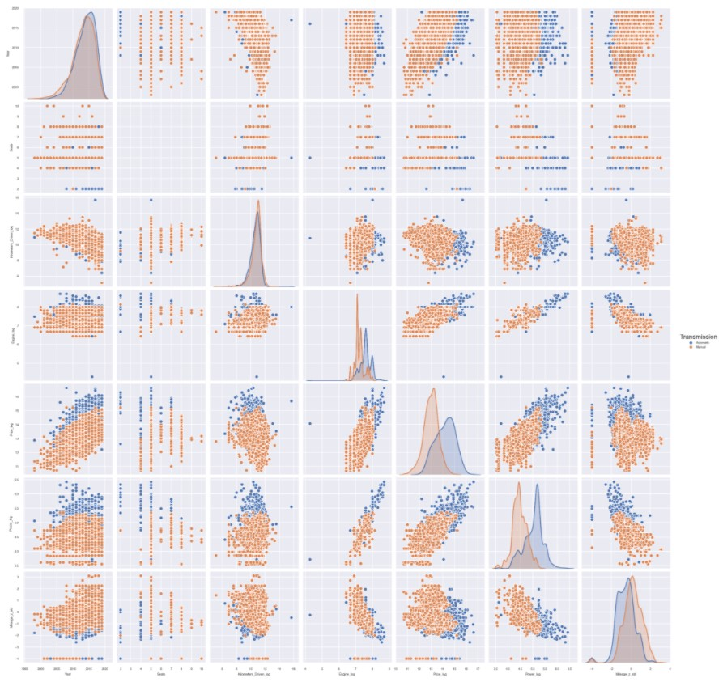
Multivariate analysis

Slide 12
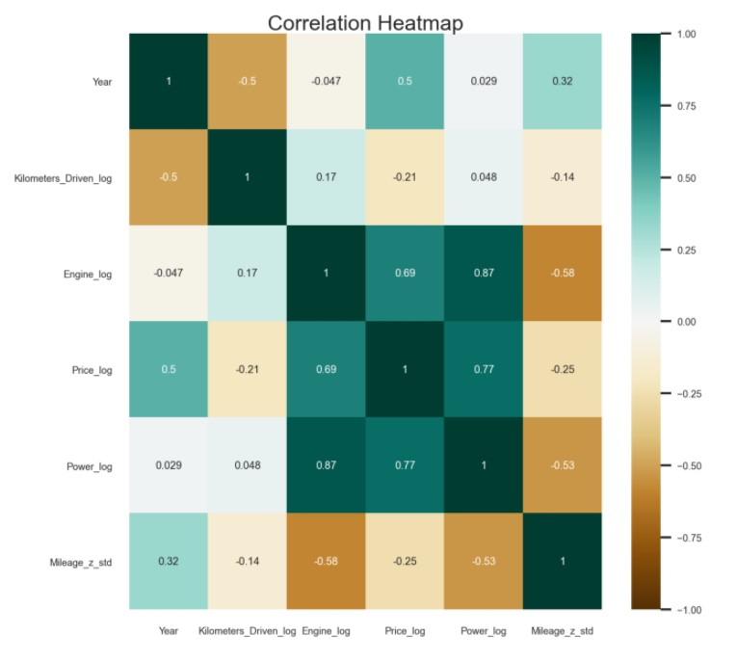
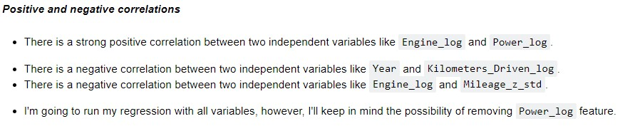
Multivariate analysis

Slide 13
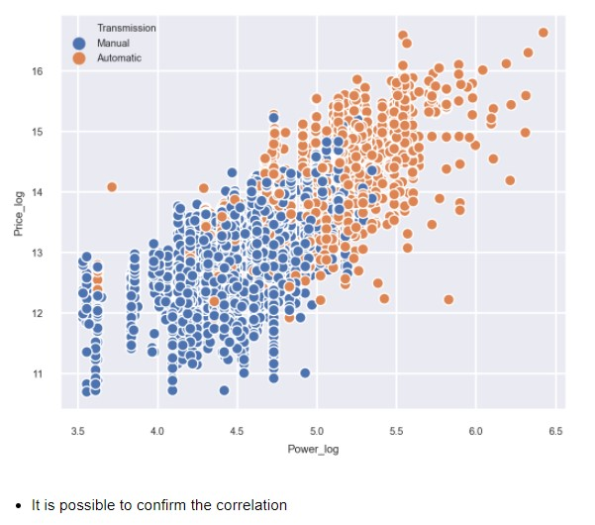
Bivariate analysis

Slide 14
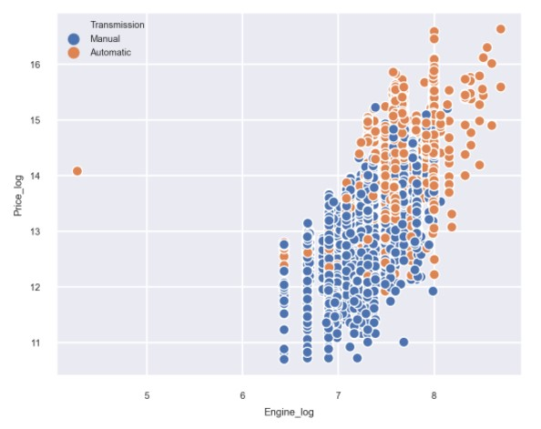
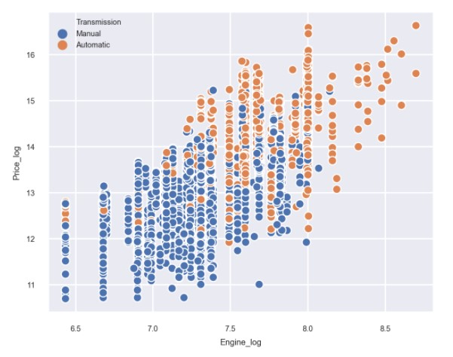
Bivariate analysis (outliers treatment)

Slide 15
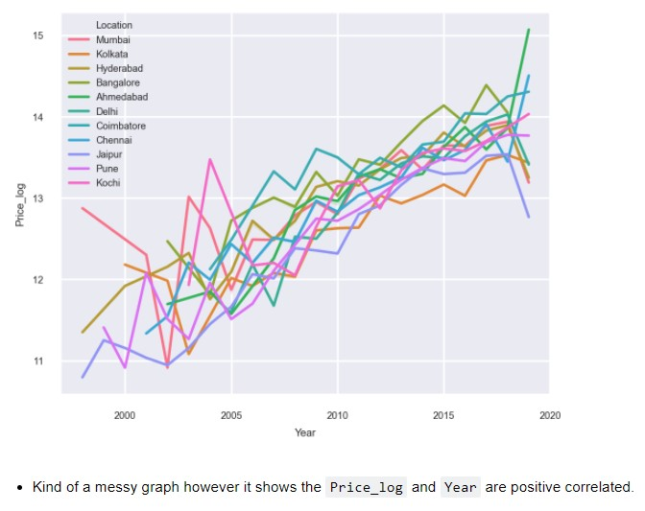
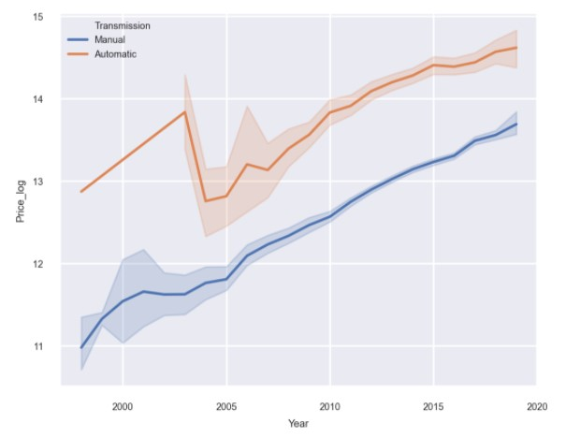
Bivariate analysis

Slide 16
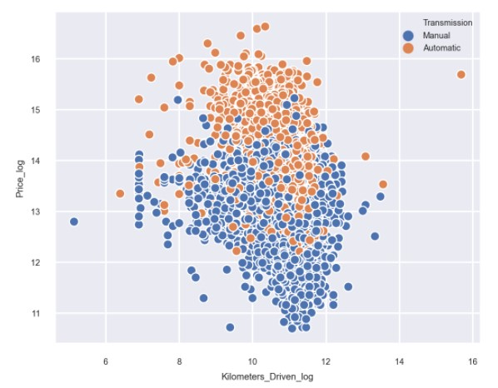
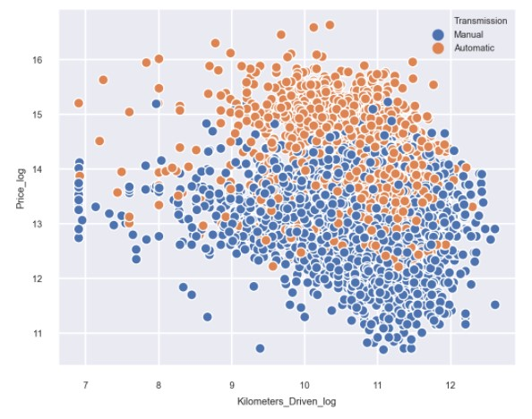
Bivariate analysis (outliers treatment)

Slide 17
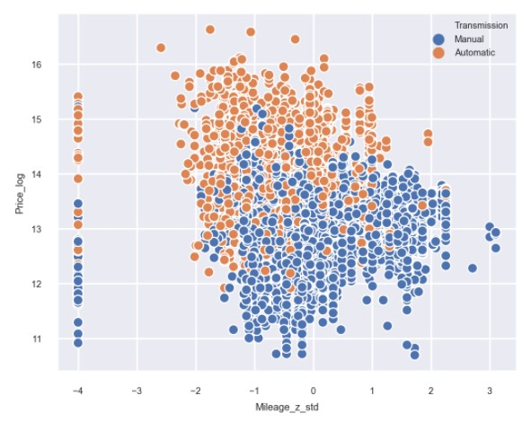
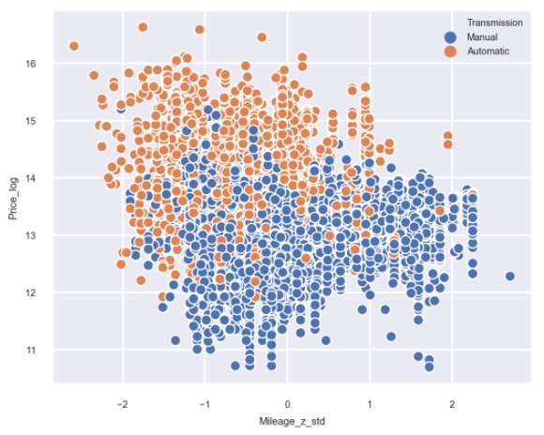
Bivariate analysis (outliers treatment)

Slide 18
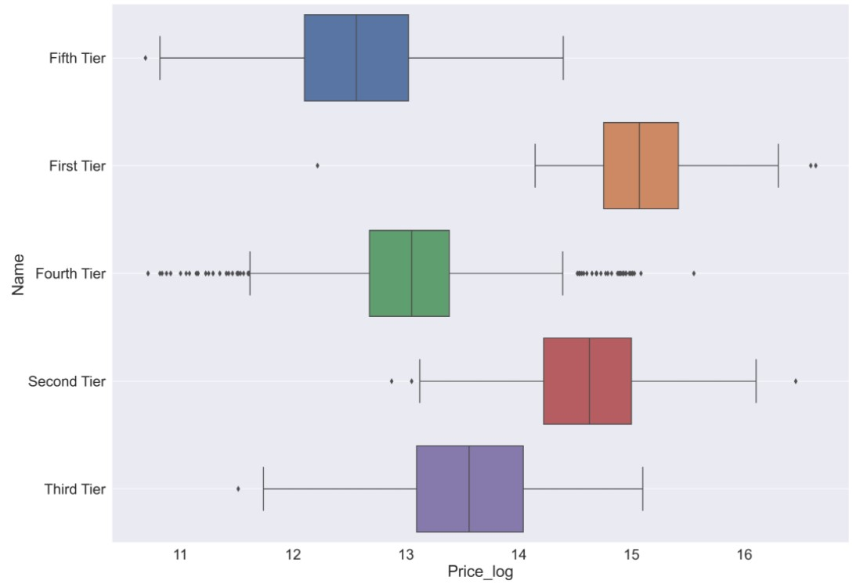
Bivariate analysis (outliers treatment)

Slide 19
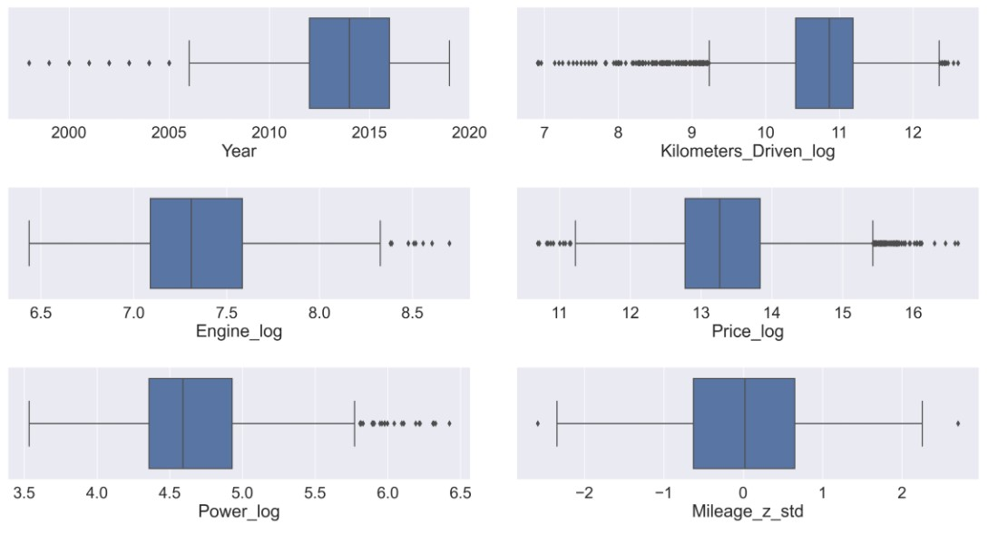
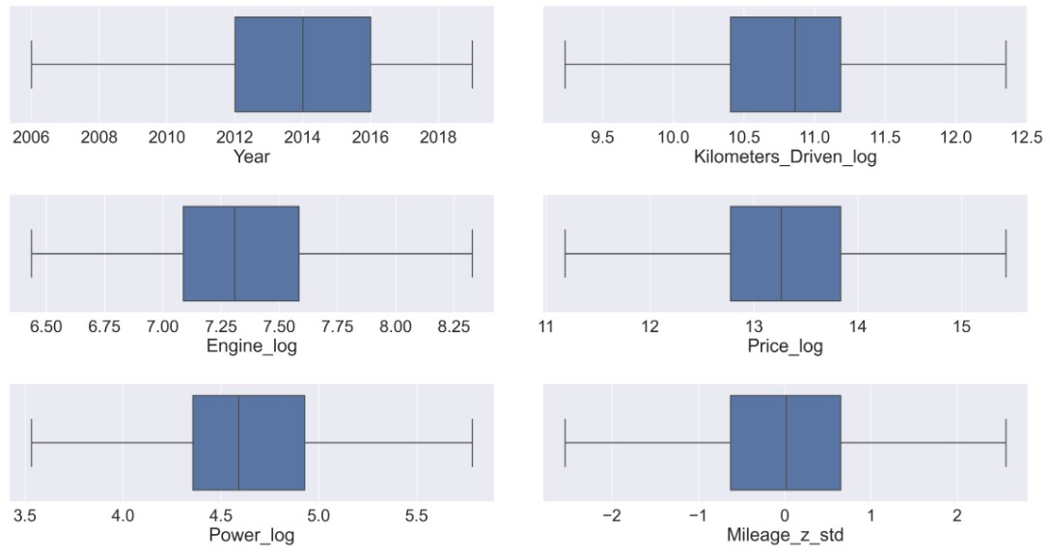
Bivariate analysis (outliers treatment)

Slide 20
2. Build a linear regression model to predict the prices of used cars.

Slide 21
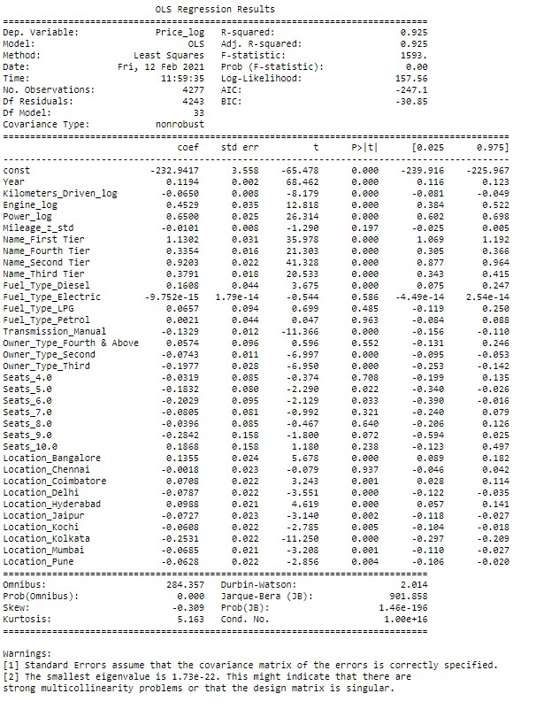
Linear Regression (With all the coefficients)

Slide 22
Linear Regression (With all the coefficients)
## Interpreting the Regression Results:
1. **Adjusted. R-squared**: It reflects the fit of the model.
- Adj. R-squared is **0.925**, which is good!
2. **const coefficient** is the Y-intercept.
- Coeff is **-232** in this first model.
3. **Each coefficient**: It represents the change in the output Y due to a change of one unit in the specific coefficient (everything else held constant).
4. **std err**: It reflects the level of accuracy of the coefficients.
- The lower it is, the higher is the level of accuracy.
5. **P > |t|**: It is p-value.
* Pr(>|t|) : For each independent feature there is a null hypothesis and alternate hypothesis
Ho : Independent feature is not significant
Ha : Independent feature is that it is significant
* Pr(>|t|) gives P-value for each independent feature to check that null hypothesis. we are considering 0.05 (5%) as significance level
* A p-value of less than 0.05 is statistically significant.
6. **Confidence Interval**: It represents the range in which our coefficients are likely to fall (with a likelihood of 95%).

Slide 23
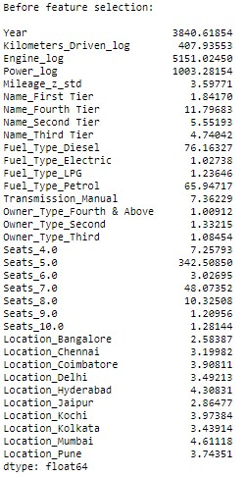
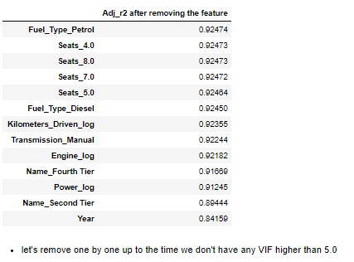
Linear Regression (With all the coefficients)
### Testing the Multicollinearity
* Predictor variables should be independent
* Detecting/testing multi-collinearity using `Variation Inflation Factor`.
### Explaining VIF (substring):
* **Variance Inflation factor, for one exogenous variable**: The variance inflation factor is a measure for the increase of the variance of the parameter estimates if an additional variable, given by exog_idx is added to the linear regression. It is a measure for multicollinearity of the design matrix, exog.
* One recommendation is that if VIF is greater than 5, then the explanatory variable given by exog_idx is highly collinear with the other explanatory variables, and the parameter estimates will have large standard errors because of this.

Slide 24
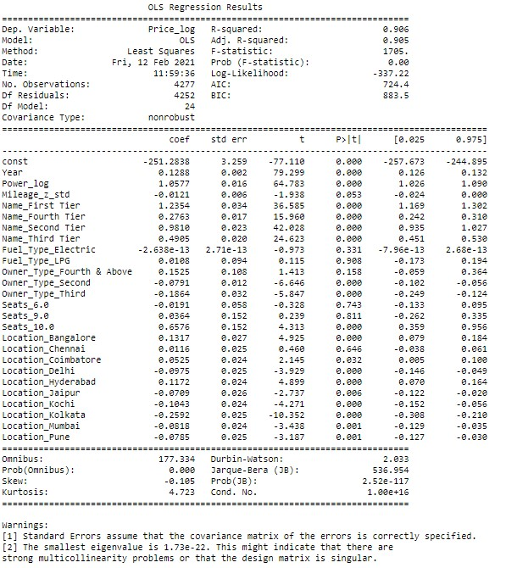
Linear Regression (without the following features: 'Fuel_Type_Petrol', 'Seats_4.0', 'Seats_8.0', 'Seats_7.0', 'Fuel_Type_Diesel’, 'Seats_5.0', 'Kilometers_Driven_log', 'Transmission_Manual', 'Engine_log')

Slide 25
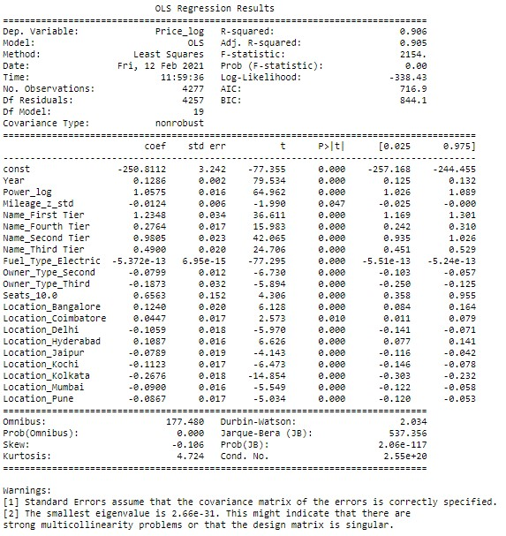
Linear Regression (without the following features: `Seats_6.0`,`Seats_9.0`, `Fuel_Type_LPG`, `Location_Chennai`, and `Owner_Type_Fourth & Above`)

Slide 26
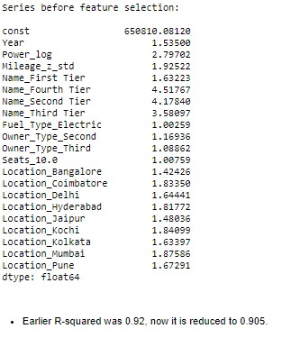
Linear Regression (cleaned)
### Testing the Multicollinearity
* Predictor variables should be independent
* Detecting/testing multi-collinearity using `Variation Inflation Factor`.
### Explaining VIF (substring):
* **Variance Inflation factor, for one exogenous variable**: The variance inflation factor is a measure for the increase of the variance of the parameter estimates if an additional variable, given by exog_idx is added to the linear regression. It is a measure for multicollinearity of the design matrix, exog.
* One recommendation is that if VIF is greater than 5, then the explanatory variable given by exog_idx is highly collinear with the other explanatory variables, and the parameter estimates will have large standard errors because of this.

Slide 27
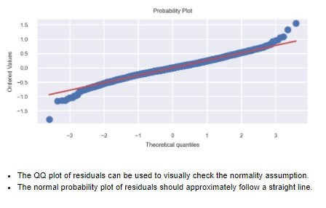
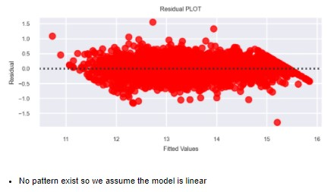
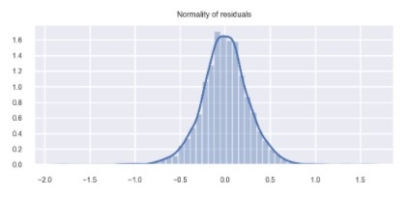
Linear Regression (Test of assumptions)
### Residuals
Mean of redisuals is very close to 0.
### ShapiroResult:
ShapiroResult(statistic=0.9883015751838684, pvalue=2.358942917530761e-18)

Slide 28
3. Generate a set of insights and recommendations that will help the business.

Slide 29
Insights
## Actionable Insights & Recommendations
- Conclude with the key takeaways for the business, what would your advice be to grow the business?
1. These features are positively correlated, as they increase so does Price_log increase. The `Year`, `Power_log`, `Name_First Tier`, `Name_Fourth Tier`, `Name_Second Tier`, `Name_Third Tier`, `Seats_10.0`, `Location_Bangalore`, `Location_Coimbatore`, `Location_Hyderabad`.
2. These features are negatively correlated as they decrease so does Price_log increase. The `Mileage_z_std`,`Fuel_Type_Electric`, `Owner_Type_Second`, `Owner_Type_Third`, `Location_Delhi`, `Location_Jaipur`, `Location_Kochi`, `Location_Kolkata`, `Location_Mumbai`,`Location_Pune`.
3. `First Tier` cars (Lamborghini, Bentley, Porsche, Jaguar, Land and Mini) and `Second Tier` cars (Audi, Mercedes-Benz, BMW, Jeep, Volvo and Isuzu) are strongly correlated with `Price_log` as we expected, as they are part of the most expensive type of car on our list. This type of car would have the possibility of providing a larger margin, and direct marketing to its public should be premium. On the other hand, `Third, Fourth` would be cars for mass sale, of lower added value, cheaper and the strategy should be something like higher volume sales.
4. It seems that `Bangalore`, `Coimbatore` and` Hyderabad` are` Location` with the highest correlation with `Price_log`, so if we have cars that we paied a little above the market price, these places are the locals we must target these “stock of cars” for sales. On the other hand, `Delhi`,` Jaipur`, `Kochi`,` Kolkata`, `Mumbai` and` Pune` are areas that appear to be more competitive in terms of `Price_log`, so it would be important to be more aggressive in price in these locations.
5. `Power_log` is an important factor in the price of cars.

