Slide 1
Biological Network analysis
Gholamreza Bidkhori
Ph.D. In Bioinformatics

Slide 2
Omics data
Information storage
DNA
Microarray
Sequencing
Gene
Regulatory
Network
(GRN)
Genomics
Genomics
Information
processing
RNA
Transcriptomics
Microarray
Chip assay
Transcriptomics
Protein
Proteomics
Proteomics
Integrative Network
Y2H, MS
PPI Ntwork
Action
Metabolite
Metabolomics
HPLC, NMR
MS, TLC
Metabolomics
Metabolic
Ntwork
Informatio flow Real Cell Model
Why Network analysis in Biology
The central step toward a systems-level understanding of biology was to move
away from reductionist to wholist approaches
make a snapshot of all
elements at a certain level
Top-Down
Approach
Organism
Pathology,
Condition
Bottom-UP
Approach
By omics data
it is impossible to assemble an airplane
by using a list of all parts like data
generated by Omics methods
Physiology
DNA RNA Protein Metabolites
Notes:
certain level (DNA, Protein,....)

Slide 3
An introduction to graph theory

Slide 4
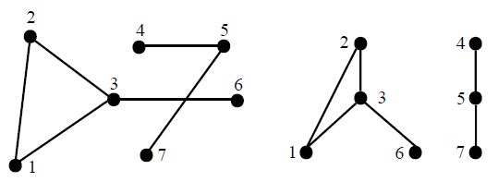
graphs
A graph G = (V, E) consists of a set of vertices (also called nodes or points) V and
a set of edges (arcs, links) E, where each edge is assigned to two vertices
An edge e connecting the vertices u, v is denoted by {u, v}, we say
u and v are incident with e and adjacent (or neighbors) to each other. The vertices
incident to an edge are called its end-vertices
Two graphical representations of the undirected graph G = (V, E)
V ={1, 2, 3, 4, 5, 6, 7}
edge set E = {{1, 2}, {2, 3}, {1, 3}, {3, 6}, {4, 5}, {5, 7}}

Slide 5
The degree of a vertex v is the number of edges that have v as end-vertex
 | V1 | V2 | V3 | V4
V1 | 0 | 1 | 1 | 0
V2 | 1 | 0 | 1 | 0
V3 | 1 | 1 | 0 | 1
V4 | 0 | 0 | 1 | 0
V1
Upper triangle
Diagonal
lower triangle
V2
V3
V4
adjacency matrix
(n × n)
L1: ({v1, v2}, {v1, v3})
L2: ({v2, v1}, {v2, v3})
L3: ({v3, v1}, {v3, v2}, {v3, v4})
L4: ({v4, v3})
G=matrix(c(0,1,1,0,
+ 1,0,1,0,
+ 1,1,0,1,
+ 0,0,1,0),nrow=4,ncol=4)
colSums(G)
[1] 2 2 3 1
adjacency list
GRAPH REPRESENTATION

Slide 6
An edge where the two end-vertices are the same vertex is called a loop.
A loop-free graph does not contain loops.
 | V1 | V2 | V3 | V4
V1 | 0 | 1 | 1 | 0
V2 | 1 | 0 | 1 | 0
V3 | 1 | 1 | 0 | 1
V4 | 0 | 0 | 1 | 1
V1
Upper triangle
Diagonal
lower triangle
V2
V3
V4
adjacency matrix
> G=matrix(c(0,1,1,0,
1,0,1,0,
1,1,0,1,
0,0,1,1),nrow=4,ncol=4)
#Find degree
> colSums(G)
[1] 2 2 3 2
> s=diag(G) # Diagonal
> s
[1] 0 0 0 1
> if(all(s == 0)){
print("loop-free graph")
}else{
print("loop found")
}
[1] "loop found"

Slide 7
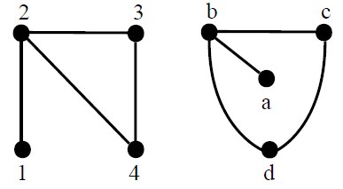
> Induced_subgraph = G[-4,-4]
> subgraph=Induced_subgraph
> subgraph[1,2]=0
> subgraph[2,1]=0
> subgraph
[,1] [,2] [,3]
[1,] 0 0 1
[2,] 0 0 1
[3,] 1 1 0
V1
V1
V1
V2
V3
V3
V3
V4
V2
V2
Graph Subgraph Induced subgraph
G = (V, E)
G’ = (V’, E’)
Two isomorphic graphs
V1 = {1, 2, 3, 4} and E1 = {{1, 2}, {2, 3}, {3, 4}, {2, 4}}
V2 = {a, b, c, d} and E2 = {{a, b}, {b, c}, {b, d}, {c, d}}
G1 = (V1,E1)
G2 = (V2,E2)
all(G1 == G2)
[1] TRUE
With different vertex and edge sets.
Notes:
A subgraph G’= (V’,E’) of the graph G = (V, E) is a graph where V’ is a subset of V and E’ is a subset of E.
If graph G’ is a subgraph of graph G and the edge set E’ contains all edges of E that connect vertices of V’, the subgraph is called an induced subgraph of G.

Slide 8
> data=data.frame(
s=c("v1","v1", "v2", "v3"),
t=c("v2","v3", "v3", "v4"))
#Library
> library(igraph)
# Turn it into igraph object
> G=graph_from_data_frame(data, directed=F)
> G
IGRAPH dcc0b94 UN-- 4 4 –
+ attr: name (v/c)
+ edges from dcc0b94 (vertex names):
[1] v1--v2 v1--v3 v2--v3 v3--v4
> V(G)
+ 4/4 vertices, named, from dcc0b94:
[1] v1 v2 v3 v4
E(G)
+ 4/4 edges from dcc0b94 (vertex names):
[1] v1--v2 v1--v3 v2--v3 v3--v4
# Count the number of degree for each node:
> d=degree(G, mode="all")
> d
v1 v2 v3 v4
2 2 3 1
v1
v2
v3
v4

Slide 9
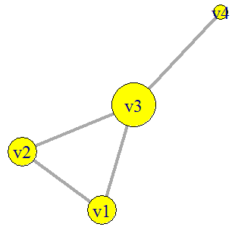
v1
# Count the number of degree for each node:
> d=degree(G, mode="all", loops = TRUE)
> d
v1 v2 v3 v4
2 2 3 1
> d=degree(G, v = c("v1","v3"), mode="all")
> d
v1 v3
2 3
# Plot
> plot(G, vertex.size=d*15,vertex.label.cex=1.5,
vertex.color="yellow",edge.width=4)
v2
v3
v4

Slide 10
A sequence (v0, e1, v1, e2, v2, . . . , vk−1, ek, vk) of vertices and edges such that
every edge ei has the end-vertices vi−1 and vi is called a walk
Usually the vertices are omitted and the walk is denoted by a sequence (e1, e2, . . . , ek).
the walk connects v0 with vk and call v0 and vk the start- and end-vertex of the walk, respectively
a path is a sequence of edges which connect a sequence of vertices which, by most definitions, are all distinct from one another and if additionally all vertices are distinct the walk is called a simple path
The length of a walk or path is given by its number of edges
A path with the same vertex as start- and end-vertex is a cycle
A graph without cycles is called an acyclic graph
the sequences:
({1, 2}, {2, 3}, {3, 6}, {6, 3}, {3, 1}) is a walk
({1, 2}, {2, 3}, {3, 1}) is a path and cycle
Two vertices of a graph are called connected if there exists a walk between them.
If any pair of different vertices of the graph is connected, the graph is connected.

Slide 11
A connected component of a graph G is a maximal connected subgraph of G.
> data=data.frame(
s=c("v1","v1", "v2", "v3","v4","v5"),
t=c("v2","v3", "v3", "v6","v5","v7"))
> G=graph_from_data_frame(data, directed=F)
#count and find connected component
> com=components(G)
> com$no
[1] 2
> com$csize
[1] 4 3
> groups(com)
$`1`
[1] "v1" "v2" "v3" "v6“
$`2`
[1] "v4" "v5" "v7"
Two connected
components.

Slide 12
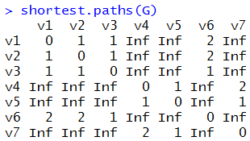
A shortest path between two vertices is a path with minimal length.
The distance
between two vertices is the length of a shortest path between them or ∞ if no such
path exists.
shortest path between vertex 1 and vertex 6:
path ({1, 3}, {3, 6})
get.shortest.paths(G, "v1", mode = "all")

Slide 13
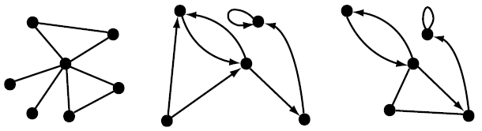
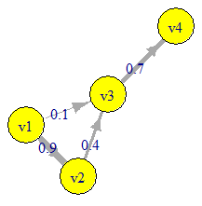
Undirected graph directed graph mixed graph Weighted graph
0.1
0.6
0.3
0.4
0.3
0.1
0.9
0.1
data=data.frame(
s=c("v1","v1", "v2", "v3"),
t=c("v2","v3", "v3", "v4"),
w=c(0.9,0.1,0.4,0.7))
> G=graph_from_data_frame(data, directed=T)
IGRAPH 99933d9 DN-- 4 4 --
attr: name (v/c), w (e/n)
edges from 99933d9 (vertex names):
[1] v1->v2 v1->v3 v2->v3 v3->v4
> E(G)$w
[1] 0.9 0.1 0.4 0.7
> plot(G, vertex.size=50, vertex.color="yellow",
edge.width=E(G)$w*8,vertex.label.cex=1.5,
edge.label=E(G)$w)
Weighted
directed graph
V1
0.1
0.9
0.7
V2
0.4
V3
V4

Slide 14
#Calculate indegree
d=degree(G, mode="in")
d
v1 v2 v3 v4
0 1 2 1
#Calculate outdegree
> d=degree(G, mode="out")
> d
v1 v2 v3 v4
1 1 0
#Calculate in+outdegree
> d=degree(G, mode=“all")
> d
v1 v2 v3 v4
2 3 1
V1
V2
V3
Source
Target
V4
walks, paths, and cycles are similar, but take the edge direction into account.
the walk strongly connects v0 with vk if the edge direction is taken into account.
Two vertices of a graph are called strongly connected if there exists such a walk between them.
If any pair of different vertices of the graph is strongly connected, the graph is strongly connected.
A strongly connected component of a graph G is a maximally strongly connected subgraph of G.

Slide 15
Shortest (directed or undirected) paths between vertices
distances(G, v = "v1", mode = c("out"),
weights = E(G)$w, algorithm = c( "dijkstra"))
v1 v2 v3 v4 v1
0 0.9 0.1 0.8
> distances(G, v = "v1", mode = c("in"),
weights = E(G)$w, algorithm = c( "dijkstra"))
v1 v2 v3 v4 v1
0 Inf Inf Inf
> distances(G, v = "v1", mode = c("all"),
weights = E(G)$w, algorithm = c( "dijkstra"))
v1 v2 v3 v4 v1
0 0.5 0.1 0.8
V1
0.1
0.9
0.7
V2
0.4
V3
If there are no weights, then an unweighted breadth-first search is used,
if all weights are positive, then Dijkstra's algorithm is used.
If there are negative weights and we do the calculation for more than 100 sources, then Johnson's algorithm is used. Otherwise the Bellman-Ford algorithm is used.

Slide 16
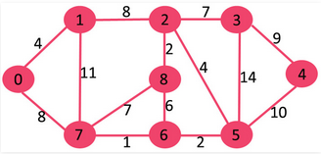

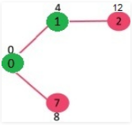
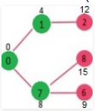
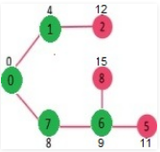
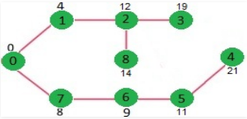
Dijkstra’s shortest path algorithm
Let us understand with the following example:
{0}
{0, 1}
{0, 1, 7}
{0, 1, 7, 6}
SPT (Shortest Path Tree) are shown in green colour.
Notes:
The vertex 0 is picked, include it in sptSet. So sptSet becomes {0}. After including 0 to sptSet, update distance values of its adjacent vertices. Adjacent vertices of 0 are 1 and 7. Pick the vertex with minimum distance value and not already included in SPT
A greedy algorithm, as the name suggests, always makes the choice that seems to be the best at that moment. This means that it makes a locally-optimal choice in the hope that this choice will lead to a globally-optimal solution

Slide 17
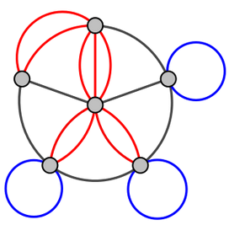
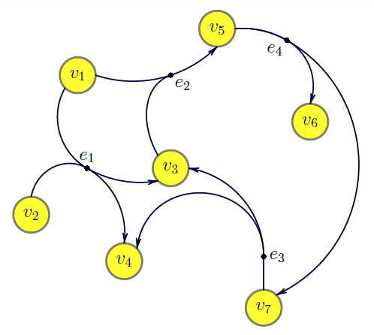
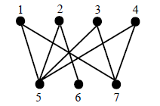
Multigraphs are graphs containing multiple edges
two or more edges that between two vertices
in case of directed graphs have the same direction
Undirected, loop-free graphs without multiple
edges are called simple graphs
hypergraph G = (V, E) consists of a set of vertices V and a set of hyperedges E
A graph G = (V, E) is called bipartite if there is a partition of its vertex set V =
S ∪ T such that each edge in E has exactly one end-vertex in S and one end-vertex
in T

Slide 18
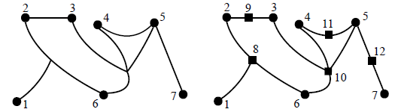
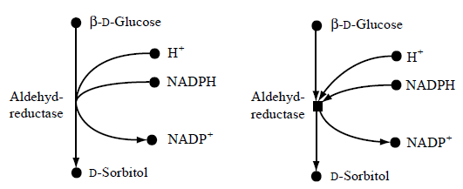
The hypergraph G = (V, E) with vertex setV = {1, 2, 3, 4, 5, 6, 7} and hyperedge
set E = {{1, 2, 6}, {2, 3}, {3, 4, 5, 6}, {4, 5}, {5, 7}} and its corresponding bipartite graph.
The two vertex sets S and T are represented by dots and squares, respectively.
A metabolic network and its modeling as bipartite graph.

Slide 19
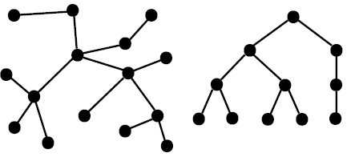
A tree is an undirected, connected, acyclic graph.
The vertices of a tree with degree 1 are its leaves, all other vertices are inner vertices.
A rooted tree (regarded directed graph) consists of a tree G = (V, E) and a distinguished vertex r ∈ V called the root.
The depth of a vertex is the length of the path between the root and this vertex, the height of a tree is the maximum depth of a vertex.
A binary tree is a tree where each vertex has at most degree 3.
For a directed tree G = (V, E) and an edge (u, v) ∈ E, the vertex u is the parent of v and v is the child of u.
For a connected, undirected graph G, a special tree can be computed, the spanning tree T of G. The spanning tree T is composed of all the vertices of G and a minimal set of edges that connect all vertices

Slide 20
Biological networks

Slide 21
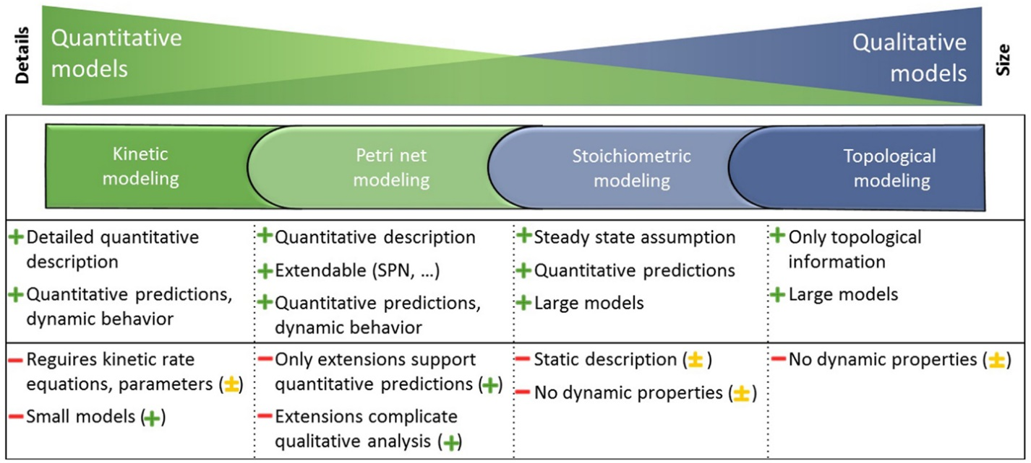
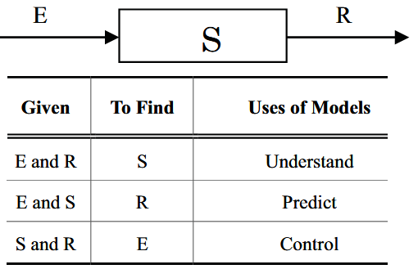
Type of Modeling of Biological Network
Static models Qualitative, Graph Representation, investigating the structure of
Dynamic models quantitatively modeling with rate laws for every step (over the time)

Slide 22
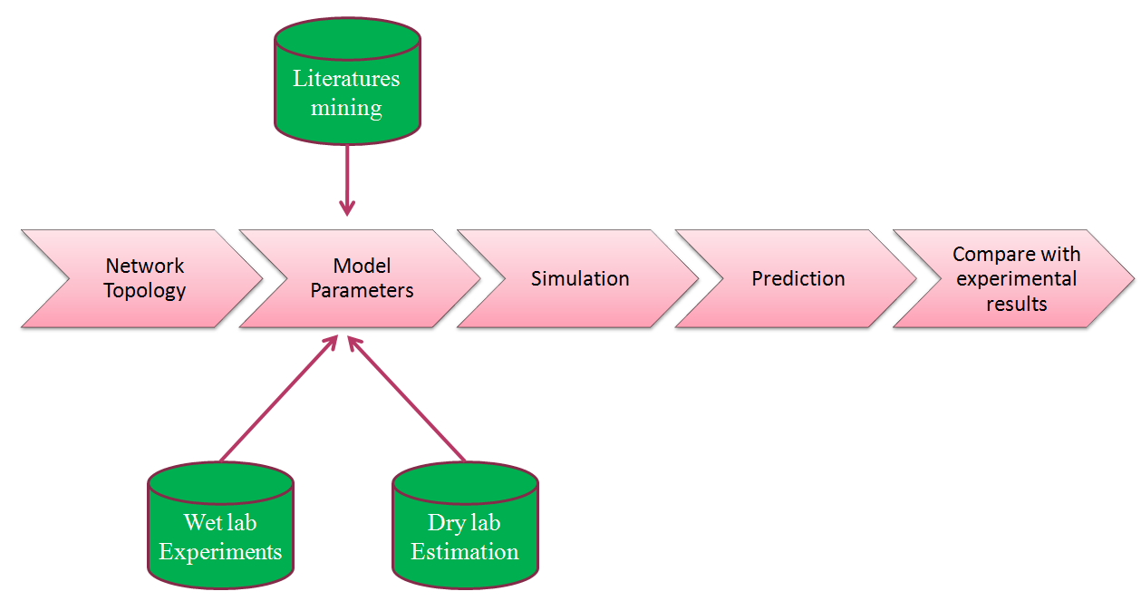
Flow chart of the steps included in the
preparation of a computational model

Slide 23
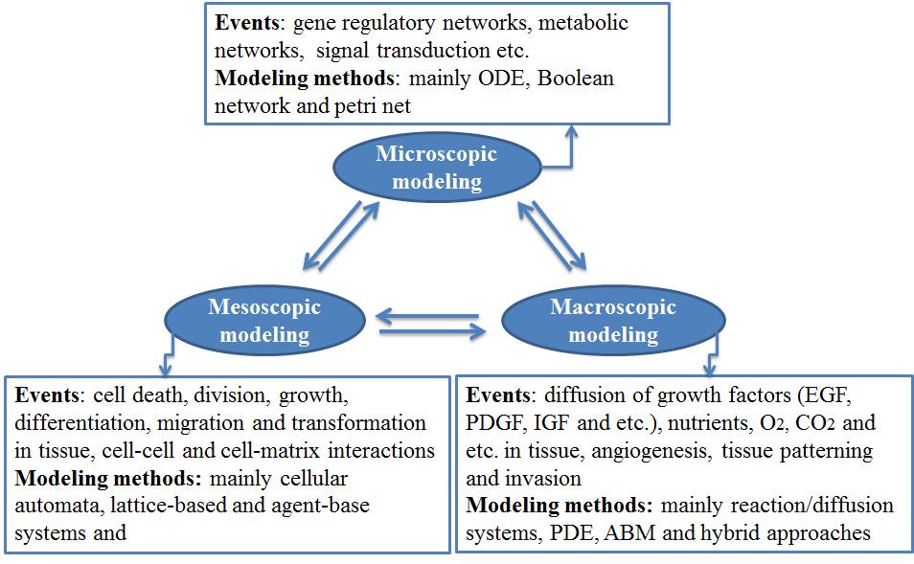
Cancer Modeling Level
The scale of Biological Networks

Slide 24
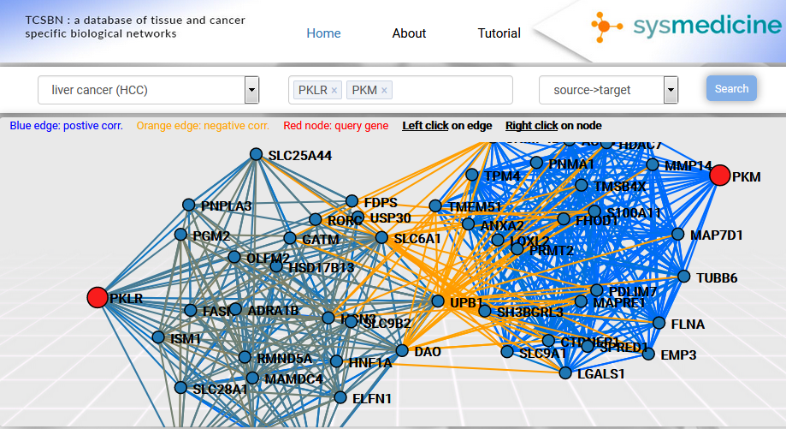
Correlation Network
http://inetmodels.com/

Slide 25
Pathway and interaction databases
selected data resources and databases for systems biology research
Pathway database
KEGG | http://www.genome.jp/kegg/
Reactome | http://www.reactome.org
Recon X | http://humanmetabolism.org/
BioCyc | http://biocyc.org/
Pathway interaction database (PID) | http://pid.nci.nih.gov/
BioCarta | http://www.biocarta.com/
IntAct | http://www.ebi.ac.uk/intact/
Database of Interacting Protein (DIP) | http://dip.doe-mbi.ucla.edu/dip/Main.cgi
STRING https://string-db.org/

Slide 26
Kinetics database
BRENDA | http://www.brenda-enzymes.org
UMBBD | http://umbbd.msi.umn.edu
SABIO-RK | http://sabio.villa-bosch.de/
Expression data resource
Gene Expression omnibus (GEO) | http://www.ncbi.nlm.nih.gov/geo
ArrayExpress | http://www.ebi.ac.uk/arrayexpress/
Stanford Microarray Database | http://smd.princeton.edu/

Slide 27
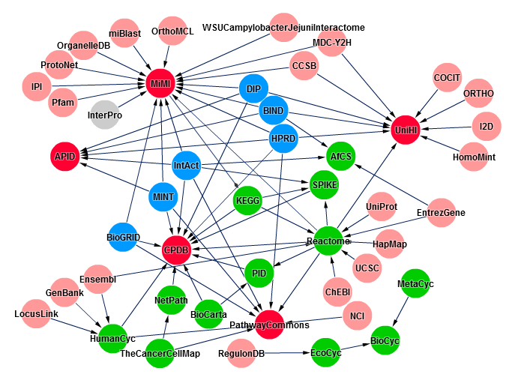
Pathway and interaction databases
Overlap between important network and pathway databases and their interaction

Slide 28
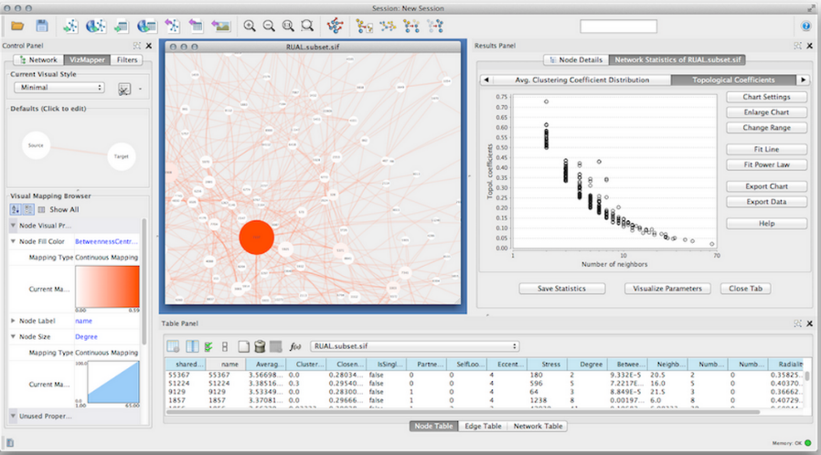
Visualization tools
Edinburgh Pathway Editor
Cytoscape
BioUML
geWorkbench
Medusa
VANTED
BioTapestry
For several kinds of network manipulations, there are many Cytoscape plugins
PROPERTIES OF BIOLOGICAL NETWORKS
small world networks
scale-free networks
follow a scale-free power-law distribution
many vertices have few links, while there are some that are highly connected.

Slide 29
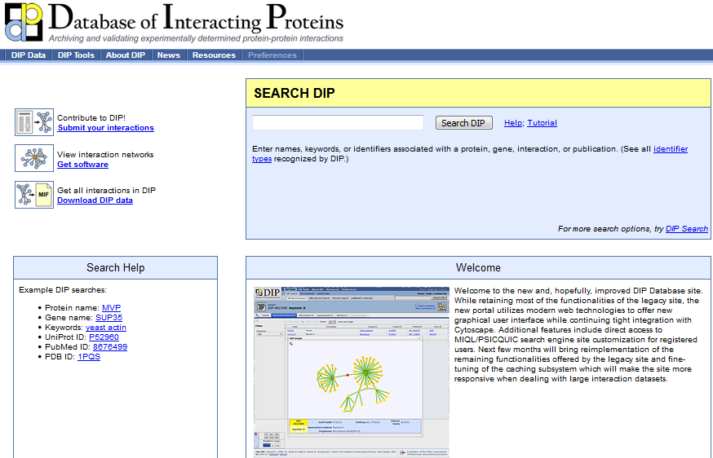
Protein Protein interaction

Slide 30
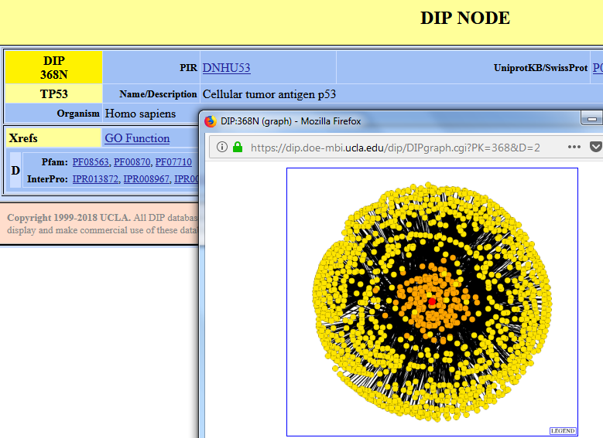

Slide 31
Comparison of the vertices to find node importance
Centrality Analysis
Centralities assign a real number to every vertex
They allow a pairwise comparison of the vertices
a vertex v1 is said to be more central or more important than a vertex
v2 if C(v1) > C(v2).
p1
p9
p5
p6
p8
p10
p2
p3
p4
p7
p11
Definition 1 Degree centrality -> finding Hub
Definition 2 Eccentricity Centrality
Let G = (V, E) be an undirected and connected graph
dist (s,t) shortest path between s and t
Eccentricity uses information about the length of shortest paths between any two
vertices of a network

Slide 32
p1
p9
p5
p6
p8
p10
p2
p3
p4
p7
p11
> data=data.frame( s=c("p1","p1","p2","p3","p3","p5","p4","p7","p8","p8","p8","p9","p9","p10"),
t=c("p2","p3","p3","p5","p4","p6","p7","p8","p9","p11","p10","p10","p11","p1"))
> G=graph_from_data_frame(data, directed=F)
eccentricity(G, vids = V(G), mode = c("all"))
p1 p2 p3 p5 p4 p7 p8 p9 p10 p6 p11
5 5 4 5 3 4 5 6 6 6 6
sort(1/eccentricity(G, vids = V(G),
mode = c("all")),decreasing = T))
p4 | 0.333
p3 | 0.25
p7 | 0.25
p1 | 0.2
p2 | 0.2
p5 | 0.2
p8 | 0.2
p9 | 0.167
p10 | 0.16
p6 | 0.16
p11 | 0.16

Slide 33
Definition 3
p1
p9
Closeness Centrality
p5
p6
C_{cl}(n) = 1 / avg( dist(n,m) )
p8
p10
p2
p3
p4
p7
p11
sort(closeness(G, vids = V(G), mode = c("all")),decreasing = T)
p4 | 0.045
p3 | 0.043
p7 | 0.043
p8 | 0.038
p5 | 0.033
p1 | 0.032
p2 | 0.032
p9 | 0.030
p10 | 0.030
p11 | 0.030
p6 | 0.025

Slide 34
betweenness
p1
p9
p5
The betweenness centrality C_{b}(n)
of a node n is computed as follows:
p6
p8
p10
p2
p3
C_{b}(n) = ∑_{s≠n≠t} (L_{st} (n) / L_{st})
p11
where s and t are nodes in the network different from n
L_{st} denotes the number of shortest paths from s to t,
L_{st} (n) is the number of shortest paths from s to t that n lies on
It is normalized based on by dividing by the number of node
pairs excluding n: (N-1)(N-2)/2, where N is the total number
of nodes in the connected component
p3 | 0.622222
p4 | 0.555556
p7 | 0.533333
p8 | 0.466667
p5 | 0.2
p1 | 0
p2 | 0
p9 | 0
p10 | 0
p6 | 0
p11 | 0
sort(betweenness(G, v = V(G), directed = F,
normalized = T),decreasing = T)

