Slide 1
Metagenomic Workshop

Slide 2
Introduction
We are going to analyze a metagenomic data from gut microbiota taken from human
This slide is providing just the steps, no deep-dive explanation. To get the explanation, please refer to the tool’s manuals or ask the instructure.
Pipeline :
Input Data: Paired read from shotgun metagenome data
Supporting File: Bowtie2 index for human as a reference for the alignment
Tools needed:
Bowtie2:
Samtools:
Bedtools:
Trimmomatic:
MetaPhlAn2:
Visualization tools
Output: Microbial species and the relative abundance and the visualization

Slide 3
Step 0: Setup
We need 3 main files to start with:
2 x Metagenome sequencing files (paired)
Bowtie2 index for human:
http://bowtie-bio.sourceforge.net/bowtie2/index.shtml
Install all the required software:
Bowtie2: http://bowtie-bio.sourceforge.net/bowtie2/index.shtml
Samtools: http://samtools.sourceforge.net/
Bedtools: https://bedtools.readthedocs.io/en/latest/
Trimmomatic: http://www.usadellab.org/cms/?page=trimmomatic
MetaPhlAn2: https://bitbucket.org/biobakery/metaphlan2
All files and softwares are available in UPPMAX, except MetaPhlAn2

Slide 4
In case you have Ana/Miniconda
Download and install miniconda in uppmax or your own computer
Create an environment and install all the packages (yaml file included in the github)
conda env create -n metagenomics -f environment.yml
Then go to your env: source activate metagenomics
environment.yml:
channels:
- conda-forge
- bioconda
dependencies:
- metaphlan2
- bowtie2
- trimmomatic
- samtools
- bedtools
- graphlan
- hclust2

Slide 5
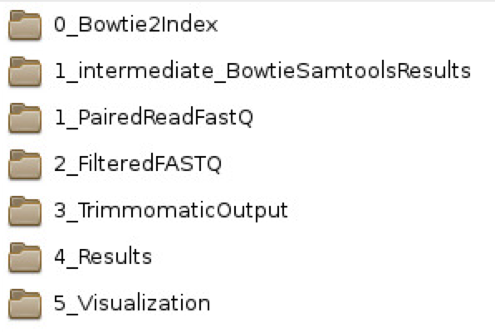
UPPMAX
Connect to interactive mode
interactive -A g2018024 -p core -n 2 -t 03:00:00 -J any.name --mail-user your_email --mail-type=ALL
Load these modules:
module load bioinfo-tools
module load bowtie2
module load BEDTools
module load samtools
module load trimmomatic
Folder of Data:
/proj/g2018024/nobackup/MetagenomicWorkshop/

Slide 6
Step 1: Alignment of the Sequences
Tool: Bowtie2
Command:
bowtie2 –x indexFolder
-1 file_R1.fastq.gz
-2 file_R2.fastq.gz
–p coreNum
–S output.sam
Options:
-x: pinpoint your index folder
-1/-2: first/second pair file
-p: number of parallel cores (optional)
-S: generating the alignment output as samfile

Slide 7
Step 2: Convert Bowtie2 output to FASTQ
We have to convert the samfile from bowtie2 to FASTQ
Reason: to make it compatible with the quality control tool (Trimmomatic)
Steps:
Step 2.1: Convert SAMfile to BAMfile with samtools
Step 2.2: Sort BAMfile
Step 2.3: Convert BAMfile to FASTQ with bedtools

Slide 8
Step2.1: SAM → BAM → Sorted BAM
Command:
samtools view -bS {samfile} | samtools view -b -f 12 -F 256 -@ {coreNum} - > {bamfile}
Input: {samfile} from Step 1
Optional argument: {coreNum} for number of cores
Output: {bamfile}
Task: Please understand all the options from the command above from samtools manual

Slide 9
Step 2.2 and 2.3: BAM → Sorted BAM → FASTQ
Command:
samtools sort -n {bamfile} -@ {coreNum} | bedtools bamtofastq -i - -fq {filtered_R1.fastq} -fq2 {filtered_R2.fastq}
Input: {bamfile} from Step 2.1
Optional argument: {coreNum}
Outputs: {filtered_R1/R2.fastq}
Task: Please understand all the options from the command above from samtools and bedtools manual

Slide 10
Step 3: Quality Control and Trimming Sequence
Software: Trimmomatic
In Trimmomatic, we can control the sequence by putting several criteria. Review the Step Options in Trimmomatic manual
In this course, we will just use the “MINLEN” as our criterion, to drop reads under 60 bases long
Command:
trimmomatic PE -threads {coreNum} -trimlog {logFile} -validatePairs {filtered_pair1.fastq} {filtered_pair2.fastq} -baseout {outputName} {criterion}
Input: {filtered_pair1/pair2.fastq} from Step 2.3
Optional Arguments:
{coreNum} → Number of cores for parallelization
{logFile} → file to write the QC log
{criterion} → MINLEN:60

Slide 11
Step 3 (Cont.): Trimmomatic Output
Trimmomatic will spit 4 files:
{outputName}_1P/2P.fastq: Output for for paired samples
{outputName}_1U/2U.fastq: Output for for unpaired samples
For this workshop, we will only use the paired sample, so we will focus on the 1P/2P output files, you can discard the rest

Slide 12
Step 4: Generating Relative Abundance Table
Tool: MetaPhlAn2
Command:
metaphlan2.py {InputName}_1P.fastq, {InputName}_2P.fastq --bowtie2out {bowtieOutput} --nproc {coreNum} --input_type fastq > {output}
Input: {InputName}_1P/2P.fastq → from Step 3
Optional Arguments:
{bowtieOutput} → saving intermediate bowtie result (will save time in case of repetition)
{coreNum}
Output: Microbial species and the relative abundance and the visualization

Slide 13
Step 5: Visualization
Step 5.1: Merge all results
metaphlan2/utils/merge_metaphlan_tables.py {all_abundance} > merged.txt
Step 5.2: get species only
grep -E "(s__)|(^ID)" merged.txt | grep -v "t__" | sed 's/^.*s__//g' > merged_species.txt

