Slide 1
Co-expression networks
Rui Benfeitas, PhD
Science for Life Laboratory
KTH – Royal Institute of Technology
rui.benfeitas@gmail.com
rui.benfeitas@scilifelab.se

Slide 2
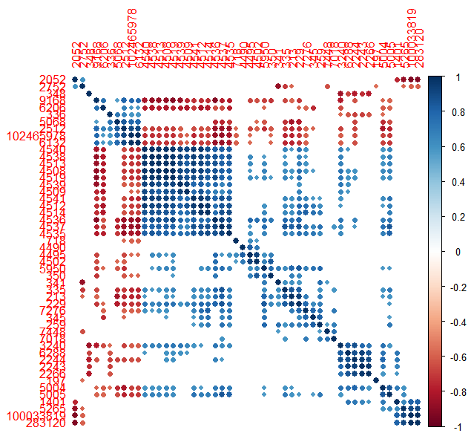
Introduction to co-expression analysis
Useful to identify biologically relevant unknown relationships between genes
Complementing known interactions:
PPI
TFRN
GEMs
Further reading:
http://science.sciencemag.org/content/302/5643/249.long
https://academic.oup.com/nar/article-lookup/doi/10.1093/nar/gkx994

Slide 3
Introduction to co-expression analysis
Compute gene-gene pairwise correlations
Pearson
Spearman
Different assumptions
Normality and gene expression

Slide 4
Introduction to co-expression analysis
Compute gene-gene pairwise correlations
Pearson
Spearman
2. Filtering
Correlation coefficient ( ρ > 0.8 U ρ < -0.8?)
P-value or adjusted P-value (FDR<0.01?)
Top genes (100-connected genes?)
Problems:
“weaker” correlation may still be important
false positives/negatives
unbalanced connections

Slide 5
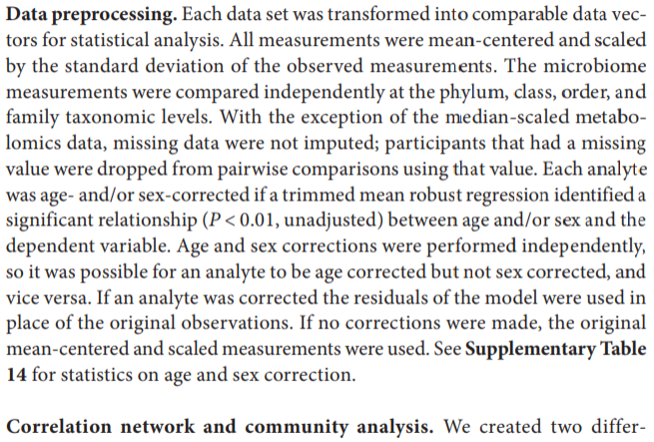
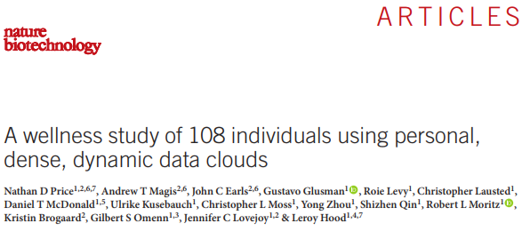
Introduction to co-expression analysis
Compute gene-gene pairwise correlations
Pearson
Spearman
2. Filtering
Correlation coefficient ( ρ > 0.7 U ρ < -0.7?)
P-value or adjP-value (FDR<0.01?)
Top genes (100-connected genes?)
[3. Adjust given experimental design]
May want to exclude confounding factors
Gender? BMI? Insulin sensitivity?
Is gene expression influenced by these factors?
Regression -> Correlation
https://www.nature.com/articles/nbt.3870.pdf

Slide 6
Introduction to co-expression analysis
General algorithm:
0. Exclude genes undetected in most samples (TPM < 1)
Matrix of gene expression (FPKM / TPM)

Slide 7

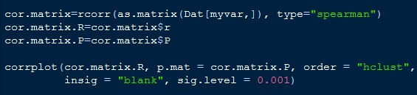
Introduction to co-expression analysis
General algorithm:
0. Exclude genes undetected in most samples (TPM < 1)
1. Compute correlation matrix (Spearman / Pearson)
Correlation matrix (R)
Significance matrix (P)
R
P

Slide 8
Introduction to co-expression analysis
General algorithm:
0. Exclude genes undetected in most samples (TPM < 1)
1. Compute correlation matrix
2. Correct for the number of tests (multiple hypothesis correction)
a. Get upper/lower triangular matrix (exclude diagonal)
b. Exclude correlations based on multiple hypothesis correction
[c. Recast matrix back to squared matrix if needed]
3. Perform additional filtering (correlation coefficient or # correlations)
4. Check if results make biological sense. If not, additional filtering is needed at this point, or in steps 0/1.
[5. Prepare table for visualization]

Slide 9
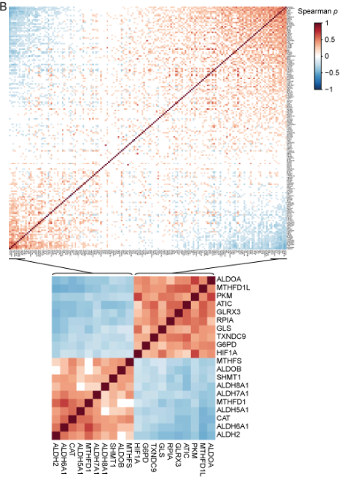
Introduction to co-expression analysis
Spearman correlation
FDR < 0.01
Ordered according to PC1

Slide 10
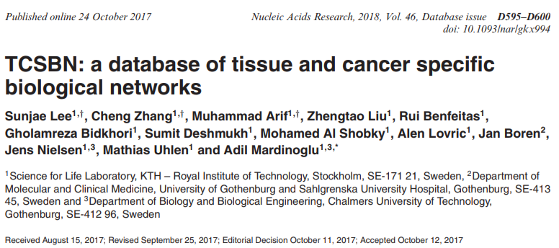

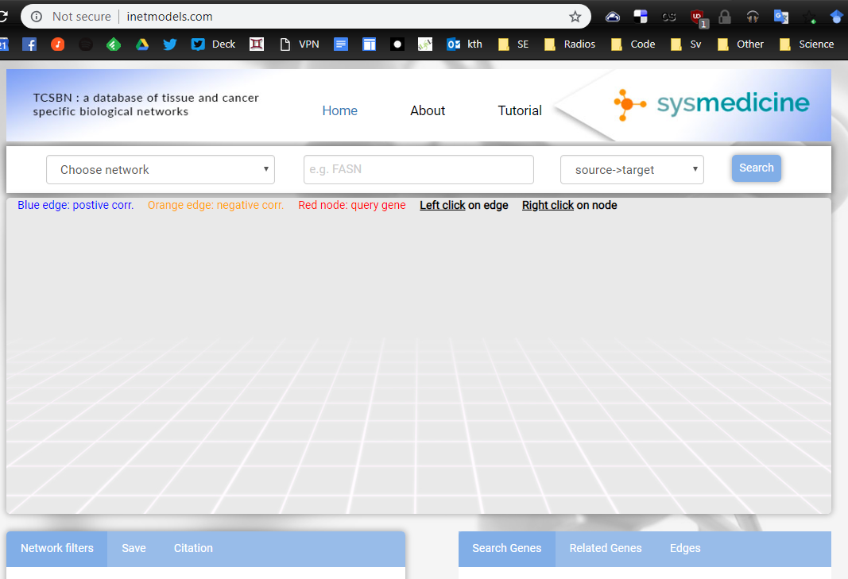
Introduction to co-expression analysis
sysmedicine.com > Research > CoExp Networks
Inetmodels.com

Slide 11
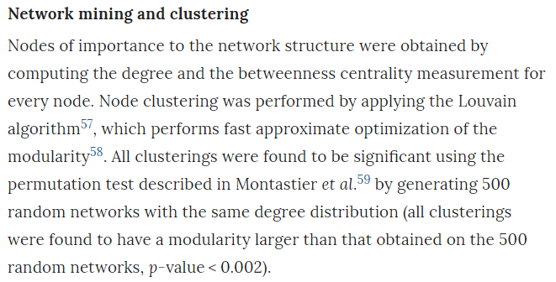
Introduction to co-expression analysis
Louvain clustering:
Optimizes modularity
Iteratively adds each node to new communities if an increase in modularity occurs
Combines modules if they increase modularity
<100m nodes; billions edges
2m nodes ~ 2 mins
https://www.nature.com/articles/s41598-018-28173-8

Slide 12

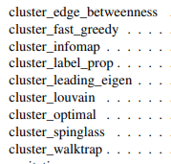
Introduction to co-expression analysis
Identifying gene modules
Louvain
Random walk
Centrality
...
Highly interconnected genes
Further reading:
http://ece-research.unm.edu/ifis/papers/community-moore.pdf

Slide 13
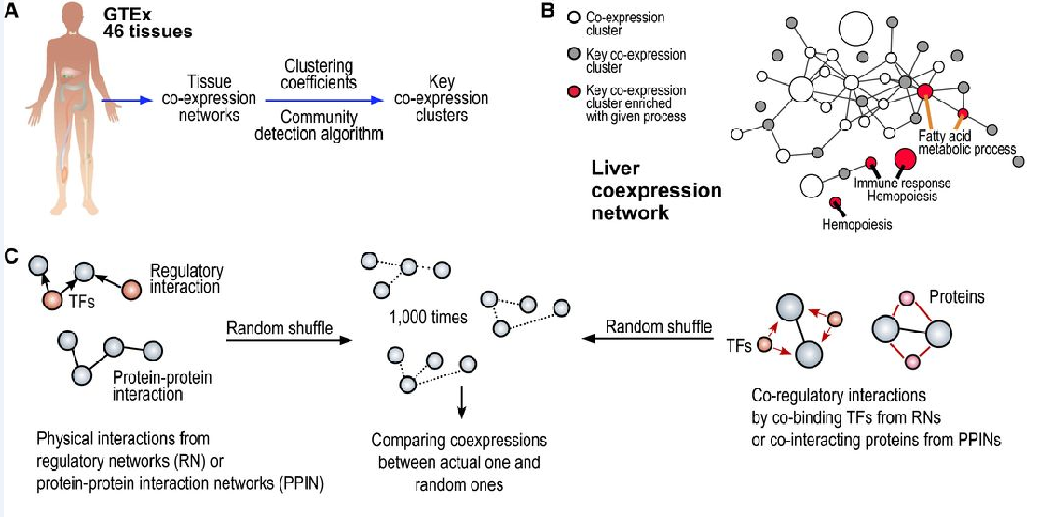
Introduction to co-expression analysis
Further reading:
http://msb.embopress.org/content/13/8/938

Slide 14
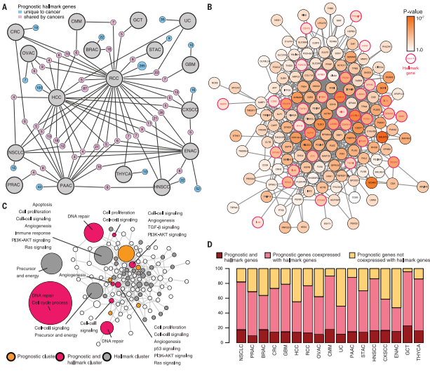
Introduction to co-expression analysis
http://science.sciencemag.org/content/sci/357/6352/eaan2507.full.pdf

Slide 15
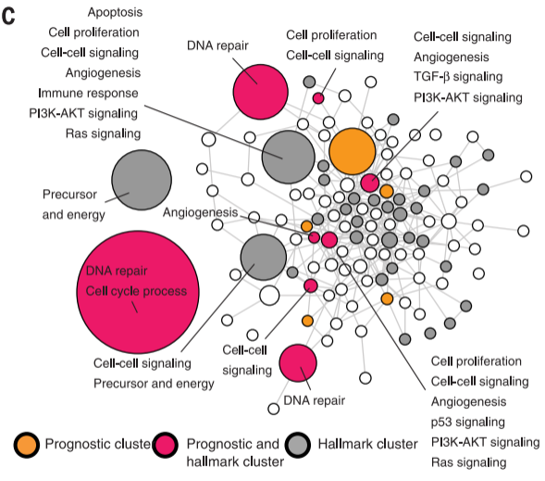
Introduction to co-expression analysis
Gene coexpression cluster from coexpression network of lung cancer enriched with both hallmark and prognostic genes
http://science.sciencemag.org/content/sci/357/6352/eaan2507.full.pdf

Slide 16
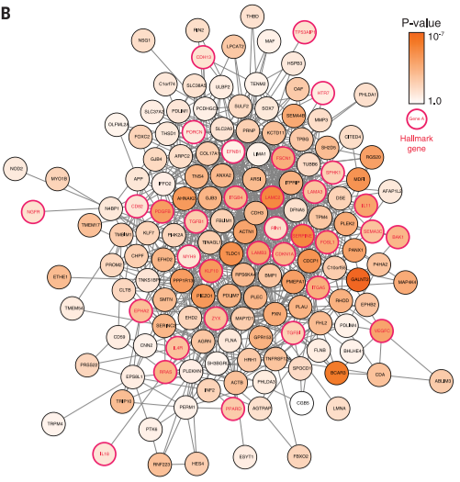
Introduction to co-expression analysis
Coexpression clusters of lung cancer.
Nodes indicate gene coexpression clusters;
Edges indicate significant coexpression links between clusters.
Gray, yellow, and red color of the nodes indicates that the cluster was significantly enriched with hallmark genes, prognostic genes, and both cases, respectively.
http://science.sciencemag.org/content/sci/357/6352/eaan2507.full.pdf

Slide 17
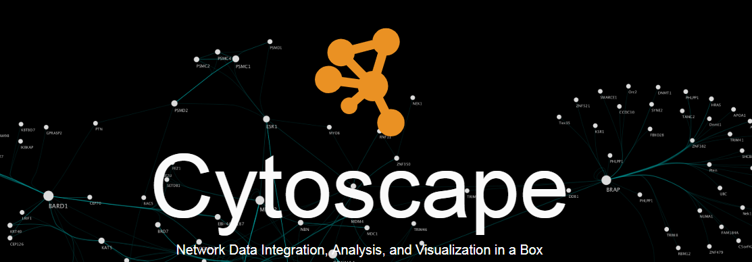
Introduction to co-expression analysis
Use as input:
Coexpression_500genes.txt
Tools > Network analyzer: Centrality
Node configuration / edge weight based on correlation
Apps > BINGO: GSEA

Slide 18
Additional reading
Co-expression networks:
http://science.sciencemag.org/content/302/5643/249.long
https://academic.oup.com/nar/article-lookup/doi/10.1093/nar/gkx994
Community identification
http://ece-research.unm.edu/ifis/papers/community-moore.pdf
https://www.nature.com/articles/s41598-018-28173-8
Co-expression and community
http://science.sciencemag.org/content/sci/357/6352/eaan2507.full.pdf
http://msb.embopress.org/content/13/8/938
https://www.nature.com/articles/s41598-018-28173-8

Slide 19
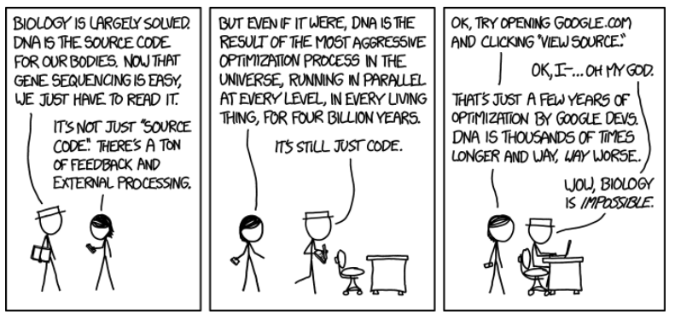

Questions?
rui.benfeitas@gmail.com
rui.benfeitas@scilifelab.se
ruifeitas

