Slide 1

Data Governance & Security
This dashboard offers a centralized view of crucial metrics across five key data domains. It helps stakeholders monitor data health, ensure regulatory compliance, and detect potential risks.

Slide 2





Dataset Overview
Data Quality
Data Access
Data Privacy
Metrics include ,AccuracyRate , CompletenessRate, and ConsistencyRate.
Tracks requests, approvals, roles, departments, and approval times.
Monitors AccessCount and ComplianceStatus by DataType and User.
Data Security
Compliance
Records IncidentType, DetectionTime, ResponseTime, and MeasuresTaken.
Shows AuditStatus and NonComplianceCount over time.

Slide 3




Dashboard Objectives
Provide Transparency
Increase visibility into organizational data governance practices.
Track Key Trends
Monitor data quality, access control, privacy compliance, and audit results.
Enable Better Decisions
Facilitate faster, more informed choices for risk mitigation and compliance.

Slide 4
Dashboard Components in Detail
Data Quality
Data Access
Data Privacy
Data Security
Line charts show average Accuracy, Completeness, and Consistency over time by data source.
Bar charts visualize access volume and approval rates; departmental breakdowns are also included.
Pie and line charts display compliant vs. non-compliant access and sensitive data access trends.
Scatter and bar charts highlight detection/response performance and unauthorized access frequency.
Compliance
Stacked bars and line charts show audit outcomes and non-compliance incident trends.

Slide 5
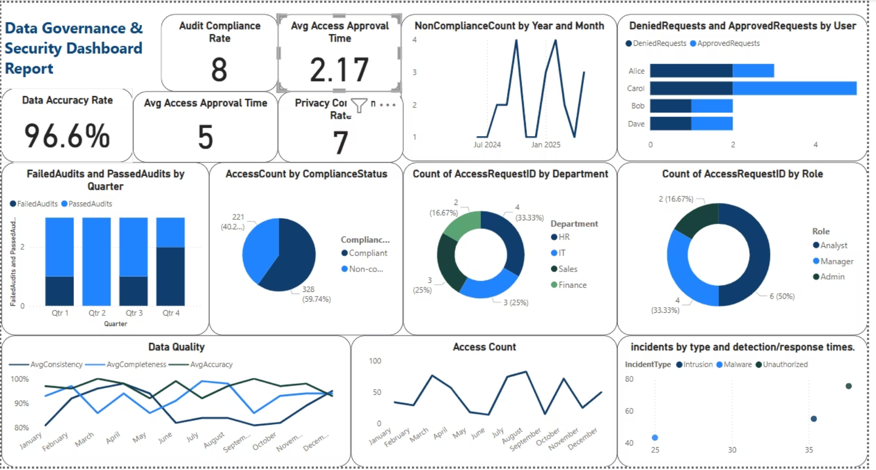

Slide 6
Key Operational Insights
Data Quality
Data Access
Data Privacy
Average accuracy: 96.7%. Completeness: 93.4%. Consistency: 91.5%, improving in H2. Dips during system transitions indicate integration needs.
150 requests, 93% approved. Average approval time: 2.4 days. Sales and IT were highest. Finance had slower approvals.
98% compliance. PII and Financial data are most accessed. Q3 compliance drop suggests training gaps.
Data Security
Compliance
36 incidents; 5 unauthorized. Detection: 29 min, Response: 47 min. Q2 had most unauthorized attempts, prompting MFA.
11 of 12 audits passed (91.7%). Failed Q4 audit was minor and corrected. Non-compliance is declining.

Slide 7

Conclusion
The dashboard shows strong data governance performance. Data quality and privacy are well-maintained. Timely access approvals and rapid security responses reflect efficiency. Ongoing improvements in audit performance and risk reduction are evident. This dashboard remains a strategic tool for continuous improvement and oversight.

