Slide 1
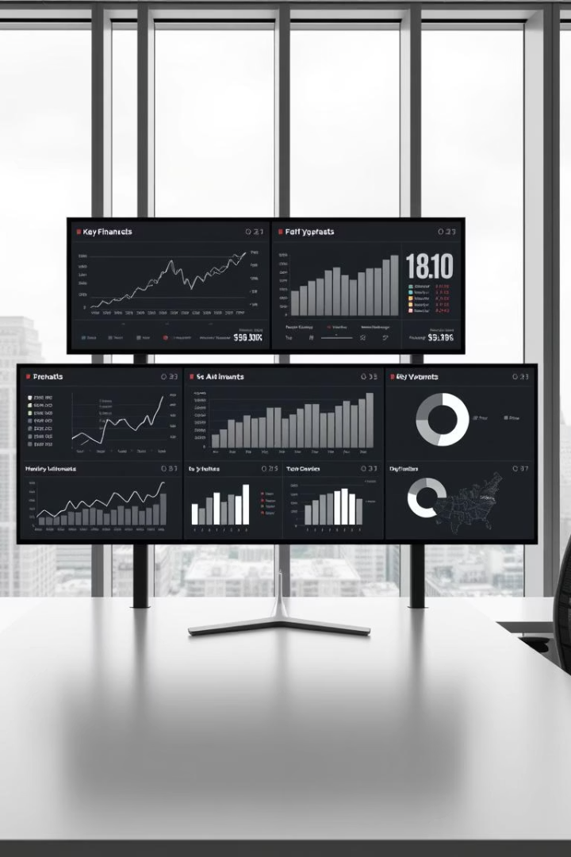
Comprehensive Financial Performance Dashboard
This presentation introduces a dashboard for analyzing company financial performance. It offers a comprehensive view of sales, profit, and key metrics.

Slide 2




Project Overview and Objectives
Analyze & Interpret
Understand financial performance.
Visualize Key Metrics
Display sales, profit, and COGS.
Optimize Strategies
Enhance pricing and promotions.
The dashboard analyzes, interprets, and visualizes company financial performance. It monitors sales, profit, and discounts to empower data-driven decisions.

Slide 3
Dataset and Key Columns
Customer Data
Product Details
Sales Data
Temporal Data
Segment
Product
Units Sold
Date
Country
Discount Band
Manufacturing Price
Month Number
Sale Price
Month Name
Gross Sales
Year
Discounts
Sales
COGS
Profit
The dataset comprises detailed financial records across various dimensions. Key columns capture granular data for comprehensive analysis.

Slide 4
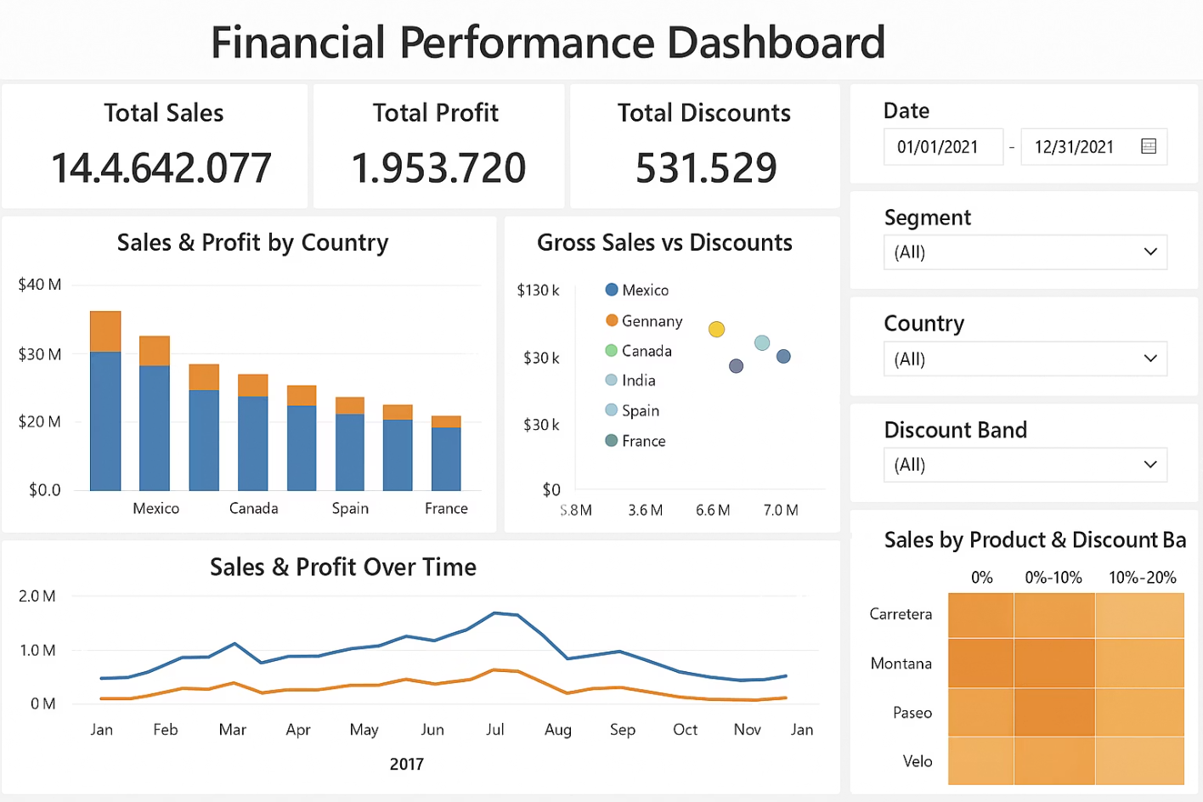

Slide 5

Key Insight
Key Financial Metrics Overview
$14.6M
Total Sales
Reflects overall revenue generation.
$1.95M
Total Profit
Indicates net financial gain.
$531K
Total Discounts
Summarizes all applied reductions.
13.34%
Profit Margin
Shows profitability efficiency.
These high-level metrics provide a foundational understanding of the company's financial health. They highlight efficiency, profitability, and pricing effectiveness.

Slide 6
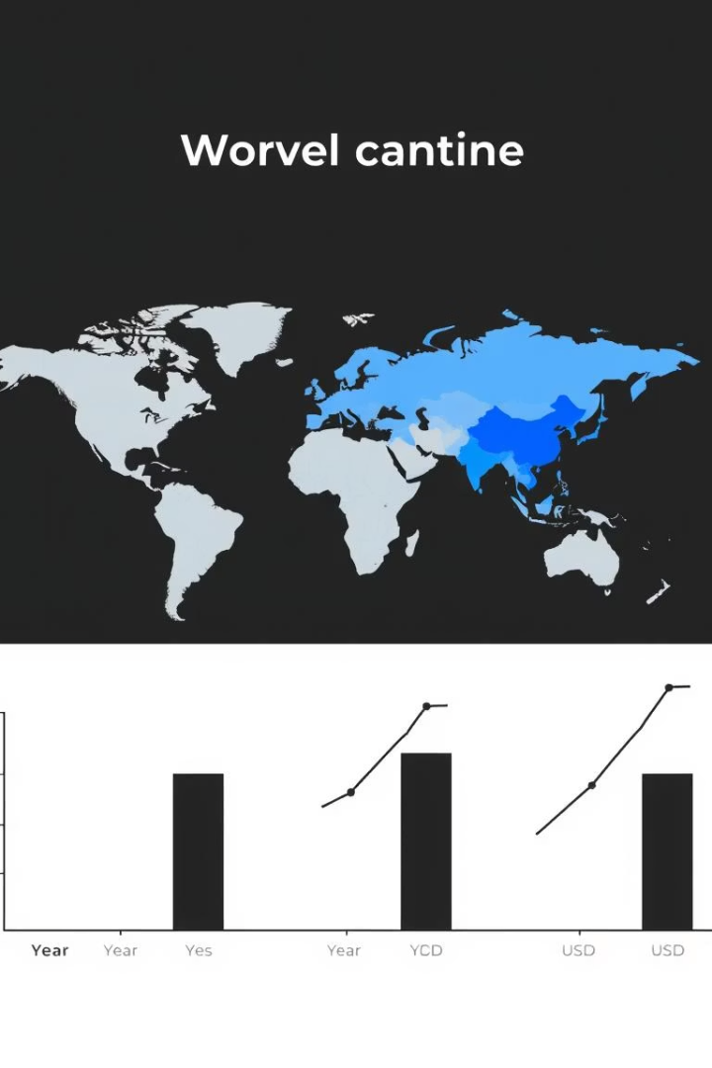



Key Insight
Geographical Performance: North American Dominance
North America
Market Share
Profit Hubs
Mexico and Canada lead in sales and profit.
Significant contribution to overall revenue.
High profitability in these regions.
North American countries, specifically Mexico and Canada, exhibit strong financial performance. They are primary drivers of both sales volume and profit generation.

Slide 7
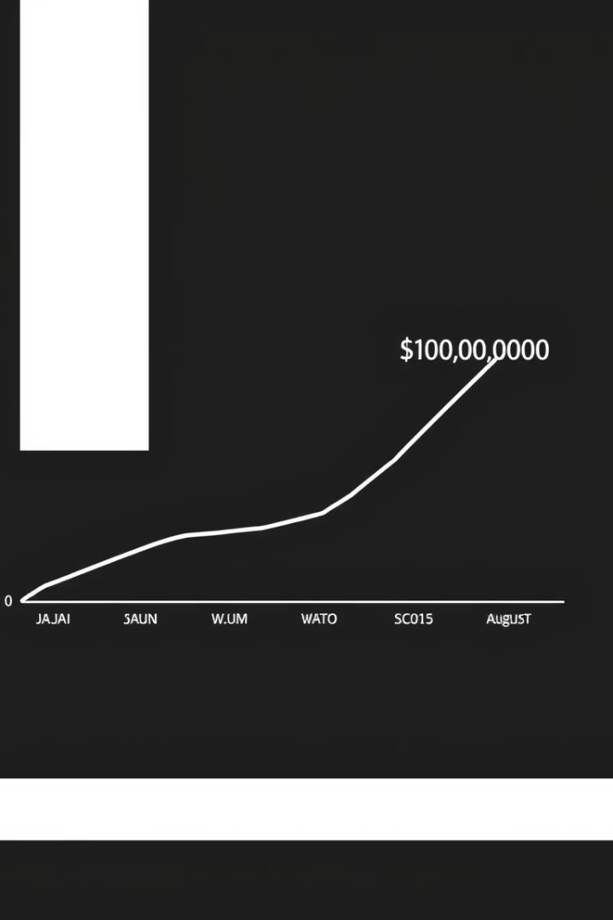
Key Insight
Temporal Trends: Mid-Year Peak Performance
1
Q1
Initial growth.
2
Mid-Year
Peak sales and profit.
3
August
Strongest performance month.
4
Q4
Steady momentum.
The company experiences its highest performance levels during the mid-year period. August consistently stands out as the month with peak sales and profit.

Slide 8
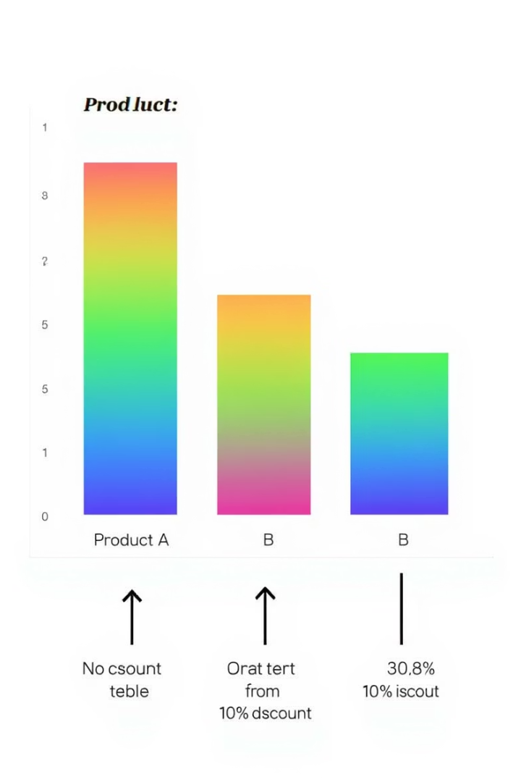
Key Insight
Product Performance and Discount Impact
Top Products
Carretera and Montana perform well.
Minimal Discounts
High value with low markdowns.
Discount Variation
Impact differs across regions.
Higher Margins
Correlate with lower discount bands.
Carretera and Montana products demonstrate robust performance, even with minimal discounts. Lower discount bands generally correlate with higher profit margins across diverse markets.

Slide 9

Strategic Business Insights
Invest in Top Countries
Low Discount Strategy
Maximize returns in leading markets.
Maintain for high-value products.
Mid-Year Marketing
Target Underperformers
Leverage seasonal sales spikes.
Tailored promotions for growth.
Strategic insights focus on leveraging strengths and addressing weaknesses. Investing in top countries, maintaining low discount strategies, and optimizing marketing timing are key.

Slide 10

Conclusion
Actionable Insights
Dashboard provides visual summary.
Informed Decisions
Stakeholders optimize strategies.
Dynamic Drill-downs
Supports detailed analysis.
The dashboard offers an actionable, visual summary for informed decision-making. It enables dynamic drill-downs across time, geography, and product categories.

