Slide 1
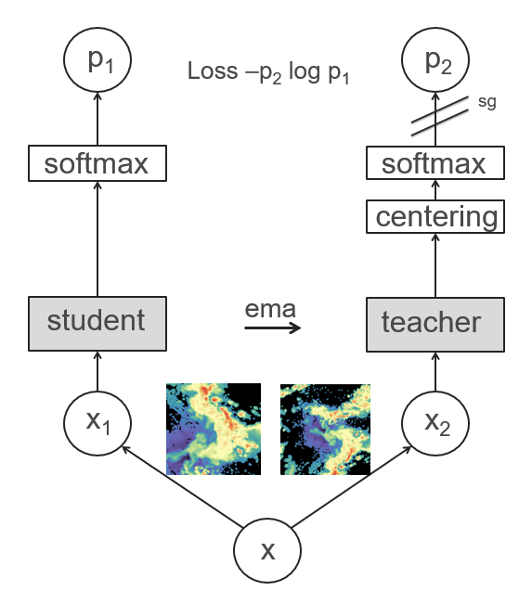
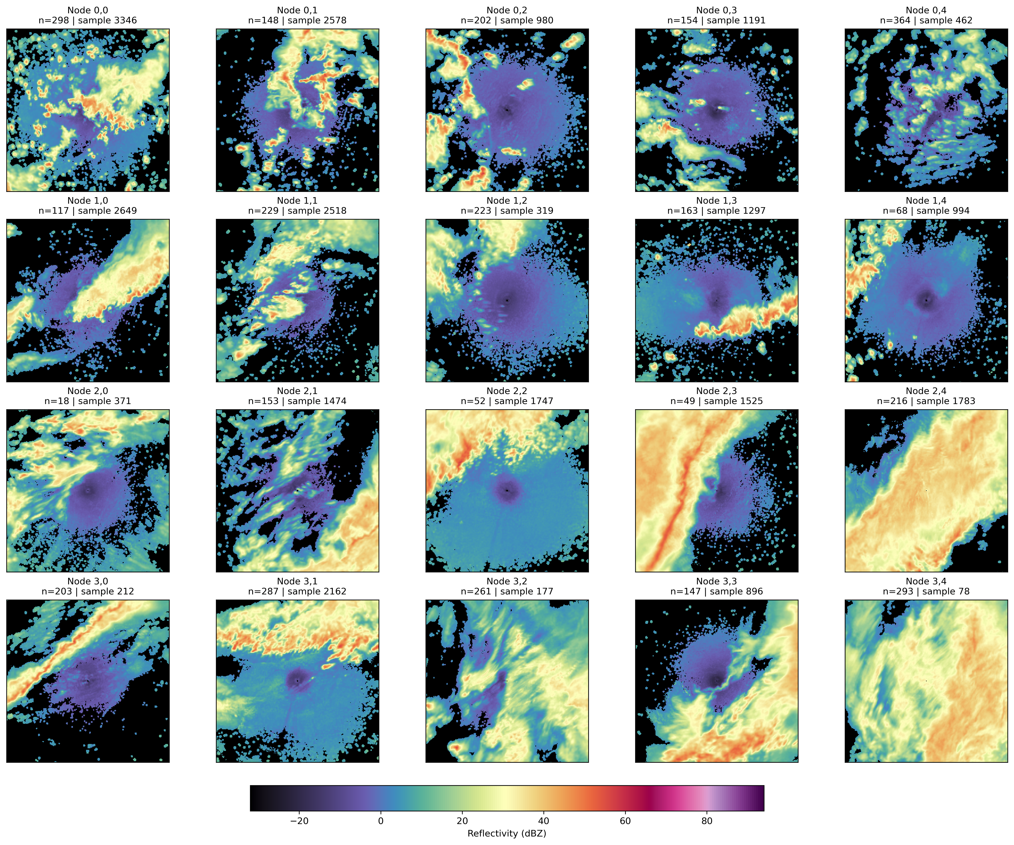
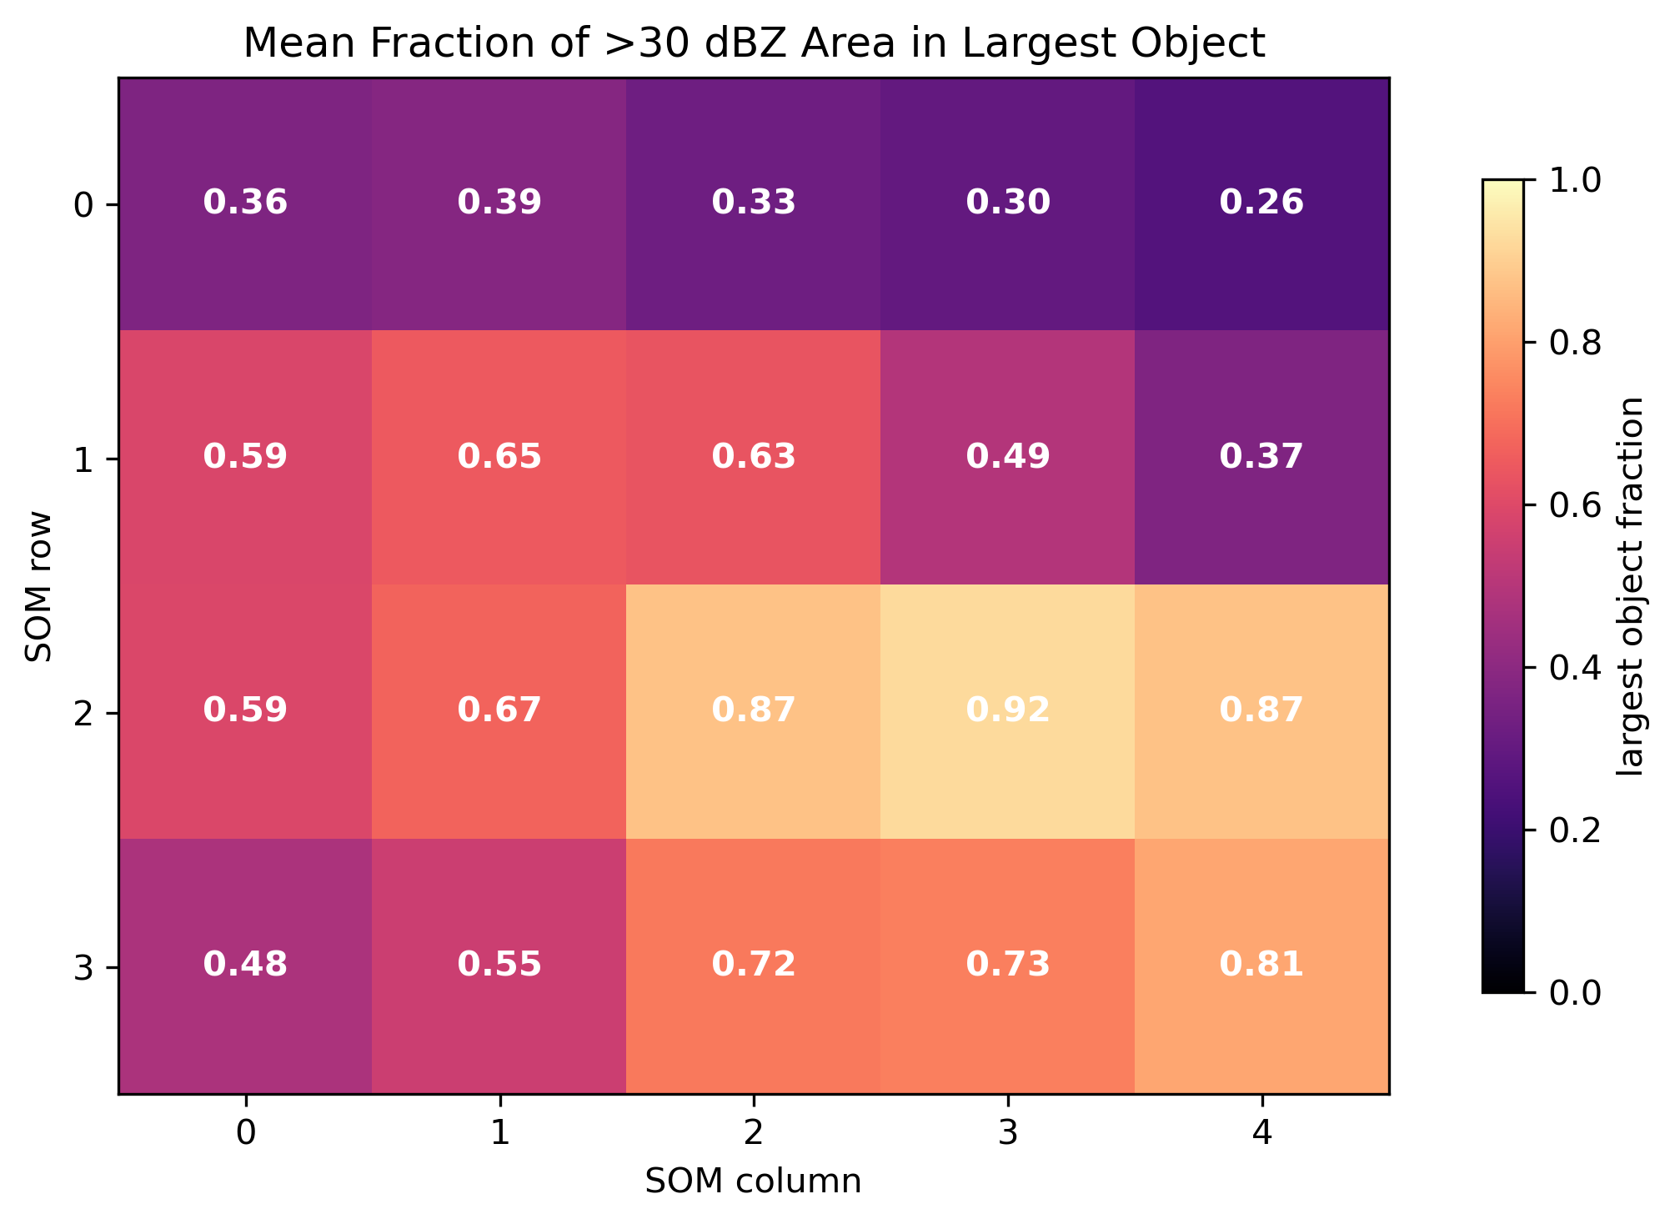
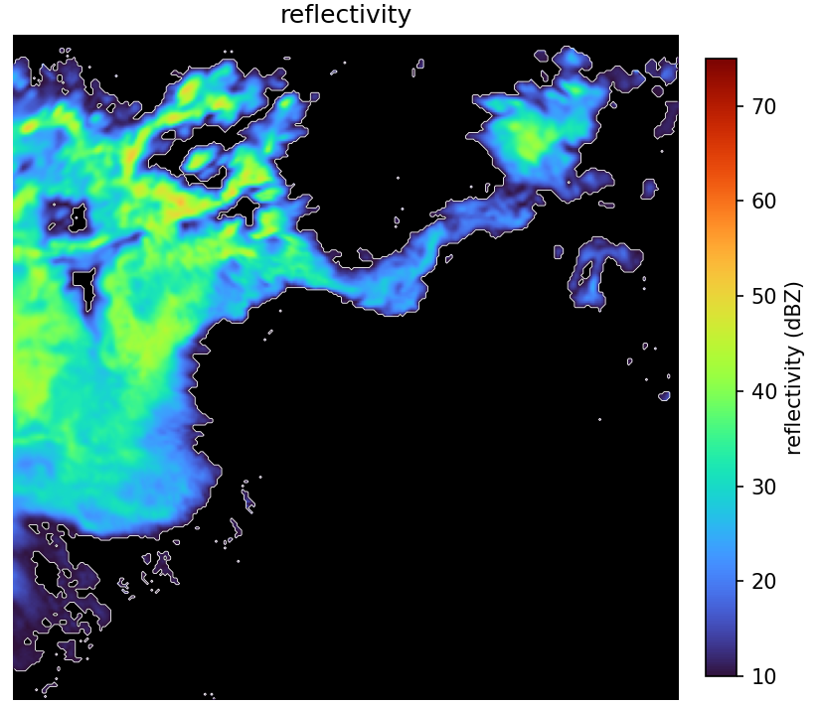
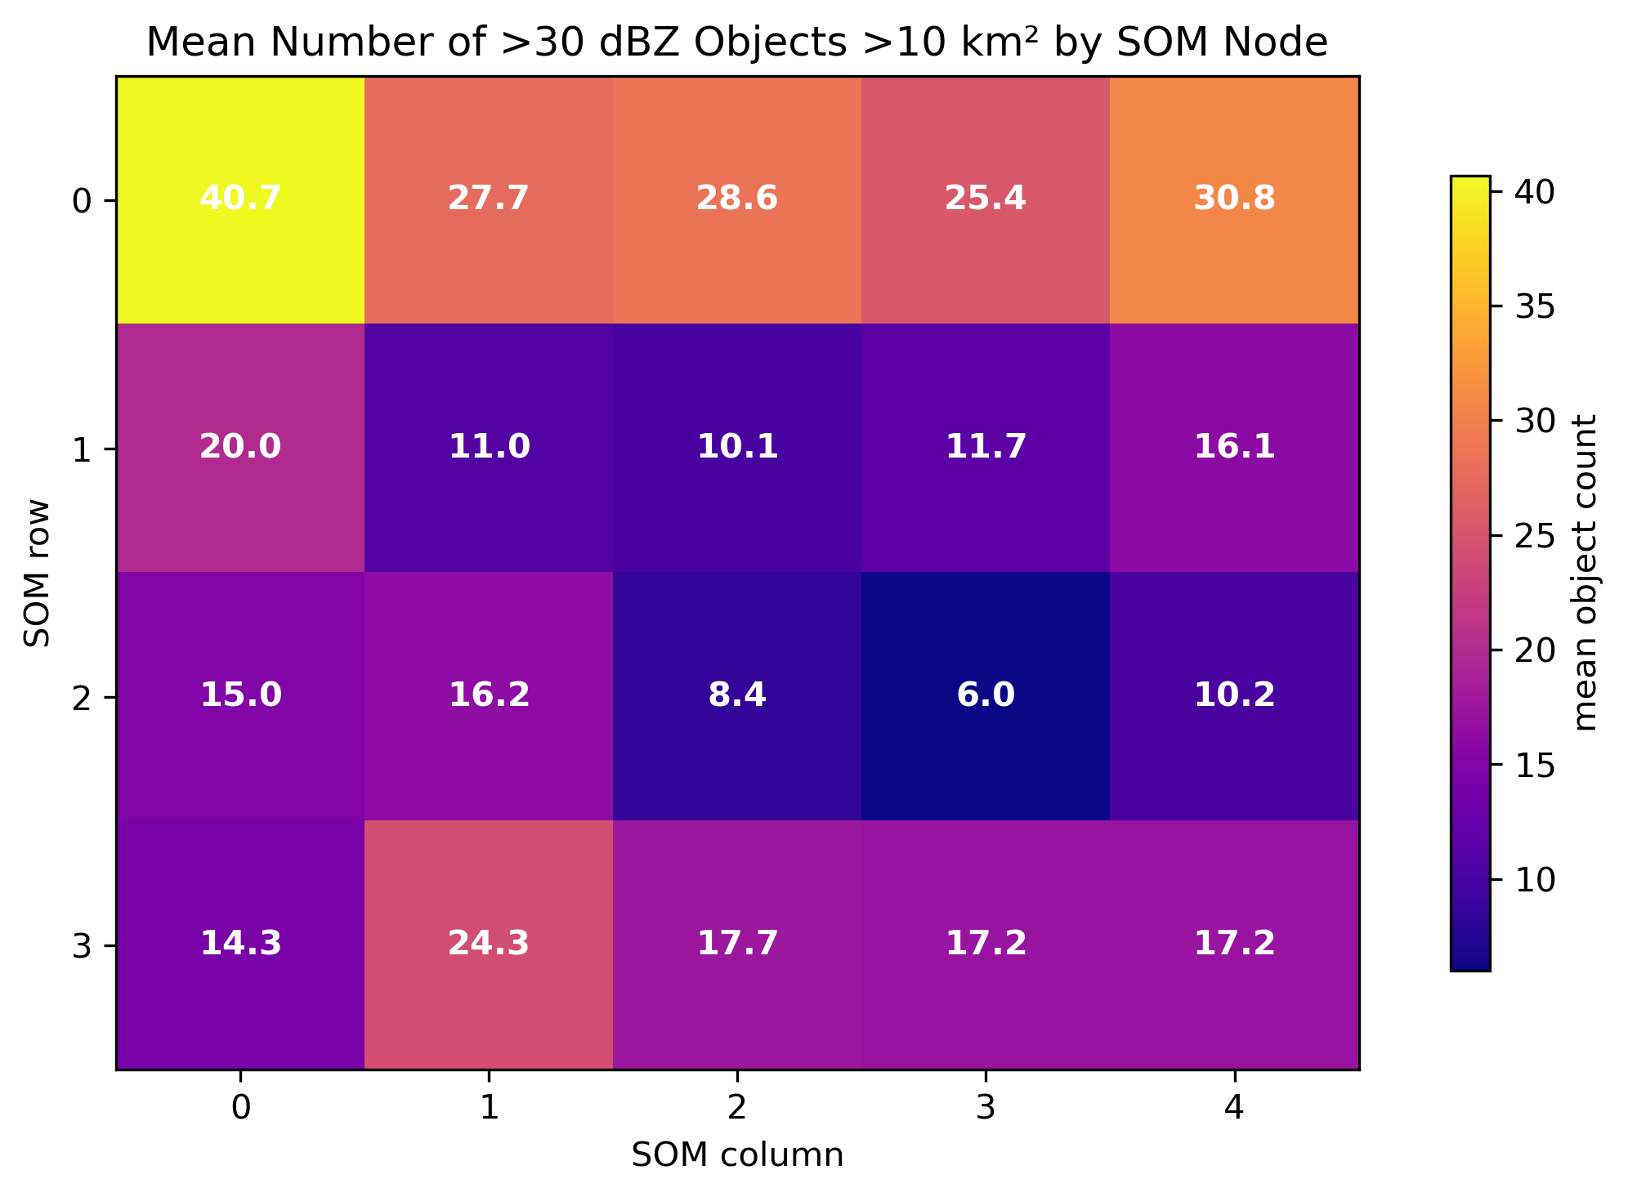
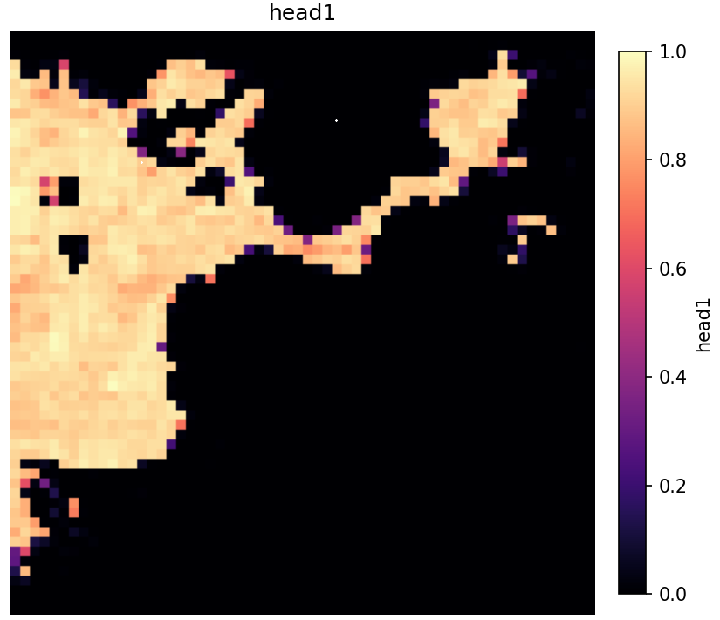
Prototyping a weather radar foundation model using self supervised learning architecture
Adapting vision transformer architecture for use on polarimetric radar data
Daniel Wefer – SULI Intern, Environmental Science. Mentors -- Bhupendra Raut and Bobby Jackson
AI-based storm mode classification, hazard detection, and hydrometeor classification are important problems in the field of meteorology.
Most implementations use supervised learning, which requires large datasets of human labeled images, which is extremely time intensive to curate.
This work explores creating a weather radar based self-supervised learning foundation model, which could serve as the basis for valuable downstream tasks.
By training a model to create meaningful but uninterpretable feature embeddings on radar images, it produces a basis for a secondary decoder model, which can be trained on specific tasks with a much smaller dataset.
Uses Meta AI’s DINO model,
adapting methods from
Dematties et al. 2023
“Student” image is altered,
and learns to predict the
features of the “teacher” image
Feature vectors can then be
clustered to find similar properties
Training dataset is thousands of
radar scans from the KHTX radar,
chosen for proximity to the BNF
ARM site.
5 radar channels, including dual-
pol fields are chosen for droplet properties.
abstract
methods
By clustering the raw feature vectors using a self-organizing map (SOM), we can see that similar feature vectors correlate to similar radar scans, proving that the feature embeddings are meteorologically meaningful.
section 1
Sample Radar scan with a given attention head.
Attention shows which parts of an image the model considers most relevant to one another.
section 2
conclusions
Self-Supervised Learning is easy to scale to thousands of images compared to other machine learning methods
Meta-AI’s DINO infrastructure can be altered to accept multichannel radar netCDF files rather than RBG images
Radar images can be used to train a foundation model for applications in future machine learning tasks.
For cross-channel learning, build a custom channel-wise tokenizer, similar to Bao et al. 2024.
Build a machine learning decoder for application on a targeted task such as storm morphology identification.
Further analyze attention maps to extract more meaning from them.
next steps
Dematties, D., and Coauthors, 2023: Let’s Unleash the Network Judgment: A Self-Supervised Approach for Cloud Image Analysis. Artif. Intell. Earth Syst., 2, 220063, https://doi.org/10.1175/AIES-D-22-0063.1.
Bao, Y., S. Sivanandan, and T. Karaletsos, 2024: Channel vision transformers: An image is worth 1 × 16 × 16 words. Proc. 12th Int. Conf. on Learning Representations, Vienna, Austria, ICLR.
references

