Slide 1
STA1 / SESSION 1
Data and
250 µm
Descriptive Statistics
a target is useful—
but it is not the whole story
How to describe an observed engineering sample
CENTRE • SPREAD • SHAPE • PATTERN
22-SLIDE STANDALONE DECK

Slide 2
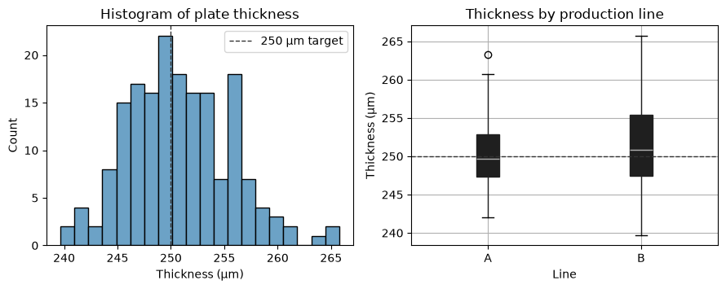
OPENING / RUNNING EXAMPLE
02 / 22
A running example: plate thickness
CONTEXT
An inline sensor records 180 manufactured plates.
MEASURE
Thickness in micrometres (µm); target = 250 µm.
STRUCTURE
Production line A or B; sample ID preserves production order.
FOUR QUESTIONS
1 What value is typical?
2 How much do values vary?
3 What is the distribution shape?
4 Do line or order patterns stand out?
STA1 • DATA AND DESCRIPTIVE STATISTICS

Slide 3
OPENING / SCOPE
03 / 22
Description comes before inference
01
02
DESCRIPTIVE STATISTICS
INFERENTIAL STATISTICS
What do these 180 observed measurements look like?
What might the wider production process be like?
This session stays with description: centre, spread, shape, potential outliers and visible patterns.
STA1 • DATA AND DESCRIPTIVE STATISTICS

Slide 4
FOUNDATIONS / SCOPE
04 / 22
Population, sample, parameter and statistic
POPULATION
All units or measurements of interest.
POPULATION
SAMPLE
The units or measurements actually observed.
observed
sample
PARAMETER
A numerical summary of a population.
STATISTIC
A numerical summary calculated from a sample.
STA1 • DATA AND DESCRIPTIVE STATISTICS

Slide 5
FOUNDATIONS / VARIABLES
05 / 22
Each variable has a role
Q
QUANTITATIVE
A continuous measurement. Mean, median, standard deviation and quartiles are meaningful.
thickness_um
C
CATEGORICAL
A label: A or B. Compare counts or the two observed distributions.
line
#
ORDER / INDEX
Production sequence. Useful for detecting drift; not itself a physical measurement.
sample_id
STA1 • DATA AND DESCRIPTIVE STATISTICS

Slide 6
SECTION 01
01
Represent the sample
Tables, plots and numerical summaries
06 / 22

Slide 7
REPRESENTATION / FREQUENCY
07 / 22
One frequency table, three graphical views
FREQUENCY TABLE
VERTICAL LINES
FREQUENCY POLYGON
Count how often each observed value occurs.
Salary (×1000 DKK) | Frequency
37 | 4
38 | 1
39 | 3
40 | 5
41 | 8
42 | 10
44 | 5
46 | 2
47 | 3
50 | 1
BAR GRAPH
Horizontal: salary (×1000 DKK) • Vertical: frequency
STA1 • DATA AND DESCRIPTIVE STATISTICS

Slide 8
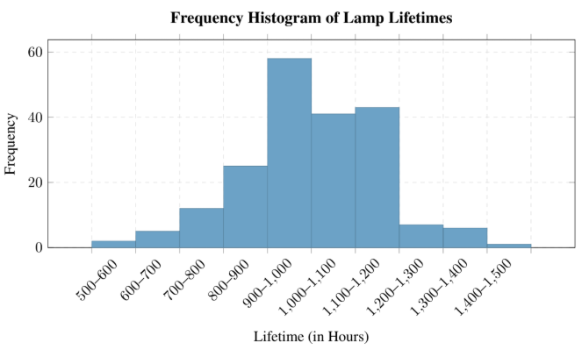
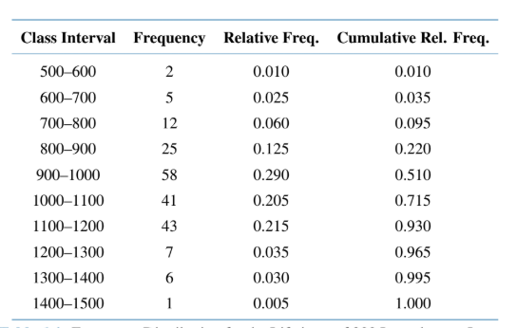
REPRESENTATION / PLOTS
08 / 22
Histograms group measurements into intervals
CONSTRUCTION
Choose measurement intervals (bins), then count the observations in each.
AXES
Horizontal: measurement intervals.
Vertical: frequency or relative frequency.
WHY BIN WIDTH MATTERS
Wide bins hide detail; narrow bins can emphasise noise.
STA1 • DATA AND DESCRIPTIVE STATISTICS

Slide 9
REPRESENTATION / CENTRE
09 / 22
Centre answers “What is typical?”
x̄
Q₂
Mo
MEAN
MEDIAN
MODE
Uses every value. Useful for roughly symmetric data, but sensitive to extremes.
The middle ordered value. Resistant to extremes and useful for skewed data.
The most frequent value or category. It may be absent or non-unique.
STA1 • DATA AND DESCRIPTIVE STATISTICS

Slide 10
REPRESENTATION / CENTRE
10 / 22
One extreme value can move the mean
ORIGINAL VALUES
7 9 11 12 13 15 17
17 → 117
MEAN 12 → 26.3
MEDIAN 12 → 12
The median depends on order; the mean is an arithmetic balance point.
STA1 • DATA AND DESCRIPTIVE STATISTICS

Slide 11
REPRESENTATION / SPREAD
11 / 22
Spread is about distance from the centre
01
02
03
04
RANGE
DEVIATION
STANDARD DEVIATION
VARIANCE
maximum − minimum
quick, but controlled by two values
xᵢ − x̄
one value’s signed distance from the mean
s
a typical distance, in the original unit
s²
the corresponding squared measure
A process can be centred on target and still vary too much.
STA1 • DATA AND DESCRIPTIVE STATISTICS

Slide 12
REPRESENTATION / SPREAD
12 / 22
Sample variance uses n − 1
SAMPLE VARIANCE
$$s^{2}=\frac{1}{n-1}\sum_{i=1}^{n}{(x_{i}-\overline{x})^{2}}$$
n
xᵢ
x̄
number of
observations
observation i
sample mean
n − 1 adjusts for estimating the unknown population mean from the same sample.
STA1 • DATA AND DESCRIPTIVE STATISTICS

Slide 13
REPRESENTATION / RESISTANT SPREAD
13 / 22
Quartiles describe the middle 50%
Order the observations, then locate three landmarks.
IQR = Q₃ − Q₁
middle half of the observed sample
Q₁
Q₂
Q₃
25%
50% / median
75%
Quartile algorithms can differ slightly; state the convention when exact agreement matters.
STA1 • DATA AND DESCRIPTIVE STATISTICS

Slide 14
REPRESENTATION / POTENTIAL OUTLIERS
14 / 22
IQR fences flag potential outliers
LOWER FENCE
UPPER FENCE
Q₁ − 1.5 × IQR
Q₃ + 1.5 × IQR
Potential outlier = an observation outside either fence
FLAG → INVESTIGATE → EXPLAIN
A flag is not an instruction to delete the observation.
STA1 • DATA AND DESCRIPTIVE STATISTICS

Slide 15
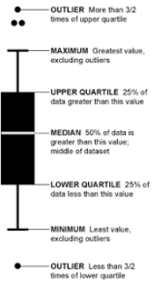
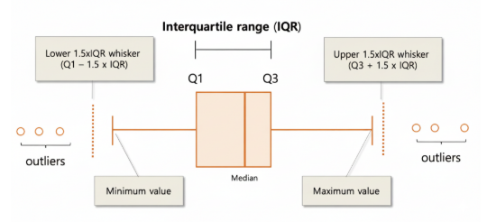
REPRESENTATION / BOXPLOT
15 / 22
A boxplot puts the summaries together
BOX
Runs from Q₁ to Q₃; the centre line is the median.
WHISKERS
End at the lowest and highest observed values inside the fences.
DOTTED LINES
The 1.5×IQR outlier boundaries—not observed minima or maxima.
OUTSIDE POINTS
Read from the centre outward:
median → box → whiskers → outside points
Potential outliers plotted individually.
STA1 • DATA AND DESCRIPTIVE STATISTICS

Slide 16
SECTION 02
02
Interpret the pattern
Shape, groups and production order
16 / 22

Slide 17
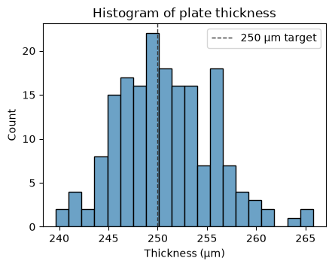
INTERPRETATION / SHAPE
17 / 22
The histogram shows the overall shape
LOOK FOR
01
one or several peaks
02
symmetry or skewness
03
concentration and spread
04
gaps and extreme values
WORKED EXAMPLE
180 observed plates; dashed line = 250 µm target
STA1 • DATA AND DESCRIPTIVE STATISTICS

Slide 18
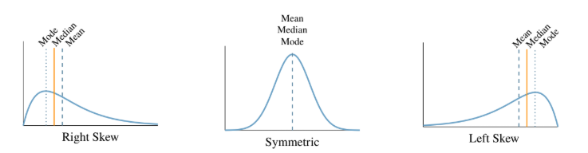
INTERPRETATION / SHAPE
18 / 22
Skewness is named by the tail
RIGHT SKEW
long tail toward higher values
SYMMETRIC
comparable tails
LEFT SKEW
long tail toward lower values
STA1 • DATA AND DESCRIPTIVE STATISTICS

Slide 19
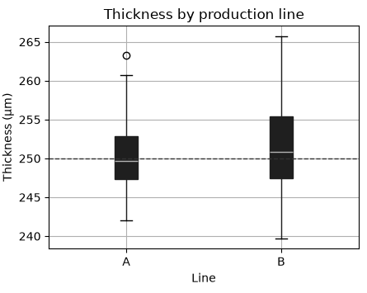
INTERPRETATION / GROUPS
19 / 22
Compare groups with side-by-side boxplots
LINE A
n = 90 median = 249.69 µm s = 4.16 µm
LINE B
n = 90 median = 250.86 µm s = 5.37 µm
In this observed sample, line B has the larger standard deviation.
That is not yet a population claim.
STA1 • DATA AND DESCRIPTIVE STATISTICS

Slide 20
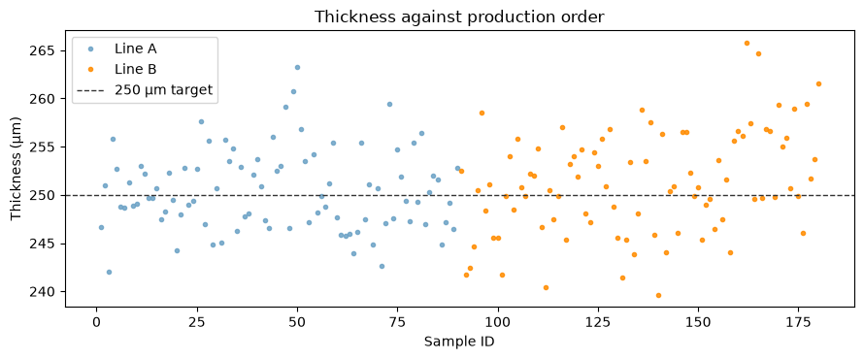
INTERPRETATION / ORDER
20 / 22
Production order can reveal drift
A histogram discards order.
A run plot preserves it.
LOOK FOR
a systematic rise, fall, shift or cycle
CAUTION
no obvious pattern is not proof of stability
STA1 • DATA AND DESCRIPTIVE STATISTICS

Slide 21
INTERPRETATION / PLOT CHOICE
21 / 22
Choose the plot that answers the question
01
02
03
HISTOGRAM
BOXPLOT
RUN / SCATTER
What is the overall shape?
How do groups compare?
Does order or a relationship matter?
one quantitative variable
centre, spread and potential outliers
sequence or paired variables
The question and variable roles determine the plot—not habit.
STA1 • DATA AND DESCRIPTIVE STATISTICS

Slide 22
CONCLUSION / RESPONSIBLE DESCRIPTION
22 / 22
Describe the sample—then stop
01
STATE THE SCOPE
what was measured, how many observations and which groups
02
REPORT CENTRE AND SPREAD
use measures that suit the observed distribution
03
DESCRIBE THE PLOTS
shape, potential outliers, group differences and order patterns
04
RESPECT THE BOUNDARY
do not turn a sample description into a population claim
Example: these 180 plates are centred near 250 µm; line B appears more variable in the observed sample.
STA1 • DATA AND DESCRIPTIVE STATISTICS

