Slide 1

simpler USDA filings for farmers
green 5x5
R. Bruce Pitt
Celia Ameline
Victor Huang

Slide 2

GREENER 5X5
The U.S. Dept of Agriculture (USDA) offers a wealth of expert assistance and financial aid to small farmers.
Value added agriculture grants
REAP grants for energy assessment
EQIP grants
Poultry & meat processing
LFPP local food promotion
HFFI healthy food financing initiative
Filing USDA Form FSA-578 is the key that unlocks these benefits…
plus state and county programs in some cases

Slide 3
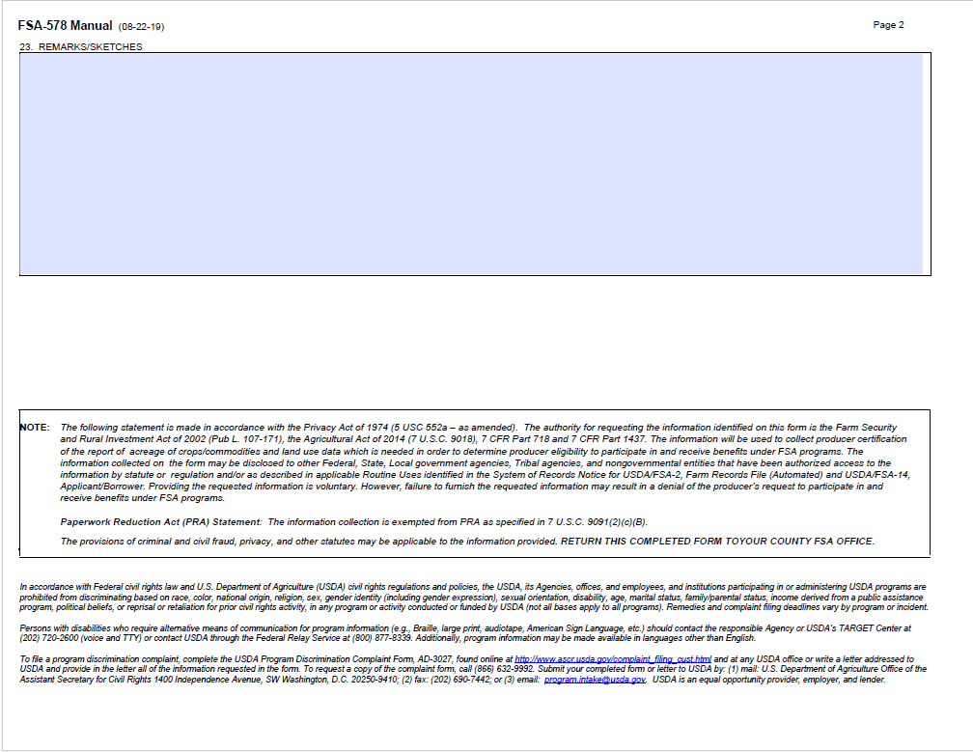
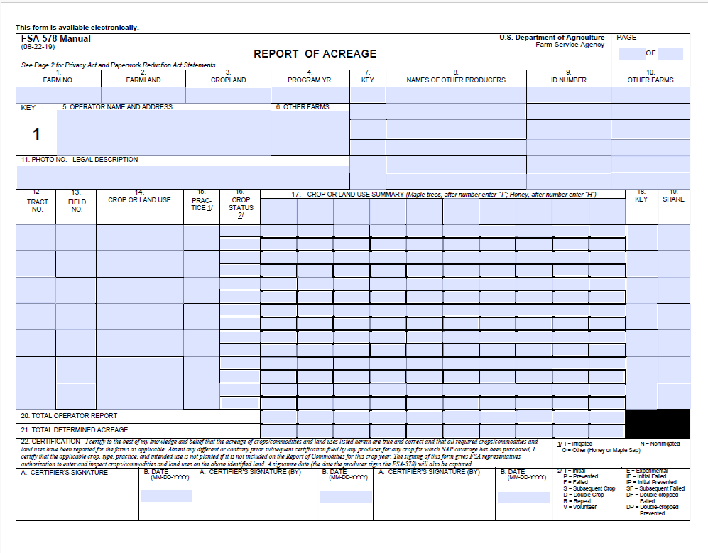
GREENER 5X5

Slide 4

GREENER 5X5
… it’s complicated.
Local USDA office staff used to fill out the form for farmers who made in-person appointments
12+ offices have been closed
2,600 experts eliminated
Traveling 100+ miles is not practical
Filing on the government website is intimidating
Commercial services are expensive
$250 per field per harvest (MyAg)
$2,495 license (PARS by Profit.ag)
State and county staff don’t have the right systems to help
Our web app makes it easier

Slide 5

DEMO

Slide 6
GREEN 5X5
MVP features
Links to USDA initial registration steps
Allow easy field mapping and crop info
Reuse data for multiple forms
Track key dates for submission and generate reminders
Business model
Free filing for small farms
Funded by state & county Economic Development grants and non-profit foundations in New Mexico
Farmers can access & file themselves
Or get help from state & county offices
Expansion
Filing other forms, guiding grant applications
Partnering with more locations, insurance agents
Targeted advertising

