Slide 1

Team: Greener5X5 (formerly: 5x5FCS578) USDA Report of Acreage
Celia Ameline
R. Bruce Pitt
Victor Huang

Slide 2

GREENER 5X5
What we are building is a digital, easy to use and file, form FSA-578 to help New Mexico’s small farmers get and stay online.
New Mexico’s agricultural infrastructure has lost one-fourth of its human capital in just 12 months. With 12+ offices closing and 2,600 experts gone.
To file these forms the old way, a farmer must make an appointment at a local office to manually certify the form or use their kiosks which could be 100 miles away.
However, this form can be filed online, but the formats the government accepts are very specific and complicated (JSON/XML/SHP) and any single mistake will cause it to be rejected it.

Slide 3

GREENER 5X5
Filing this specific form opens up a vast amount of government resources, grants, insurance, and tax advantages for the farmer.
- Value added agriculture grants
- REAP grants (energy assessment)
- EQIP grants
- Poultry & meat processing grants
- LFPP local food promotion
- HFFI healthy food financing initiative grants
and others….
This form is accepted by almost all county and state agencies in New Mexico.

Slide 4
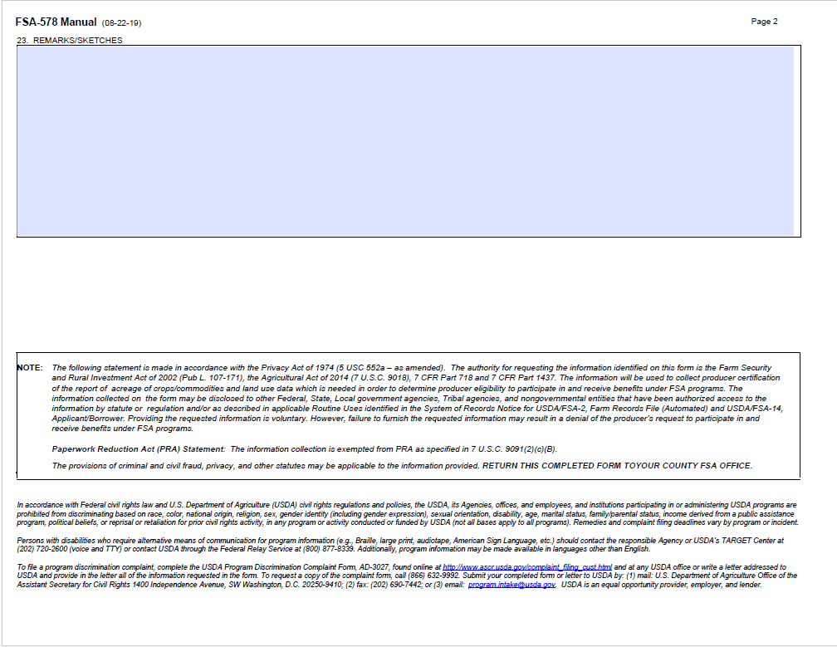
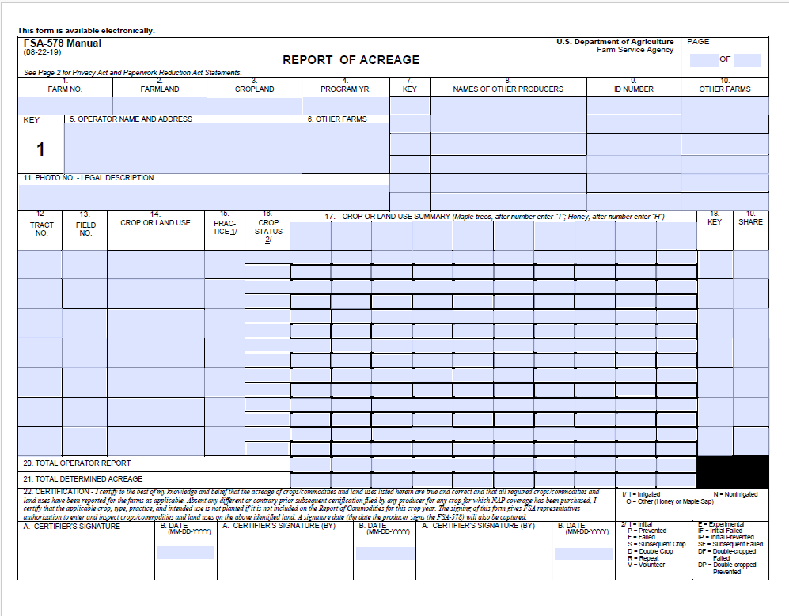
GREENER 5X5

Slide 5

DEMO

Slide 6
GREENER 5X5
Competition
MyAgData - $250/report
Pulls data from John Deer, Case IH, others
Profit.ag - $2,495 for lifetime access
PARS (Precision Acreage Reporting System)
Local FSA Service Centers
Goals
Make it easy for farmers to use
Eliminate visits to the USDA
Generate complicated submission data
Track key dates for submission and generate reminders
Allow easy field location and crop info
Allow duplicate data to be used on multiple forms
Walk throughs/Links on USDA access/forms generation
Free to NM Farmers under a certain size (10 Acres??)

