Slide 1
Segmenting anatomic images with AI/ML
RadSeg
Hamza Mir, Bruce Pitt, Harry Snow, Erik Taylor

Slide 2
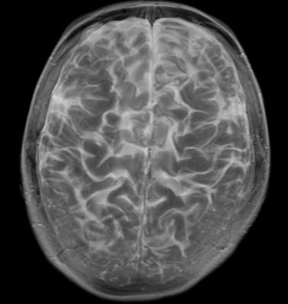
Frustration
Emergency Room
Late at Night
Rural scenario
The Radiologist is unavailable
Short Treatment Windows
100+ images and 3D volumes
https://www.itnonline.com/content/rage-disorder-linked-smaller-brain-volume-emotional-areas

Slide 3

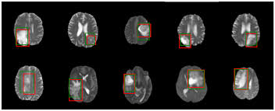
Solution -> Software, Library, Add-in
Assists
Prioritizes without diagnosis
Anotates raw images
Creates structured (searchable) information
Identified deviations from normal template
Machine Learning
https://fsl.fmrib.ox.ac.uk/fsl/fslwiki/Atlases?highlight=%28atlas%29
https://arxiv.org/pdf/1806.07589.pdf

Slide 4
Market Space
Interviews - We conducted 7 interviews
Doctors and medical professionals including:
Pediatrician, UNMH; Physician; Medical Students, UNM
“I’d find it helpful to have another read, and the ability to search for what I’m looking for. Make me a computer program!” -Pediatrician
“It would be really helpful if the scans could be segmented and anatomical features labelled to orient us quicker” -Medical Student
“I’d absolutely consider using something like that in my residency program.” - Physician, head of residency
Medical Students
Researchers
Operating Rooms/ER
Licensing to large hospitals/libraries

Slide 5
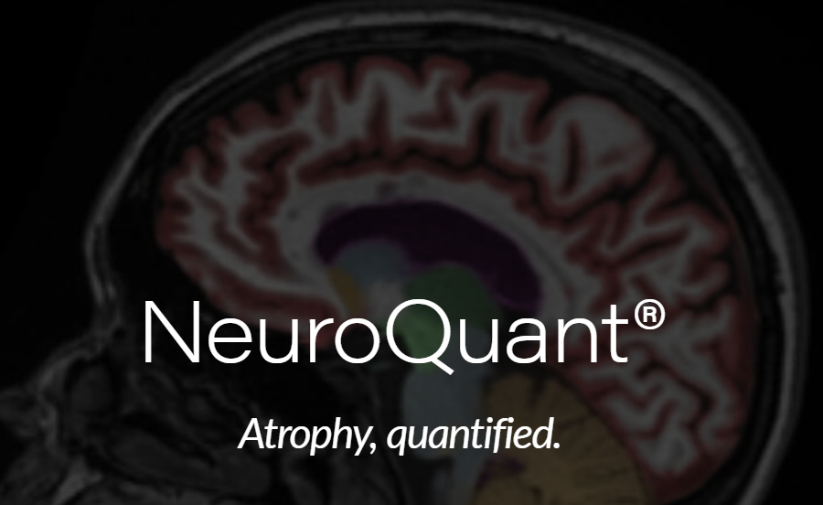

Competition
Experts available -> resources if available
Manual segmentation and reading
Existing software for stroke (clinical trials)
Existing software for brain tumors (research)
Other images -> Breast, Lung, Cardiac
Brain segmentation based on co-registration

Slide 6
Use of Funds
Grant of 10K
Pilot grant award
STTR - 150K (Experience in grant writing)
Prototype environment
Software development
Data set development
Radiologist to annotate and advise
Pilot tests
Publication of results internally

Slide 7
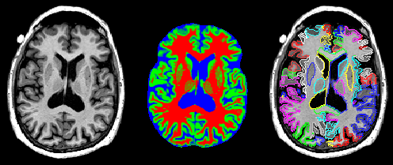
RadSeg
Access to experts
Imaging/Data Scientist
AI/ Programming experts
Plan that will lead to success
https://www.sciencedirect.com/science/article/pii/S1053811917300964?via%3Dihub
Thank you

Slide 8
Demo

Slide 9
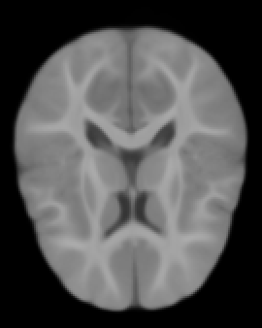
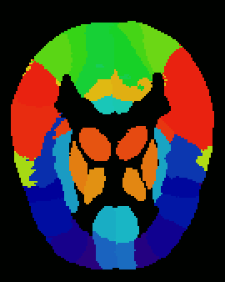
Our Team
Hamza Mir - Statistician
Bruce Pitt - Business/Start-up and Software
Harry Snow - Data Scientist
Erik Taylor - Radiology Research Asst. Professor and Physicist

