Slide 1
INVESTMENT ASSIGNMENT SUBMISSION
Name: Rajaa C

Slide 2
Spark Funds Investment Case Study
Spark Fund Investment Company Objectives:
*To Identify Best Sectors
*Countries to invest
*Better Investment Type to choose
Constraints:
* wants to invest between 5-15 million USD
* English Speaking countries are preferred.

Slide 3
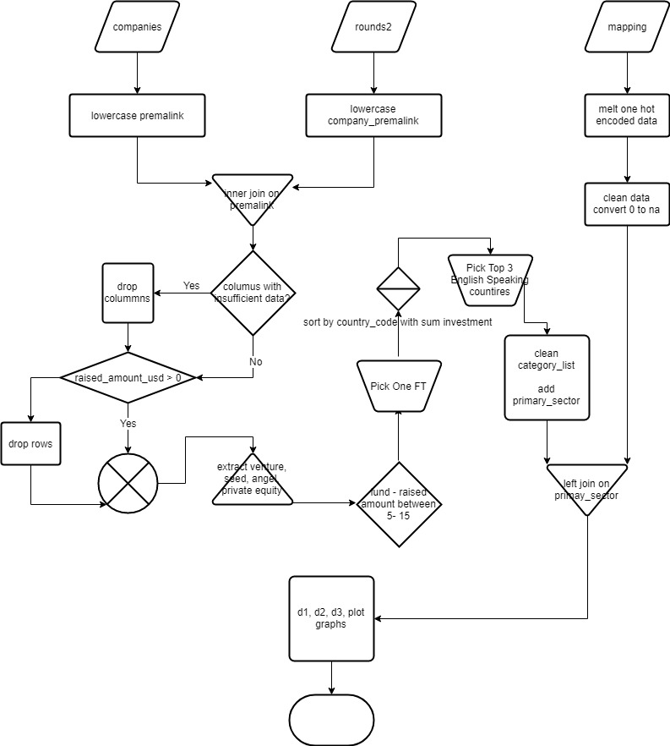
Flow chart

Slide 4
Investment type Analysis
Venture Investment is the most preferred investment type as it the within the price range and it is most chose by most of the companies.

Slide 5
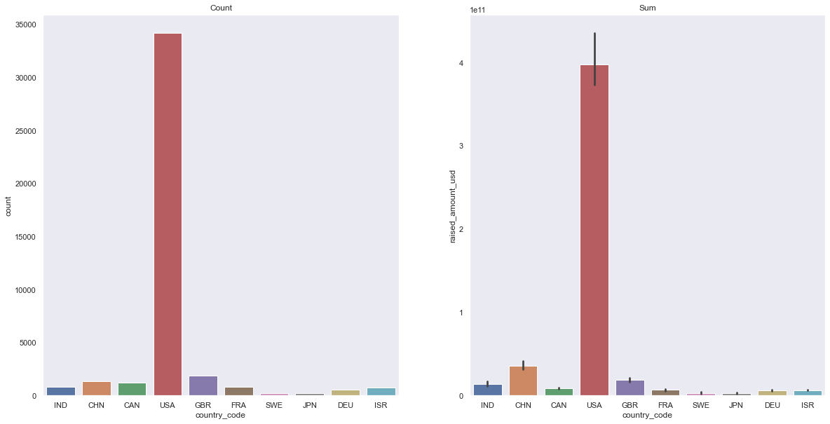
Country Analysis- USA, Great Britain, Canada & India are most preferred English speaking countries

Slide 6
Results & conclusion
Based on the analysis done it is clear that USA is an ideal place to make investment, as per the volume of investment done there are various sectors.
The next preferred place to invest is GBR, Canada & India were next 25% of the investments are made.

