Slide 1
Titanic Survival Dataset Micro-Project #4 https://github.com/RCC0149/ANA500
Randall C. Crawford
6-2-2025

Slide 2
Problem Statement
This project aims to identify which passenger attributes (e.g. name, age, gender, socio-economic class, etc..) were most predictive of survival in the Titanic disaster.

Slide 3
Hypothesis Formulation
Build a predictive model that predicts survival based on some of the passenger attributes mentioned in the Problem Statement, then use that model to predict survival of passengers in a test dataset.

Slide 4
Acquire
The classic Titanic dataset was downloaded from the provided site.
The dataset was successful loaded into a Jupyter Notebook file in Visual Studio.
The dataset contained 1309 records representing individual passengers and 12 variables.
The binary variable ‘Survived’ was identified as the outcome variable.
891 records have outcome values and are meant to be the training dataset.
418 records have missing outcome values and are meant to be the testing dataset.
Ten variables were initially identified as explanatory variables (‘Pclass’, ‘Name’, ‘Sex’, ‘Age’, ‘SibSp’, ‘Parch’, ‘Ticket’, ‘Fare’, ‘Cabin’, ‘Embarked’).
Five Object Variables (‘Name’, ’Sex’, ‘Ticket’, ‘Cabin’, ‘Embarked’)
Three Integer Variables (‘Pclass’, ‘SibSp’, ‘Parch’)
Two Float Variables (‘Age’, ‘Fare’)
Descriptive statistics were generated for the Integer and Float explanatory variables.
A missing value assessment was performed on the explanatory variables (‘Age’: 263, ‘Fare’: 1, ‘Cabin’: 1014, ‘Embarked’: 2).

Slide 5
Prepare
Perform an outcome and potential explanatory variable evaluation.
A value count was assessed on the binary outcome variable ‘Survived’ (0=No, 1=Yes) (No: 549, Yes: 342).
Value counts were assessed on select explanatory variables (‘Pclass’, ‘Sex’, ‘SibSp’, ‘Parch’, ‘Embarked’).
Value counts concerning survival were assessed on select explanatory variables (‘Pclass’, ‘Sex’, ‘SibSp’, ‘Parch’, ‘Embarked’).
The ‘Name’ variable was parsed into two separate variables ‘Title’ (Mr, Miss, Mrs, Master, Rev, Dr, etc…) and ‘Surname’ that was the family or individual last name.
The previously performed value counts were assessed on the ‘Title’ variable.
A ‘FamilyID’ variable was created from the concatenation of the ‘Surname’ and ‘Ticket’ variables.
Histograms, boxplots, normality assessments (Anderson-Darling and QQ Plot), and skewness tests were created for two numeric variables (‘Age’, ‘Fare’).
A ‘FamilySize’ variable was created from the sum of the ‘SibSp’ and ‘Parch’ variables.
The previously performed value counts were assessed on the ‘FamilySize’ variable.
The ‘Ticket’ variable was parsed into two separate variables ‘TicketPrefix’ likely indicating the ticket vendor and ‘TicketNumber’ for individual identification of payment.
The previously performed value counts were assessed on the ‘TicketPrefix’ variable.

Slide 6
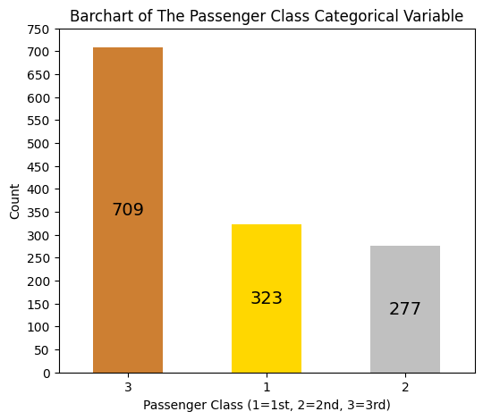
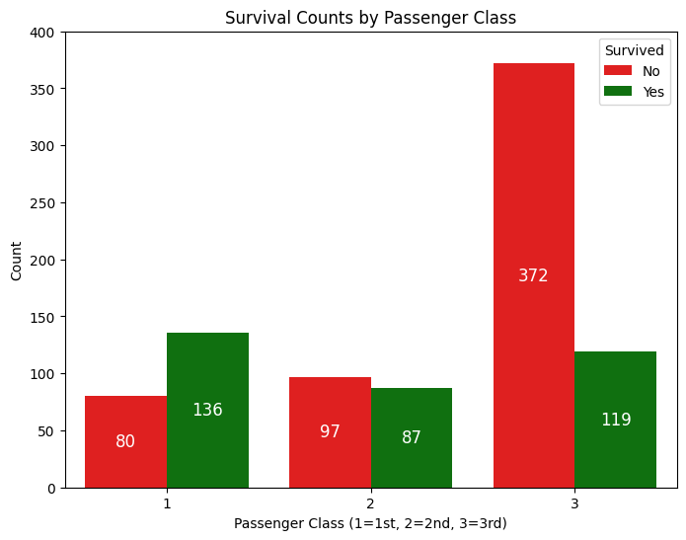
Passenger Class Bar Charts

Slide 7
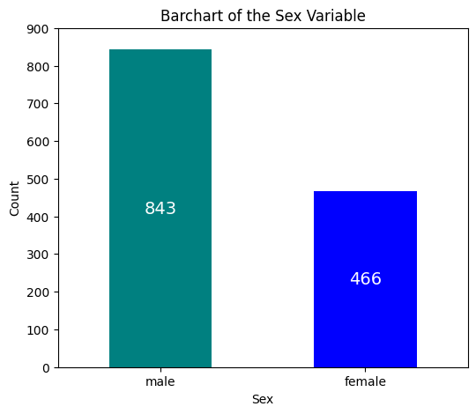
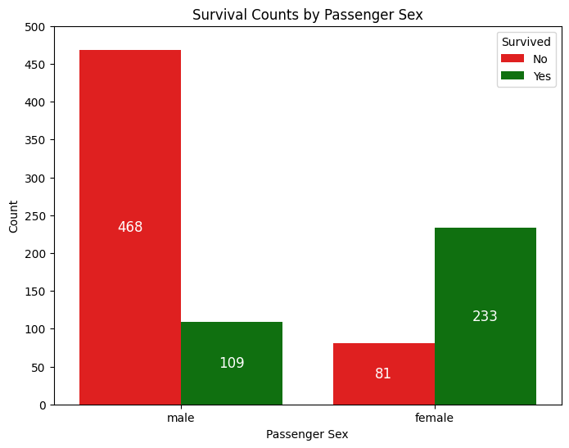
Passenger Sex Bar Charts

Slide 8
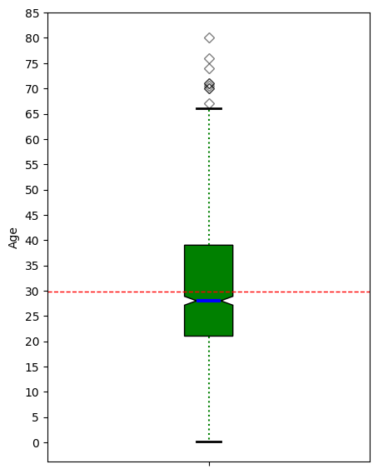
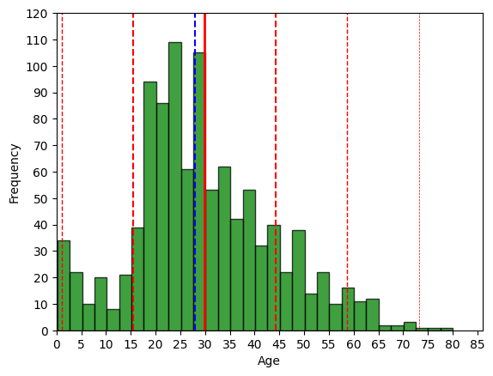
Passenger Age Histogram & Boxplot

Slide 9
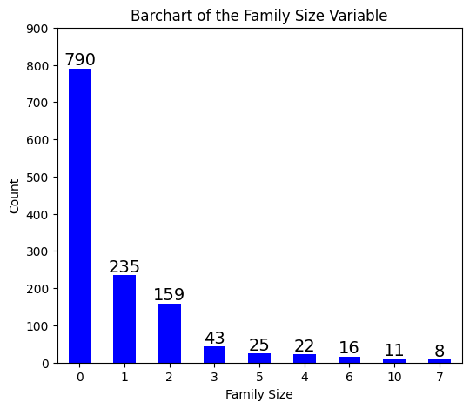
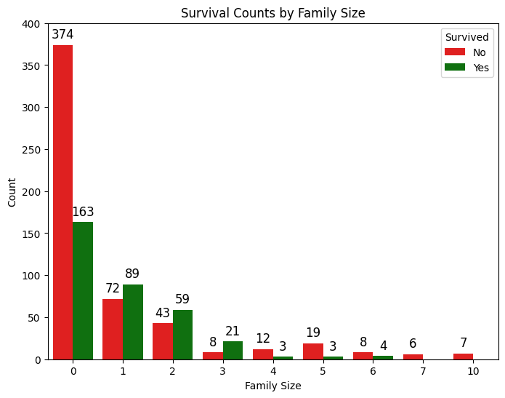
Passenger Family Size Bar Charts

Slide 10
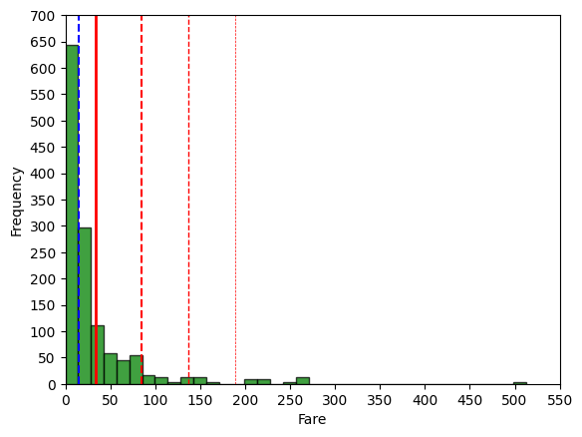
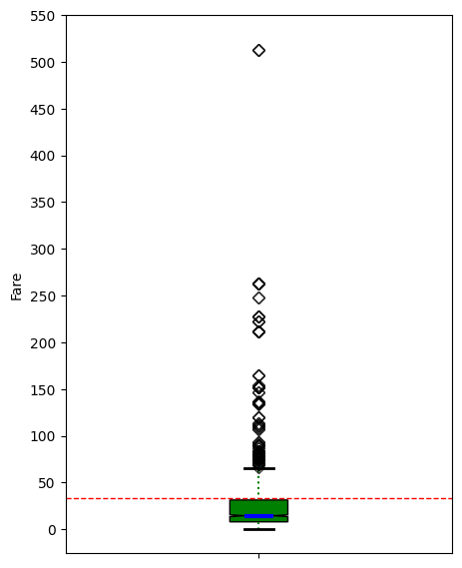
Passenger Fare Histogram & Boxplot

Slide 11
Prepare (cont.)
A ‘Deck’ variable (A, B, C, D, E, F, G, T, Lower) was created from parsing the ‘Cabin’ variable with its missing values assigned to the value “Lower”.
The previously performed value counts were assessed on the ‘Deck’ variable.
Perform imputation for the ‘Fare’ (1), ‘Embarked’ (2), ‘Deck’ (1014), and ‘Age’ (263) variables.
‘Fare’ imputation was done by identifying the sole passenger, Storey, that had a missing ‘Fare’ value, calculating the median fare associated with the passenger’s class (‘Pclass’), 3rd Class, and port of embarkment (‘Embarked’), Southhampton, and imputing that fare for the passenger.
‘Embarked’ imputation was done by identifying the two passengers, Mrs. Stone and Miss Icard, that shared a ticket number and cabin on the voyage, conduct some research to determine their relationship to each other (Icard was Stone’s maid) and their port of embarkment, Southhampton, and impute that port for both passengers.
‘Deck’ imputation started with ticket number (‘TicketNumber’) sequence analysis by passenger class (Pclass). This showed that the White Star Line had created the tickets with certain ticket number ranges that reflected a specific passenger class predominately. Ticket numbers 2667 through 9549 mostly and 330971 through 3101317 completely were 3rd class, and 9550 through 28210 mostly were 1st class. With the passenger class distribution being 1st: 323, 2nd: 277, and 3rd: 709, I needed to gain some understanding of the ship accommodation per deck for passenger classes. Please refer to the table on the next slide.

Slide 12
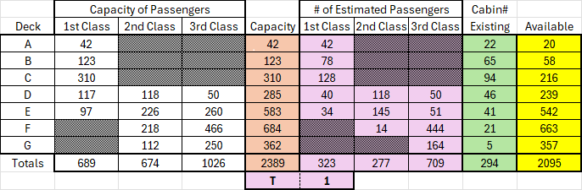
Prepare (cont.)
As you can see, the Titanic had considerably more capacity for passengers than was utilized on its maiden voyage. Regarding the estimations, I am reasonably confident on the 3rd Class estimations based on historical information concerning number of steerage passengers, the 164 G deck occupancy, and 113 Queenstown 3rd Class passengers that were put there.
The cabin number existing information is mostly 1st Class. Hoping that through ticket number and possibly ticket prefix analysis, possibly embarkment, and more research, I will be able to better define the estimated passenger allocation. Used an official document on the next slide to understand cabin vs. steerage passengers.

Slide 13
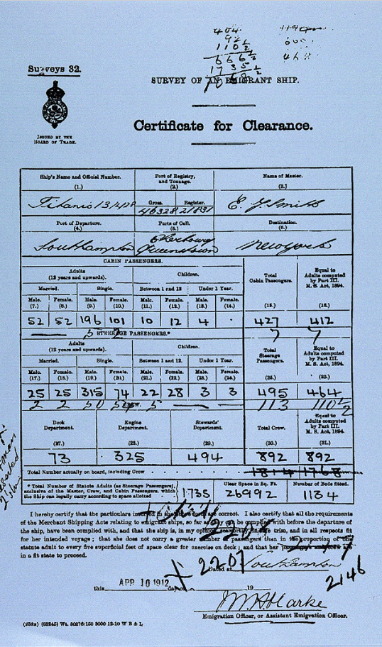
Prepare (cont.)
With the markings on this document, one can tell that it was being modified, but the 113 3rd Class Queenstown passengers were written. It also notes an estimation of steerage passengers vs. cabin passengers. Steerage passengers are 3rd Class passengers that were located on Deck F and G. On the other hand, the majority of those who embarked from Cherbourg were in 1st Class.
After exhaustive review of tickets, limited cabin assignment information, ship accommodations capacity numbers, and Certificate for Clearance documentation, it became apparent that there was insufficient resources to fully and accurately impute ‘Deck’ values for passengers. Though deck locations probably played a role in the survival of passengers, the variable had to be sacrificed.
Certificate of Clearance counts for children was used to verify Age imputation results.

Slide 14
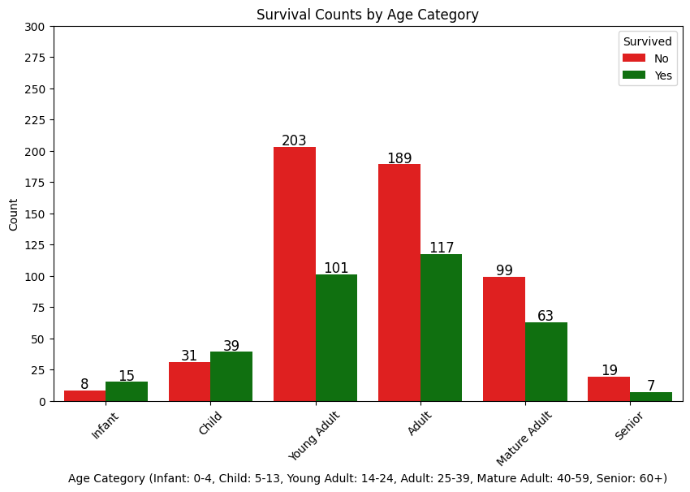
Prepare (cont.)
‘Age’ imputation was done by using a combination of the ‘Title’ (Mr, Mrs, Miss, Master), ‘FamilySize’, ‘SibSp’, ‘Parch’, and ‘FamilyID’ to evaluate family member median age relationships and impute missing age values.
‘Age_Cat’ variable was created from the ‘Age’ variable to represent significant age groups (Infant 0-4, Child 5-13, Young Adult (14-24), Adult (25-39), Mature Adult (40-59), Senior(60+)).

Slide 15
Analyze data
Unnecessary or non-predictive variables were removed from the training and test datasets.
Omitted: PassengerId, Name, Surname, Ticket, TicketPrefix, TicketNumber, Cabin, Deck, FamilyID, SibSp, Parch
Retained: Survived, Pclass, Sex, Age, Fare, Embarked, Title, FamilySize, Age_Cat
Rare titles were grouped together to form the Title_Other variable.
Grouped Titles: Dr, Rev, Major, Don, Col, Jonkeer, Lady, Dona, Countess, Sir, Mme, Ms, Mlle, Capt
Common Titles: Mr, Miss, Mrs, Master
Encoded variables for Age_Cat, Title, and Embarked values were created.
Age_Cat_Infant, Age_Cat_Child, Age_Cat_Young Adult, Age_Cat_Adult, Age_Cat_Mature Adult, Age_Cat_Senior
Title_Mr, Title_Miss, Title_Mrs, Title_Master, Title_Other
Embarked_S, Embarked_C, Embarked_Q
A total of 19 explanatory variables were slotted for model use.
Boolean and string values were converted to binary values for model use.

Slide 16
Analyze data (cont.)
Logistic Regression
Backward Elimination feature reduction was performed and recommended the retention of all 19 features. Received a HessianInversionWarning indicating the presence of multi-collinearity.
Class Weights were implemented that were representative of the proportion of non-survivors (1) to survivors (1.6) to insure a balanced focus on model results.
Created an initial model using all 19 features, then logged results.
Generated a correlation heatmap with all 19 features (see heatmap on the next page).
Highly Correlated Feature Pairs (|corr| > 0.7):
Sex and Title_Mr: -0.867
Embarked_C and Embarked_S: -0.783
Title_Master and Age_Cat_Infant: 0.751
Through modeling trial and error, the removal of Embarked_S and Age_Cat_Infant made the most sense. Embarked_C with its 1st Class passengers is likely more predictive of survivors, and though Title_Master represents one sex, it also represents a larger age demographic than Age_Cat_Infant. Sex and Title_Mr seemed to depreciate the model quality with their absence.
Created a L1 Regularization (Lasso) model with the remaining 17 features, and 10 features were ultimately used. Logged results.
Utilized Features: Pclass, Sex, Age, Fare, FamilySize, Embarked_C, Title_Master, Title_Mr, Title_Mrs, Age_Cat_Adult
A ‘liblinear’ solver was used, and C was optimized at 0.6
Created a L2 Regularization (Ridge) model with the remaining 17 features, then logged results.
A ‘lbfgs’ solver was used, and C was optimized at 0.7
Created a ElasticNet model with the remaining 17 features, and 12 features were ultimately used. Logged results.
A ‘saga’ solver was used, l1_ratio was tuned to 1.0, and C was optimized to 0.6
Optimized model suggested use of L1 Regularization primarily.

Slide 17
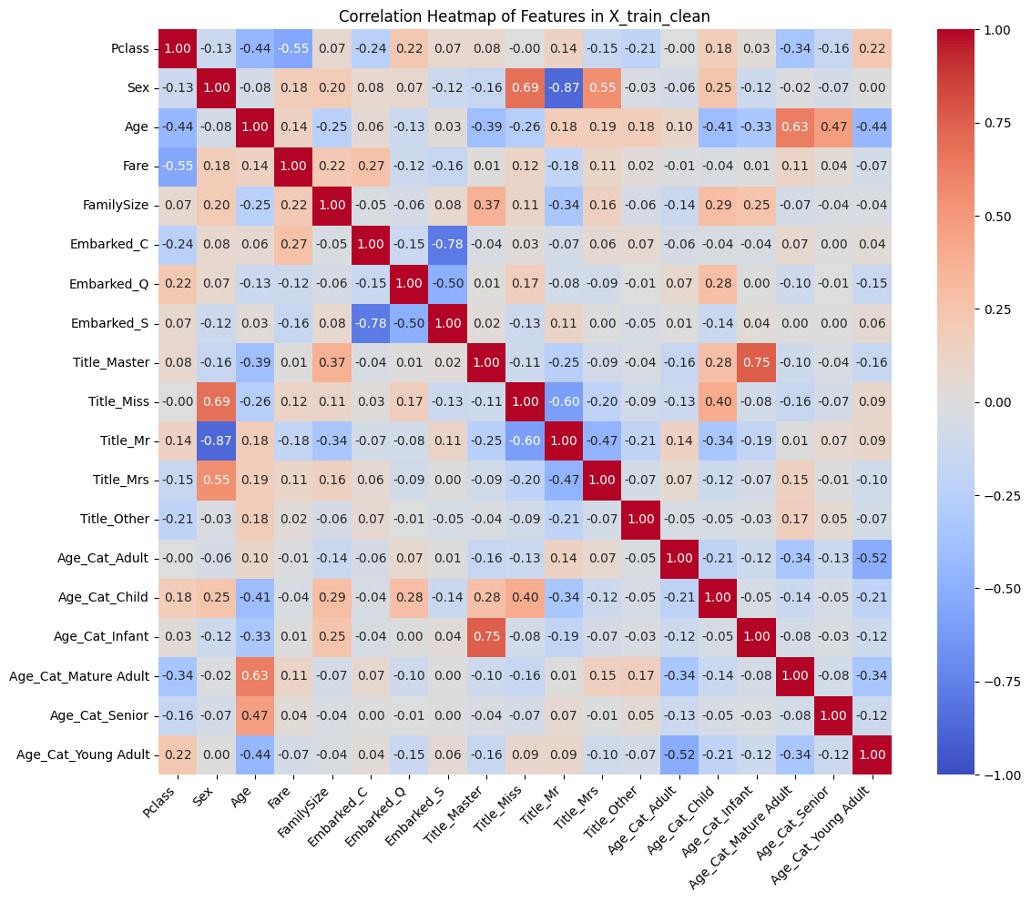
Analyze data (cont.)

Slide 18
Analyze data (cont.)
Random Forest Classifier
Created an initial model using all 19 features, then logged results.
Parameters Optimized: n_estimators=135, max_depth=8, min_samples_split=8
Created a model using 14 features with Title features removed, then logged results.
Parameters Optimized: n_estimators=155, max_depth=18, min_samples_split=8
Created a model using 8 features with Title and Age_Cat features removed, then logged results.
Parameters Optimized: n_estimators=145, max_depth=10, min_samples_split=5
Created a model using 5 features with Title, Age_Cat, and Embarkment features removed, then logged results.
Parameters Optimized: n_estimators=200, max_depth=11, min_samples_split=5
Created a model using 5 features by RF feature importance, then logged results.
Parameters Optimized: n_estimators=135, max_depth=8, min_samples_split=4
Features Utilized: Fare, Age, Sex, Title_Mr, Pclass
SVM
Created a Linear SVM model with the 10 Lasso reduced features, then logged results.
A ‘linear’ kernel was used, and C was optimized at 2.0
Created a RBF SVM model with the 10 Lasso reduced features, then logged results.
A ‘rbf’ kernel was used, C was optimized at 2.3, and gamma was optimized at ‘scale’.
Created a RBF SVM model with the 17 features by SHAP feature importance, then logged results.
A ‘rbf’ kernel was used, C was optimized at 2.4, and gamma was optimized at ‘auto’.

Slide 19
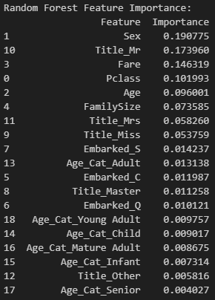
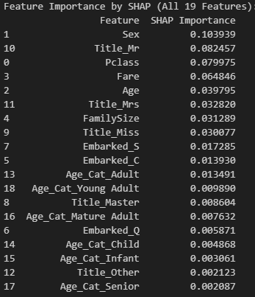
Analyze data (cont.)

Slide 20
Analyze data (cont.)
XGBoost Classifier
Created a model using 15 features by XGB feature importance from 17 features after correlation reduction, then logged results.
Hyperparameters Optimized: scale_pos_weight=1.6, max_depth=4, learning_rate=0.2, n_estimators=50, min_child_weight=3, reg_alpha=0.01, reg_lambda=0, gamma=0.1, subsample=0.8, colsample_bytree=0.8
GradientBoosting Classifier
Created a model using 17 features by GB feature importance, then logged results.
Hyperparameters Optimized: max_depth=3, learning_rate=0.05, n_estimators=100, min_samples_split=5, subsample=0.8
AdaBoost Classifier
Created a model with 17 features after correlation reduction, then logged results.
Parameters Optimized: n_estimators=100, learning_rate=1.0, estimator__max_depth=1
Created a model with 9 features by permutation feature importance, then logged results.
Parameters Optimized: n_estimators=100, learning_rate=1.0, estimator__max_depth=1
Features Utilized: Title_Miss, Embarked_C, Pclass, Sex, Age, Fare, Title_Other, Age_Cat_Adult, Embarked_Q
Tensorflow/Keras
Created a machine learning model with all 19 features, then logged results.
Parameters Used: 2 layers, Dense (30, 15, 1), activation=‘relu’, Dropout (0.3), learning_rate=0.0006, epochs=90, batch_size=30

Slide 21
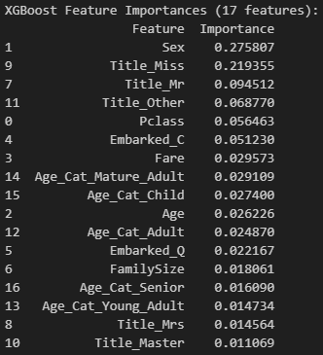
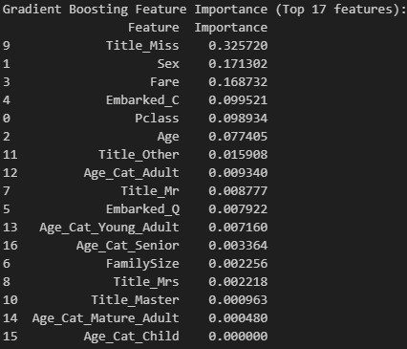
Analyze data (cont.)

Slide 22
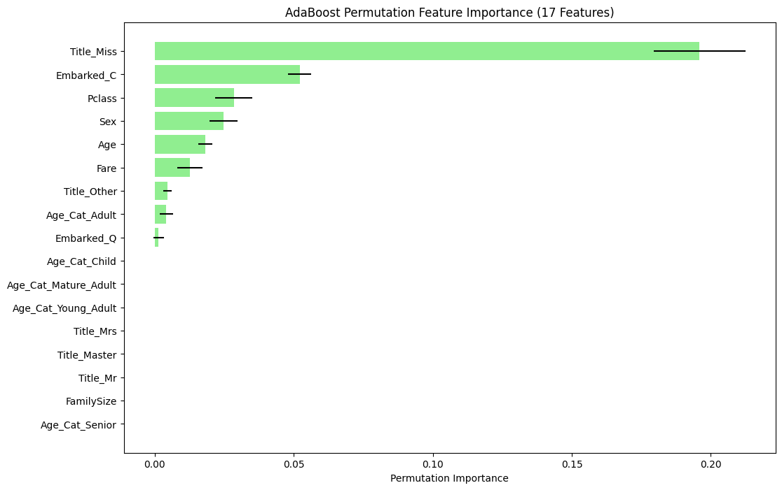
Analyze data (cont.)

Slide 23
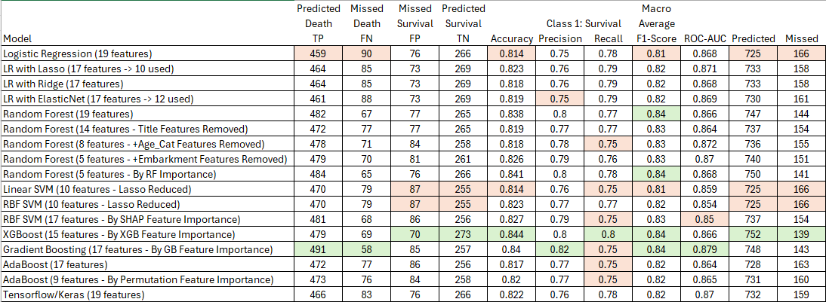
Report
Model Summary Results

Slide 24
Act
Considered generating a ROC-AUC chart, but there did not seem to much difference in the model ROC-AUC values (0.85 to 0.879). In addition, my final decision on a model did not rely on that statistic, but on an Accuracy (0.844), Macro Average F1-Score (0.84), and general Confusion Matrix performance (752 Predicted and 139 Missed). XGBoost (15 features - by XGBoost Feature Importance) stood out from the rest. Found the project rewarding in the sense of delving more deeply into an involved imputation strategy and model use and testing. Not sure that anyone has approached this problem the way that I did regarding imputation, and the review of multiple classification models with the training dataset.
Used the XGBoost model and its top 15 features to generate predictions for the test dataset and save them as a .csv file. Will post it with the program and data file on mt Git Hub account.
Will take more time to carefully review the Age imputation to make sure it is working as intended. At that point, I will look at posting something on Kaggle.
Thank you so much, and I feel that this course has been a great preparation for AI/Optimization core courses to come.

