Slide 1
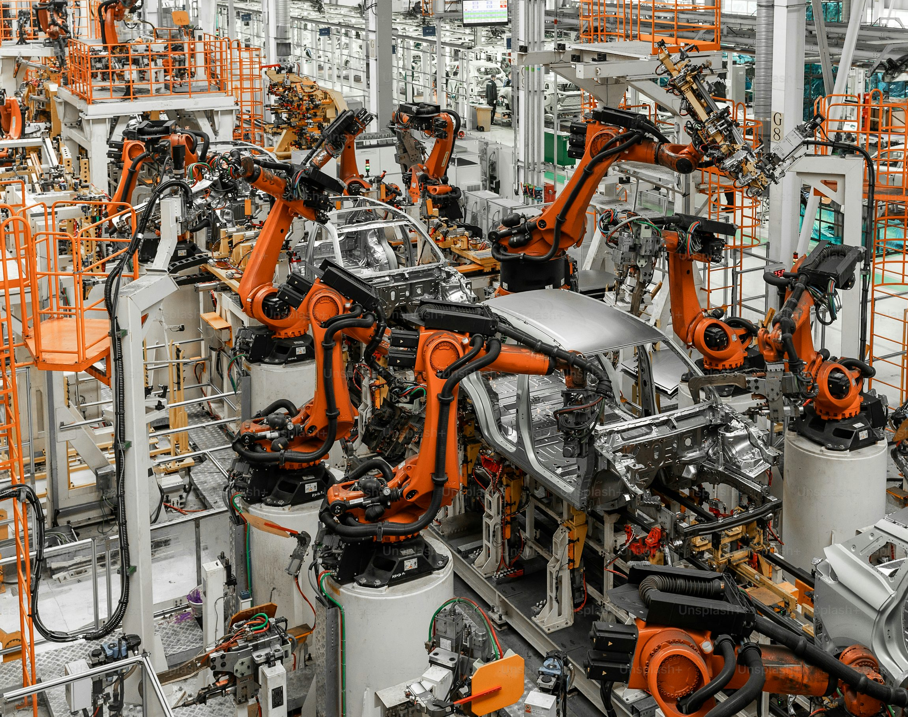

Collaborative Multi-Robot Inspection System for Weld Quality Assurance in Automotive Manufacturing
Utilizing Reinforcement Learning for Adaptive Defect Detection and Coordination, Integrated with Human Oversight for Real-Time Process Control Monitoring on the Production Line
Randall Crawford September 7, 2025

Slide 2
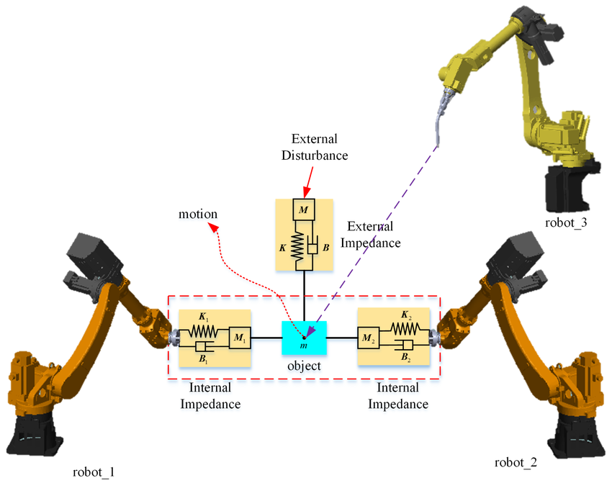
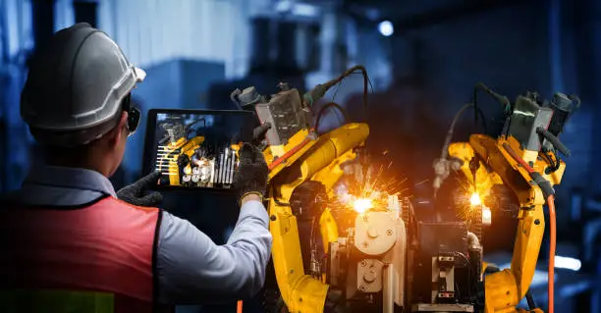
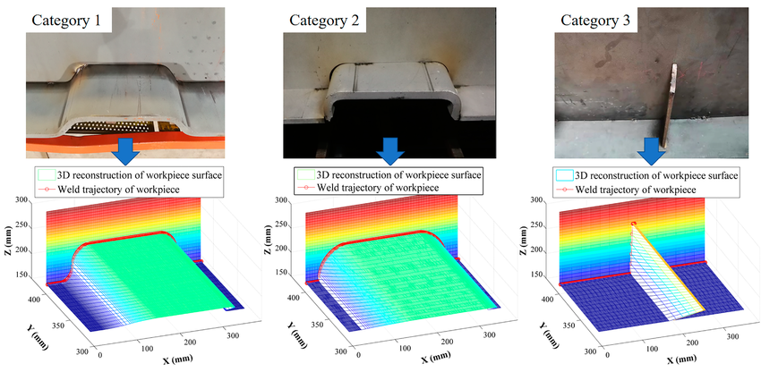
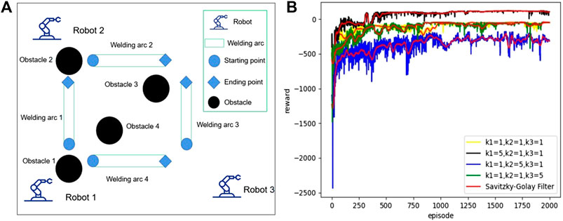
The collaborative weld inspection system integrates autonomy, human interaction, multi-robot coordination, and reinforcement learning to enhance quality assurance and process control in automotive manufacturing.
Application: Weld Quality Inspection In Automotive Assembly
Human Interaction: Operators Providing Oversight For Real-Time Monitoring
Multi-Robot Coordination: Multiple Robots Synchronizing Defect Scans
Reinforcement Learning: Agents Optimizing Detection Via Trial-And-Error
Autonomy: Robots Adapting To Weld Variations Independently

Slide 3
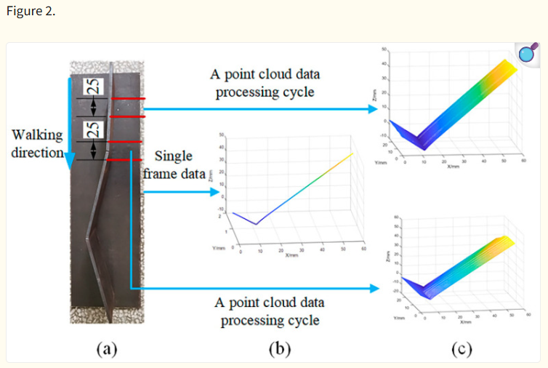
Autonomy in robotic systems allows for real-time adaptation to weld variations, reducing defect rates in automotive manufacturing.

Slide 4
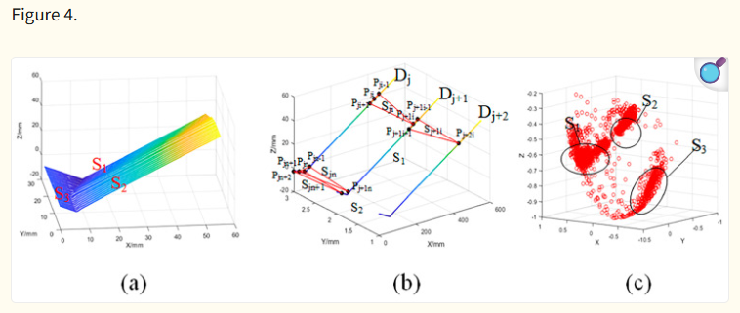

Dual-driven algorithms enhance robotic autonomy by combining physics and data models, improving weld stability and quality in production lines.

Slide 5
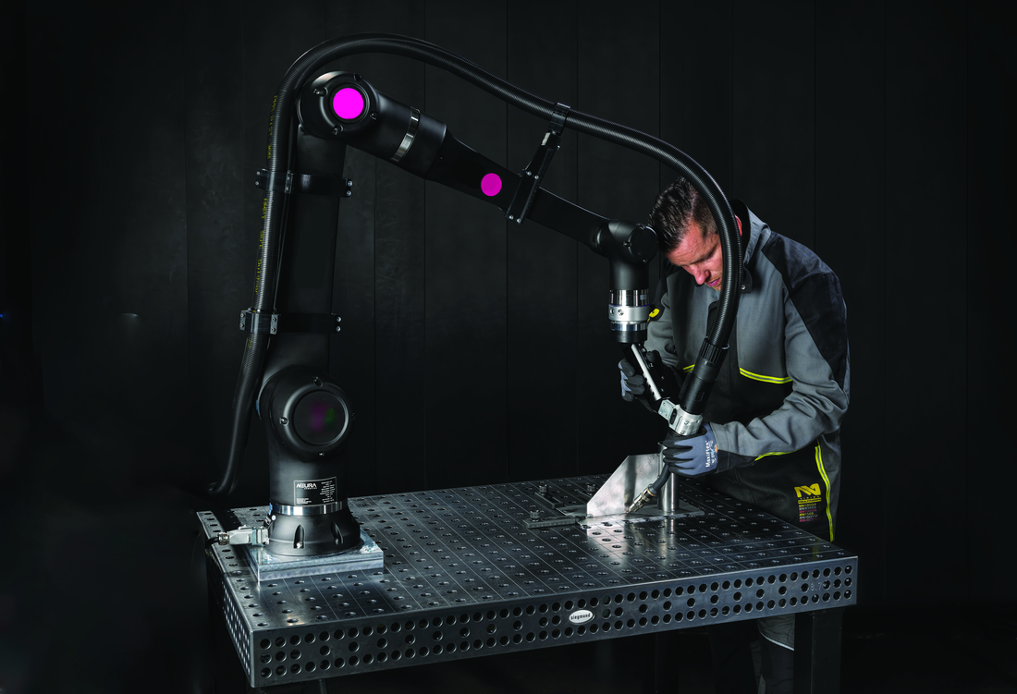
Integrating human oversight ensures safe and efficient robot interactions, enabling collaborative weld defect monitoring without compromising operator safety.
Zero safety incidents via human oversight.

Slide 6
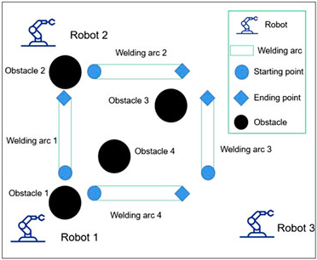
Coordinated multi-robot systems optimize task allocation in weld inspection, minimizing downtime in automotive production lines.

Slide 7
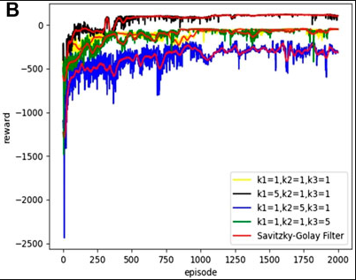
Reinforcement learning enables robots to learn adaptive strategies for weld defect detection, handling uncertainties like production interruptions.
Input Layer
Hidden Layers
Output Layer
Robot 1 Pos
Feature Extraction
Decision Making
No Defect
Robot 2 Pos
Weld Temp
Defect Detected
Defect Size
Interruption
Reward curve shows learning convergence after 1500 episodes, improving detection success rates from 76% to 96% in multi-robot welding scenarios.
Reward Signal
RL Agent Updates Based On Reward

Slide 8
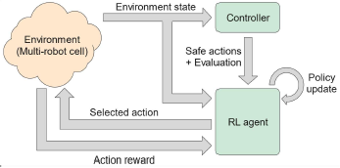
Controller-based safe reinforcement learning ensures error-free multi-robot operations during weld inspection, enhancing reliability in automotive settings.

Slide 9
Reinforcement learning-driven multi-robot coordination with human integration revolutionizes automotive weld quality assurance by boosting efficiency, safety, and process control.
Reinforcement Learning Successful Detection Rate Increase*
96%
General Defect Detection Rate Increase
95%
Width/Height Weld Bead Variances Reduction
Single To Cobot Cycle Time Reduction 120 sec
HRC Efficiency Impact Increase
HRC Associated Safety Incidents
7%
66.6%
30%
0
75 sec
20%
88%
45 sec
76%
*Controller-based safe reinforcement learning can reduce violations to 0 and garner a 3.5% cycle time improvement under stochastic interruptions.

Slide 10
References: Keçibaşa, G., Şahina, M. A., Arayıcı, K. C., & Üresin, U. (2024). WAS (Welding Analytics System): Addressing Automotive Welding Challenges through Machine Learning. Procedia CIRP, 00, 000–000. https://doi.org/10.1016/j.procs.2024.01.128 Othman, U., & Yang, E. (2023). Human–robot collaborations in smart manufacturing environments: Review and outlook. Sensors (Basel, Switzerland), 23(12), 5663. https://doi.org/10.3390/s23125663 Wete, E., Greenyer, J., Kudenko, D., & Nejdl, W. (2024). Multi-robot motion and task planning in automotive production using controller-based safe reinforcement learning. Proceedings of the 23rd International Conference on Autonomous Agents and Multiagent Systems (AAMAS 2024), Auckland, New Zealand, 10. Xu, L.-X., & Chen, Y.-Y. (2021). Deep reinforcement learning algorithms for multiple arc-welding robots. Frontiers in Control Engineering, 2, Article 632417. https://doi.org/10.3389/fcteg.2021.632417 Yan, Z., Liu, C., Li, T., Ma, Z., Wu, Y., Cheng, Y., & Chen, S. (2025). Autonomous optimization technology for welding parameters based on a dual-driven model incorporating physics and data. Journal of Manufacturing Processes, 135, 131-141. https://doi.org/10.1016/j.jmapro.2025.01.019 Court, E. H.-D. le, Belardinelli, F., & Goodall, A. W. (2025). Probabilistic Shielding for Safe Reinforcement Learning. Proceedings of the AAAI Conference on Artificial Intelligence, 39(15), 16091-16099. https://doi.org/10.1609/aaai.v39i15.33767 Slide 2 Images: A human monitoring weld operation performance, https://unsplash.com/s/photos/human-watching-robotic-weld-inspection-arm-in-automotive A weld scan image from ResearchGate, https://www.researchgate.net/figure/Shape-characteristic-curves-under-different-segmentation-arc-lengths_fig9_342546163 A multi-robot diagram from ResearchGate, https://www.researchgate.net/figure/The-schematic-diagram-of-multi-robot-position-force-coordination-control_fig6_331536074 Slide 2, 6, & 7 Images: A multi-robot layout and learning curve graph from Frontiers article, https://www.frontiersin.org/files/Articles/632417/fcteg-02-632417-HTML/image_m/fcteg-02-632417-g001.jpg Slide 3 & 4 Images: Figures 2 and 4 from PMC article, https://pmc.ncbi.nlm.nih.gov/articles/PMC7827984 Slide 5 Image: Figure 1 from AWS article, https://www.aws.org/magazines-and-media/welding-digest/wd-nov-24-safe-cobot-welding Slide 8 Image: Wete, E., Greenyer, J., Kudenko, D., & Nejdl, W. (2024). Multi-robot motion and task planning in automotive production using controller-based safe reinforcement learning. Figure 1

