Slide 1
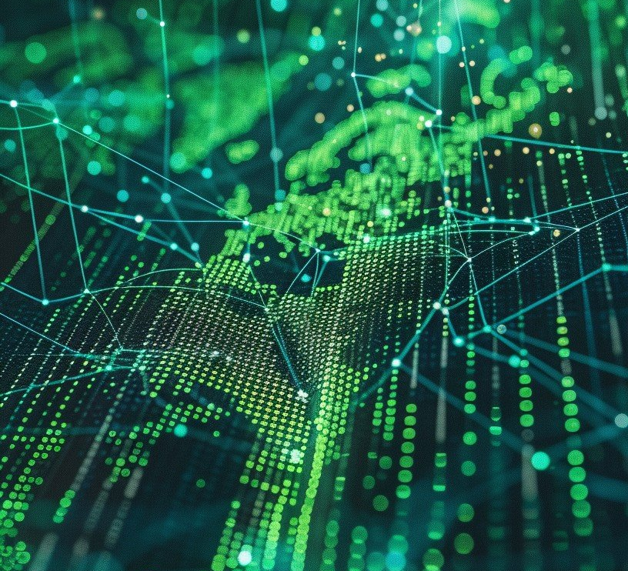
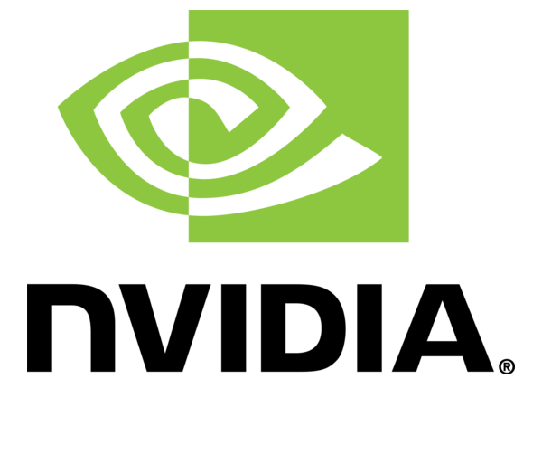

Factory Digital Twins with NVIDIA Omniverse: AI-Driven Workflows with Network Collaboration
Randall Crawford
September 21, 2025

Slide 2
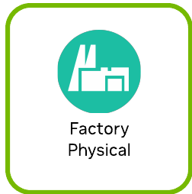
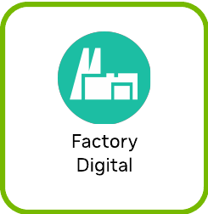
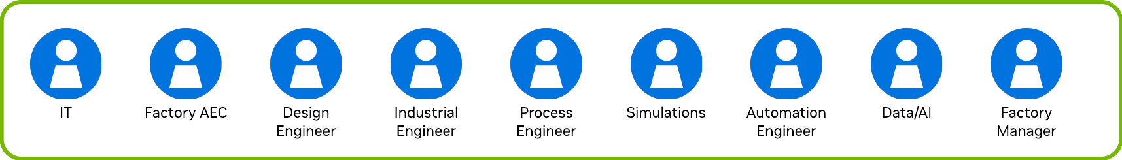
Omniverse’s Factory Digital Twin architecture drives AI-Optimized workflows.
IT
Geometry Creation
Omniverse Platform
Simulation | Synthetic Data
AI
Delivery
Data | IoT

Slide 3
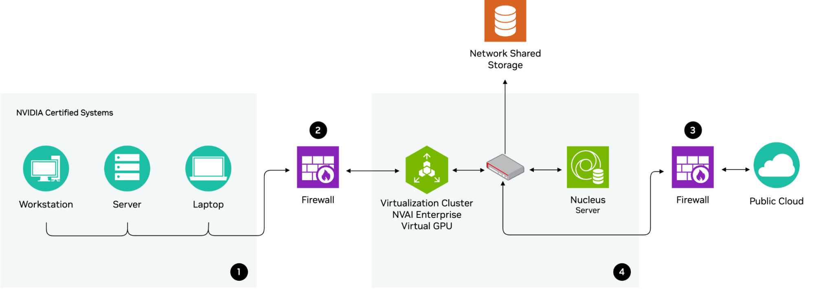
The IT infrastructure is built around a design of ensuring sensitive data is kept with internal and external firewalls for security.
(nvidia omniverse, 2025)

Slide 4
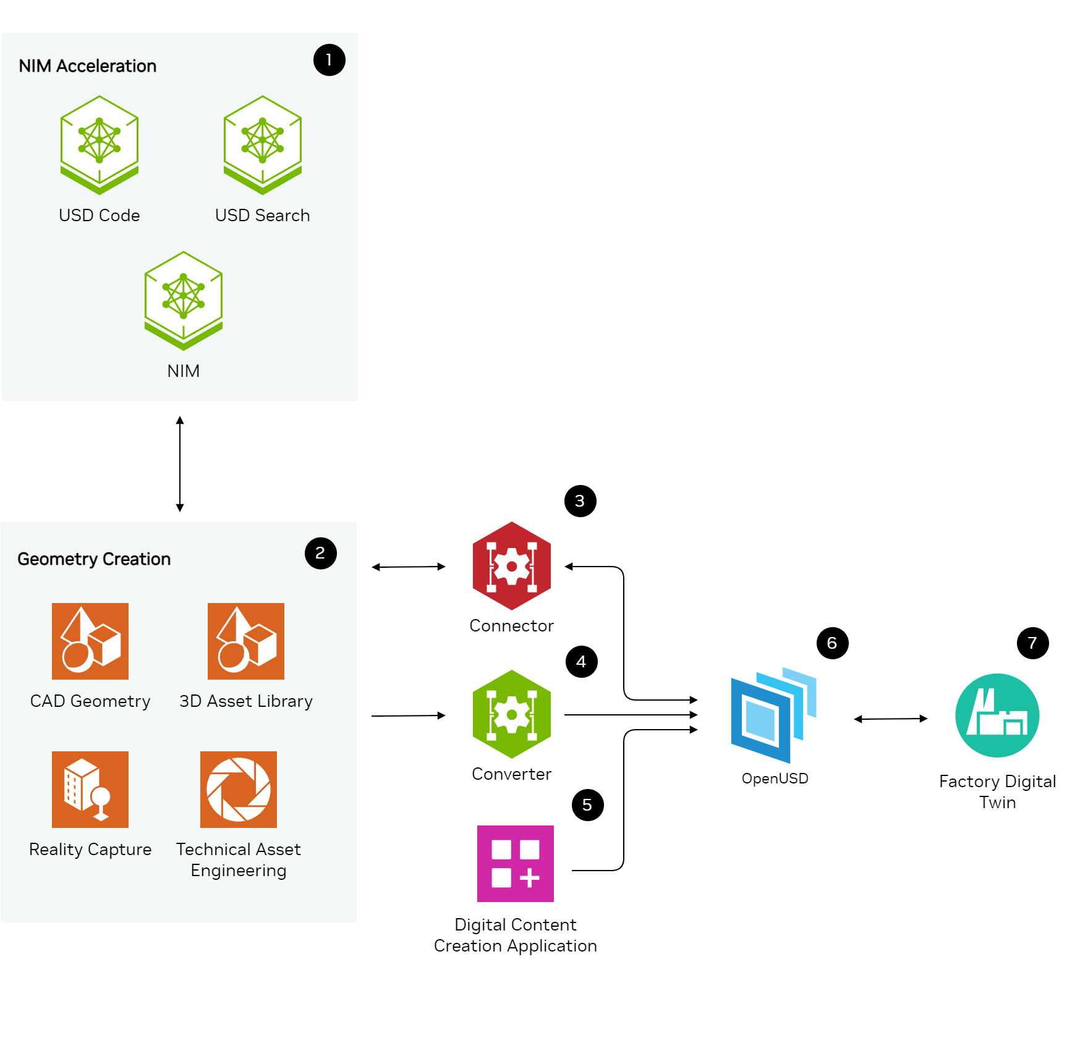
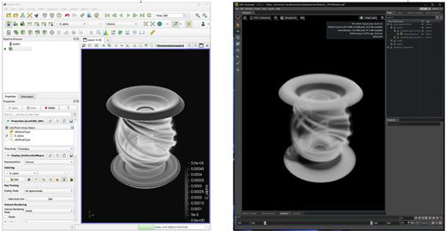
Geometrical creation can be incorporated into a factory digital twin.
Representative Workflow, not Explicit
Tokamak Fusion Reactor
CAD
OpenUSD
(AIP, 2025)
(nvidia omniverse, 2025)

Slide 5
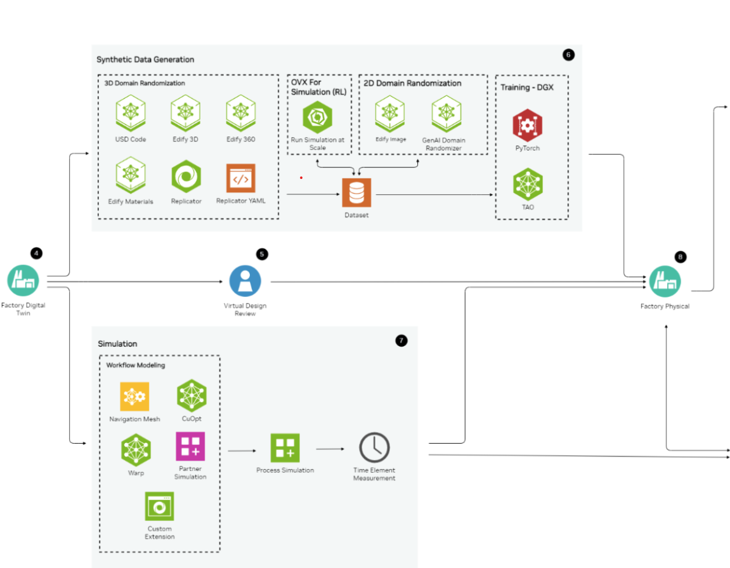
Simulation and synthetic data are used with a factory digital twin to perform tasks which can improve a physical factory.
Model Deployment
Continued from previous slide
Process Improvement
Representative Workflow, not Explicit
Representative Workflow, not Explicit
(nvidia omniverse, 2025)

Slide 6
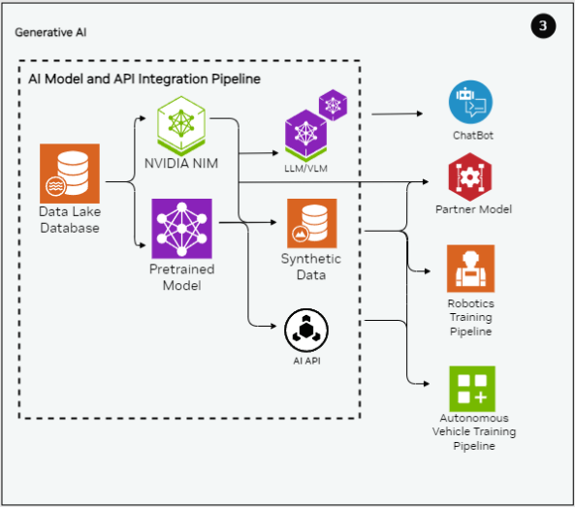
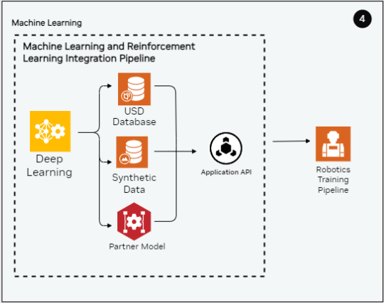
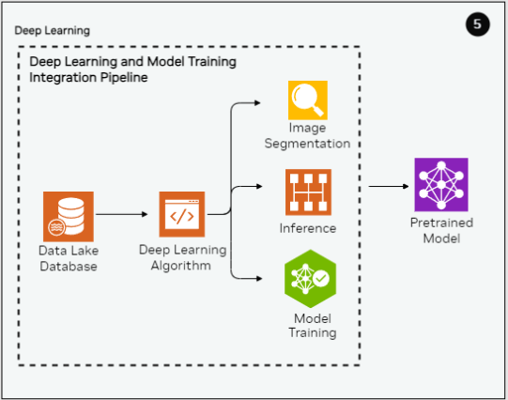
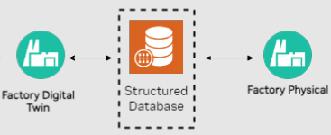

AI integration across Generative AI, Machine Learning, and Deep Learning contributes to the overall functionality and efficiency of the digital twin.
Delivery Pipeline
(nvidia omniverse, 2025)

Slide 7
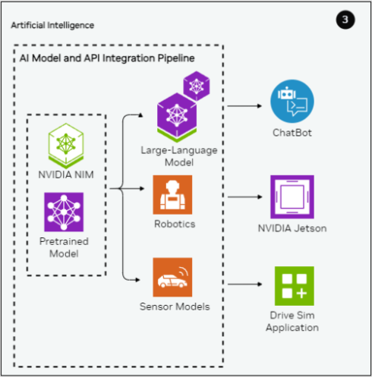
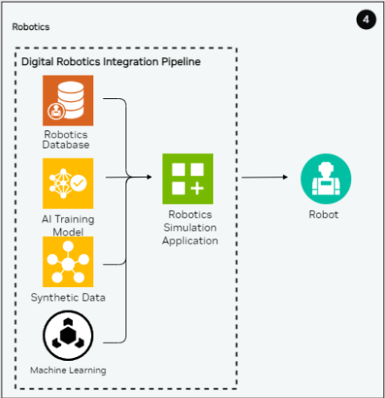
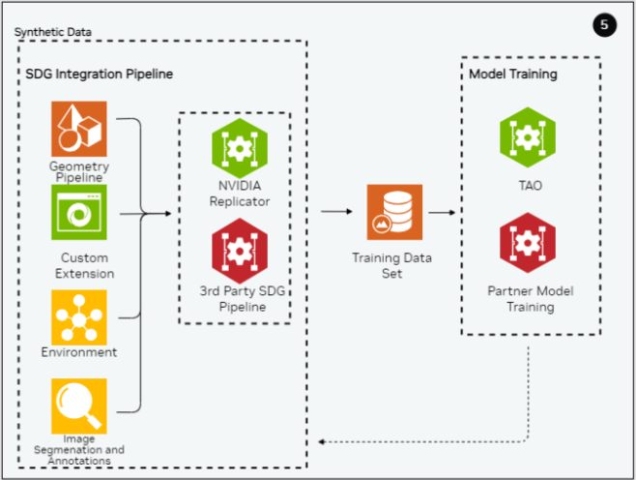
Data/IoT integration across Artificial Intelligence, Robotics, and Synthetic Data contributes to the overall functionality and efficiency of the digital twin.
Delivery Pipeline
(nvidia omniverse, 2025)

Slide 8

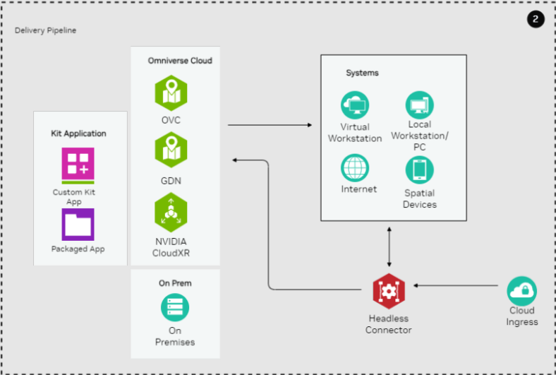

A Factory Digital Twin application can be delivered to an on-premise environment or Omniverse on DGX Cloud, and accessed from various designated systems.
(yahoo search, 2025)
(nvidia omniverse, 2025)

Slide 9
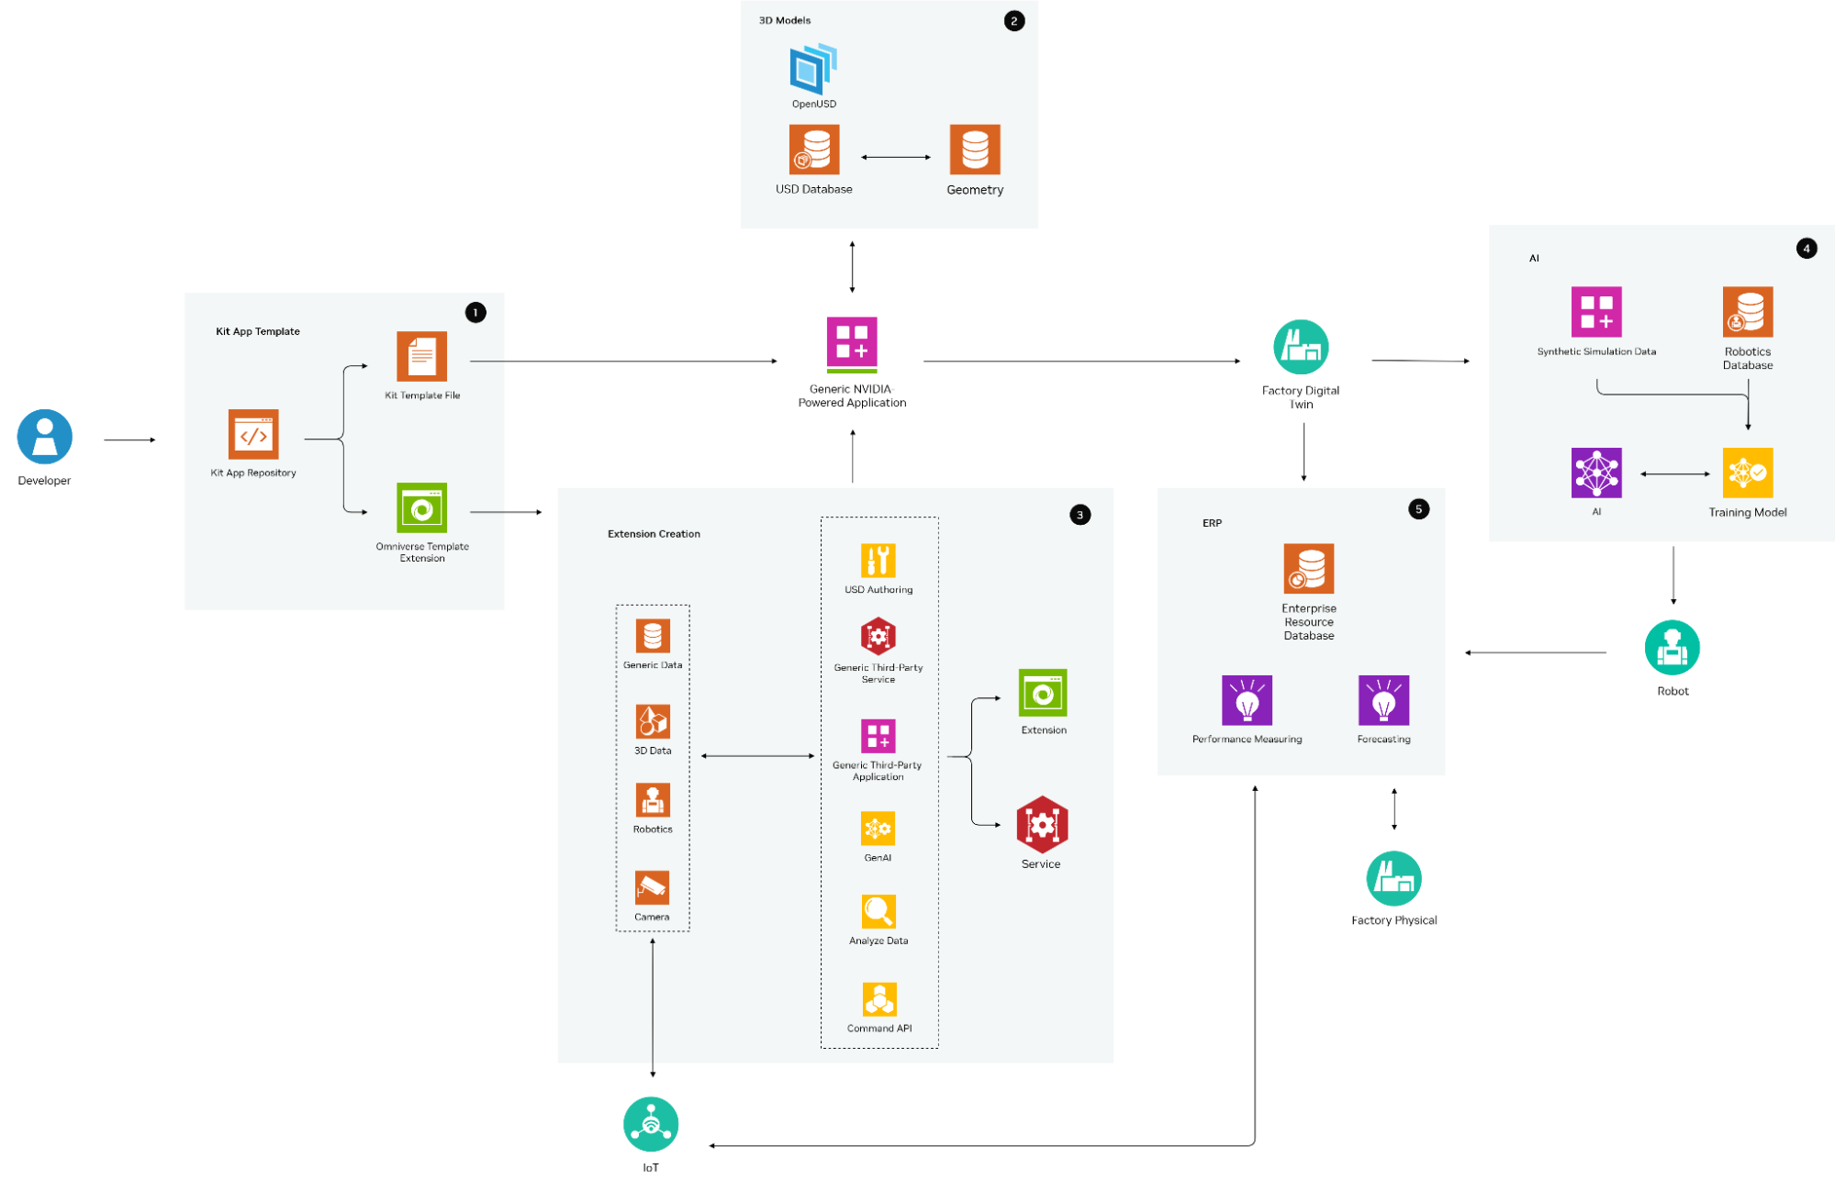
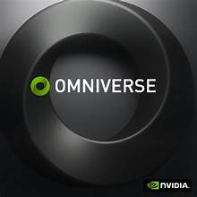
The Omniverse platform provides a comprehensive and secure digital twin solution for modern manufacturing environments.
(yahoo search, 2025)
(nvidia omniverse, 2025)

Slide 10
References
Hu, J., & Zheng, Y. (2024). Frontiers in Computer Science, 6. https://doi.org/10.3389/fcomp.2024.1423129
Bhatia, N., et al. (2025). AIP Advances, 15(4), 045018. https://doi.org/10.1063/5.0261883
Tao, F., Zhang, M., & Qi, Q. (2024). A comprehensive review of the dynamic applications of the digital twin technology in the energy sector. Sustainable Cities and Society, 102, 105225. https://doi.org/10.1016/j.scs.2024.105225
Yang, J. (2025). NVIDIA Aerial Omniverse Digital Twin boosts development of AI-native wireless and deployment flexibility. NVIDIA Technical Blog. https://developer.nvidia.com/blog/nvidia-aerial-omniverse-digital-twin-boosts-development-of-ai-native-wireless-and-deployment-flexibility/
Li, X., et al. (2022). Space Resources Week 2022. https://orbilu.uni.lu/handle/10993/51217
NVIDIA Omniverse Documentation. (2025). Factory Digital Twin Reference Architecture. Retrieved from https://docs.omniverse.nvidia.com/arch-diagrams/latest/
StockCake. (2025). Digital connectivity concept. Retrieved from https://stockcake.com/i/digital-connectivity-concept_339694_759088
NVIDIA Logo. (2025). https://seeklogo.com/vector-logo/101614/nvidia
NVIDIA Omniverse Logos. (2025). https://images.search.yahoo.com/search/images

