Slide 1
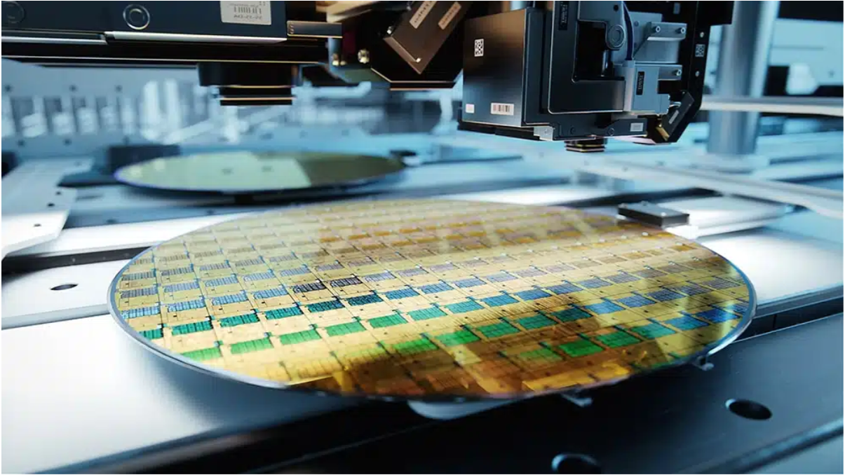

Explainable AI in Computer Vision for Defect Detection in Manufacturing: Boosting Quality and Trust
Insights from Scholarly Research on Algorithmic Defect Detection in Smart Manufacturing
Randall Crawford
September 28, 2025

Slide 2
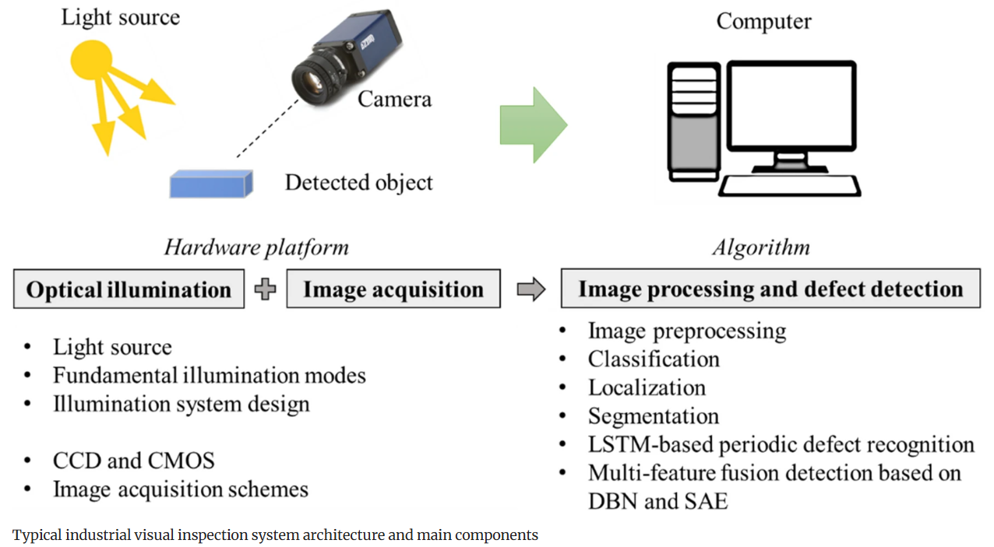
XAI enhances algorithmic tasks in computer vision for wafer defect detection, including image preprocessing, classification, localization, segmentation, periodic detection, and multi-feature fusion.
(Springer, 2021)

Slide 3
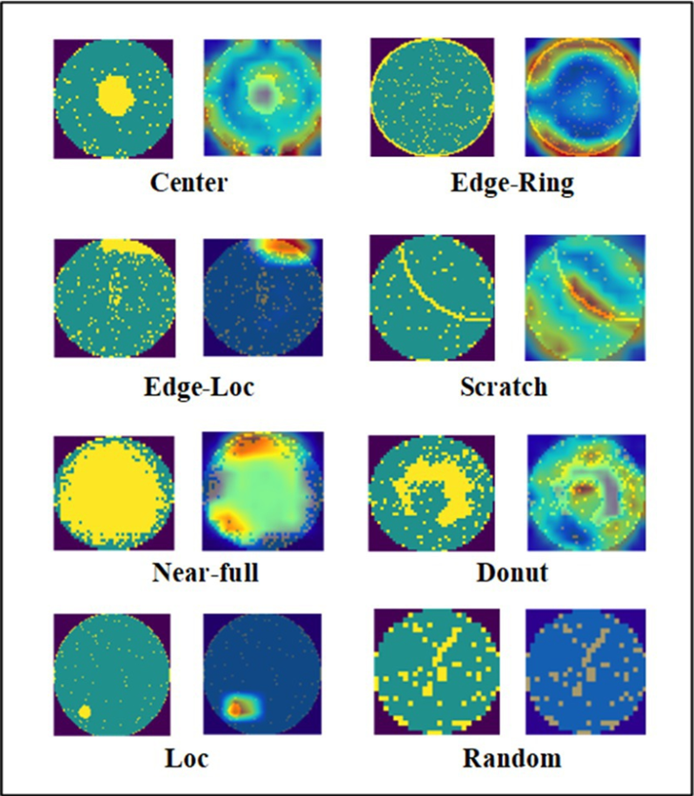
Grad-CAM heatmaps, with image preprocessing, enhance inspection accuracy for wafer defect detection.
(Frontiers, 2023)

Slide 4
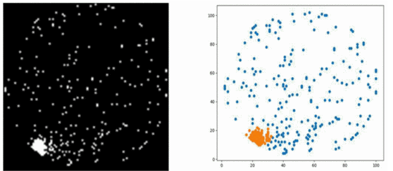
SHAP enhances classification accuracy for wafer defect types.
Edge-Local Wafer Defect Identification
(IEEE, 2022)

Slide 5

LIME supports localization and segmentation by delineating wafer defect boundaries.
Edge-Local Wafer Defect Identification
Original Scan
Grad-CAM
LIME
(Micromachines, 2025)

Slide 6
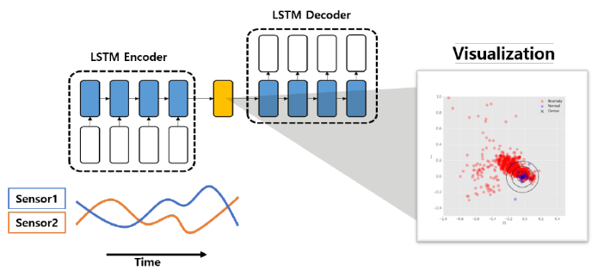
LSTM-based periodic defect detection is enhanced by XAI for recurring wafer flaws.
Sensor Time-Series & LSTM Encoding/Decoding Process
(ResearchGate, 2023)

Slide 7
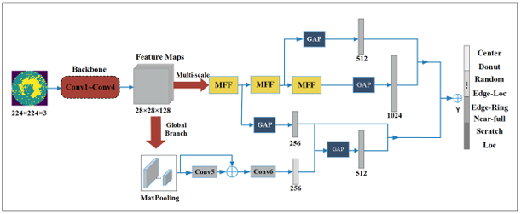
Multi-feature fusion with DBN/SAE leverages XAI for integrated wafer defect analysis.
Multi-Feature Fusion Perceptual Network Structure
(Frontiers, 2023)

Slide 8
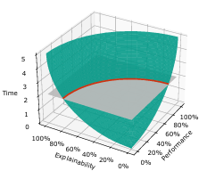
XAI balances trade-offs between algorithmic performance and explainability in wafer defect detection.
PET Trade-Off Diagram
(arxiv, 2023)

Slide 9
XAI is vital for scaling computer vision algorithms in wafer defect detection.
Image Preprocessing
(ex. Grad-CAM)
Multi-Feature Fusion
(ex. DBN/SAE)
Classification
(ex. SHAP)
XAI in CV for Wafer Defect Detection
Periodic Detection
(ex. LSTM)
Localization
(ex. LIME)
Segmentation
(ex. LIME)

Slide 10
References
Cheng, J., Zhang, X., & Li, Y. (2022). Wafer defect pattern classification with explainable decision tree technique. 2022 IEEE International Test Conference (ITC), 549–553. https://www.researchgate.net/publication/364678922_Wafer_defect_pattern_classification_with_explainable_decision_tree_technique
Crook, B., Schluter, M., & Speith, T. (2023). Revisiting the performance-explainability trade-off in explainable artificial intelligence (XAI). arXiv. https://arxiv.org/pdf/2307.14239.pdf
Emergent Vision Technologies (2025). Title page image. https://emergentvisiontec.com/applications/inspection-and-automation/metrology/
Kim, J., Park, S., & Lee, H. (2025). Enhancing confidence and interpretability of a CNN-based wafer defect classification model using temperature scaling and LIME. Micromachines, 16(9), 1057. https://www.mdpi.com/2072-666X/16/9/1057
Lee, J.-H., Kim, S., & Park, H. (2023). Anomaly detection in time series data and its application to semiconductor manufacturing. 2023 IEEE International Conference on Semiconductor Technology (ICST). https://www.researchgate.net/publication/375659051_Anomaly_Detection_in_Time_Series_Data_and_Its_Application_to_Semiconductor_Manufacturing
Li, W., Wang, Y., & Zhang, Q. (2023). Wafer defect recognition method based on multi-scale feature fusion. Frontiers in Neuroscience, 17, 1202985. https://www.frontiersin.org/articles/10.3389/fnins.2023.1202985
Senoner, J., Netland, T., & Feuerriegel, S. (2022). Using explainable artificial intelligence to improve process quality: Evidence from semiconductor manufacturing. Management Science, 68(8), 5704–5723. https://pubsonline.informs.org/doi/pdf/10.1287/mnsc.2021.4190
Wang, J., Ma, F., & Zhang, L. (2021). State of the art in defect detection based on machine vision. International Journal of Precision Engineering and Manufacturing-Green Technology, 9(5), 1237–1258. https://link.springer.com/content/pdf/10.1007/s40684-021-00343-6.pdf

