Slide 1
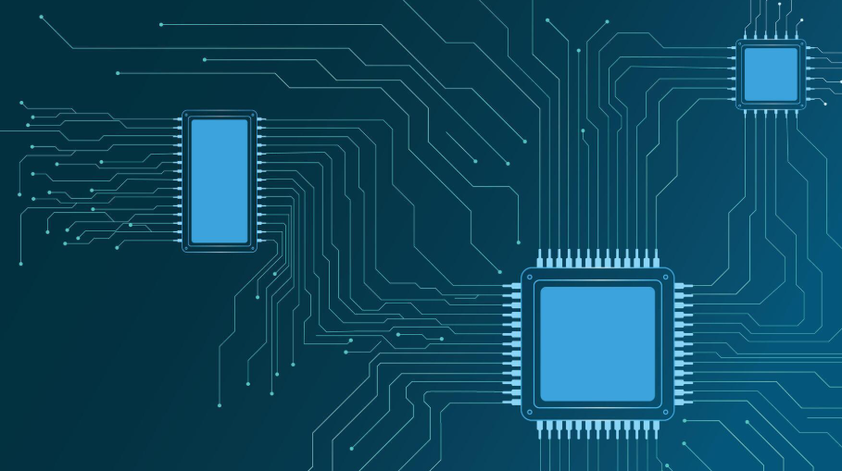

Reinforcing Innovation: RL Optimization for TSMC’s 2nm Chip Design
Leveraging Reinforcement Learning in Physical Design for Advanced Nodes
Randall Crawford
September 14, 2025

Slide 2
Reinforcement learning drives optimization across TSMC’s 2nm physical design domains.
Physical Design Domains
Optimization Algorithmic Solution
Partitioning
Floorplanning
Placement
Reinforcement Learning
Clock Tree Synthesis
Signal Routing
Timing Closure
RL w/ Benders Decomposition

Slide 3
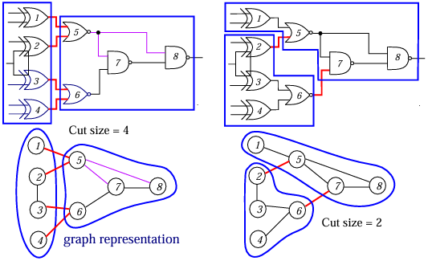
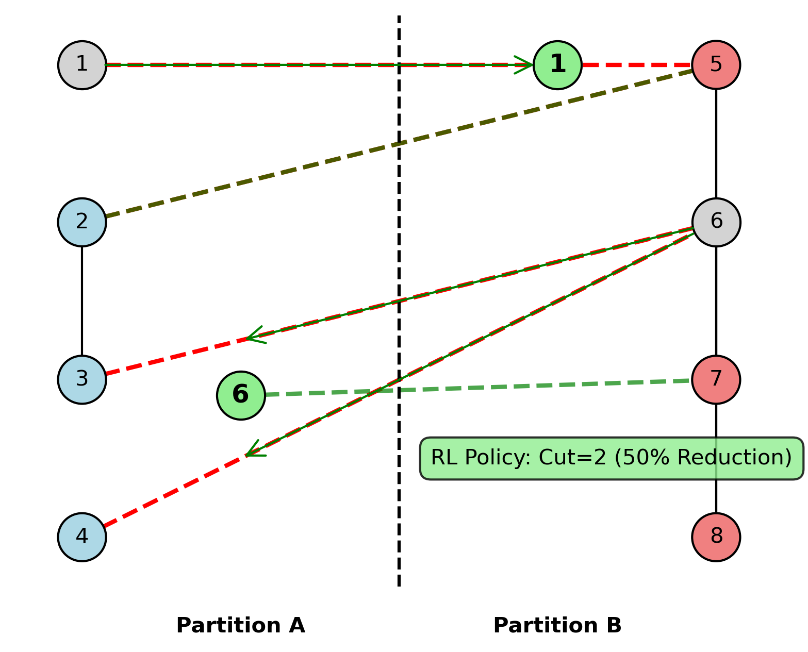
Reinforcement learning minimizes cut sizes in TSMC 2nm partitioning.
Circuit Partitioning Example
RL Optimization for TSMC 2nm Partitioning
(northwestern, 2020)
Special Note: This simple example uses single-unit edge weighting, whereas real-world applications often employ weighted edges representing signal frequency, timing criticality, power consumption, and physical distance. These weights are used to prioritize weighted cut size rather than just the number of crossing edges.

Slide 4
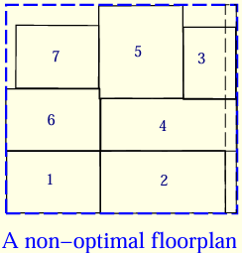
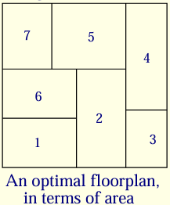
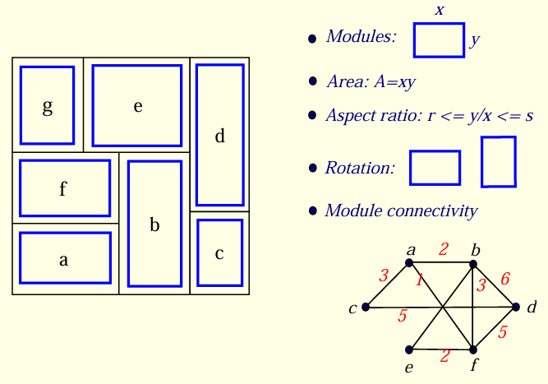
Reinforcement learning optimizes floorplans for TSMC 2nm area efficiency.
RL Optimization for TSMC 2nm Floorplanning
General Floorplanning Design Considerations
(gatech, 2015)
(gatech, 2015)
(gatech, 2015)
Special Note: This example emphasizes floorplan area optimization, but floorplanning can also optimize for wirelength, timing, power consumption, and other design metrics to enhance TSMC 2nm performance.

Slide 5
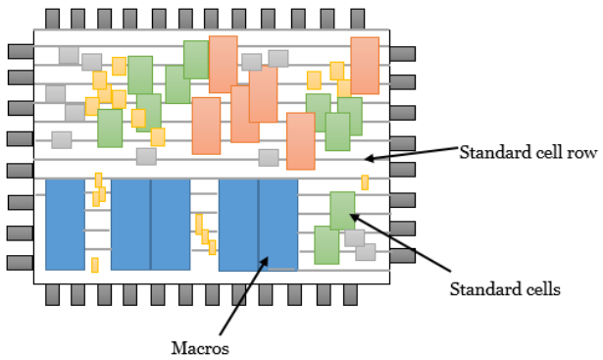
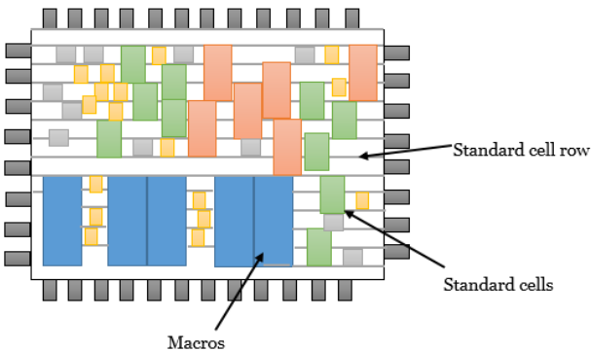
Reinforcement learning enhances TSMC 2nm placement with neural guidance.
Coarse Placement
After Legalization
RL Guidance
(vsli-physical design, 2020)
(vsli-physical design, 2020)
Coarse Placement: Random cell distribution with high wirelength and density variation.
Legalized Placement: RL with neural guidance further optimizes, reducing runtime 20x and wirelength, guided by a neural subgrid.
Special Note: This example uses wirelength optimization, but TSMC 2nm leverages RL for timing, power, density, and DTCO in advanced placement.

Slide 6
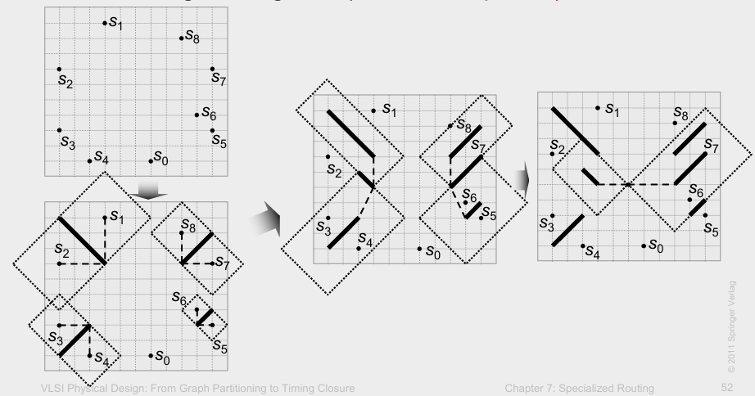
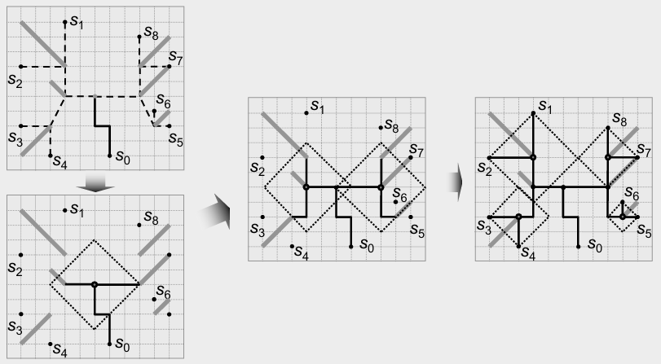
Reinforcement learning drives TSMC 2nm clock tree synthesis. Deferred-Merge Embedding (DME)
Build Tree of Segments Algorithm (DME Bottom-Up Phase)
Find Exact Locations (DME Top-Down Phase)
(umich, 2011)
(umich, 2011)
Optimized CTS: RL enhances DME with neural guidance, reducing skew to 10% and runtime by 20x.
Special Note: This example uses skew optimization, but RL with neural guidance can optimize timing, power, and density for TSMC 2nm efficiency.

Slide 7
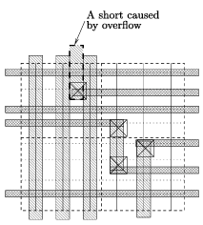
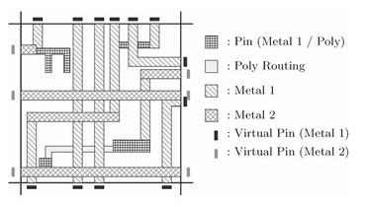
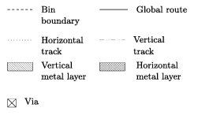
Reinforcement learning refines TSMC 2nm signal routing congestion.
Initial Routing: High congestion with vias and overflow
Optimized Routing: RL reduces congestion by 30% with neural-guided paths
(iczhiku, 2007)
(iczhiku, 2007)
Special Note: This example optimizes congestion, but RL can address timing, power, and density for TSMC 2nm’s high-density challenges.

Slide 8
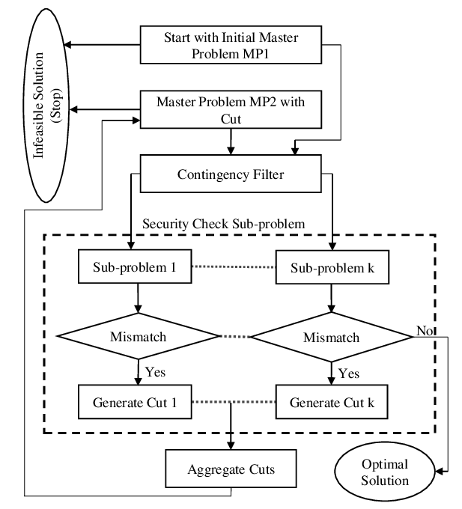
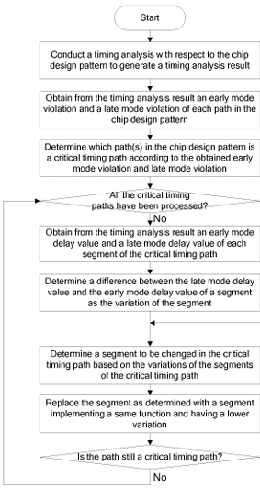
Reinforcement learning accelerates TSMC 2nm timing closure with Benders Decomposition.
Benders Decomposition Process Flowchart
Timing Closure in Chip Design Flowchart
Special Note: Optimized Timing: RL
with Benders Decomposition improves
slack by 15%. These flowcharts relate
to timing optimization, but power,
congestion, and area could also be
optimized for TSMC 2nm.
Yes
End
Yes
(Wassem, 2020)
(US8769470B2, 2011)

Slide 9
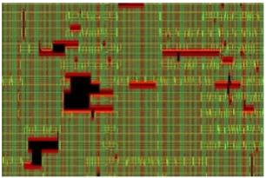
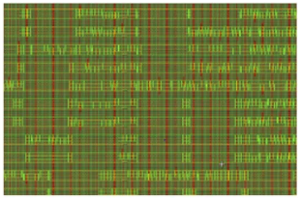
Conclusion: Reinforcement Learning (RL) Transforms TSMC 2nm Design
Before Optimization
After Optimization
50% Cut Reduction
20x Runtime Gain
30% Congestion Drop
15% Slack Improvement
(Wilson, 2023)
(Wilson, 2023)
Summary Note: Reinforcement Learning (RL) revolutionizes design by enhancing efficiency across all stages, driving scalable 2nm innovations for TSMC.

Slide 10
References
Kahng, A. B., Lienig, J., Markov, I. L., & Hu, J. (2011). VLSI physical design: From graph partitioning to timing closure. Springer.
Held, S. (2008). Timing closure in chip design [Doctoral dissertation, University of Bonn]. http://www.or.uni-bonn.de/~held/publications/sh_diss.pdf
Guo, C., Bodur, M., Aleman, D. M., & Urbach, D. R. (2019, July). Logic-based Benders decomposition and binary decision diagram-based approaches for stochastic distributed operating room scheduling. Optimization Online. https://optimization-online.org/wp-content/uploads/2019/07/7320.pdf
Botlagunta, P. N. (2025, July 24). Reinforcement learning approaches to optimize chip layout and power consumption. Medium. https://medium.com/@preethishnananbotlagunta/reinforcement-learning-a-a18f9479
TSMC. (2024, September 26). Advancing 3D IC design for AI innovation. TSMC Blog. https://www.tsmc.com/english/news-events/blog-article-20240926

Slide 11
Image References
Partitioning: Circuit Partitioning pg. 2
https://users.eecs.northwestern.edu/~haizhou/357/lec2.pdf
Floorplanning: Floorplanning pg. 4 and Floorplan Design pg. 5
https://limsk.ece.gatech.edu/course/ece6133/slides/floorplanning.pdf
Placement: Coarse and Legalization Placement
https://www.physicaldesign4u.com/2020/02/placement.html
Clock Tree Synthesis: Constructing Trees with Zero Global Skew pg. 52 and 55
http://vlsicad.eecs.umich.edu/KLMH/downloads/book/chapter7/chap7-111206.pdf
Signal Routing: Routing Congestion in VSLI Circuits pg. 9 (Fig. 1.4b) and 113 (Fig. 4.6)
https://picture.iczhiku.com/resource/eetop/WHKDfRjygeqLPnbB.pdf
Timing Closure: Benders Decomposition Process & Timing Closure Flowcharts
https://www.researchgate.net/figure/Flowchart-of-Benders-Decomposition_fig1_347880772
https://patents.google.com/patent/US8769470B2
Conclusion: A new approach to design stage layout optimization (Fig. 3)
https://semiengineering.com/a-new-approach-to-design-stage-layout-optimization-can-speed-time-to-tapeout-while-improving-power-management/

