Slide 1
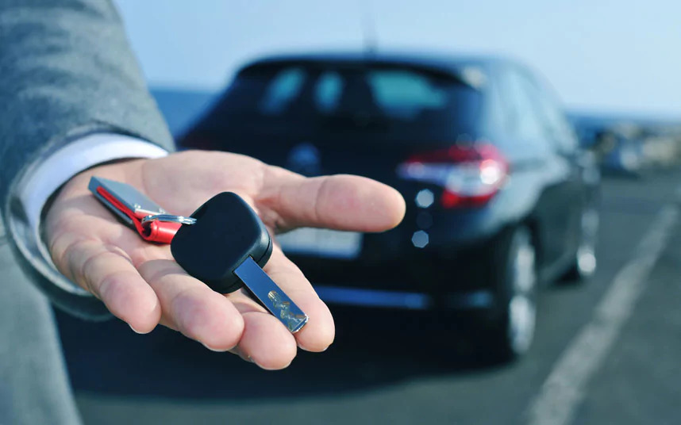
Car and bike rental

Slide 2

ABSTRACT:
The website is a full-stack web application which allows the clients to rent a car or bike.
The main goal of the website is to facilitate the process of renting a vehicle.
HTML,CSS and JavaScript involves in the client side and also AJAX.

Slide 3
PHP involves in the server side.
MySQL is used as the database.
The user can rent a vehicle by uploading his details which will be stored in the database for later use.
The agency can organize and deliver the vehicles according to the entries in the database.

Slide 4




TECHNOLOGY AND TOOLS:
HTML 5
CSS 3
JavaScript 1.8.5
PHP 7.1.12

Slide 5





MariaDB 10.1.29
XAMPP v3.2.2
Apache 2.4.29
phpMyAdmin 4.7.4
AJAX

Slide 6
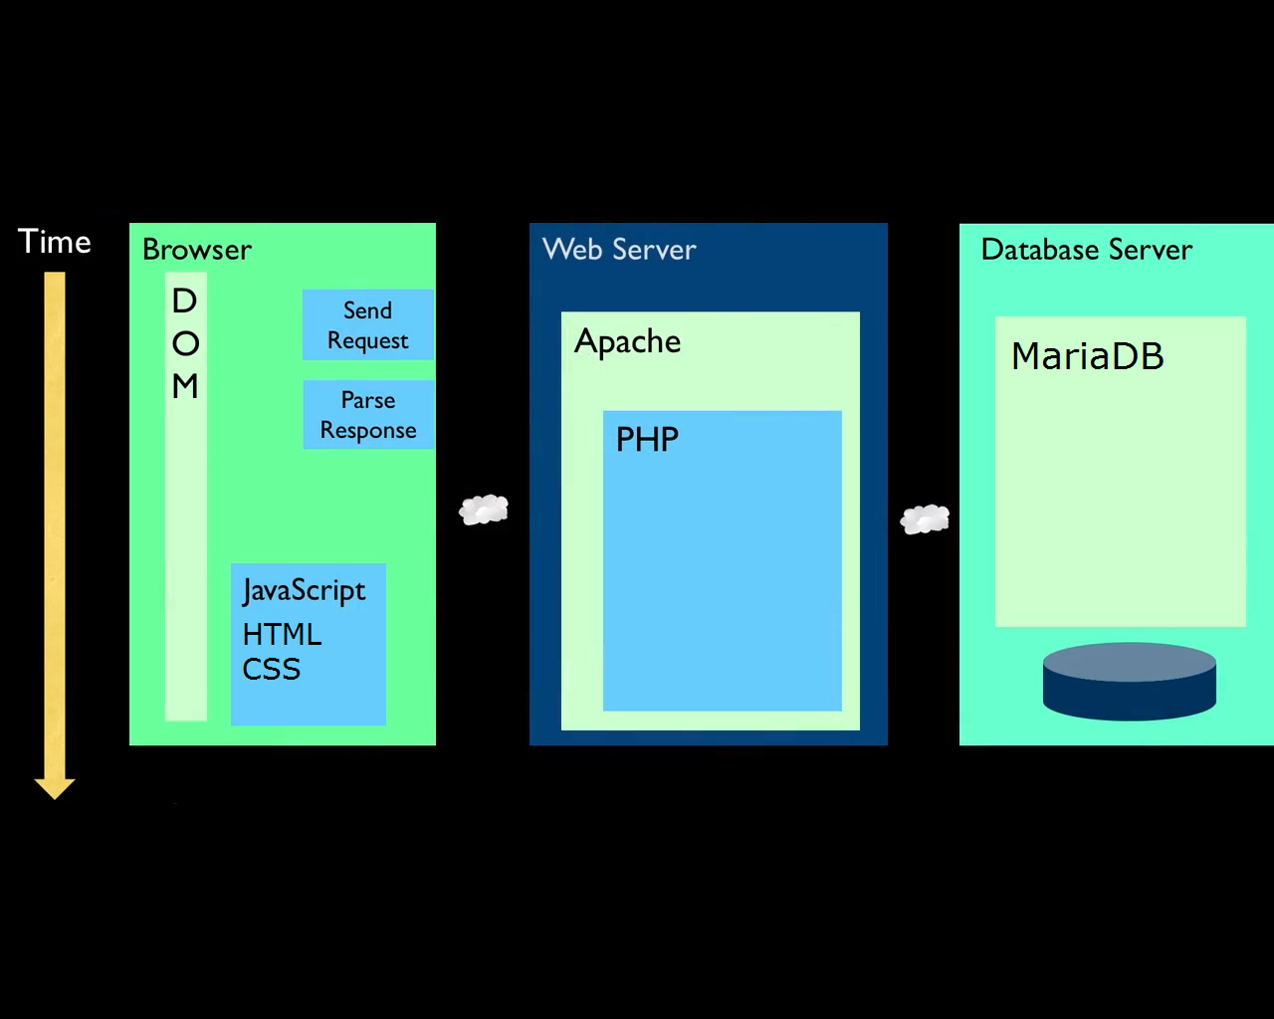
ARCHITECTURAL DIAGRAM:

Slide 7
The browser which is the client side deals with the user interface/display and sends request to the server and parses it.
The Apache server receives the request and deals with the generation of content of web page by performing operations over the database.
For example,if user input is a text in search box, run a search algorithm on data stored on database and send the results.

Slide 8
FUNCTIONAL SPECIFICATIONS:
A Responsive Website so that it can adapt to any screen size.
The icon of the agency is displayed in the tab of every page of the website.
The website offers an attractive navigation bar that allows to navigate to any page of the website with ease.

Slide 9
The contact details are also specified in the navigation-bar so that the user can get in contact with the agency anytime.
Pictures that allure and set the mood for the user.
A Slideshow of relevant images in the home page that makes the website more attractive.
The user can also contact the agency by sending a message with his details by clicking on enquire now.
A footer that holds details about the agency.

Slide 10
The variety of services provided by the agency are also listed in the website.
The website displays the list of all rental cars and bikes offered by the agency with the their image, fees and details.
The user can browse and choose the desired vehicle for a particular date.
The user need to upload his details and driving license in a form which will be stored in the database with the vehicle’s details for later use.

Slide 11
The form will also be validated for any incomplete or invalid entries.
Also the user don’t need to enter the vehicle’s details in the form again as the website itself will auto-fill that.
The code also checks if the vehicle is already booked on same date simultaneously using AJAX and warns the user.
The website also displays the details of the agency like the terms and the services offered by them.

Slide 12
The location of the agency is also displayed in the website so that the user can pick-up the vehicle without trouble.
The terms of the agency is also displayed in the website.
A confirmation message will be displayed if the vehicle is successfully booked.
The user can also give feedback and that will be stored in the database.

Slide 13
CONCLUSION:
Notepad++ was used as code editor.
XAMPP was used as an alternative for server and database(Apache and MariaDB).
The package consists of totally 16 items,13 php files,2 css font files and 1 script file including a folder for images.

Slide 14
The wheelzonrent icon is used in some parts of the package.
Some of the images used in this package are taken from the wheelzonrent page.

Slide 15

Image SLide
REFERENCE
www.w3schools.com
www.stackoverflow.com
www.wheelzonrent.com

Slide 16
THANK YOU

