Slide 1
Ecommerce Products
Analysis and explanation

Slide 2
Hypotheses and Data Cleaning
This report will present a comprehensive analysis of an ecommerce product dataset, with particular focus on multiple hypotheses. Hypothesis 1: Higher-rated products have a higher number of reviews. Hypothesis 2: The price of the product is correlated with its rating. Hypothesis 3: Certain categories of products have higher average ratings than others. Hypothesis 4: There is a seasonal trend in the number of reviews; specifically there are more reviews during holiday seasons. I also used the Pearson Correlation Coefficient to understand any linear relationship between two variables.
The dataset was cleaned and analysed to provide insights into various aspects such as product ratings, prices, number of reviews, and their distributions. The report includes statistical summaries and visualizations generated using R and Python. The initial dataset was loaded, and a summary was created to understand its structure. The data was then cleaned by removing any missing values.

Slide 3
Dataset Summary
ProductID ProductName Category Price
Min. : 1.0 Length:1000 Length:1000 Min. : 10.11
1st Qu. : 250.8 Class :character Class :character 1st Qu.:133.09
Median : 500.5 Mode :character Mode :character Median :251.31
Mean : 500.5 Mean :253.78
3rd Qu. : 750.2 3rd Qu.:375.83
Max. :1000.0 Max. :499.74
Rating NumReviews StockQuantity Discount Sales
Min. :1.000 Min. : 3 Min. : 0.0 Min. :0.0000 Min. : 0
1st Qu.:2.100 1st Qu.:1202 1st Qu.:241.8 1st Qu.:0.1300 1st Qu.: 502
Median :3.100 Median :2476 Median :505.0 Median :0.2500 Median : 998
Mean :3.026 Mean :2499 Mean :495.4 Mean :0.2516 Mean :1011
3rd Qu.:4.000 3rd Qu.:3798 3rd Qu.:743.5 3rd Qu.:0.3800 3rd Qu.:1540
Max. :5.000 Max. :4994 Max. :993.0 Max. :0.5000 Max. :1997
DateAdded City
Min. :2023-06-14 Length:1000
1st Qu.:2023-09-09 Class :character
Median :2023-12-05 Mode :character
Mean :2023-12-10
3rd Qu.:2024-03-09
Max. :2024-06-11

Slide 4

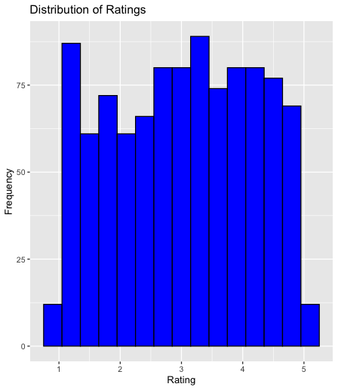
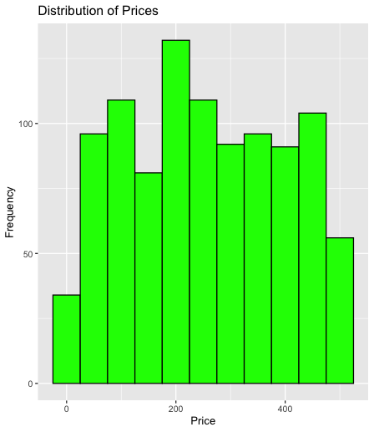
Distribution of Ratings and Prices

Slide 5
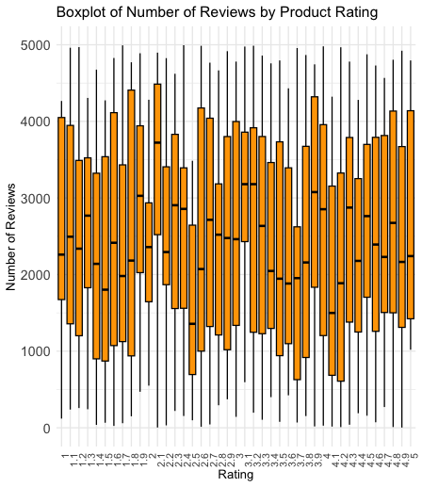
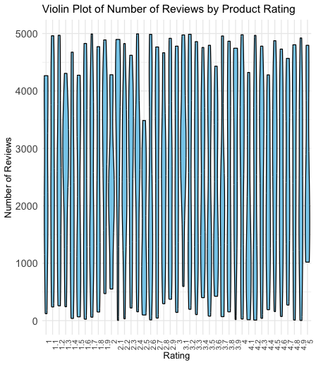
Number of Reviews by Product Rating

Slide 6
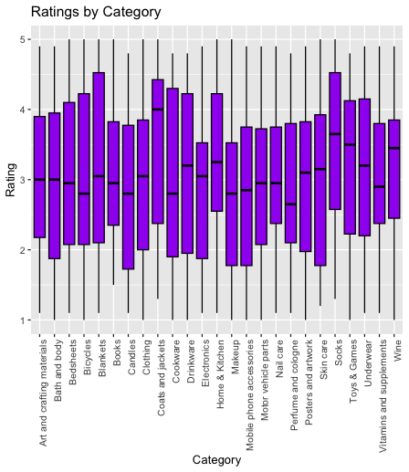
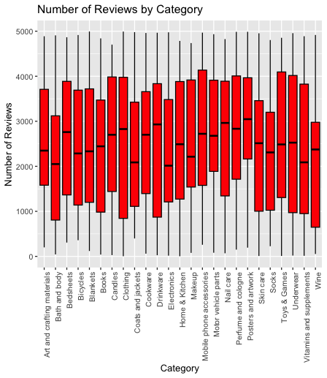
Distribution of Ratings and Number of Reviews

Slide 7
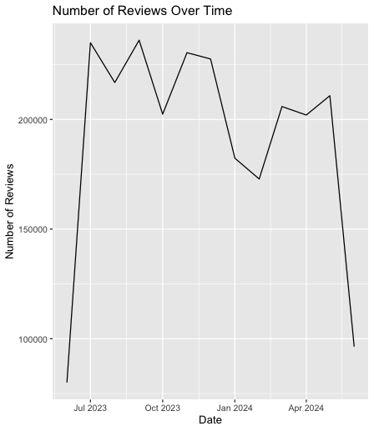
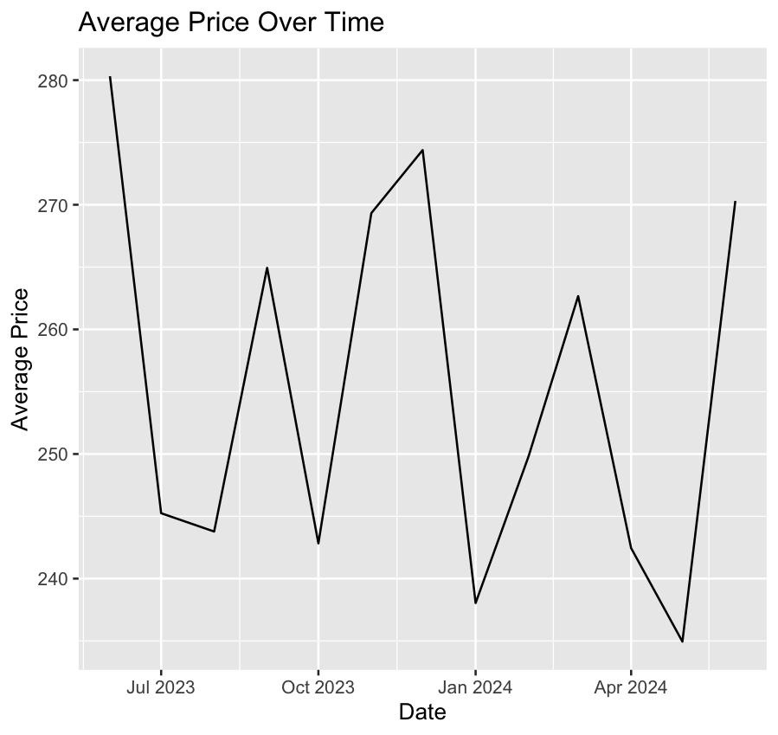
Trends Over Time

Slide 8
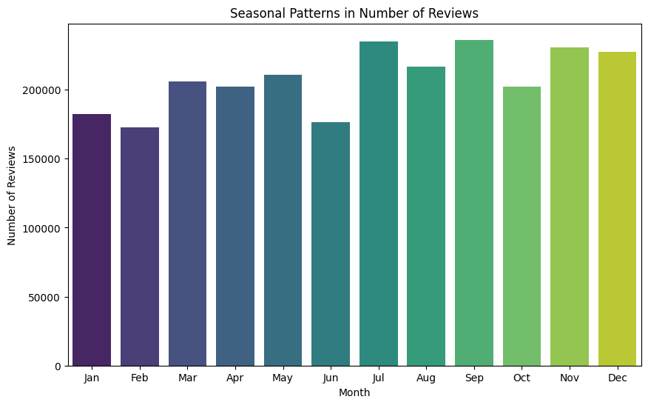
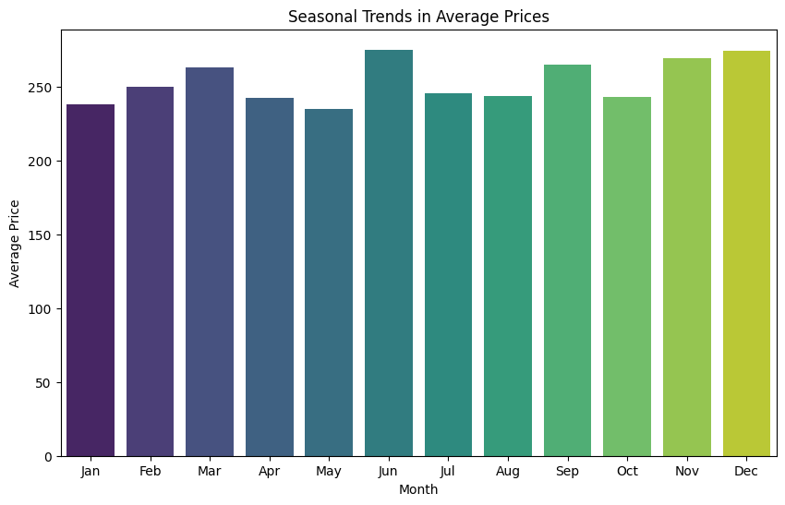
Seasonal Trends Number of Reviews & Average Prices

Slide 9
Correlation Matrix
ProductID Price Rating NumReviews StockQuantity
ProductID 1.0000000000 -0.040180334 -0.0002887686 0.043875378 -0.015074422
Price -0.0401803341 1.000000000 -0.0064621904 0.012781943 -0.006409298
Rating -0.0002887686 -0.006462190 1.0000000000 -0.009832483 0.000575592
NumReviews 0.0438753784 0.012781943 -0.0098324833 1.000000000 -0.020957835
StockQuantity -0.0150744218 -0.006409298 0.0005755920 -0.020957835 1.000000000
Discount -0.0167460051 -0.045133213 0.0244951626 -0.015579497 -0.007659338
Sales 0.0020034377 0.029076056 0.0084753829 0.056586375 -0.001457783
Discount Sales
ProductID -0.016746005 0.002003438
Price -0.045133213 0.029076056
Rating 0.024495163 0.008475383
NumReviews -0.015579497 0.056586375
StockQuantity -0.007659338 -0.001457783
Discount 1.000000000 0.027413470
Sales 0.027413470 1.000000000

Slide 10
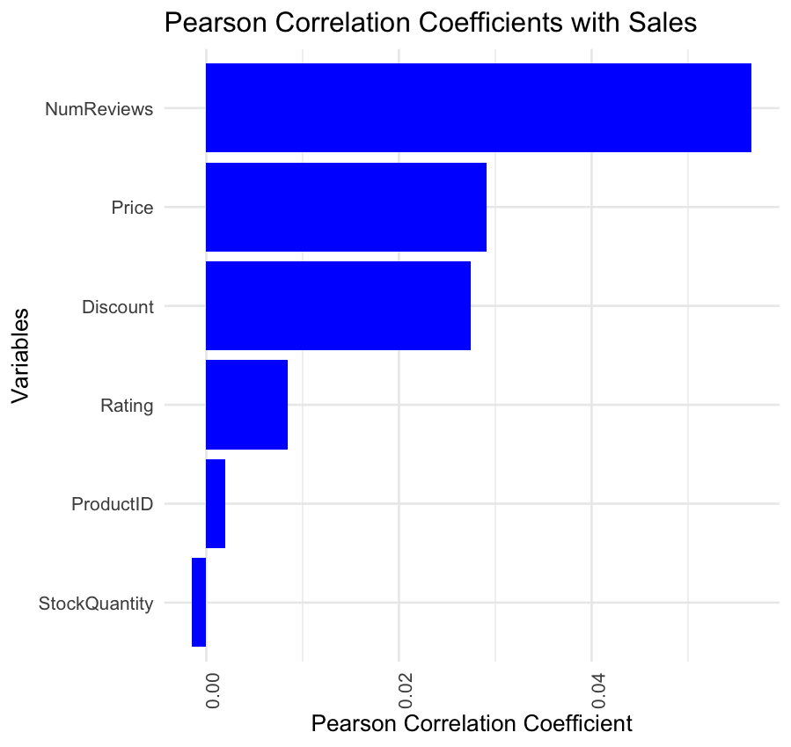
Pearson Correlation Coefficient

Slide 11
Statistical Significance
variable1 variable2 correlation p_value
cor ProductID Price -0.0401803341 0.20424952
cor1 ProductID Rating -0.0002887686 0.99272320
cor2 ProductID NumReviews 0.0438753784 0.16562675
cor3 ProductID StockQuantity -0.0150744218 0.63398468
cor4 ProductID Discount -0.0167460051 0.59685405
cor5 ProductID Sales 0.0020034377 0.94954745
cor6 Price Rating -0.0064621904 0.83827618
cor7 Price NumReviews 0.0127819434 0.68642489
cor8 Price StockQuantity -0.0064092975 0.83958185
cor9 Price Discount -0.0451332125 0.15381662
cor10 Price Sales 0.0290760562 0.35835201
variable1 variable2 correlation p_value
cor11 Rating NumReviews -0.0098324833 0.75614347
cor12 Rating StockQuantity 0.0005755920 0.98549601
cor13 Rating Discount 0.0244951626 0.43907726
cor14 Rating Sales 0.0084753829 0.78894200
cor15 NumReviews StockQuantity -0.0209578347 0.50797845
cor16 NumReviews Discount -0.0155794968 0.62266235
cor17 NumReviews Sales 0.0565863749 0.07367708
cor18 StockQuantity Discount -0.0076593378 0.80884979
cor19 StockQuantity Sales -0.0014577834 0.96327715
cor20 Discount Sales 0.0274134699 0.38650741

Slide 12
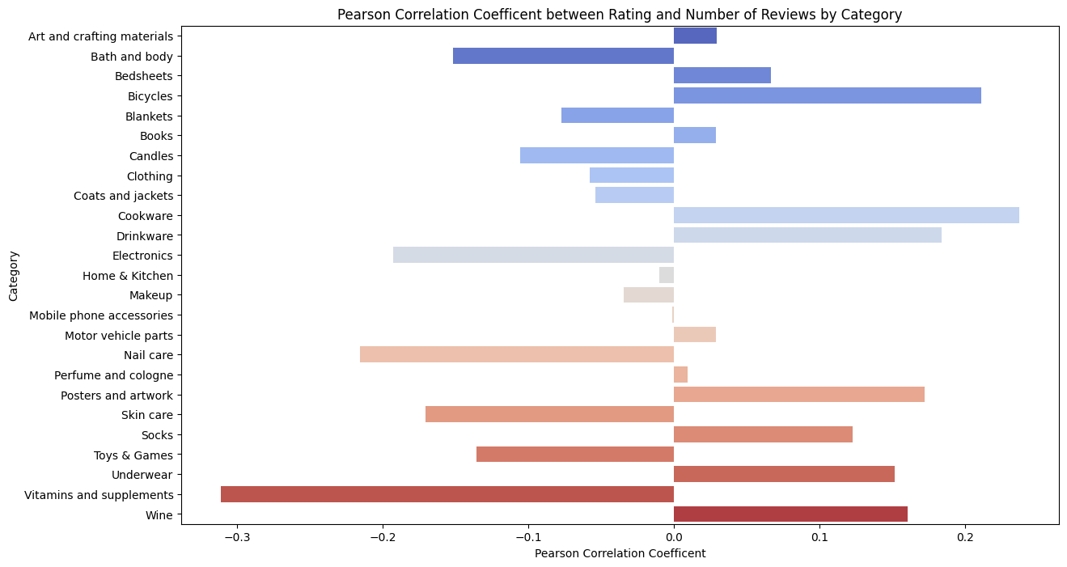
Correlation Between Ratings and Number of Reviews by Category

Slide 13
Conclusion
This analysis provides valuable insights into the distribution and relationships between product attributes in the e-commerce dataset. The visualizations highlight key trends and correlations that can be leveraged for strategic decisions in e-commerce platforms. For instance, understanding the weak correlation between price and rating can help in pricing strategies, and recognizing seasonal trends in reviews can inform marketing campaigns.

