Slide 1
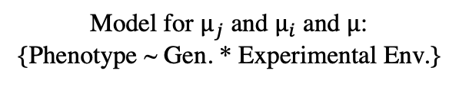


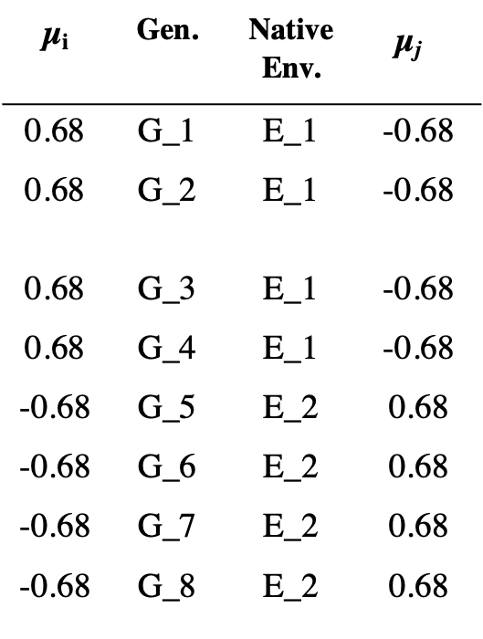
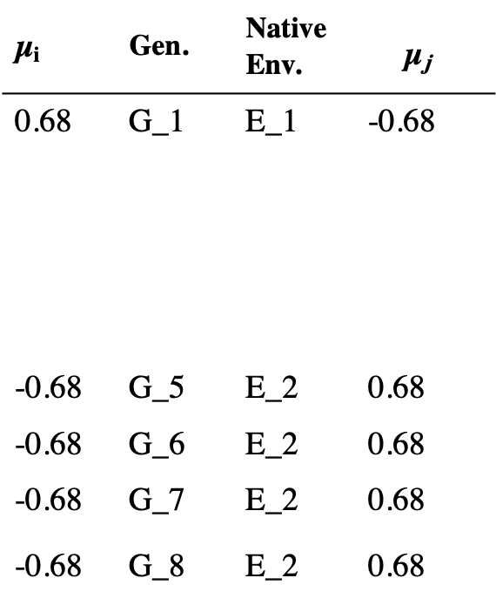
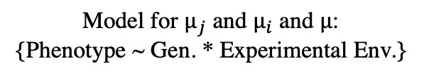

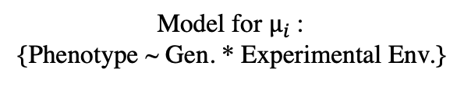
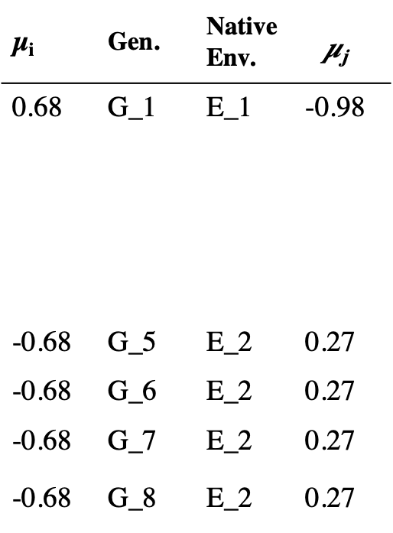
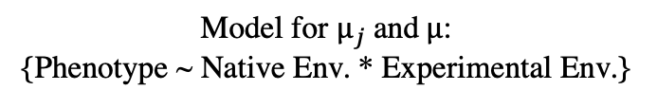
A) Original Design
B) Imbalanced Design
C) Imbalanced Design using correction
Model for $µ_{j}$and$µ$:
{Phenotype ~ Native Env. * Experimental Env.}
Model for $µ_{j}$ and $µ_{i}$ and $µ$:
{Phenotype ~ Gen. * Experimental Env.}
Model for $µ_{j}$ and $µ_{i}$ and $µ$:
{Phenotype ~ Gen. * Experimental Env.}
Model for $µ_{i}$:
{Phenotype ~ Gen. * Experimental Env.}
µ_{i} | Gen. | Native Env. | $${\text{µ}\text{j}}_{}$$
0.68 | G_1 | E_1 | -0.68
0.68 | G_2 | E_1 | -0.68
0.68 | G_3 | E_1 | -0.68
0.68 | G_4 | E_1 | -0.68
-0.68 | G_5 | E_2 | 0.68
-0.68 | G_6 | E_2 | 0.68
-0.68 | G_7 | E_2 | 0.68
-0.68 | G_8 | E_2 | 0.68
µ_{i} | Gen. | Native Env. | $${\text{µ}\text{j}}_{}$$
0.68 | G_1 | E_1 | -0.98
-0.68 | G_5 | E_2 | 0.27
-0.68 | G_6 | E_2 | 0.27
-0.68 | G_7 | E_2 | 0.27
-0.68 | G_8 | E_2 | 0.27
µ_{i} | Gen. | Native Env. | $${\text{µ}\text{j}}_{}$$
0.68 | G_1 | E_1 | -0.68
-0.68 | G_5 | E_2 | 0.68
-0.68 | G_6 | E_2 | 0.68
-0.68 | G_7 | E_2 | 0.68
-0.68 | G_8 | E_2 | 0.68
$µ$= 0.00
$µ$ = -0.21
$µ$ = 0.00

Slide 2
Incompatible Designs
Compatible Designs
A)
B)
. . .
. .
.
...
..
.
. . .
. .
.
. . .
. .
.
. . .
. .
.
. . .
. .
.
. . .
. .
.
. . .
. .
.
Genotype 1
. . .
. .
.
. . .
. .
.
...
..
.
. . .
. .
.
. . .
. .
.
Genotype 1
. . .
. .
.
...
..
.
Phenotype
. . .
. .
.
. . .
. .
.
Phenotype
. . .
. .
.
. . .
. .
.
. . .
. .
.
. . .
. .
.
Genotype 2
...
..
.
. . .
. .
.
Genotype 2
0
25.0
50.0
10
40
Environment
Environment
C)
D)
. . .
. .
.
. . .
. .
.
. . .
. .
.
. . .
. .
.
. . .
. .
.
. . .
. .
.
. . .
. .
.
. . .
. .
.
. . .
. .
.
. . .
. .
.
. . .
. .
.
. . .
. .
.
. . .
. .
.
. . .
. .
.
. . .
. .
.
. . .
. .
.
. . .
. .
.
. . .
. .
.
. . .
. .
.
. . .
. .
.
. . .
. .
.
. . .
. .
.
. . .
. .
.
. . .
. .
.
. . .
. .
.
. . .
. .
.
. . .
. .
.
. . .
. .
.
Phenotype
. . .
. .
.
. . .
. .
.
. . .
. .
.
Phenotype
. . .
. .
.
. . .
. .
.
. . .
. .
.
. . .
. .
.
. . .
. .
.
. . .
. .
.
. . .
. .
.
. . .
. .
.
. . .
. .
.
. . .
. .
.
. . .
. .
.
. . .
. .
.
. . .
. .
.
0
10
25.0
40
50.0
0
10
25.0
40
50.0
Notes:
I think it would help to have a panel showing how the genotypes were collected.
I also think it would make more sense to remove the arrow in the top row, but we can just flag that for discussion. Here are additional situations that are troublesome:
1) Multiple genotypes collected from one environment and raised in multiple environments or transplanted to many sites
2) The Conover-type data, in which the source environments of the genotypes are known, but the treatment environments do not match the source
environments.

Slide 3
A)
Data collection:
G1
Native Environment 1
Native Environment 2
G7
G4
G5
G2
G8
G3
G6
B)
Compatible Experimental design:
G1
G2
Experimental
Environment 1
G5
G6
G1
G2
Experimental
Environment 2
G5
G6
G3
G4
G7
G8
G3
G4
G7
G8
Example reaction norms compatible with analysis:
C)
D)
. . .
. .
.
. . .
. .
.
. . .
. .
.
...
..
.
. . .
. .
.
. . .
. .
.
. . .
. .
.
...
..
.
. . .
. .
.
. . .
. .
.
Genotype 1
. . .
. .
.
. . .
. .
.
...
..
.
. . .
. .
.
. . .
. .
.
Phenotype
Phenotype
. . .
. .
.
. . .
. .
.
. . .
. .
.
. . .
. .
.
...
..
.
Genotype 2
. . .
. .
.
Experimental Env. 1
Experimental Env. 2
Experimental Environment →
Example reaction norms incompatible with analysis:
E)
. . .
. .
.
. . .
. .
.
F)
. . .
. .
.
. . .
. .
.
. . .
. .
.
G)
. . .
. .
.
. . .
. .
.
. . .
. .
.
. . .
. .
.
. . .
. .
.
. . .
. .
.
. . .
. .
.
. . .
. .
.
. . .
. .
.
. . .
. .
.
. . .
. .
.
. . .
. .
.
. . .
. .
.
. . .
. .
.
. . .
. .
.
. . .
. .
.
. . .
. .
.
. . .
. .
.
. . .
. .
.
. . .
. .
.
Phenotype
. . .
. .
.
Phenotype
. . .
. .
.
. . .
. .
.
Phenotype
. . .
. .
.
. . .
. .
.
. . .
. .
.
. . .
. .
.
. . .
. .
.
. . .
. .
.
. . .
. .
.
. . .
. .
.
. . .
. .
.
. . .
. .
.
Experimental Environment →
Experimental Environment →
Experimental Env. 1
Experimental Env. 2

Slide 4
Im

