Slide 2
A
B
C
Rates
D
E

Slide 4
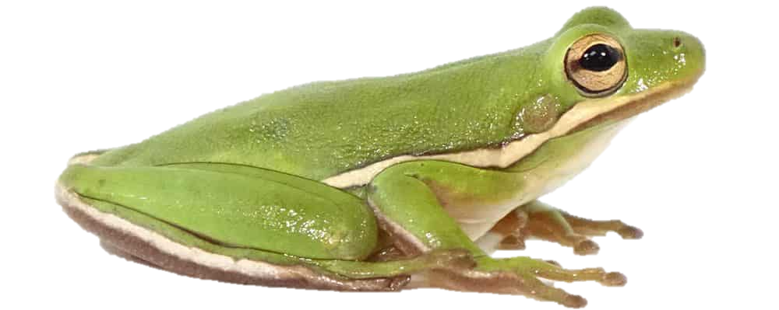
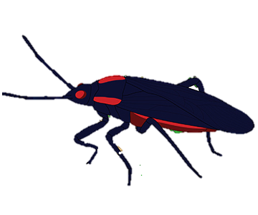



Cov_{GE} = -0.42 *
Native to freshwater habitats
Native to saltwater habitats
$${\overline{∆}}_{GxE}$$
= 0.29
Cov_{GE} = -0.38 *
Cov_{GE} = 0.25
$${\overline{∆}}_{GxE}$$
= 0.37
$${\overline{∆}}_{GxE}$$
= 0.51
Native to native host plant species (C. corundum)
Native to introduced host plant species (K. elegans)

Slide 5
A
B
C
D

Slide 7












A
Non-Significant GxE
Significant GxE
Cov_{GE} = 0.98 (0.42 – 0.99); P = 0.01
Cov_{GE} = 0.98 (0.42 – 0.99); P = 0.01
CoGV
$${\overline{∆}}_{GxE}$$
= 0.05; P = 0.96
$${\overline{∆}}_{GxE}$$
= 0.95; P = 0.004
Cov_{GE} = -0.98 (-0.98 - -0.15); P = 0.009
Cov_{GE} = -0.98 (-0.98 - -0.46); P = 0.008
$${\overline{∆}}_{GxE}$$
= 0.09; P = 0.98
$${\overline{∆}}_{GxE}$$
= 0.88; P = 0
CnGV
B
Full Reciprocal Transplant
Cov_{GE} = 0.92 (0.69 – 0.97); P = 0.001
Cov_{GE} = 0.94 (0.37 – 0.95); P = 0.002
$${\overline{∆}}_{GxE}$$
= 0.09; P = 0.98
$${\overline{∆}}_{GxE}$$
= 0.71; P = 0
CoGV
Cov_{GE} = -0.9 (-0.98 - -0.69); P = 0.005
Cov_{GE} = -0.82 (-0.91 - -0.05); P = 0.03
$${\overline{∆}}_{GxE}$$
= 0.13; P = 0.95
$${\overline{∆}}_{GxE}$$
= 0.72; P = 0
CnGV
C
Common Garden
Cov_{GE} = 0.91 (0.62 – 0.96); P = 0.004
Cov_{GE} = 0.95 (0.55 – 0.98); P = 0
$${\overline{∆}}_{GxE}$$
= 0.12; P = 0.63
$${\overline{∆}}_{GxE}$$
= 0.74; P = 0
CoGV
Cov_{GE} = -0.79 (-0.92 – -0.34); P = 0.02
Cov_{GE} = -0.81 (-0.96 – -0.47); P = 0.01
$${\overline{∆}}_{GxE}$$
= 0.20; P = 0.91
$${\overline{∆}}_{GxE}$$
= 0.92; P = 0
CnGV

