Slide 1
A
B
C
D
E
F

Slide 2
A
B
C
D
E
F
G

Slide 4
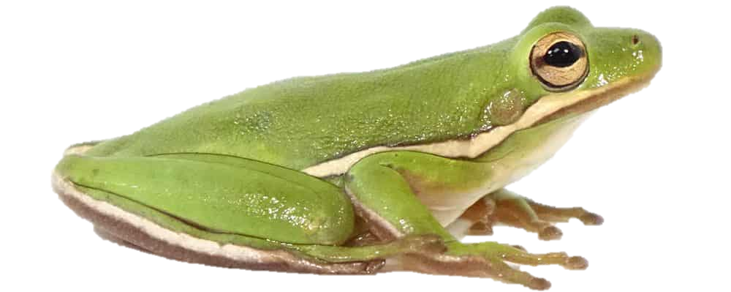
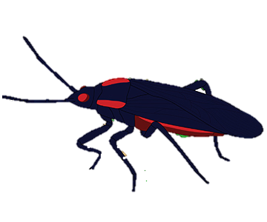



Cov_{GE} = -0.42
Native to freshwater habitats
Native to saltwater habitats
$${\overline{∆}}_{GxE}$$
= 0.29
Cov_{GE} = -0.38
Cov_{GE} = 0.25
$${\overline{∆}}_{GxE}$$
= 0.37
$${\overline{∆}}_{GxE}$$
= 0.51
Native to native host plant species (C. corundum)
Native to introduced host plant species (K. elegans)

