Slide 1
Transformer: Attention Is All You Need

Slide 2
Introduction
RNN: no parallelization
CNN and RNN: difficult to learn long distance dependencies
Attention: solve these problems
Notes:
It can solve various tasks by simply conditioning the models on a few examples (few-shot) or instructions describing the task (zero-shot). The method of conditioning the language model is called “prompting”

Slide 3
Introduction
Transformer: without RNN or CNN, self-attention only
Encoder-decoder structure
Notes:
It can solve various tasks by simply conditioning the models on a few examples (few-shot) or instructions describing the task (zero-shot). The method of conditioning the language model is called “prompting”

Slide 4
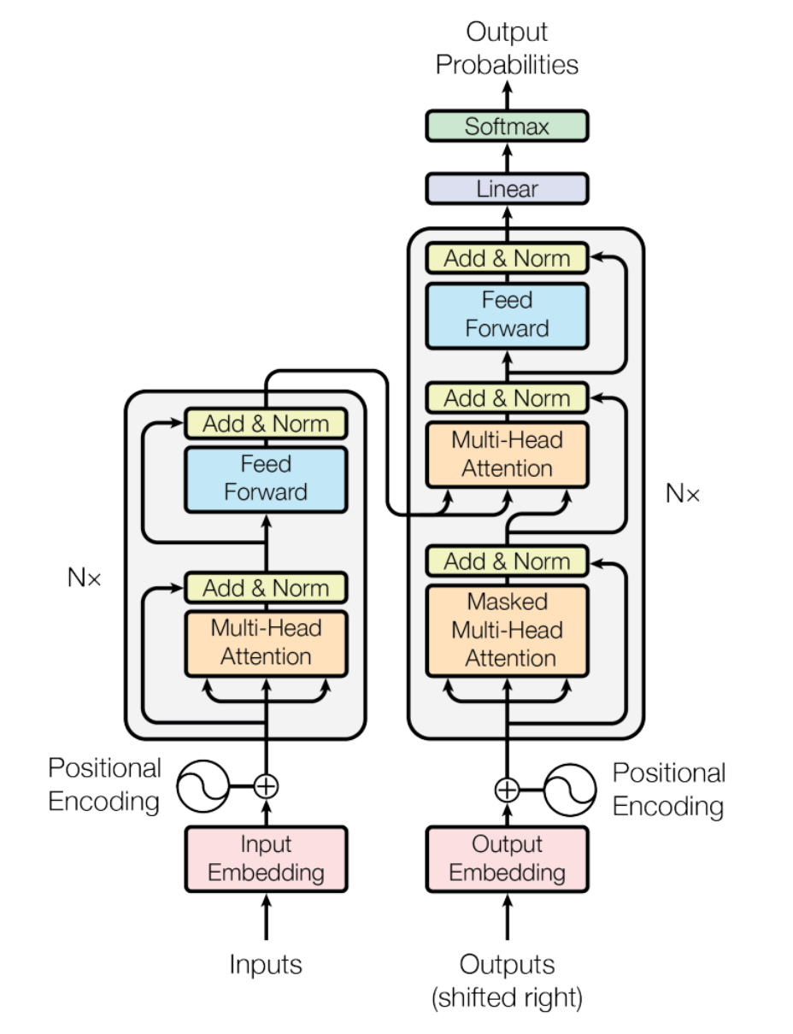
Implementation
encoder: multi-head self-attention + fully connection, residual, layer norm
decoder: three sub-layers, one performs multi-head attention over the output of encoder
Notes:
It can solve various tasks by simply conditioning the models on a few examples (few-shot) or instructions describing the task (zero-shot). The method of conditioning the language model is called “prompting”

Slide 5
Implementation
Scaled Dot-Product Attention
previous works use additive attention(using a simple feed-forward layer), or simply dot product
this: scaling by 1/sqrt(dk) because if dk is too big, the gradient of softmax will be really small
Notes:
It can solve various tasks by simply conditioning the models on a few examples (few-shot) or instructions describing the task (zero-shot). The method of conditioning the language model is called “prompting”

Slide 6
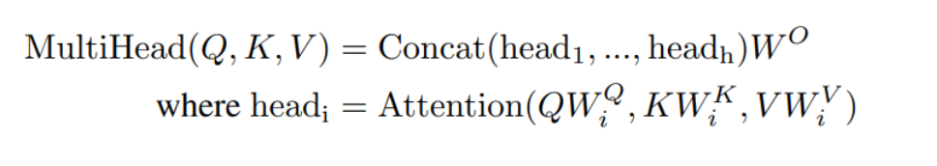
Implementation
Multi-head attention:
Allow the model to jointly attend to information from different representation subspaces at different positions
Notes:
It can solve various tasks by simply conditioning the models on a few examples (few-shot) or instructions describing the task (zero-shot). The method of conditioning the language model is called “prompting”

Slide 7
Implementation
Multi-head attention:
Allow the model to jointly attend to information from different representation subspaces at different positions
Notes:
It can solve various tasks by simply conditioning the models on a few examples (few-shot) or instructions describing the task (zero-shot). The method of conditioning the language model is called “prompting”

Slide 8
Implementation
Details about attention:
In encoder-decoder attention, Q and V are from encoder output, K from decoder output
In decoder, add mask to prevent leftward information
Notes:
It can solve various tasks by simply conditioning the models on a few examples (few-shot) or instructions describing the task (zero-shot). The method of conditioning the language model is called “prompting”

Slide 9

Implementation
Fully connection feed forward
Embeddings: learned embeddings to convert tokens to vectors of dimension d_model
Notes:
It can solve various tasks by simply conditioning the models on a few examples (few-shot) or instructions describing the task (zero-shot). The method of conditioning the language model is called “prompting”

Slide 10
Implementation
Positional encoding
PE_{pos+k} can be represented as a linear function of PE_{pos}
Notes:
It can solve various tasks by simply conditioning the models on a few examples (few-shot) or instructions describing the task (zero-shot). The method of conditioning the language model is called “prompting”

Slide 11
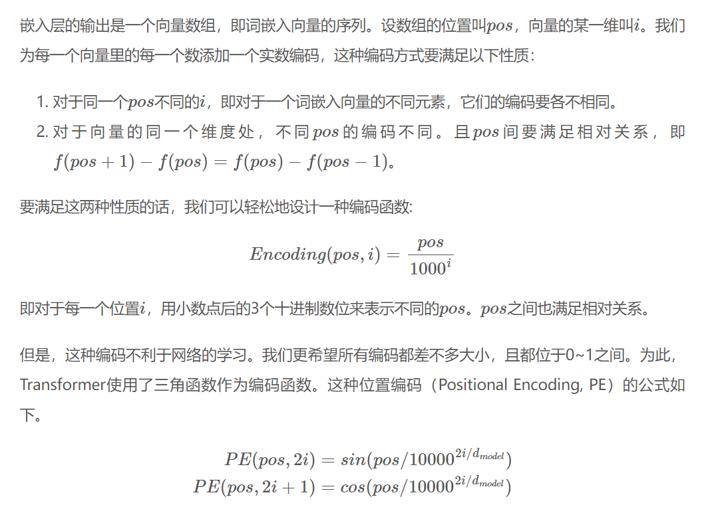
Implementation
Notes:
It can solve various tasks by simply conditioning the models on a few examples (few-shot) or instructions describing the task (zero-shot). The method of conditioning the language model is called “prompting”

Slide 12
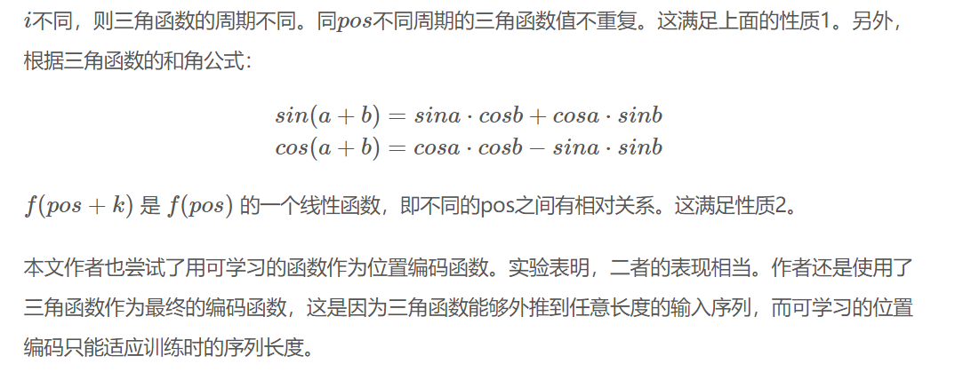
Implementation
Notes:
It can solve various tasks by simply conditioning the models on a few examples (few-shot) or instructions describing the task (zero-shot). The method of conditioning the language model is called “prompting”

Slide 13
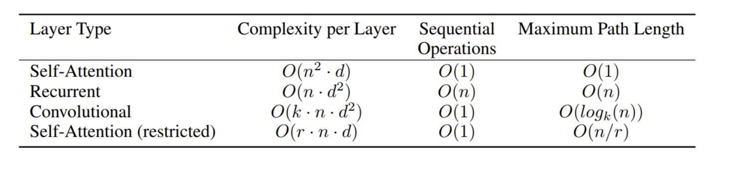
Results and Discussion
Why Self Attention:
Notes:
It can solve various tasks by simply conditioning the models on a few examples (few-shot) or instructions describing the task (zero-shot). The method of conditioning the language model is called “prompting”

Slide 14
Results and Discussion
Results:
Number of heads: too few, too many both not good
Reducing attention key size: getting worse
Notes:
It can solve various tasks by simply conditioning the models on a few examples (few-shot) or instructions describing the task (zero-shot). The method of conditioning the language model is called “prompting”

Slide 15
GPT-1

Slide 16
Note
GPT-1 is earlier than BERT!!! Maybe GPT-1 inspires BERT.
BERT performs better than GPT-1, even GPT-2
Notes:
It can solve various tasks by simply conditioning the models on a few examples (few-shot) or instructions describing the task (zero-shot). The method of conditioning the language model is called “prompting”

Slide 17
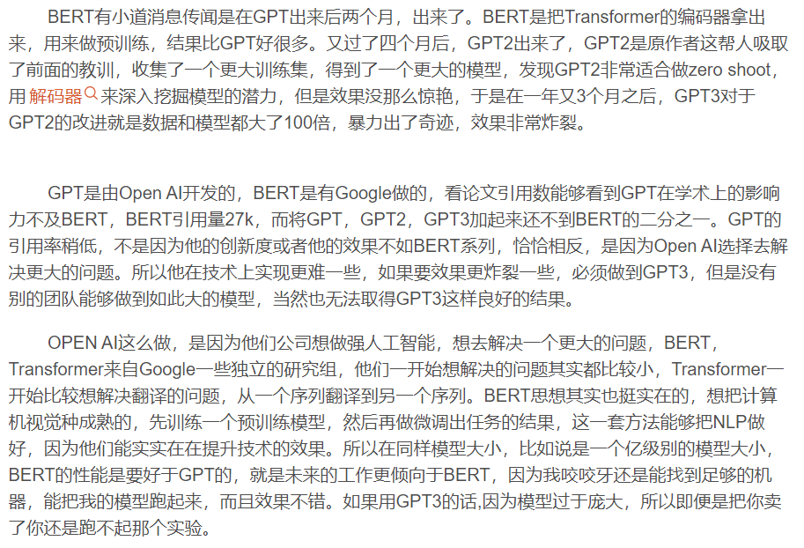
Note
CSDN上的一个解读，不知道对不对
Notes:
It can solve various tasks by simply conditioning the models on a few examples (few-shot) or instructions describing the task (zero-shot). The method of conditioning the language model is called “prompting”

Slide 18
Introduction
Problems:
models that can leverage linguistic information from unlabeled data provide a valuable alternative to gathering more annotation, which can be time-consuming and expensive
even in cases where considerable supervision is available, learning good representations in an unsupervised fashion can provide a significant performance boost

Slide 19
Introduction
Solution(GPT-1):
semi-supervised approach for language understanding tasks
using a combination of unsupervised pre-training and supervised fine-tuning.

Slide 20
Introduction
Difficulties in using unlabled text:
unclear what type of optimization objectives are most effective at learning text representations that are useful for transfer
no consensus on the most effective way to transfer these learned representations to the target task

Slide 21
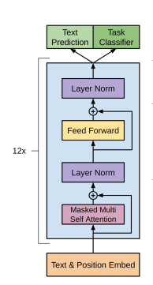
Implementation
Multi-layer transformer decoder

Slide 22

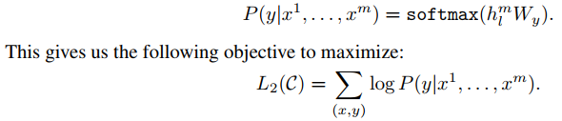
Implementation
Pre-training:
Fine-tuning:

Slide 23
Implementation
including language modeling as an auxiliary objective to the fine-tuning helped learning by (a) improving generalization of the supervised model, and (b) accelerating convergence.
(why?)

Slide 24
Implementation
Task-specific input transformations
Adding delimiter
For similarity, both possible sentence orderings

Slide 25
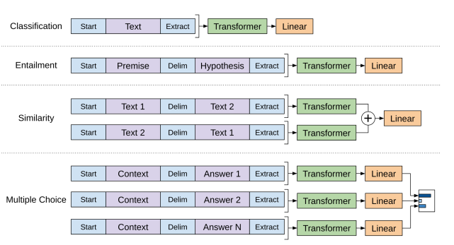
Implementation

Slide 26
Implementation
Pre-training: BooksCorpus dataset
Fine-tuning:
Natural Language Inference
Question answering and commonsense reasoning
Semantic Similarity
Classification

Slide 27
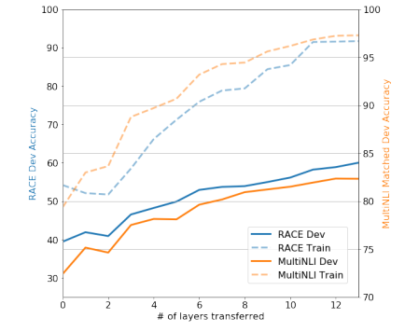
Results
Number of layers:

Slide 28
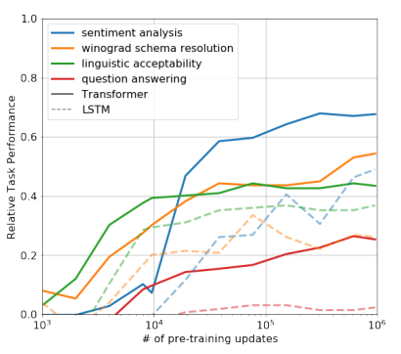
Results
Zero-shot: use the underlying generative model to perform tasks without supervised finetuning
(why?怎么看出来的)

Slide 29
Results
Ablation:
Without auxiliary LM
Compare to LSTM
Without pre-training

Slide 30
BERT

Slide 31
Introduction
Other work like ELMo, GPT-1: unidirectional
This: bidirectional
trained using masked language model
Notes:
It can solve various tasks by simply conditioning the models on a few examples (few-shot) or instructions describing the task (zero-shot). The method of conditioning the language model is called “prompting”

Slide 32
Introduction
At Contoso, we empower organizations to foster collaborative thinking to further drive workplace innovation. By closing the loop and leveraging agile frameworks, we help business grow organically and foster a consumer first mindset.

Slide 33
Primary goals
Annual revenue growth

Slide 34
Areas of growth
 | B2B | Supply chain | ROI | E-commerce
Q1 | 4.5 | 2.3 | 1.7 | 5.0
Q2 | 3.2 | 5.1 | 4.4 | 3.0
Q3 | 2.1 | 1.7 | 2.5 | 2.8
Q4 | 4.5 | 2.2 | 1.7 | 7.0

Slide 35
Business opportunities are like buses. There's always another one coming.
“
”
Richard Branson

Slide 36




Meet our team
Takuma Hayashi
Mirjam Nilsson
President
Chief Executive Officer
Flora Berggren
Rajesh Santoshi
Chief Operation Officer
VP Marketing

Slide 37








The full team
Takuma Hayashi
Mirjam Nilsson
Flora Berggren
Rajesh Santoshi
President
Chief Executive Officer
Chief Operations Manager
VP Marketing
Graham Barnes
Rowan Murphy
Elizabeth Moore
Robin Kline
VP Product
SEO Strategist
Product Designer
Content Developer

Slide 38
Plan for product launch
Deploy strategic networks with compelling e-business needs
Planning
Synergize scalable e-commerce
Marketing
Disseminate standardized metrics
Design
Coordinate
Foster holistically superior methodologies
Launch
Strategy
e-business applications
1
2
3
4
5

Slide 39
Timeline
Deploy strategic networks with compelling e-business needs
Sep 20XX
Synergize scalable e-commerce
Nov 20XX
Disseminate standardized metrics
Jan 20XX
Coordinate e-business applications
March 20XX
Foster holistically superior methodologies
May 20XX

Slide 40
Areas of focus
B2B market scenarios
Cloud-based opportunities
Develop winning strategies to keep ahead of the competition
Capitalize on low-hanging fruit to identify a ballpark value
Visualize customer directed convergence
Iterative approaches to corporate strategy
Establish a management framework from the inside

Slide 41
How we get there
ROI
Niche Markets
Supply chains
Envision multimedia-based expertise and cross-media growth strategies
Visualize quality intellectual capital
Engage worldwide methodologies with web-enabled technologies
Pursue scalable customer service through sustainable strategies
Engage top-line web services with cutting-edge deliverables
Cultivate one-to-one customer service with robust ideas
Maximize timely deliverables for real-time schemas

Slide 42
Summary
At Contoso, we believe in giving 110%. By using our next-generation data architecture, we help organizations virtually manage agile workflows. We thrive because of our market knowledge and great team behind our product. As our CEO says, "Efficiencies will come from proactively transforming how we do business."

Slide 43
Thank you
Mirjam Nilsson​
mirjam@contoso.com
www.contoso.com

