Slide 1

MIPS
Tudusciuc Cristian-Rafael
github.com/RCTd/AMD_SummerPractice

Slide 2
Cuprins
In aceste saptamani am finalizat urmatoarele cerinte:
Mips in Verilog
Compilator
Mips in C

Slide 3
Implementare
1
Mips in Verilog

Slide 4
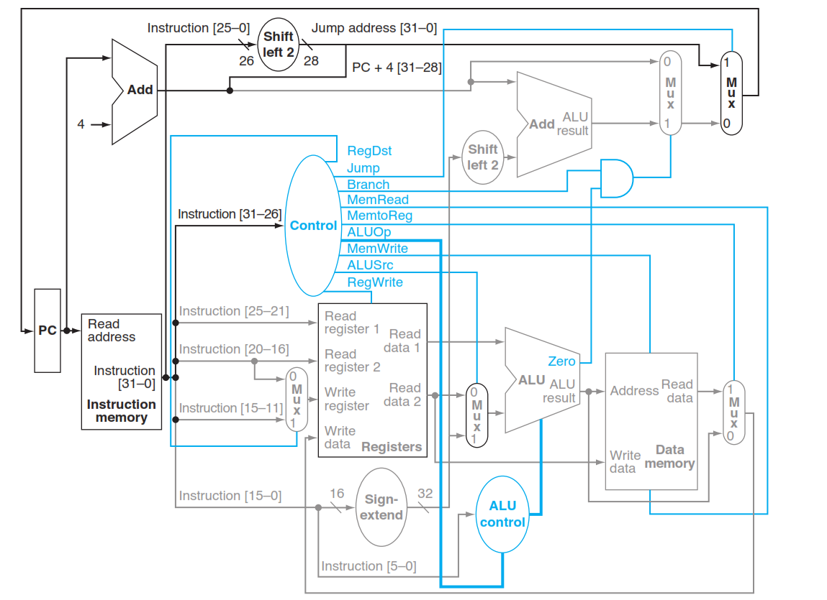
Mips in Verilog

Slide 5
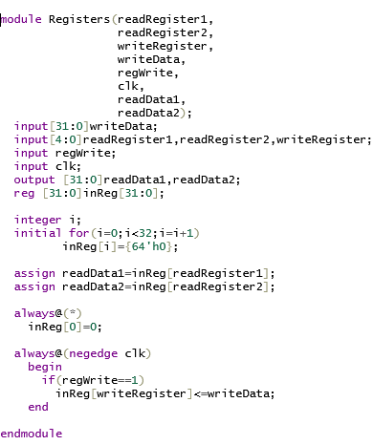
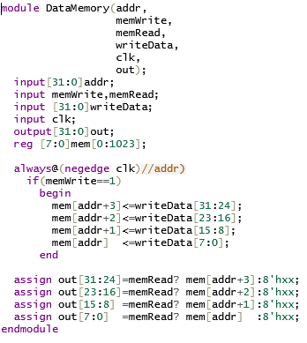
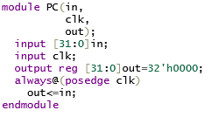
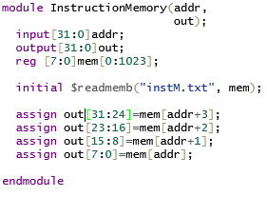
Mips in Verilog
Calea de date

Slide 6
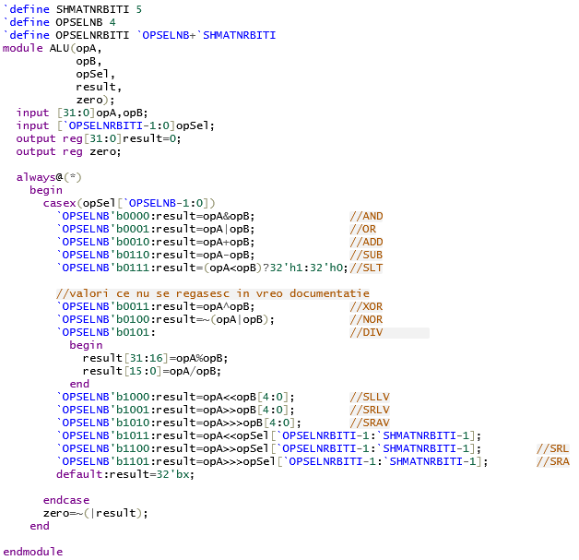
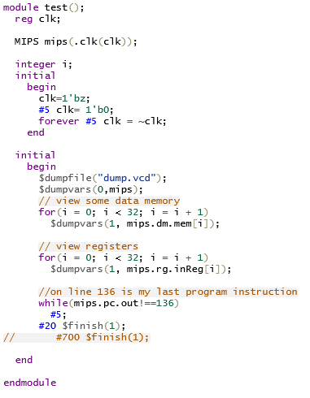
Mips in Verilog
Testbench

Slide 7
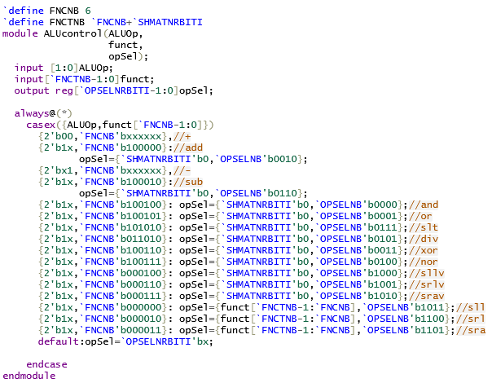
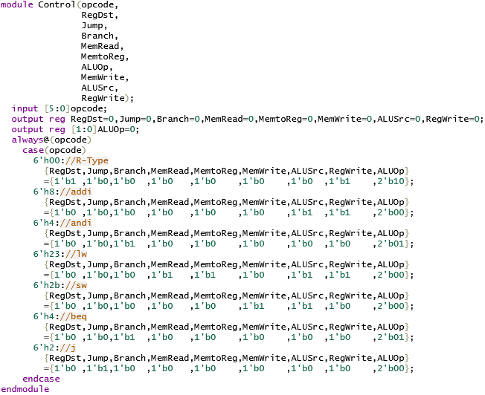
Mips in Verilog
Calea de control

Slide 8
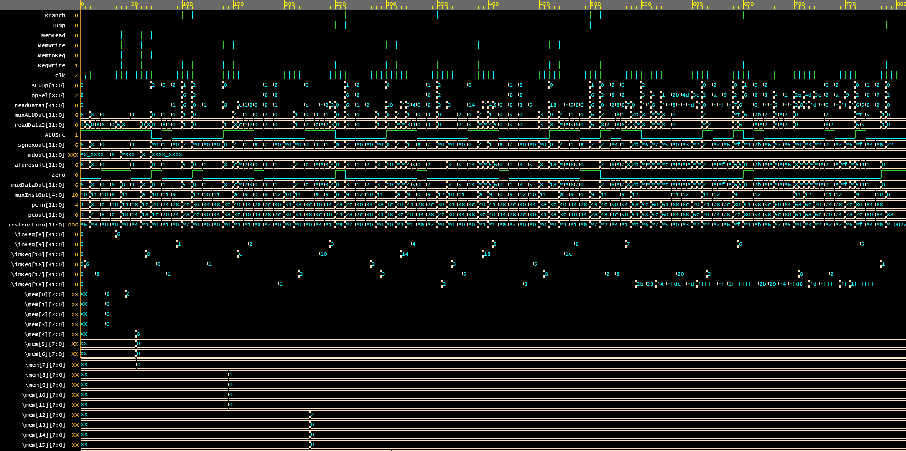
Mips in Verilog
Waveform

Slide 9
Implementare
2
Compilator

Slide 10
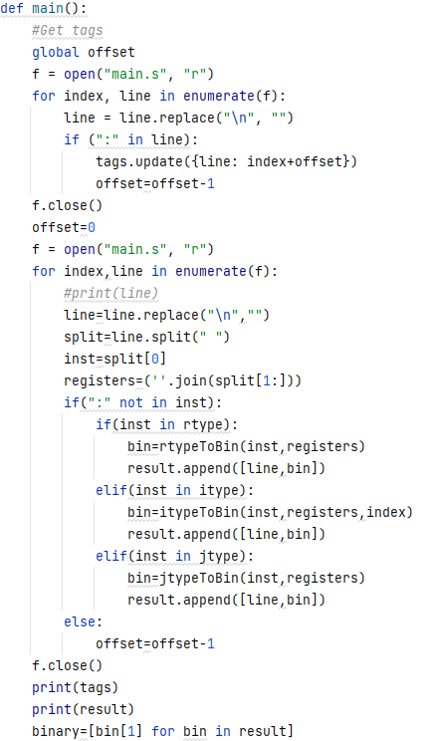
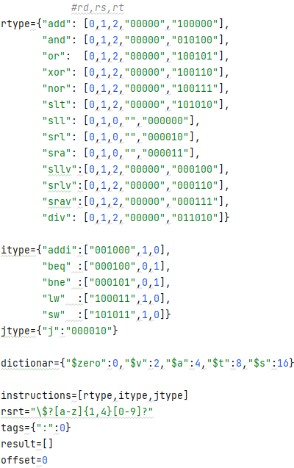
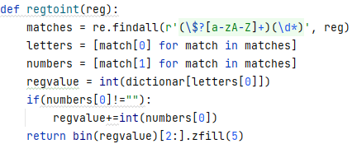
Compilator
Puncte atinse:
-Functional
-Usor de extins
-Contine taguri
-Contine toate instructiunile ce pot fi executate in implementarea din verilog

Slide 11

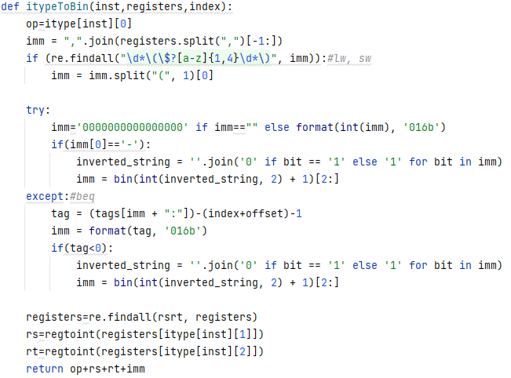
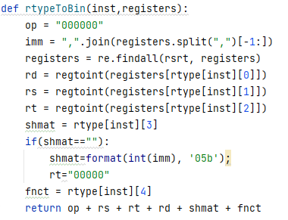
Compilator
Tratarea fiecarui tip de instructiune

Slide 12
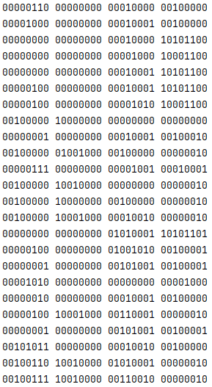
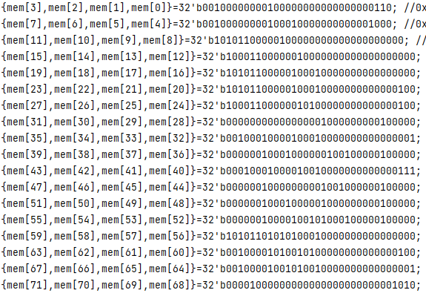
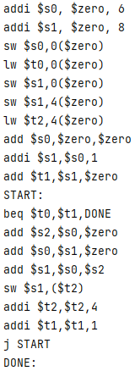
Compilator
Rezultat
=>
sau

Slide 13
Implementare
3
Mips in C

Slide 14
Mips in C
main
PC&IM
DE&EX
PC
IM
DE
EX

Slide 15
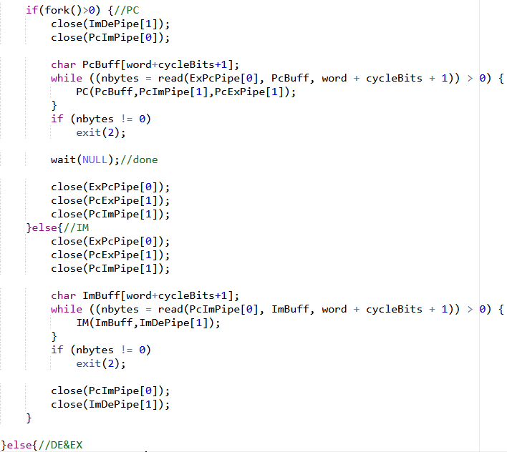
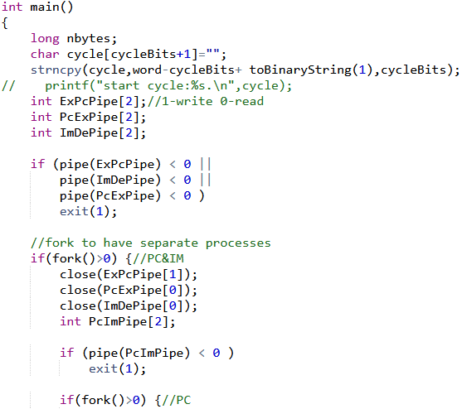
Mips in C

Slide 16
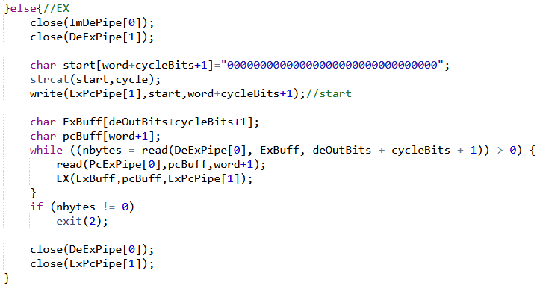
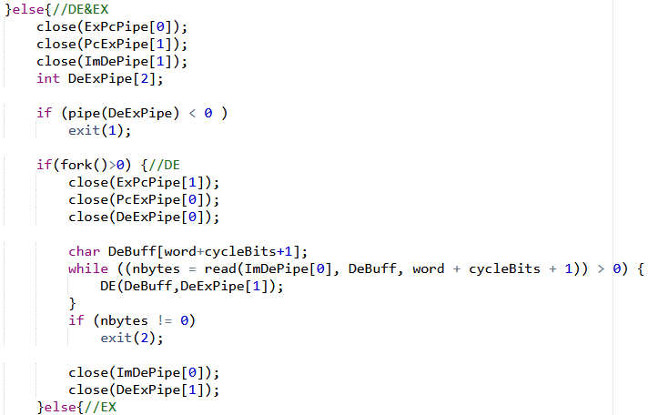
Mips in C

Slide 17
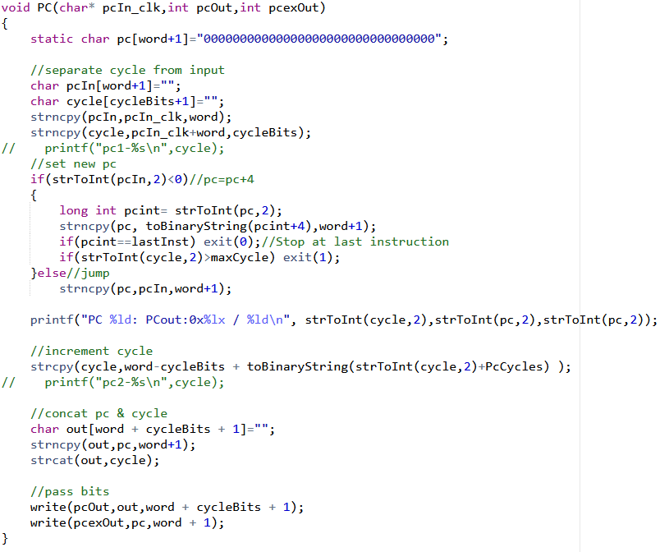
Mips in C

Slide 18
OPENING
I hope and I believe that this Template will your Time, Money and Reputation.
A complex idea can be conveyed with just a single still image, namely making it possible to absorb
15%
40%
20%
Complain
A complex idea can be conveyed with just a single still image, namely making it possible to absorb
I hope and I believe that this Template will your Time, Money and Reputation.
35%

Slide 19
OPENING
Free
70%
Time
92%
Mission
87%
Vision
52%

Slide 20
OPENING
Services
I hope and I believe that this Template will your Time, Money and Reputation.
1
2
Forum
3
Easy to change colors, photos and Text.
1
About us
Get a modern PowerPoint Presentation that is beautifully designed.
Our Values
2
Easy to change colors, photos and Text.
3

Slide 21
OPENING
Timeline
Future
Pricing
What we do?

Slide 22
CERENOMY
09%
Transport
03%
Annual
Get a modern PowerPoint Presentation that is beautifully designed.
Easy to change colors, photos and Text.
Suggest
20%
Conferences
68%
Meeting
Easy to change colors, photos and Text.
Get a modern PowerPoint Presentation that is beautifully designed.

Slide 23
CERENOMY
75%
You have to be signed in to your Google account.
63%
57%
55%
43%
Click on the button under the presentation preview that says "Use as Google Slides Theme.
23%
21%
18%
You have to be signed in to your Google account.
-12%
-05%
-23%
Click on the button under the presentation preview that says "Use as Google Slides Theme.
-45%

Slide 24
CERENOMY
You have to be signed in
to your Google account.
You will get a copy of this document on your Google Drive and will be able to edit, add or delete slides.
You will get a copy of this document on your Google
Drive and will be able to
edit, add or delete slides.
You have to be signed in
to your Google account.

Slide 25
CERENOMY
Add or delete slides. You have to be signed in to your
1
2
Is the color of gold, butter and ripe lemons. In the spectrum of visible light, yellow is found between green and orange.
4
3
Add or delete slides. You have to be signed in to your
Is the color of gold, butter and ripe lemons. In the spectrum of visible light, yellow is found between green and orange.

Slide 26
SPEAKERS
Add
1
We press play on your digital story. Using conceptual
This allows us to achieve high quality outcomes and full transparency towards.
2
Split
EXCLUSIVE
We use well-known development methodologies
Shar
3
This allows us to achieve high quality outcomes and full transparency towards.
We press play on your digital story. Using conceptual
4
Bill

Slide 27
SPEAKERS
Signature
Occupation
Moving from creative ideas to solid strategy and execution, we help your target market resonate fully with your brand. When you get them, they will get you, quicker. We leverage digital tools, design and words, to become even more relevant.
We press play on your digital story. Using conceptual, digital design, we work with you to build experiences that feel 'right' for your users. We create a solid user-product relationship, one that's long and fruitful.

Slide 28
SPEAKERS
Add
Moving from creative ideas to solid strategy and execution
93%
82%
Simple & Smooth, exactly how purchasing experiences
Lower
Send
70%
Moving from creative ideas to solid strategy and execution

Slide 29
SPEAKERS
Advise
Your audience relate and absorb information on different
25
Agenda
The user can demonstrate on a projector or computer。
55
Apply
The user can demonstrate on a projector or computer
20
Approve
Your audience relate and absorb information on different
80

Slide 30
Project Introduction
4
INTRODUCTION

Slide 31
INTRODUCTION
55%
97%
39%
Brand
Bill
Authorize
Film to be used in a wider
field. Using PowerPoint
The user can make a presentation
on a projector or computer
Film to be used in a wider
field. Using PowerPoint

Slide 32
INTRODUCTION
Certification
The user can make a presentation on a projector or computer, or print out the presentation to make a film. The user can make a presentation on a projector or computer, and can also make a presentation. You can also print out the presentation to make a film
Buy
Budget
Choose
Enter the comprehensive description of the above chart here, enter the comprehensive description of the above chart here, enter the comprehensive description of the above chart here, enter the comprehensive description of the above chart here
Cancel
Calculate

Slide 33
INTRODUCTION
It is a very sad thing that nowadays there is so little useless information. Oscar Wilde It is a very sad thing that nowadays there is so little useless information. Oscar Wilde
79%
39%
90%
67%
54%
We certainly do not forget you as soon as you forget us. It is, perhaps, our fate rather than our merit. We cannot help ourselves. We live at home, quiet, confined, and our feelings prey upon us. You are forced on exertion.
Fix Cost
Property
Cost
Interest
Another
Cost
Labor
Payment

Slide 34
INTRODUCTION
Competition
We certainly do not forget you as soon as you forget us. It is, perhaps, our fate rather than our merit. We cannot help ourselves. We live at home, quiet, confined, and our feelings prey upon us. You are forced on exertion.
Comparison
I believe that people would be alive today I
f there were a death penalty. Nancy Reagan
Commission
We certainly do not forget you as soon as you forget us. It is, perhaps, our fate rather than our merit. We cannot help ourselves. We live at home, quiet, confined, and our feelings prey upon us. You are forced on exertion.

Slide 35
THANK YOU !
Formal Presentation Template
www.freepptbackgrounds.net

