Slide 1

MIPS
Tudusciuc Cristian-Rafael
github.com/RCTd/AMD_SummerPractice

Slide 2
Cuprins
In aceste saptamani am finalizat urmatoarele cerinte:
Mips in Verilog
Compilator
Mips in C

Slide 3
Implementare
1
Mips in Verilog

Slide 4
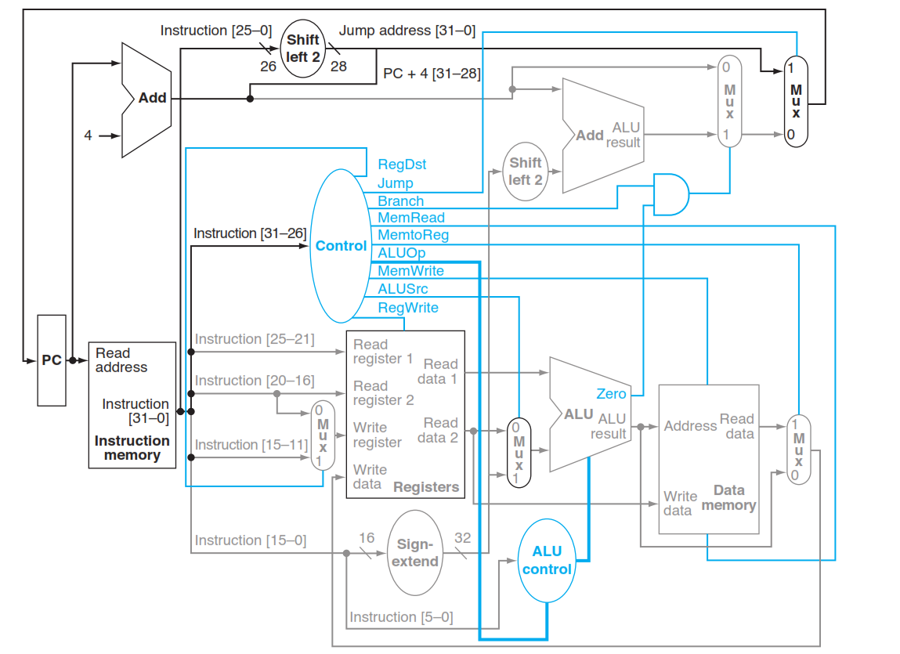
Mips in Verilog

Slide 5
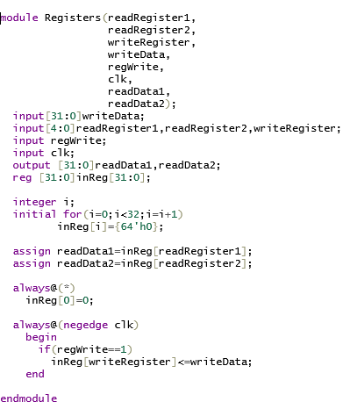
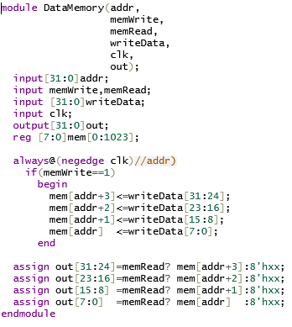
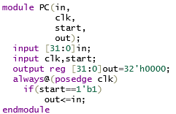
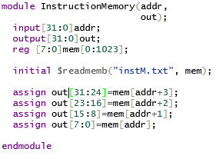
Mips in Verilog
Calea de date

Slide 6
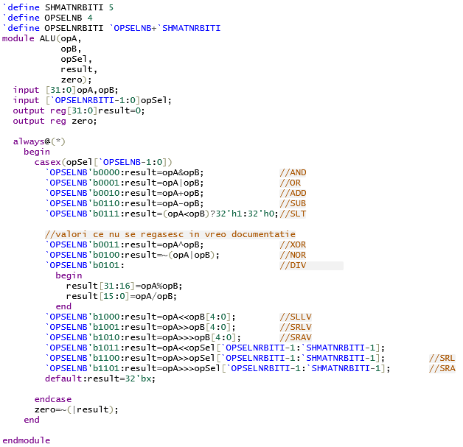
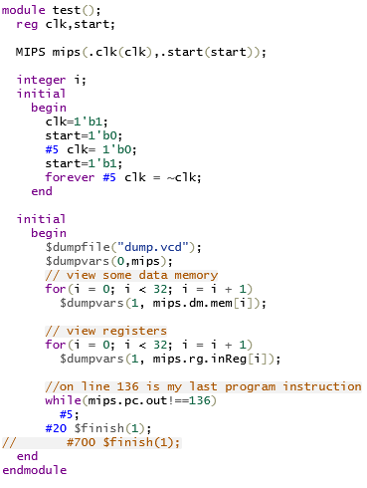
Mips in Verilog
Testbench

Slide 7
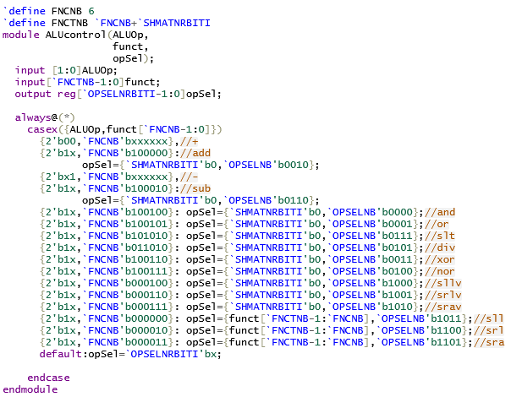
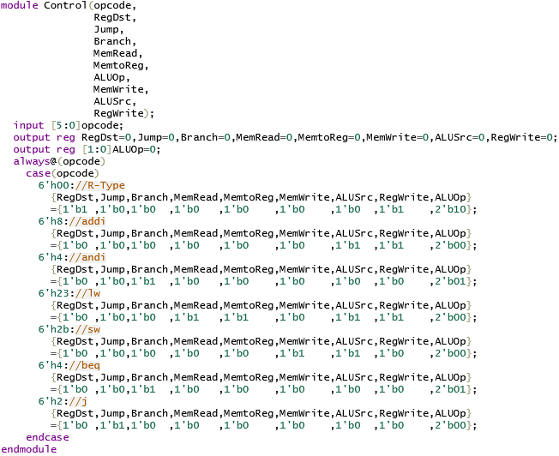
Mips in Verilog
Calea de control

Slide 8
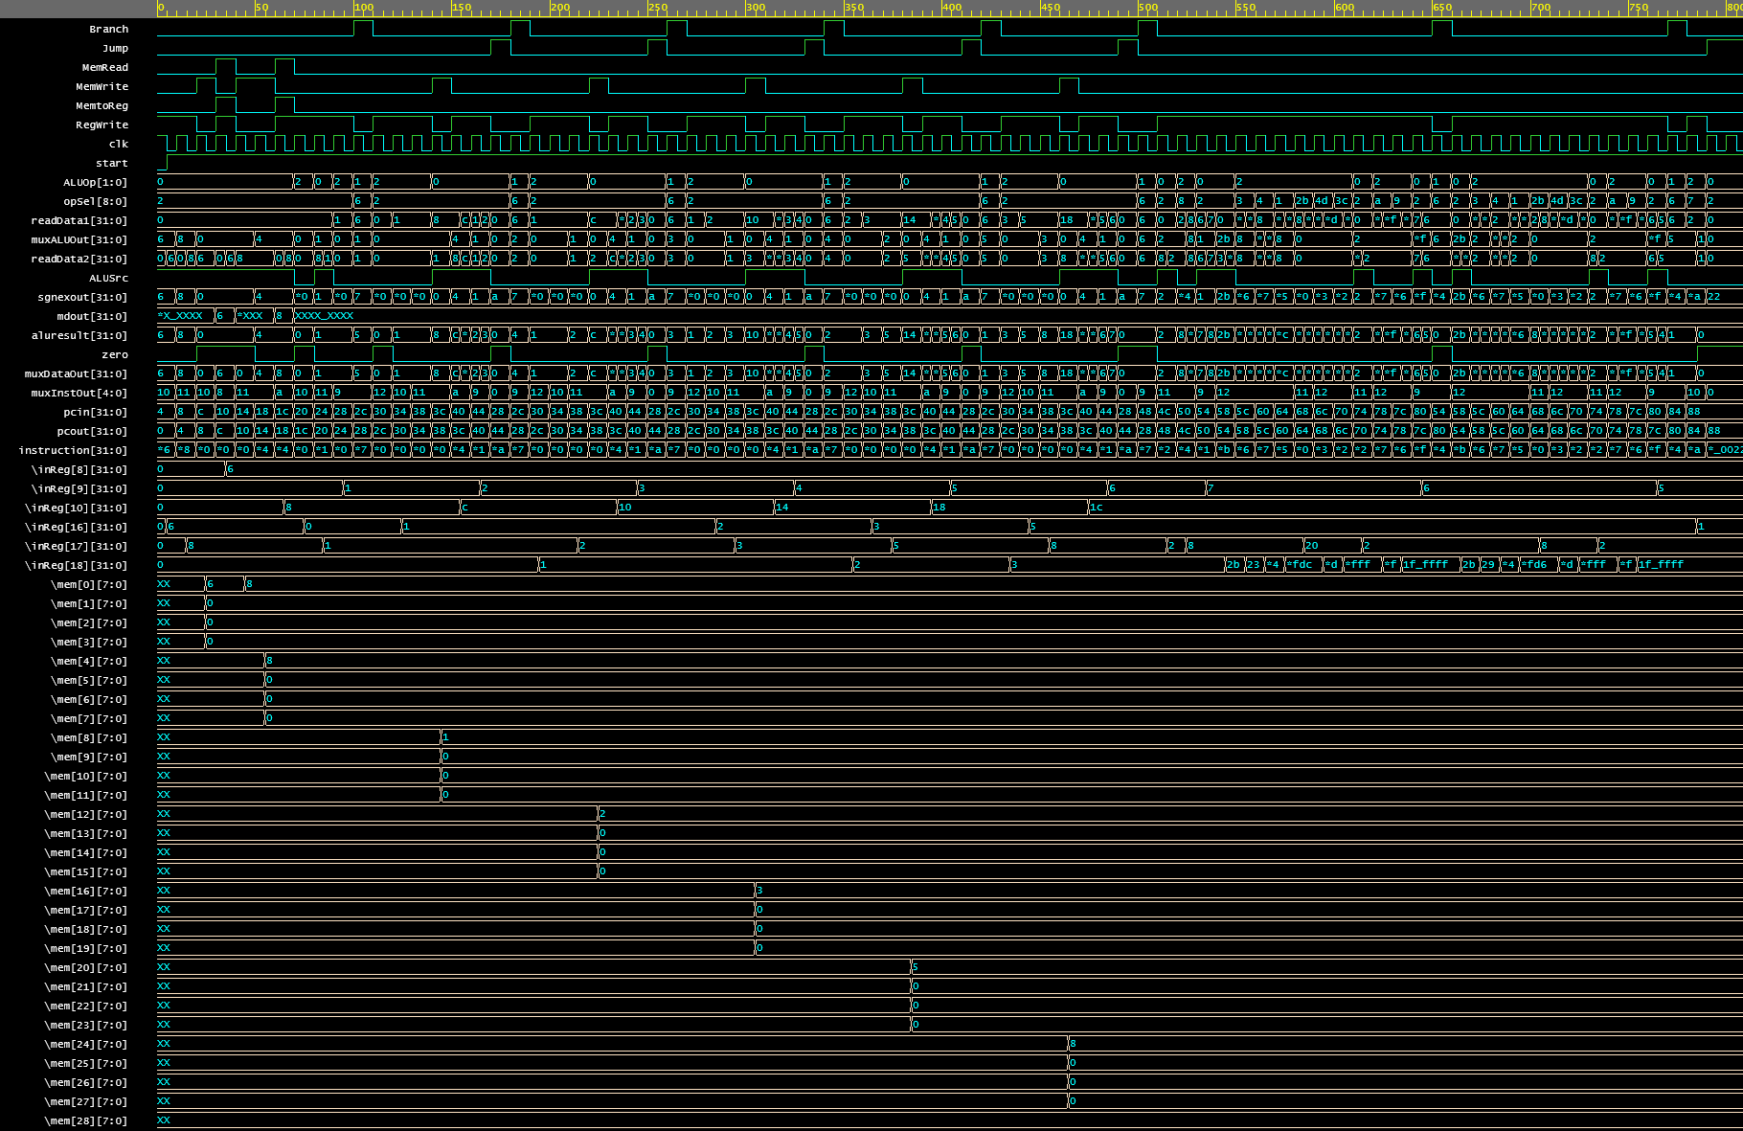
Mips in Verilog
Waveform

Slide 9
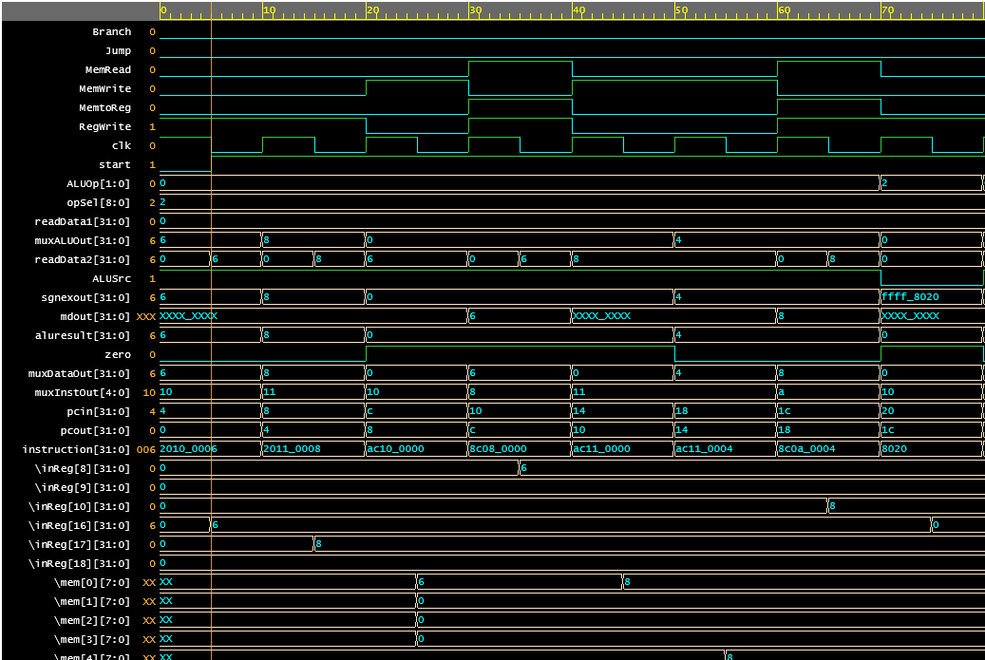
Mips in Verilog
addi $s0, $zero, 6
addi $s1, $zero, 8
sw $s0,0($zero)
lw $t0,0($zero)
sw $s1,0($zero)
sw $s1,4($zero)
lw $t2,4($zero)
add $s0,$zero,$zero

Slide 10
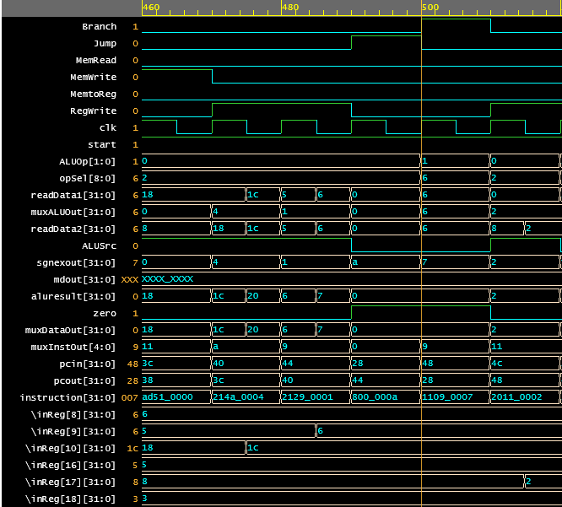
Mips in Verilog
START:
0x28:beq $t0,$t1,DONE
…
0x38:sw $s1,($t2)
0x3c:addi $t2,$t2,4
0x40:addi $t1,$t1,1
0x44:j START
DONE:
0x48:addi $s1,$zero,2

Slide 11
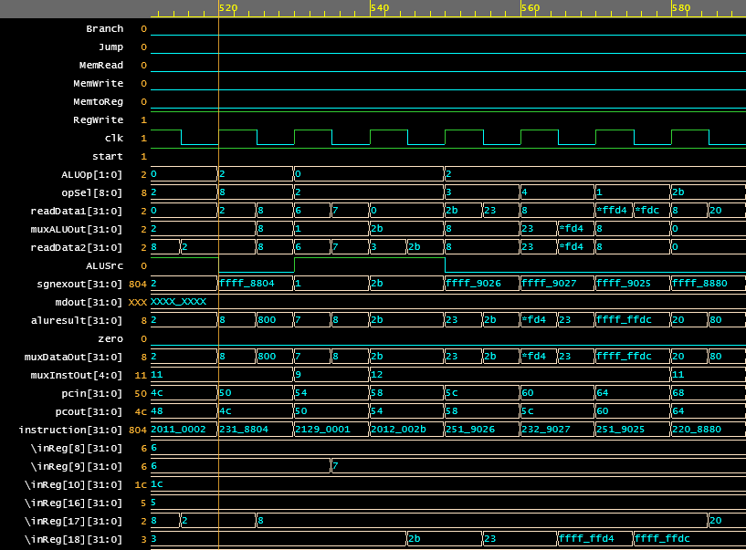
Mips in Verilog
addi $s1,$zero,2
sllv $s1,$s1,$s1
addi $t1,$t1,1
addi $s2,$zero,43
xor $s2,$s2,$s1
nor $s2,$s1,$s2
or $s2,$s2,$s1
sll $s1,$s1,2

Slide 12
Implementare
2
Compilator

Slide 13
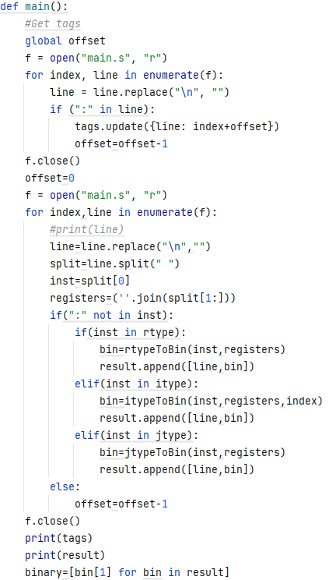
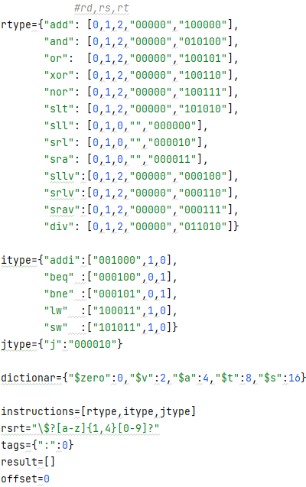
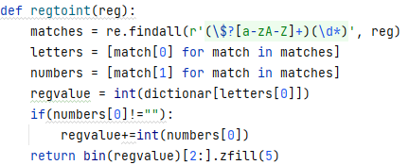
Compilator
Puncte atinse:
-Functional
-Usor de extins
-Contine taguri
-Contine toate instructiunile ce pot fi executate in implementarea din verilog

Slide 14

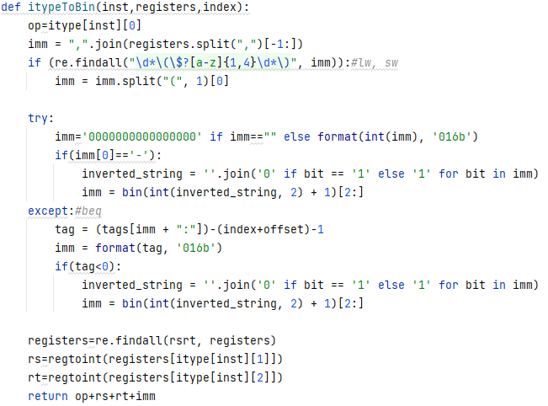
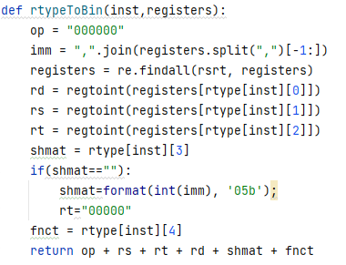
Compilator
Tratarea fiecarui tip de instructiune

Slide 15
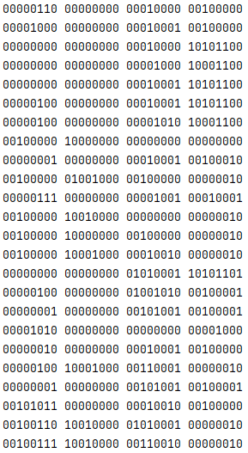
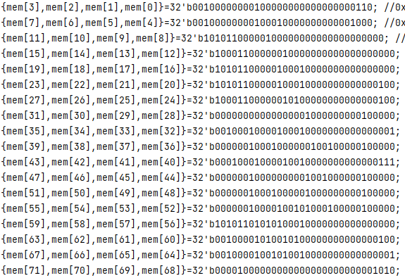
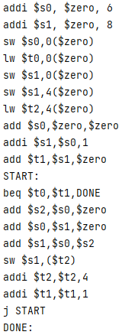
Compilator
Rezultat
=>
sau

Slide 16
Implementare
3
Mips in C

Slide 17
Mips in C
main
PC&IM
DE&EX
PC
IM
DE
EX

Slide 18
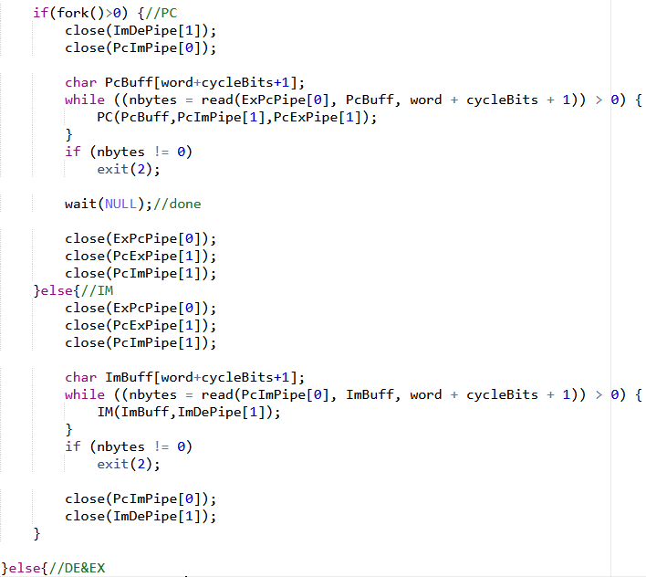
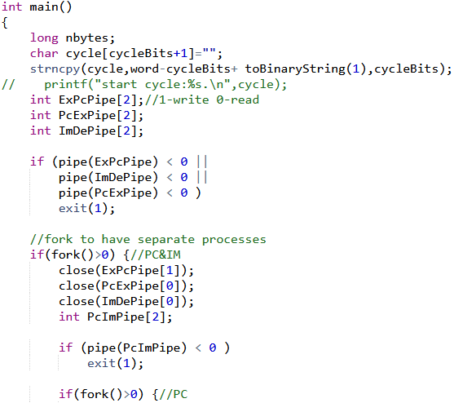
Mips in C

Slide 19
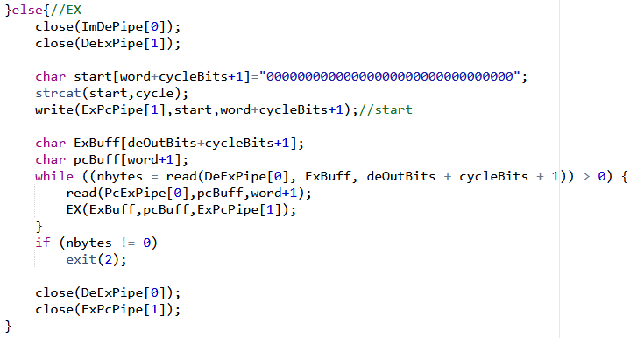
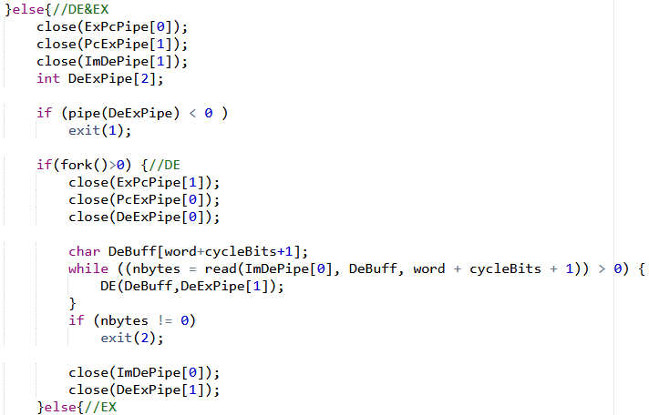
Mips in C

Slide 20
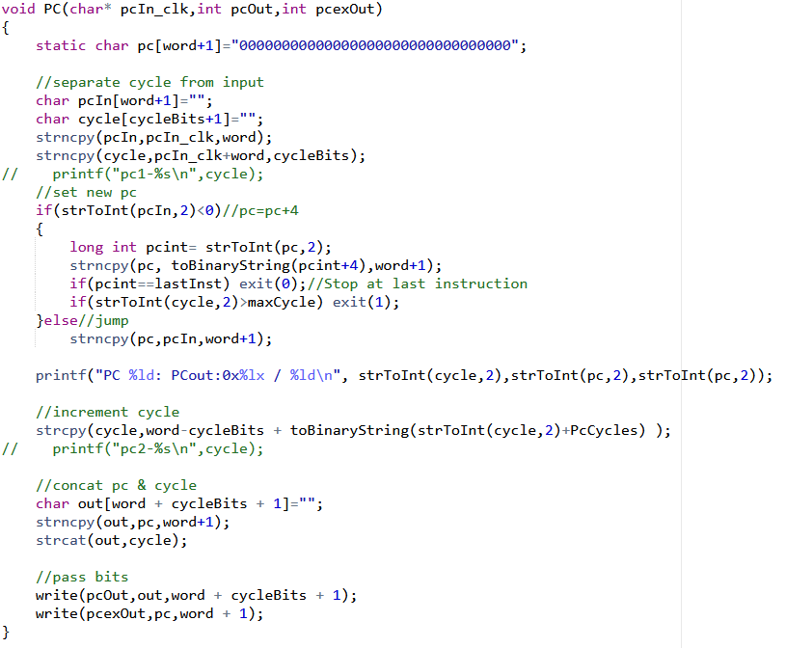
Mips in C

Slide 21
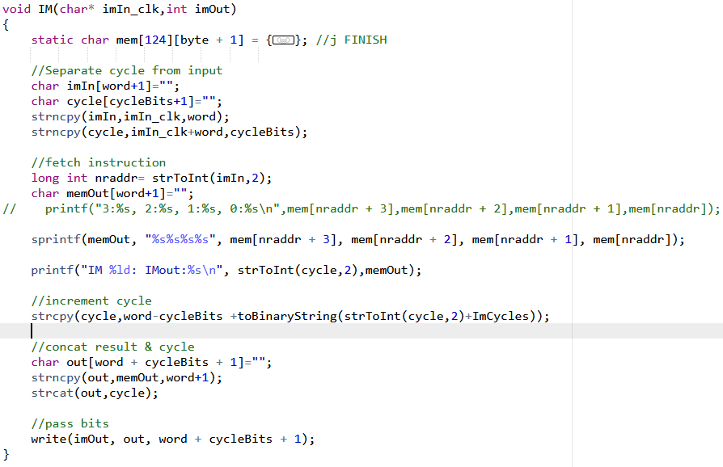
Mips in C

Slide 22
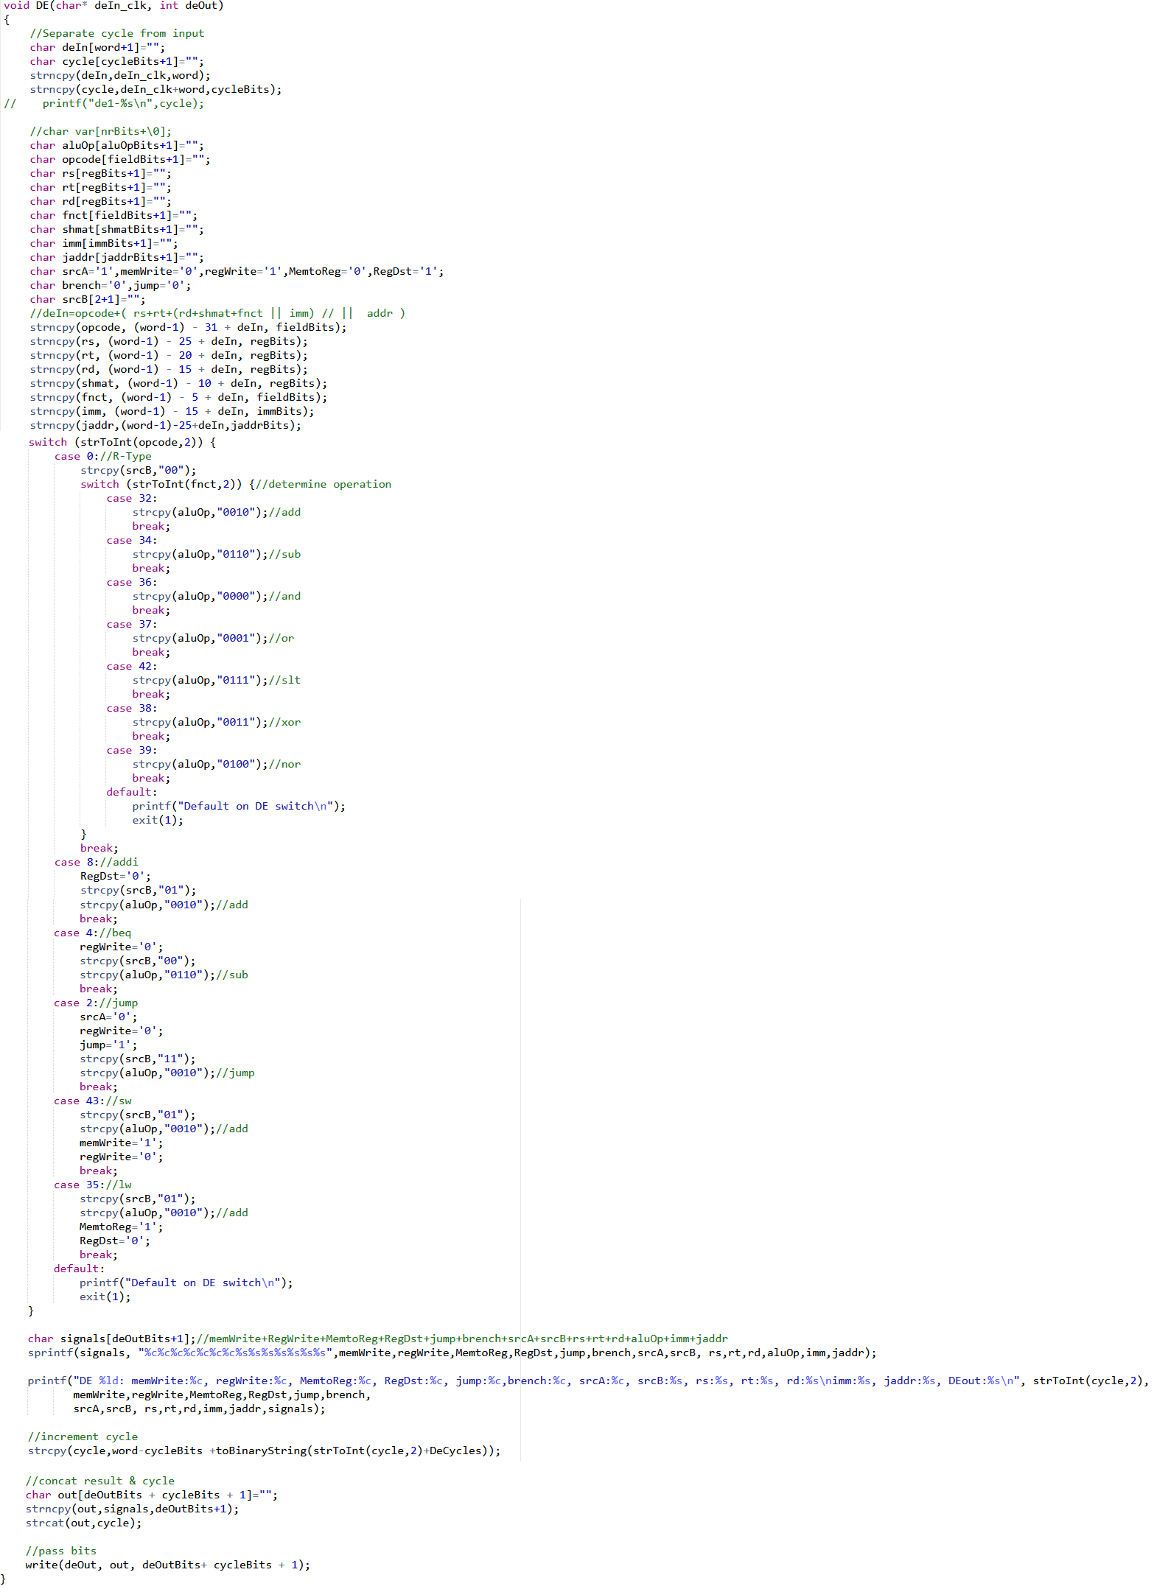
Mips in C

Slide 23
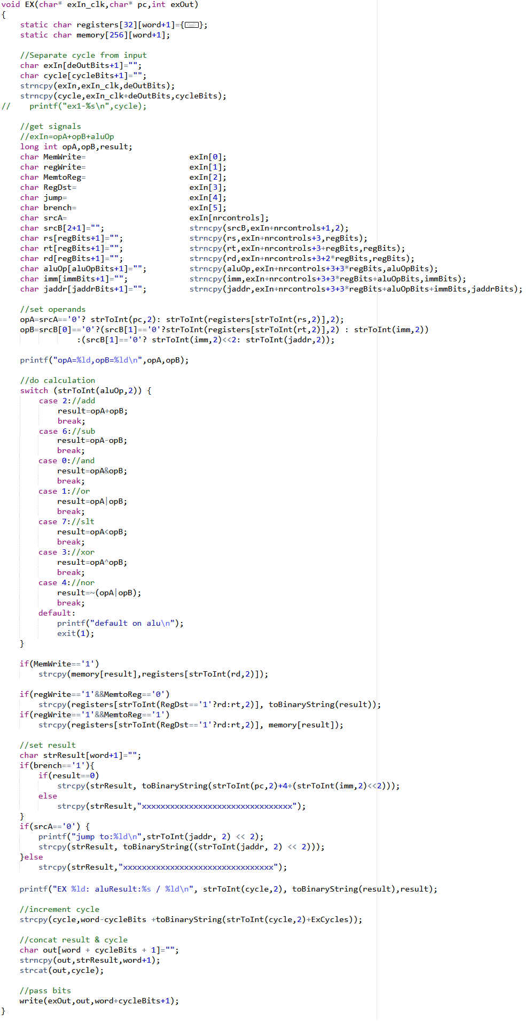
Mips in C

Slide 24
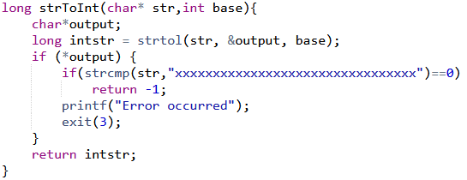
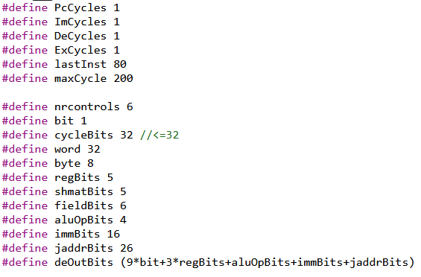
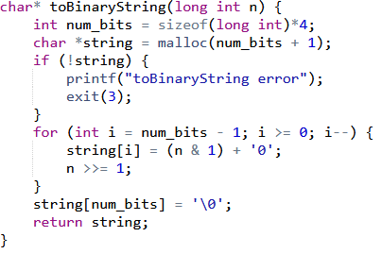
Mips in C

Slide 25
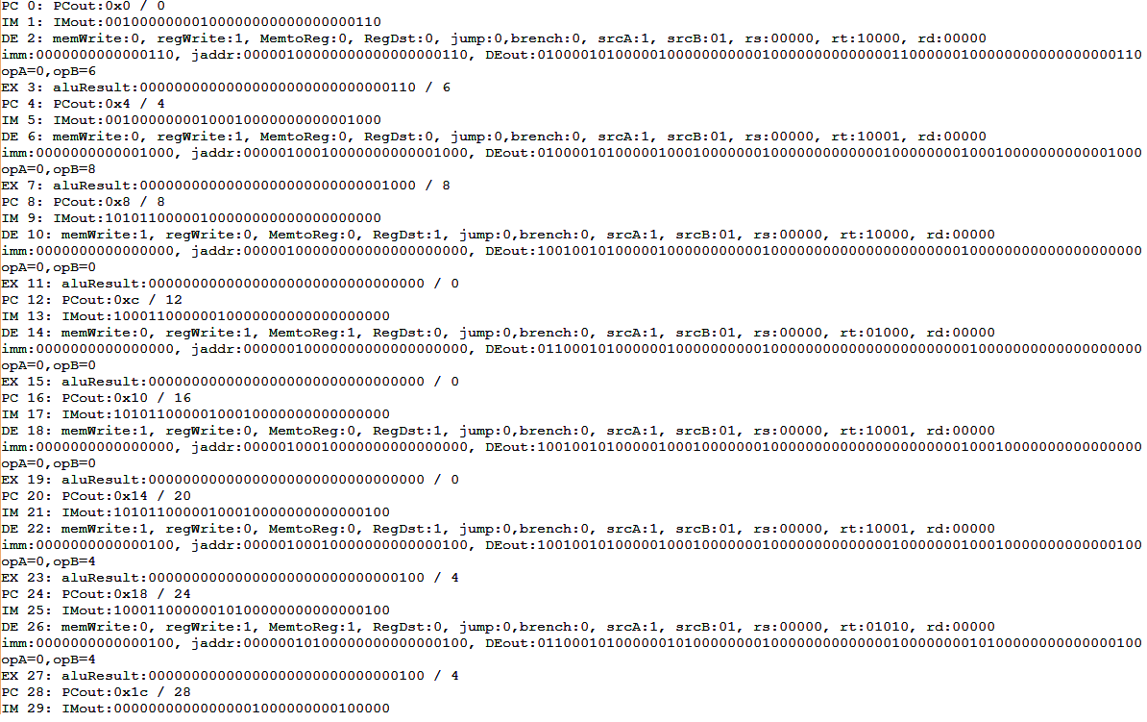
Mips in C
Output

Slide 26
THANK YOU !
Tudusciuc Cristian-Rafael
github.com/RCTd/AMD_SummerPractice

