Slide 1
A guide to making the best use of SPOT (spend and outcome tool)
Dr Rory O’Conor PHE Health Economics team 15-Oct-2015 / 23-Nov-2015

Slide 2
Overview
Resources
Assistance
Scenario 1 – an organisation would like to review their overall spend and outcomes
Scenario 2 – an LA commissioner wants information to assist in commissioning a specific service
Scenario 3 – a CCG commissioner / PH lead working with CCG wants information to assist in commissioning a specific service
You may want to use the Excel tool whilst following through the scenarios.
Note: the scenarios are purely for demonstration purposes. The commentary is that of the author and has not been checked by those with local knowledge. There may well be local knowledge, data issues or other information which might mean that some of the commentary could be modified.

Slide 3
Resources
The SPOT products are all available at www.yhpho.org.uk/spot or google “PHE SPOT”
These include:
pdf profiles for organisations: Upper tier local authorities and CCGs in England
An Excel spreadsheet tool
Support documentation including an introductory video
Advanced users may be able to access a more up-to-date beta version of the product by contacting the team

Slide 4
Assistance
This includes:
An introductory video
Trained single point of contact experts in all PHE local KIS teams
Webinars and presentations contact the team for details
Email response to queries
healtheconomics@phe.gov.uk
Case studies on the website
The SPOT tool FAQ tab

Slide 5
Scenario 1 – An authority, Liverpool, wants to review their overall spend and outcomes
SPOT looks at the spend and outcomes for directorates such as Public Health, Adult Social Care in local authorities and for programmes such as Cancer, Cardiovascular disease in clinical commissioning groups
The first page of the factsheet (Home tab of tool) shows the various peer groups to which the authority belongs and the top areas of spend
It can be helpful to review the biggest areas of spend
The second page of the factsheet (Quadrant tab) shows overall comparative spend and outcome on all programmes for the authority
This may identify some programme areas which seem out of sync with other authorities
Other tabs may help to inform this understanding
Example 1 – Liverpool LA 2015

Slide 6
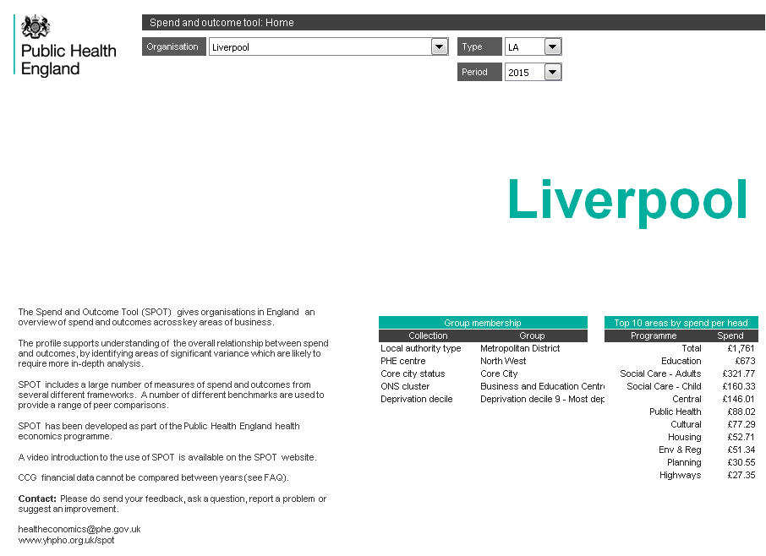
Liverpool review - The home page
Highest spend on Education and social care, but a lot on central services
Liverpool is a highly deprived, core city in the North West

Slide 7
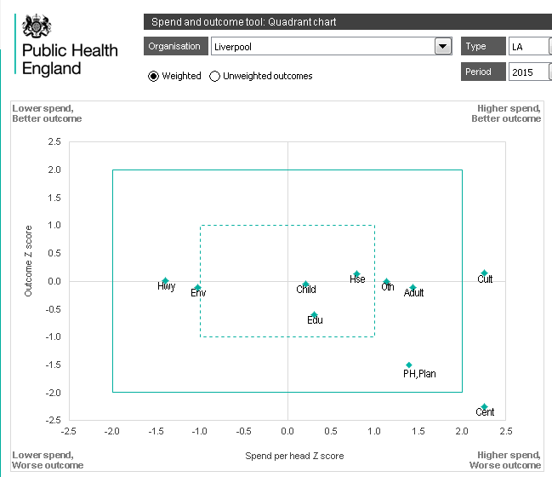
Liverpool review - The quadrant chart
No great outcomes anywhere, and seems to spend a lot on culture and central services. Poorer outcomes for public health and planning.

Slide 8
Liverpool review – information so far
From the first two pages we have identified:
Biggest areas of spend are Education and Social care
No particularly good outcomes
Apparently higher than expected spend in culture and central services
Poor outcomes in Public Health, Planning and Central services
Before we look at Central Services, we can note the tool tabs:
Peers – with a list of all the authorities in the relevant peer groups
Reference – with details of the spend and outcome measures used in the quadrant chart
And most importantly remember to consider the quality of the data

Slide 9
Liverpool review – further exploration
We have identified Central services as an area to explore further
There is no specific quadrant chart (quadrant 2) for Central services
The main spine chart gives an overview of all services
Spine chart 2 looks in more detail at individual programmes
Selecting central on spine chart 2
We identify some areas where spend is high and outcomes poor
We can also look at the Outlier summary to see areas where Liverpool is an outlier
Both the service-specific spine chart and the outlier summary identify a number of outlier spend lines within Central services

Slide 10
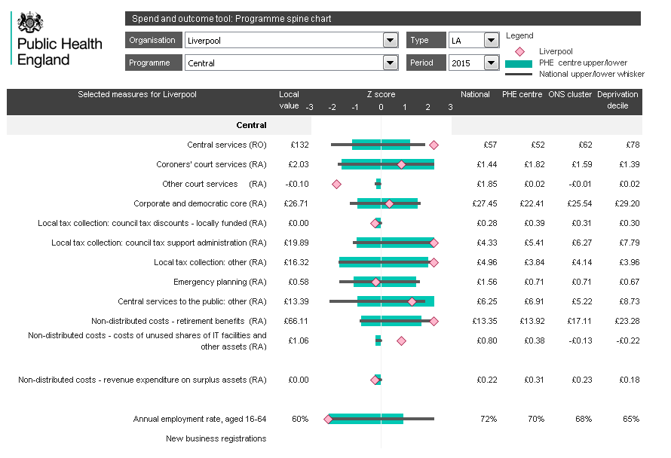
Liverpool review - The spine chart
£130 on central services compared with £60. £65 on retirement compared with £15. £37 on tax collection compared with £10
The only outcome measure is employment which is low

Slide 11
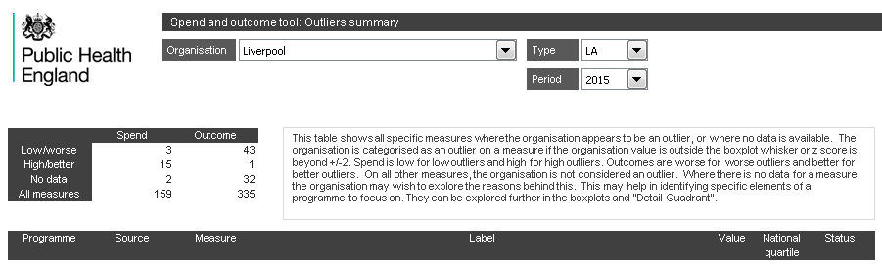
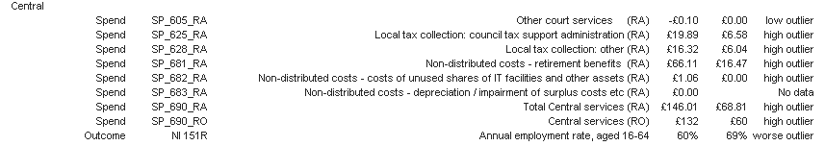
Liverpool review - The Outlier summary
A number of spend lines within central services where Liverpool is an outlier

Slide 12
Liverpool review – looking at the detail
We used the home page, quadrant chart and spine chart to identify Central services as an area to review
We used the service-specific spine chart and outlier summary to gain more insight into the issues within this area
A number of high spend line items
We can now use the spend and outcome boxplots, and the detailed quadrant chart to explore these indicators further
Let us look at spend on retirement and outcome on employment
Let us look at the same elements on the detailed quadrant chart
And choose deprivation decile as the comparator

Slide 13
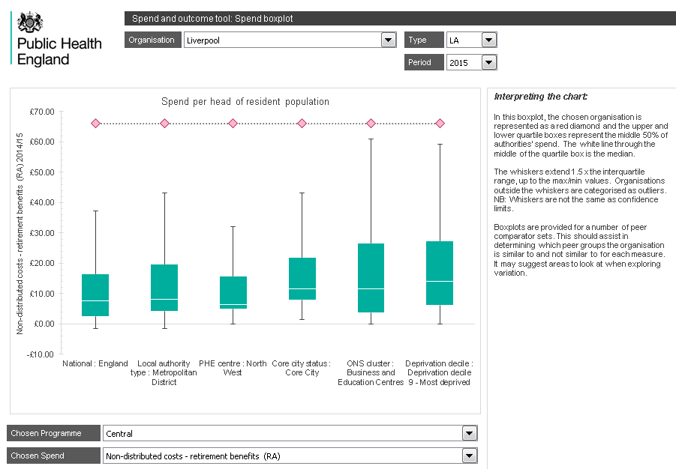
Liverpool review - The spend boxplot
£66 on retirement benefits is a significant outlier. £20 might be an aspiration.

Slide 14
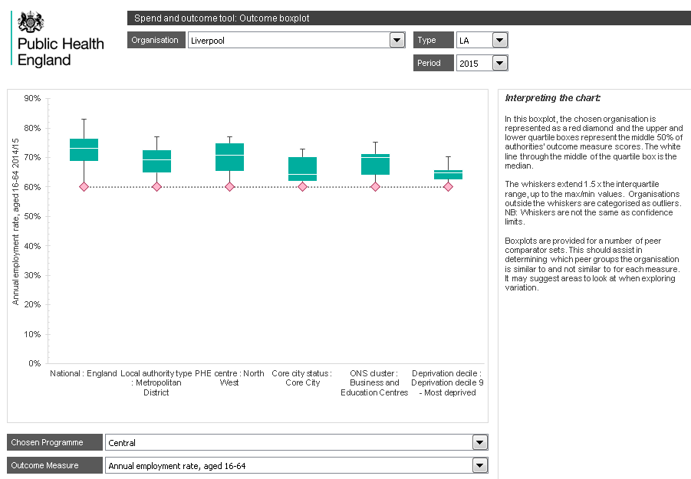
Liverpool review - The outcome boxplot
The employment rate is low in those authorities in the most deprived decile but Liverpool is doing badly even by these standards.

Slide 15
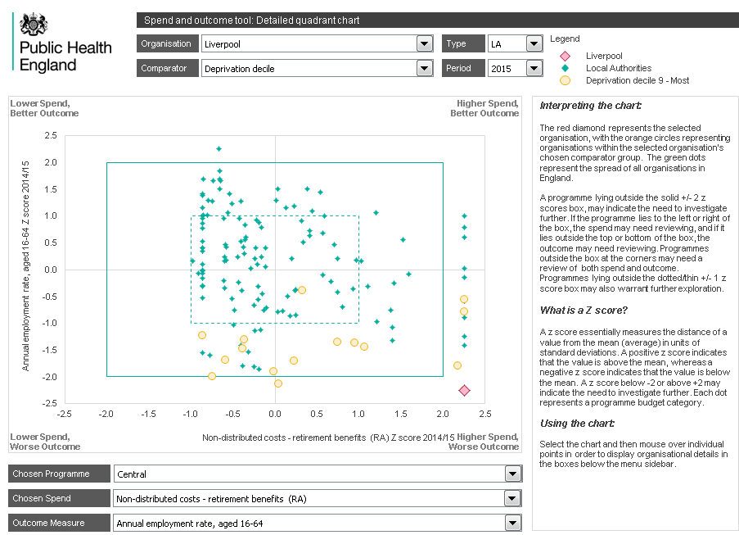
Liverpool review - The detail quadrant chart
There are about 10-15 authorities with high retirement benefits. Clicking on the chart and using mouse to check identifies a mix from NW, NE and London
Looking at authorities with better employment but in same deprivation decile identifies Stoke as doing well.

Slide 16
Liverpool review – so far
So we have looked at central service
Found a number of high spend lines such as
Retirement benefits and tax collection
Found no very good story that this is a group issue – deprivation, geography etc
Identified some authorities in a similar position and also other authorities which seem to be doing better
Let us go back and look at one of the big spend areas
Education
Spend £673 per person per year
The main quadrant chart shows reasonable spend and outcomes
As does the main spine chart
DFE spend includes academies
The service-specific spine chart gives more detail
And the outlier summary may be helpful

Slide 17
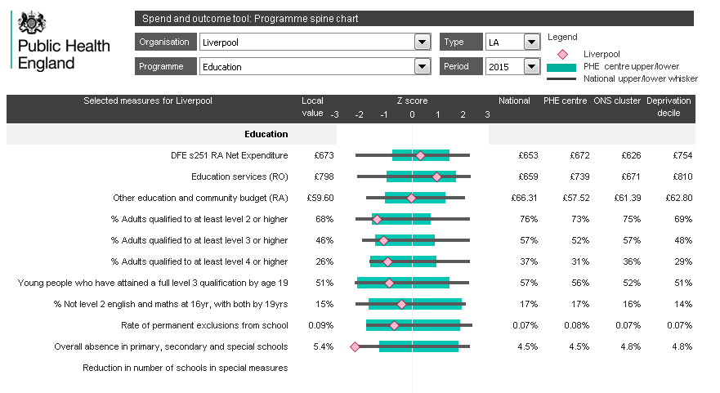
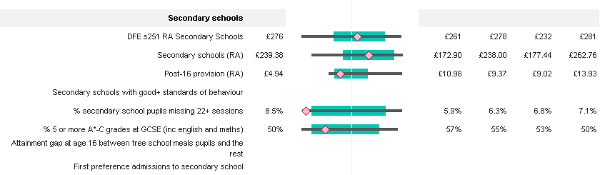
Liverpool review - Education spine chart
Lots of indicators in interquartile range. Outliers: overall absence and secondary pupils missing sessions

Slide 18
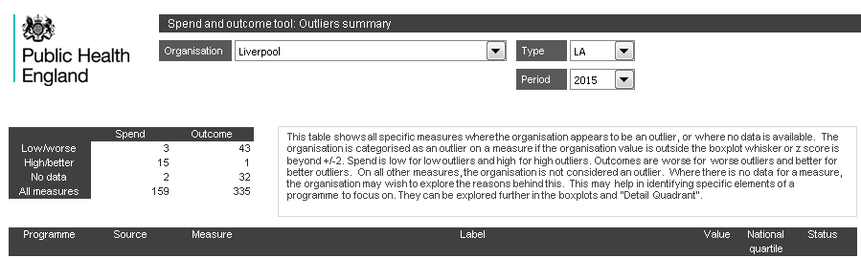
Liverpool review - Education – outlier summary
The same two educational outcome indicators are identified as outliers.

Slide 19
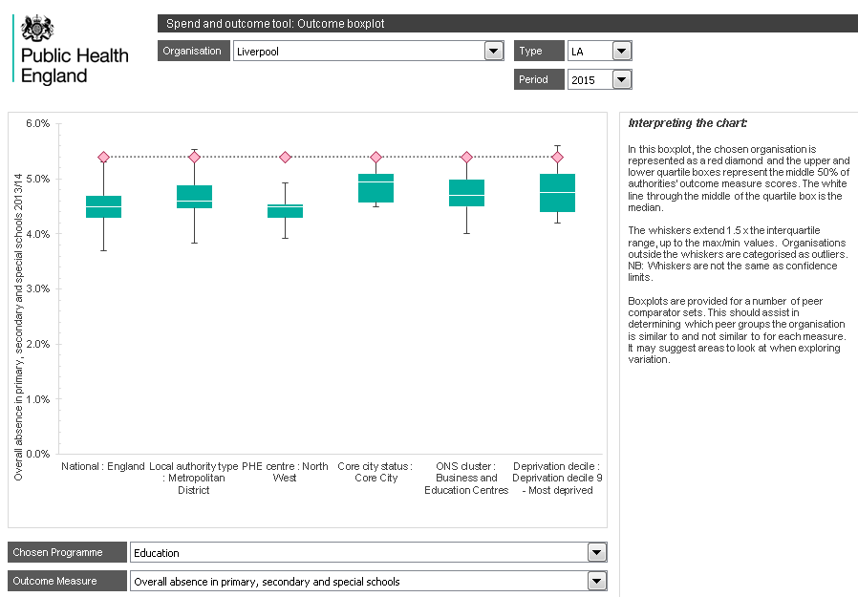
Liverpool review - Education – outcome boxplot
It might be appropriate to look further at absence rates, but overall the position on Education, a high spend area seems consistently average.

Slide 20
End of scenario 1 – Liverpool review
We have looked at an authority – Liverpool
We have identified services with high spend and higher than expected spend
We have explored some of the elements of this high spend
We have identified some areas which might need addressing
We have identified possible peers with similar issues
We have identified possible exemplar peers who don’t seem to have the same issues
We can potentially go to the source data and explore trends over time in that data

Slide 21
Scenario 2 – a LA commissioner wants information to assist in commissioning a specific service
Spot will only be useful if it contains data relating to the specific service
SPOT contains publically available data covering many areas, particularly Public Health
If relevant data exists but has not been included in SPOT, then contact the team
Let us look at the information available to a commissioner looking at Sexual Health services in a London authority, Lambeth.
As well as local authority data within Public Health, there may be helpful data in CCG SPOT – programmes – Genitourinary, Maternity and Neonates

Slide 22
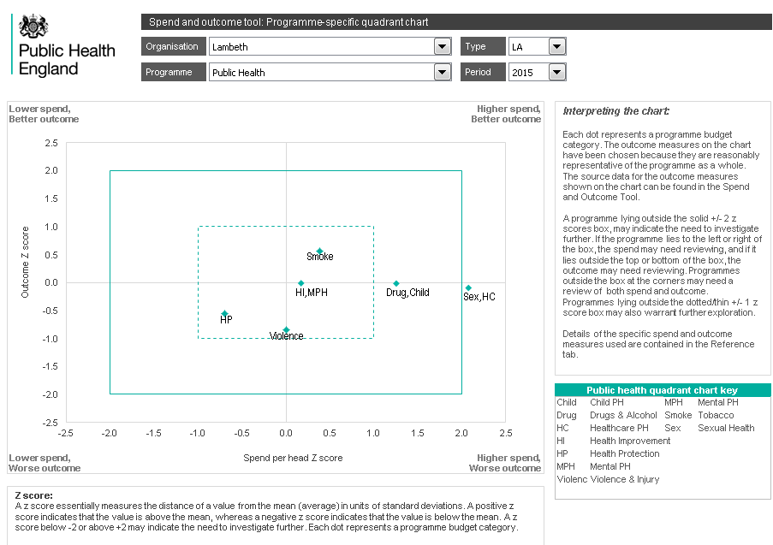
Lambeth sexual health – quadrant chart 2
The Public health quadrant chart shows Lambeth spending significantly more than others on Sexual Health (and healthcare public health)

Slide 23
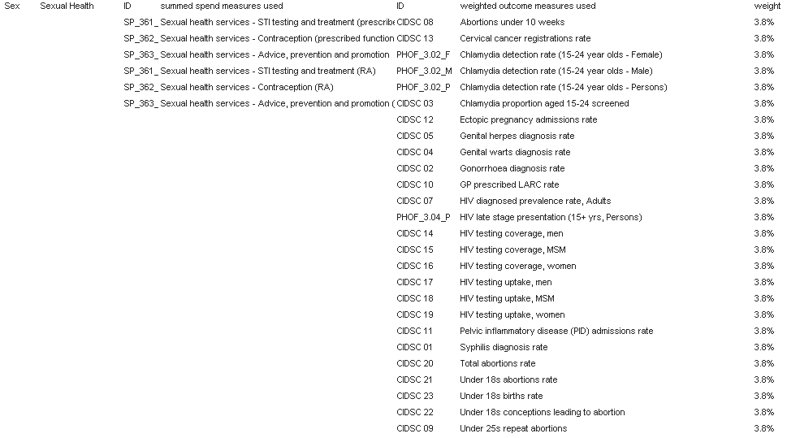
Reference detail for the quadrant chart
The sexual health spend value on the quadrant chart is the sum of several lines. There are about 25 outcome indicators all equally weighted in the outcome value. If the weighting could be improved, contact the SPOT team.

Slide 24
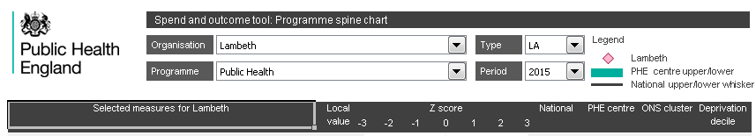
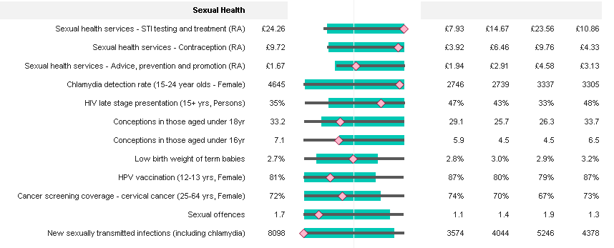
Lambeth sexual health – PH spine chart
The spine chart shows high spend on treatment and contraception, and also issues with Chlamydia.

Slide 25
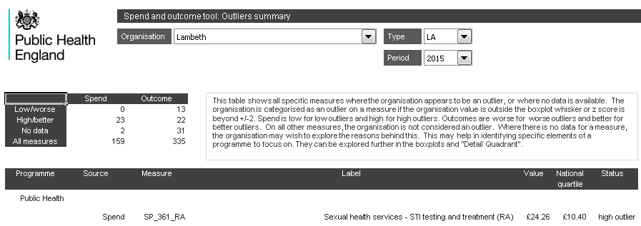
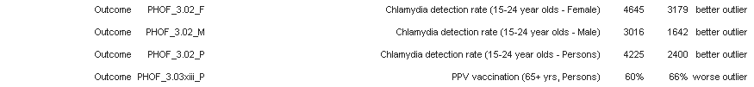
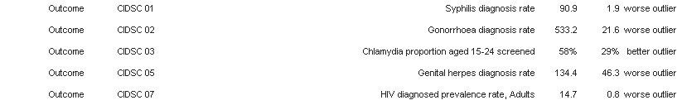
Lambeth sexual health – outlier summary
One spend line and 10 sexual health outcomes seem to be outliers

Slide 26
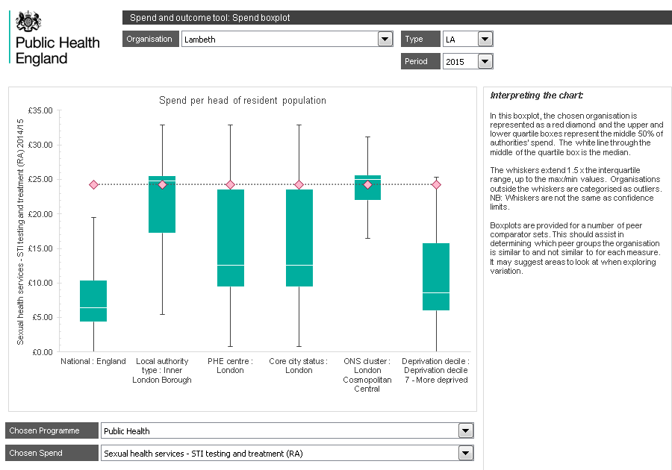
Lambeth sexual health – spend boxplot
Whilst Lambeth is an outlier on sexual health treatment spend, this seems to be an inner London cosmopolitan centre issue, unrelated to deprivation.

Slide 27
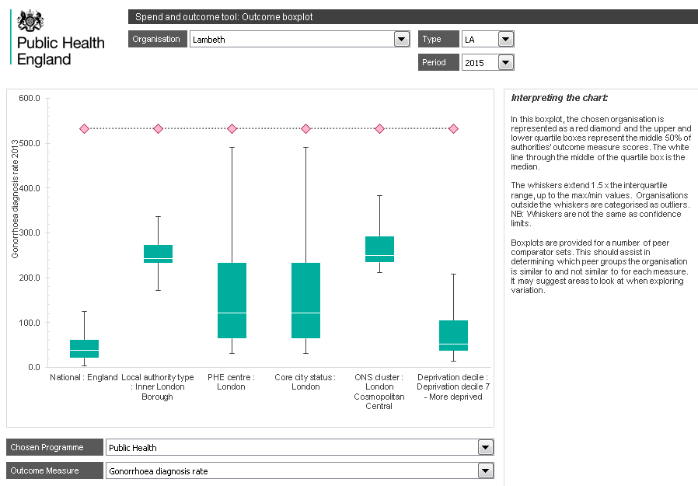
Lambeth sexual health – outcome boxplot
The gonorrhoea diagnosis rate seems high even by the standards of inner London. (as does the Syphilis diagnosis rate).
At least the rates for genital herpes and warts are in line with inner London (not shown).

Slide 28
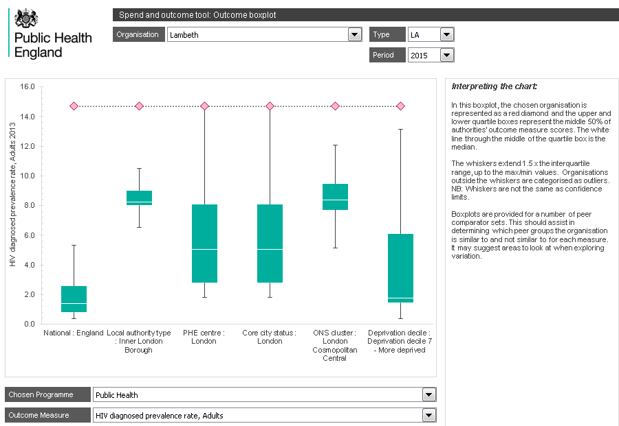
Lambeth sexual health – outcome boxplot
The HIV prevalence rate is also high even by inner London standards. But there don’t seem to be issues with HIV late presentation or HIV testing. (not shown)

Slide 29
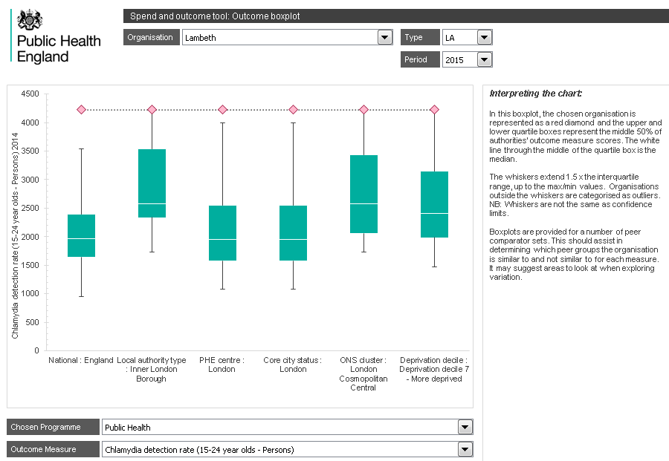
Lambeth sexual health – outcome boxplot
Lots of young adults have been screened for Chlamydia (not shown) and large numbers of them have Chlamydia.

Slide 30
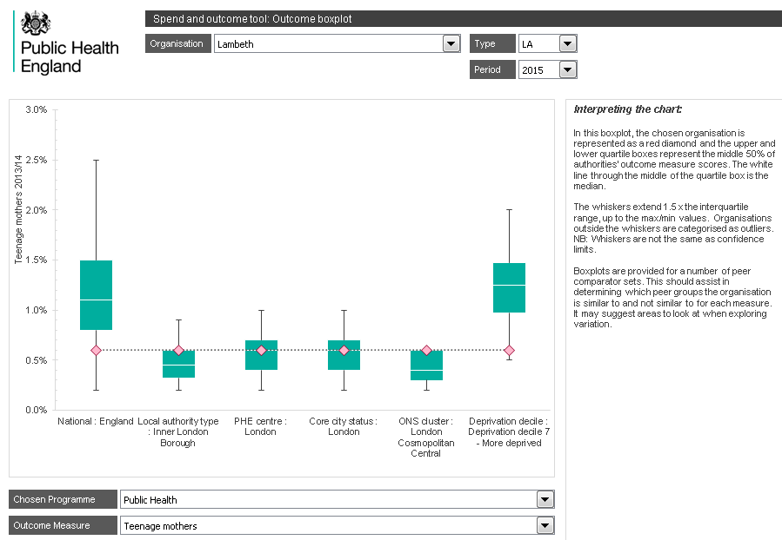
Lambeth sexual health – outcome boxplot
In terms of teenage pregnancy and abortions, the position in Lambeth appears similar to that in the rest of London.

Slide 31
Lambeth sexual health – story so far
Lambeth appears to have issues with sexual health
This may be partially a London issue, particularly an inner London cosmopolitan issue
Spending is high, particularly on treatment
Diagnosis rates, HIV and Chlamydia rates are high or outlier even by inner London standards
Teenage pregnancy and abortion seems less of a problem in Lambeth and London.
Maybe the detailed quadrant chart will allow us to gain further insight

Slide 32
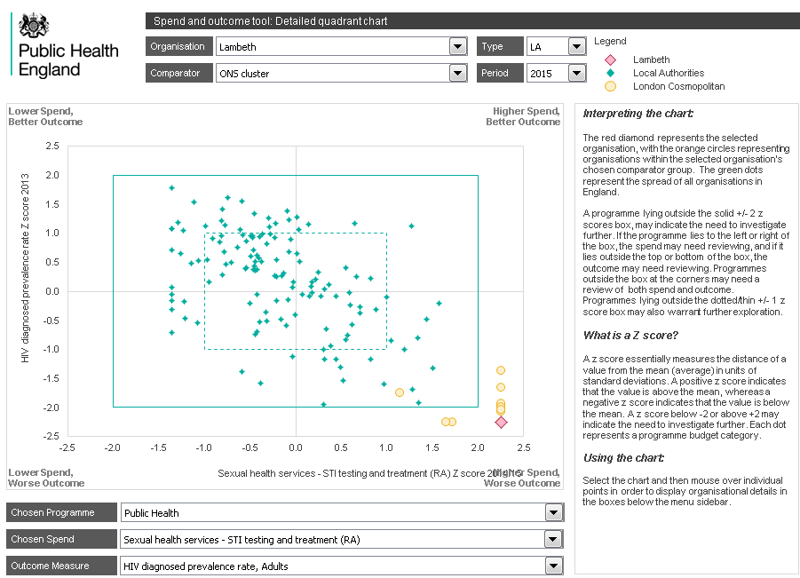
Lambeth sexual health – detailed quadrant
Most of the London cosmopolitan authorities are spending outliers on sexual health treatment and HIV prevalence. Highlighting the chart and moving the mouse, identifies Haringey as spending the least.

Slide 33
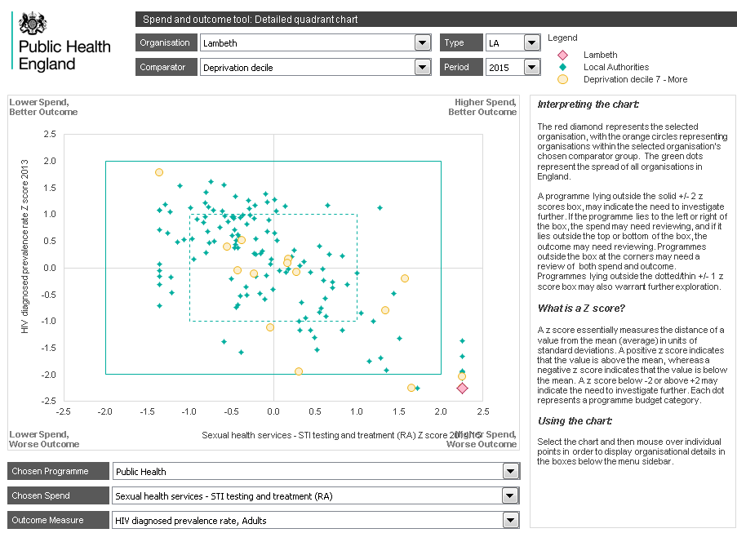
Lambeth sexual health – detailed quadrant
Changing the peer comparator group from ONS cluster to deprivation decile, highlights that this does not appear to be in the first instance, a problem of deprivation but is more a London cosmopolitan issue.
Redcar & Cleveland does not have the same sexual health profile.

Slide 34
End of scenario 2 – Lambeth sexual health
We have looked at a specific service within an authority
Sexual health services in Lambeth
We have reviewed the relevant quadrant and spine charts
Lambeth spends a lot on sexual health services and has a lot of STI
We have reviewed the outlier summary
Lambeth is an outlier on many sexual health outcome indicators
For indicators within the relevant thematic area, particularly those which are outliers, we have reviewed the boxplots
Sexual health spend is high, and sexually transmitted disease is high in London cosmopolitan authorities
For several sexual conditions, the values in Lambeth are high even by London standards
We have made use of the detailed quadrant chart
The issues are London cosmopolitan rather than deprivation related

Slide 35
Scenario 3 – A CCG commissioner or PH lead wants information to assist in commissioning a healthcare service
Spot will only be useful if it contains data relating to the specific service
SPOT contains publically available data covering many areas, particularly Public Health
If relevant data exists but has not been included in SPOT, then contact the team
Let us look at the information available to a CCG commissioner looking at respiratory services in Wakefield.
As well as CCG data, there may also be useful data in the Local Authority - Public Health section of SPOT

Slide 36
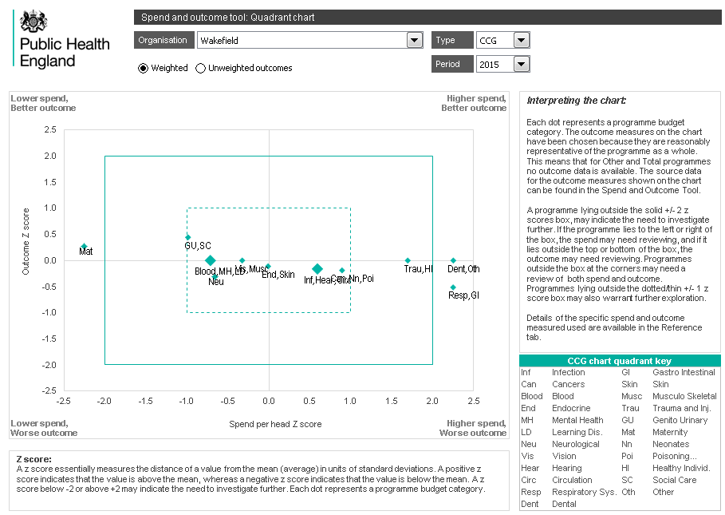
Wakefield respiratory – quadrant 2015
Wakefield CCG seems to be a high outlier on spend in several areas: Respiratory, GI, Dental and Other. Also the CCG seems to spend less than others on Maternity.
Let us check the previous year, to see if there might be a data quality issue.

Slide 37
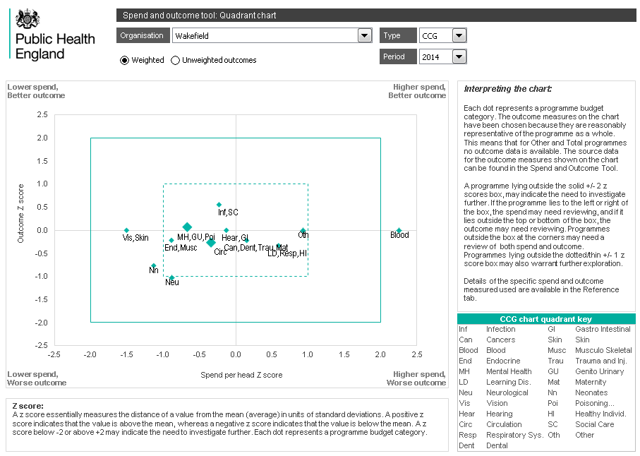
Wakefield respiratory – Quadrant 2014
Wakefield CCG wasn’t an outlier on spend in areas such as respiratory and Gastrointestinal in 2014. But then we need to bear in mind the note on the homepage and in the FAQ that CCG financial data cannot be compared between years. SPOT 2014 includes NHSE spend, SPOT 2015 is limited to CCG spend.

Slide 38
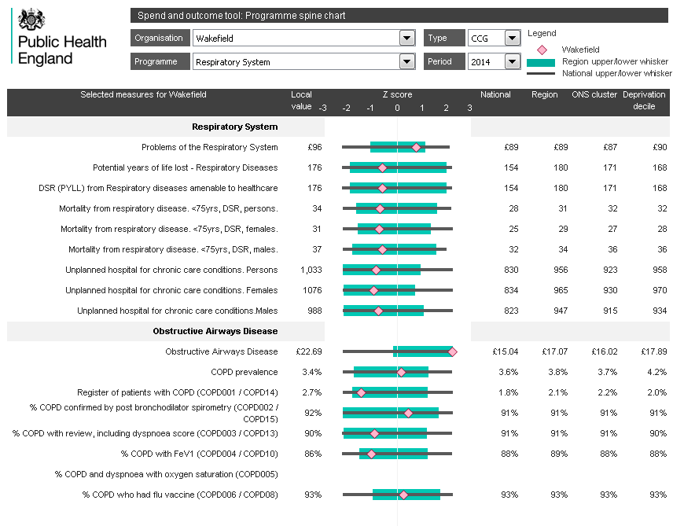
Wakefield respiratory – Spine 2a 2014
We will look at the 2014 data first and then move on to the latest data.
Wakefield seems to spend a lot on COPD, yet have an average prevalence. The QOF register shows a much higher prevalence. In spite of this expenditure, the recording of FEV1 seems low.
Mortality is poor but not an outlier.

Slide 39
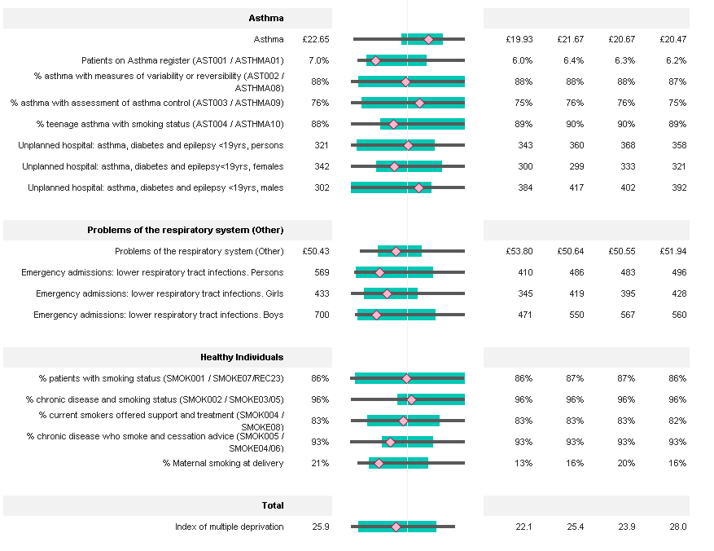
Wakefield respiratory – spine 2b 2014
Asthma spend is high but then Asthma QOF prevalence is also high.
There may be issues with respiratory related emergency admissions, and maternal smoking at delivery seems high. We may want to check the LA Public Health details on the latter.

Slide 40
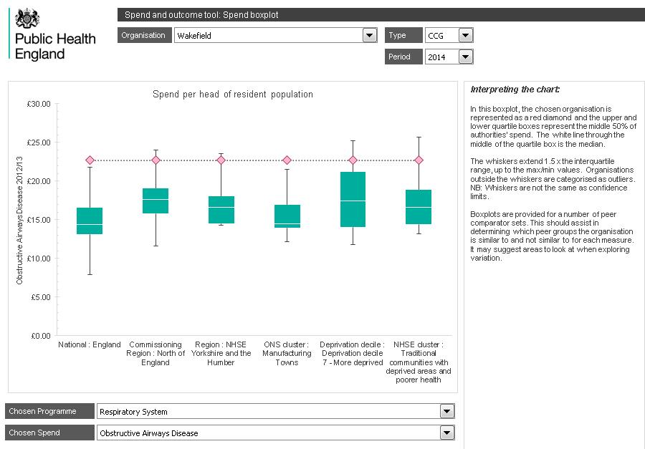
Wakefield respiratory – Spend boxplot 2014
In 2014, the quadrant chart and outlier summary identify spend on COPD as an outlier.
This spend seems high even considering the deprived population.

Slide 41
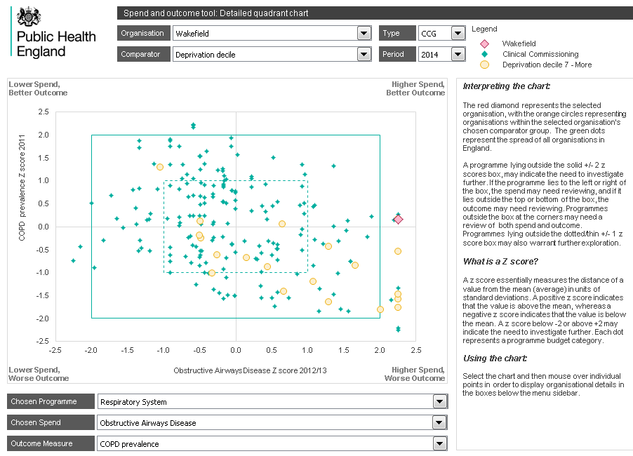
Wakefield respiratory – detail COPD 2014
The detailed quadrant chart doesn’t show much relationship between spend on COPD and prevalence of COPD.
Surprisingly Wakefield has a lower COPD prevalence than nationally.

Slide 42
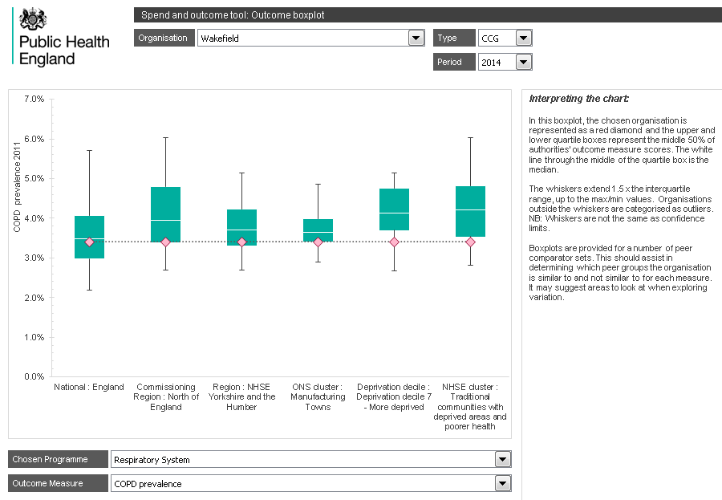
Wakefield respiratory – outcome boxplot
The prevalence of COPD appears to be less than the national figure, which seems a little strange.

Slide 43
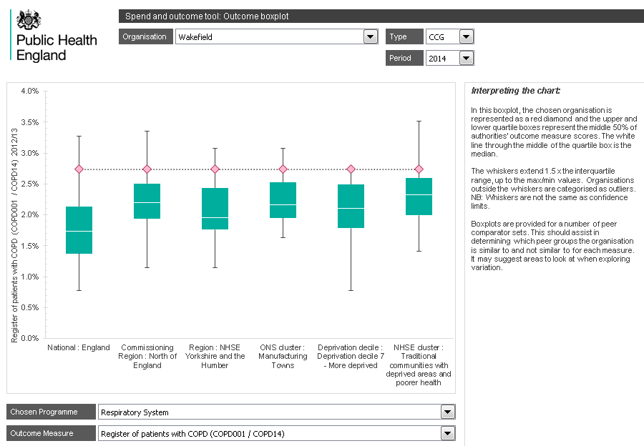
Wakefield respiratory – outcome boxplot
Whilst the APHO COPD prevalence appears lower than national, the QOF register shows a lot more patients with COPD.
There is a difference between these two measures and analysts / managers may need to make an intelligent judgement as to which is a better measure.

Slide 44
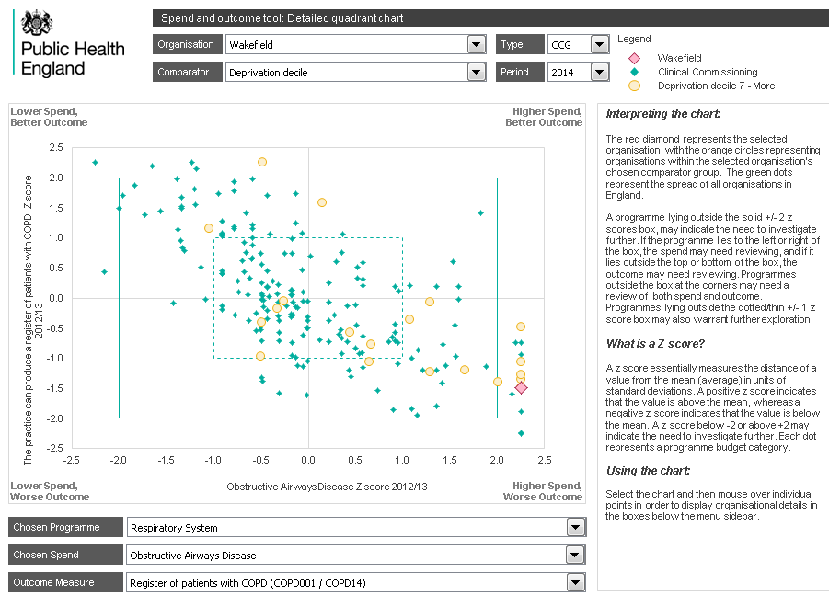
Wakefield COPD – detailed quadrant again
A detailed quadrant comparing COPD spend against COPD QOF registration shows a better match with worse outcomes associated with higher spend (lower right quadrant).
If the QOF indicator is an appropriate measure of need then the spend may be appropriate.

Slide 45
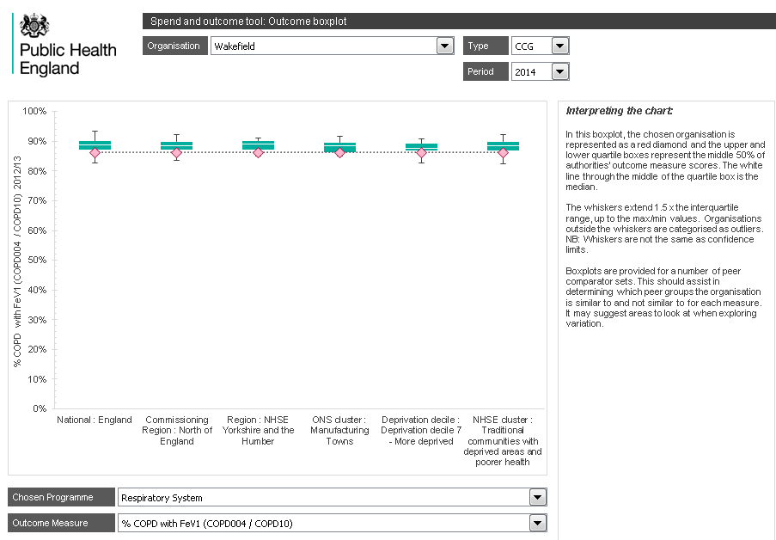
Wakefield respiratory – outcome boxplot
In spite of all the COPD, the recording of FEV1 on QOF seems low.
The national and peer ranges suggest than maybe some incentive issues are involved because very few practices nationally seem to be recording FEV1 for more than 90% of patients.

Slide 46
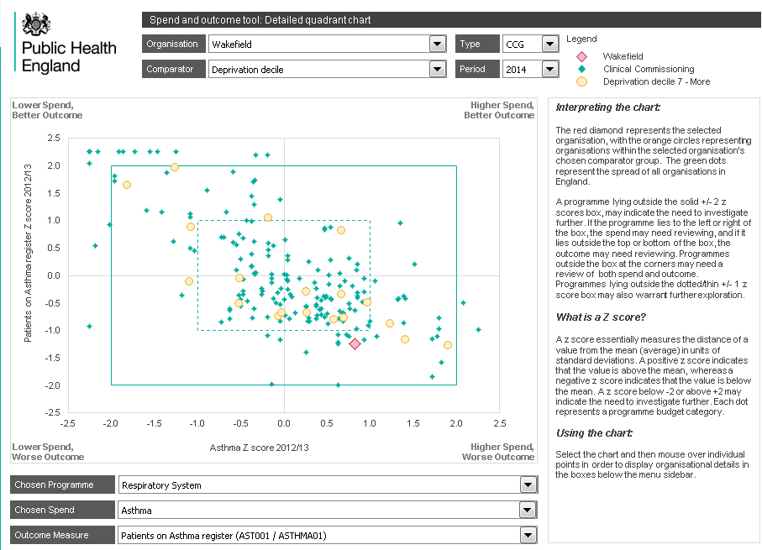
Wakefield respiratory – detailed quadrant
The quadrant chart comparing spend on Asthma against Asthma QOF registrations shows the appropriate high spending for the high prevalence and if anything indicates scope for further spending.

Slide 47
Wakefield respiratory - 2014 findings
Wakefield is not an overall outlier on respiratory spend in 2014, when both NHSE and CCG expenditure are included
There is a mismatch between the prevalence of COPD as reported by APHO and the QOF registrations for COPD
The QOF registrations seem a better measure and the high spend on COPD seems to be in line with the high QOF prevalence.
In spite of the high spend, the recording of FEV1 seems below average.
There is also a high QOF prevalence of asthma, with appropriate high spend which might even be higher.
There is poor respiratory mortality and higher emergency admission rates, but these values are not outliers.

Slide 48
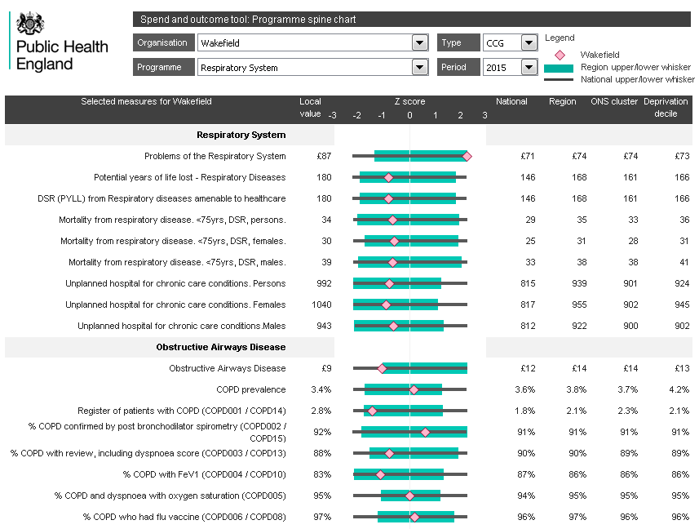
Wakefield respiratory – spine 2a 2015
Spend on respiratory is high, but seems low on COPD, unlike in 2014. Again the APHO prevalence for COPD is average, whilst the QOF prevalence is high. Most other indicators are below average.

Slide 49
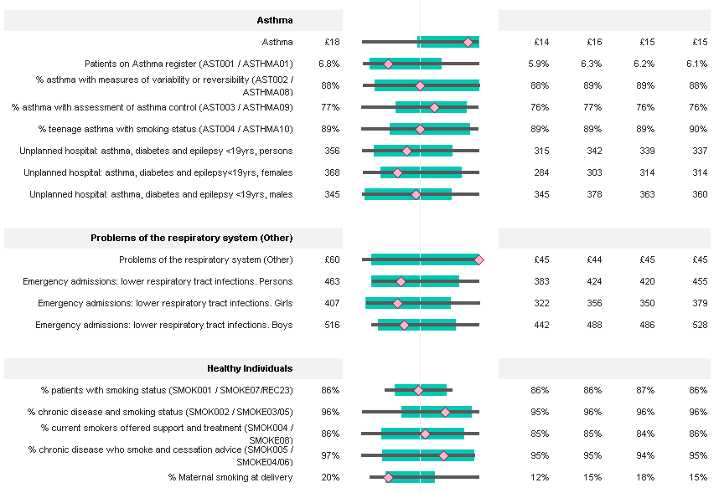
Wakefield respiratory – spine 2b 2015
Spend on Asthma remains high as is the prevalence.
Outcomes for maternal smoking and emergency admissions continue to be poor.

Slide 50
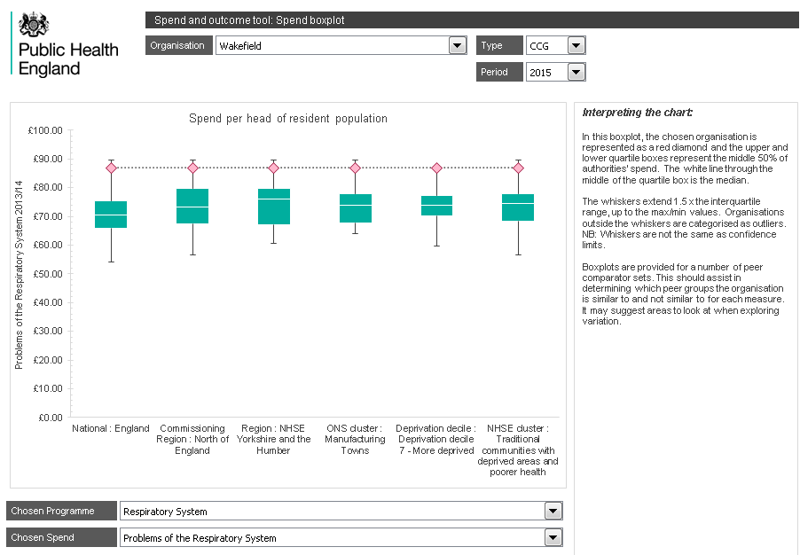
Wakefield respiratory – spend boxplot
Wakefield seems to spend more than comparators on respiratory problems.

Slide 51
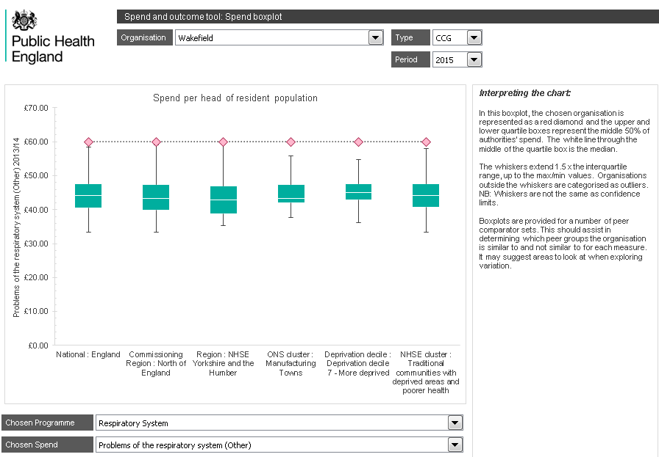
Wakefield respiratory – spend boxplot
The spend on respiratory other seems particularly high, and this may indicate data quality issues.

Slide 52
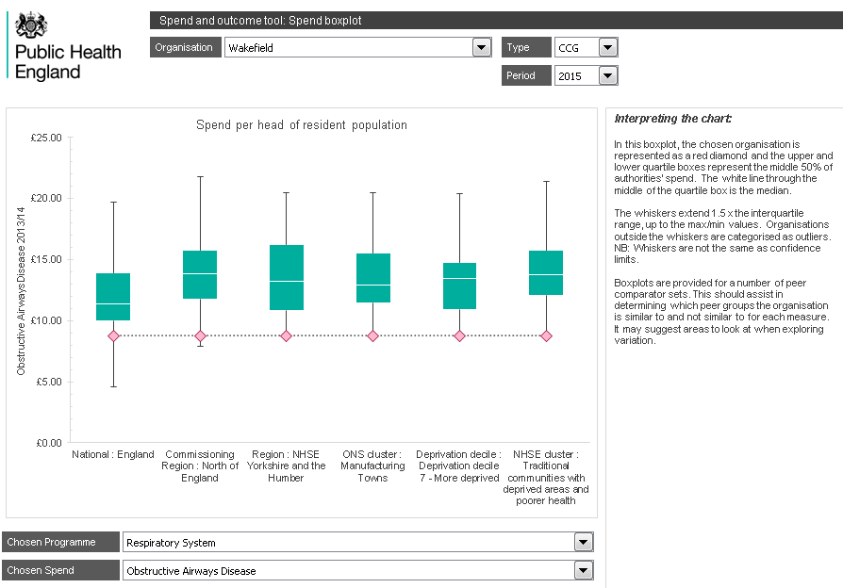
Wakefield respiratory – spend boxplot
The spend boxplot for COPD for 2015 is very different from that for 2014. This is most likely to reflect the quality of the financial returns and maybe underlying coding, rather than any substantial funding shift. It may also reflect the difference after NHSE funding is excluded.

Slide 53
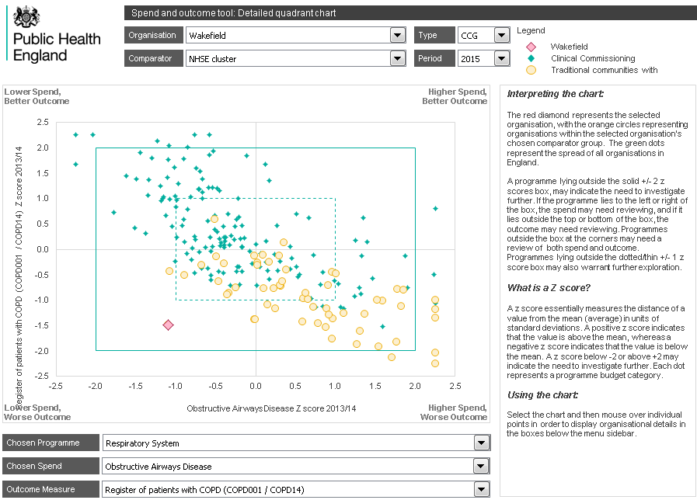
Wakefield respiratory – detailed quadrant
The detailed quadrant of COPD spend against QOF prevalence shows the apparently anomalous spend this year, and the NHSE cluster seems a slightly better peer group to use than the deprivation decile in this instance.

Slide 54
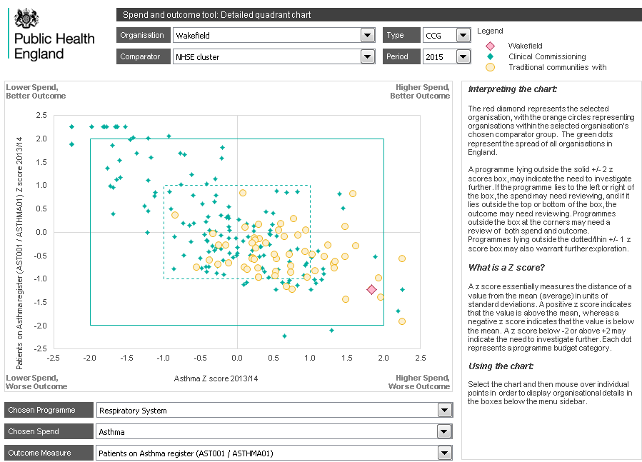
Wakefield respiratory – detailed quadrant
As in 2014, the spend on Asthma seems commensurate with the high prevalence. Again the NHSE cluster seems the best peer comparator, as opposed to deprivation decile or region. This is not obvious just from looking at the boxplots. (other charts not shown).

Slide 55
Wakefield respiratory – 2015 findings
Spend on respiratory is high
Particularly on Respiratory – other, which may suggest data quality issues
Spend on Asthma seems appropriately high
Spend on COPD is variable and possibly more reflective of data quality issues
A wide range of respiratory outcomes continue to be poor
The NHSE cluster group “Traditional communities with deprived areas and poorer health” seems to be a better peer group than region or deprivation decile, and it may be worth identifying comparator organisations from within that group where lessons may be learnt.
A between-years comparison in some cases, reinforces certain messages and in others identifies the variability of the data and potential data quality issues.

Slide 56
SPOT usage - Conclusion
These walk-through scenarios give examples of how SPOT may be used to explore the spend and outcome in an authority
Both at a whole authority level and within a specific programme area
The insights gained can then be used
To identify areas for further local analysis / discussion
To identify data quality issues that may need addressing
To identify suitable peers, peer groups, exemplars for further collaborative work
To identify indicators needing further analysis such as trend analysis using the source data
To prioritise areas for work and target those areas which seem to have the most significant issues

