Slide 1
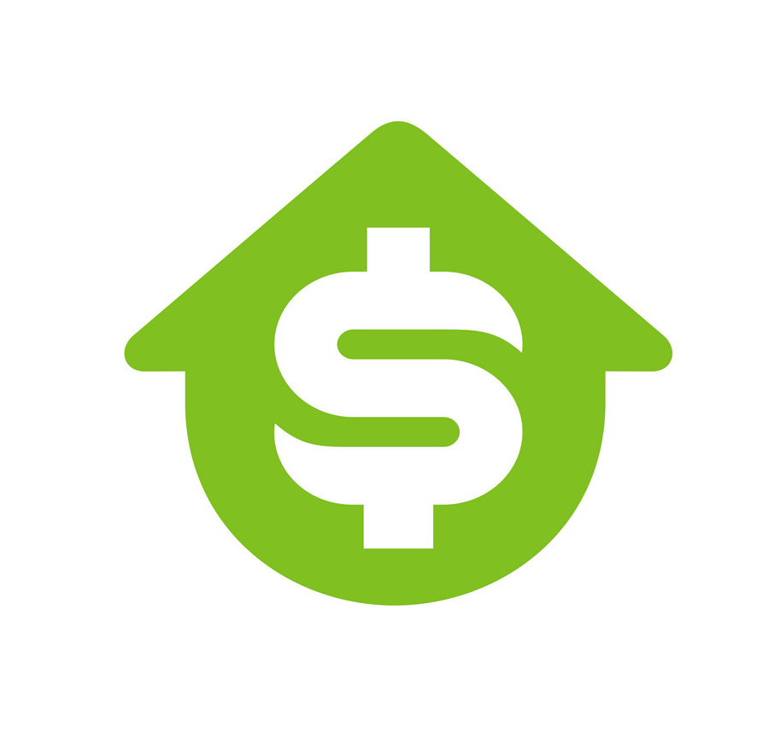
Real
Estate
Network
Token
By: Roberto Cantu, Cristian Smoger, and Mina Kasrai

Slide 2
STEP 1
BaaS Provider
STEP 2
Tokenize Non-fungible Real Estate Assets
STEP 3
Oversee Sales and Transfer of Ownership
STEP 4
Scale with Front End Interface

Slide 3
Act as middlemen for customers daunted by blockchain technology to help them reap the benefits without needing to understand the intricacies of the field.
STEP 1
BaaS Provider
STEP 2
Tokenize Non-fungible Real Estate Assets
STEP 3
Oversee Sales and Transfer of Ownership
STEP 4
Scale with Front End Interface

Slide 4
Mint non-fungible tokens for property assets on the blockchain for irrefutable proof of ownership.
STEP 1
BaaS Provider
STEP 2
Tokenize Non-fungible Real Estate Assets
STEP 3
Oversee Sales and Transfer of Ownership
STEP 4
Scale with Front End Interface

Slide 5
Arrange for sale of property assets and transfer of tokens to new owners.
STEP 1
BaaS Provider
STEP 2
Tokenize Non-fungible Real Estate Assets
STEP 3
Oversee Sales and Transfer of Ownership
STEP 4
Scale with Front End Interface

Slide 6
Scale the business to provide a front end user interface allowing easier viewing for potential buyers.
STEP 1
BaaS Provider
STEP 2
Tokenize Non-fungible Real Estate Assets
STEP 3
Oversee Sales and Transfer of Ownership
STEP 4
Scale with Front End Interface

