Slide 1


Sentiment Analysis in FinBERT for Stock Market Text Data using Global News Data
Track No. Track 1-A: Artificial Intelligence & Machine Learning
Paper ID: 814
Presenting Author: R Chahana

Slide 2


Introduction
Financial markets are highly influenced by global news, investor sentiment, and geopolitical events, not just numerical indicators
Traditional market analysis methods based on historical prices fail to capture real-time emotional and behavioral factors.
Financial sentiment analysis has emerged as a powerful tool to understand market reactions and stock investor sentiment.
Objective of this study:
Build a cross-market sentiment analysis framework
Use global news data (GDELT 2.0) and FinBERT
Analyze sentiment patterns across US and Indian stock markets
Validate performance using real-time news streams

Slide 3

Literature Review
Author & Year | Model / Method Used | Dataset / Domain | Key Contributions | Limitations
Shen et al. (2022) | Big-data sentiment analysis using GDELT | Chinese stock market news | Constructed sentiment indices with strong predictive power for market returns and volatility | Restricted to China; no cross-market or real-time analysis
Nguyen et al. (2025) | Lexicon-based sentiment index | Vietnamese economic news (CPI prediction) | Improved inflation forecasting using sentiment indicators | Rule-based, region-specific, lacks contextual understanding
Jonnala et al. (2025) | Bi-LSTM + Logistic Regression (Hybrid) | Twitter data | Achieved strong precision and recall for sentiment classification | Not finance-domain specific; no cross-country analysis
Delgadillo et al. (2024) | FinSoSent (Financial LLM) | Financial news & social media | Demonstrated superiority of finance-specific language models | Static dataset; no real-time or cross-market integration
Leippold (2023) | Transformer-based sentiment models | Financial text (Adversarial testing) | Highlighted vulnerabilities of sentiment systems to adversarial attacks | Focused on robustness, not market-wide sentiment
Davidovic & McCleary (2025) | FinBERT-based sentiment learning | Equity market news | Improved stock prediction using decomposed sentiment scores | Geographically constrained; lacks global news integration
Bharathi Mohan et al. (2024) | FinBERT + DRL (PPO, DQN, A2C) | Financial news + stock data | Enhanced trading performance using sentiment-driven RL | Trading-focused; no large-scale global sentiment study
Anjali Chennupati et al. (2024) | Web scraping + XGBoost + Sentiment Analysis | NSE stock data & CNBC news | Combined sentiment with time-series forecasting for trading | Limited to Indian market; no cross-market sentiment
Srigiri Sruthi et al. (2024) | CNN, RNN, Transformer models | Benchmark sentiment datasets | Showed transformers outperform traditional DL models | Generic datasets; not finance-focused
Sohangir et al. (2018) | LSTM, CNN, Doc2Vec | StockTwits data | Proved effectiveness of deep learning in financial sentiment | Single platform; no global or real-time analysis
Proposed Work (This Study) | FinBERT with batched GPU inference | GDELT 2.0 + NewsAPI (US & India) | Large-scale cross-market sentiment analysis with real-time validation and high confidence scoring | English-only data

Slide 4
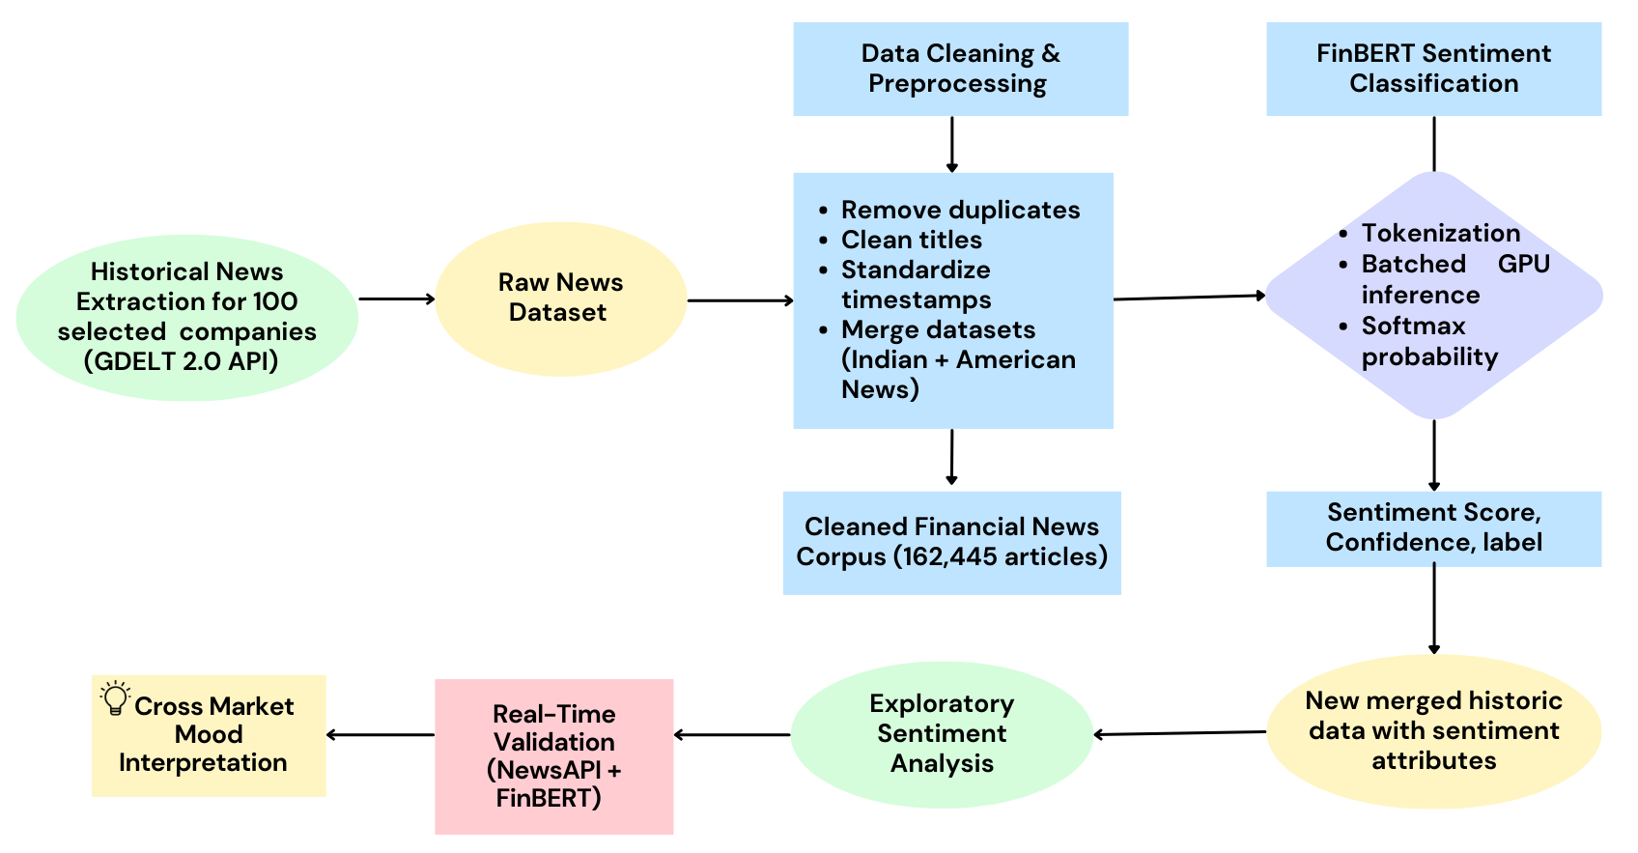

Technology
Process Flow Diagram

Slide 5
Technology
What is GDELT?
Global Database of Events, Language, and Tone
Monitors 250+ million news articles daily from 100+ countries
Covers 65 languages globally
Updates every 15 minutes - near real-time data
Free and open-source - no API costs
Why Use GDELT?
Comprehensive global news coverage
Pre-computed sentiment metrics (tone, polarity)
Historical data available for full year 2024
Cost effective

Slide 6
Technology
Stock Portfolio:
100 Companies Total:
50 US stocks (AAPL, MSFT, TSLA, GOOGL, AMZN, etc.) +
50 Indian stocks (TCS, RELIANCE, INFY, HDFCBANK, etc.)
Markets Covered: NYSE, NASDAQ, NSE (India)
Data Collection Statistics
Articles: 18,000-72,000 annually (1,500-6,000/month)
Data Size: 2-7 GB per year
Coverage: 30-120 articles per ticker per month
System Features: Smart caching, parallel processing, resume capability

Slide 7
Technology
How Finbert was used
Implementation
Model Loading: ProsusAI/finbert via Hugging Face Transformers
Device: CUDA (GPU) for faster processing, CPU fallback
Input: News title + description (max 512 tokens)
Processing: Tokenization → Truncation → Padding
Softmax probability calculation to determine sentiment confidence
Aggregation of sentiment scores by day and month for trend analysis
Output Categories
Positive: Bullish signals, growth news, achievements
Negative: Bearish signals, losses, scandals, downgrades
Neutral: Factual reporting, routine announcements
Example:
Article: "Apple reports record quarterly earnings"
Label: Positive
Confidence: 0.92 (high certainty)
Score: +0.85 (strongly positive)

Slide 8
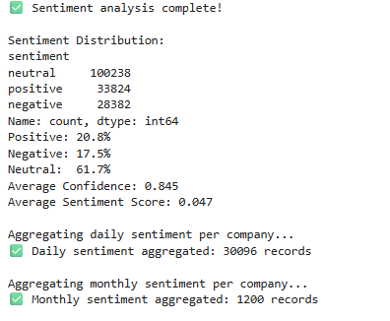
Results
Descriptive and diagnostic analysis of sentiment-labeled news articles. Computes distribution, confidence metrics, score statistics, company- and market-level sentiment averages, and temporal trends. Includes visualizations and quality checks to assess model performance and data reliability.
The sentiment analysis was performed on a merged GDELT news dataset containing 162,444 financial articles across 100 companies from both U.S. (106,419 articles) and Indian (56,025 articles) markets. After processing with the FinBERT model, the overall sentiment distribution showed 61.7% neutral, 20.8% positive, and 17.5% negative tones, with an average model confidence of 0.845 and an average sentiment score of 0.047.

Slide 9
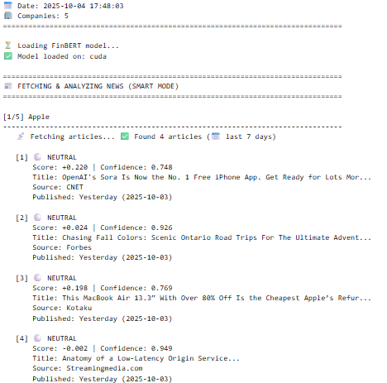
Results
Real Time Live API Testing:
The Live Sentiment Analysis successfully collected and analyzed the latest financial news articles for major technology companies such as Apple, Tesla, Microsoft, Google, and Amazon using the News API and FinBERT model. The system first attempted to fetch today’s news, and if unavailable, automatically retrieved articles from the past seven days.

Slide 10
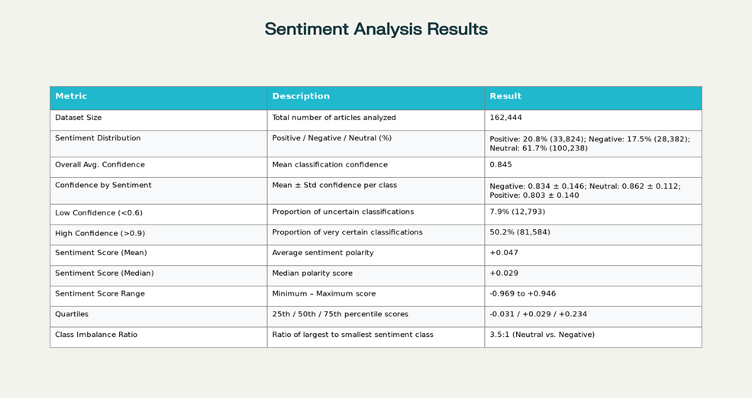
Results
Performance Metrics

