Slide 1
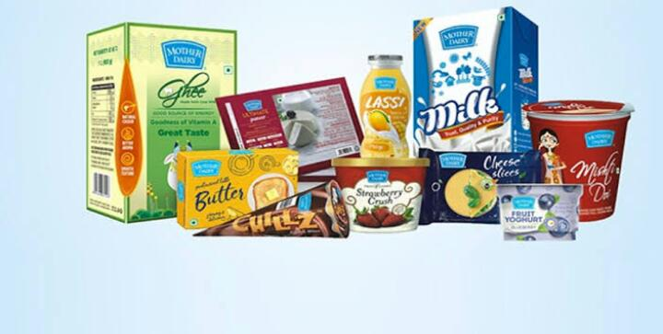


Slide 2
Mother dairy
Mother Dairy is a wholly owned subsidiary of the National Dairy Development Board which is
a statutory body under the ownership of the Ministry of Fisheries, Animal Husbandry and
Dairying of the Government of India that manufactures, markets and sells milk and dairy
products.[2] Mother Dairy was founded in 1974, as a subsidiary of the National Dairy
Development Board.
It was an initiative under Operation Flood, the world's biggest dairy development
program launched to make India a milk sufficient nation. Over the years, Mother Dairy has
contributed significantly in achieving this objective through a series of innovations and
programs. Today, Mother Dairy manufactures markets & sells milk and milk products
including cultured products, ice creams, paneer and ghee under the Mother Dairy brand. The
Company also has a diversified portfolio with products in edible oils, fruits & vegetables,
frozen vegetables, pulses, processed food like fruit juices, jams, etc. to meet the daily
requirements of every household.

Slide 3
The Company over the last many years has created a market leadership position for itself in
branded milk segment in Delhi & NCR through a robust network of its booth and retail
channels. It has also expanded its reach to other regions in North, South, East and West
with its offering of Milk and Milk products pegging it among the few companies to own such a
vast channel of distribution in India.

Slide 4
Type:
Subsidiary of National Dairy Development Board
Industry:
Milk and Dairy Products
Founded:
1974; 49 years ago
Headquarters:
Sector-1, Noida, Uttar Pradesh, India
Key people:
Manish Bandlish (Managing Director)
Products:
Milk
Dairy Products
Revenue:
₹11,000 crore ($1.6 Billion) (2020)[1]
Owner:
National Dairy Development Board, Ministry of Fisheries, Animal Husbandry and Dairying,
Government of India
Website:
www.motherdairy.com

Slide 5
Mother dairy products
Mother dairy full cream milk :
Mother Dairy Full Cream Milk.
Minimum Fat: 6%, Minimum SNF: 9%
Available in: Delhi & NCR, Lucknow, Kanpur, Jaipur ,Mumbai, Pune, Nagpur, Hyderabad,
Chennai, Tirupathy and selected North upcountry markets.
Shelf Life:48 Hours from the date of packing if kept under refrigeration below 80C
Net Quantity: 200 ml, 500 ml, 1 L
Storage Conditions: Under Refrigeration.

Slide 6
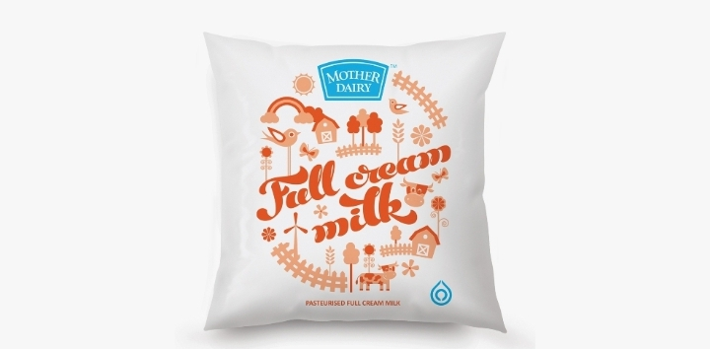
Mother dairy products picture

Slide 7
Mother dairy toned milk
Mother dairy toned milk :
Mother Dairy Toned Milk.
Minimum Fat: 3%, Minimum SNF: 8.5%
Available in: Delhi & NCR , Jaipur , Lucknow, Kanpur, Mumbai, Pune, Nagpur, Hyderabad,
Chennai, Tirupathy
Shelf Life: 48 Hours from the date of packing if kept under refrigeration below 80C
Net Quantity: 500 ml, 1 L
Storage Conditions: Under Refrigeration (Below 80C).

Slide 8
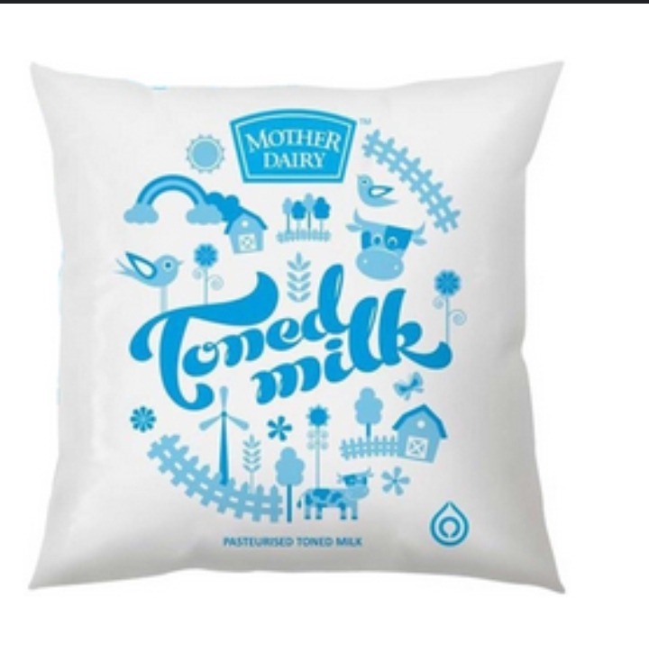
Mother dairy toned milk picture

Slide 9
Mother dairy Standardized milk
Mother dairy standardized milk:
Mother Dairy Standardized Milk.
Minimum Fat: 4.5%, Minimum SNF: 8.5%
Available in: Chandigarh, Dehradun, Ludhiana, Shimla, Chennai, Tirupathy and other
cities in North
Shelf Life: 48 Hours from the date of packing if kept under refrigeration below 80C
Net Quantity: 500 ml, 1 L
Storage Conditions: Under Refrigeration (Below 80C).

Slide 10
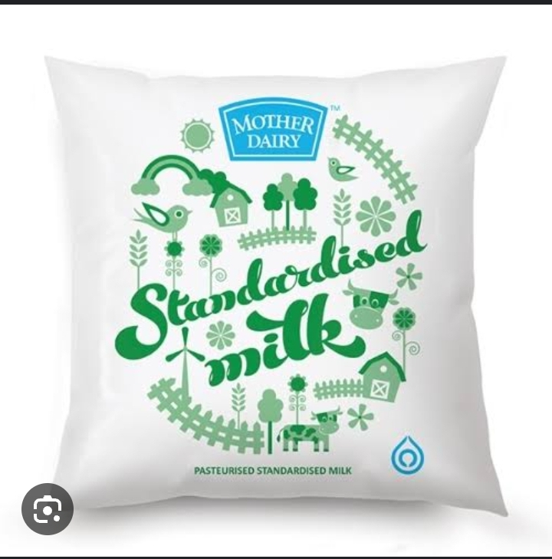
Mother dairy Standardized picture

Slide 11
Mother dairy competetor
The top competitors of Mother Dairy include Akshayakalpa, Godrej Agrovet, Dodla
Dairy, Milk Mantra and Provilac Dairy Farms. Mother Dairy has 273 active competitors.
competitors of Mother Dairy.
● Akshayakalpa - Tiptur based, 2010 founded, Series B company.
● Godrej Agrovet - Mumbai based, 1992 founded, Public company.
● Dodla Dairy - Hyderabad based, 1995 founded, Public company.
● Milk Mantra - Bhubaneswar based, 2009 founded, Series D company.
● Provilac Dairy Farms - Pune based, 2013 founded, Seed company.
● Parag Milk Foods - Mumbai based, 1992 founded, Public company.
● Milky Mist - Erode based, 1985 founded, Late Stage company.
● Sid's Farm - Hyderabad based, 2014 founded, Series A company.
● Heritage Foods - Hyderabad based, 1992 founded, Public company.
● Osam Dairy - Ranchi based, 2010 founded, Series B company

Slide 12
Mother dairy competetor graph table
Company name | Total funding | Founded year
Godrej agroben | $105M | 1992
Dadla daily | $70.5M | 1995
Milk mantra | $32.7M | 2009
Akshayakalpa | $32.1M | 2010
Provilac dairy farms | $348k | 2013

Slide 13
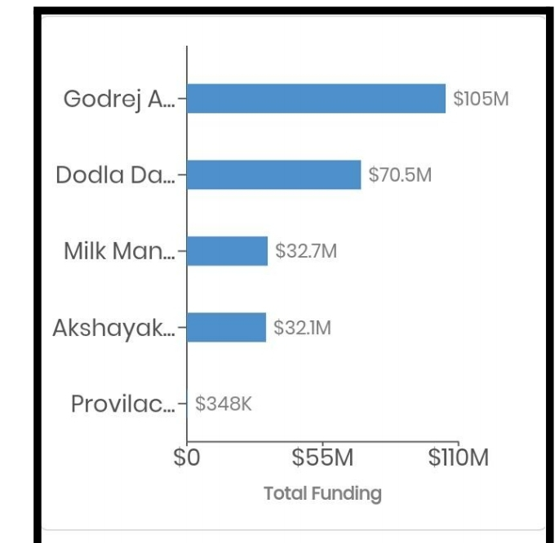
Mother dairy competetor graph

Slide 14
Swot analysis of mother dairy
Mother Dairy is one of the leading brands in the food & beverages sector. Mother Dairy
SWOT analysis evaluates the brand by its strengths & weaknesses which are the internal
factors along with opportunities & threats which are the external factors. Let us start the
SWOT Analysis of Mother Dairy.
● Strength
● Weaknesses
● Opportunities
● Threats

Slide 15
Strength
Awell-recognized brand name.
● Popular subsidiary brands like Dhara, Safal, b-Activ, etc.
● A wide variety of products like milk, dairy products, fruits, vegetables,
groceries, edible oil, beverages, frozen food, etc.
● It is an IS/ ISO-9002, IS-15000 HACCP and IS-14001 EMS certified company.
● An employee strength of 3000 people.
● Strong and efficient supply chain network.
● Procurement of milk from co-operative. dairies and vegetables from farmers,
providing them with fair prices.
● Technological advancement
Popular for its quality and affordable price.

Slide 16
2. Weaknesses
Limitednumber of Mother Dairy and Safal outlets.
● Difficult to maintain competitive pricing.
● Vegetables and milk products are perishable.
These were the weaknesses in the Mother Dairy SWOT Analysis. The weaknesses of a
brand are certain aspects of its business which it can improve.

Slide 17
3.opportunities
Continuous demand of dairy products and other products by Mother Dairy.
● Open more number of Mother Dairy outlets
● Market and advertise the products.
● Increase its market share by expansion in untapped markets.
Above we covered the opportunities in Mother Dairy SWOT Analysis. The opportunities for
any brand can include prospects of future growth.

Slide 18
4. Threats
Strong marketing muscle by competitors.
● Unstable economic condition in India.
● Other competitor brands.
● The threats in the SWOT analysis.
Analysis of Mother Dairy are as mentioned above. The threats for any business can be
external factors which can negatively impact its business

Slide 19
New product strategies
Marketing Strategy of Mother Dairy analyzes the brand with the marketing mix
framework which covers the 4Ps (Product, Price, Place, Promotion). These business
strategies, based on Mother Dairy marketing mix, help the brand succeed in the market. Let
us start the Mother Dairy Marketing Strategy & Mix to understand its product, pricing,
advertising & distribution strategies.
1. Products strategy
2. Pricing strategy
3. Place and distribution strategy
4. Promotional and advertising strategy

Slide 20
1.Products strategies
The product strategy and mix in Mother Dairy marketing strategy can be
explained as follows.
● Mother Dairy is a leading brand offering milk, milk based products & other
food items in India. Mother Dairy product portfolio is majorly divided based on
the three brands Mother Dairy, Dhara and Safal. These brands cover the
product strategy in the marketing mix of Mother Dairy

Slide 21
2. Pricing strategies
Mother dairy a very penetrative pricing strategy. Since its suppliers are farmers and
cooperatives and needs to support them, milk prices change with inflations and certain
amount of fluctuations are visible in Mother Dairy milk prices.
Mother Dairy also maintains a differential pricing strategy in its marketing mix and
varies according to geographical regions. Prices also vary with packages and variants of
milk. Other milk products also have similar situations and we can see pricing done according
to rising prices of other input factors. In the Mother Dairy ice creams segment, it keeps for
regular ice creams competitive prices and premium prices for other special flavours.

Slide 22
Place and distribution strategies
Mother Dairy has a wide presence across India. In the milk industry, distribution is
quite a critical part of the business and hence to tap into various regions all over the country
it has 1400 retail outlets and and 1000 exclusive stores in place. As its suppliers are farmers
and cooperatives, it is able to save on other middle men costs. Since Mother Dairy deals
with a perishable which needs refrigeration and has very less shelf life, it produces as per
demand of the regions. After being brought in from the farmers in tankers or being collected
at the collection centres, it goes on for processing in the plants and then on it is delivered to
it Local Area Distributors. These Local Area Distributors then send it to its exclusive Mother
Dairy booth, convenience stores, supermarkets and other smaller retailers. Since consumers
are able to find to Mother Dairy booths very close to their homes, it has built customer

Slide 23
Promotional and advertising strategies
Mother Dairy has adopted a subtle yet effective marketing strategy. As it is facing stiff
competition from national player Amul, Mother Dairy has moved onto smart marketing
strategy wherein it is working on better communication strategies. It is now coming up with
various advertising strategies to gain customer’s mind share. Recently Mother Dairy has
come up with ‘Tweet to Farmer’ campaign where we thank them for giving us milk. It has
roped in a mascot Makhan Singh which is targeted on the kids for various products like
cheese, butter and milk. The Mother Dairy ice creams have also been quite popular because
of TV commercials. Safal also takes help of green and environment friendly themes for
selling many of its products. Dhara brand has been on TV commercials from quite a long
time. It also has tied up with Paytm and UPI for cashless payment at its booths and hence
showing it is technologically updated. Hence, this covers the entire Mother Dairy

Slide 24
Mother dairy tools and buyer openion
Buyers must also source quality items at competitive prices that are useful to
their company’s bottom line. This may require them to predict what
consumers will want by forecasting next season’s trends. Buyers also need to
find trustworthy wholesalers and manufacturers and ensure their deliveries
are on time, complete, free of damage, and within budget. This position often
leads to becoming a Purchasing Manager, Purchasing Director, Assistant to
the Chief Procurement Officer (CP

Slide 25
Education
Education Requirements:
● High school diploma or equivalent.
● Associate or bachelor’s degree.
● 0-2 years of related experience.
● Trade-specific certification like CPP, CPPB, or CPPO (optional)

Slide 26
Buyer essential skills
Analytical and math skills.
● Negotiation skills.
● Ability to perform under stress.
● Purchasing and inventorymanagement skills.
● Knowledge of a specific sector’s needs.

Slide 27
Buyer roles and responsibilities
Search for and negotiate contracts with suppliers and manufacturers.
● Craft purchase order and inventory reports for management.
● Solve supply chain problems.
● Work within the management team to ensure that all deliveries satisfy the
assigned orders.
● Develop an effective and accurate system for monitoring purchase orders.

Slide 28
Day to Day duties
Order products and authorize payments.
● Manage inventory, including current stock and new deliveries.
● Ensure the accuracy of purchase orders.
● Research possible item selections.

Slide 29
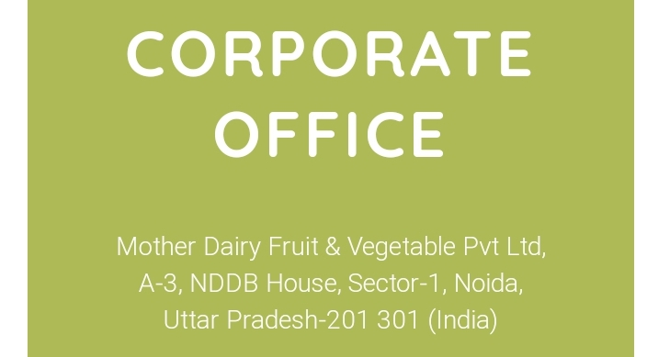
Mother dairy suggestions

Slide 30
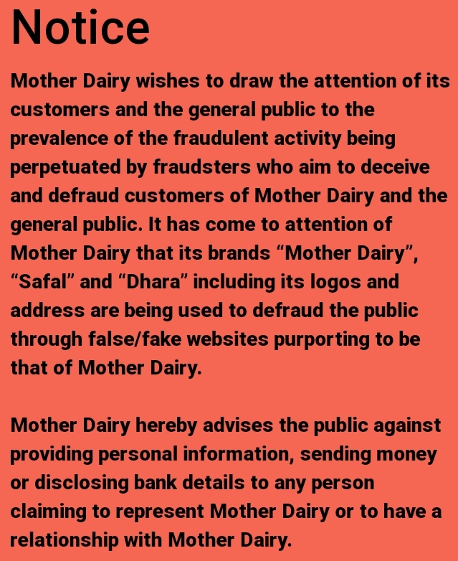

Slide 31
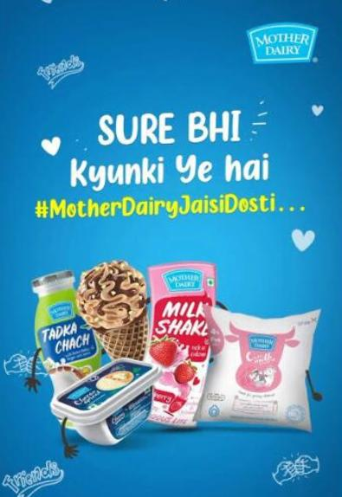
Instagram story
https://www.instagram.com/s/aGlnaGxpZ2h0OjE4MDE1Mzg4ODg4ODA4MjMw?story_media_id=3212626636646537500_62092107712&igshid=NTc4MTIwNjQ2YQ==

Slide 32
Presented by
R.chaithra
G.pavithra
Girayi Vamsi reddy
J.kumar

Slide 33


Slide 34


