Slide 1
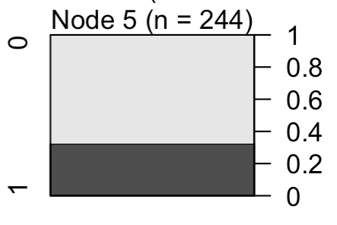
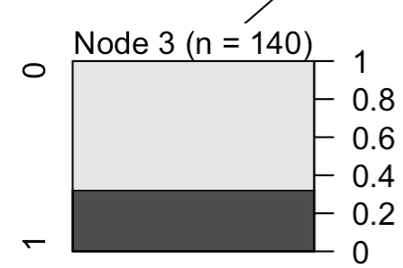
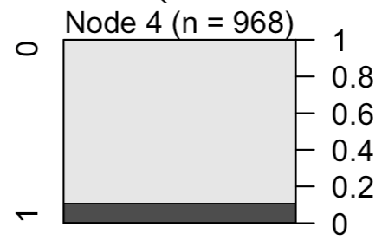
Model 7: Trouble Finding Childcare: No Reported Challenges
Why Not Enrolled in VPK:
Found Alternative Care
Yes
No
Household Income
$100K+
< $100K &
Prefer not to answer

Slide 2
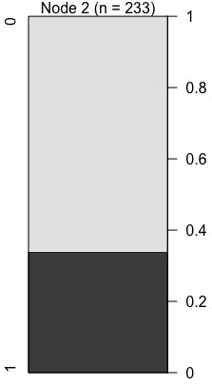
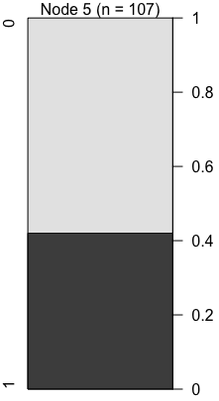
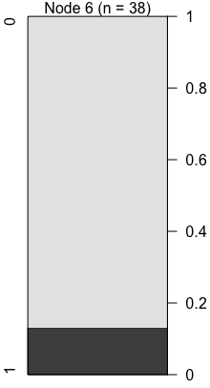
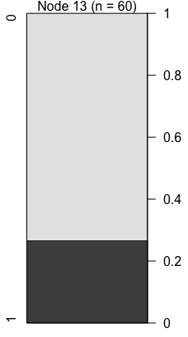
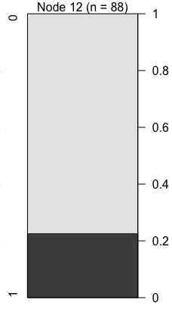
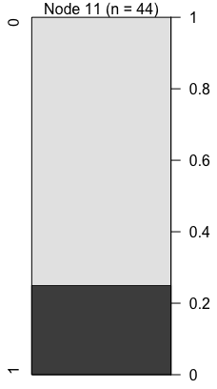
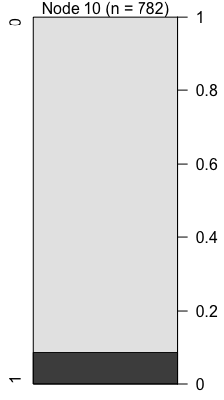
Trouble Finding Care:
No Challenges
Model 9: Why Not Enrolling in VPK: Enrolled in Alternative Care
Yes
No
Household Income
$100K+
< $100K &
Prefer not to answer
Trouble Finding Care:
No Public Schools
Trouble Finding Care:
Provider
Hours
No
Yes
Yes
No
Trouble Finding Care:
Provider
Fit
Yes
No
Trouble Finding Care:
Provider
Quality
Yes
No

