Slide 1
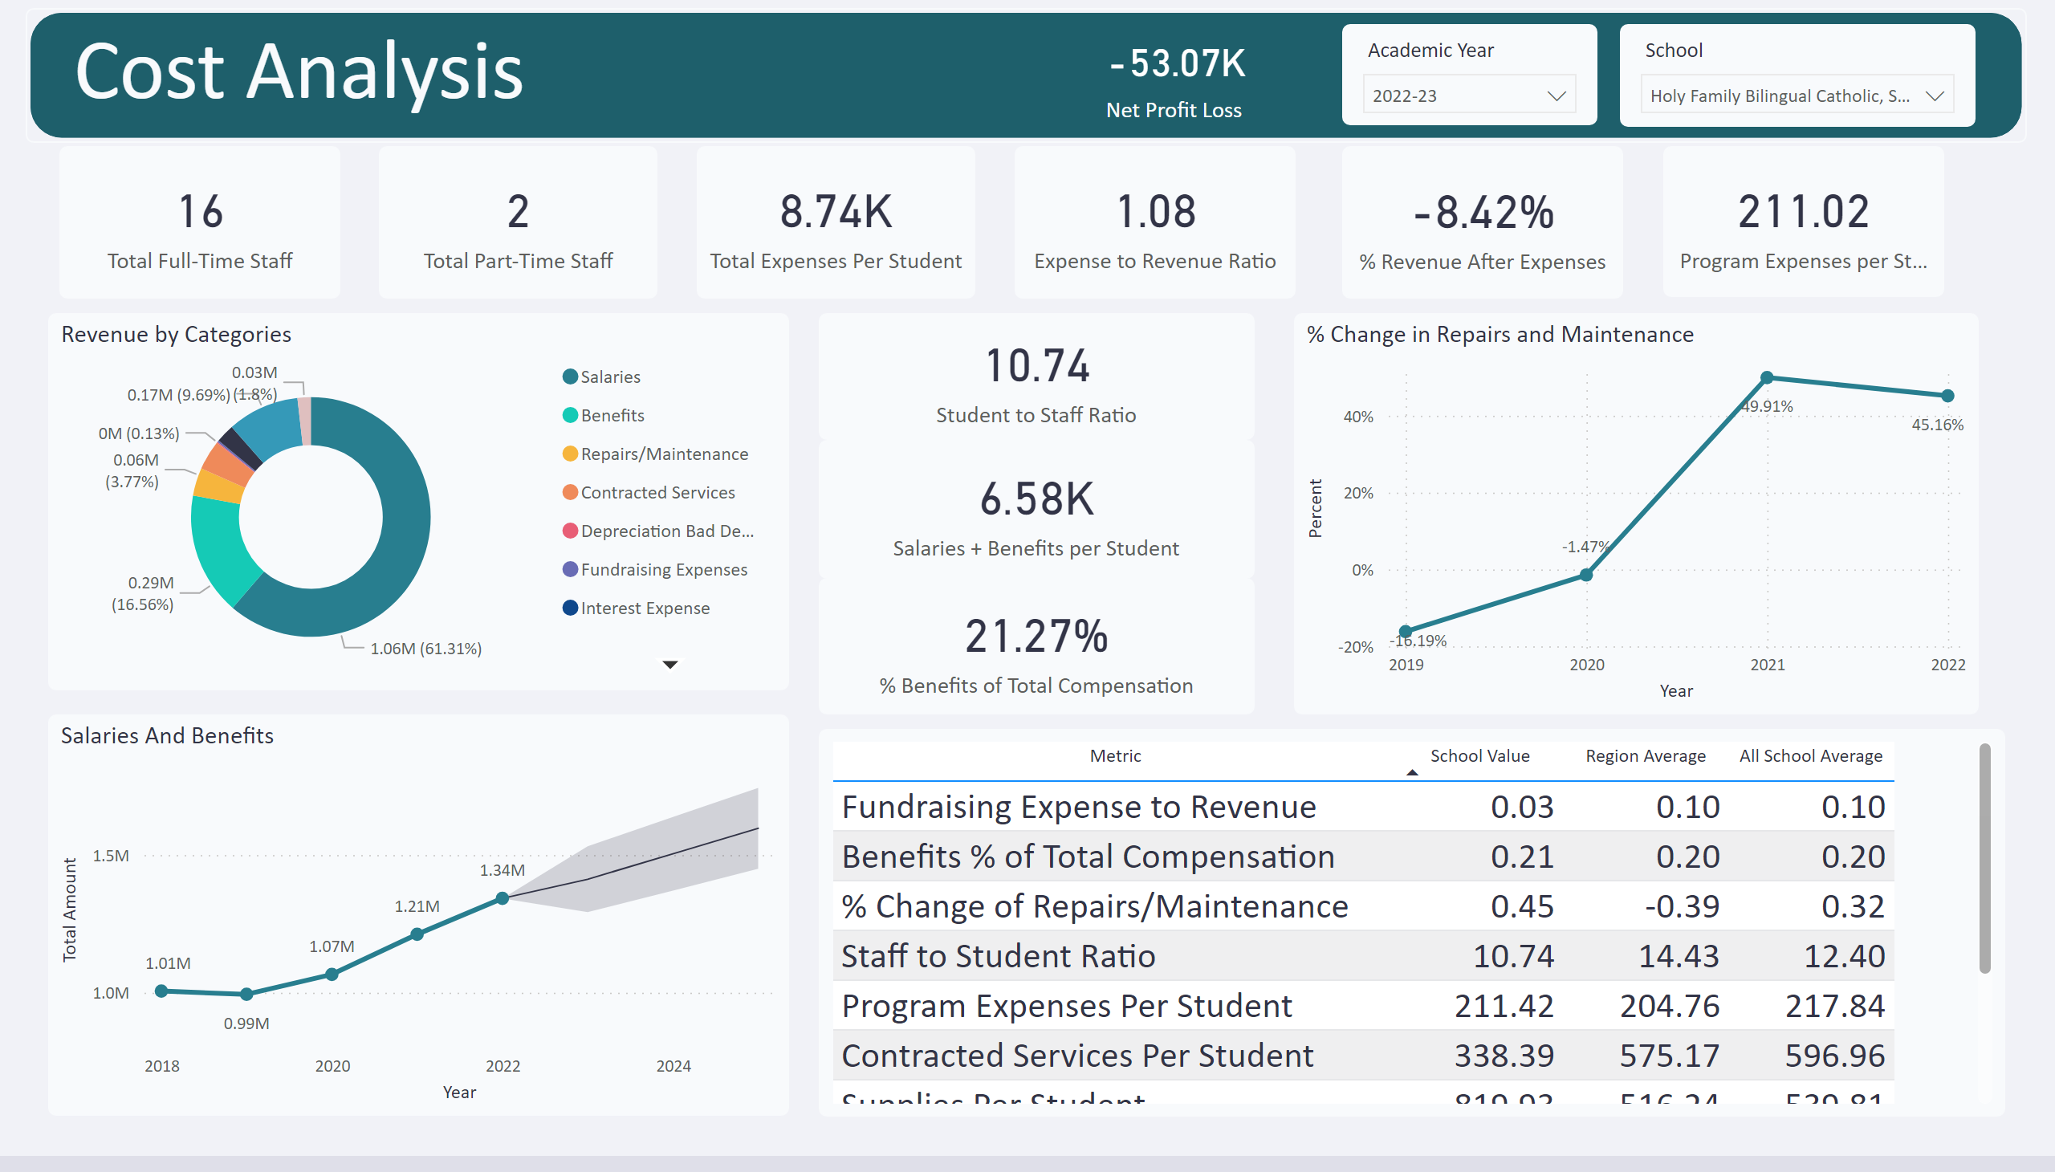
Cost Analysis
Notes:
shape
No alt text provided
slicer
No alt text provided
slicer
No alt text provided
Revenue by Categories
No alt text provided
textbox
No alt text provided
card
No alt text provided
Salaries And Benefits
No alt text provided
card
No alt text provided
card
No alt text provided
card
No alt text provided
% Change in Repairs and Maintenance
No alt text provided
card
No alt text provided
% Revenue Retained after Expense
No alt text provided
tableEx
No alt text provided
card
No alt text provided
card
No alt text provided
card
No alt text provided
card
No alt text provided

Slide 2
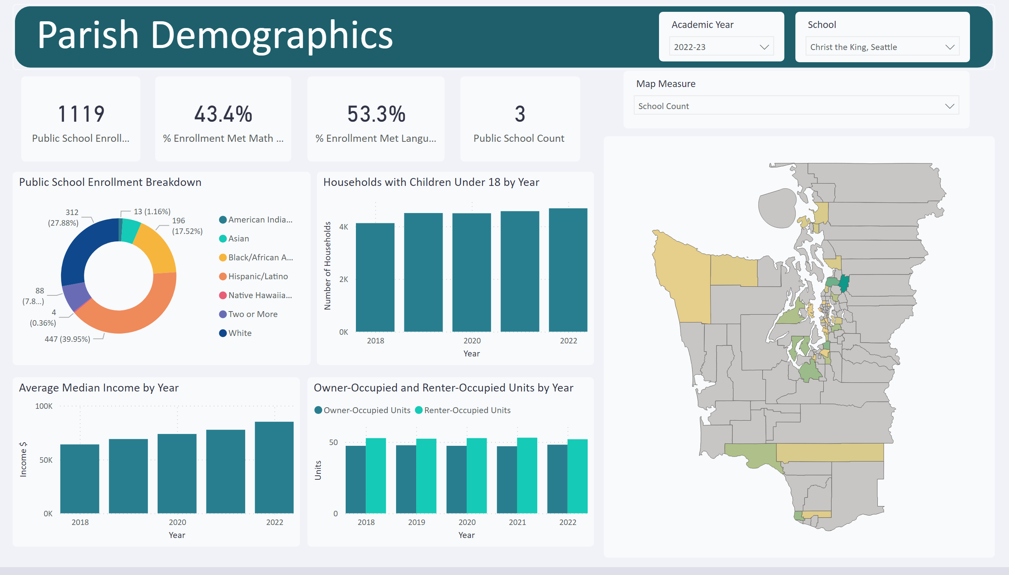
Parish Data
Notes:
shape
No alt text provided
slicer
No alt text provided
slicer
No alt text provided
textbox
No alt text provided
shapeMap
No alt text provided
Public School Enrollment Breakdown
No alt text provided
card
No alt text provided
slicer
No alt text provided
card
No alt text provided
card
No alt text provided
columnChart
No alt text provided
columnChart
No alt text provided
Owner-Occupied and Renter-Occupied Units by Year
No alt text provided
card
No alt text provided

Slide 3
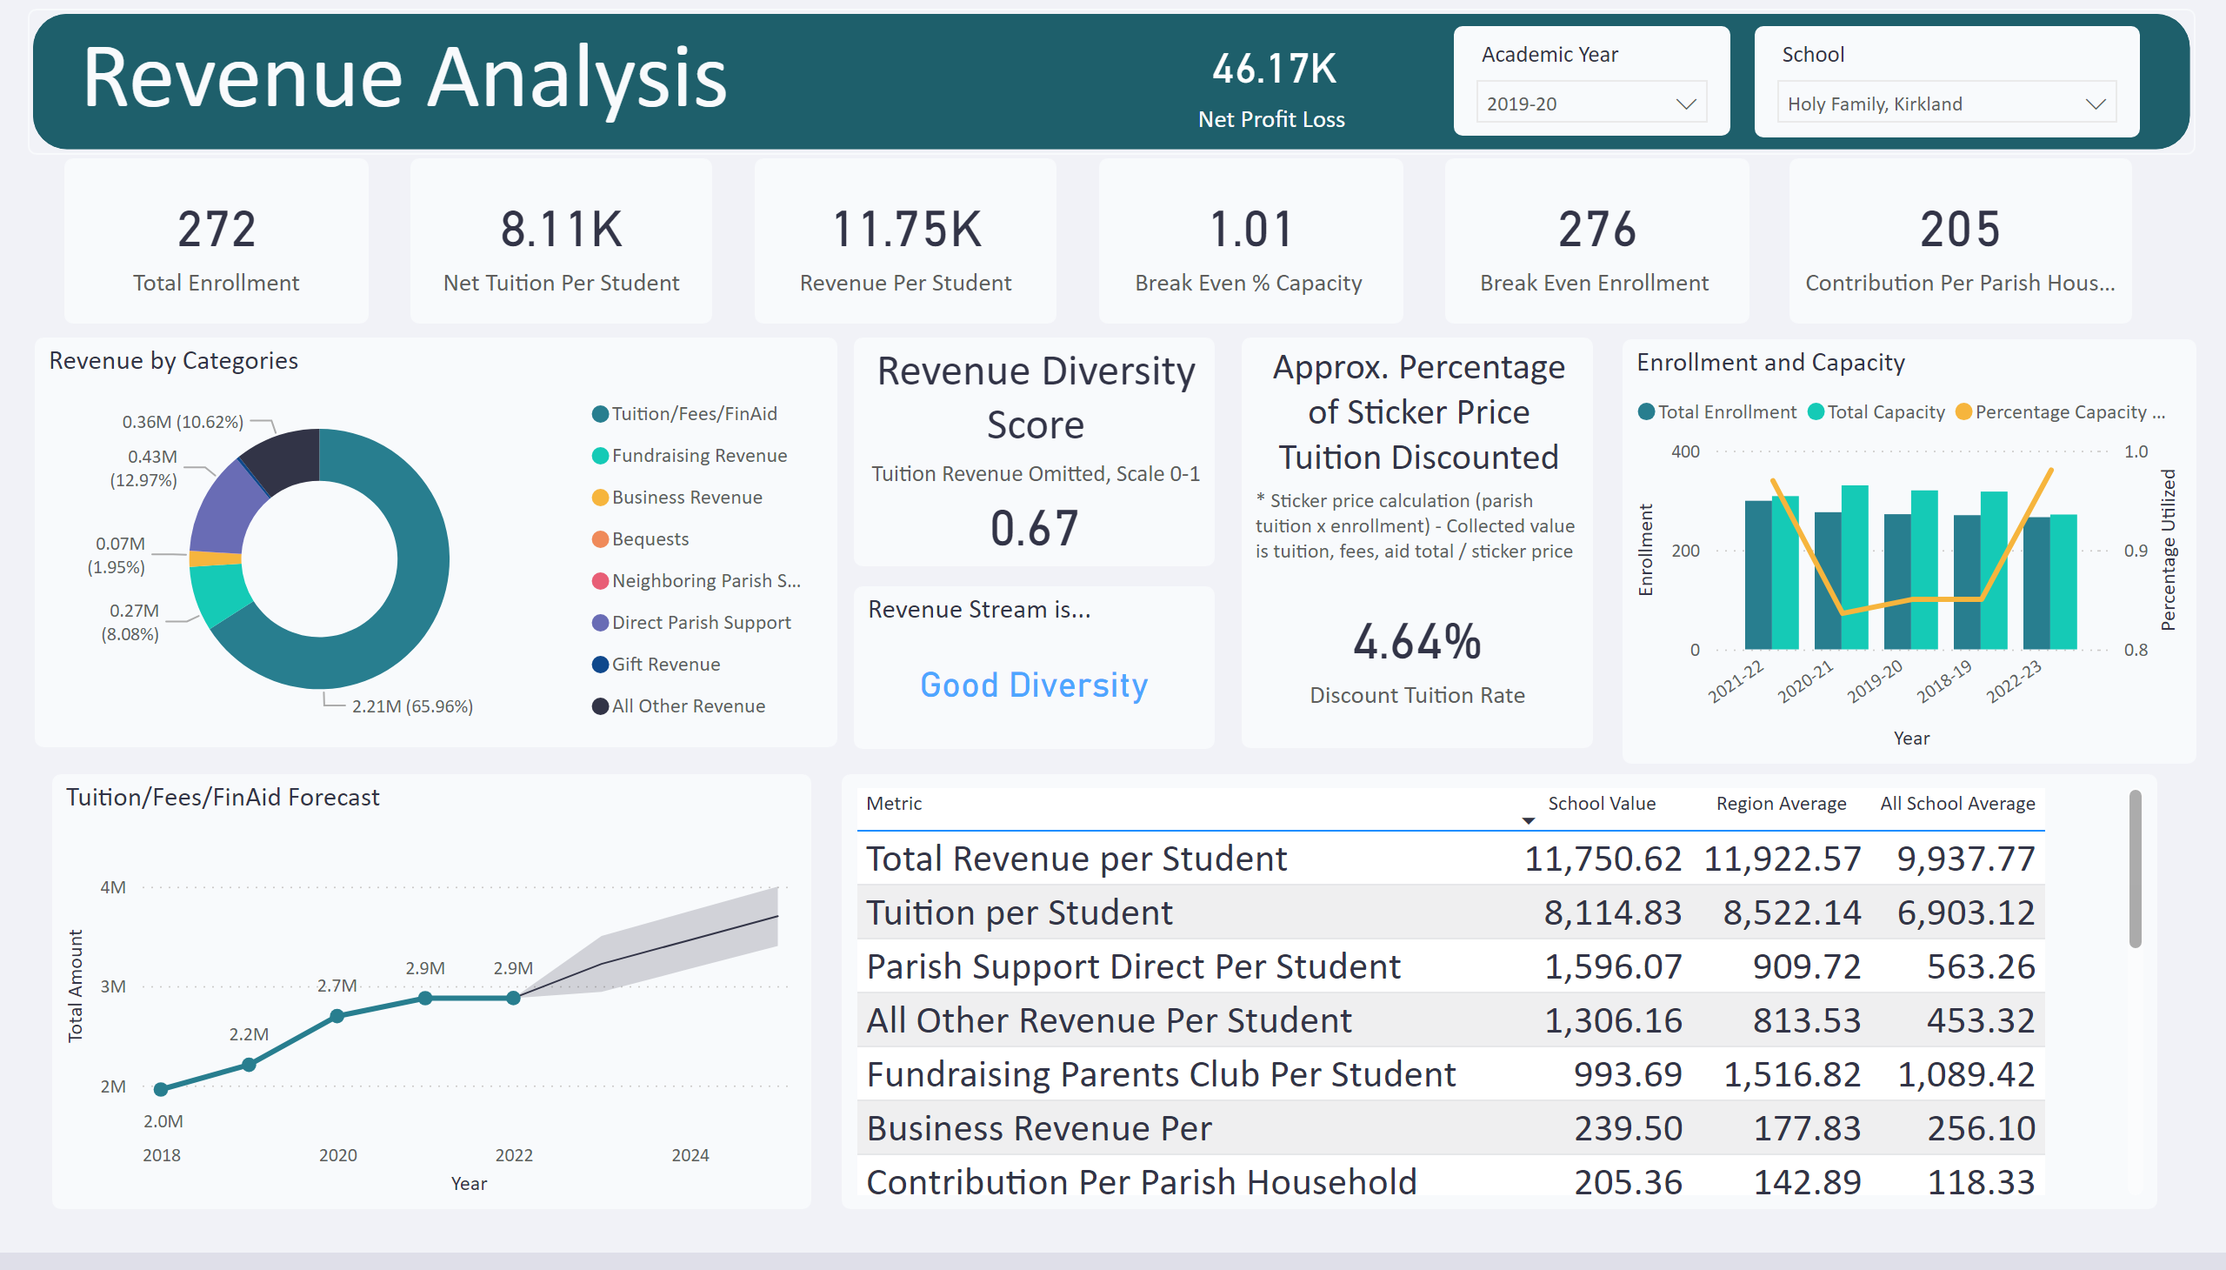
Duplicate of Revenue Analysis
Notes:
shape
No alt text provided
Approx. Percentage of Sticker Price Tuition Discounted
No alt text provided
slicer
No alt text provided
slicer
No alt text provided
Revenue by Categories
No alt text provided
textbox
No alt text provided
card
No alt text provided
Tuition/Fees/FinAid Forecast
No alt text provided
card
No alt text provided
card
No alt text provided
card
No alt text provided
Enrollment and Capacity
No alt text provided
Revenue Diversity Score
No alt text provided
card
No alt text provided
card
No alt text provided
Revenue Stream is...
No alt text provided
tableEx
No alt text provided
card
No alt text provided

