Slide 1
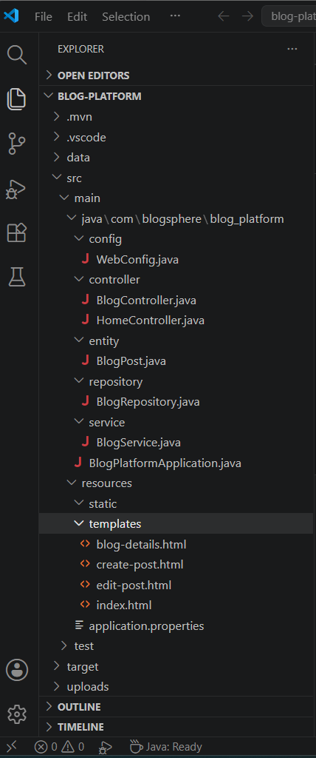
BLOGSPHERE
INTERNSHIP PROJECT REPORT
A Modern Blog Management Platform
Built Using Java Spring Boot
Developed Using
Java 21
Spring Boot
Spring Data JPA
Thymeleaf
H2 Database
Maven
Bootstrap
Project Features
✓ Create Blog
✓ View Blog
✓ Edit Blog
✓ Delete Blog
✓ Search Blog
✓ Image Upload
✓ Popularity Score
Submitted By:
Rahul Kumar Chourasia
Technology Stack:
Java 21, Spring Boot, Thymeleaf, H2 Database
Internship Project Submitted To
Java Development Internship Program
"Designing a simple, scalable, and database-driven blogging platform using modern Java technologies."

Slide 2
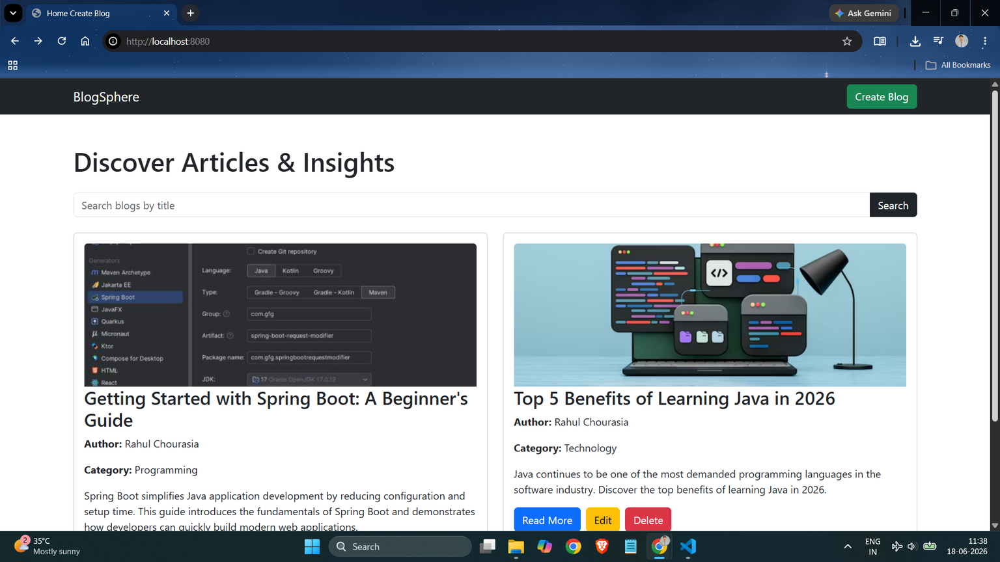
INTRODUCTION
BlogSphere is a web-based blog management platform developed using Java Spring Boot.
The system allows users to:
Create blog posts
View blogs
Edit blogs
Delete blogs
Search blogs
Upload images
Track popularity scores
The platform stores all blog data in a persistent H2 database.

Slide 3
OBJECTIVES
Develop a complete blog management system
Implement CRUD operations
Store data using a database
Provide search functionality
Support image uploads
Create a user-friendly interface
Apply Spring Boot MVC architecture

Slide 4
TECHNOLOGIES USED
Technology
Purpose
Java 21
Soring Boot
Spring Data JPA
Thymeleaf
H2 Database
Maven Bootstrap
Backend Framework
Database Operations
Frontend Templates
Data Storage
Dependency Management
Responsive UI

Slide 5
SYSTEM ARCHITECTURE
User
↓
Thymeleaf UI
↓
Controller Layer
↓
Service Layer
↓
Repository Layer
↓
H2 Database
Components
Controller handles requests
Service contains business logic
Repository manages database operations
H2 stores blog information

Slide 6
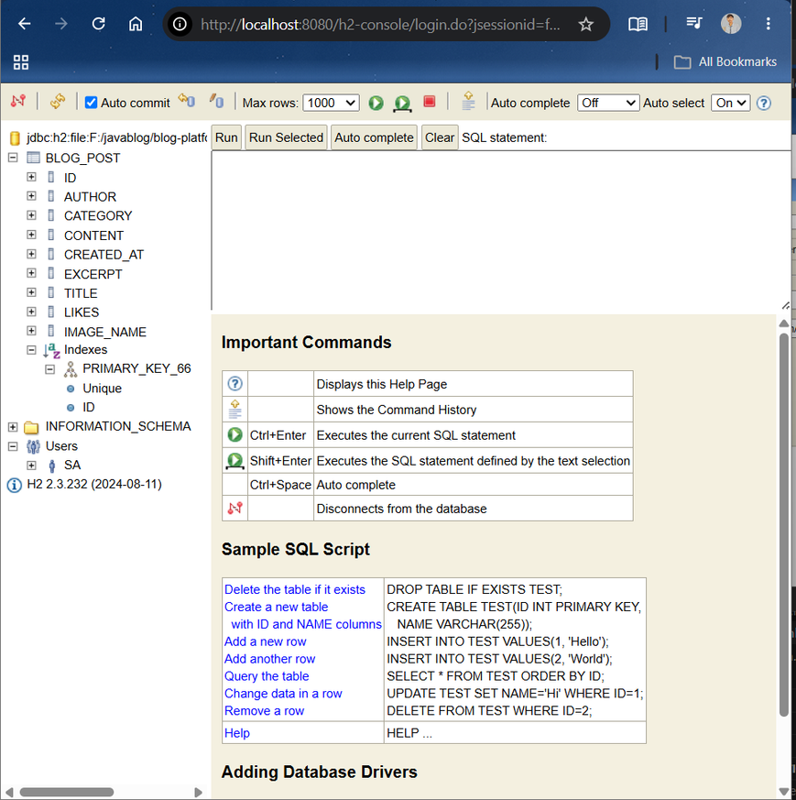
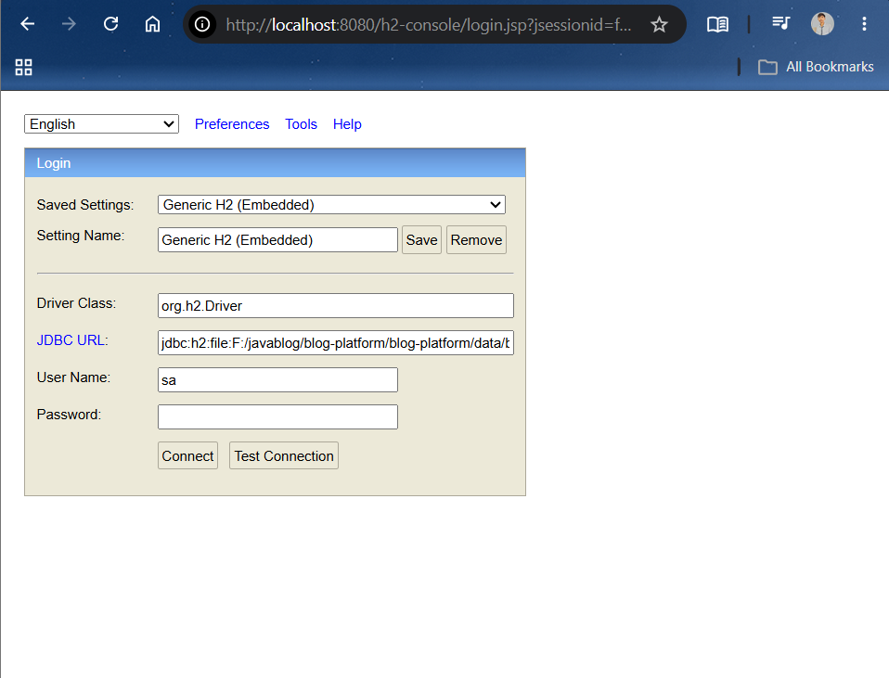
DATABASE STRUCTURE
BlogPost Entity
Field
Type
id
title
author
category
excerpt
content
imageName
likes
createdAt
Long
String
String
String
String
Text
String
Integer
LocalDateTime

Slide 7
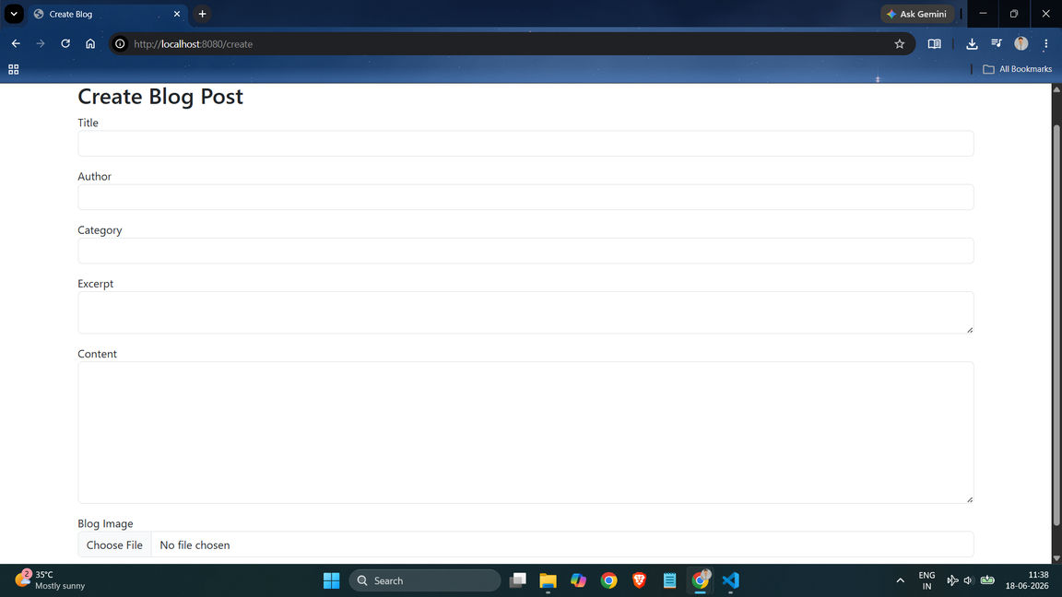
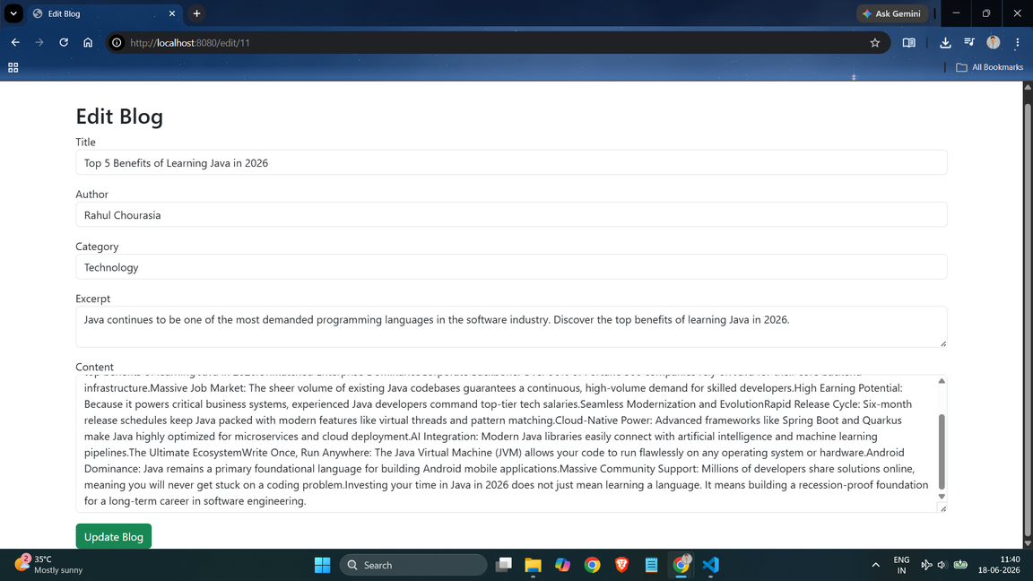
IMPLEMENTED FEATURES
Blog Management
Additional Features
✅ Create Blog
✅ View Blog
✅ Edit Blog
✅ Delete Blog
✅ Search Blog
✅ Image Upload
✅ Popularity Score
✅ Persistent Database Storage

Slide 8
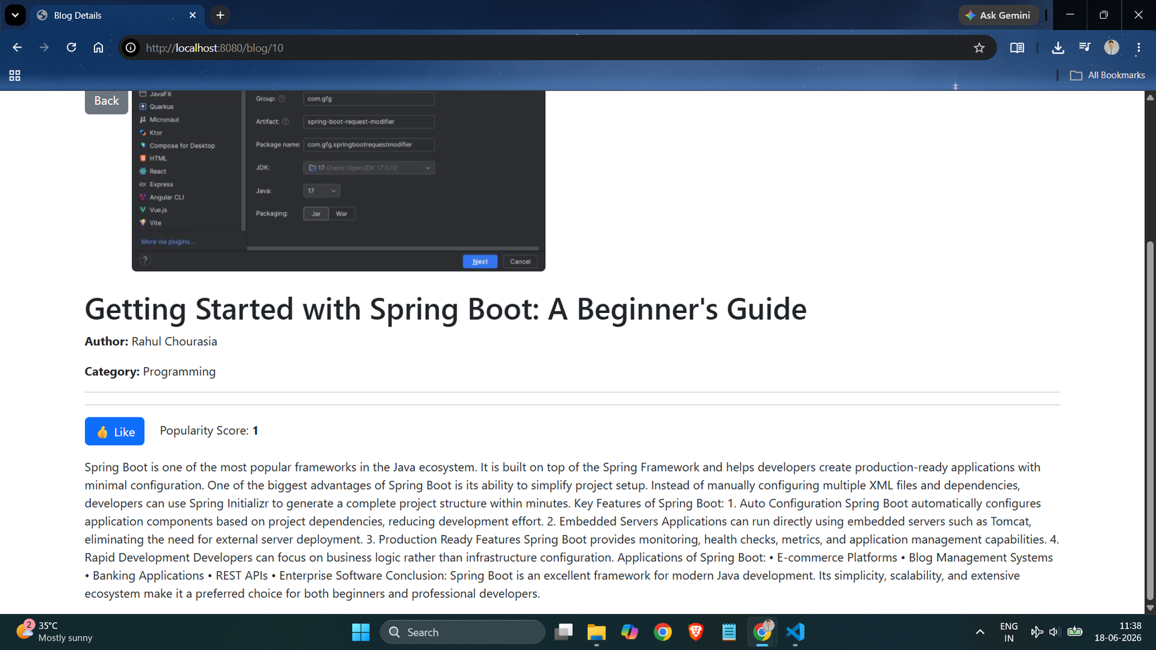
WORKING FLOW
Step 1
User creates a blog post.
Step 2
Blog information is stored in H2 Database.
Step 3
Uploaded images are stored locally.
Step 4
Blogs are displayed on the homepage.
Step 5
Users can search, edit, delete, and view blogs.

Slide 9
ADVANTAGES & LIMITATIONS
Advantages
Limitations
Easy to use
Fast performance
Database-driven
Responsive interface
Supports image uploads
Persistent storage
No user authentication
Single-user environment
Local image storage only

Slide 10
FUTURE SCOPE & CONCLUSION
Future Scope
Conclusion
User Authentication
Comment System
Cloud Image Storage
Blog Categories Management
Advanced Analytics
BlogSphere successfully demonstrates the implementation of a complete blog management platform using Spring Boot, Thymeleaf, and H2 Database while providing essential CRUD operations and additional features such as search, image upload, and popularity tracking.

