Slide 1
Week 9
Agenda:
1. Vector Processors and RISCV Vector Extension
2. SiFive Vector Processor

Slide 2
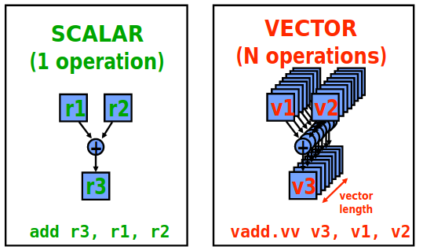
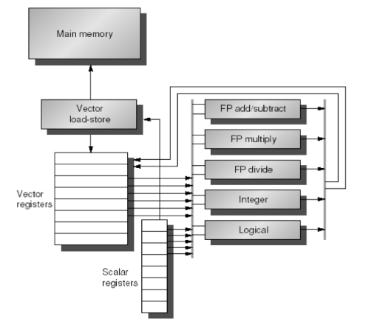
Vector Processors
Source : Patterson Lecture , Vector Processor
Constituents of Vector Processor
1. Vector Register File: Each vector register is fixed length bank holding a single vector
- Has atleast 2 read and 1 write ports
- 32 Vector Regs in RISCV – V Spec
2. Vector Functional Unit(FU): Fully pipelined to start new operation every clock. Control unit to manage hazards
3. Load Store Unit(LSU): Fully pipelined unit to amortize the memory latency over one vector load.
4. Crossbars to connect LSU and FU
Source : Patterson Hennesy, Comp Arch Text

Slide 3
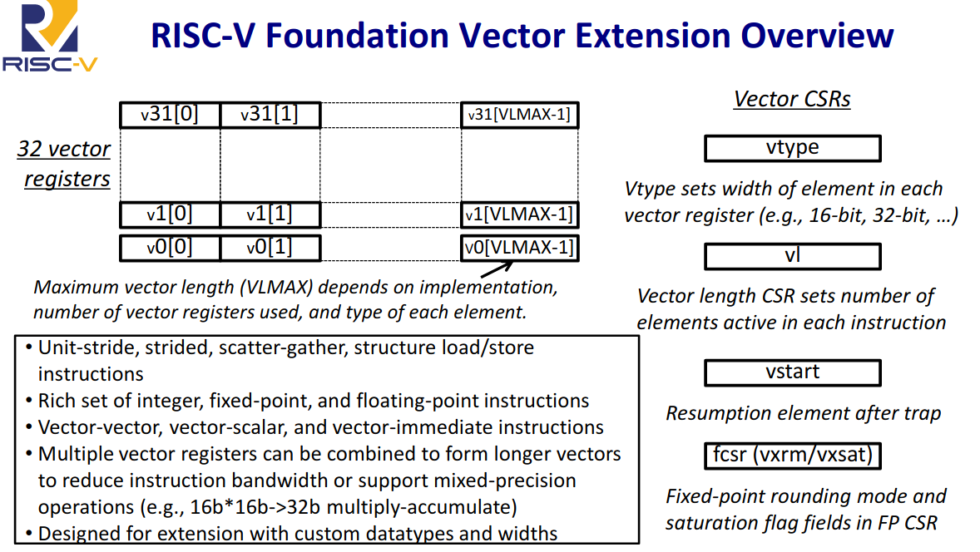

Slide 4
RISC V Vector ISA
32 vector registers (v0 ... v31)
Each register can hold either a scalar, a vectoror a matrix(shape)
Each vector register can optionally have an associated type(polymorphic encoding)
Variable number of registers (dynamically changeable)
Vector instruction semantics
All instructions controlled by Vector Length (VL) register
All instructions can be executed under mask
Intuitive memory ordering model
Precise exceptions supported
Vector instruction set:
All instructions present in base line ISA are present in the vector ISA
Vector memory instructions supporting linear, strided & gather/scatter access patterns
Optional Fixed-Point set
Optional Transcendental set

Slide 5
Week 10: Oct 2nd 2020
Actions
1. Study RISC-V Vector Extension
2. Case Study RISCV Vector Processors
Work Done
1. Study RISC-V Vector Extension Spec
2. Detailed study of Ara RISC-V Vector Processor

Slide 6
Ara : RISC-V Vector Processor
Overview
Developed by PULP team, Integrated Systems Laboratory, ETH-Zurich in 2019
64-bit vector co-processor to Ariane (which is RV64GC application processor)
Based on RISC-V Vector Spec. Version 0.5
Operating Frequency 1 Ghz
Designed for low power
Contains Floating Point Support with 64 bit/cycle throughput (1 DP / 2 SP / 4 HP ouptuts/cycle)
Peak Performance : 33 DP – GFLOPS (41 DP-GFLOPS/W)
Exploits Data Level paralellism for efficient execution of Scientific and Matrix oriented computations, as well as DSP and Machine learning algorithms

Slide 7
Topics of discussion
ARA Microarchitecture
ARA Performance Benchmarking

Slide 8
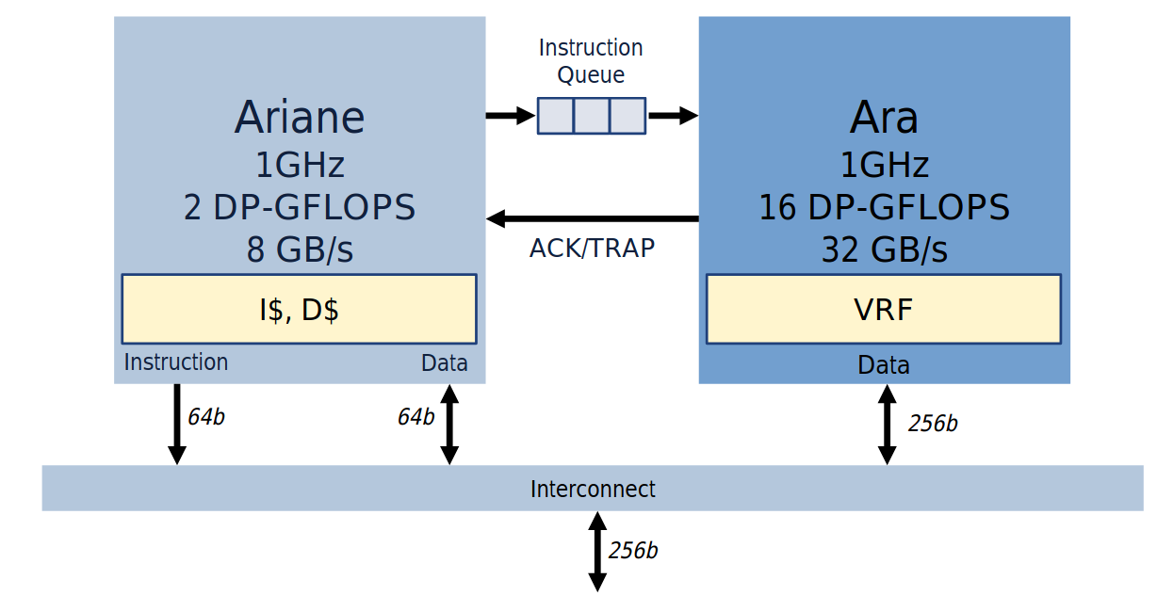
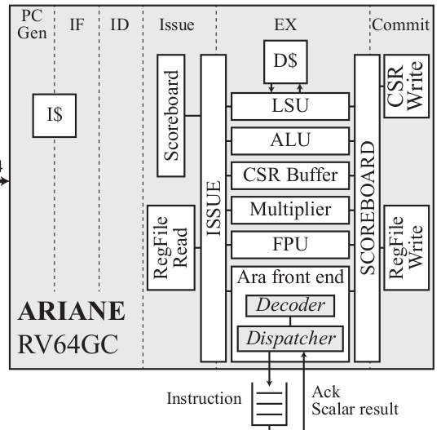
Ariane Vector Processor System
Ariane is a RV64GC based in-order , single issue application class processor having a 6-stage pipeline
Vector instructions are partially decoded in Ariane’s Instruction Decoder, and then completely in a dedicated Vector Instruction Decoder insider Ara.
The dispacher controls the interface between Ara and Ariane’s dedicated Scoreboard port.
While Ariane sends Instructions, Ara sends Ack/Scalar results through the Scoreboard port.
The decoupled execution works well, except when Ariane expects a result from Ara, e.g., reading an element of a vector register
Block Level Interface between Araine and Ara. Courtesy: ETH Zurich ppt
ARA RV64V
Fine Grain Block Level Interface between Ariane and Ara. Courtesy: Ara Paper

Slide 9
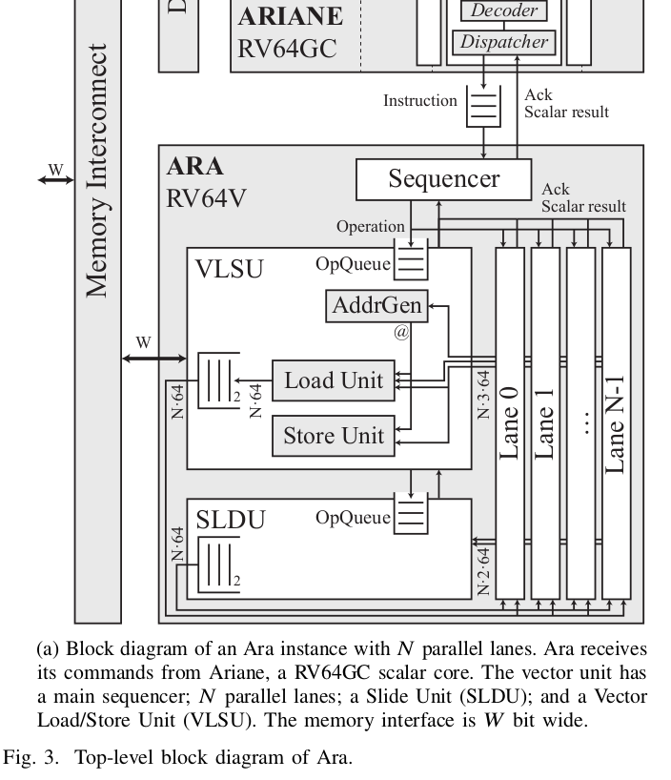
Components of Ara
Sequencer
Slide Unit (SLDU)
Vector Load Store unit (VLSU)
Vector Lanes
Lane Sequencer
Vector Register File
Operand Queues
Execution Units

Slide 10
Sequencer
Responsible for keeping track of vector instructions running on Ara, dispatching them to different execution units and acknowledging them with Ariane.
This unit has a global view of the instruction execution execution progress across all lanes.
The sequencer can handle upto 8 parallel instructions
Hazards among pending vector instructions are resolved by this block.
In case of a structural hazard, the sequencer delays the issue of vector instructions until the contending instruction releases the shared resource.
Sequncer stores information about which vector instruction is accessing which vector register. This information is used to resolve data hazards between instructions

Slide 11
Slide Unit (SLDU)
Vector Register File (VRF) is spread across all lanes. Thus, a given lane cannot access all VRF banks directly.
SLDU is responsible for handling instructions that must access all Vector Register File (VRF) banks at once.
Handles tasks such as insertion of an element into a vector, extraction of an element from a vector, vector shuffles, vector slides etc.,
  vdest[i] <-- vsrc[i + slide_amount]
Possible area of improvement: Vector Reducion operations are given in the latest RISC-V spec. These have not been implemented in Ara. Vector Reuctions are managed using SLDU.

Slide 12
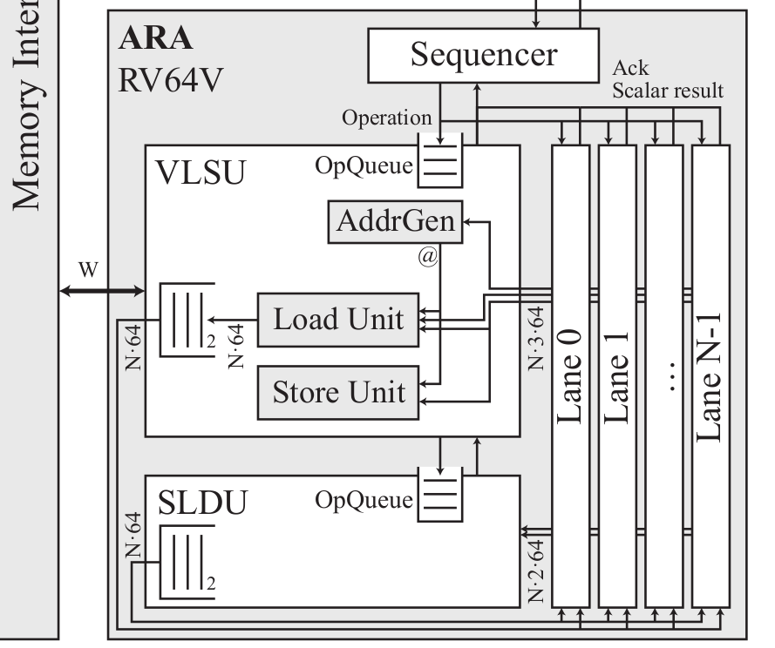
Vector Load Store Unit (VLSU)
Ara has a single memory port.
VLSU has an address generator to generate address sequences for :
1. Unit Stride loads and stores, which access a contiguous chunk of memory
2. Constant Stride memory Operations, which access memory address spaced by a fixed offset.
3. Scatters and Gathers , which uses a vector of offsets to allow general access patters.
This block converts unit-stride memory requests into burst requests through AXI interface, instead of accessing all elements individually.

Slide 13
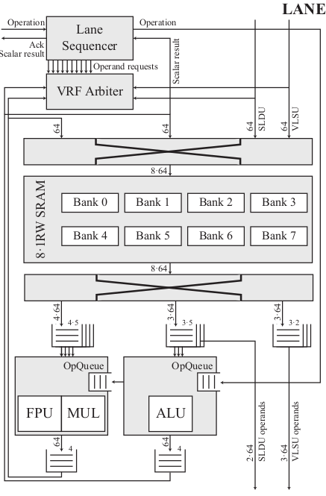
Vector Lanes : Organization
Ara can be configured with variable number of identical lanes
Each lane has its own lane-sequencer for keeping track of upto 8 parallel vector instructions.
Each lane contains part of Ara’s whole VRF and execution units.
VRF arbiter controls access to VRF
Inter-lane communication is only required by VLSU and SLDU
Each lane has a command interface attached to the main sequencer, through which the lanes indicate they finished execution of an instruction.

Slide 14
Lane Sequencer
Responsible for issuing vector instructions to the functional units, controlling theor execution in the context of a single lane.
Generate requests to read operands from VRF
Upto 10 operand requests can be generated which are given to the VRF arbiter.
In case of data hazards, the operand request rate is lowered as there is NO FORWARDING logic.

Slide 15
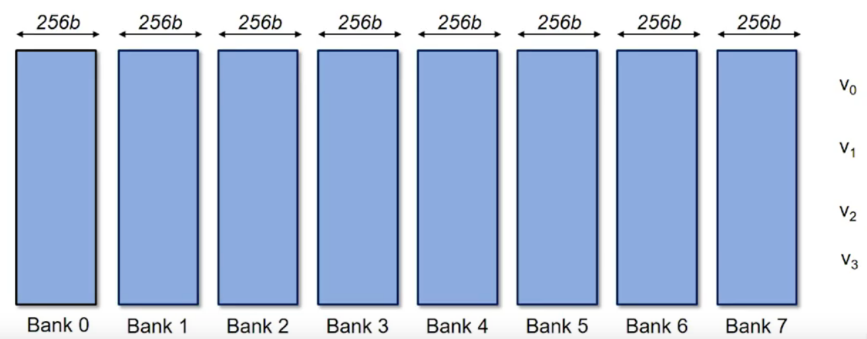
Vector Register File
Assume there are 4 lanes (N = 4). Reg. File contains 256b banks. However, physically, each lane contains only 1/4 th of each bank.
Assuming there re only 4 Vector Registers in the VRF, One bank stores 4 operands consumed in parallel by 4 lanes.
VRF Bank Organization.Courtesy: Ara RISC-V Conference ppt

Slide 16
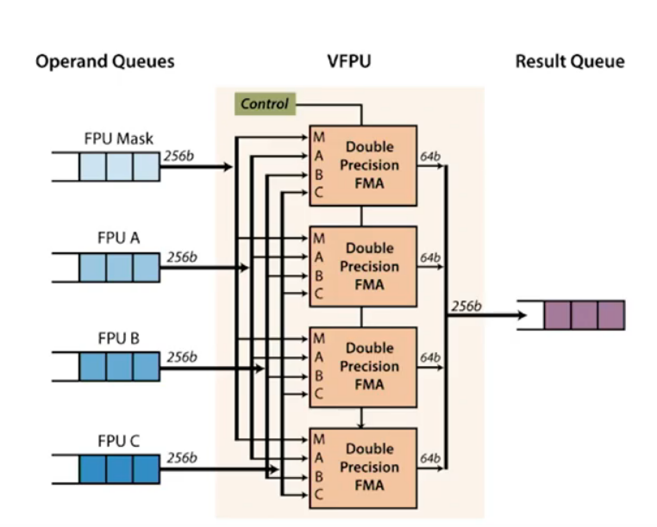
Most Complex Instruction: Fused Multiply Add (FMA instruction)
FMA insructions contain Four operands
vd[i] = lsb(vmask[i]) ? vsa[i] + vsb[i] + vsc[i] : 0;
FMA is pipelined (5 cycles) to meet fminconstraint
The four lanes operate in lockstep
  Low control overhead
Each lane gets 64b operands from four 256b input FIFO buffers (A, B, C, VMASK)
  Number of lanes determines buffer width

Slide 17
Vector Register File
Multi-poted Registers are essential for a VRF as several instructions in the pipeline or sevaral data in the same instruction may access the same RF elements independently.
Due to physical design implemention contraints, Ara’s VRF is implemented as a set of single-ported (1RW) banks.
The width of each bank is 64-bits
In RISC-V’s vector instruction, the predicated multiply and add (FMA) instruction is the worst case regarding throughput, which reads 4 operands to produce one result and takes 5 clock cycles(details in next slide)
Therefore, in steady state, 5 banks are accesses simultaneously to sustain maximum throughput for FMA instruction.
Ara’s VRF has 8 banks per lane.

Slide 18
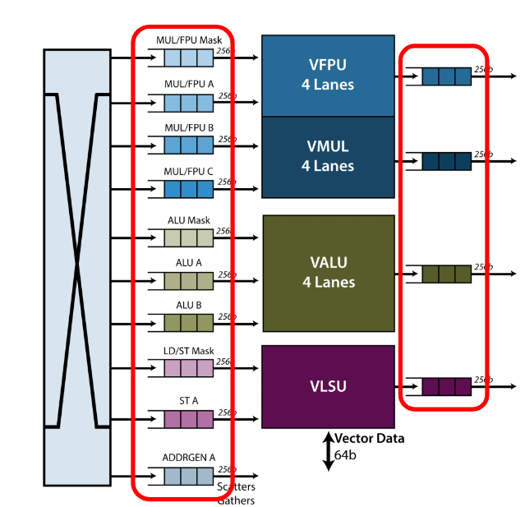
Operand Queues
Queues needed to sustain maximum throughput for the lock-step operation of the FUs, while hiding the latency caused by banking conflicts in the VRF
One input queue buffer provides one operand to all the (four) lanes
256b (4x64b) wide entries
One FIFO buffer per operand per multi-lane datapath unit
10 FIFO buffers
Output queue buffers for output operands, one per multi-lane datapath unit
Operand Q : Courtesy : Ara RISCV Summit

Slide 19
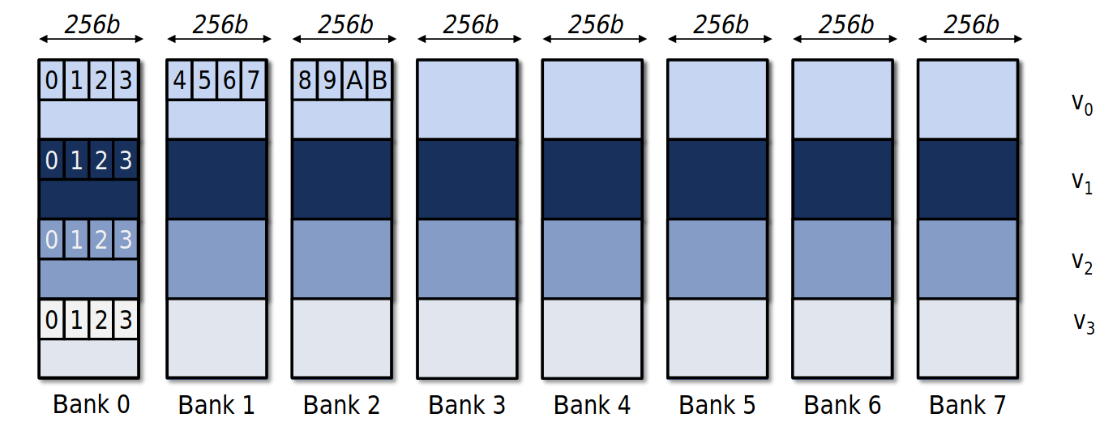
Data Organization in VRF

Slide 20
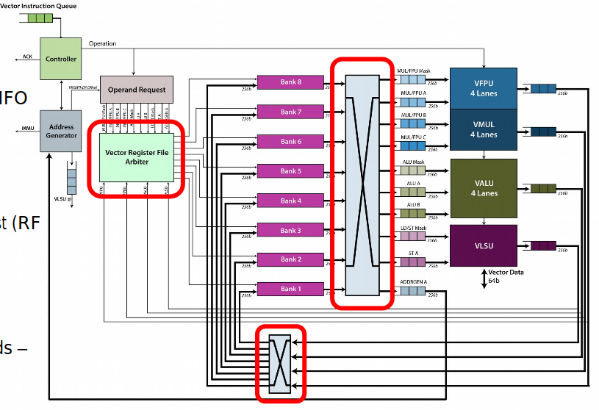
Vector Register File and Operand-Deliver Interconnect

Slide 21
Vector Register File and Operand-Deliver Interconnect
All-to-all input log-interconnect
  256b wide (64bx4)
  8-source (VRF banks) x 10-dest (FIFO buffers)
  Registered boundaries (for timing)
All-to-all output log-interconnect
  256b wide (64bx4)
  4-source (out FIFO buffers) x 8 dest(RF banks)
Fixed-priority arbiter
  VRF is built as 1RW SRAM bank
  𝑃𝑀>𝑃𝐴>𝑃𝐵>𝑃𝐶
  Writes have lower priority than reads –unless output queue is full

Slide 22
Computation Cycle – Execution of an FMA Instruction
Consider the execution of the following instruction:
vmadd vd, vsa, vsb, vsc, vsmask
We take a vector of length = 256
What is the execution time?
Ideally, with 4 lanes, it should be 256/4 = 64
However, due to overheads due to pipeline start, register bank clashes, it will be be slightly more.

Slide 23
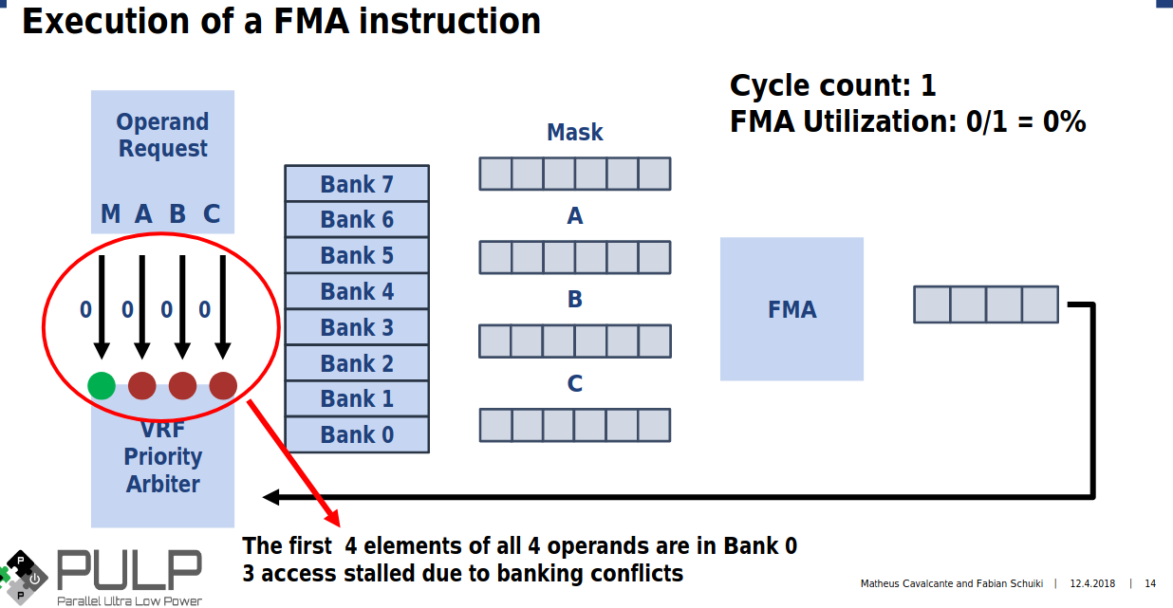

Slide 24
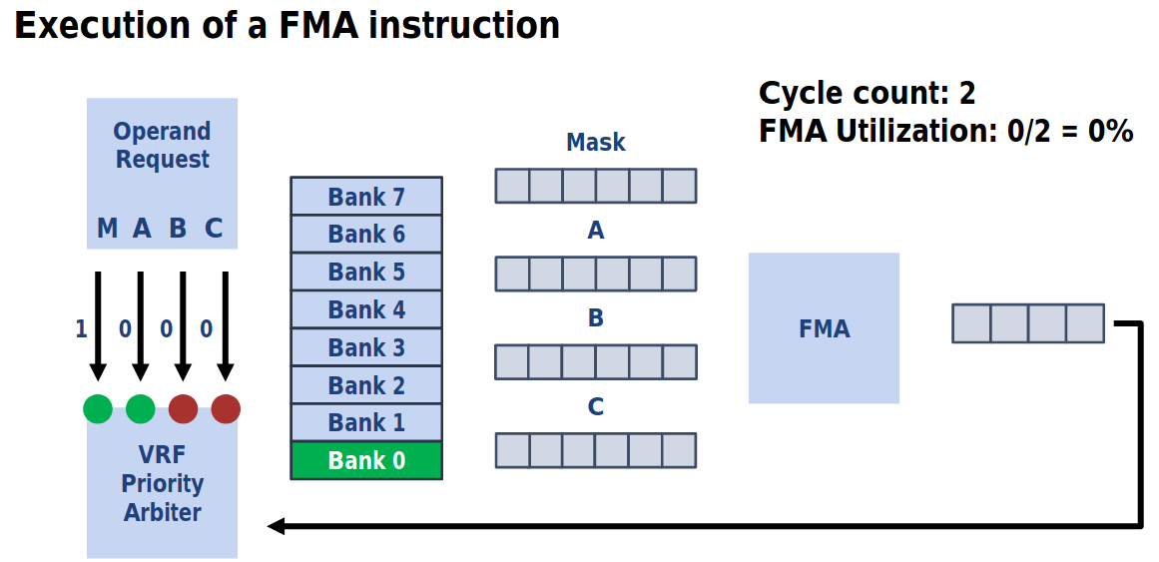

Slide 25
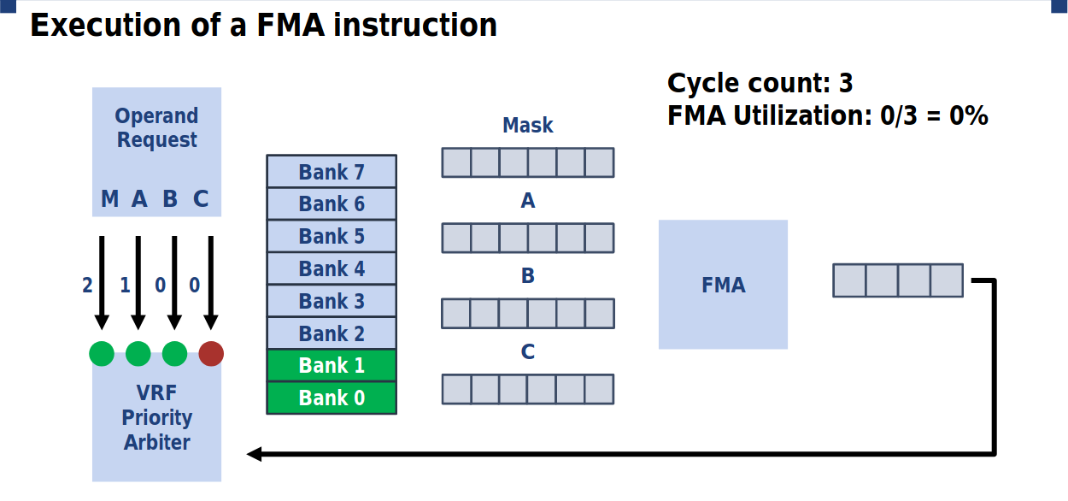

Slide 26
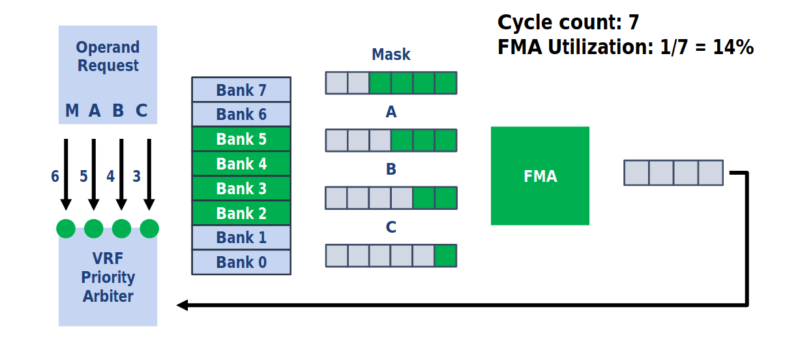

Slide 27
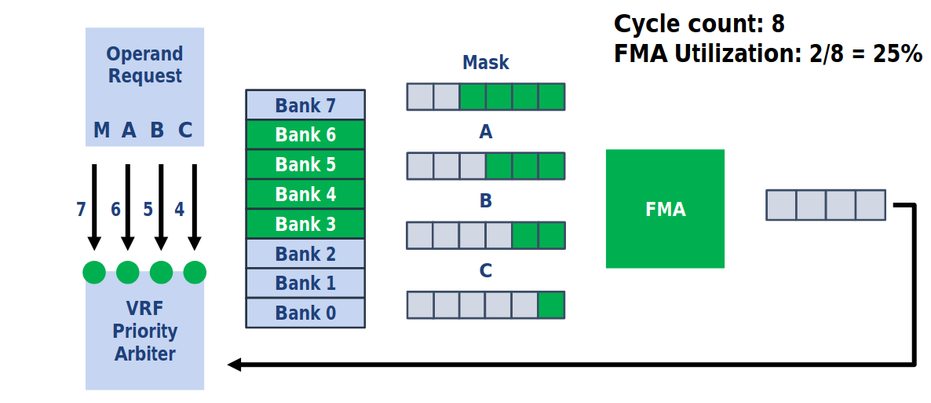

Slide 28
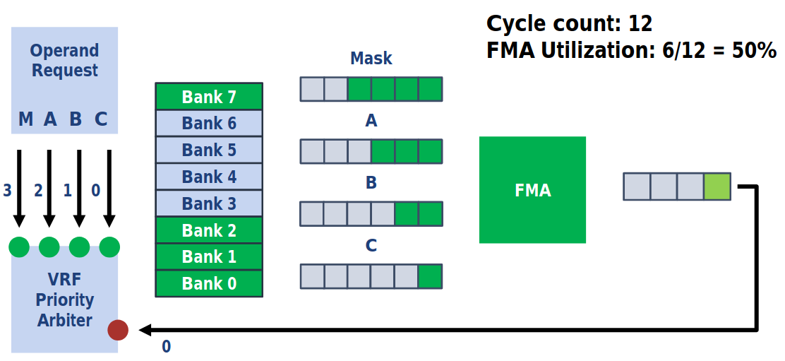

Slide 29
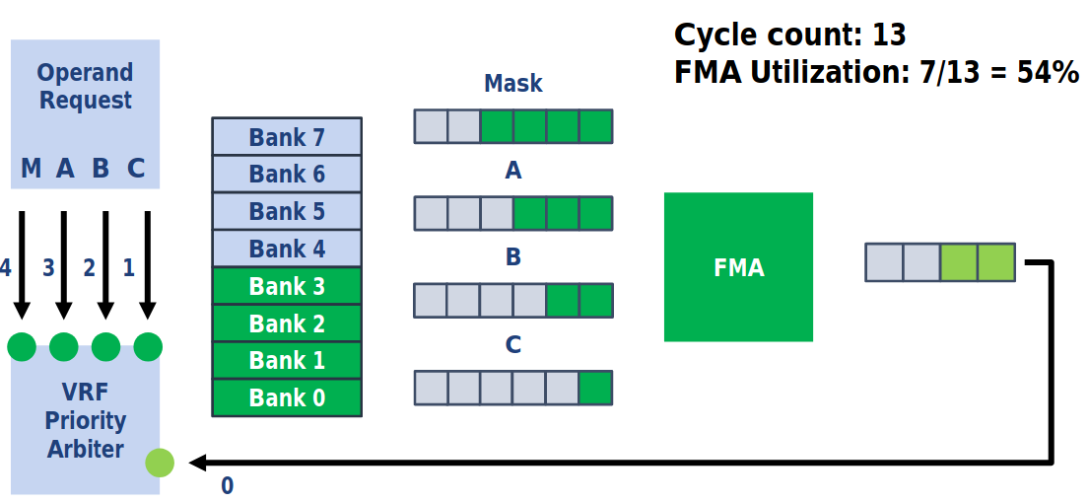

Slide 30
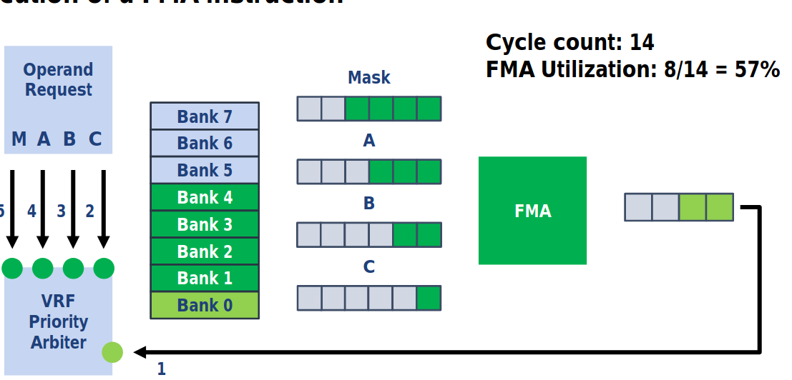

Slide 31
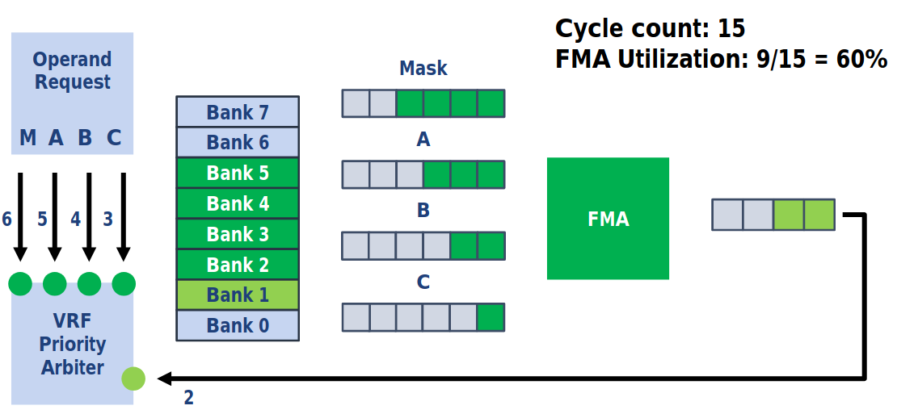

Slide 32
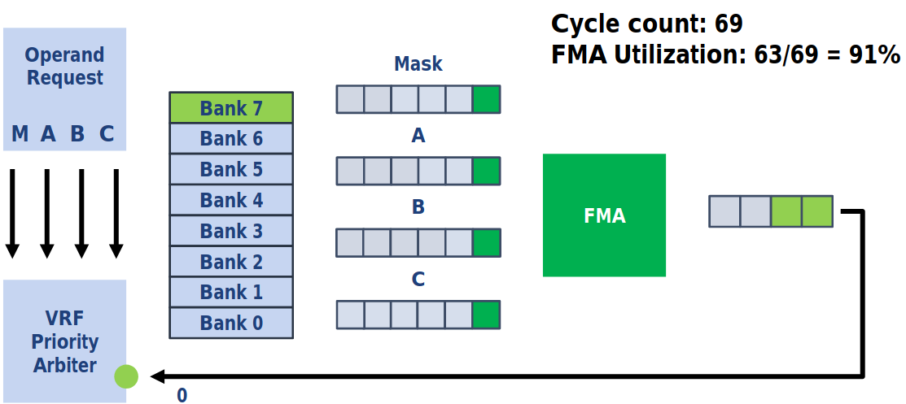

Slide 33
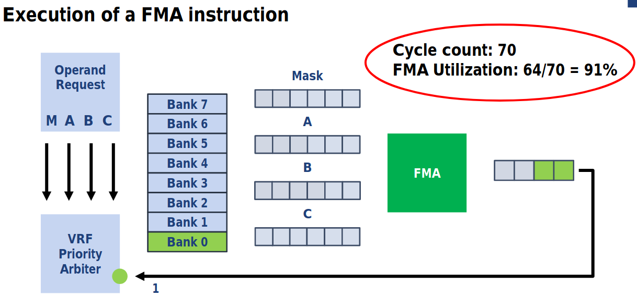

Slide 34
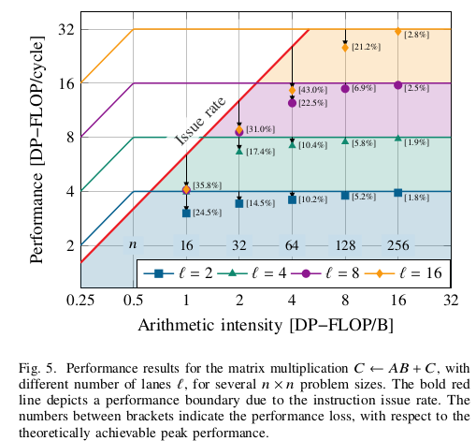
Benchmarking
The relationship between processor performance and memory bandwidth can be analyzed with the roofline model.
Depicts the peak achieveable performance (in OP/cycle) as a function of the arithmetic intensity I, defined as the algorithm- dependent ratio of operations per byte of memory traffic.
According to this model, computations can be either compute-ound or memory bound
The peak performance is achieveable only if the algorithm’s arithmetic intensity, in operations per byte, is higher than processor’s performance per memory bandwidth ratio.
For Ara, it enters compute-bound region when arithmetic intensity > 0.5 DP-FLOP/B.
Courtesy: Ara paper

Slide 35
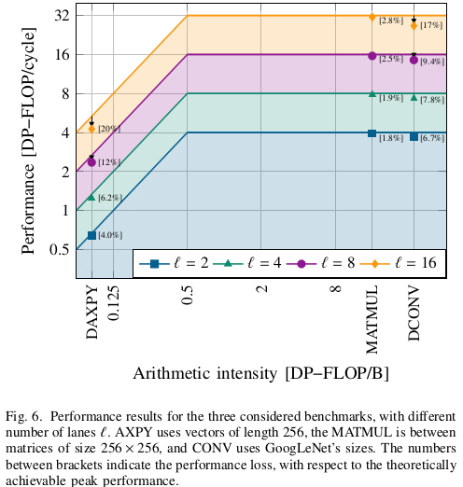
Three Benchmarks
Matrix Multiplication
  C <-- AB + C where all matrices are n x n having DP elements
  The algorithm requires 2n^3 floating-point operations (one FMA is considered as 2 operations) and 32n^2 Bytes of memory transfers.
  Therefore, the algorithm has arithmetic intensity 2n^3 / 32n^2 = n/16 DP-FLOPS/B
Convolution(DCONV)
  Example frm GoogLeNet CNN, Input Image = 112 x 112 x 3; kernel = 7 x 7 x 3 x 64
  This results in a total of 7 x 7 x 3 x 64 x 112 x 112 FMAs, or 236 DP-MFLOPS
  Memory : (3 x 118 x 118 + 7 x 7 x 3 x 64 + 64 x 112 x 112 ) x 8 Bytes = 6.44 MiB
  Therefore, arithmetic intensity = 34.9 DP-FLOPS/B =>Heavily Compute Bound
DAXPY
  Y <-- aX+Y where X, Y are n-dim vectors and a is a DP scalar
  Requires 2^n operations (n FMAs) and 24n bytes of memory transfers
  Therefore, this algorithm has arithmetic intensity = 1/12 DP-FLOPS/B =>Memory Bound

Slide 36
Week 11: Oct 9th 2020
Actions
1. Study RISC-V Vector Extension
Work Done
1. Study RISC-V Vector Extension Spec (7 out 20 Chapters)

Slide 37
Goals for Standard RISC-V “V” Extension
Efficient and Scalable to all reasonalble design-points
  Low Cost Micro-controller or high-performance supercomputer
  In-order, decoupled, or out-of-order microarchitectures
  Integer, fixed-point, or floating-point data types
Compiler Support for Auto-vectorization
All instructions to fit into Standard 32-bit encoding space
Be base for future vector++ extensions such as Crypto, Machine Learning extensions on top of RISC-V “V” extension.
Source: RISCV “V” Extension Proposal by Krste Asanovic, UC-Berkeley and SIFive, 2016

Slide 38
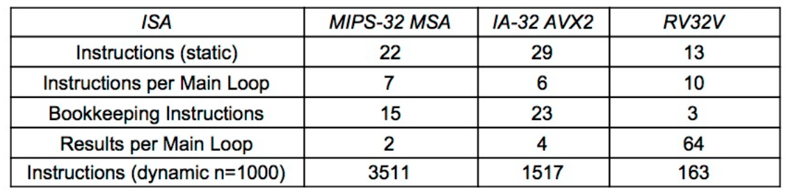
V Key features
Cray-style vectors
  “The right way” to exploit SIMD parallelism
  Packed-SIMD, GPU etc., are inefficient in terms of number of instructions in the instruction set, number of instructions executed and lack of portability. (Source: Computer Organization RISC-V Edition , Chapter 8)
Implementation-dependent vector length
  Same binary runs on different CPUs with different hardware vector lengths
Reconfigurable Vector Register File (allow different vector lengths and elemenet sizes)
Mixed Precision Support (can operate with operands with different widths in the same op)
Source: Comp Org. Ch 8

Slide 39
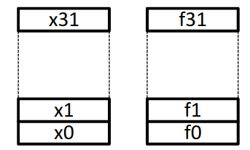
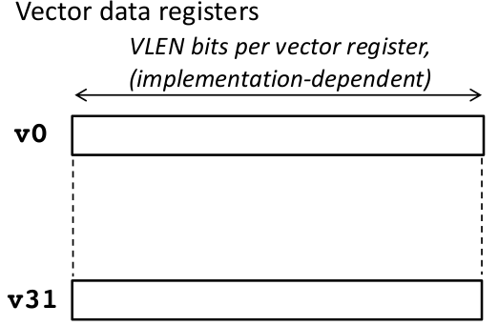
V Extension State
Standard RISC-V scalar x and f registers
Upto 32 vector registers v0-v31 of atleast 4 elements each, with variable bits/element(size in powers of 2)
Vector Configuration
  Vector Length Register vl
  Vector type register vtype
  Other Control Registers
    vstart (For trap handling)
    vrm/vxsat - Fixed point rounding mode/ sateuration
MVL = Maxiumum Vector Length
One Predicate Register - v0 for containing vector masks

Slide 40
Vector Unit Implementation Dependent Parameters
ELEN : Size of largest element in bits
VLEN : No. Of bits in each vector register
  VLEN >= ELEN
SLEN : Striping Distance in bits
  Sets how many bits are packed contiguously into one vector register before moving to the next vector register in the group.
  The striping length SLEN for an implementation is set to optimize the tradeoff between datapath wiring for mixed-width operations and buffering needed to corner-turn wide vector unit-stride memory accesses into parallel accesses for the vector register file.
  This is generally the width of the memory port.
  VLEN >= SLEN >= ELEN

Slide 41
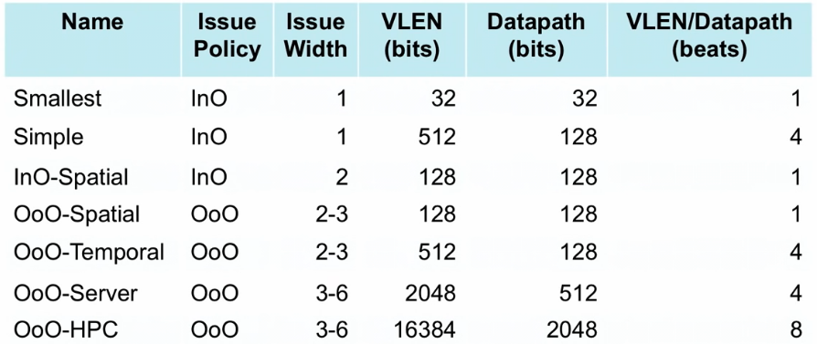
Some Microarchitecture Design Points
Source: Vector Extension 0.7 Slides , Krste Asanovic, UC Berkeley, RISCV Summit - 2019

Slide 42
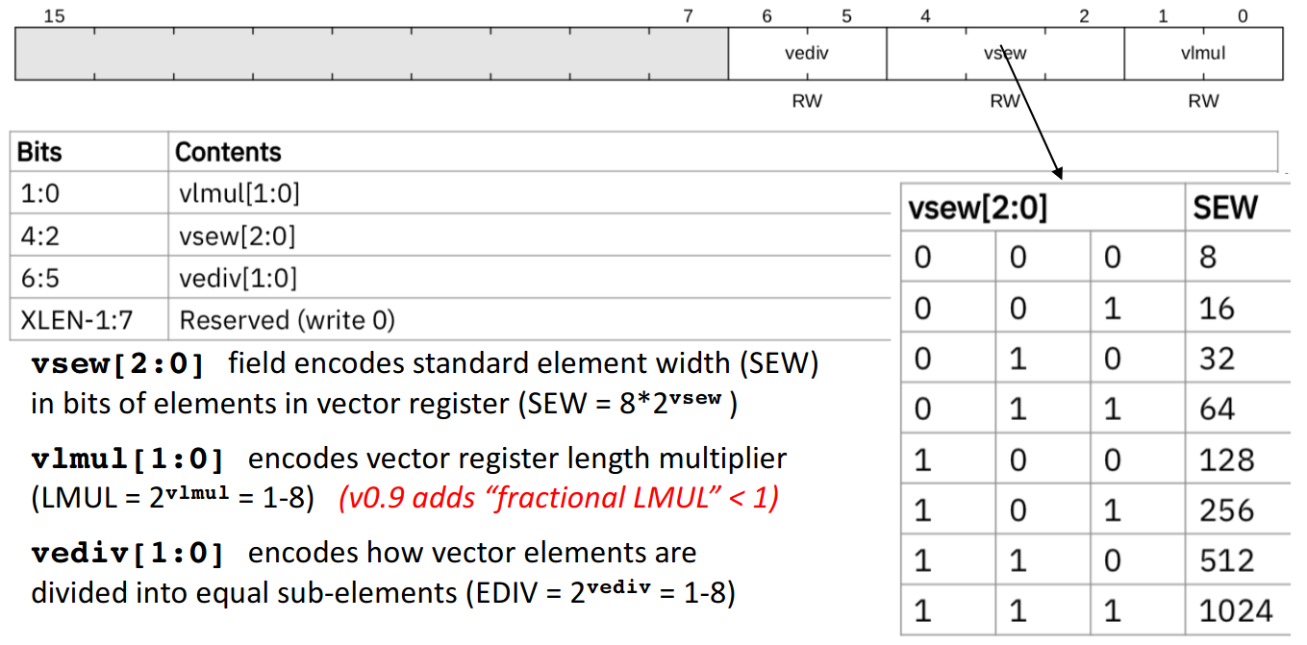
Vector Type Register
Slide adapted from :https://inst.eecs.berkeley.edu/~cs152/sp20/lectures/L17-RISCV-Vectors.pdf -2020

Slide 43
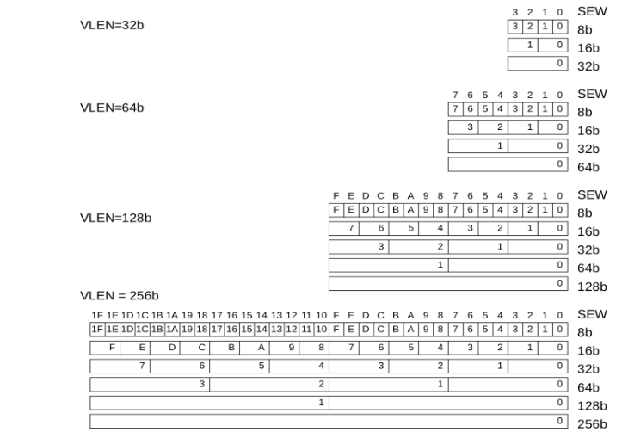
Example Vector Register Layouts

Slide 44
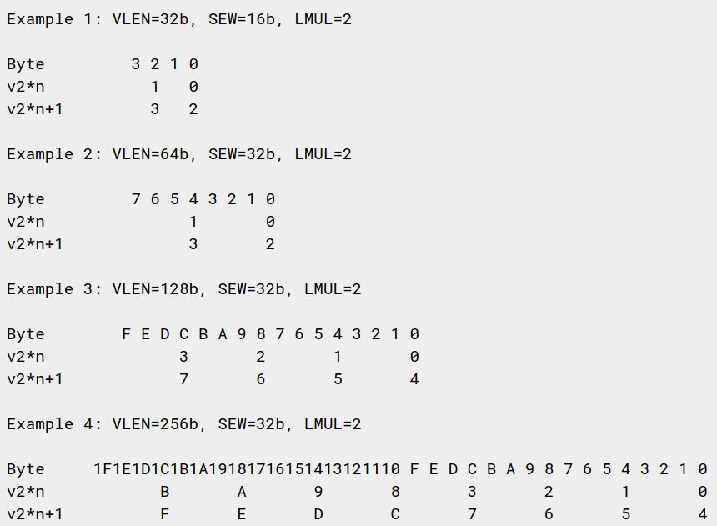
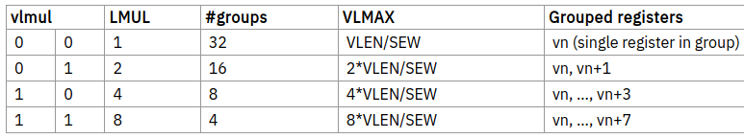
Vector Register Grouping (lmul)
Multiple registers can be grouped together so that a single instruction can operate on multiple vector registers
Term “Vector Register Group” referes to one or more registers that form a single operand
Used for :
  Accomodate mixed-width precision ops
  To increase efficiency by using longer vectors when fewer separate registers needed

Slide 45
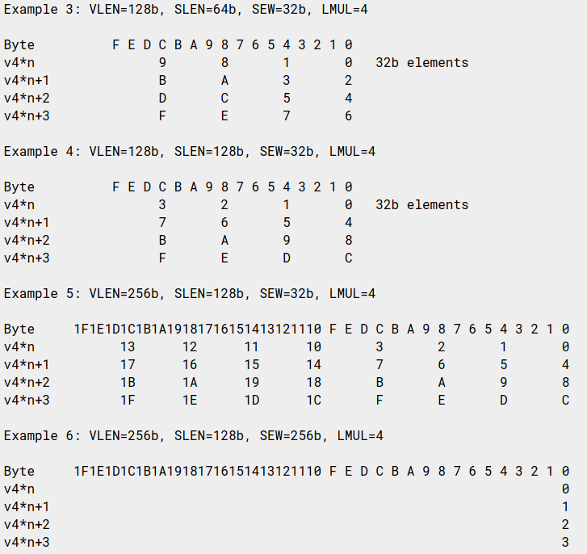
LMUL with shorter striping length (SLEN < VLEN)

Slide 46
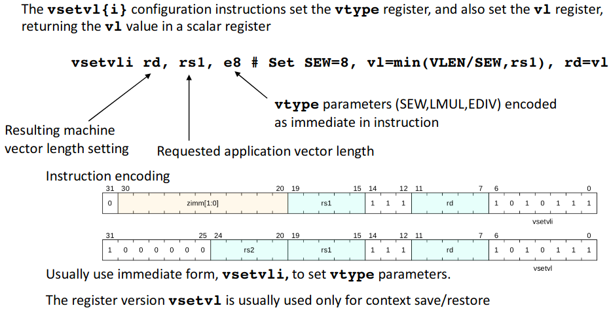
Setting vector configuration, vsetvli/vsetvl

Slide 47
vsetvl{i} Instruction
The first scalar register argument, rs1, is the requested application vector length (AVL)
  The type argument (either immediate or second register rs2) indicates how the vector registers should be configured
Configuration includes size of each element, SEW, and LMUL value
The vector length is set to the minimum of requested AVL and the maximum supported vector length (VLMAX) in the new configuration
  VLMAX = LMUL*VLEN/SEW
  vl = min(AVL, VLMAX)
The value placed in vl is also written to the scalar destination register rd

Slide 48
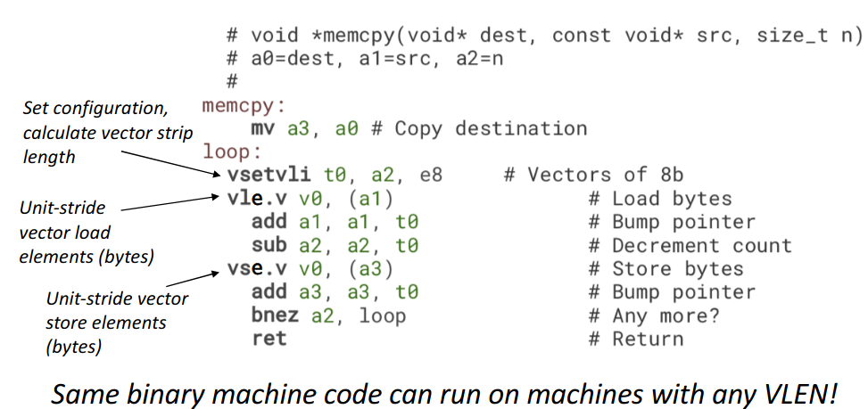
Stripmined vector Memory Copy Example

Slide 49
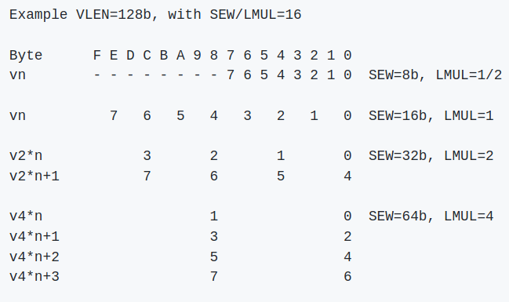
Mixed Precesion Operations Support
The vector ISA is designed to support mixed-width operations without requiring explicit additional rearrangement instructions.
The recommended software strategy is to modify vtype dynamically to keep SEW/LMUL constant (and hence VLMAX constant) when operating on vectors of different precision values.
The following example shows four different packed element widths (8b, 16b, 32b, 64b) in a VLEN=128b implementation. The vector register grouping factor (LMUL) is increased by the relative element size such that each group can hold the same number of vector elements (VLMAX=8 in this example) to simplify stripmining code.

Slide 50
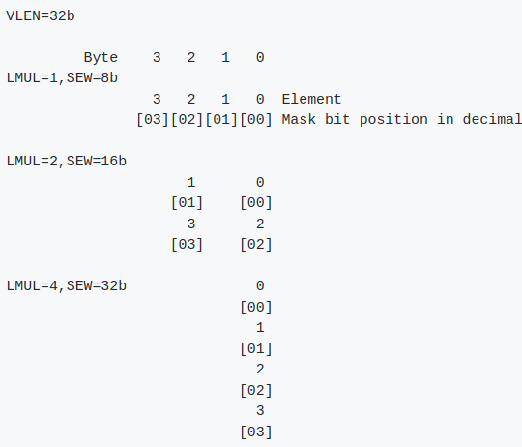
Mask Register
Nearly all operations can be optionally under a mask (or predicate) held in vector register v0
A single vm bit in instruction encoding selects whether unmasked or under control of v0
A vector mask occupies only one vector register regardless of SEW and LMUL.
Each element is allocated a single mask bit in a mask vector register.
The mask bit for element i is located in bit i of the mask register, independent of SEW or LMUL.

Slide 51
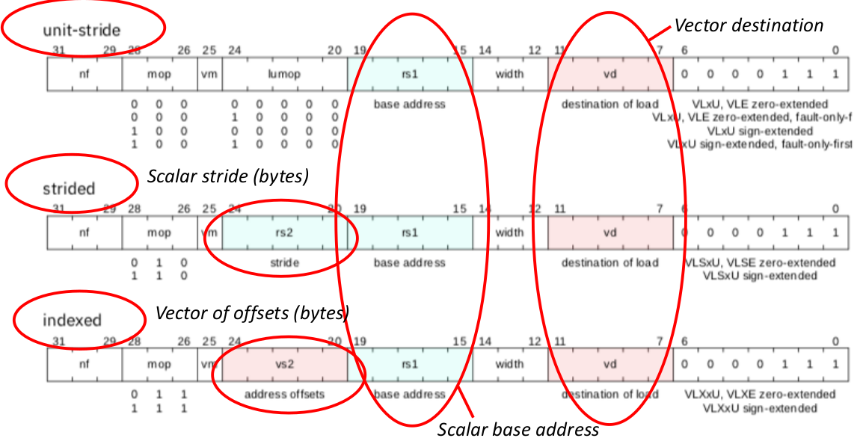
Vector Load Instructions
Move values between vector registers and memory

Slide 52
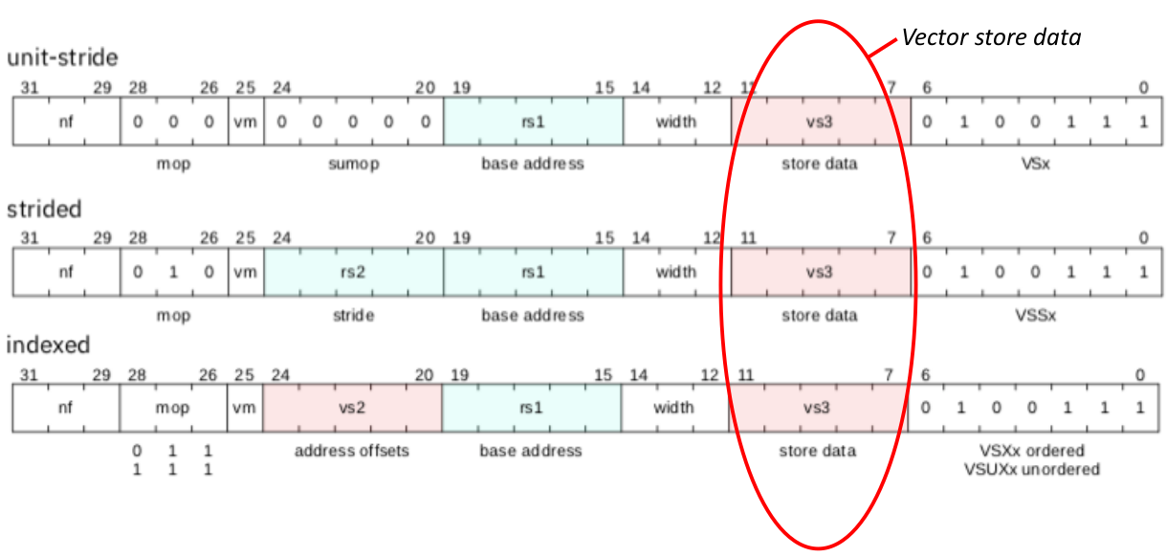
Vector store Instructions

Slide 53
Vector Unit Stride Load Stores
Vector Strided Load Stores
Vector Strided Load Stores
Vector Indexed Load Stores

Slide 54
Week-12 16 Oct 2020
1. RISC-V ISA Vector Extension
Instruction Set {Chapters 7 – 17}
2. Further Course of Action

Slide 55
ARITHMETIC AND LOGICAL VECTOR INSTRUCTIONS
ADD
SUB
MUL
DIV
FMA
CMP
CVT
LOGIC
CLIP
SHIFT
REDUCTION
INTEGER
FLOATING POINT
FP
WIDENING / NARROWING
W/N
VECTOR - VECTOR
VECTOR - SCALAR
V-S
VECTOR - IMMEDIATE
1. There is NO SPERERATE FP Vector Regsiter file. Both Integer and FP values are stored in the same Vector Register files.
2. Nearly all operations can be optionally under a mask (or predicate) held in vector register v0.
3. A single vm bit in instruction encoding selects whether unmasked or under control of v0

Slide 56
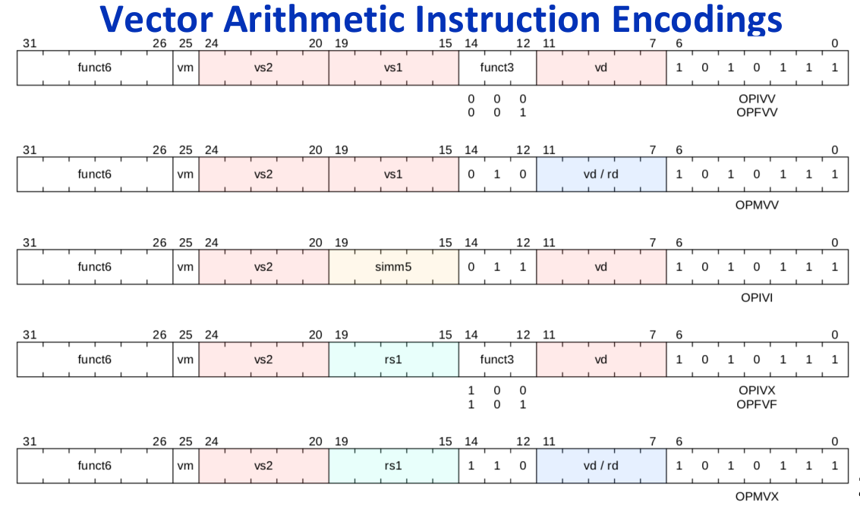

Slide 57
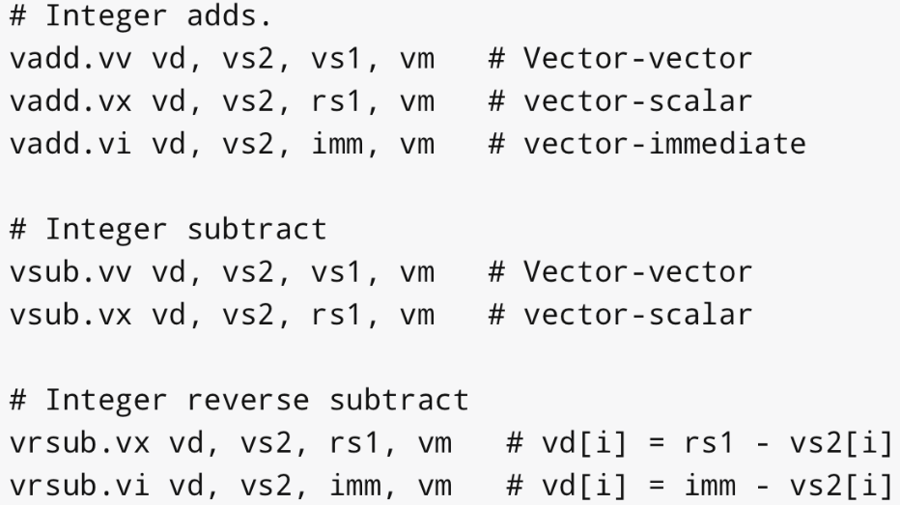
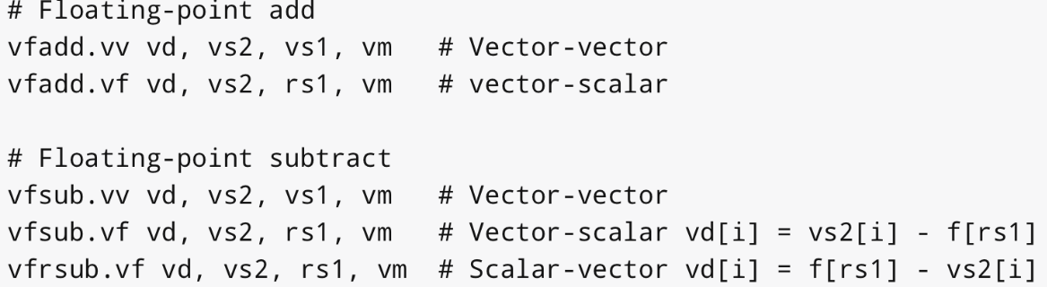
Vector Add Instructions

Slide 58
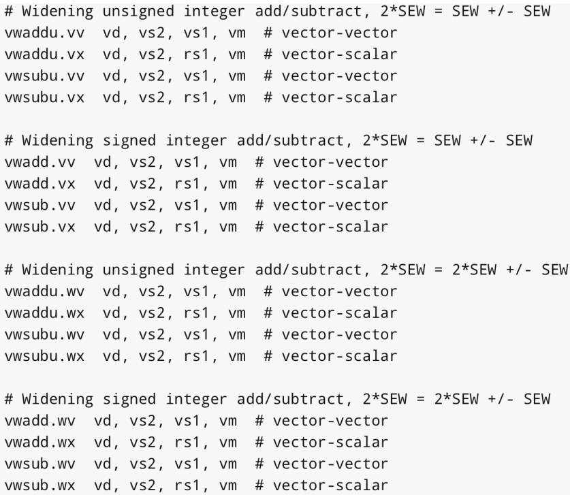
Widening Integer Add Instructions

Slide 59
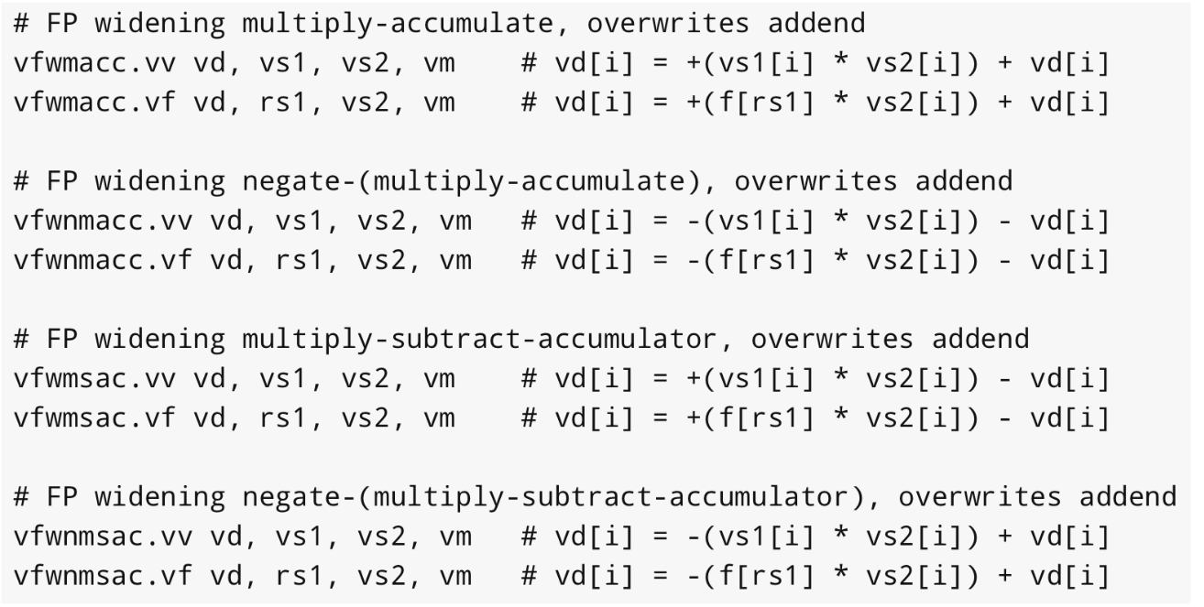
Widening FP Fused Mult-Acc

Slide 60
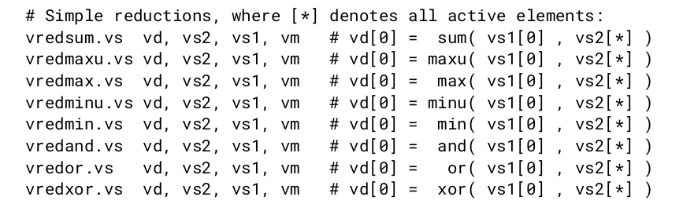

Vector Reduction
Take a Vector Register group of elements and a scalar held in element 0 of a vector register(vs1[0]), and perform a reduction operation using some binary operator to produce a scalar result in element 0 of a vector register(vd[0]).
Supports FP, Widening, Ordered and Un-ordered sums

Slide 61
Recent Developents in RISCV-V Ext
Andes Group develops Vector based Core for RISCV -V Specifications (First Company to do so) - May 26, 2020
GNU-tool chain for Vector Spec v0.8 available on GitHub
RISC-V V likely to finallize in Ver1.0

Slide 62
Future Course of Action(s)
Micro-architecture design
  Very basic outline provided in Patterson Hennessy text(5th Edition)
  Krste Asanovac’s PhD thesis (1998) discusses microarchitectural design in slightly more detail (reg-file, memory design (w/o cache),
  Couple of papers such as Hwacha, Ara (Open Source, not gone thru yet)
High level design for integrating Vector processor into RISCV core
  Interface between main core and vector core
  How closely coupled ? On which bus should the Vector Unit be present Main bus or peripheral(AXI) bus?
Design of FPU (16,32)
  I’m unfamiliar
  IP-Core available to integrate OR else, design from scratch?
ISA-Simulator coding required ? yes
Resources on FPGA . Require Part number details

Slide 63
Ordered and Unordered Sums
Ordered Sum Must sum the values in element order, starting with the scalar in vs1[0]--that is, it performs the computation: (((vs1[0] + vs2[0]) + vs2[1]) + ... ) vs2[vl-1], where each addition operates identically to the scalar floating-point instructions in terms of raising exception flags and generating or propagating special values. Code good for compiler to auto-vectorize.
Unordered Sum provides freedom to the implementation to perform reduction – Binary Tree of all vector operands followedby log2(n) steps of addition. This is faster

Slide 64
Vector Permutation Instructions
Provided to move elements around within the vector registers.
Integer Scalar Move Instruction transfers a single value between a scalar x register and element 0 of a vector register.
Vector Slide Instructions move vector elements up or down in a vector register group
Vector Register Gather Instruction reads elements from a first source vector register group at locations given by a second source vector register group.
Vector Compress Instruction allows elements selected by a vector mask register from a source vector register group to be packed into contiguous elements at the start of the destination vector register group.
Whole Vector Register Move Instruction copies all VLEN bits in rs -->rd

