Slide 1
RISC-V for AI
Progress

Slide 2
Week 5:
Agenda:
1. Compiler Optimization
2. Execution on Raspberry Pi3
3. Profiling Results for Convolution, Maxpooling and Matrix-Vector Multiplication operations

Slide 3
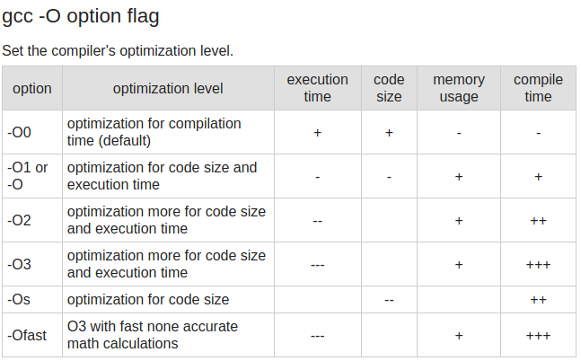
Compiler Optimization
Usage of gcc flag: -O3
Results in (1/4) execution time and (1/8) code size
The Assembly Code reveals the usage of SIMD Instructions in x86 and NEON-Vector Extension Insturctions in ARM
https://www.rapidtables.com/code/linux/gcc/gcc-o.html

Slide 4
Intel Corei3 8145U CPU Specs.
No. of Cores | 64-bit Dual -core/Two computing threads per core
CPU Clock Speed | 2.1 Ghz to 3.9 GHz
Memory | 12 GB DDR4
Cache Organization | L1: 128 KiB ->L1i = 64 KiB , L1d = 64 KiB, 8 -way Set Associative L2: 512 KiB ->4 Way Set Associative L3: 4 MiB -> 12 Way Set Associative
ISA Extensions | Supports SIMD, Vector Extensions
https://en.wikichip.org/wiki/intel/core_i3/i3-8145u

Slide 5
ARM Cortex A53 (BCM2837 SoC)
CPU | 4 x ARM Cortex A-53, 1.2 GHz
RAM | 1GB LPDDR2
Cortex A53 Processor | 2-wire decode superscalar, 8-stage pipelined , in-order execution (based on ARM v8-A ISA)
ISA Extension Support | Floating Point, DSP, NEON SIMD Instructions
Cache | 64-byte lines L1 -8KiB to 64 KiB L2 – 128 KiB to 2MiB

Slide 6
Comparison of Execution Times
Function | x86 | Cortex A53 | x86 with 03 | A53 with O3
CNN_main() | 228 205 668 | 227 123 968 | 59 625 565 | 59 916 093
Conv2d_2() Image =[12 , 12] kernel = [5,5,32,64] | 201 948 748 | 196 015 915 | 57 662 471 | 57 727 822
Conv2d_1() Image = [28, 28] Kernel = [5,5,1,32] | 24 691 568 | 29 450 033 | 1 703 225 | 1 833 513
Maxpool2_1() Inp = [24,24] | 638 077 | 671 422 | 109 532 | 128 582
Perceptron(2-layer) 1024 -->10 | 391 168 | 411 898 | 125 477 | 197 073
relu | 10 | 14 | 2 | 5.5
Maxpool2_2 Inp = [8,8] | 101 441 | 173 322 | 24 474 | 28 728
max4 | 21 | 18 | 4 | 10

Slide 7
Profiling Analysis for CNN
Analysis of Innermost Loop of Convolution
{
filt_offset = x*((FILT1_DIM2)*(FILT1_DIM3)*(FILT1_DIM4))\
+ y*((FILT1_DIM3)*(FILT1_DIM4))\
+ z*(FILT1_DIM4)\
+ output_depth;
img_offset = (output_row+x)*((IMG_DIM2)*(IMG_DIM3))\
+ (output_col+y)*(IMG_DIM3)\
+ z;
sum+= filter[filt_offset] * img[img_offset];
}
No. of Iterations : 3 276 800

Slide 8
Inner Loop Analysis contd...
No. of Iterations : 3 276 800
Parameter | x86 | Cortex-A53 | X86 with O3 | A53 with O3
No. of instructions | 54 | 50 | 7 | 7
CPI | 1 for all except 11.10 for 1 movss | 1 for all except 11.097 for 1 vld | 1 for all except 11.10 for 1 movss | 1 for all except 11.097 for 1 vld
Observations:
1. For computing the Matrix offsets, both x86 and ARM compilers have
replaced all multiplications with a combination of SLL and ADD
2. All Loads appear to take 1 clock cycle for L1- Cache hit.
3. Instruction distribution: LD (13), ADD(12), LSL(8), STR(4), MOV
4. Possibility of Improvement: Even with -O3 optimization, the loop executes for 3276800 times.
Possibly imptrove by unrolling the inner loop 5 x 5 x 32 (800 - 1) times by accepting image and filters as vectors.
5. -O3 uses instructions such as vmla (mac) , vpust/pop (multiple regs to mem), vldmia(load multiple)

Slide 9
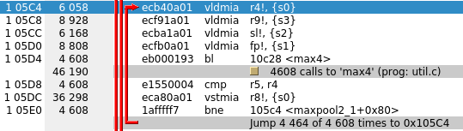
Profiling Analysis for Maxpool Operation
for (int row=0; row<MAXPOOL2_DIM1;row++)
{
for (int col=0;col<MAXPOOL2_DIM2;col++)
{
for (int depth=0; depth<MAXPOOL2_DIM3;depth++)
{
e1 = row*2*(CONV2_DIM2)*(CONV2_DIM3) + col*2*(CONV2_DIM3) + depth; //00
e2 = row*2*(CONV2_DIM2)*(CONV2_DIM3) + (col*2 + 1)*(CONV2_DIM3) + depth;//01
e3 = (row*2 + 1)*(CONV2_DIM2)*(CONV2_DIM3) + col*2*(CONV2_DIM3) + depth; //10
e4 = (row*2 + 1)*(CONV2_DIM2)*(CONV2_DIM3) + (col*2 + 1)*(CONV2_DIM3) + depth;//11
op_offset = row*(MAXPOOL2_DIM2)*(MAXPOOL2_DIM3) + col*(MAXPOOL2_DIM3) + depth;
output[op_offset] = max4(input[e1],input[e2],input[e3],input[e4]);
}
}
}
Observation : A53 and x86 use Vector and SIMD instructions respectively
with Compiler Optimization (-O3)

Slide 10
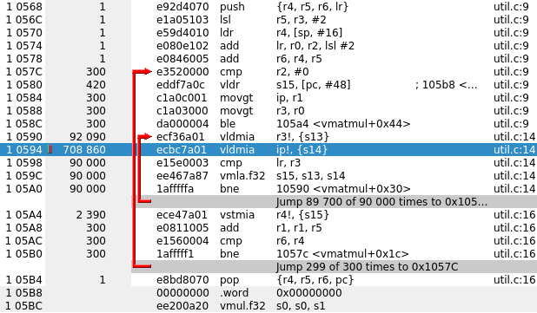
Matrix Vector Multiplication [1 x 300] x [300 x 300]
3 void vmatmul(float vect[], float mat[],int vdim, int mat_dim2, float res[])
4 {
5 // Multiply [ 1 x dim1] x [dim1 x dim2]
6 int mat_offset;
7 float mac;
8 float prod, mult_1, mult_2;
9 for (int i=0;i<mat_dim2;i++)
10 {
11 mac=0;
12 for(int j=0;j<vdim;j++)
13 {
14 mac += vect[j] * (*(mat + mat_dim2*i + j));
15 }
16 *(res+i) = mac; //store result into product
17 }
18 }

Slide 11
Cache Memory Profiling
Cache Level-wise Profile | x86 | Cortex-A53 | X86 with -O3 | A53 with -03
I refs | 193 809 805 | 192 768 160 | 25 663 967 | 25 987 578
I1 misses | 882 | 1139 | 879 | 1 121
LLi Misses | 877 | 832 | 875 | 812
D refs | 82 153 327 | 86 582 493 | 7 705 355 | 7 872 700
D1 misses | 3 350 271 (4.1 %) | 3 354 623 (3.8 %) | 3 355 431 (43.5%) | 3 355 668(42.6 %)
LLd misses | 7 320 | 7122 | 8197 | 7 086
Inference: Results are similar and cache memory performance is sufficiently good for Convolution

Slide 12
Week 6
Week 5 :Action
Run Neon Assembly for understaind its performance better
Agenda
Survey of ARM based Vector Extensions
Study of ARM’s Edge ML Inference SoC

Slide 13
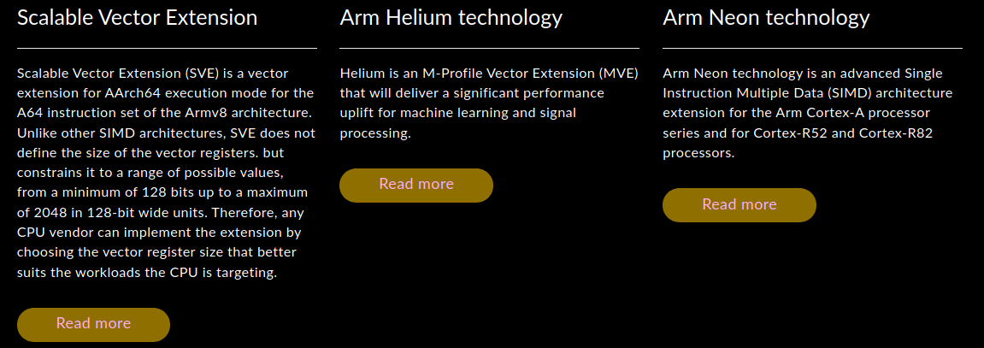
ARM SIMD ISAs
https://developer.arm.com/architectures/instruction-sets/simd-isas

Slide 14
Scalable Vector Extension (SVE)
SVE enables vectorization of loops which would either be impossible or not beneficial to vectorize with Neon.
Scalable Vector Length
Vector code allows each implementation to automatically choose its vector length, provided it is a multiple of 128 bits and does not exceed the architectural maximum of 2048 bits. SVE provides 32 scalable vector registers, named Z0 – Z31.
Per-lane predication
SVE provides 16 predicate registers, named p0-p15, with each predicate register being 1/8th of the size of the vector register (1 bit per byte), and therefore scalable in size. Predicate registers are written to use condition-creating instructions, such as compares. Condition-creating instructions allow later instructions to control which elements (or 'lanes') that a vector should be operated on (the 'active' elements).
Gather-load and scatter-store
Gather-load and scatter-store allows data to be efficiently transferred to or from a vector of non-contiguous memory addresses. The efficient transfer of data enables a wider range of source code constructs to be vectorized. To permit efficient accesses to contiguous memory, SVE provides an extensive set of load and store instructions which progress sequentially forwards through an array, supporting a full range of packed 8, 16, 32, and 64-bit vector element organizations.

Slide 15

Neon ARM Vector Floating Point Processor
SIMD architecture extension for the Arm Cortex-A and Cortex-R series processors.
Neon technology is a packed SIMD architecture.
Neon registers are considered as vectors of elements of the same data type, with Neon instructions operating on multiple elements simultaneously.
Adds about 23 new instructions
https://developer.arm.com/architectures/instruction-sets/simd-isas/neon

Slide 16
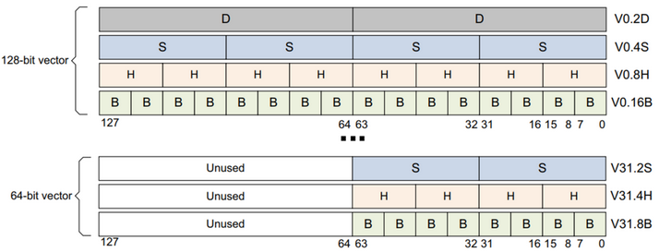
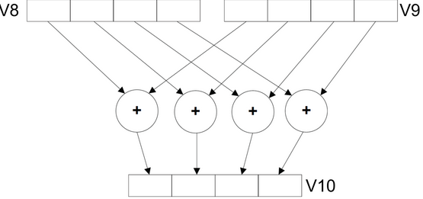
Packed SIMD Data Processing
Seperate Vector Register File that features 128 bit data.
Perform the same operation simultaneously for multiple data items. These data items are packed as separate lanes in a larger register.
The diagram shows 128-bit registers each holding four 32-bit values, but other combinations are possible for Neon registers:
Two 64-bit, four 32-bit, eight 16-bit, or sixteen 8-bit integer data elements can be operated on simultaneously using all 128 bits of a Neon register.
Two 32-bit, four 16-bit, or eight 8-bit integer data elements can be operated on simultaneously using the lower 64 bits of a Neon register (in this case, the upper 64 bits of the Neon register are unused).
https://developer.arm.com/architectures/instruction-sets/simd-isas/neon/neon-programmers-guide-for-armv8-a/introducing-neon-for-armv8-a/data-processing-methodologies

Slide 17
Classes of Instructions
1. Load /Store : vldr/vstr, vldm, vstm
2: Data Processing: vadd, vsub, vmul, vnmul, vdiv
3. Data Movement vmov,
4. Data type Conversion vcvt
Packed SIMD Drawbacks :
1. The length of all vectors is clamped
2. All operands should be of same type.

Slide 18
Helium ISA Extension
Helium is a new ground-up design that enables efficient signal processing performance in small processors. It provides many new architectural features that are not available in Neon. The key differences between Helium and Neon are as follows:
Helium is optimised for low power, high performing CPUs. As such, the architecture is designed to maximise usage of all available hardware.
Helium has fewer vector registers than Neon, however, some Helium vector instructions can access the scalar register file and the vector register file simultaneously.
Helium supports features like loop predication, lane predication, complex maths operations, and scatter-gather memory accesses.
Vector Processing Support
2 x 32-bit MAC/cycle
4 x 16-bit MAC/cycle
8 x 8-bit MAC/cycle

Slide 19
ARM Ethos-U55 NPU for ML
Coprocessor for ARM-Cortex M55
Embedded ML Inference on Cortex-M uCs
Designed to accelerate ML inference in area-constrained embedded and IoT devices.
Uses: ARM Helium Vector ISA extension
Helium is analogous to NEON for ARM-CortexM Series

Slide 20
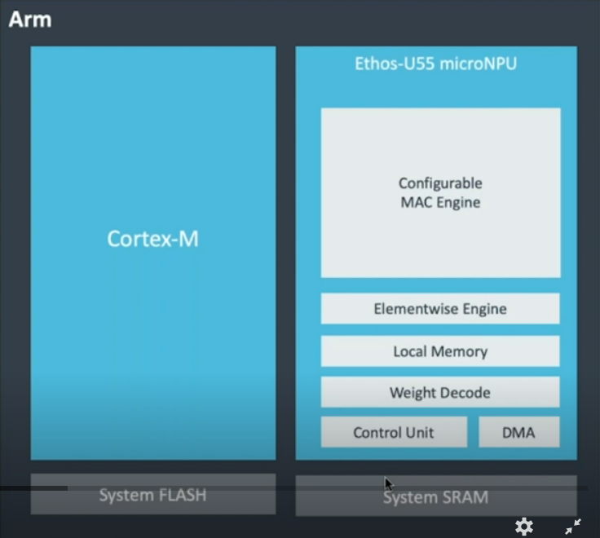
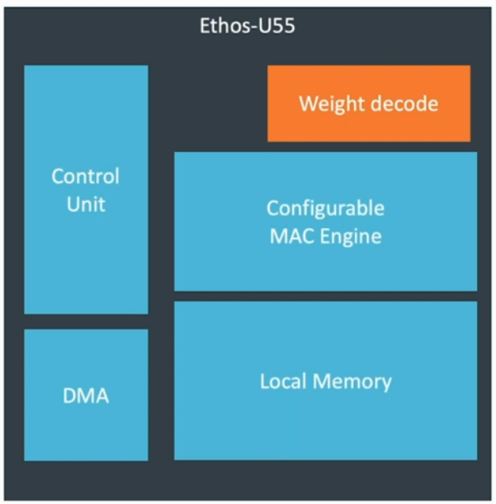
ARM Ethos-U55 NPU for ML – introduced in Feb 2020
https://www.brighttalk.com/webcast/17792/391867/technical-overview-of-the-arm-cortex-m55-and-ethos-u55-processors

Slide 21
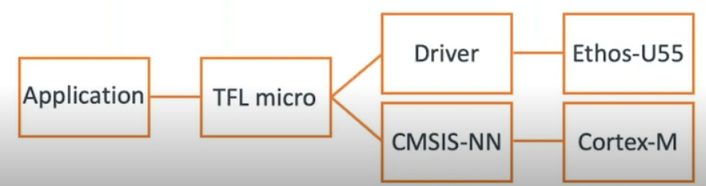
Features
> 150 new scalar and vector instructions
Low overhead loops (due to predication)
Weight Decoder and DMA for on the fly weight decompression (Weight Compression done offline)
Configurable MAC(32/64/128/256)
Ethos-U55 can completely execute networks that map to the supported operator set. Such as : Deepspeech-V1 , RNNNoise, Wav2letter ,
Any unsupported operation falls back to Cortex-M55 for execution
Softmax is not supported
Execution Flow

Slide 22
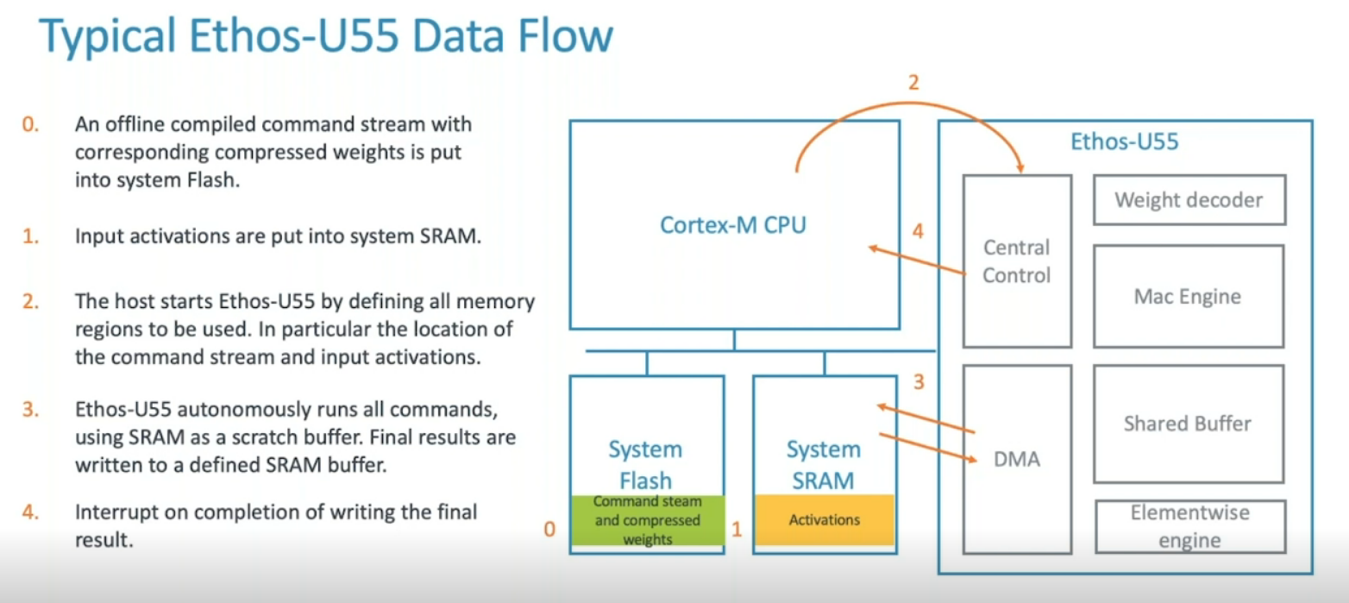
https://www.brighttalk.com/webcast/17792/391867/technical-overview-of-the-arm-cortex-m55-and-ethos-u55-processors

Slide 23
Week-7 and 8
Getting Started with ARM Assembly
Disassembly analysis of Arm Neon Code using Raspberry Pi 3
Assemling on ARM
as -g main.s -o main.o
as -g mvmul.s -o mvmul.o
ld -o mvmul main.o mvmul.o

Slide 24
Fact Check
 | Understanding | Source
1. | Raspberry Pi3 contains ARM Cortex A53 | Rpi3 User manual
2. | Raspberry Pi3 contains ARM Neon CoProcessor | Cortex A53 Datasheet
3. | Command for Compiling NEON Assembly on Rpi is: gcc -mfpu=neon-vfpv4 -o <exe> <src1.c> <src2.c> ... | 1. ARM v8 Programmers Manual, 2. Raspberry Pi Assembly Language Programming by Stephen Smith (z-lib.org) 3. If Flag not given, “illegal instruction” compiler error pops up.

Slide 25
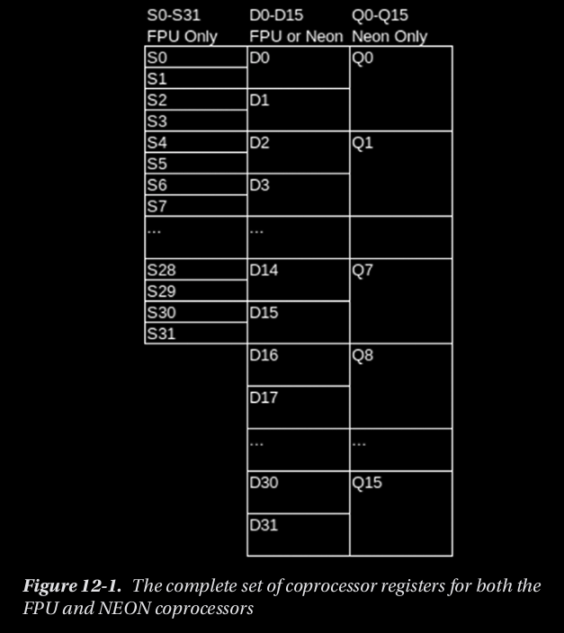
Programming with NEON
SIMD Topology
Can operate on 8,16,32 bit INT and Single Precision Float Numbers.
It cannot perform 64-bit or 128-bit arithmetic.
All elements getting operated should be of the same type.
Greatest Parallelism is obtained using INT8.

Slide 26
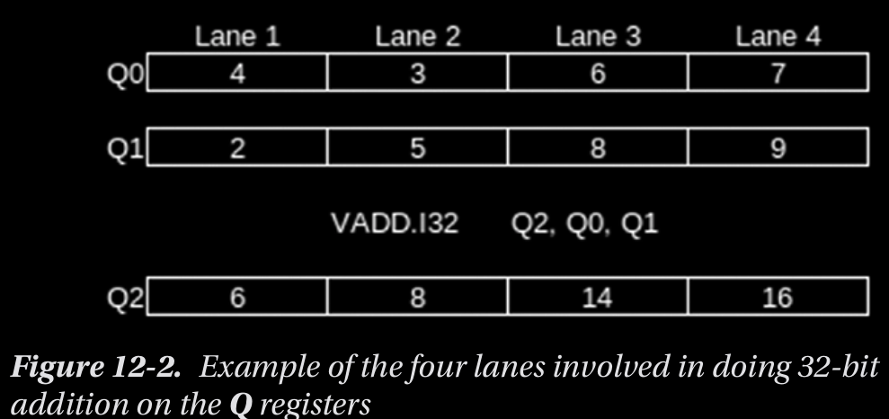
Lanes
Depending on the data-type, the NEON divides the 128-bit register into equal lanes of size (128/size_of_datatype)

Slide 27
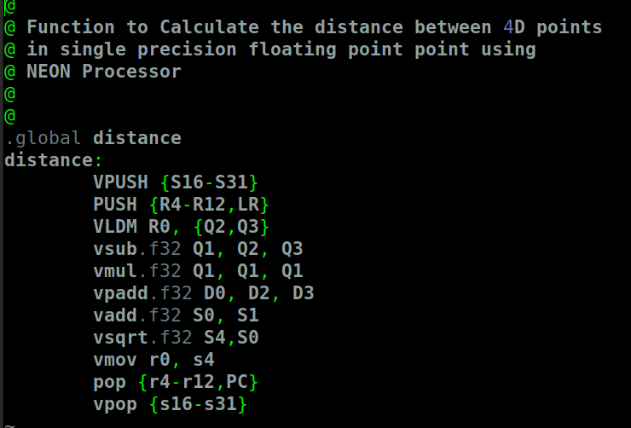
Example: Distance in 4D
gcc -mfpu=neon-vfpv4 -o distance distance.s main.s
Generates Executable on NEON. If the -mfpu is not specifed, illegal instruction error is obtained during compilation. Source : https://gcc.gnu.org/onlinedocs/gcc/ARM-Options.html

Slide 28
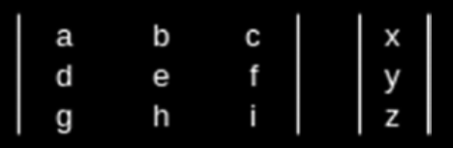
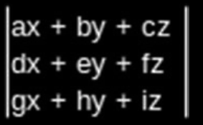
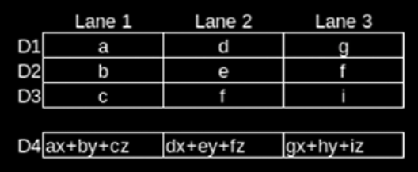
SIMD Coding for Matrix Vector Multiplication on NEON : Matrix 3x3 Vec 3x1
Put a, d, and g in a register in separate lanes
b, e, and h in another register in matching lanes
c, f, and i in a third register in the matching lanes
Multiply each of the lanes with x,y and z respectively and then add all three vector
Thus, there are no loops
All three coumns of the output are computed parallely

Slide 29
NEON Assembly vs NEON C Code
C Code for Matrix Vector Multiplication compiled for NEON does not use the optimal SIMD discussed in the previous slide.
Instead, it continues to loop three times for a 3x3 Matrix .
Inference : gcc for NEON does not auto-vectorize

Slide 30
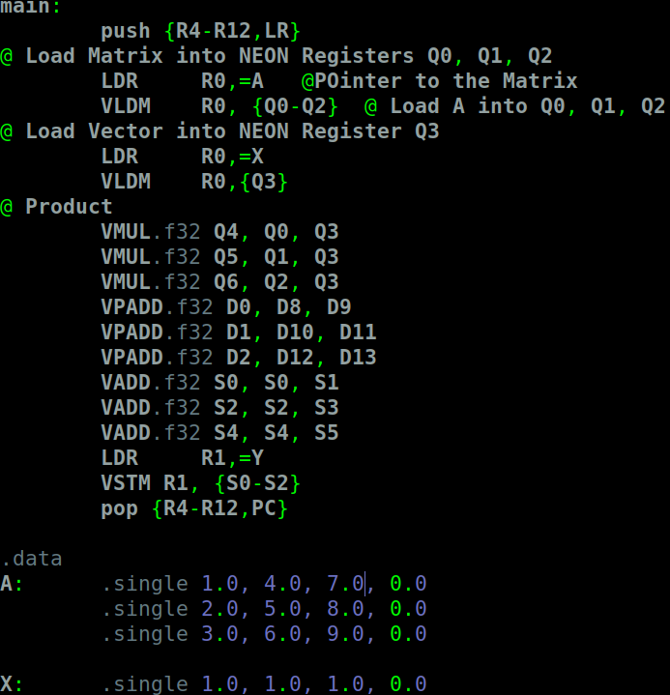
SIMD Assembly for NEON
Hand-coded Assembly Program for Matrix Vector Multiplication using SIMD programming
Steps are:
1. Load 3x3 Matrix A into Q0, Q1 and Q2
2. Load 3x1 Vector X into Q3.
3. Multiply each of Q0, Q1, Q2 with Q3
4. Perform Pair-wise addition of elements inside the products
5. Store Results in Y (3 x 1)

Slide 31
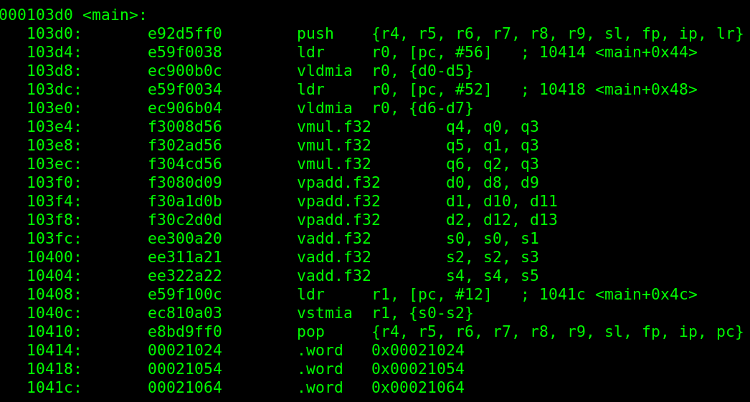
Disassembly of NEON Assembly Code for VMATMUL

Slide 32
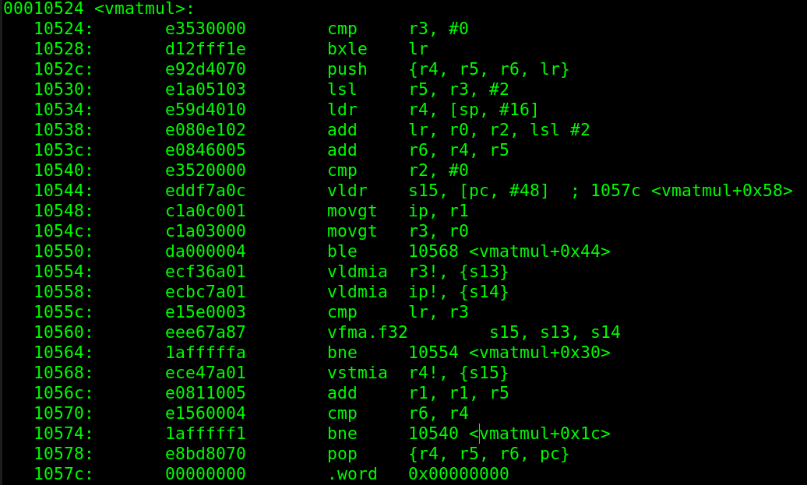
VMATMUL for C Code targetting NEON

Slide 33
Observations
1. Even with -O3 optiization, the code does not produce SIMD Code for Matrix Vector Multiplication of size 3x3.
2. NEON SIMD is not scalable for Matrices beyond 4 rows as the intermediate results have to be stored onto Stack and then retrived.

Slide 34
Desirable Instructions
1. Dot product of two Vectors : Exists in NEON but is only supported for INT8 numbers
2. Add all elements in a vector register (currently, only Pair Add is available)

