Slide 1
RISC-V for AI
Literature Survey and Profiling Analysis

Slide 2
Analysis of CNNs
CNN for MNIST dataset :
Neural Network Architecture
Coded the network in C and executed on x86 and riscv platforms and results were verified.
Layer (type) Output Shape Param #
=================================================================
conv2d (Conv2D) (None, 24, 24, 32) 832
_________________________________________________________________
max_pooling2d (MaxPooling2D) (None, 12, 12, 32) 0
_________________________________________________________________
conv2d_1 (Conv2D) (None, 8, 8, 64) 51264
_________________________________________________________________
max_pooling2d_1 (MaxPooling2 (None, 4, 4, 64) 0
_________________________________________________________________
flatten (Flatten) (None, 1024) 0
_________________________________________________________________
dense (Dense) (None, 10) 10250
=================================================================
Total params: 62,346
Trainable params: 62,346
Non-trainable params: 0
_________________________________________________________________

Slide 3
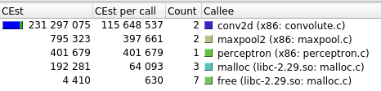
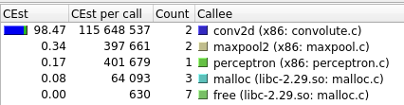
Profiling Analysis of CNN
Done using Valgrind and Kcachegrind tools

Slide 4
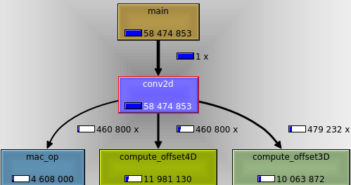
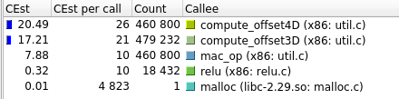
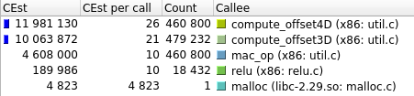
Convolution -only Profiling
Done using Valgrind and Kcachegrind tools
1. Work-load division

Slide 5
Analysis
1. Computing Array Indicies consume considerable amount of time(about 33%)
Formula: x1*d2*d3*d4 + x2*d3*d4 + x3*d4 + x4
Idea: For upto 4D arrays, whose dimension along each axis is < 256, the index computation can be vectorized.
Algorithm for Accelerating the above computation
We store these in 2 registers say, r1,r2 as 8-bit unsigned integers:
t | r1 | r2 | r3 | r4 | r5
0 | x1,x2,x3,x4 | d1,d2,d3,d4
1 |  |  | x1*d2, d3*d4 |  | x3*d4
2 |  |  |  | r3[31:16]+x2 | r5+x4
3 |  |  |  | r3+r4
4 |  |  |  |  | r4+r5
r1 | x1 | x2 | x3 | x4
r2 | d2 | d3 | d4
Using 8 bit Multipler with
4 clock cycles
(CSA+Wallace Tree),
this operation can be
completed within 10 clocks

Slide 6
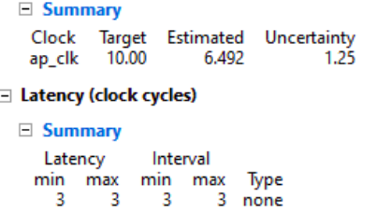
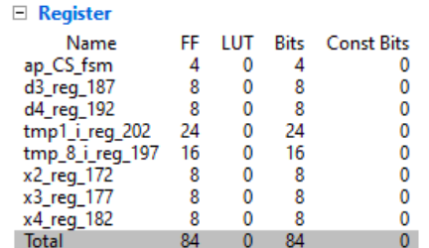
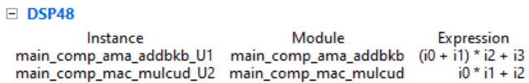
High Level Synthesis of Offset Compute
Hardware accepts 2 int arrays , x and d as inputs and returns an integer
It extracts x1,x2,x3 andx4 ; d2,d3,d4 using AND and Shift Ops and passes it to
offset_compute

Slide 7
Desirable elements in an low-power RISC processor for ML
1. ISA Extensions for commonly used instructions such as vector/tensor operations
2. Scratch-pad memory for working with intermediate results
3. Resource efficient Floating Point Unit – bfloat16, DLFLoat

Slide 8
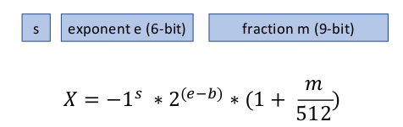
Brain Floating Point - bfloat16
16-bit FPU alternative to IEEE754 Half Precision FPU
Format : 1(sign) + 8(exp) + 7(mantissa).
Used in Google TPU cloud v3 MAC units. Multiplication is done in bfloat16 while Accumulation is done in FP32.
AMD likely to incorporate
DL Float16- Floating Point format for DL Training and Inference
1. Format : 1(sign) + 6(exp) + 9(mantissa)
2. FMA Hardware : Fused Multiply Add

Slide 9
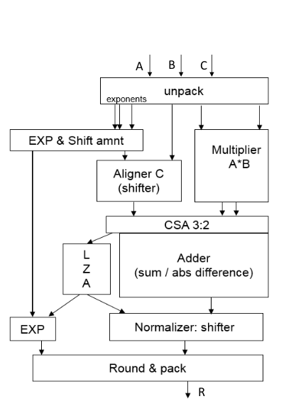
Fused Multiply Add Hardware
Useful for Matrix Multiplications, Convolutions
R = C + A*B
FMA in blfloat is mixed(blfloat-16 for multiplications and FP-32 for add). However, in DLFloat FMAs, it is fully DLFloat-16

Slide 10
DSP ISA augmentation to RISC-V
Paper on PULP-RISCV core for IoT
Microarchitectural Improvements to RISCV32IM
1. 4-core with shared TCDMs
2. Instruction Pre-fetch buffer + Shared I-Cache
3. ALU Datapath enables operations on 8-bit / 16-bit vectors, supporting unaligned memory accesses.
4. Instructions for Packed-SIMD,Fixed-point , shuffling bytes in a word and hardware loop unrolling, dot-product

Slide 11
Algorithms for Accelerating Activations
CORDIC : To study

Slide 12
Week-3 (Aug 7-14, 2020)
Week 2 Actions
1. Perform profiling of various other ML algorithms and other Neural Network Topologies and find out if there can be any general instructions for spped up.
2. Exploration of Implementing Brain Float 16 FPU to be explored.

Slide 13
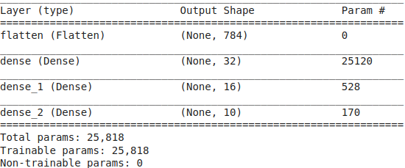
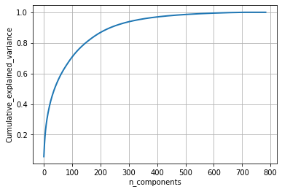
Week -3 :Profiling Other ML Algorithms
1. Unsupervised Learning – Principle Component Analysis (PCA)
Use Case: To reduce the Size of Input Dimensions for classifying MNIST Dataset
A 4-layer fully-connected Neural Network is used for MNIST digit classification where the input dimension is 784.(28x28)
Since Image matrices are sparse, their variances will be limited to only a subset of 784 dimensions. PCA is used to capture the most significant Eigen Vectors in the Image Dataset (60,000 x 784).
The plot aside shows the fraction of variance of the Image Dataset that can be catured as a function of the number of significant eigen vectors used. So, in order to capture 75% of the variance in the images, only 100 out of 784 dimensions are sufficient.

Slide 14
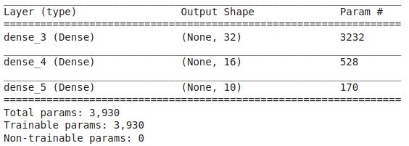
PCA-Inference
The Neural Network Model for the reduced set of Inputs (100) is shown below:
It can be seen that the new model
features only ~4,000 parameters as
Compared to ~26000 in the original one
Computational Overhead
In the inference engine,
1. All inputs have to be normallized to Zero-mean and UNIT standard deviation.
2. These scaled inputs(784 dim) have to be transformed to 100-dimension space using SVD matrix. This results in a matrix – vector multiplication
INPUT_TRANSFORMED = [ 1 x 784 ] * [784 x 100] with 78400 multiplications.
The PCA-transformation + 4 layer NN was coded in C language and profiled with Valgrind.
Result : 85% of the processor cycles are used for PCA.(3 442 401 cycles ) (115 648 537 cycles for Conv2D)
Followed by 3% load (117 266) cycles for perceptron
Followed by 1.25% for 47 136 cycles for normallizing function.

Slide 15
Autoencoder
Studied Auto-encoder
Use Case: Same as PCA
Auto-encoders can be designed using the same structre as used for PCA.
Auto-encoders and PCA differ in the way they are trained.
Thus, computational load is expected to be the same.

Slide 16
Week 4:
Week3 Actions:
1. Cambricon is a useful paper. Get statistics on computational load of instructions used in Deep Learning operations from the paper.
2. Continue profiling for other NN topologies.
----------------------
Week 4:
Realized mistakes in coding styles
1. Use of malloc() to be avioded as it consumes substantial amount of time itself. Instead crete all arrays and allocate memory for them during compile time. Tradeoff: Generallization
2. Rmove all funtion calls inside forloops . They add to enormous amounts of push-pop overheads.

Slide 17
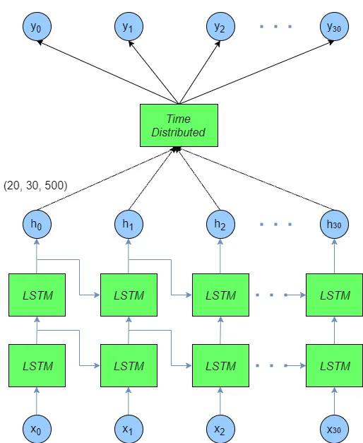
Week-4 : Recurrent Neural Network
RNN for classifying Sequential MNIST dataset.
Each image is fed to the RNN one row at a time.
Input Dimensions = 28
LSTM-1 Layer has 128 neurons
LSTM-2 layer has 128 neurons
The output of the last LSTM layer (128 dimensions) is fed to 3-layer perceptron to obtain class conditional densities 0->9.
Layer (type) Output Shape Param #
=================================================================
lstm (LSTM) (None, 28, 128) 80384
_________________________________________________________________
lstm_1 (LSTM) (None, 128) 131584
_________________________________________________________________
dense (Dense) (None, 64) 8256
_________________________________________________________________
dense_1 (Dense) (None, 10) 650
=================================================================
Total params: 220,874
Trainable params: 220,874
Non-trainable params: 0

Slide 18
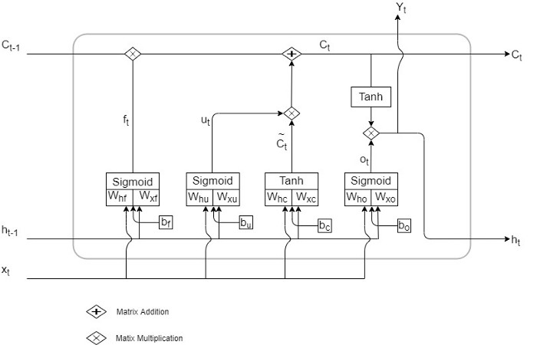
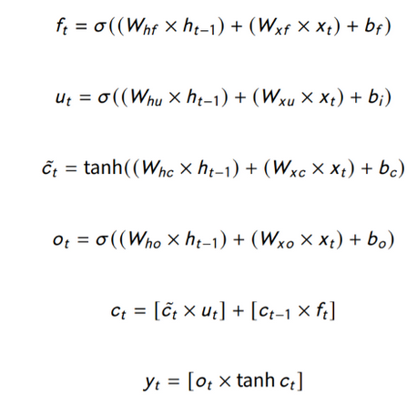
LSTM
Source: https://medium.com/analytics-vidhya/demystifying-lstm-weights-and-biases-dimensions-c47dbd39b30a

Slide 19
Implementation and Profiling Results
C-code compiled and run on x86. For infering 1 image, the following are the profiling results:-
Profiling Results show that RNN takes a total of 148,051,630 cycles to complete one run, almost thrice as long as CNN (830 648 537)
Mthematical Operation | %Exe. Time Of the total prgm | No. of times called | Avg Execution cycles per call
Matrix Vector Multiplication [1 x 128]* [128 x 128] [1 x 28] * [28 x 128] [1 x 128] * [128 x 64] [1 x 64] * [64 x 10] | 96.92% | 450 | 409, 245 251, 335 40, 680
2 vector Addition (128) | 1.04% | 506 | ~3,000
exponent(x) | 0.72% | 35, 904 | 30

Slide 20
Profiling Matrix Vector Multiply
1. In order to obtain percentage of time a given piece of code took for execution, a function was created. This function was being called from the program.Problem: Since the funtion is repeatedly called from inner loop, execution overheads suck as stack operations were found to each away a significant amount of time. (almost 50% of original function time)
2. Therefore, all functions called within loops were removed; Code was flattened.
Line-wise Assembly Level Code breakup for Matrix vector Multiply
Total Assembly Instructions(x86): 65
Innermost loop : 24 instructions
Break up:
Offset Calculation : 6
Load ith element : 7
Load ijth element : 8
Multiply : 3
Accumulate : 3

Slide 21
Ara: RISC-V Vector Processor, Oct 2019, arXiv
Specifications:
64-bit Vector processor based RISC-V’s vector extension ISA
Freq of Operation ~ 1.2 GHz
Performance : 33 Dp-GFLOPS (41 DP-GFLOPS/Watt)
Power : 794 mW (max.)
Main Idea: Exploits regularity in Parallel Data Workloads
Vector Instruction: A single vector instruction can be used to express a data-parallel computation on a very large vector => Reduces Fetch, Decode , Store Overhead significantly.
Advantage over GPUs
In Single Instruction- Multiple thread(SIMT) architectures, the fetch.decode,store overhead amortization is limited to the number of execution elements in a proessing block (32, 64). Whereas, in Vector Processors, there is no cap on Vector length.

Slide 22
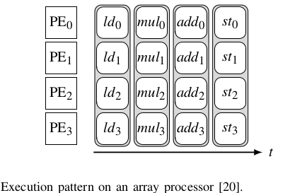
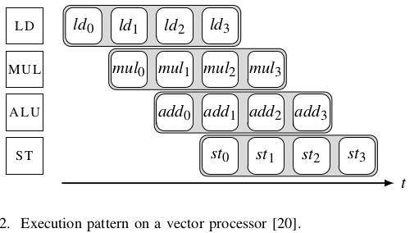
Architectures to handle Vector data
1. Array Processors: Implement Packed-SIMD architecture
Several independent processing elements having a
Common control unit
Limitation : Vector length is fixed.
Ex: Intel Streaming SIMD Extension (SSEs), ARM Neon,
RISC-V DSP extension
2. Vector Processors
Time-multiplexed version of Array Processors, implemening
vector-SIMD instructions
Several speciallized functional units stream the
micro-operations on consecutive cycles, as shown in figure.
By doing so, the number of functional units no longer
constrains the vector length.
Ex: Cray SuperComputer, ARM Scalable Vector Extnsion,
Fujitsu A64FX

Slide 23
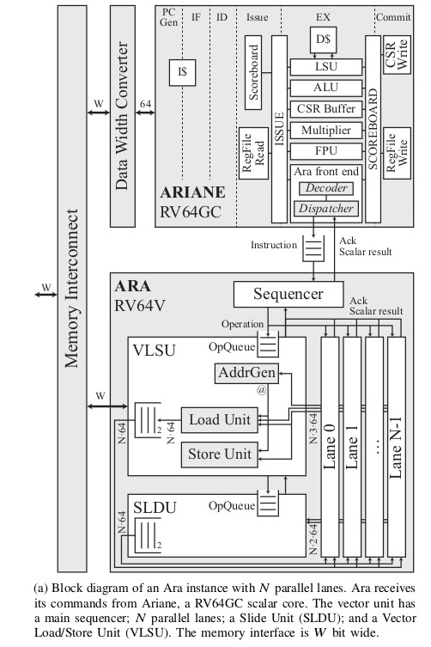
Microarchitecture
Ara works in tandem with Ariane, an open source Linux Capable application-class core
Ariane has been been extended to drive the accompanying vector unit as a tightly coupled
co-processor
Ariane:
Six-Stage Pipeline
In-order
All vector instructions are decoded in Ara.
Handshaking mechanism between Ara and Ariane
Consists of Several lanes.
Each lane can handle Upto 8 instructions in Parallel

Slide 24
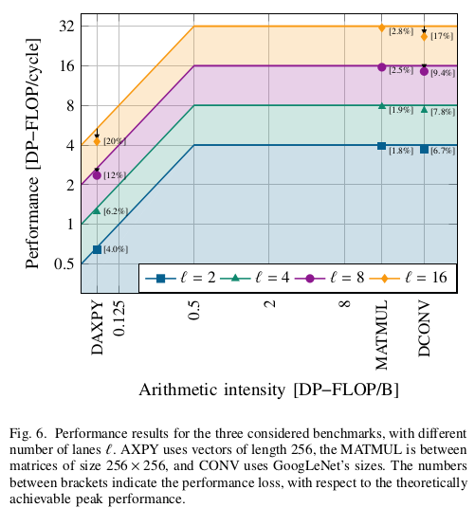
Results
Benchmarking:
Y <-- aX + Y =>Memory Intensive
Convolution =>Compute Intensive
Matrix Multiplication : Moderately Computationally Intensive
Performance figures:
No comparison done with a non-vector processor

Slide 25
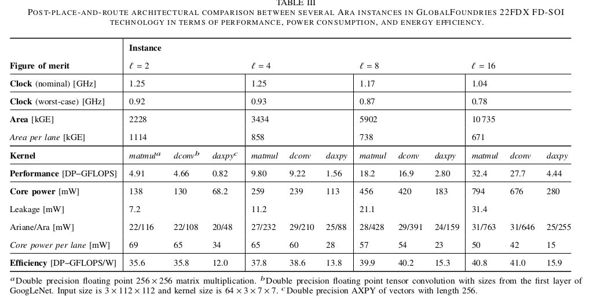
Performance with Different Lane Widths

Slide 26
Vector Architectures contd ...
3. SIMT : Single instruction to multiple independent threads running in parallel
Ex: NVIDIA Volta GPU
While this model is efficient to handle data intensive workloads, it consumes substantial power
4. Vector Thread: A compromise between SIMD and MIMD.
Supports Loops with cross iteration dependencies
Main difference between SIMT and VT is that in the latter the vector instructions reside in another thread, and scalar book-keeping instructions can potentially run concurrently with scalar ones.
This division alleviates the problem of SIMT threads running reduendant scalar instructions that must be later coalesced in hardware

Slide 27
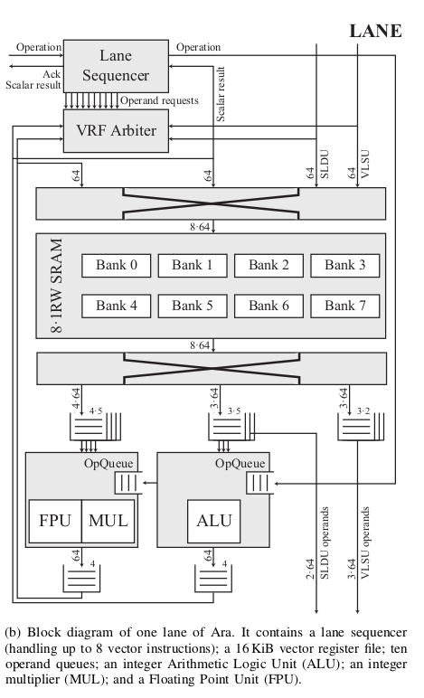
Lane Microarchitecture
Each lane has :
1. Lane Sequencer that can keep track of upto 8 parallel instructions
2. Vector RegFile(which can be accessed by other lanes as well), Operand Queues
3. Integer ALU, Integer MUL, FPU

Slide 28
Paper Summary: “Cambricon : AN ISA for Neural Networks” ACM/IEEE-2016
Propose a domain specific Instruction Set Architecture for NN Accelerators
Integrates Scalar, Vector, Matrix,logical, data transfer, and control instructions based on a comprehensive analysis of existing Neural Network Techniques
Architecture Highlights:
1. Accelerator is designed to accept instruction sequentially and run like a processor.
2. Data-level parallelism :- Instructions to load Vectors and matrices onto scratch-pad memory from Main Memory
3. Scratch Pad Memory :- Uses Scratch Pad memory(High speed) for fast computations instead of the Register Files and Cache Memories.
4. Vector /Matrix Instructions :- Dot-product, ADD, SUB, MULT for matrix and vectors
5. Engines for computing vector-wise (exp(x), log(x), tanh(x)) using CORDIC algorithm
Evalutation:
Evaulated over ten representative NN techniques:- MLP, CNN, RNN, LSTM, Autoencoder, Sparse Autoencoder, Boltzmann machine, RBM, Self Organized Mapping and Hopfeld NN.

Slide 29
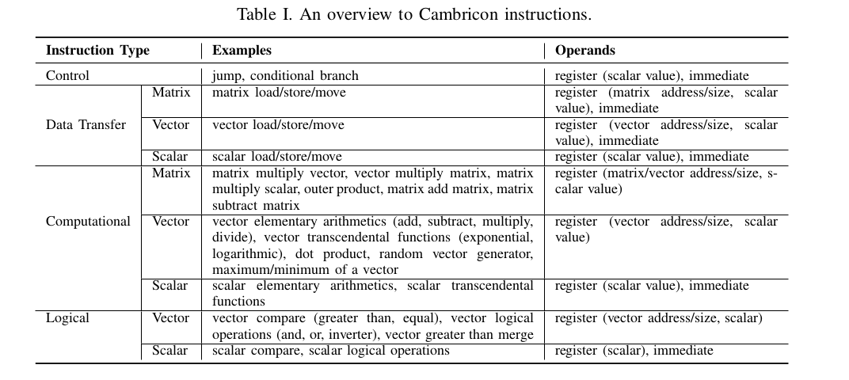
Microarchitecture

Slide 30
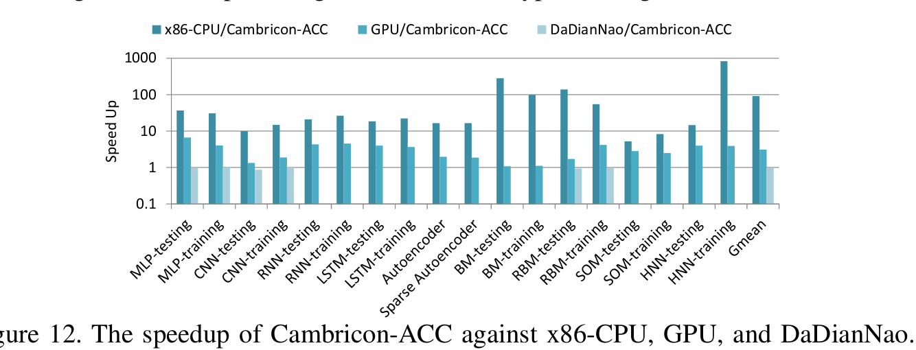
Cambricon Performance Results

