Slide 1
Week 13,14
RISCV Vector Extension

Slide 2
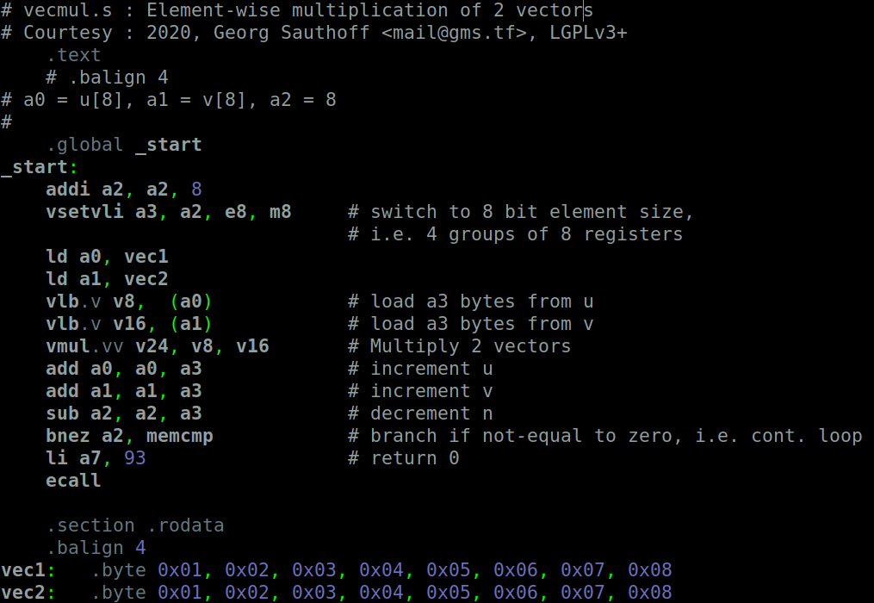
Assembly for Element-wise Vector multiplication of 2 vectors

Slide 3

Problem with RISCV-GNU Toolchain for Vector Ext
Experiencing run-tim error while running the code.
Reason: Spike raises Illegal Instruction Trap
Similar concerns have been raised by Vector Extension users on GitHub
Developers say, Vector Extension is yet to be ratified and undergoing changes.(as on Jan2020).
Since the toolchain involves building 3 packages – RISCv-GNU-TOOLCHAIN, SPIKE and PROXY-KERNEL, it is possible that all three packages might not be in sync with the particular vector extension.
So, thinking to keep the vector programming on hold for a while.

Slide 4
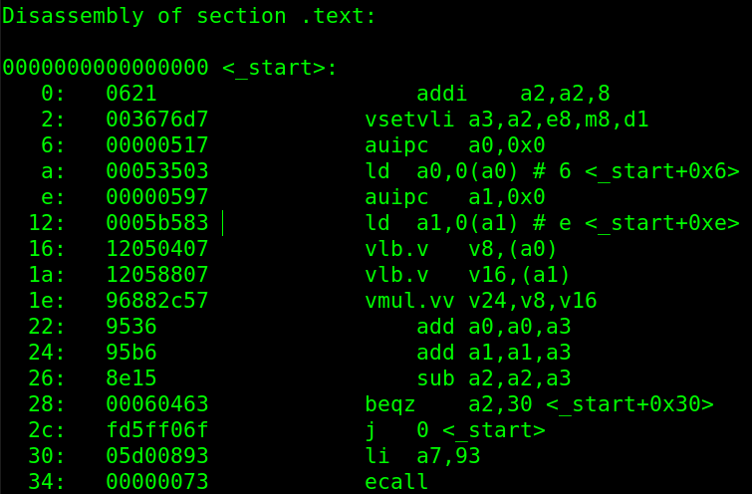
Disassembly

Slide 5
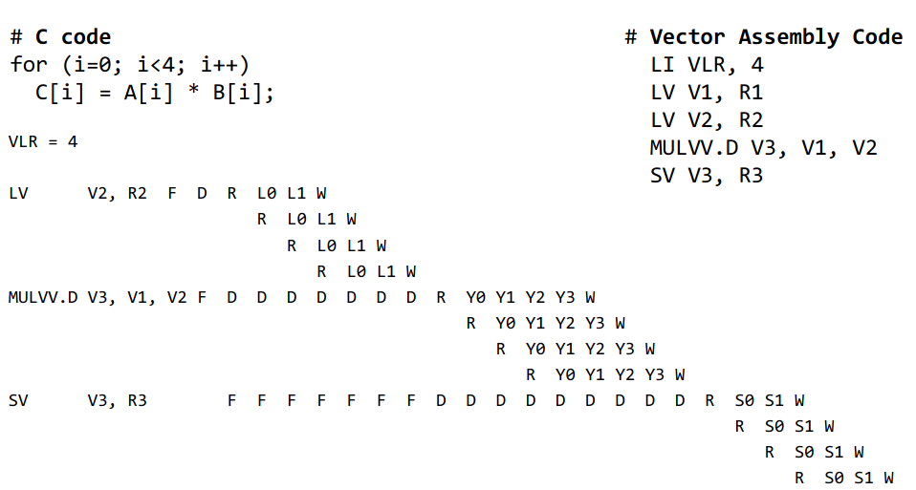
Vector Execution Timing
Courtesy : Computer Architecture :Princeton Uiversity Course

Slide 6
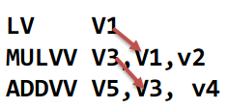
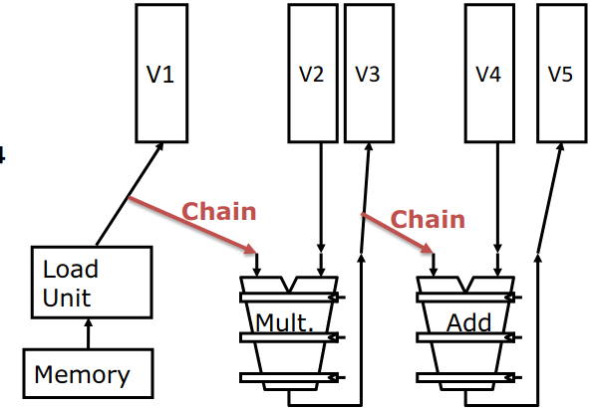
Vector Chaining
Close to Vector Version of Register by-passing

Slide 7
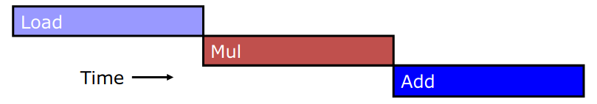
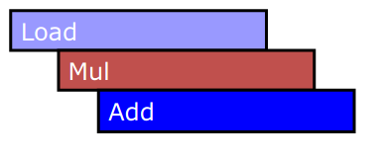
Execution Time with Vector Chaining
Without chaining, must wait for last element of result to be written before starting dependent instruction
With chaining, can start dependent instruction as soon as first result appears

Slide 8
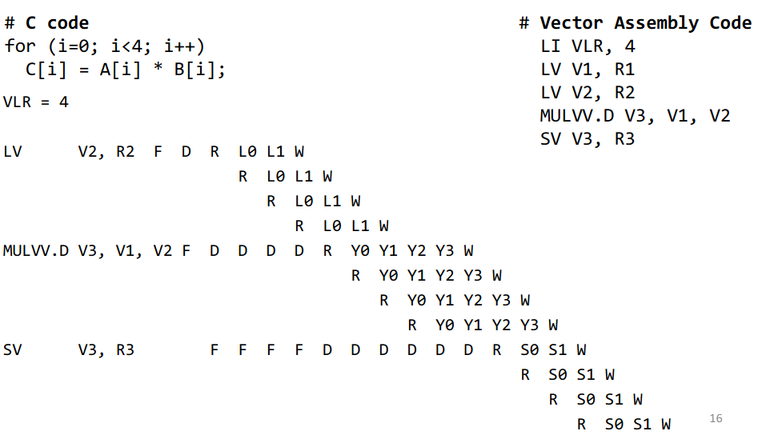
Chaining alone might not help
Structural Hazard for Reading from Register File delays by 1 clock cycle.
This can be overcome by having 2 ports at RF for Read

Slide 9
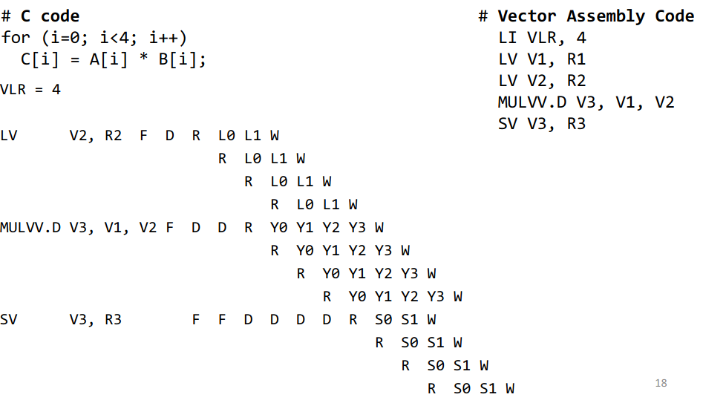
Chaining with more RF Ports

Slide 10
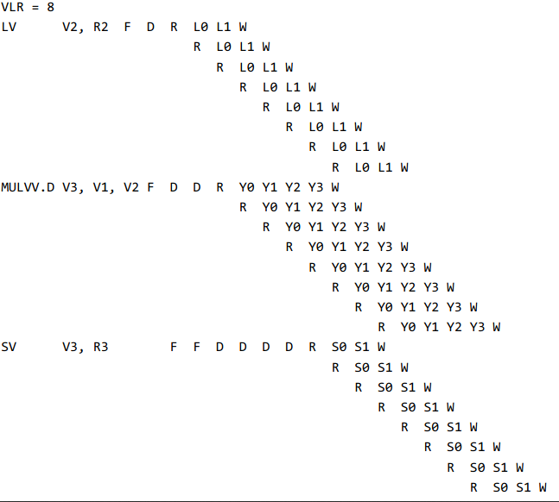
For N = 8
Number of RF ports should be as high as max. Elements in a vector !

Slide 11
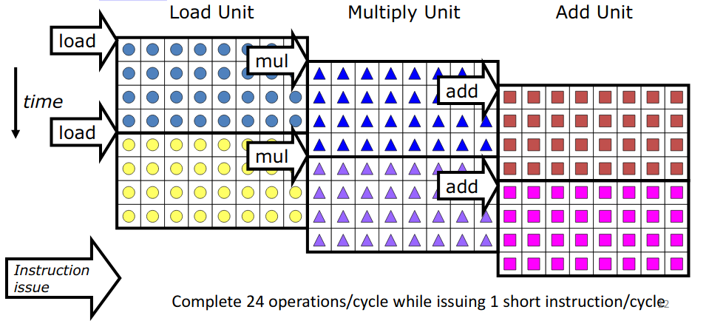
Vector Parallelism = ILP + DLP
Can overlap execution of multiple vector instructions
  example machine has 32 elements per vector register and 8 lanes

Slide 12
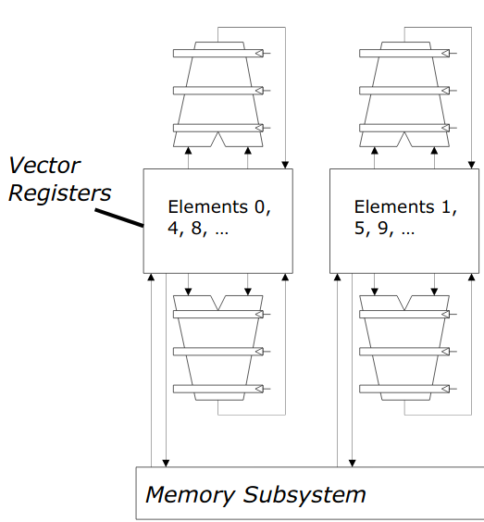
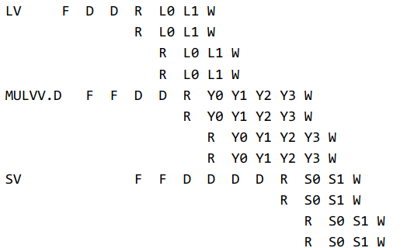
Lanes : DLP

