Slide 1
Introducing openstatsware
Who we are and what we build together Ya Wang on behalf of the working group and co-chair Daniel Sabanes Bove

Slide 2
Outline
Introducing the Working Group
Overview of Active Workstreams
Lessons Learned on Best Practices
Long Term Perspective

Slide 3
Introducing the Working Group

Slide 4
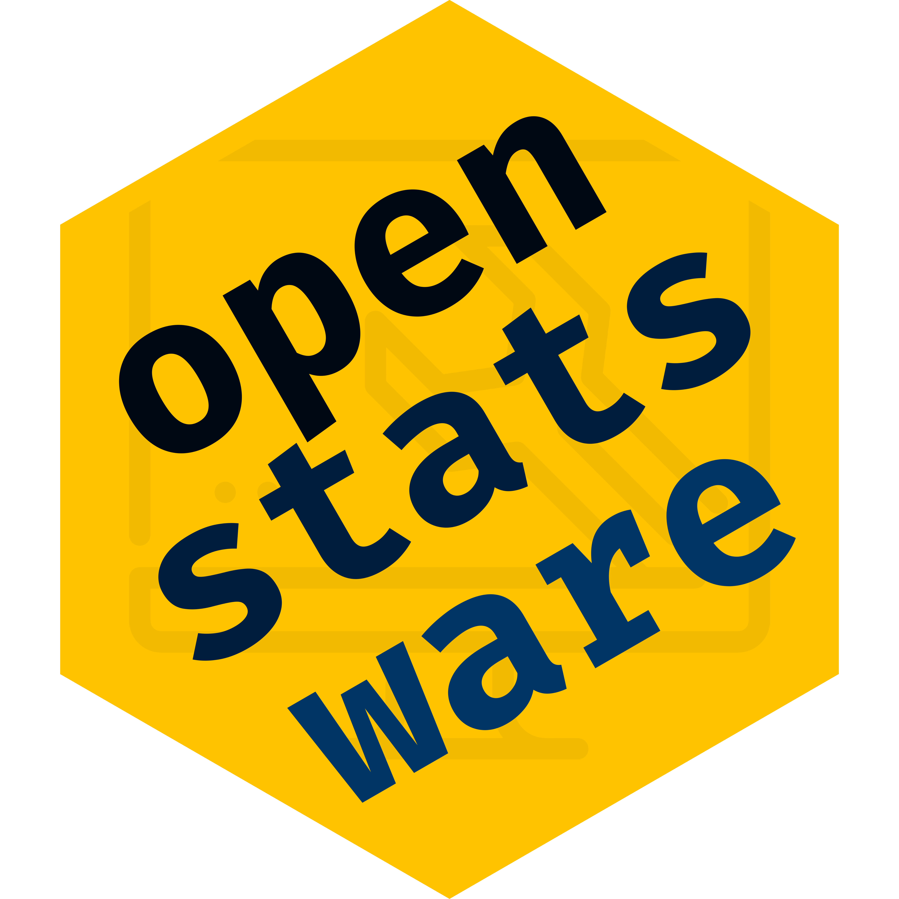
openstatsware
Official working group of the American Statistical Association (ASA) Biopharmaceutical Section
Formed on 19 August 2022
Cross-industry collaboration (55 members from 36 organizations)
Full name: Software Engineering Working Group
Short name: openstatsware
Homepage: openstatsware.org
We welcome new members to join!

Slide 5
Motivation
Open-source software increasing popularity in Biostatistics
Rapid uptake of novel statistical methods
Unprecedented opportunities for collaboration
Transparency of methods and implementation
Variability in software quality
No statistical quality assurance on open-source extension package repositories, e.g. CRAN
No industry standard for assessing quality of R packages
Reliable software for core statistical analysis is paramount

Slide 6
Working Group Objectives
Primary
Engineer R packages that implement important statistical methods
to fill in gaps in the open-source statistical software landscape
focusing on what is needed for biopharmaceutical applications
Secondary
Develop and disseminate best practices for engineering high-quality open-source statistical software
By actively doing the statistical engineering work together, we align on best practices and can communicate these to others

Slide 7
Workstreams in R Package Development
Mixed Models for Repeated Measures (MMRM)
Develop mmrm R package for frequentist inference in MMRM
Bayesian MMRM
Develop brms.mmrm R package for Bayesian inference in MMRM
Health Technology Assessment (HTA)
Develop open-source R tools to be used in HTA submission

Slide 8
Best Practices
User interface design
Code readability
Unit and integration tests
Documentation
Version control
Reproducibility
Maintainability
etc.

Slide 9
Best Practices Dissemination - Workshop
Workshop “Good Software Engineering Practice for R Packages” on world tour
To teach hands-on skills and tools to engineer reliable R packages
Topics: R package structure, engineering workflow, ensuring quality, version control, collaboration and publication, and shiny development
5 events in 2023 at Basel, Shanghai, San José, Rockville, and Montreal

Slide 10
Best Practices Dissemination - Video
Youtube video series Statistical Software Engineering 101
To introduce tips and tricks for good statistical software engineering practices
2 videos on unit testing for R developers

Slide 11
Overview of Active Workstreams

Slide 12
MMRM R Package Development
The mmrm R package is the first product of openstatsware
Motivation
Mixed models for repeated measures (MMRM) is a popular choice for analyzing longitudinal continuous outcomes in randomized clinical trials
Existing R packages are not great for one of the following reasons
Model convergence issues
Limited choices of covariance structures
Lack of adjusted degrees of freedom methods
Computational efficiency is not satisfactory

Slide 13
Features of mmrm
Linear model for dependent observations within independent subjects
Covariance structures for the dependent observations:
Unstructured, Toeplitz, AR1, compound symmetry, ante-dependence, spatial exponential
Allows group specific covariance estimates and weights
REML or ML estimation, using multiple optimizers if needed
emmeans interface for least square means
tidymodels for easy model fitting
Satterthwaite and Kenward-Roger adjustments
Robust sandwich estimator for covariance

Slide 14
Why It’s Not Just Another Package
Ongoing maintenance and support from the pharmaceutical industry
5 companies being involved in the development, on track to become standard package
Development using best practices as show case for high quality package
Thorough unit and integration tests (also comparing with SAS results) to ensure accurate results

Slide 15
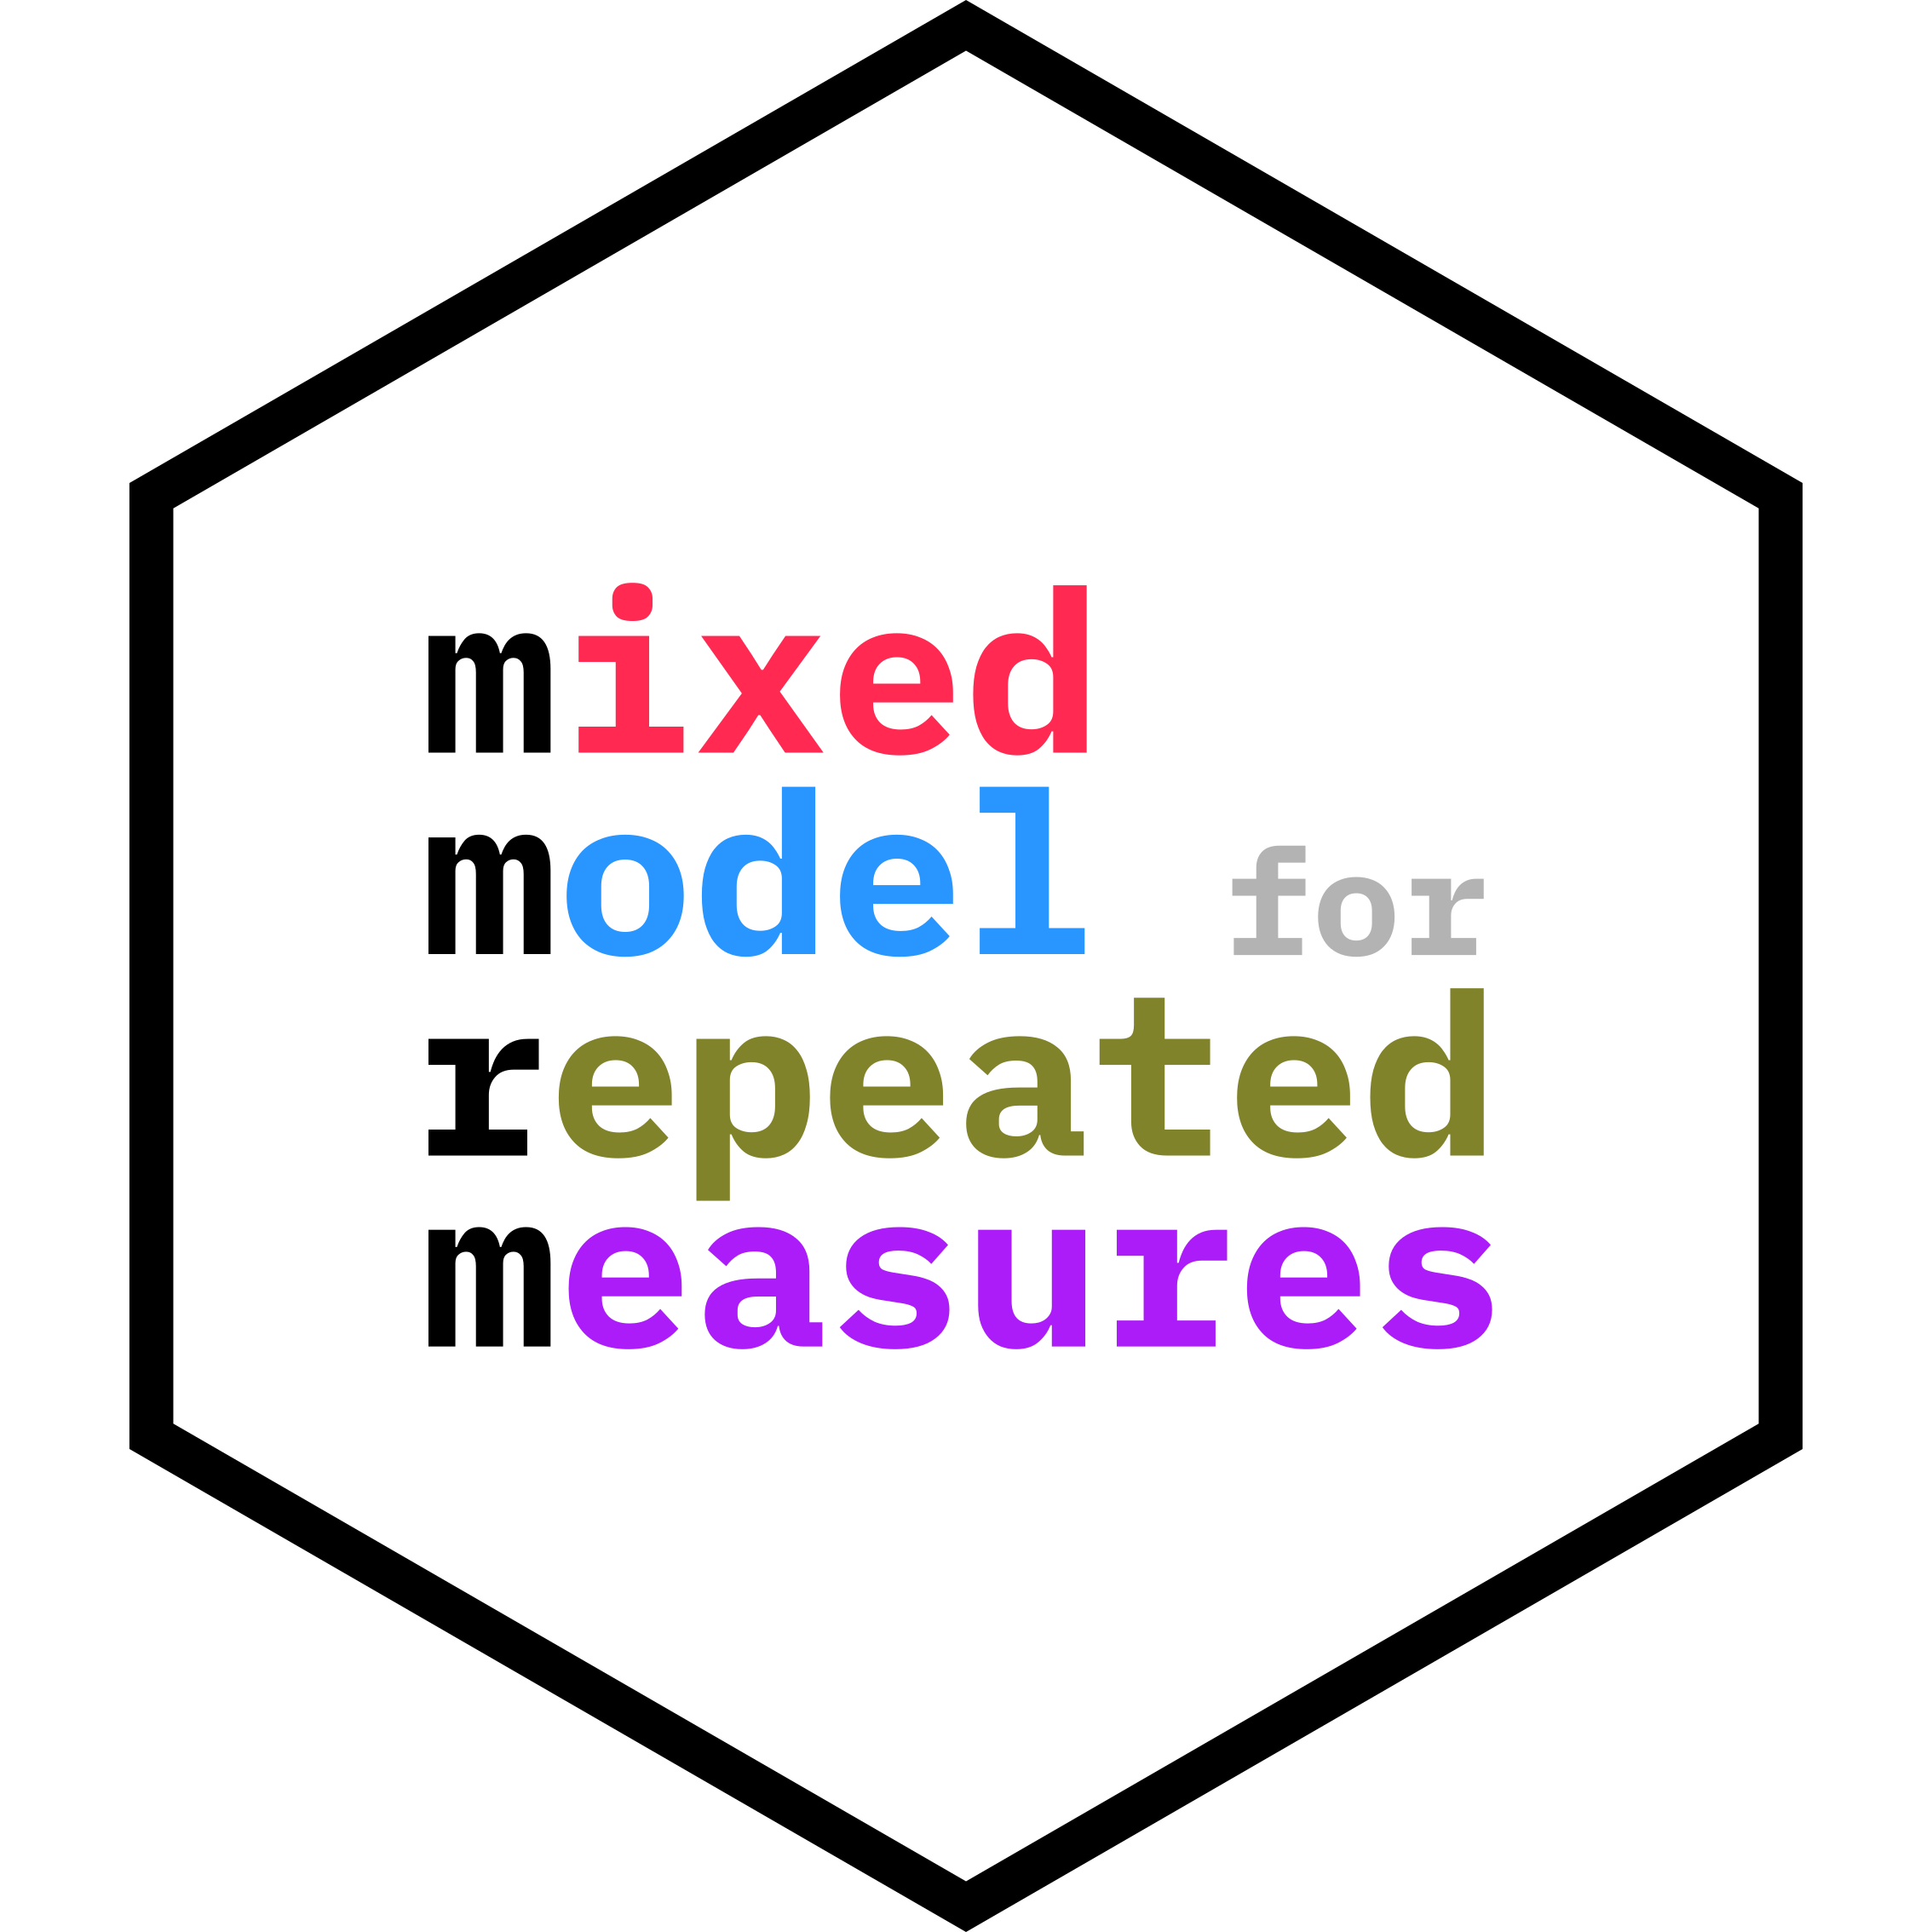
mmrm on CRAN
First available on CRAN in October 2022
Latest update in January 2024
Links
CRAN: https://cran.r-project.org/package=mmrm
Workstream: openstatsware.org/mmrm_R_package.html

Slide 16
Bayesian MMRM R Package Workstream
The brms.mmrm R package leverages brms to run Bayesian MMRM
brms is a powerful and versatile package for fitting Bayesian regression models
Support a simplified interface and align with the best practices
Documentation website has a complete function reference and tutorial vignettes
Rigorous validation using simulation-based calibration and comparisons with the frequentist mmrm package on two example datasets

Slide 17
brms.mmrm on CRAN
First version available in August 2023
Latest update in February 2024
Links
CRAN: https://cran.r-project.org/package=brms.mmrm
Workstream: openstatsware.org/bayesian_mmrm_R_package.html

Slide 18
HTA-R Package Workstream
Develop and maintain a collection of open-source R tools of high quality in the right format (R packages, apps, user guides) to support crucial analytic topics in HTA
In close collaboration with HTA SIG in PSI/EFPSI (a group of HTA SMEs with statistical background, who help to generate pipeline ideas, ensure relevance of developed tools, pilot created tools in real business setting)
R package under development: maicplus

Slide 19
maicplus R package
An R package to support analysis and reporting of matching-adjusted indirect comparison (MAIC) for HTA dossiers
Motivation
Sponsors are required to submit evidence of relative effectiveness of their treatment comparing to relevant comparators that may not be included in their clinical trial, for health technology assessment (HTA) in different countries
MAIC is a prevalent and well-accepted method to derive population-adjusted treatment effect in such case for two trials, one of which has Individual patient data and the other has only aggregate data
There is a lack of open-source R packages following good software engineering practices for conducting and reporting MAIC analyses
workstream: openstatsware.org/hta_page.html

Slide 20
Lessons Learned on Best Practices

Slide 21
Development process
Important to go public as soon as possible
don’t wait for the product to be finished
you never know who else might be interested/could help
Version control with git
cornerstone of effective collaboration
Building software together works better than alone
Different perspectives in discussions and code review help to optimize the user interface and thus experience

Slide 22
Coding standards
Consistent and readable code style simplifies joint work
Written (!) contribution guidelines help
Lowering the entry hurdle using developer calls is important

Slide 23
Robust test suite
Unit and integration tests are essential for preventing regression and assuring quality
Especially with compiled code critical to see if package works correctly
Use continuous integration during development to make sure nothing breaks along the way

Slide 24
Documentation
Lots of work but extremely important
start with writing up the methods details
think about the code structure first in a “design doc”
only then put the code in the package
Needs to be kept up-to-date
Need to have examples & vignettes
Testing alone is not sufficient
Builds trust with users
Reference for developers over time

Slide 25
Long Term Perspective

Slide 26
Long Term Perspective
Software engineering is a critical competence in producing high-quality statistical software
A lot of work needs to be done regarding the establishment, dissemination and adoption of best practices for engineering open-source software
Improving the way software engineering is done will help improve the efficiency, reliability and innovation within Biostatistics

Slide 27

Q&A

