Slide 1



Johnson & Johnson’s Hybrid R Submission Strategy: Successful story of the R submission to the FDA
21 Oct 2025
Alicia Humphreys
Steven Haesendonckx
Linshan Yuan

Slide 2
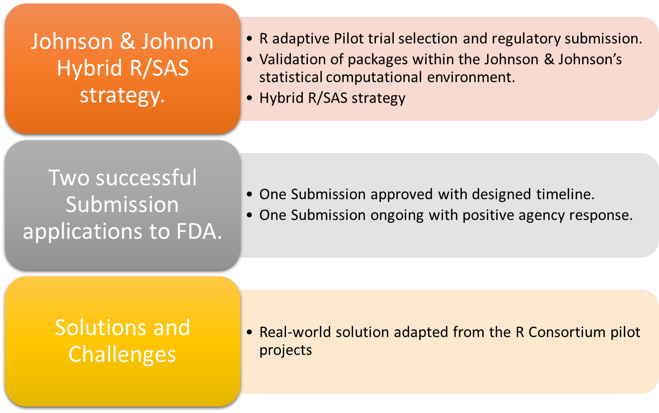
Highlights

Slide 3
Contents
Pilot trial selection and regulatory submission.
In-house developed packages to open-source packages
New ADRG with Appendix for R environment set up based on R Consortium pilot project
Walk through from R TFL development to hybrid SAS/R submission
Interaction with HAs and milestones of two submissions to FDA
Conclusion and Challenges
R Consortium pilot: https://github.com/RConsortium/submissions-pilot3-adam-to-fda

Slide 4
Pilot trial selection & Hybrid SAS/R strategy
Early R Adaptors Identification:
Trials from different therapeutic areas and phases particularly those with submission potential
Submission Pilot Trails :
Trials featuring TFLs developed in R, intended for submission to the FDA, with potential for other health authorities.
Two studies from different therapeutic area were submitted to FDA following hybrid SAS/R strategy
Hybrid SAS/R strategy
ADaM datasets were created using SAS: Keeping current standards/knowledges reusability.
TFLs are generated by R: more flexible and extensive visualization framework benefiting from a large, active and constantly evolving open-source community.
Cutting edge statistical methods readily available and supports complex modeling.
Seamlessly moving workflow integration towards multiple languages while maintaining compatibility with existing in-house tools that were built before with one language centric.
Take advantage of the strengths offered by various programming languages.

Slide 5

In-House Developed Package: envsetup
https://github.com/pharmaverse/envsetup
Support the setup of the R environment.
Manages I/O locations during the development of programs through a configuration file.
Configuration file is tailed to Statistical Computing Environment of sponsor or reviewer
rprofile()
read_path()
write_path()
Notes:
Before we dive into the submission strategy, let’s take a moment to highlight two in-house developed R packages that were instrumental in our hybrid submission to the FDA.
The first package is called envsetup, and it plays a critical role in managing input and output paths throughout the lifecycle of a typical programming script.
In our workflow, each script transitions through three distinct environments, each with a different physical location:
Development – where initial coding happens.
Quality Control (QC) – where independent validation is performed.
Production – the finalized environment used to generate outputs for external stakeholders, including regulatory agencies.
To support this, envsetup uses a configuration file tailored to the sponsor’s Statistical Computing Environment (SCE). For submission purposes, this configuration is adapted to match the reviewer’s environment, ensuring reproducibility.
Three core functions make this possible [are central]:
rprofile(): Reads the configuration file and stores the working paths.
read_path(): Locates and reads input files, checking across multiple predefined locations.
write_path(): Writes outputs to the designated location. While this is typically hardcoded for submission, the function also supports dynamic path resolution during development.

Slide 6

In-House Developed Package: tidyTLG
https://github.com/pharmaverse/tidytlg, https://cran.r-project.org/web/packages/tidytlg/index.html
Create table, figure and listing using the 'tidyverse'.
General descriptive functions:
Set up column metadata:
Generate outputs:
Other functions:
univar()
freq()
Nested_freq()
tlgsetup()
gentlg()
roundSAS()
Notes:
The second package, tidyTLG, is used for summary stats and generating the final outputs file. It is available on CRAN. Key functions are listed on the slide.
We have grouped them into the categories shown here. We have functions for descriptive functions, one to add column metadata, generate outputs and one utility function.
This package is used to generate summary statistics and final output files—tables, figures, and listings—using the tidyverse framework. It’s available on CRAN, making it easily accessible and installable for anyone working in R.
On this slide, we’ve grouped the core functions into four categories:
Descriptive functions – such as univar() and freq() for basic summaries.
Column metadata setup – handled by tlgsetup(), which defines how columns should be structured.
Output generation – using gentlg() to produce the final TFLs.
Utility functions – like roundSAS() to ensure formatting consistency with SAS outputs.
These functions are designed to be intuitive for tidyverse users and help streamline the creation of submission-ready outputs. They also support reproducibility and transparency, which are essential in a regulatory context.

Slide 7
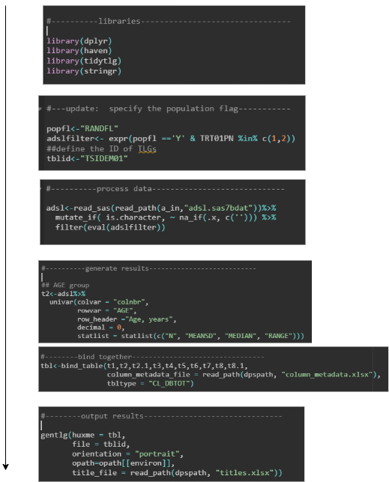
Example of R script for analysis output
Follow the clear analysis logic to develop the R code
Applying column meta data
Adding titles/footnotes
Notes:
Let’s now look at how these packages come together in practice.
This slide shows a typical R script used to generate an analysis output. The workflow is designed to follow a clear and logical structure, which is critical for both internal reproducibility and external review.
Here’s how it works:
First, we apply column metadata using tlgsetup() from the tidytlg package. This defines how the output should be structured—what goes into each column and how it's labeled.
Next, we add titles and footnotes to ensure clarity and compliance with submission standards.
Finally, we use gentlg() to generate the actual output—whether it’s a table, figure, or listing.
This modular approach makes it easy to trace each step of the analysis and ensures that outputs are consistent, well-documented, and ready for submission.

Slide 8
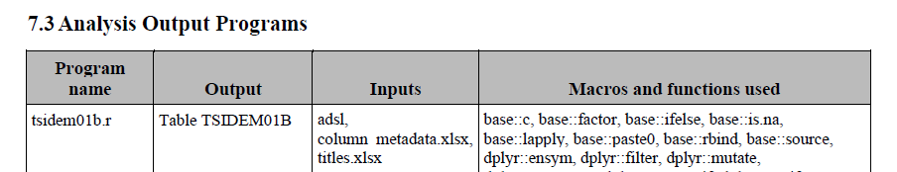
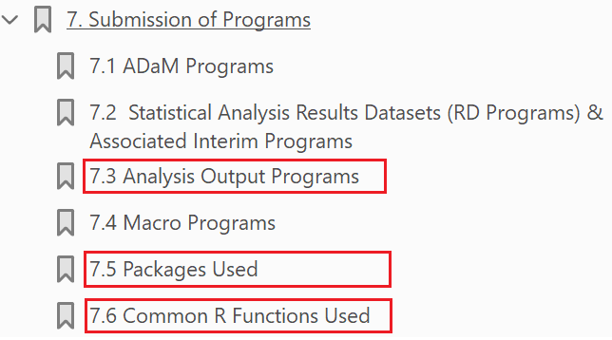
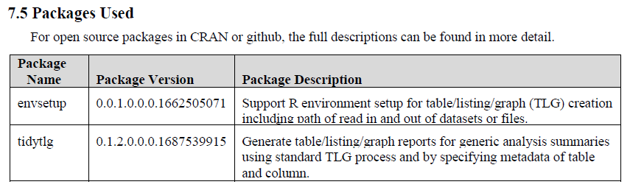
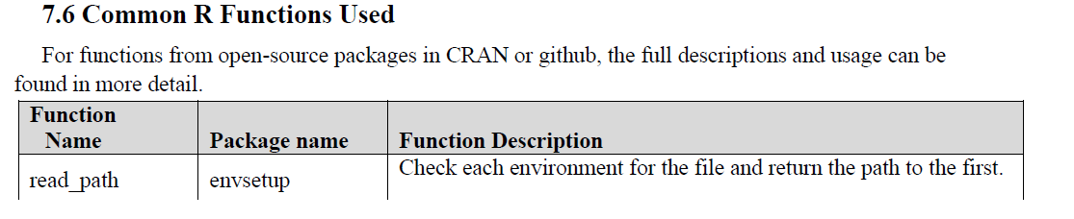
ADRG for Hybrid SAS/R: Section 7
ADRG in submission: adding description of major R functions
Notes:
In the next part of the presentation we want to focus on the Analysis Data Reviewer’s Guide, or ADRG.
We based our structure on the R Consortium Pilot 3 ADRG template, but made targeted updates to reflect our own system configuration and submission context.
In this slide we are highlighting parts of section 7, while in the next slides we will go into the Appendix 1 for R setup and analysis.

Slide 9
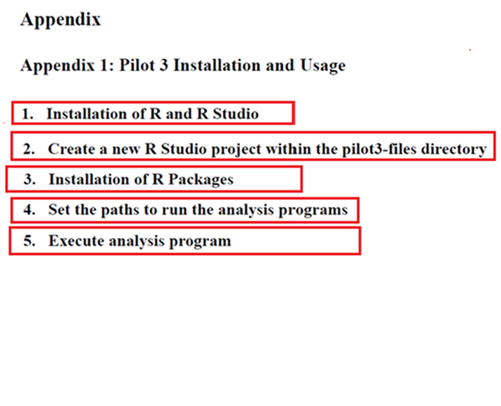
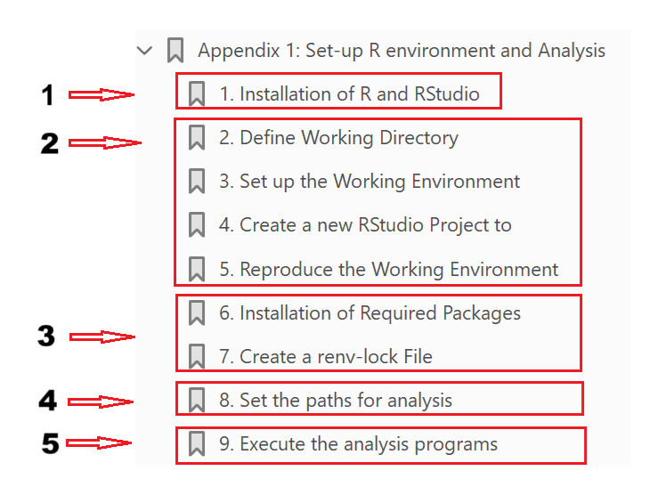
ADRG for Hybrid SAS/R: Appendix
The appendix is added to facilitate the R environment setup, including installation of required R packages. It provides guidance on how tables, figures, and listings developed in R can be executed to reproduce the analysis report in RTF format independently of the sponsor's computational system.
ADRG in submission: update to reflect our system configuration
ADRG from Pilot 3 as template
Notes:
In the

Slide 10
ADRG – Define working environment
Redirect files from submission package to folders inside R project, created on C-drive:
  adam: Converted analysis datasets from .xpt to .sas7bdat
  codelib: R functions files converted from -r.txt to original extension .r
  input: Metadata files
  output: Analysis outputs
  programs: R TFL scripts converted from -r.txt to original extension .r

Slide 11
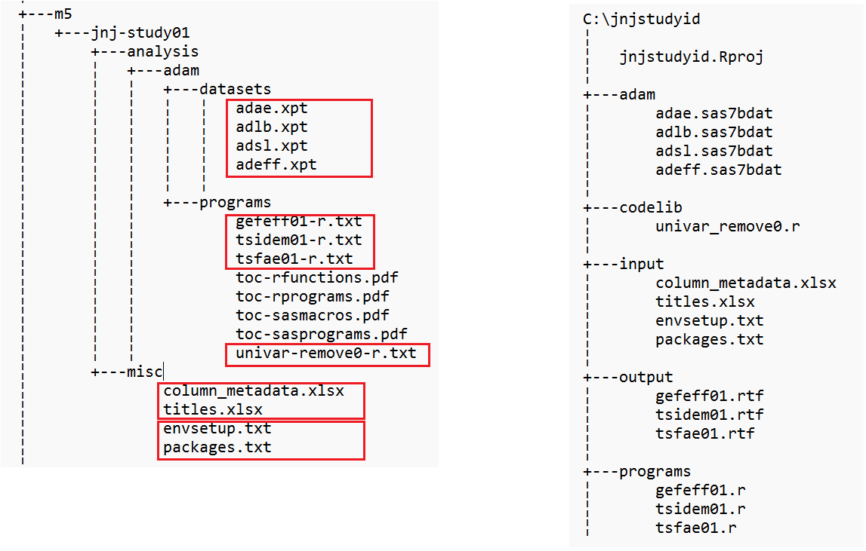
ADRG – Define working environment
New R project file is created following steps in Rstudio
Covert ADaM .xpt to .sas7bdat
Covert function file .txt to original extension .r
Copy metadata files to ‘input’ folder
Copy R configuration files to ‘input’ folder
Covert TLF program file .txt to original extension .r

Slide 12
ADRG – Reproduce Environment - Install packages
Pre-requisite packages are required to install first:
{remotes} package: it allows to download and install R packages stored in remote locations such as CRAN and Github
{renv} package: it supports reproducible environments for R projects, such as an ‘renv’ folder activated within a new project, where the required R packages are installed specifically for that project in the following step.
Notes:
renv::init(bare = TRUE, repos = "https://packagemanager.posit.co/cran/2022-09-15")
pkgs <- read.csv(file.path(getwd(), "input/packages.txt"))
install.packages(pkgs$Package, repos = "https://packagemanager.posit.co/cran/2022-09-15")
Sets the CRAN mirror to a Posit Package Manager snapshot from September 15, 2022.
Everyone using this environment installs packages as they existed on that date.
-----------------------------------------
Renv package will help us to recreate and lock down the environment the sponsor has used. This will allow the reviewer to perfrom the analysis in a reproducible way.

Slide 13
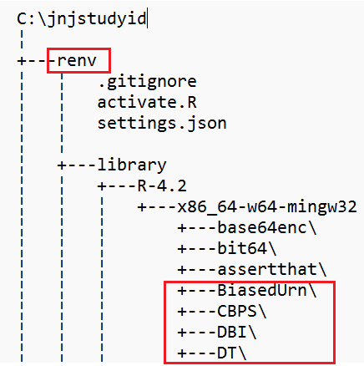
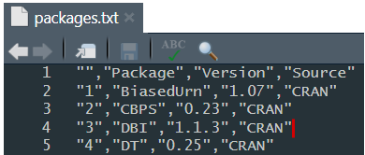
ADRG – Reproduce Environment - Install packages
Statistical Computing Environment (SCE) in Linux
Configuration file
Window System
CRAN curated packages
Github package
Install.package()
renv.lock is not portable between SCE and Windows
CRAN curated packages and Github packages ({envsetup})
Notes:
To ensure the reviewer is using the same packages, we use a separate configuration file
Typical approach from the pilots that we have been part of is to sent the lock file, created by renv to the reviewer.
For us this was not an option since our SCE works on a linux platform and we have noticed that the
Note: the renvlock file is created on a linux system. Unfortunately, renvlock only tracks “install from source” which takes installation files that match the system which might cause issues cross platform.

Slide 14

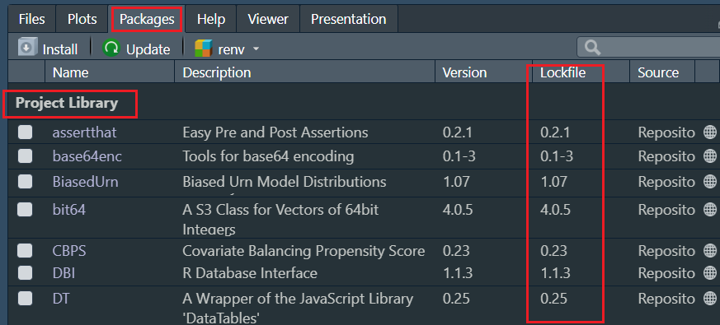
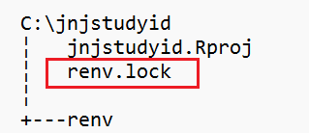
ADRG – Reproduce Environment – renv.lock
Locks down the snapshot of the project’s package ecosystem
Ensure multiple reviewers can recreate the same analysis (now and later)
Facilitates sharing the project between collaborators
Isolates the projects dependencies from global R environment
Notes:
📦 renv::snapshot(type = "all")
Creates a snapshot of all packages used in the project, including:
Packages in the project library.
Packages loaded from outside the project (if type = "all" is used).
This ensures that the renv.lock file reflects everything needed to reproduce the environment, even if some packages were loaded from the global library.
Repos:
Specifies a fixed CRAN snapshot from Posit Package Manager.
Guarantees that anyone restoring the environment will get exactly the same package versions as they existed on September 15, 2022.
This is especially important in regulated environments (e.g., clinical trials) where reproducibility and traceability are required.

Slide 15
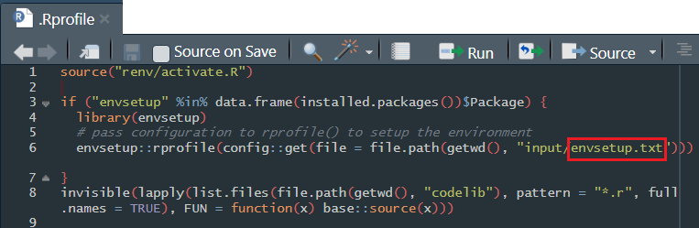
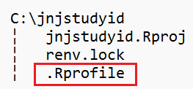
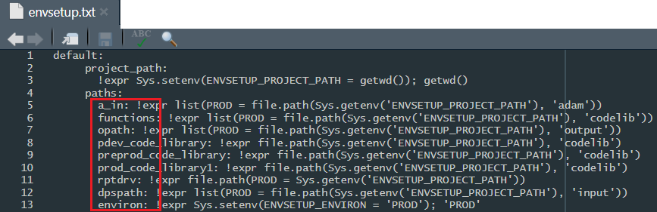
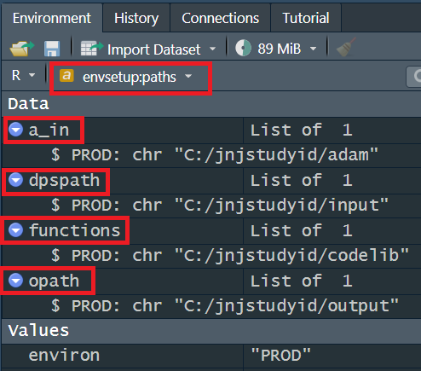
ADRG – Set paths for analysis {envsetup}
The configuration file references working directory to ingest data sources, leverage proprietary helper functions and generate outputs.
To ensure smooth execution, we request the reviewer to incorporate the path setting in .Rprofile.
rprofile()

Slide 16
ADRG – Run analysis

Slide 17
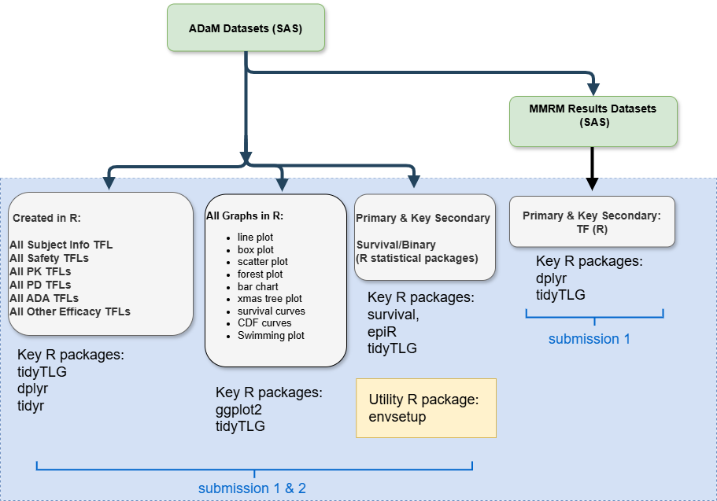
Organization of Hybrid SAS/R strategy
All ADaM datasets are generated using SAS.
All Tables/figures/Listings (TFLs) are created in R.
All R packages are open-source .
All R packages are validated following JNJ GxP.

Slide 18
Verification of R TFLs results: multiple languages
General summary table verification:
Utilizing SAS standard macros/programs
Keep qc results in rtf file
SAS rtf and R rtf file comparison by extracting contents using R or SAS utilities functions.
Allow multiple files Comparison in batch or through application.
At current stage, utilizing our established stable in-house SAS standards alongside the extensive functions available in R to accelerate the overall verification progress
Critical statistical method analysis verification:
Utilizing SAS corresponding statistical procedures
Review discrepancies with team whether they may affect the conclusion, taking appropriate actions.
Graph (figure) verification:
Utilizing the ggplot2 built-in functions such as ‘ggplot_build’ to extract values from the figure created.
Present the extracted values to R log file useful to cross check with the values in associated table.

Slide 19
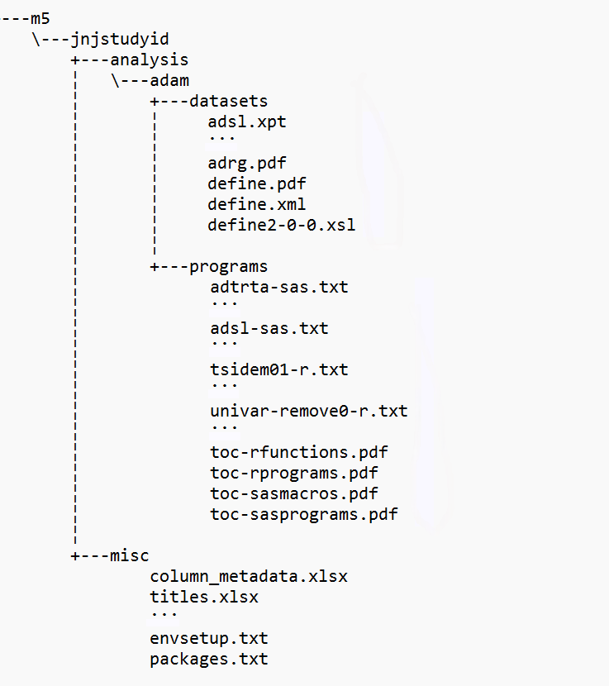
ADaM esub package
Following JNJ process, both SAS and R scripts are converted to txt files while maintaining the original naming convention. The file extension is appended with a suffix indicating the original programming language (SAS or R) before the .txt extension.
toc pdf files: toc files separated for SAS and R, and programs and functions.
New ADRG: update with study information incorporated
  Section 7: includes the essential R functions and packages used in the study
  Appendix: the overall instructions to reproduce the same results as the R TFL scripts in window system.
ADaM in xpt
SAS macros in txt
SAS programs in txt
R programs in txt
R functions in txt
Configuration files used for R setup in ADRG appendix

Slide 20
Interaction with regulatory agencies
 | Submission 1 | Submission 2
Briefing book | ADaM datasets in xpt SAS & R scripts in txt format ADRG: providing R packages/version information Mock eCTD requested and accepted | ADaM datasets in xpt SAS & R scripts in txt format ADRG: providing R packages/version information
Mock eCTD | Dummy ADaM datasets in xpt 5 R table/figure scripts in txt format ADRG: new JNJ ADRG template with R packages/version information and recreation of R environment. Mock eCTD validated and submitted through FDA gateway
Real submission | All ADaM datasets in xpt All MMRM results datasets in xpt All ADaM SAS macros/programs in txt Over 200 R TFLs scripts in txt ADRG with study related R sections Validated eCTD submitted to the FDA | All ADaM datasets in xpt All ADaM SAS macros/programs in txt Over 300 R TFLs scripts in txt ADRG with study related R sections Validated eCTD submitted to the FDA

Slide 21
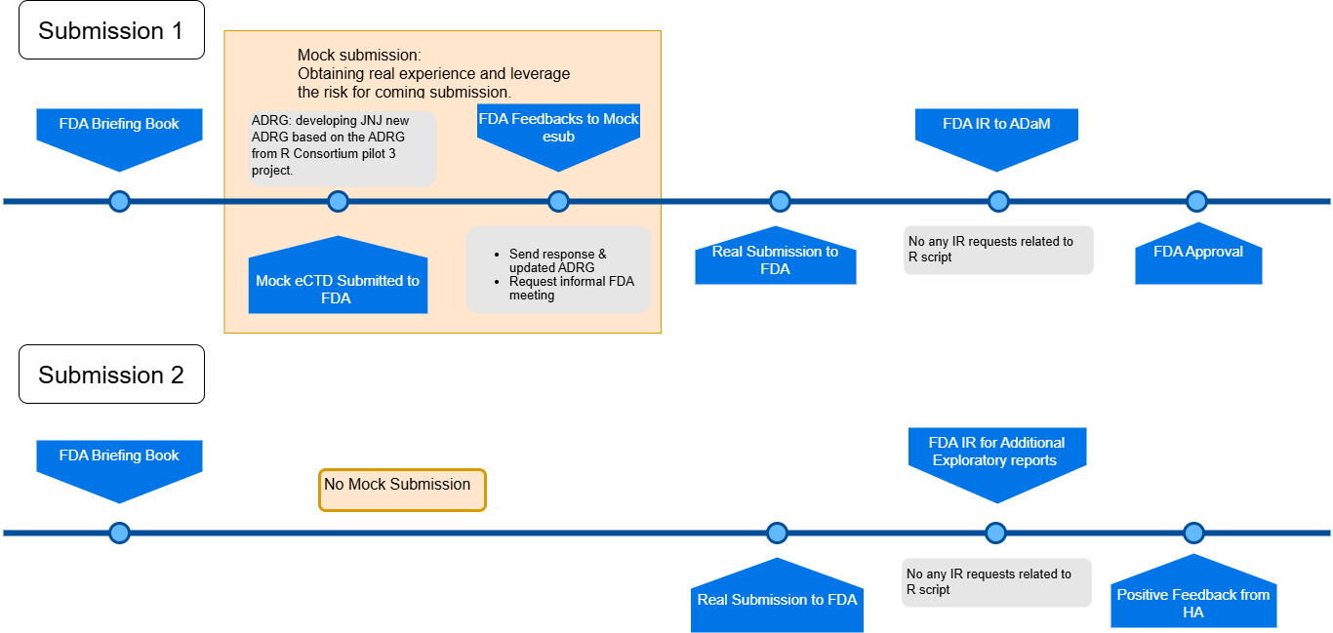
Milestones in Two Submissions

Slide 22
Conclusions
  Adhere to open-source R packages to avoid extra work for the submission, simplify the R setup process for reviewers with more transparent.
  R packages used to generate the analysis results are validated following GxP.
  Enhancing Reliability of R Analysis Results and building trust to reviewer:
    Detailed explanations of program logic
    R session information saved in R log file
    Results being validated
  ADaM with the traceability of one step away to TFL: minimized of customized functions developed to handle additional derivations or data manipulations.
  ADRG incorporate clear R packages information including R environment set up guidance by taking Consortium FDA pilot projects and other R submission cases as reference.
  Using single file which contains all the required R packages and included in the submission package. It is to simplify the installation process for the reviewer. The renv.lock file is required to create after installation serves to stabilize and lock the project environment.
  Meet the requirements of eCTD file structure and file formats following the latest FDA Study Data technical conformance guide and passed validation.

Slide 23
Challenges for R Submission
Challenges/Findings, from R Consortium & internal testing/mock submissions
  Replicating the sponsor’s R environment.
  Different operating systems require different settings and generate different warnings
  →in the ‘renv’ set up, different options might need to be selected to make it work
  Different R versions don’t perform similarly,
  Not ideal to switch R versions in RStudio for every submission
  →‘renv’ package is part of the solution to reproduce the R environment but creates challenges when transferred between different operating systems.
Recommendations/Exploration
  Add the question for R based submission in the pre-submission briefing book,
  Use CRAN or a curated repo for sourcing packages (GitHub is allowed),
  Use standard packages and minimize dependencies on sponsor developed packages,
  The required R packages are installed using a single package list file. The renv.lock file is created upon completion of the R package installation to lock down the R environment .
  Provide thorough documentation and detailed comments in ADRG.

Slide 24
Reference
R packages validation process in Johnson&Johnson
Using R in a GxP environment: https://www.youtube.com/watch?v=lWXqfuaxNL8
Johnson&Johnson’s Open Source Journey in R
https://posit.co/webinar/johnson-johnsons-open-source-journey-in-r/
R Consortium Pilot Projects
R Consortium Pilot 1, https://github.com/RConsortium/submissions-pilot1-to-fda
R Consortium Pilot 2, https://github.com/RConsortium/submissions-pilot2-to-fda
R Consortium Pilot 3, https://github.com/RConsortium/submissions-pilot3-adam-to-fda
R Consortium Pilot 4, https://github.com/RConsortium/submissions-pilot4-container
R Consortium Pilot 5, https://github.com/RConsortium/submissions-pilot5-datasetjson

Slide 25
The opinions in this presentation are our own and do not necessarily reflect the views and policies of Johnson&Johnson

