Slide 1
CST-391 Milestone 6
Rodrigo Cornidez
April 4, 2026

Slide 2
Features Built
Back End
User authentication & secure API key storage (GitHub, DigitalOcean)
Payment info storage, subscription tracking & billing
Provisioned server tracking
Front End (Angular & React)
Landing, login/sign-up, and dashboard pages
Dashboard sections: Getting Started, How-To Guides, Features, Keys, Account, Billing
Domain-based API clients: Auth, API Keys, Billing, Subscriptions
Shared components: Confirmation Modal, Snackbar notifications
Auth interceptor with auto-redirect to login

Slide 3
Challenges Encountered
Back End
Mocking external services (Stripe, DigitalOcean) for testing
Refining provisioning and billing logic for testing. This separating active (read-only) from passive (scheduled/automated) billing actions
Front End (Angular)
Learning Angular's template, logic, and style syntax
Working with template decorators and component-scoped styling
Front End (React)
Learning React hooks: useState, useRef, useEffect, useContext
Resolving CSS class name conflicts through targeted cleanup

Slide 4
TODO/Pending Bugs
Back End
Integrate real Digital Ocean SDK/API to replace mock provisioning service
Implement scheduled billing. Automate monthly/annual bill creation and payment handling
Front End (Angular & React)
Build out How-To Guides and Feature Voting sections. Currently placeholders; requires new DB table, API endpoints, and client-side service/component logic

Slide 5
Lessons Learned
Architecture & Planning
MVC/Layered architecture streamlines aligning schemas, queries, and business logic
Planning entity relationships and class fields/actions upfront speeds up development
Front End (Angular & React)
Separating pages, components, utilities, services, and interceptors improves developer experience
Component-scoped CSS is easier to manage than a single global stylesheet
React-Specific
Component CSS conflicts can be resolved using SCSS nesting or CSS component syntax
Proper use of hooks enables clean state, DOM, and context management

Slide 6
Website Accessibility
From a Christian Worldview perspective. It is our responsibility to love our neighbors. Accessible design ensures no user is left behind, regardless of ability.
What It Means for UX
Broader reach: sites work for users with visual, motor, auditory, or cognitive disabilities.
Builds trust and inclusivity into the product.
Best Practices
Use semantic HTML
Use sufficient color contrast and scalable font sizes
Support keyboard navigation and screen readers

Slide 7
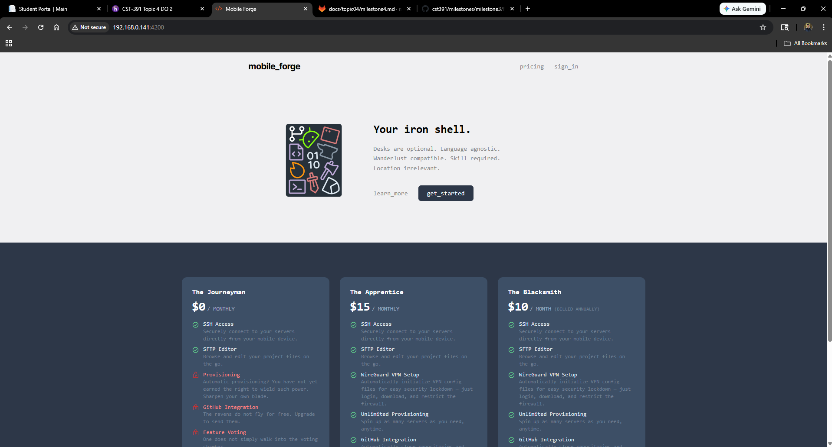
Angular – Landing Page

Slide 8
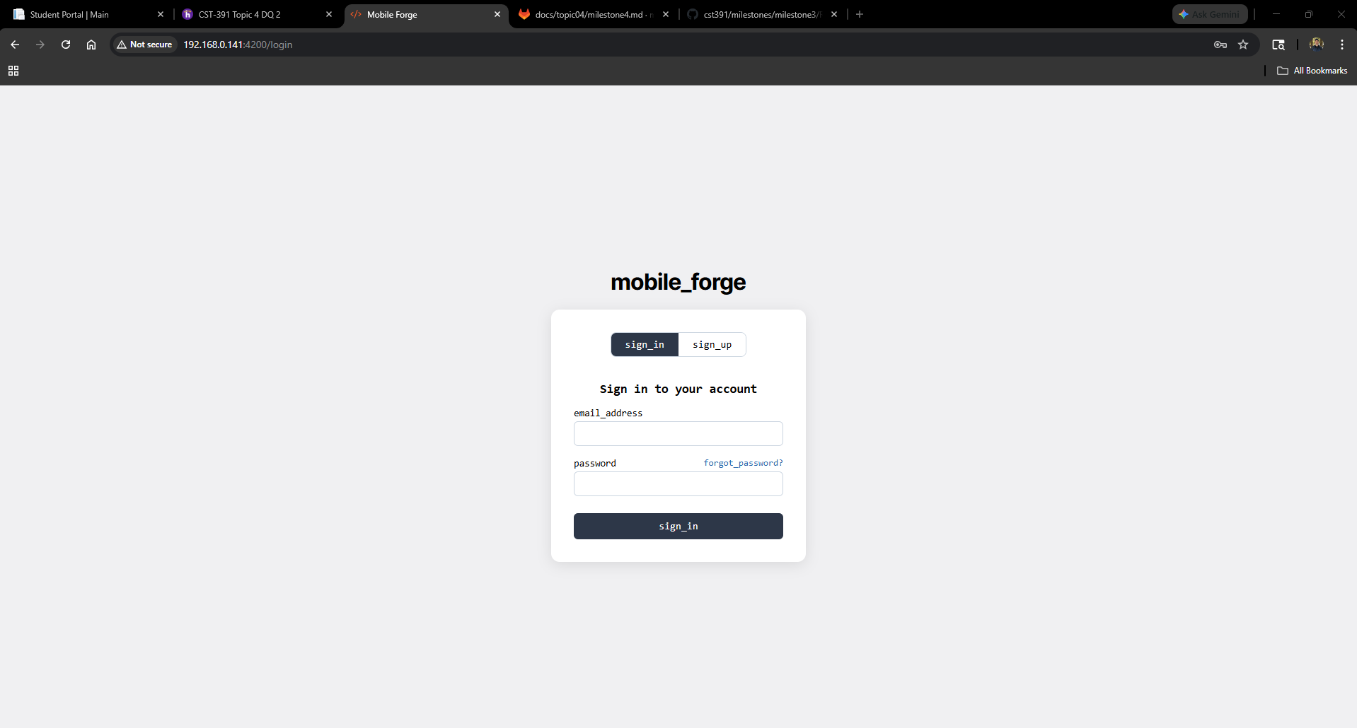
Angular – Login Page

Slide 9
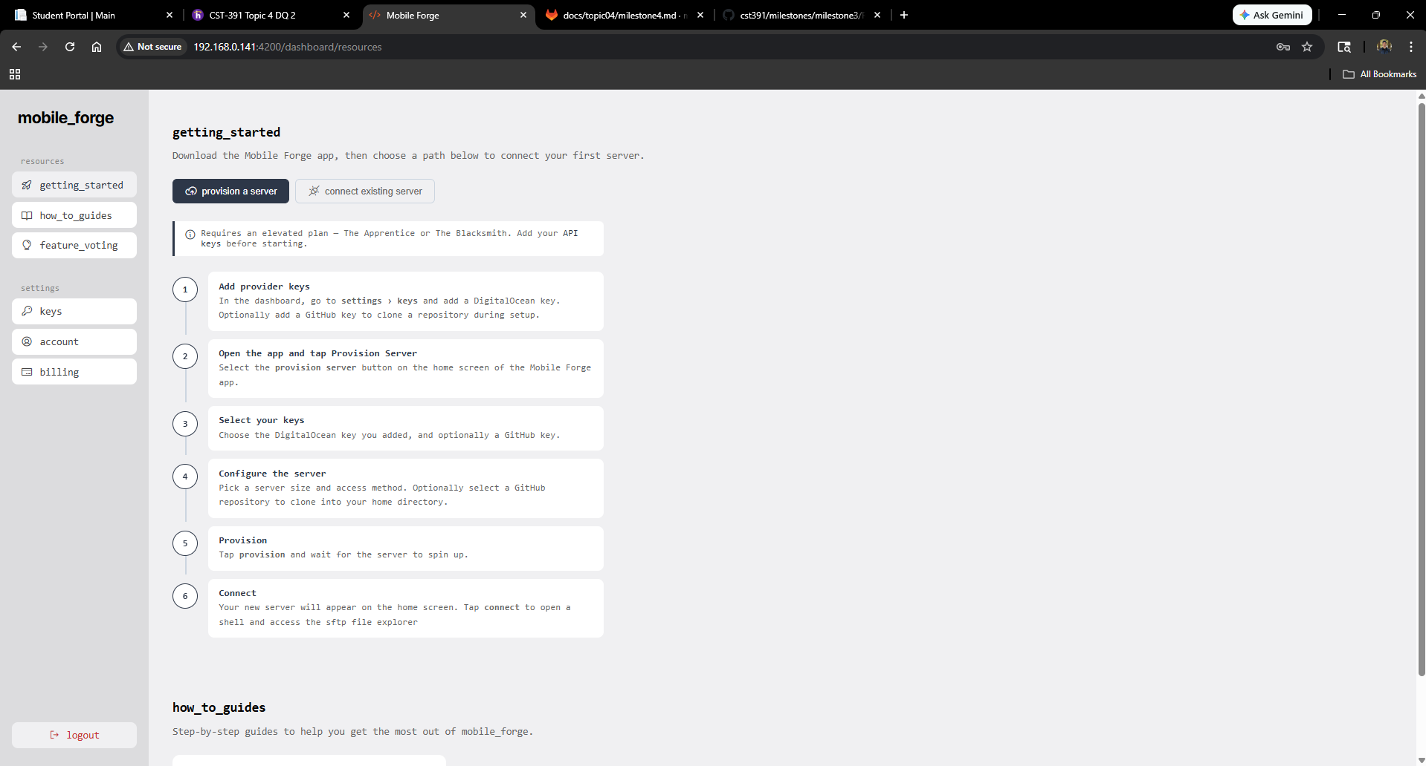
Angular – Resources – Getting Started

Slide 10
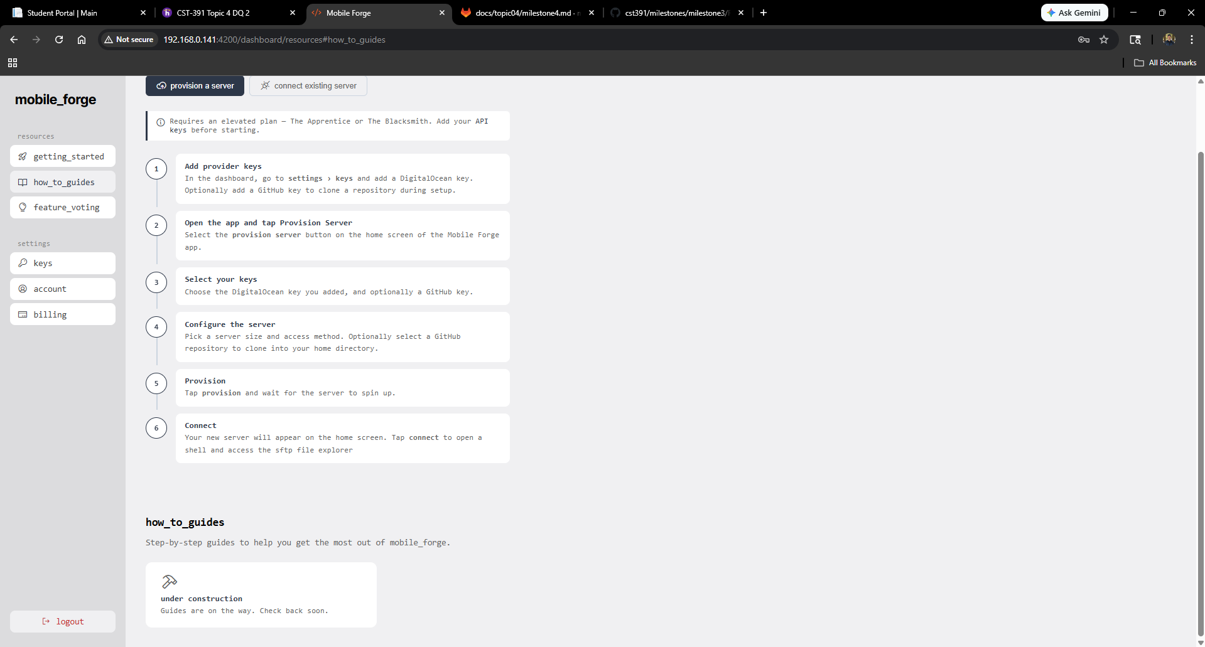
Angular – Resources – How To Guides

Slide 11
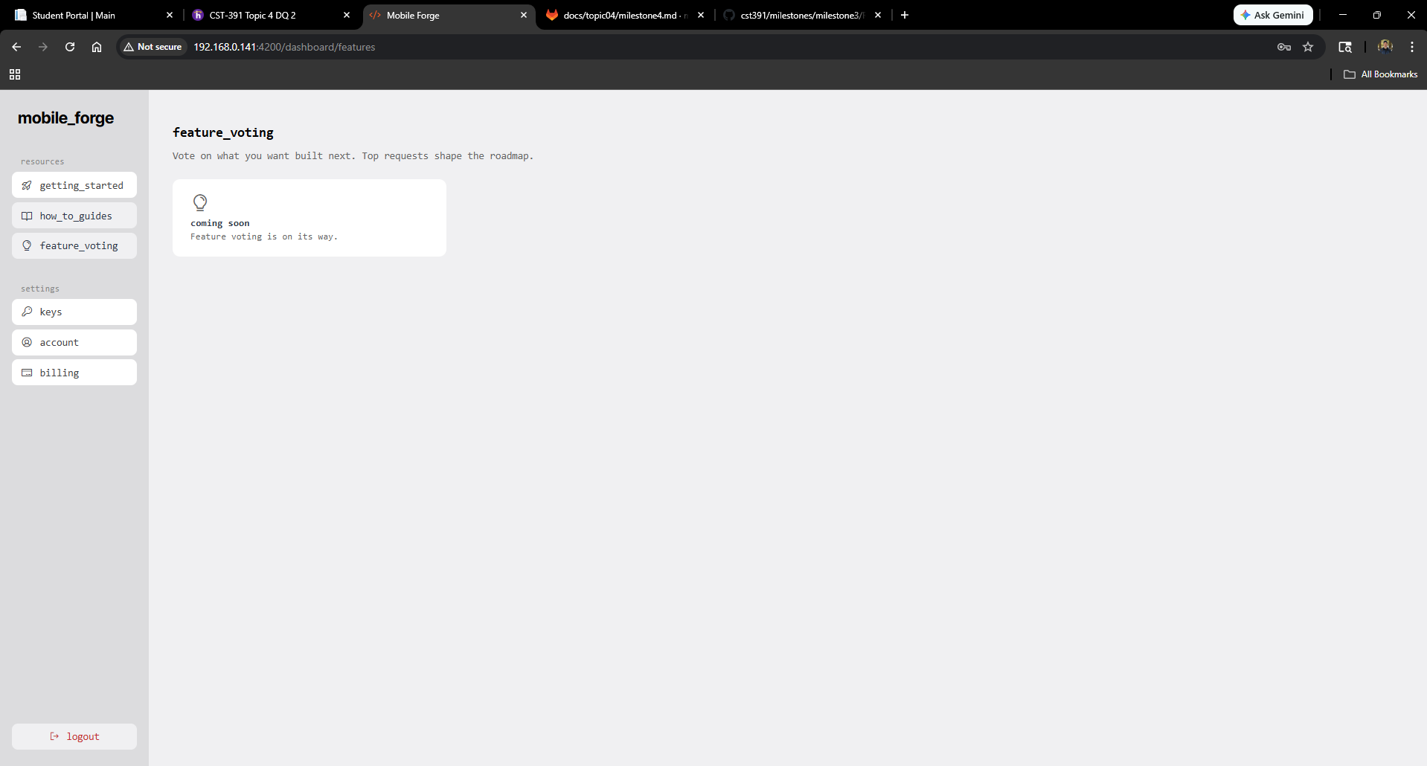
Angular – Features

Slide 12
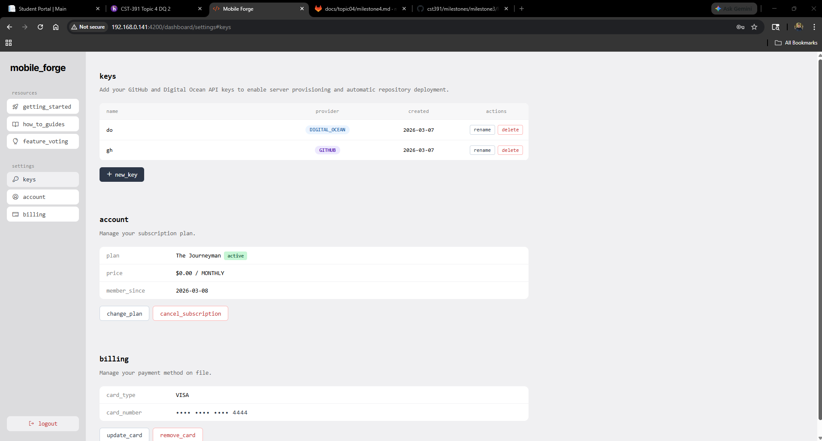
Angular – Settings

Slide 13
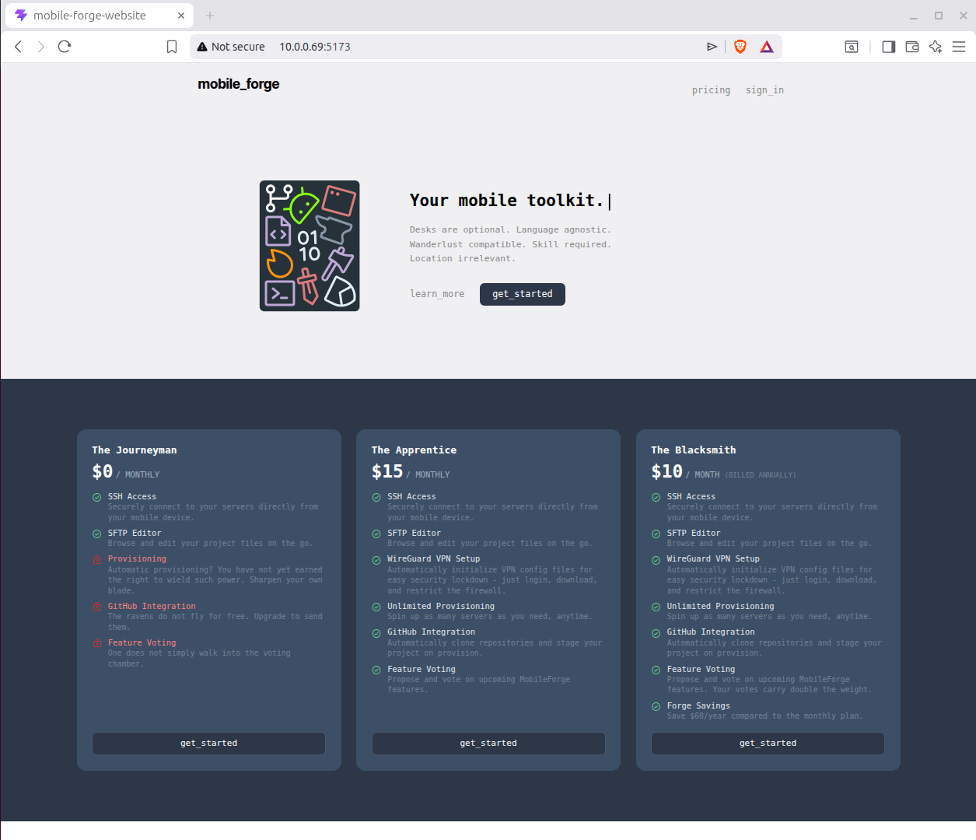
React – Landing Page

Slide 14
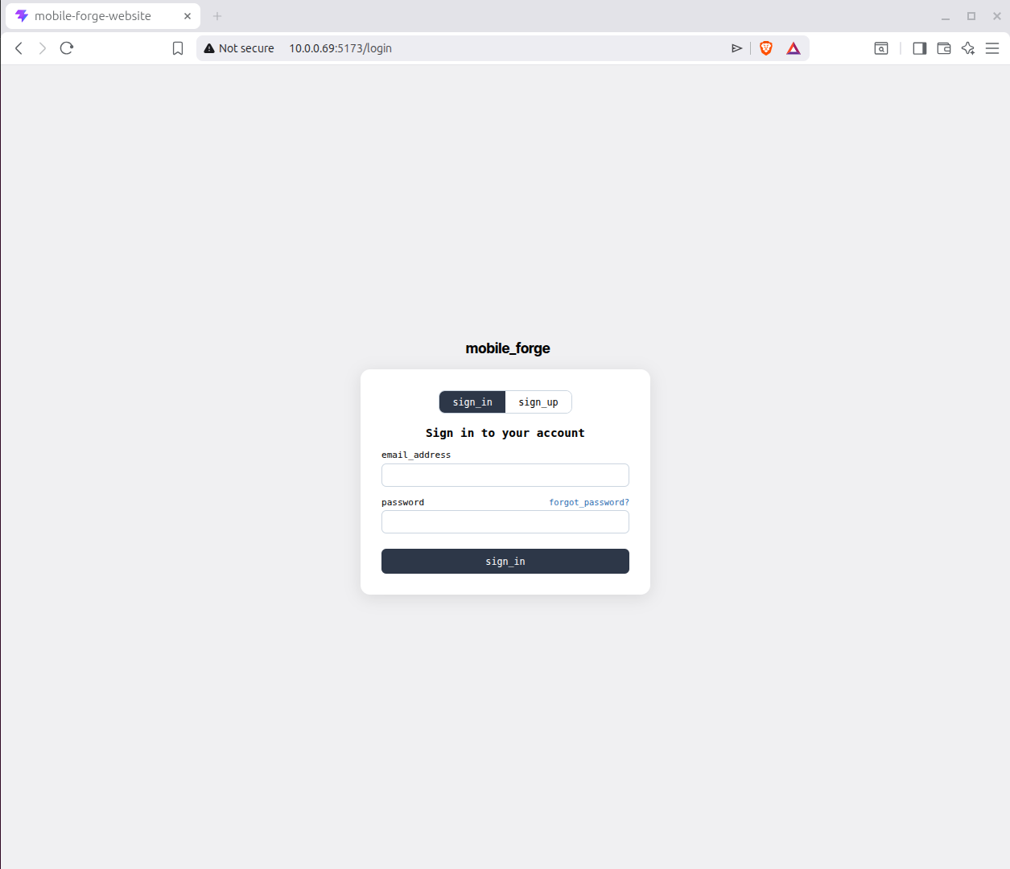
React – Login Page

Slide 15
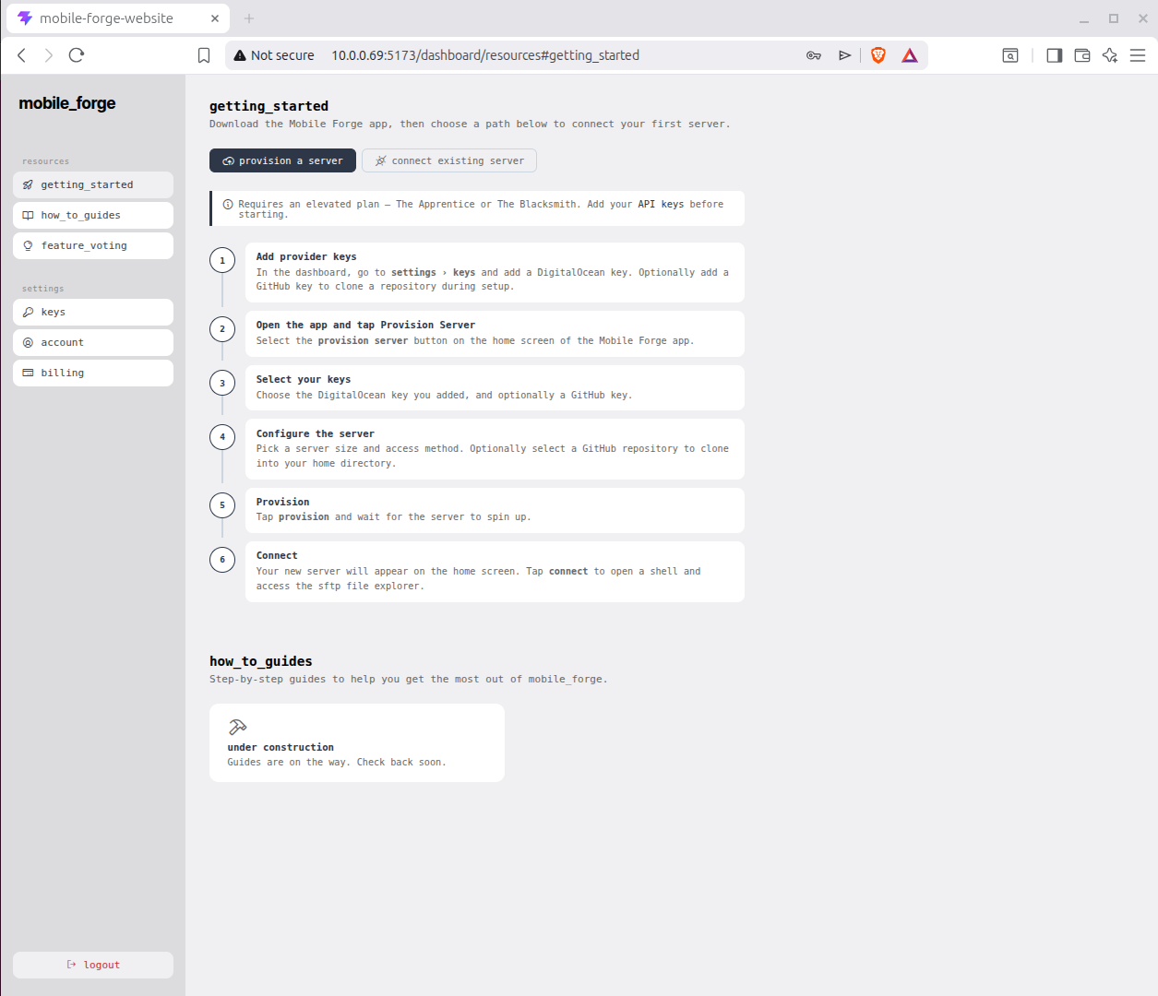
React – Resources – Getting Started

Slide 16

React – Resources – How To Guides

Slide 17
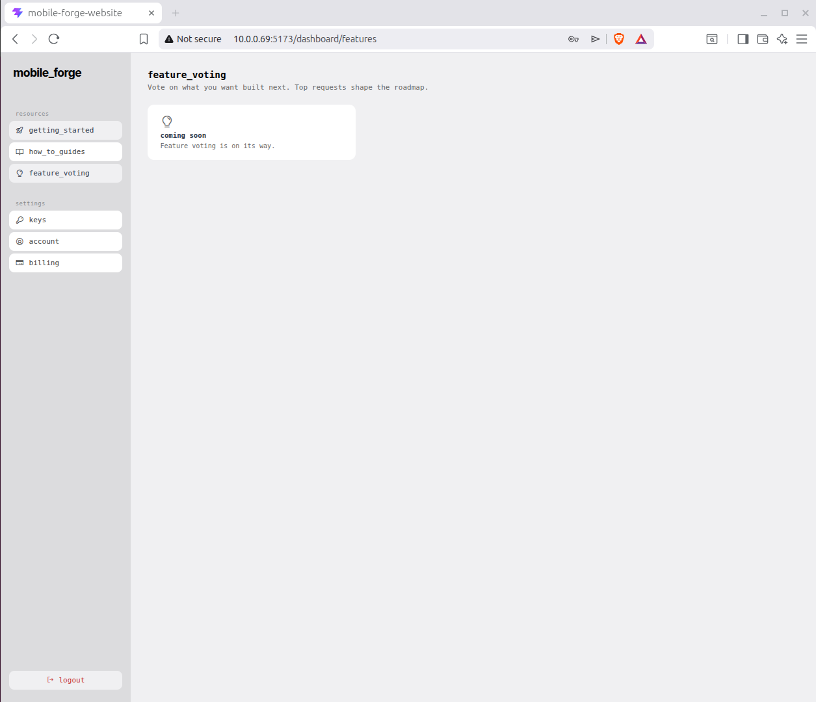
React – Features

Slide 18
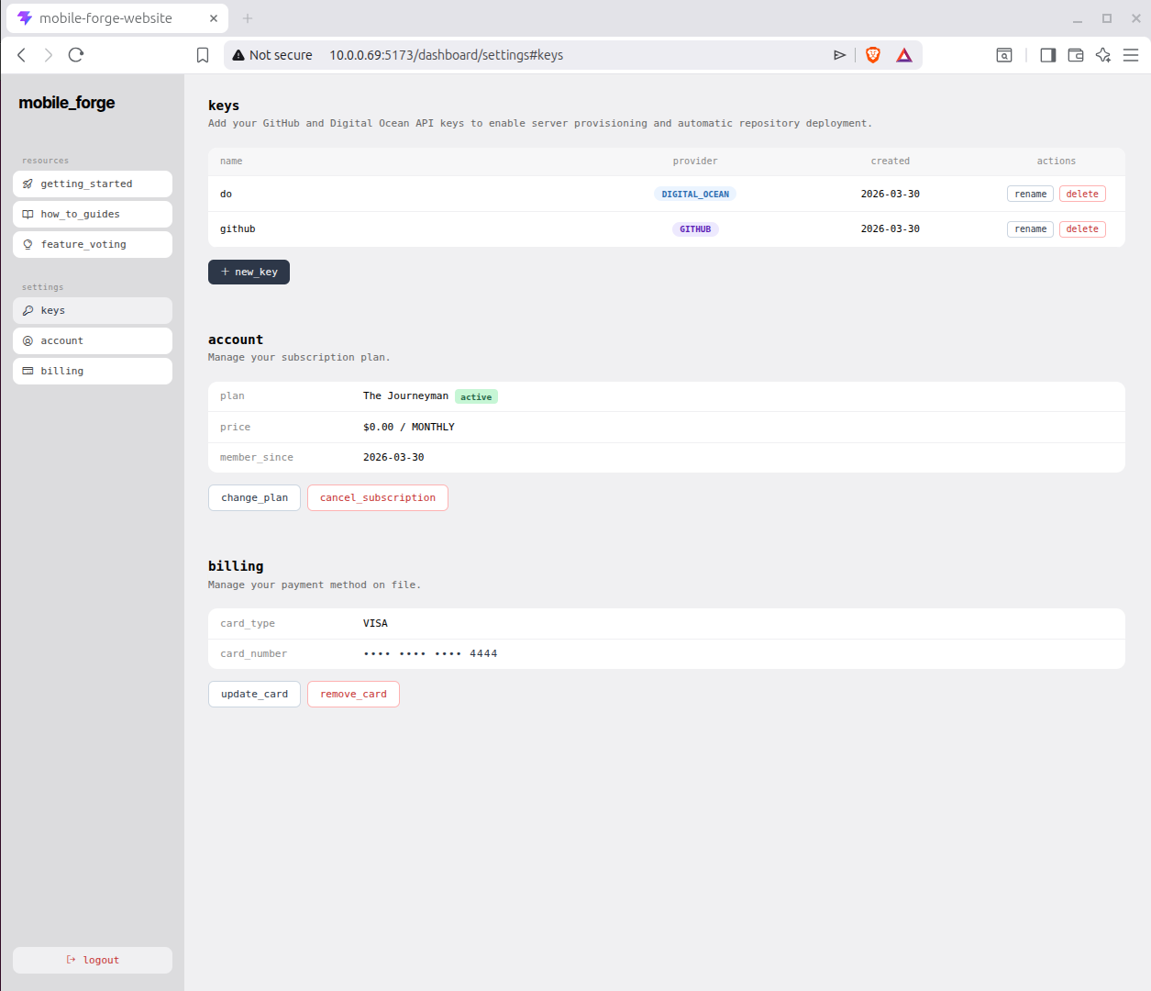
React – Settings

