Slide 1
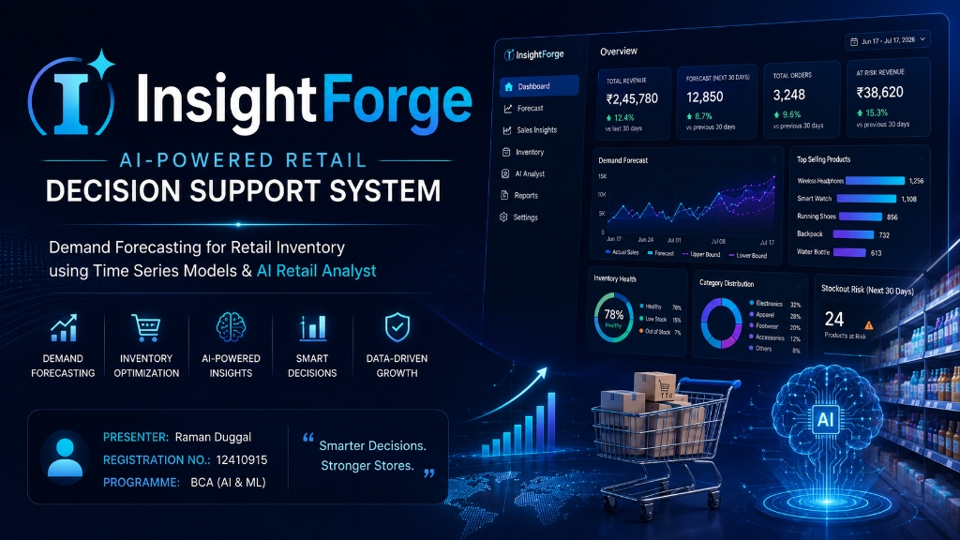

Slide 2
THE BUSINESS PROBLEM
INSIGHTFORGE AI
Why InsightForge?
02
📦
Overstocking
Capital tied up in slow-moving inventory
⚠️
Understocking
Stockouts lose sales & customer trust
💸
Lost Revenue
Missed demand signals cost real money
🎲
Manual Decisions
Reorder quantities guessed, not calculated
📉
No Forecasting
Zero visibility into next week's demand
📊
Scattered Data
Sales data trapped across spreadsheets
💡 OUR SOLUTION — InsightForge combines AI, Machine Learning & Business Intelligence to help retailers make smarter inventory decisions through automated forecasting and an AI-powered retail assistant.

Slide 3
GOALS
INSIGHTFORGE AI
Project Objectives
03
01
Actionable Data Insights
Convert raw retail sales data into actionable, evidence-based business insights.
02
Multi-Model Forecasting
Ridge, Gradient Boosting & Prophet models trained and compared per individual product.
03
Automatic Best Selection
Optimal model chosen strictly from real validation error (MAE/RMSE), never hardcoded.
04
Inventory Decision Support
Automated reorder quantities, stockout risk alerts, and quantified revenue at risk.
05
AI Retail Analyst
Conversational AI answers grounded directly in real pandas computation, with zero hallucinated stats.
06
Interactive Dashboard
Filterable BI views with 10+ Plotly charts covering the entire store catalog.
💡 CORE PURPOSE — Empowering store managers with enterprise-grade predictive analytics without needing data science expertise.

Slide 4
ENGINEERING
INSIGHTFORGE AI
System Architecture Flow Diagram
04
1. Retail Data
2. Cleaning
3. Feature Eng.
4. Forecasting
5. Selection
6. Decision Support
7. BI / AI Analyst
➔
➔
➔
➔
➔
➔
⬇ 3 Competing Models
Ridge Regression
L2 Regularized Linear Baseline
Gradient Boosting
Non-Linear Decision Tree Ensemble
Prophet
Additive Seasonality & Trend Model
💡 PIPELINE INTEGRITY — Every stage runs on real pandas computation — no step in this pipeline invents a number. The dataset flows through cleaning, feature engineering, and three competing forecasting models before the best performer per product is automatically selected.

Slide 5
BUILT WITH
INSIGHTFORGE AI
Technology Stack
05
💻 FRONTEND
HTML5 • CSS3 • JS
Modern dark UI, vanilla JS state machine.
⚡ BACKEND
FastAPI
High-performance Python ASGI web API.
🤖 MACHINE LEARNING
scikit-learn • Prophet • Pandas
Forecasting models & feature engineering.
📈 VISUALIZATION
Plotly.js
Interactive dynamic chart rendering.
🧠 AI CORE
Groq • Ollama
Fast cloud API & private local LLM engine.
💾 STORAGE
JSON • Pickle
Lightweight registry & model serialization.
🔧 VERSION CONTROL
Git
Modular codebase architecture & versioning.
💡 ROBUST STACK — Modern Python ML stack paired with lightweight FastAPI and interactive Plotly visual frontend.

Slide 6
END TO END
INSIGHTFORGE AI
Working Flow & Operational Pipeline
06
1
2
3
4
5
Upload Dataset
CSV/Excel sales ingestion
Data Validation
Schema & type checking
EDA Analysis
Anomaly & trend discovery
Feature Eng.
Lags & rolling metrics
Train Models
3 algorithms fitted
6
7
8
9
10
Compare Models
MAE / RMSE ranking
Forecast Curve
30-day projection
Decision Support
Reorder & risk metrics
AI Analyst
Grounded chat queries
Dashboard BI
Interactive overview
💡 STREAMLINED EXECUTION — A single continuous pipeline — from raw CSV upload to clear business decisions the store manager can execute today.

Slide 7
MACHINE LEARNING
INSIGHTFORGE AI
Forecasting Pipeline & Metrics
07
Dataset
Cleaning
Feature Eng.
Train
Evaluate
Compare
Best Model
Forecast
MAE
Mean Absolute Error
Average absolute forecast error measured in physical product units.
RMSE
Root Mean Squared Error
Penalizes large outlier misses heavily to ensure stability.
MAPE
Mean Absolute % Error
Relative forecast error expressed as a clear percentage.
R² Score
Variance Explained
Quantifies how accurately the model captures trend & seasonality.
💡 CHRONOLOGICAL VALIDATION — Models are trained strictly on early historical dates and validated on the final 30 days — never a random shuffle, which would leak future information into the past. Three models are validated per product; the lowest real validation error wins.

Slide 8
CONVERSATIONAL AI
INSIGHTFORGE AI
AI Retail Analyst Architecture
08
🔄 DETERMINISTIC AI FLOW
• 1. User Natural Language Question
• 2. Intent Classifier LLM (Groq / Ollama)
• 3. Structured Tool Selection
• 4. Python Pandas Deterministic Execution
• 5. Grounded Real Data Result
• 6. Formatted LLM Response + Chart
No Hallucinated Numbers
Every single stat traces directly to real pandas computations.
Structured Tool Calling
11 deterministic backend tools — zero arbitrary code risk.
Actionable Insights
Identifies slow movers, restock alerts, & plain advisories.
Dynamic Chart Generation
Real Plotly interactive charts built live from text requests.
Session Memory
Remembers conversation context seamlessly across queries.
💡 ZERO HALLUCINATIONS — The LLM never computes a number — it only chooses which deterministic tool to call and how to phrase the answer for the manager.

Slide 9
PRODUCT TOUR
INSIGHTFORGE AI
Dashboard & System Modules
09
📁 Data Upload
CSV, Excel, or built-in demo dataset ingestion with automatic column alias detection.
🔍 EDA & Diagnostics
Automated exploratory analysis, anomaly flags, & missing value remediation.
📈 Demand Forecasting
Per-product 30-day demand curves with upper/lower confidence bounds.
📊 Sales Insights BI
Filterable business intelligence dashboard featuring 10+ interactive Plotly charts.
🛡️ Decision Support
Plain-language reorder advisories, stockout countdowns, & revenue at risk.
💬 AI Chat Analyst
Ask any question in plain English to get immediate grounded answers or charts.
💡 MODULAR DESIGN — Complete end-to-end platform bridging raw data analysis, machine learning forecasting, and AI-driven decision making.

Slide 10
OUTCOMES
INSIGHTFORGE AI
Key Results & Business Value
10
🎯 Automatic Best Model Selection
Three competing algorithms compared per product. Selection driven strictly by real validation metrics, eliminating human bias.
🛡️ Proactive Stockout Prevention
Stockout risk identified 30 days before inventory depletes. Revenue-at-risk quantified directly in monetary value.
⚡ Faster Evidence-Based Decisions
Reorder quantities calculated deterministically. Store managers move from guesswork to automated data science.
💡 KEY TAKEAWAY — Across the real product catalog, Prophet, Gradient Boosting, and Ridge Regression each won on different products depending on seasonality strength and price signal — confirming that per-product model selection is genuinely necessary.

Slide 11
REFLECTION & ROADMAP
INSIGHTFORGE AI
Challenges Encountered & Future Scope
11
⚠️ KEY TECHNICAL CHALLENGES
• Data Cleaning: Handling non-UTF8 encodings & noisy Excel formats.
• Feature Eng.: Designing lag & rolling windows for recursive forecasts.
• Prophet Seasonality: Overriding forced yearly seasonality on short series.
• AI Grounding: Ensuring zero LLM hallucination on numeric values.
• Column Aliases: Supporting flexible CSV headers in real datasets.
🚀 FUTURE ROADMAP & EXPANSION
• SQLite Registry: Migrate flat JSON storage to concurrent DB.
• ONNX Export: Cross-platform model export for fast inference.
• SHAP Explainability: Feature importance breakdown per forecast.
• Streaming AI: Progressive SSE response streaming in chat.
• Multi-User Support: Isolated dataset tenant environments.
• Live POS Integration: Continuous live API ingestion from POS.
💡 CONTINUOUS EVOLUTION — Architected for easy scalability from a standalone retail tool to an enterprise-wide inventory management platform.

Slide 12
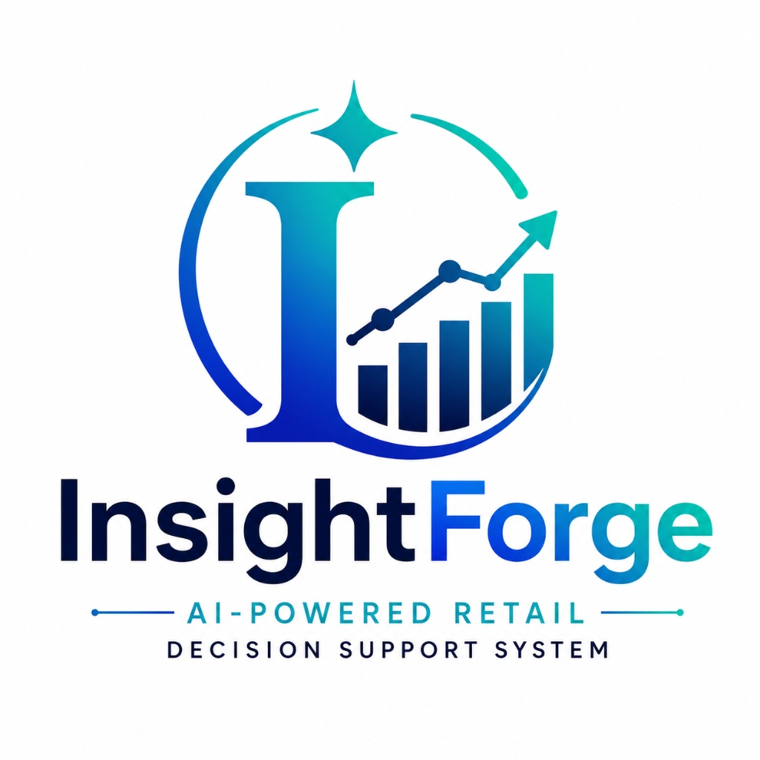
Thank You!
Smarter Decisions. Stronger Stores.
Raman Duggal • 12410915 • BCA (AI & ML)

