Slide 1
AI Agent Self-Consistency
Severin Bratus, David Dinucu-Jianu, Ilias Mc Auliffe

Slide 2
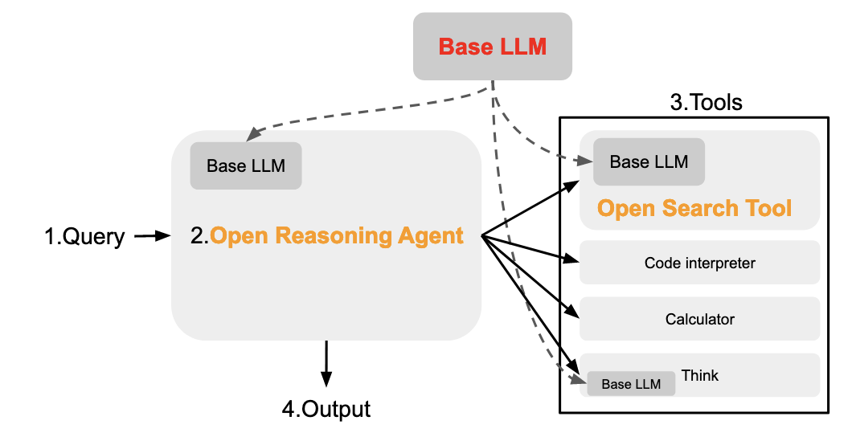
Motivation
Main idea: open-source AI enabled search (e.g. alternative to Google/Bing/DuckDuckGo and Perplexity/ChatGPT Search)
The LLM acts as the agent and combines reasoning with external tools to provide the best possible response to a user query

Slide 3


Query
As of August 1, 2024, which country were holders of the FIFA World Cup the last time the UEFA Champions League was won by a club from London?
France
France
Spain
No answer
The country was France

Slide 4
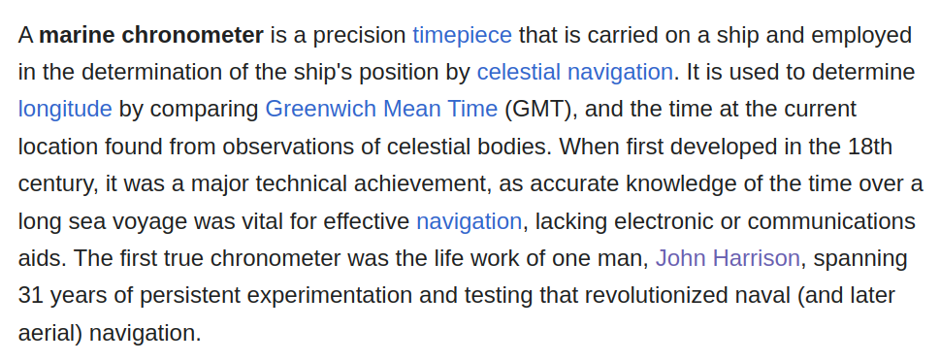
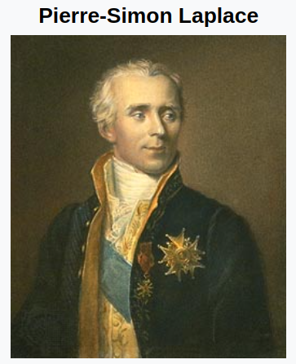
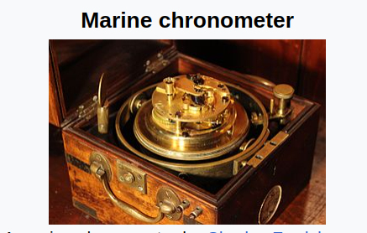
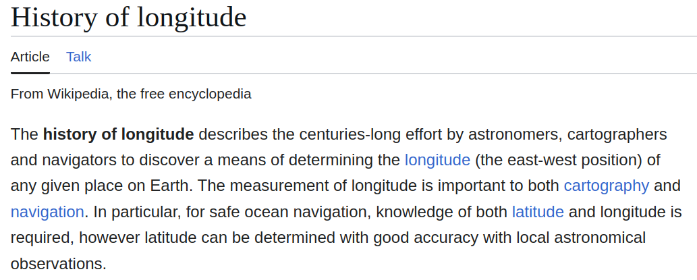
Dataset
In physics, when speaking of classical mechanics, there is an infamous problem that involves taking the initial positions and velocities of three point masses that orbit each other and attempting to calculate their trajectories. There is no general closed-form solution for this infamous problem. French mathematicians in the 18th century focused on solving this problem in regards to astronomical motion, specifically how the Moon rotates on its apsides. Their work led to a solution using Newton's laws of physics and the Discrete Fourier Transformation (DFT), which ultimately changed how sailors were able to determine longitude at sea. The inventor of the device that would revolutionize naval navigation using these new principles and proofs spent how many years testing and perfecting his work?

Slide 5
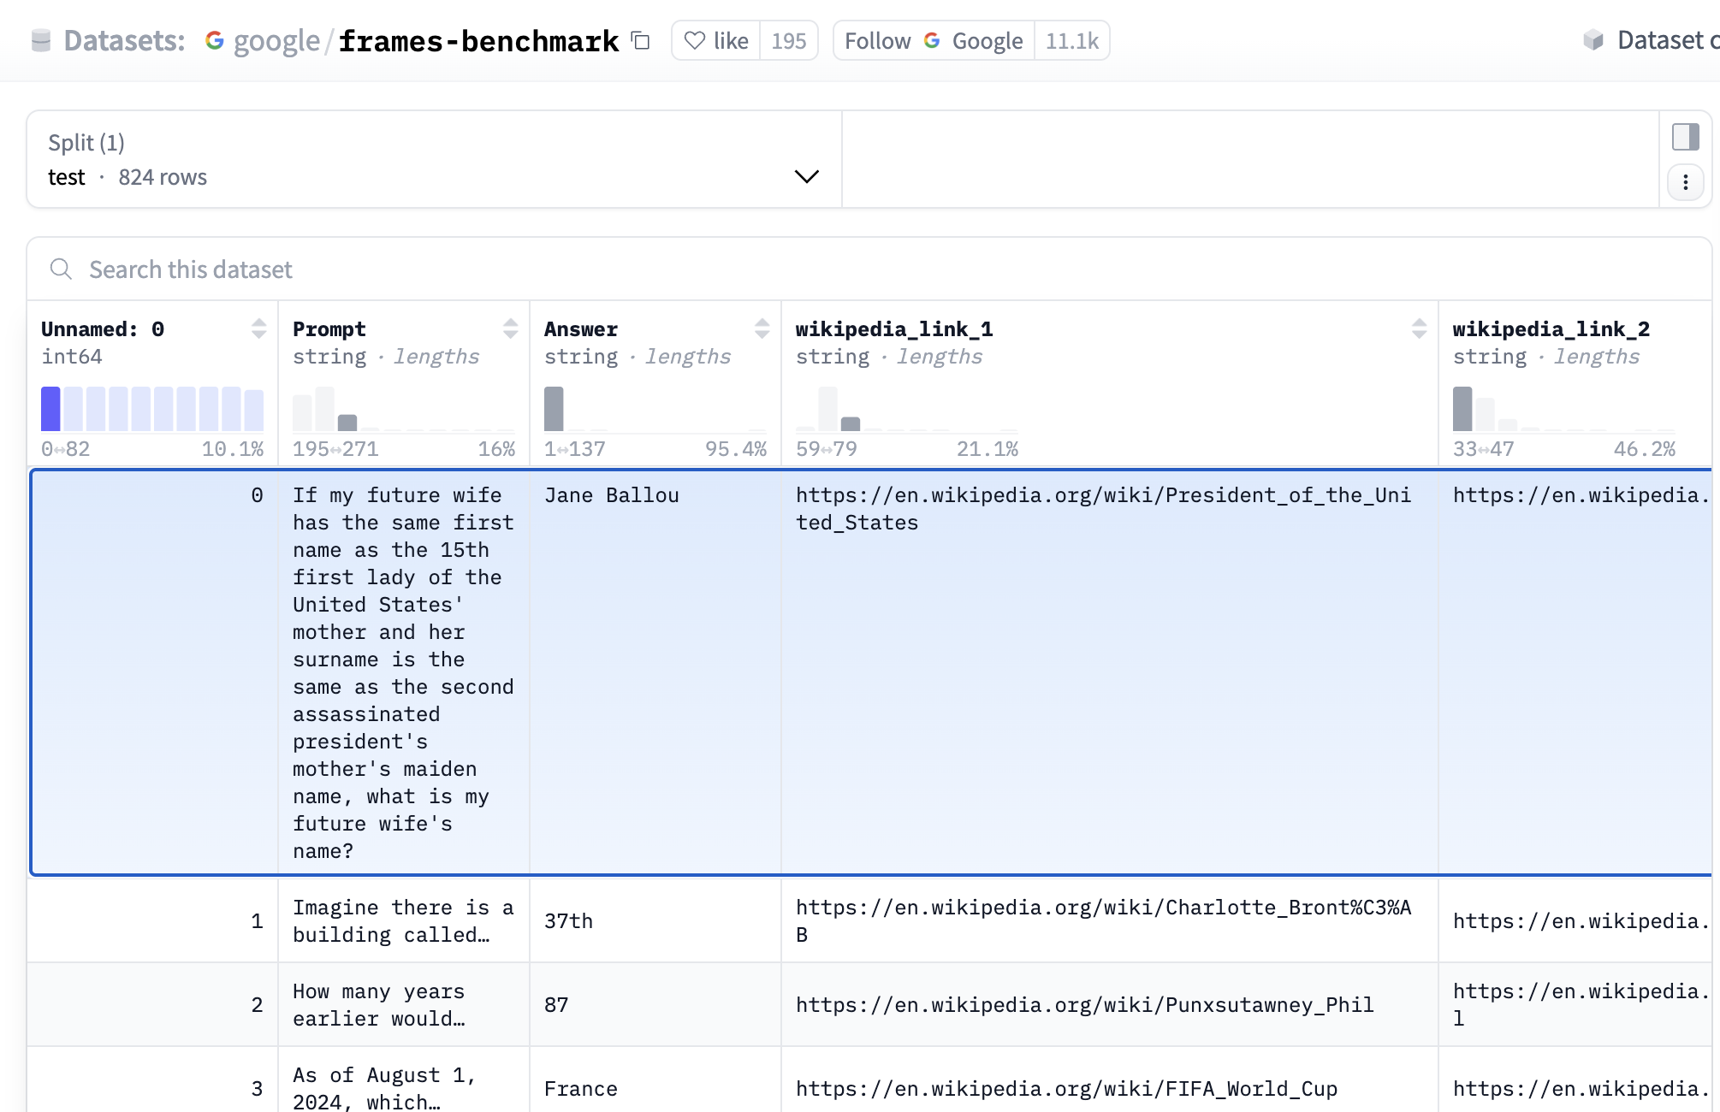
Dataset

Slide 6
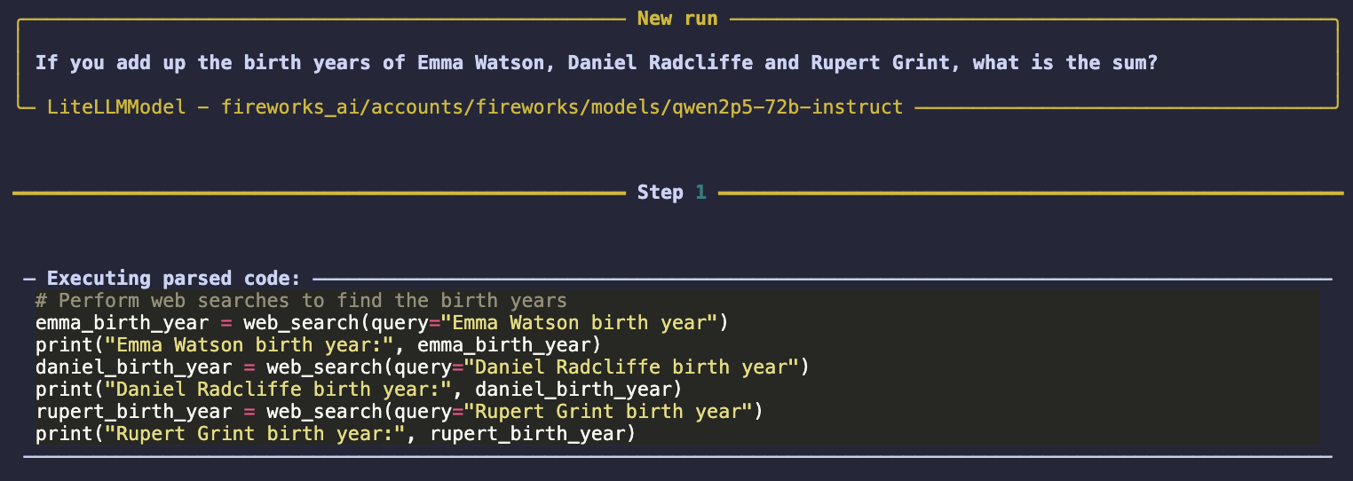
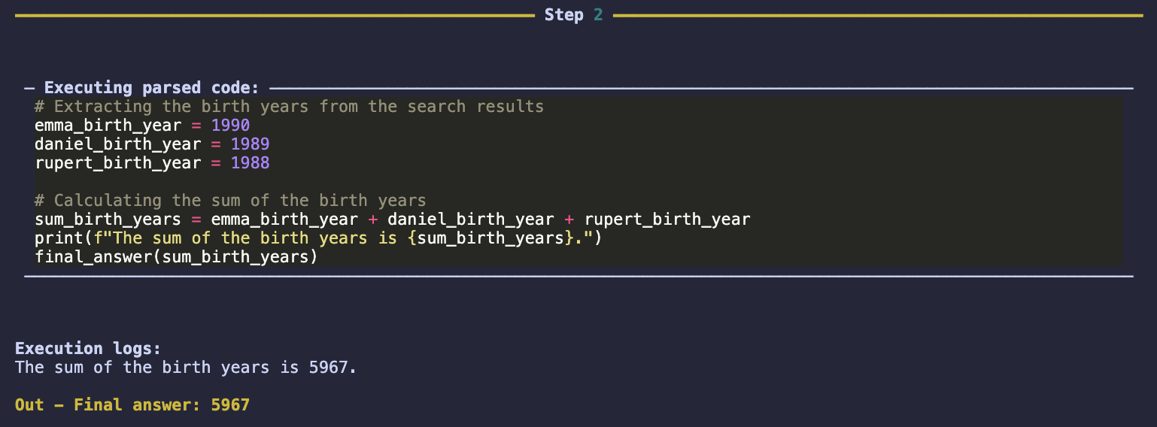
Single Agent Chain-of-Thought + Tools

Slide 7
Results (easy)
Query: As of August 2024, who was president of the United States the last time The Beach Boys topped the chart on the Billboard Hot 100?
Ensemble Answers: ['Ronald Reagan', 'Ronald Reagan', 'Ronald Reagan', 'Ronald Reagan']
Final Result: Ronald Reagan

Slide 8
Results (hard)
Query: I can't recall who I'm trying to think of. This person was the partner of someone in the 1984 Olympic keelboat competition. Their partner's sister was the only American who placed in the 2003 Pan American Games for sailing in the men's or women's competition (not including the open events).
Answers: ['Richard Coxon', 'Stephen Erickson', 'Richard Coxon', 'Richard Coxon', 'Diane Crocker', 'Colin Beashel', 'Stevie Erickson', 'Unknown, but possibly the sister of William E. Buchan', 'Richard Coxon']
Final Result: Richard Coxon

Slide 9
Results (hard)
Query: I can't recall who I'm trying to think of. This person was the partner of someone in the 1984 Olympic keelboat competition. Their partner's sister was the only American who placed in the 2003 Pan American Games for sailing in the men's or women's competition (not including the open events).
Answers: ['Richard Coxon', 'Stephen Erickson', 'Richard Coxon', 'Richard Coxon', 'Diane Crocker', 'Colin Beashel', 'Stevie Erickson', 'Unknown, but possibly the sister of William E. Buchan', 'Richard Coxon']
Final Result: Richard Coxon

Slide 10
Thank you

