Slide 1
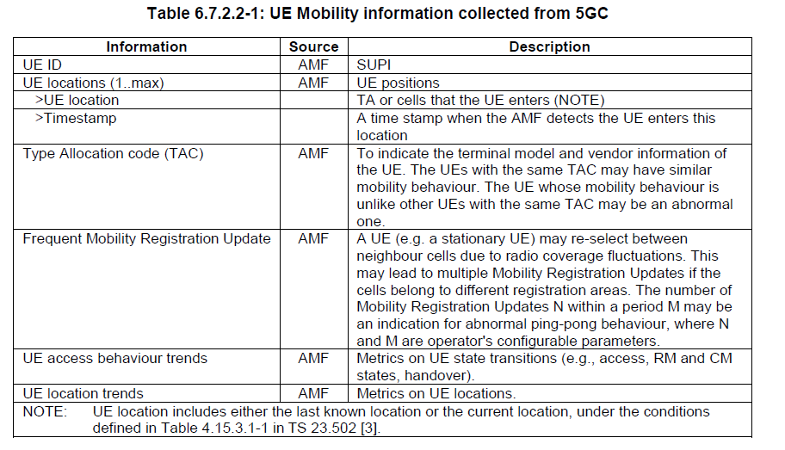
NWDAF and UE’s analytics collection
NWDAF provides analytics about UE behaviour such as:
UE mobility
UE communication
Expected UE parameters related to the network
Abnormal behaviour
NWDAF service consumers can have access to these informations
NWDAF retrieves user consent for the UE with UDM prior to data collection
The NWDAF shall be able to collect UE mobility information from OAM, from 5GC (via AMF) and from application function (AF).
The NWDAF shall be able to collect UE communication information from SMF, from 5GC (via AMF) and from application function (AF) and from UPF.

Slide 2
7.5.2 Providing Multiple Classes of Service Perhaps the simplest enhancement to the one-size-fits-all best-effort service in today’s Internet is to divide traffic into classes, and provide different levels of service to these different classes of traffic. For example, an ISP might well want to provide a higher class of service to delay-sensitive Voice-over-IP or teleconferencing traffic (and charge more for this service!) than to elastic traffic such as email or HTTP. Alternatively, an ISP may simply want to provide a higher quality of service
to customers willing to pay more for this improved service. A number of residential
wired-access ISPs and cellular wireless-access ISPs have adopted such tiered levels
of service—with platinum-service subscribers receiving better performance than
gold- or silver-service subscribers.
We’re all familiar with different classes of service from our everyday lives—
first-class airline passengers get better service than business-class passengers, who
in turn get better service than those of us who fly economy class; VIPs are provided
immediate entry to events while everyone else waits in line; elders are revered in
some countries and provided seats of honor and the finest food at a table. It’s important
to note that such differential service is provided among aggregates of traffic,
that is, among classes of traffic, not among individual connections. For example, all
first-class passengers are handled the same (with no first-class passenger receiving
any better treatment than any other first-class passenger), just as all VoIP packets
would receive the same treatment within the network, independent of the particular
end-to-end connection to which they belong. As we will see, by dealing with a small
number of traffic aggregates, rather than a large number of individual connections,
the new network mechanisms required to provide better-than-best service can be
kept relatively simple.
The early Internet designers clearly had this notion of multiple classes of service
in mind. Recall the type-of-service (ToS) field in the IPv4 header in Figure 4.13.

Slide 3
QOS insights
Insight 1: Packet marking allows a router to distinguish among packets belonging to different classes of traffic.
Insight 2: It is desirable to provide a degree of traffic isolation among classes so that one class is not adversely affected by another class of traffic that misbehaves.
Insight 3: While providing isolation among classes or flows, it is desirable to use resources (for example, link bandwidth and buffers) as efficiently as possible.
Insight 4: If sufficient resources will not always be available, and QoS is to be guaranteed, a call admission process is needed in which flows declare their QoS requirements and are then either admitted to the network (at the required QoS) or blocked from the network (if the required QoS cannot be provided by the network).

Slide 4
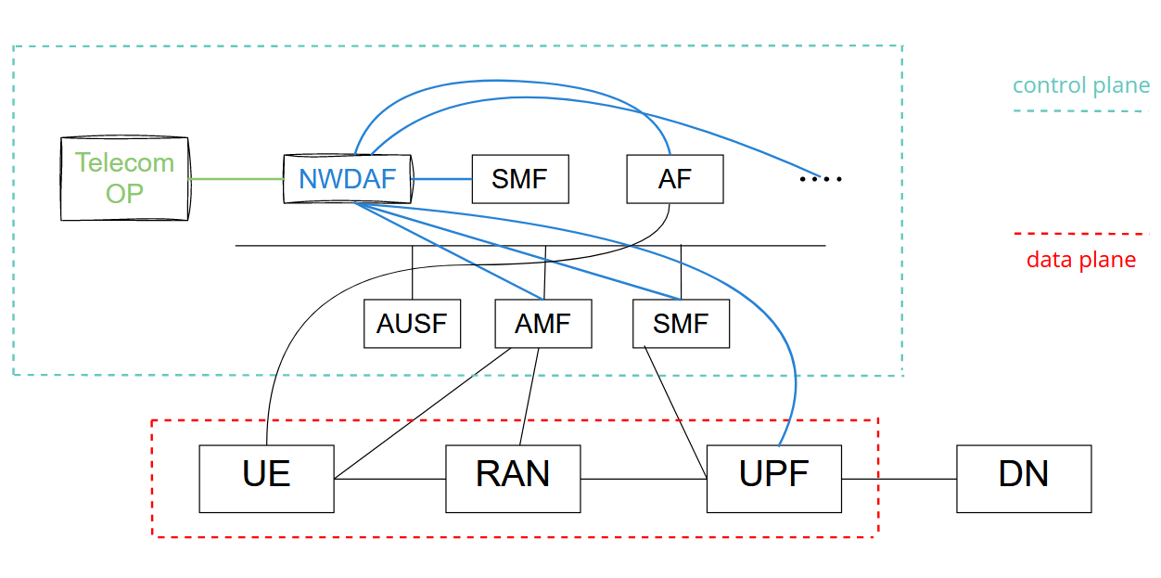
Estrutura do Sistema

