Slide 1
Network Neutrality
All internet traffic should be processed without differentation
Origin
Destination
Content (outdated) - 5g slices/categories
Increasingly important as global debate intensifies and governments worldwide implement and withdraw regulations
Motivations for discriminatory traffic management
ISP obtaining competitive edge
Increase the number of customers and/or charge higher fees
Some traffic management pratices are considered to be “reasonable” and are allowed (should be transparent)
Addressing ilegal content (piracy, spam or viroses)
Prioritazing DNS queries
Prioritize special services
Problem with detecting TD
External observer with no access to network configurations
Detect TD with only features of network(source,dst,port,etc)
Identify which features trigger TD and where its happening

Slide 2
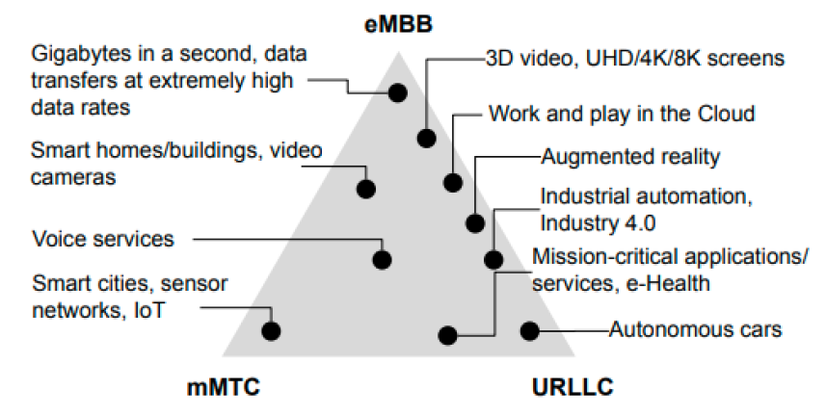
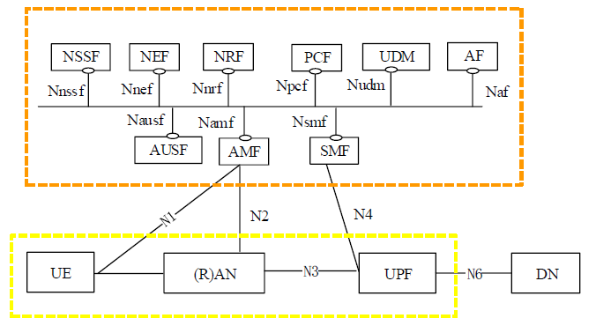
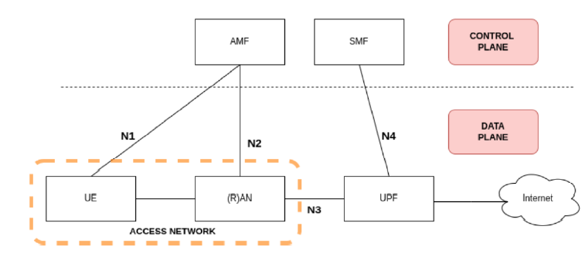
5g architecture and three main categories

Slide 3
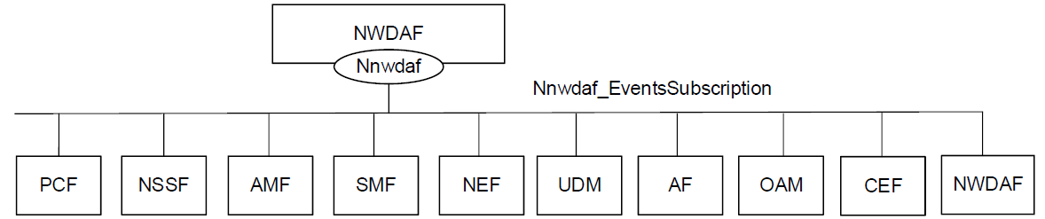
NWDAF
The Network Data Analytics Function (NWDAF) provides analytics information for different analytic events to NF consumers. It also allows NF consumers to subscribe/unsubscribe from notifications when an event is detected.
Main NF services provided by NWDAF:
Nnwdaf_AnalyticsSubscription - Enables the consumer to subscribe/unsubscribe for network data analytics
Nnwdaf_AnalyticsInfo - Enables the NF service consumers to request and get specific analytics from the NWDAF
Nnwdaf_DataManagement - Enables the NF service consumers to subscribe/unsubscribe from notifications when subscribed event(s) are detected or retrieve the subscribed data from the NWDAF
Nnwdaf_MLModelProvision - Enables the consumer to receive a notification when an ML model matching the subscription parameters becomes available
Nnwdaf_MLModelInfo - Enables the consumer to request and get from NWDAF data containing MTLF ML Model Information
The first three services are provided by the Analytics logical function (AnLF) of NWDAF and the last two are provided by the Model Training logical (MTLF) function of NWDAF

Slide 4
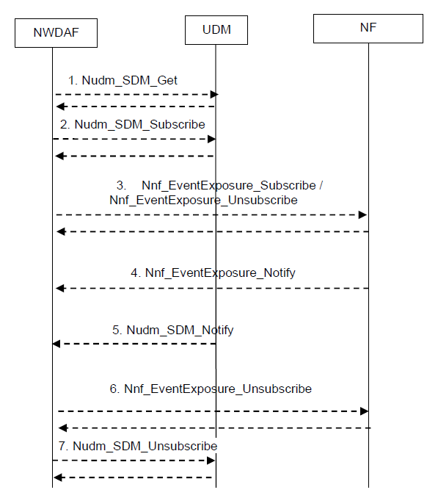
NWDAF Data Collection from NFs
Unified Data Management
The Data Collection from NFs is used by NWDAF to subscribe/unsubscribe at any 5GC NF to be notified for data on a set of events.
The Data Collection from NFs is based on the services of AMF, SMF, UDM, PCF, NRF:
Event Exposure Service offered by each NF
other NF services (e.g. Nnrf_NFDiscovery and Nnrf_NFManagement in NRF

Slide 5
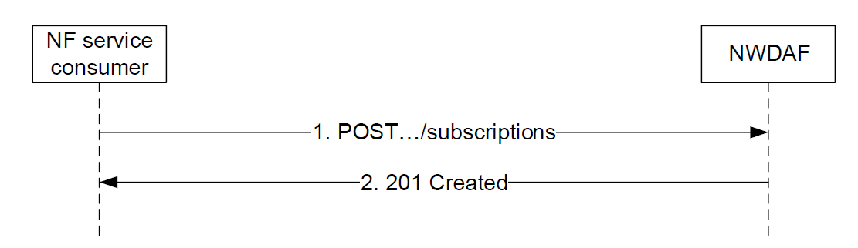
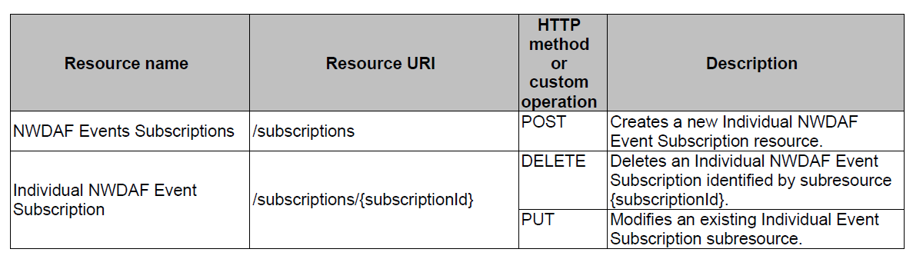
NWDAF API
HTTP/2 messages
HTTP headers
JSON content
The request URIs used in each HTTP requests from the NF service consumer towards the NWDAF shall have the Resource URI structure as :
{apiRoot}/<apiName>/<apiVersion>/<apiSpecificResourceUriPart>
Example of the API URI of the Nnwdaf_EventsSubscription
{apiRoot}/nnwdaf-eventssubscription/v1/subscriptions

Slide 6
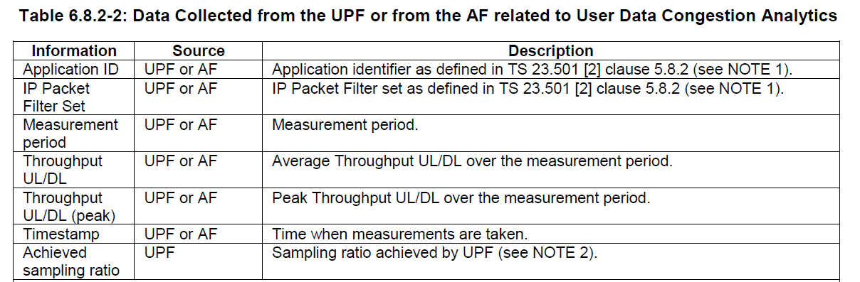
NWDAF and data collection from data plane
NWDAF can get information from the data plane in two ways:
Directly from UPF
Indirectly through AF and other NFs
Important information NWDAF can get from the data plane:
User data Congestion Analytics
Throughput UL/DL
Throughput UL/DL (peak) - Peak Throughput UL/DL over the measurement period.
Timestamp - Time when measurements are taken.
Measurement period
Observed Service experience related network analytics
Average packet delay and average loss rate

Slide 7
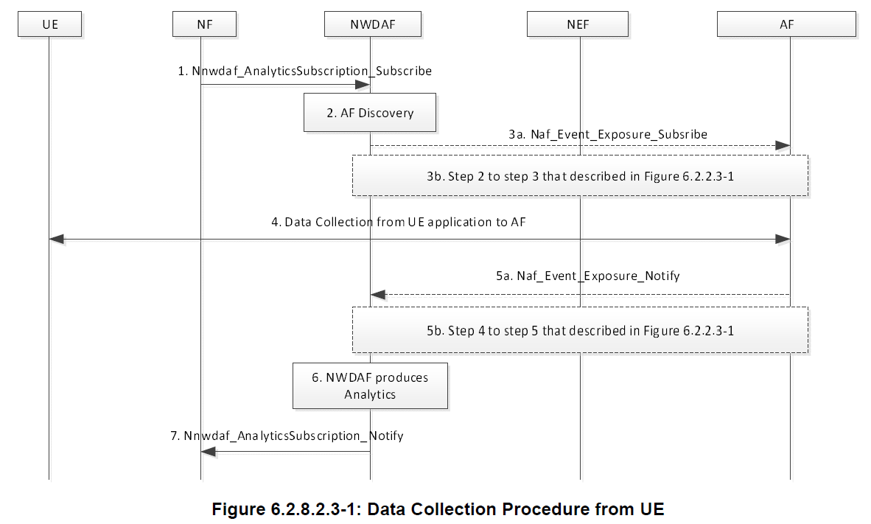
NWDAF data collection from AF
AF acts as an interface between the UE and NWDAF
The AF communicates with the UE Application and collects data from UE Application
NWDAF gets information about UE from AF

Slide 8
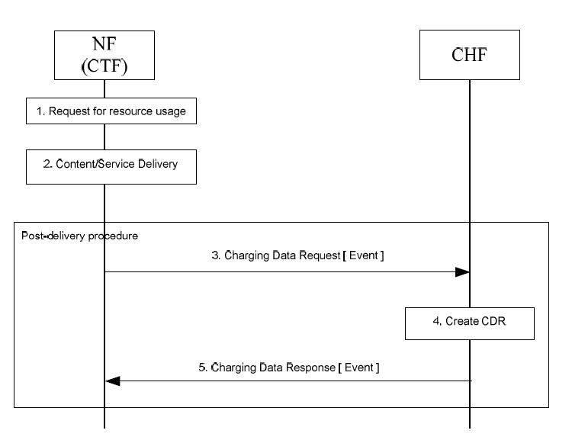
NWDAF and Charging information
CHF – Charging function and Nchf service interface
NF’s with CTF interact with CHF
SMF, AMF, SMSF and NEF support interactions with the CHF
Interactions done via Nchf interface
CTF (Charging trigger function)
CDR (Charging Data Record) – A structured collection of data that is utilized to compute billing. More than one CDR may be made if an event is lengthy or involves multiple costumers.

Slide 9
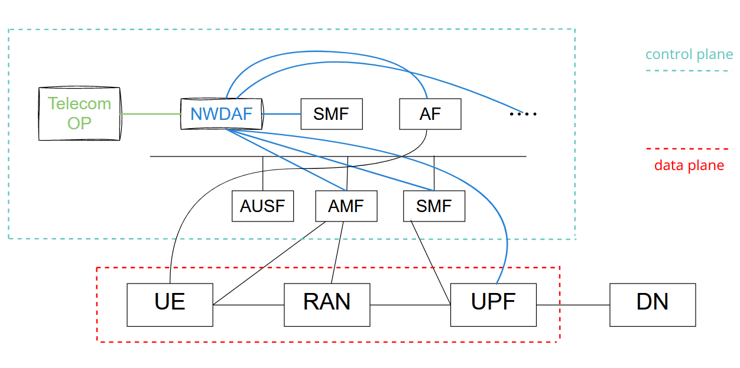
Estrutura do Sistema

Slide 10
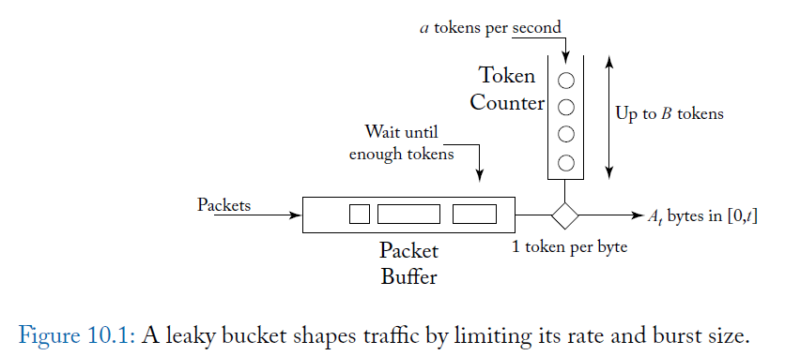
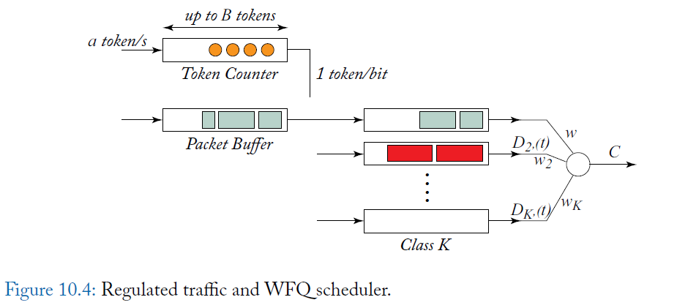
QOS
Traffic Shaping
Policing mechanism
Avoids congestion on routers
Controls packet bursts
Scheduling
Garantees a minimum service rate
Weighted fair queuing (R · wi /(Σwj) )
End-to-End QOS
Charge directly for marked ACKs
Indirectly by slowing down

Slide 11
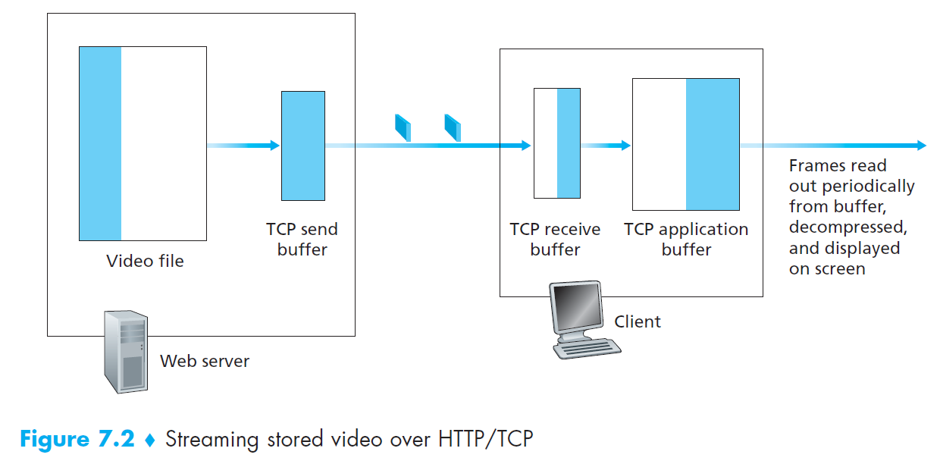
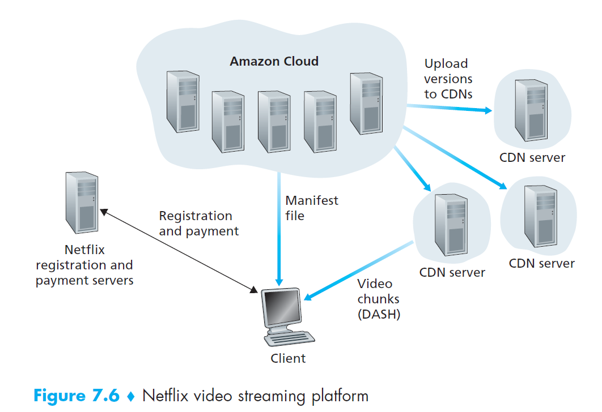
Multimedia Networking
Multimedia applications:
Streaming stored audio/vídeo
average throughput -> most important factor
Interactivity - Dynamic Adaptive Streaming over HTTP (DASH)
Continuous playout - (pre-fetching)
Conversational voice/video-over-IP over UDP (delay)
Real-Time Transport Protocol (RTP), streams of media
Session Initiation Protocol (SIP), ASCII messages
Streaming live audio/vídeo
Content distribution networks (CDNs) , clusters
Youtube HTTP streaming (private google CDN), no DASH (user selection), private google data centers
Netflix HTTP streaming (third-party CDNs, Amazon Servers)

