Slide 1
Network Neutrality
All internet traffic should be processed without differentation
Origin
Destination
Content (outdated) - 5g slices/categories
Increasingly importante as global debate intensifies and governments worldwide implement and withdraw regulations
Motivations for discriminatory traffic management
ISP obtaining competitive edge
Increase the number of customers and/or charge higher fees
Some traffic management pratices are considered to be “reasonable” and are allowed (should be transparent)
Addressing ilegal content (piracy, spam or viroses)
Prioritazing DNS queries
Prioritize special services

Slide 2
Fig. 1. High-level description of traffic differentiation(TD) on an ISP network
Classification may be based on several criteria:
Source address
Destination address
Application protocol
etc
Problem with detecting TD
External observer with no access to network configurations
Detect TD with only features of network(source,dst,port,etc)
Identify which features trigger TD and where its happening

Slide 3
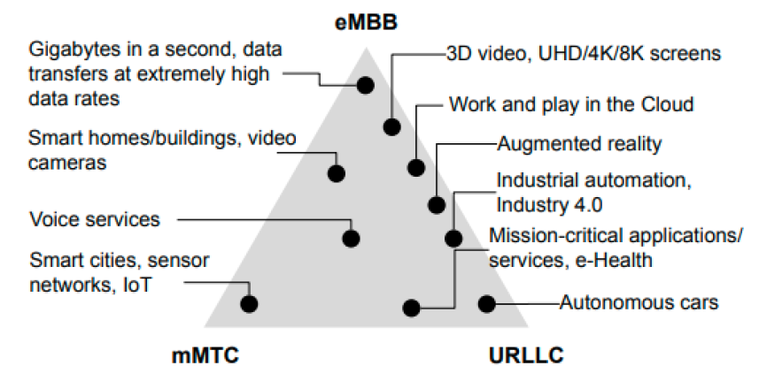
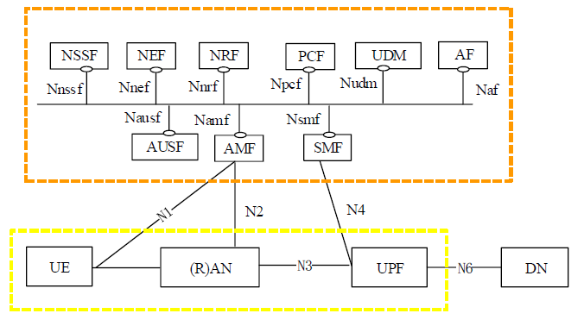
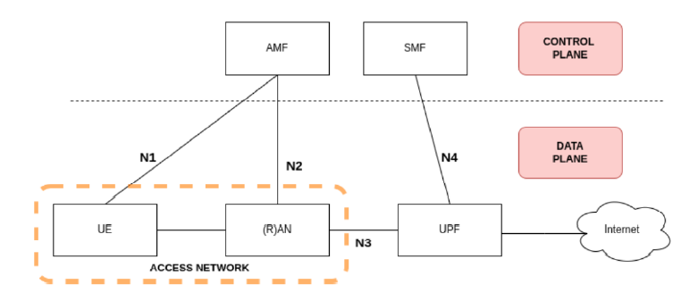
5g architecture and three main categories

Slide 4
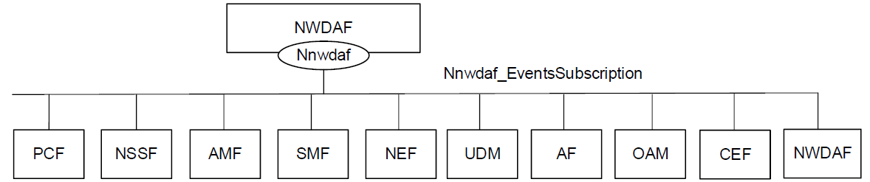
NWDAF
The Network Data Analytics Function (NWDAF) provides analytics information for different analytic events to NF consumers. It also allows NF consumers to subscribe/unsubscribe from one-time, periodic notifications or notifications when an event is detected.
Main NF services provided by NWDAF:
Nnwdaf_AnalyticsSubscription - Enables the consumer to subscribe/unsubscribe for network data analytics
Nnwdaf_AnalyticsInfo - Enables the NF service consumers to request and get specific analytics from the NWDAF
Nnwdaf_DataManagement - Enables the NF service consumers to subscribe/unsubscribe from notifications when subscribed event(s) are detected or retrieve the subscribed data from the NWDAF
Nnwdaf_MLModelProvision - Enables the consumer to receive a notification when an ML model matching the subscription parameters becomes available
Nnwdaf_MLModelInfo - Enables the consumer to request and get from NWDAF data containing MTLF ML Model Information
The first three services are provided by the Analytics logical function (AnLF) of NWDAF and the last two are provided by the Model Training logical (MTLF) function of NWDAF

Slide 5
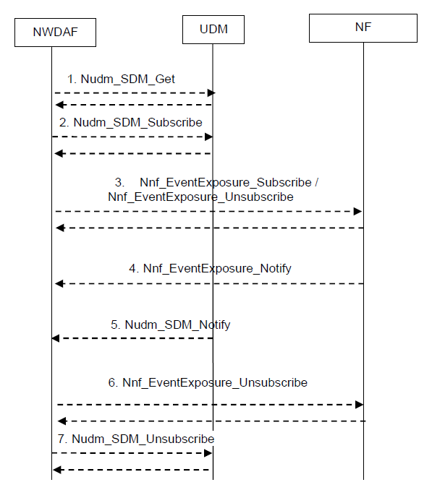
NWDAF Data Collection from NFs
Unified Data Management
The Data Collection from NFs is used by NWDAF to subscribe/unsubscribe at any 5GC NF to be notified for data on a set of events.
The Data Collection from NFs is based on the services of AMF, SMF, UDM, PCF, NRF:
Event Exposure Service offered by each NF
other NF services (e.g. Nnrf_NFDiscovery and Nnrf_NFManagement in NRF

Slide 6
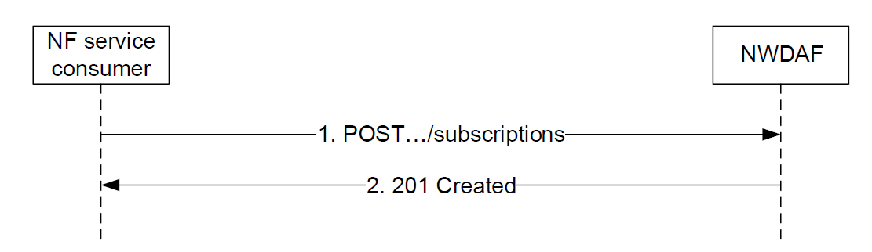
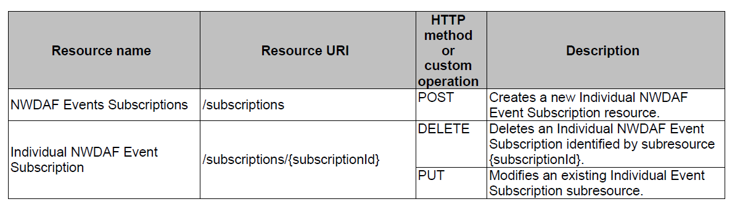
NWDAF API
HTTP/2 messages
HTTP headers
JSON content
The request URIs used in each HTTP requests from the NF service consumer towards the NWDAF shall have the Resource URI structure as :
{apiRoot}/<apiName>/<apiVersion>/<apiSpecificResourceUriPart>
Example of the API URI of the Nnwdaf_EventsSubscription
{apiRoot}/nnwdaf-eventssubscription/v1/subscriptions

