Slide 1
Traffic Forecasting
By Roberto Dominguez

Slide 2
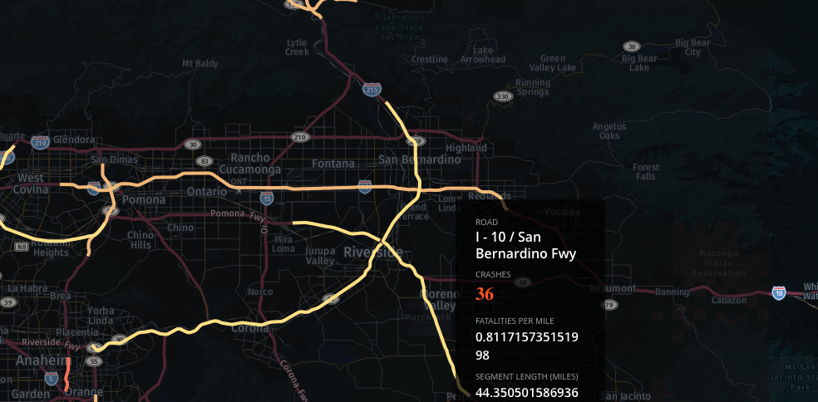
I-10 San Bernardino Fwy

Slide 3
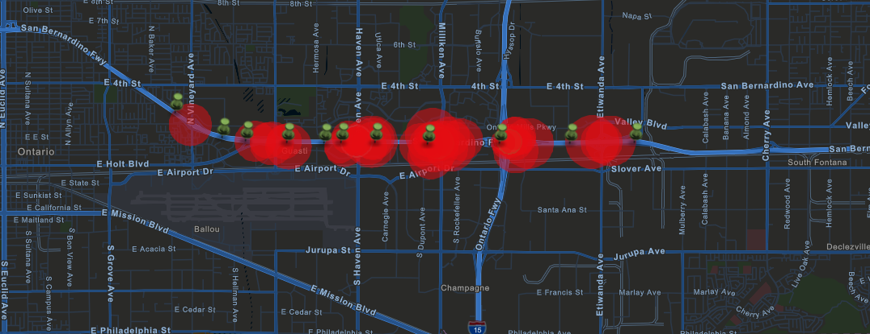

Slide 4



Slide 5



Slide 6
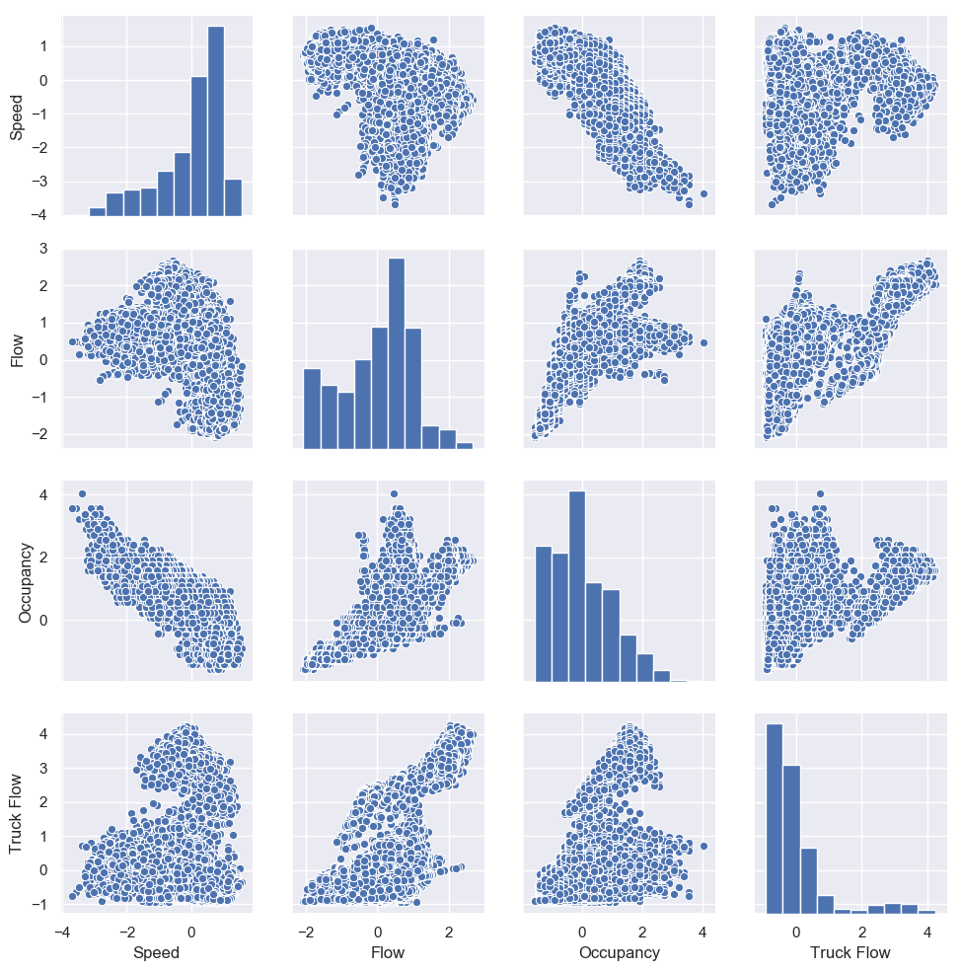

Slide 7
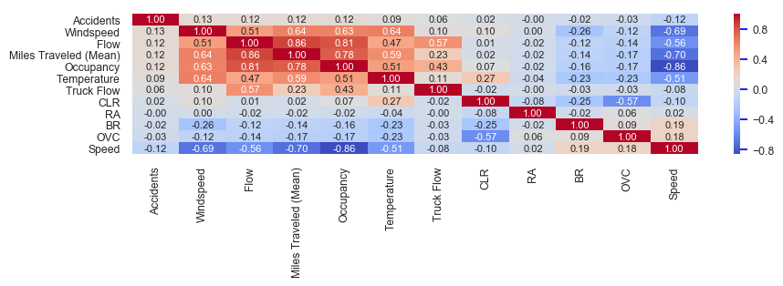

Slide 8

Prediction
FC
FC
LSTM
LSTM
…………………
LSTM
LSTM
Conv
…………………
Conv

