Slide 1

Network Anomaly Detection
Submitted by: Reetam Dan (E23CSEU0283)
Statistical Machine Learning (CSET211)
Instructor: Dr. Ashima Yadav
GitHub Repo: https://github.com/RD945/Network-Anomaly-Detection

Slide 2
Machine learning Models used
This project focuses on detecting Network Anomalies using Machine Learning models.
It explores algorithms such as Logistic Regression, Decision Trees, KNN, Random Forest, SVM, and Naive Bayes.
Random Forest was identified as the best-performing model with an F1 score of 99.56% and an average score of 99.55%.
The study includes data preprocessing, feature selection using Recursive Feature Elimination, and hyperparameter tuning with Optuna.

Slide 3
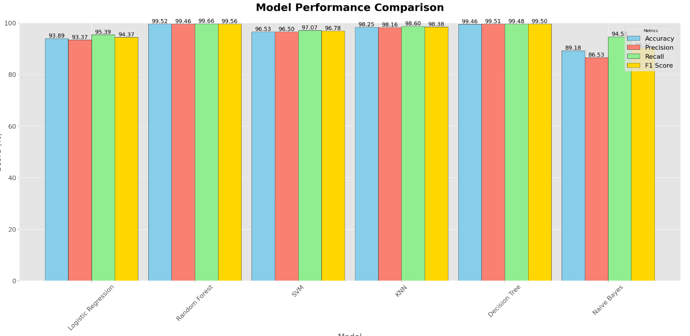

Slide 4
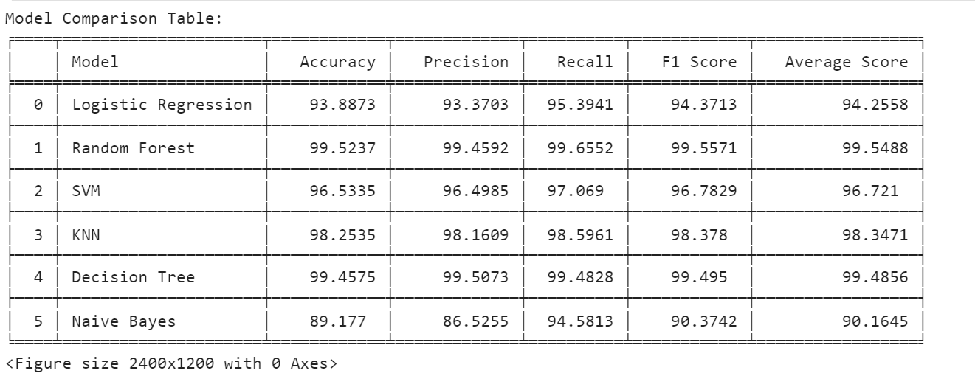

Slide 5
Why random forest gives best results?
Built-in Feature Importance:
Random Forest ranks feature importance based on how much each feature improves splits across all trees. This allows it to focus on the most critical features for accurate predictions, enhancing precision and recall.
Scalability and Efficiency
Random Forest scales well to large datasets with many features due to its parallel training of trees. This efficiency makes it a practical choice for datasets like yours, where high-dimensional feature spaces are common.
Random Forest’s combination of robustness, ability to handle complexity, and reduced overfitting makes it the highest-performing model across accuracy, precision, recall, and F1 score in the Network Anomaly Detection project

Slide 6
Handling Feature Interactions and Nonlinear Relationships
Random Forest models can naturally handle:
-Feature interactions: They can capture complex relationships between features that simpler models like Logistic Regression or KNN may miss.
-Nonlinear relationships: Random Forest is non-parametric, meaning it doesn’t assume linear relationships between input features and the target variable.
In network anomaly detection, where patterns may involve intricate dependencies, this capability provides a significant edge.
Ensemble Learning
Random Forest is an ensemble learning method that combines multiple decision trees:
- Each tree is trained on a random subset of the training data and features.
- The final prediction is made by aggregating (majority voting for classification) the outputs of all trees.
This approach reduces the likelihood of overfitting, a common issue with single decision trees, while enhancing the model’s robustness.

Slide 7
Comparison to Other Models
- Logistic Regression: While effective for linear relationships, it struggles with the nonlinear and complex patterns in anomaly detection.
- KNN: It is sensitive to noise and computationally expensive with large datasets, impacting precision and recall.
- Decision Tree: Although interpretable, a single decision tree tends to overfit, leading to reduced generalization compared to Random Forest.
- Naive Bayes: Assumes feature independence, which is unrealistic in network data, leading to lower performance.
-SVM: Though powerful, it can be computationally expensive and challenging to tune for large, imbalanced datasets.

Slide 8
Data Preprocessing
1. Handling missing values and duplicates
2. Encoding categorical variables
3. Scaling features using StandardScaler
4. Splitting data into training and testing sets
5. Feature selection with Recursive Feature Elimination (RFE)
6. Hyperparamter tuning with Optuna
Optuna is a hyperparameter optimization framework designed to automate the process of searching for the best hyperparameters for machine learning models. It uses Bayesian optimization to explore the hyperparameter space efficiently and finds the best parameters by balancing exploration and exploitation.

Slide 9
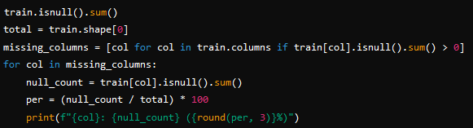

Checking for missing values
Purpose: This identifies and quantifies missing values in the dataset.
Helps determine whether to fill missing values (e.g., mean, median imputation) or remove affected columns.
Removing duplicate rows
Purpose: Duplicate rows can distort training results. Identifying and removing them ensures data integrity

Slide 10
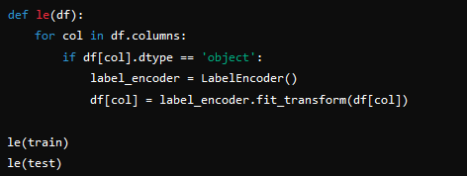

Encoding categorical variables
Purpose: Converts categorical variables into numerical representations using LabelEncoder.
Models like Random Forest or Logistic Regression require numerical inputs, as they cannot process string categories.
Dropping unnecessary columns
Purpose: Removes columns that do not contribute meaningful information or have negligible variance (num_outbound_cmds in this case).

Slide 11


Splitting features and target
Purpose: Separates the dataset into:
Features (X_train): Variables used for prediction.
Target (Y_train): The variable to be predicted (class labels).
Feature selecting
Purpose: Uses Recursive Feature Elimination (RFE) with a Random Forest classifier to select the 10 most important features:
RFE iteratively removes less important features based on the model's performance.
This helps reduce overfitting and improves model interpretability by focusing on relevant data.

Slide 12

Scaling the data
Purpose: Applies StandardScaler to standardize the dataset by removing the mean and scaling to unit variance:
Ensures all features have similar magnitudes, which is crucial for algorithms like SVM, KNN, or gradient-based models.
Train-test split
Purpose: Splits the training data into:
Training set: 70% of the data for model training.
Validation set: 30% of the data for evaluating model performance before testing on unseen data.
The dataset is cleaned, structured, and optimized for machine learning models:

Slide 13
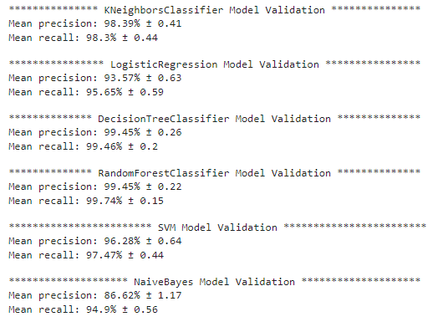
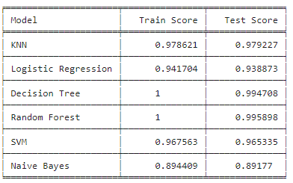
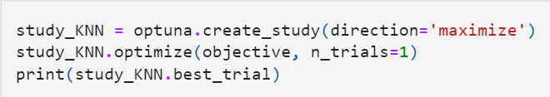


Slide 14
Train Score
Definition: The model's performance on the training data, which it used to learn the patterns.
Purpose: Measures how well the model fits the training data. A high train score may indicate that the model is capturing the data's structure well, but it could also suggest overfitting if the test score is significantly lower.
Test Score
Definition: The model's performance on the test data, which the model has never seen during training.
Purpose: Provides an unbiased evaluation of how the model generalizes to unseen data. A high test score indicates good generalization.
Comparison of Train and Test Scores
Ideal Scenario: Train and test scores are close and high, meaning the model generalizes well without overfitting or underfitting.
Overfitting: Train score is significantly higher than the test score. The model has learned the training data too well, including noise and outliers, but doesn't perform well on new data.
Underfitting: Both train and test scores are low, suggesting the model is too simple to capture the patterns in the data.

Slide 15
