Slide 1

Internet of things capstone project:
Hotdog SEIS 785-01
Robert Driesch

Slide 2
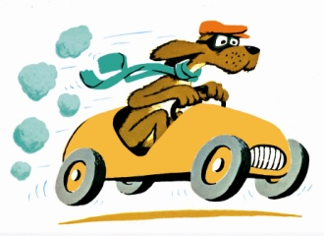
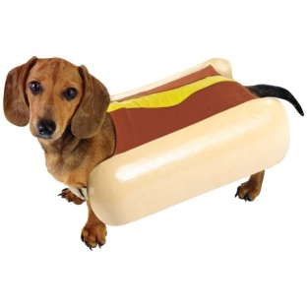

Project hotdog requirements
A wearable (collar based) safety device for pets to warn when the Heat Index starts to approach dangerous levels
Solicit help from neglectful owners and passers-by when a pet is in a dangerous situation
For example: locked in a car
Fully mobile & independent solution to protect pets while in a car and not at home (e.g. no wifi)
Waterproof and wearable on a collar but yet still visible enough to indicate when a dangerous situation is present

Slide 3

Statistics & Market Potential
A dog can succumb to Heat Stroke in under 10 minutes in a vehicle
Temperatures (Heat Index) can quickly rise 20 to 30 degrees within a car even with the windows rolled down
No official statistics are kept of dogs injured or dead because of Heat Stroke
News is still littered with stories every year
Estimated 70 – 80 million dogs owned in the U.S.
Appx. 37% - 47% of all households have at least one dog
Pet owners spent $60.28 Billion on products in 2015
32% was spent on Pet Supplies and Services, continues to grow 4% annually
How much would you spend to ensure the safety of your pet??

Slide 4
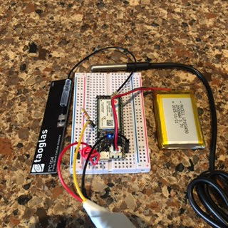
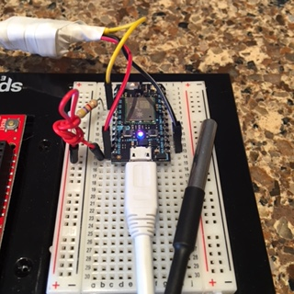
Ingredients
Particle Electron w/Breadboard
Particle SIM Card
Cellular Antenna
2000mAh 3.7V LiPo Battery (rechargeable)
Sensors
DS18B20 Waterproof Temperature Sensor
4.7k Resistors
Various Jumpers
Extras - Optional
Particle Photon (instead)
External RGB LED (e.g. NeoPixel)
Piezo Buzzer
Humidity Sensor
Various Jumpers and Resistors

Slide 5
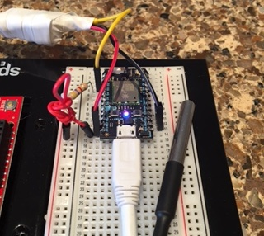
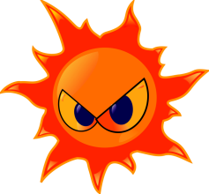
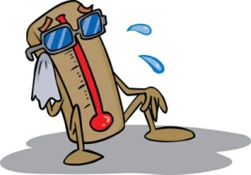
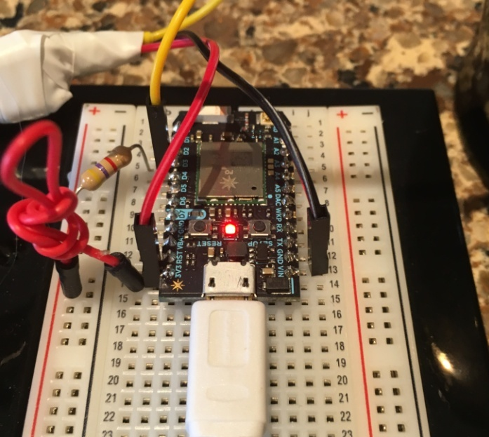
How It Works
Temperature & Humidity sensor data is collected
Heat Index is calculated and threat levels are determined
Alert conditions are identified
External events can also trigger alerts
Feedback is Generated
RGB LED’s are set from Heat Index threat levels
Sliding color/intensity scale from Blue to Red
Data is published via Webhooks
SMS Text messages are sent to owner(s) for Alert conditions
Activity is governed to minimize battery drawdown

Slide 6
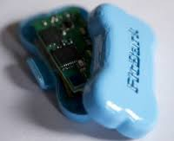
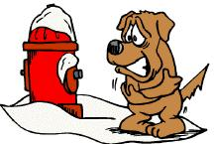
Future Improvements
Hardware
Continue to shrink the form factor & components to make it wearable
Develop a waterproof shell to contain the components
Develop a recharging port for the battery
Software
Improve algorithm to conserve power & data by controlling battery and publishing intervals
Expand the functionality of the cellular interface (geo-location)
Tie the data being generated into IBM’s BlueMix Suite
Refine the external inputs (Weather Data)
Mobile App
Make it beautiful, elegant and clean
Expand to support “Chilly Dog”

Slide 7


