Slide 1
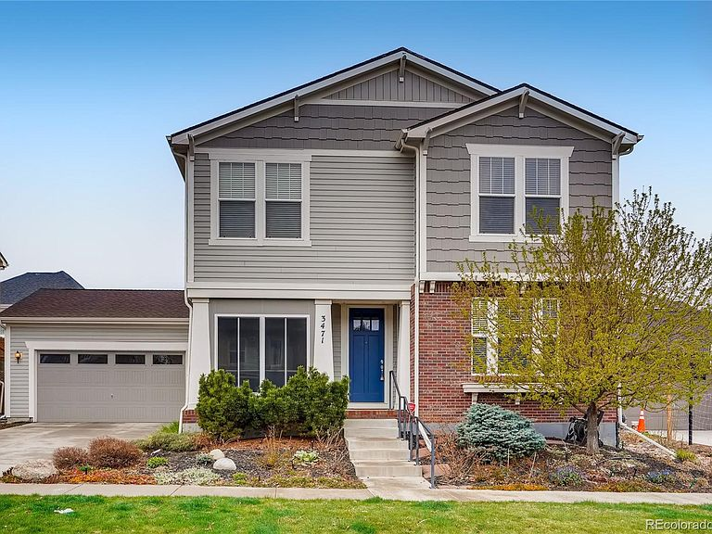
Housing Price Prediction: Multi Input Neural Network
Rodney Cordova

Slide 2
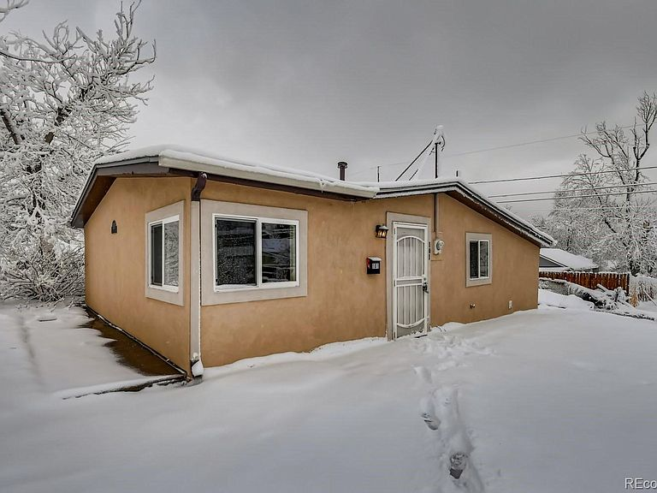
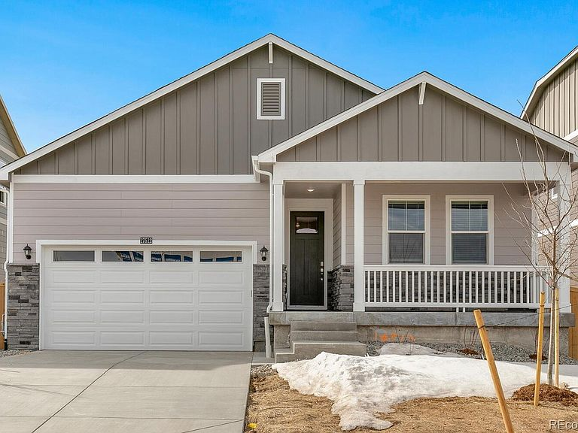
What house is more expensive?
House 1
Bedrooms: 3
Bathroom: 2
Square Feet: 1255
House 2
Bedrooms: 3
Bathroom: 2
Square Feet: 1411

Slide 3
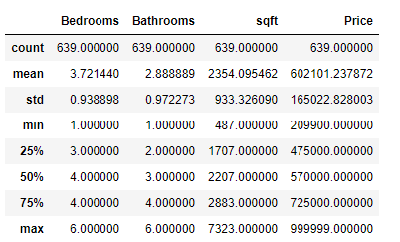
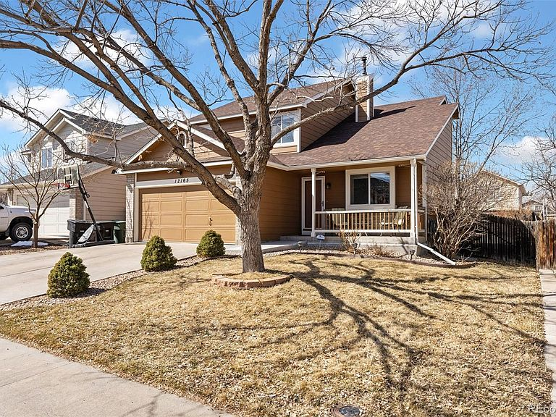
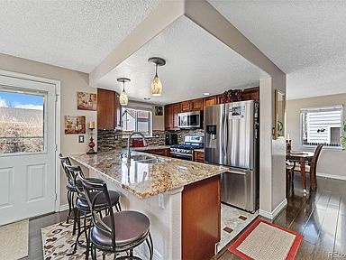
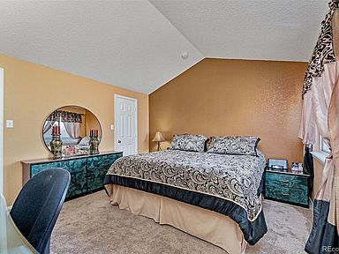
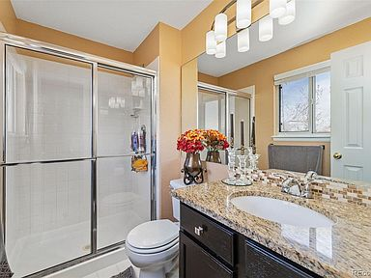
Data

Slide 4
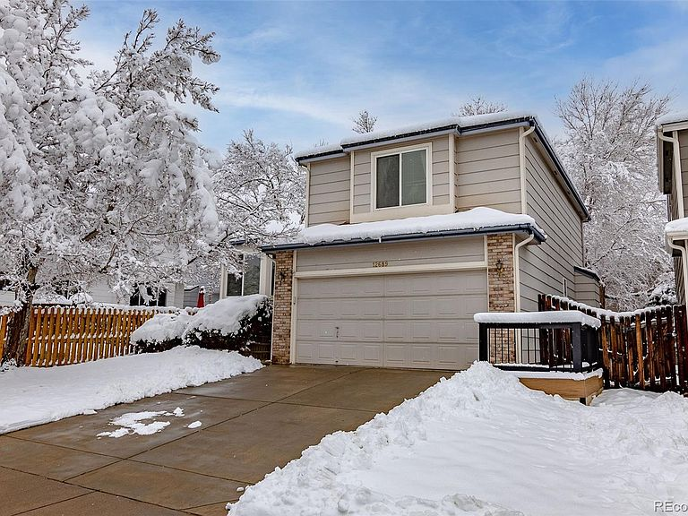
Image Augmentation

Slide 5
Numeric Data
Image Data
Multi-layer Perceptron
Convolutional Neural Network
Concatenation
Full Connected Layer and Linear Activation
Output

Slide 6
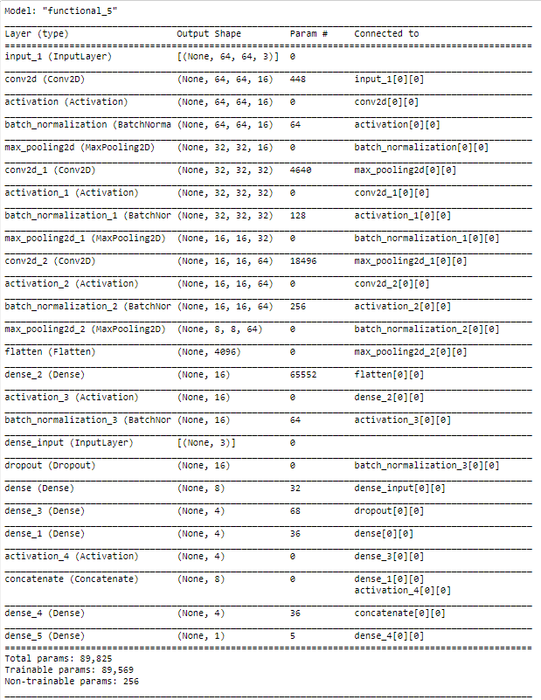
Results
Average Home Price: $602,101.24
MAPE: 19.20%

