Slide 1
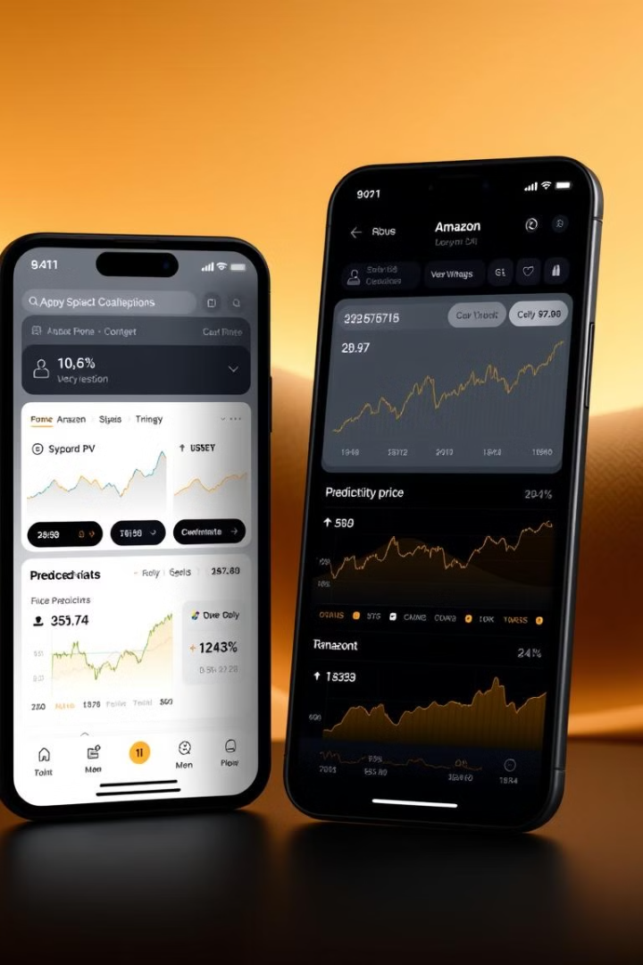
Amazon Stock Predictor - A Python and React App
This presentation outlines the development of an Amazon stock predictor app. The app combines Python for data analysis and React for a user-friendly interface. It provides valuable insights into potential stock movements.
~Team Alone

Slide 2

Project Overview and Goals
Project Introduction
An application designed to predict Amazon stock prices with reasonable accuracy.
React Interface
Develop a user-friendly frontend for easy interaction and data visualization.
Python Backend
Implement data analysis and prediction algorithms using Python.
Key Technologies
Pandas, Scikit-learn, TensorFlow/PyTorch for robust functionality.

Slide 3
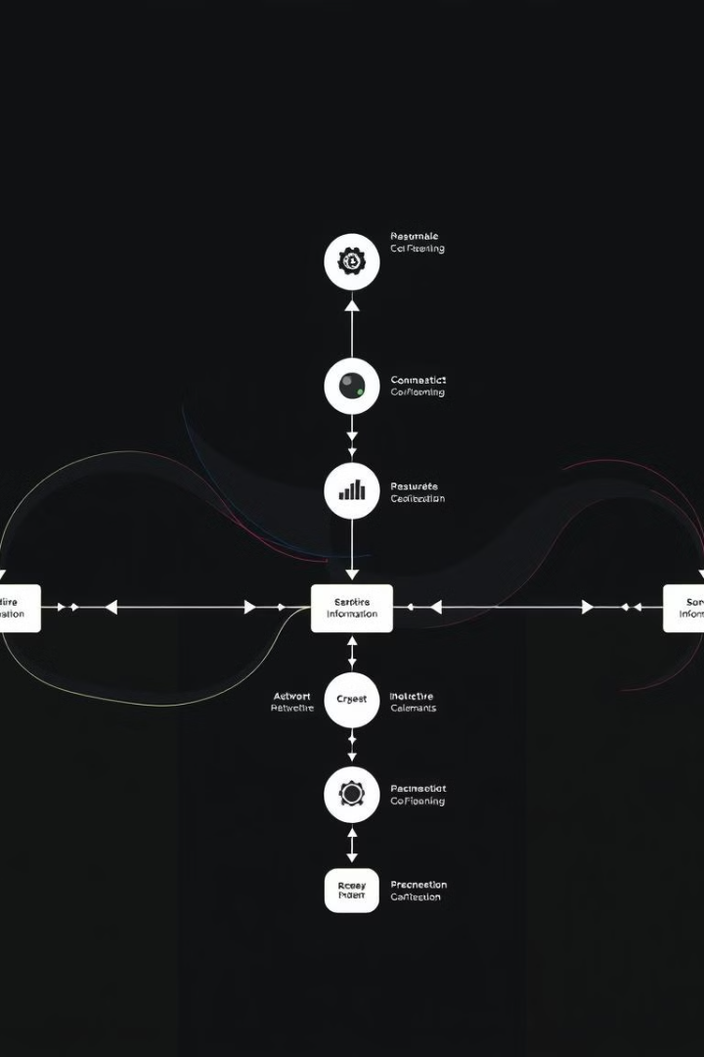



Data Acquisition and Preprocessing (Python)
Data Source
Utilize historical Amazon stock data from Yahoo Finance or Alpha Vantage.
Data Acquisition
Employ Python libraries like `yfinance` or APIs to gather data.
Preprocessing
Handle missing values, clean, and format the data for analysis.
Feature engineering includes moving averages and RSI. Data normalization ensures consistency and improves model performance.

Slide 4

Predictive Model Development (Python)
Model Selection
Rationale
Choose a suitable machine learning model (e.g., LSTM, ARIMA, Random Forest).
The rationale depends on data characteristics and desired prediction accuracy.
Training
Split data into training, validation, and testing sets for robust evaluation.
Model parameter tuning optimizes performance. Metrics like RMSE and MAE evaluate accuracy.

Slide 5



Backend Implementation (Python - Flask/FastAPI)
API Endpoints
2
Design endpoints for prediction requests and results.
Framework
1
Flask or FastAPI provides the backend structure.
Model Integration
Incorporate the trained model for real-time predictions.
3
Database integration may be included. The backend handles data requests and model execution.

Slide 6
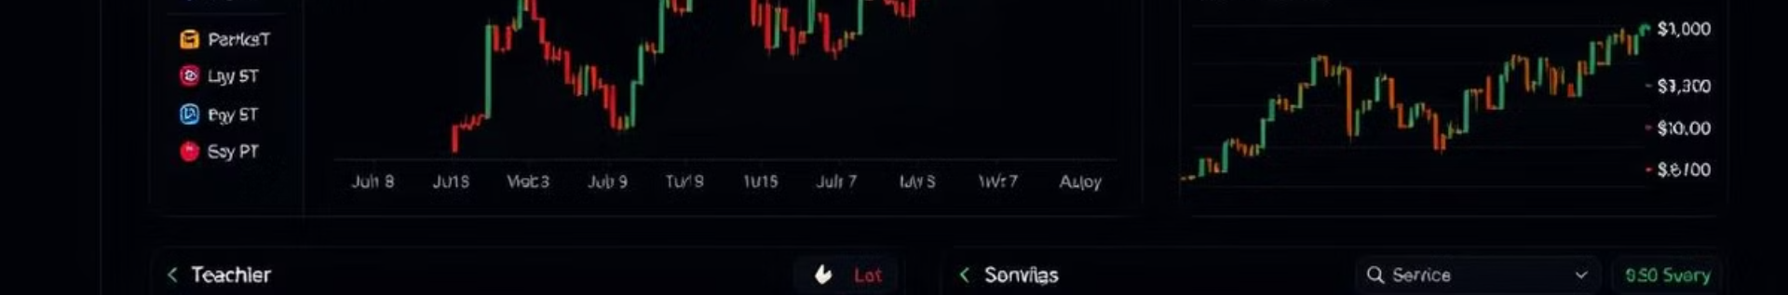



Frontend Implementation (React)
User Interface
Display historical and predicted stock prices dynamically.
API Interaction
Retrieve predictions from the Python backend.
Charting Libraries
Utilize Chart.js or Recharts for data visualization.
The React app makes API calls. It presents data in an intuitive format for users.

Slide 7
Results and Evaluation
Prediction Accuracy
Model Limitations
Areas for Improvement
Compare predicted stock prices to actual market values.
Address potential sources of error in the model.
Using advanced models, features and parameter optimization.

Slide 8

Conclusion and Future Work
Project Summary
A successful application for predicting Amazon stock prices.
Future Enhancements
Integrate real-time stock data and advanced indicators.
Deployment
Deploy the application to a cloud platform.
Future work could add user authentication. Acknowledgements to collaborators are due.

