Slide 1
Analyzing Global Surface Temperatures Since 1750

Slide 2

Purpose for Research
Potential consequences of rising global surface temperatures according to the Third National Climate Assessment Report in 2014 with a team of 300 experts guided by a 60-member Federal Advisory Committee¹:
Lengthening frost-free growing season
Changing regional precipitation trends
An increase in heavy downpour frequency
Intensifying heat waves and droughts; fewer and shorter cold waves
Potential increase in North Atlantic hurricane intensity and frequency
Sea level rise
Melting polar ice lending to ecosystem modification in the high latitudes
Ocean acidification from increased ${CO}_{2}$ absorption

Slide 3
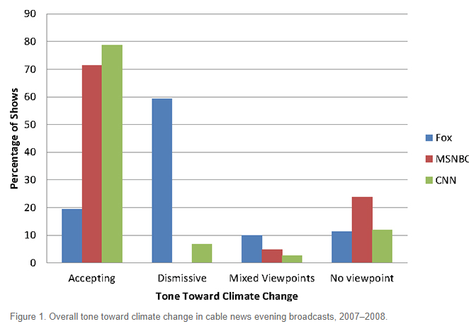
Purpose for Research
While the scientific community has overwhelmingly come out in support of the notion climate change is real², US cable news media has offered differing degrees of acceptance or outright dismissiveness³.
Source: Feldman, Lauren; Effects of TV and Cable News Viewing on Climate Change Opinion, Knowledge, and Behavior”; http://climatescience.oxfordre.com/view/10.1093/acrefore/9780190228620.001.0001/acrefore-9780190228620-e-367

Slide 4
Purpose for Research
Seek to determine the feasibility and necessity of the Paris Agreement’s objective to prevent global surface temperature increase to less than 2 degrees Celsius since the [Second] Industrial Revolution.
The Paris Agreement is a multi-national agreement, ratified by 168 countries, to enact policies that combat the effects of global climate change

Slide 5
The Goal
Determine if Earth is warming since the Second Industrial Revolution (approx. 1870-1914)^{4,} and, if it is, find out the extent of that warming.

Slide 6
Data Sources
From Kaggle.com: “Climate Change: Earth Surface Temperature Data, Exploring Global Temperatures Since 1750”⁵
Original data sourced from Berkeley Earth data page
Dates
Average temperature data per month
Temperature uncertainty expressed as the 95% confidence interval around the reported temperature for a given month
Locations by political boundary (city names, state names, etc.) and coordinates
Sources to analyze correlations between global surface temperatures and factors that previous research suggests are fueling a warming trend in the last century
U.S. Energy Information Administration
Organisation for Economic Co-operation and Development
NASA – Sea Level Change Observations From Space

Slide 7
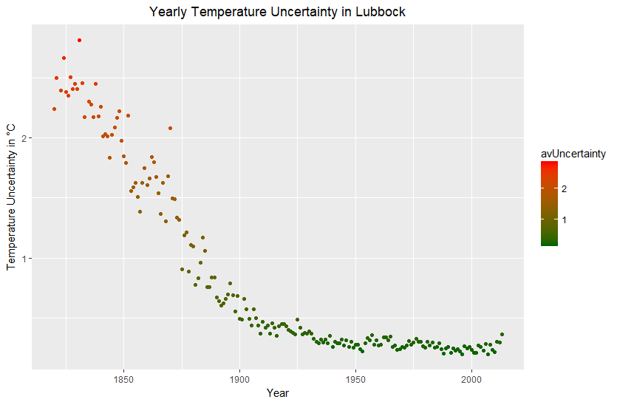
Let’s Start Local A Lubbock Analysis
Observation Precision Increased Notably Between
1820 and 1925 Before Leveling off Through to the Present

Slide 8
Temperature Analysis For Lubbock Various Plotting Methodologies
Three Ways Of Plotting Temperature Data
Average Monthly Temperatures → Average Yearly Temperatures (T)
plot Temperatures vs. Year
2. Average Monthly Temperatures →
Formulate Theoretical Monthly Temps For Maximum Warming (T_{fastwarm}) →
Average Yearly T_{fastwarm} temperature (T_{fastwarm, yearly})
3. Average Monthly Temperatures →
Formulate Theoretical Monthly Temps For Minimum Warming (T_{slowwarm}) →
Average Yearly T_{slowwarm} temperature (T_{slowwarm, yearly})

Slide 9

Temperature Analysis For Lubbock Relevant Formulas
$$T_{fastwarm}=\left(T−\frac{[AverageTemperatureUncertainty]}{2}\right)+\frac{month_{n} −1}{n −1}∗\left[AverageTemperatureUncertainty\right]$$
$$T_{slowwarm}=\left(T+\frac{[AverageTemperatureUncertainty]}{2}\right)−\frac{month_{n} −1}{n −1}∗\left[AverageTemperatureUncertainty\right]$$
Where $n=\# of months in the data set$

Slide 10
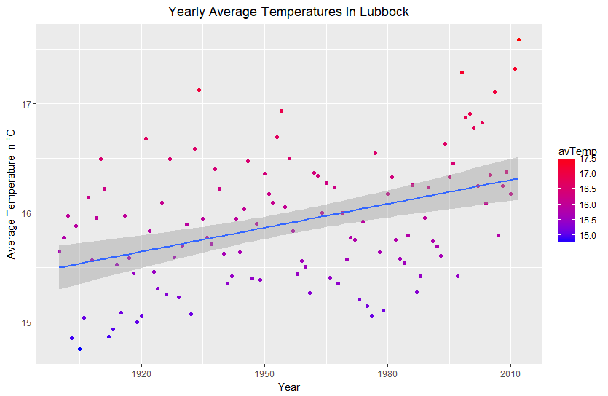
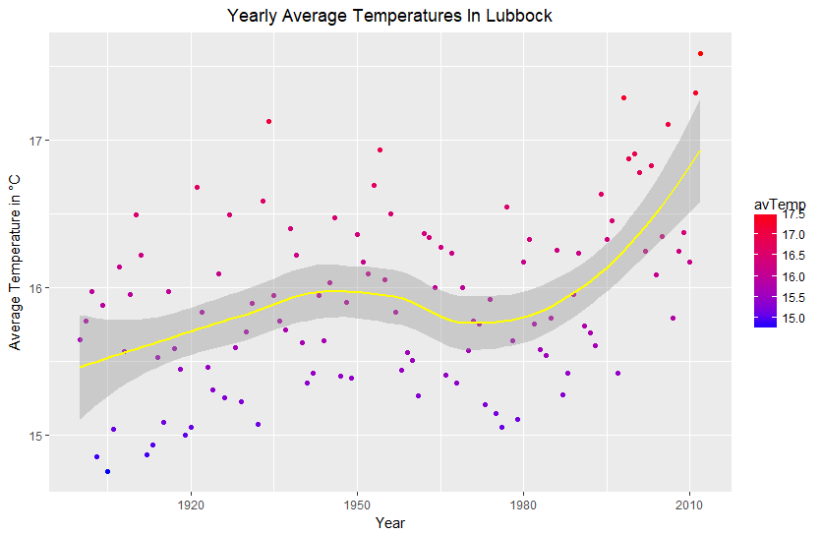
Temperature Analysis For Lubbock Plotting Average Temperatures
Average Warming Rate: +0.73°C/100 years

Slide 11
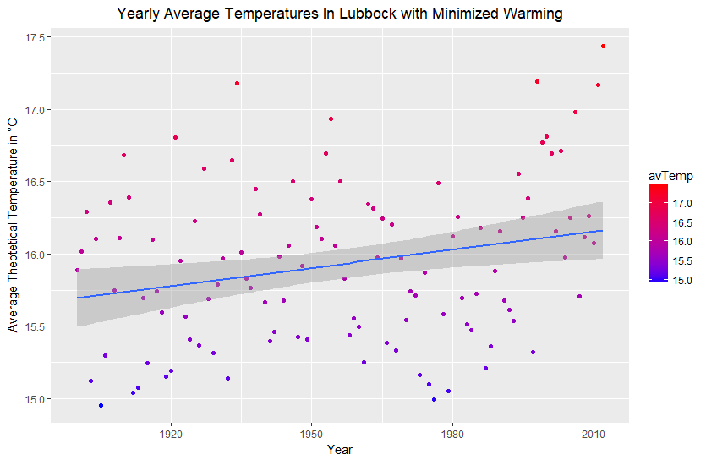
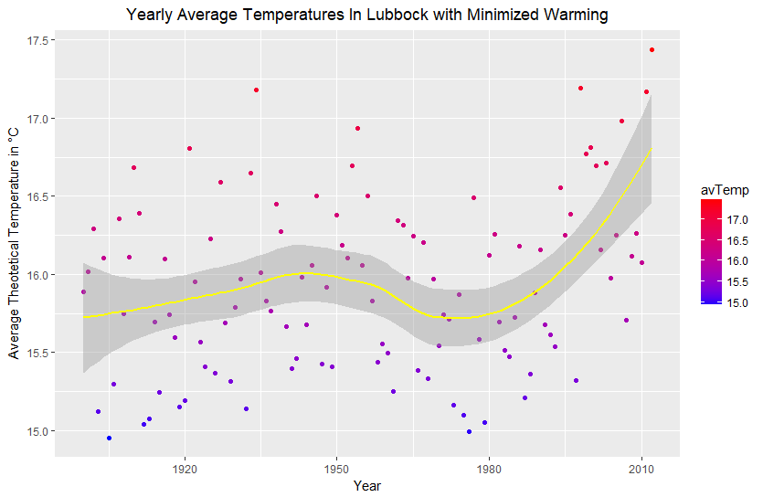
Temperature Analysis For Lubbock Plotting Theoretical Temperatures Producing Minimized Warming
Minimized Warming Rate: +0.42°C/100 years

Slide 12
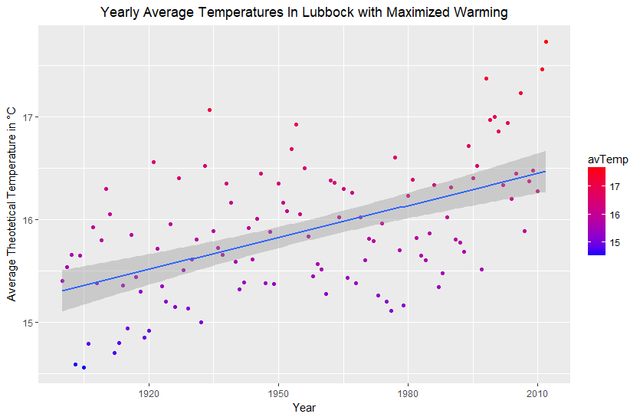
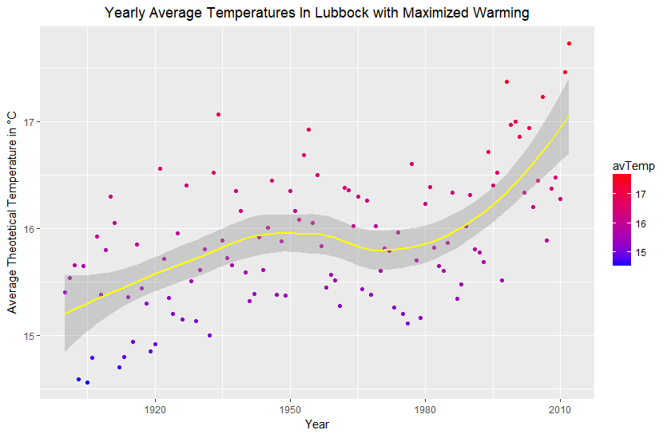
Temperature Analysis For Lubbock Plotting Theoretical Temperatures Producing Maximized Warming
Maximized Warming Rate: +1.04°C/100 years

Slide 13
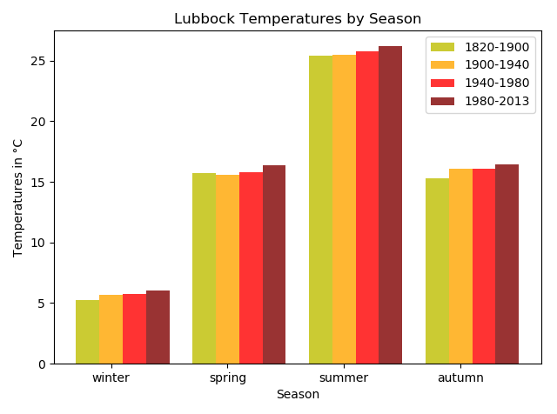
Temperature Analysis For Lubbock Seasonal Trends
Average Rate of Temperature Change by Season since 1900
Season | Avg. Rate of Temperature Change per 100 years
Winter | +0.41°C
Spring | +1.07°C
Summer | +0.98°C
Autumn | +0.79°C
Created using numpy and matplot.pyplot packages in Python

Slide 14
Temperature Analysis For State And National Levels
The Local level is the area that most people will be able to relate to the effects of the warming caused global climate change.
Organization of Data some 645675 observations of 5 variables. Reducing the size of the observation relevant to the climate rather than the weather.
Local surface temperature warming is at +1.18 C /100 year period with little change when examined over short term period.
The results seen at the national level are a +.82 /100 years warming period with a short tern of +.9 C.
Within in the range that NASA (1.1) and the EPA (.85)are producing for the surface warming temperatures .

Slide 15
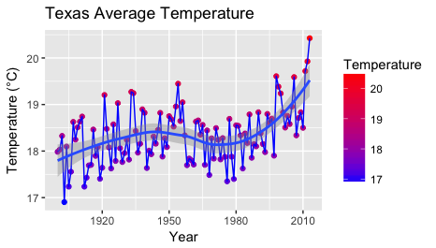
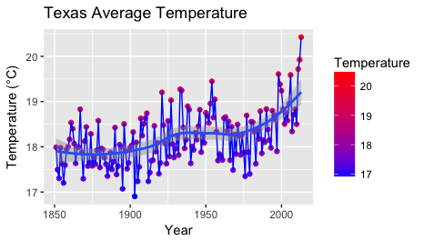
A Lone Star State Perspective Texas Temperature Analysis
Recent/Long-term View:
1900-2013 +1.18°C/100 years
1850-2013 +1.3°C/100 years
*Excluding Hawaii and Alaska

Slide 16
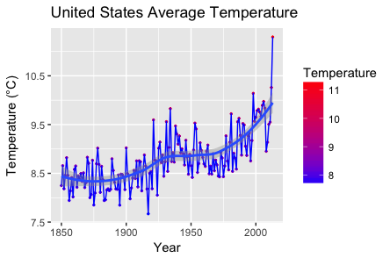
United States of America Perspective Surface Temperature Analysis
*Excluding Hawaii and Alaska

Slide 17
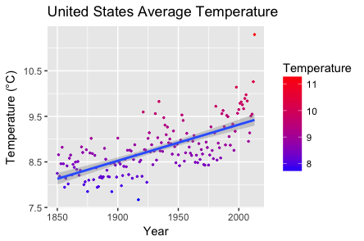
United States of America Perspective Surface Temperature Analysis
Long-term View:
1900-2013 +.81°C/100 years
1850-2013+1.2°C/100 years
*Excluding Hawaii and Alaska

Slide 18
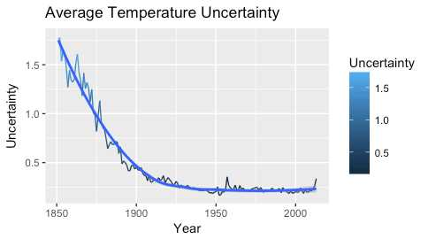
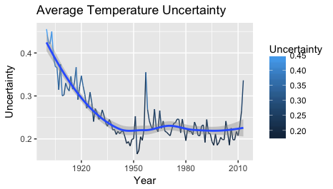
United States of America Perspective Temperature Uncertainty
Recent View:
0.2 °C
1900-2013
Long-term View:
1.35 °C
1850-2013
*Excluding Hawaii and Alaska

Slide 19
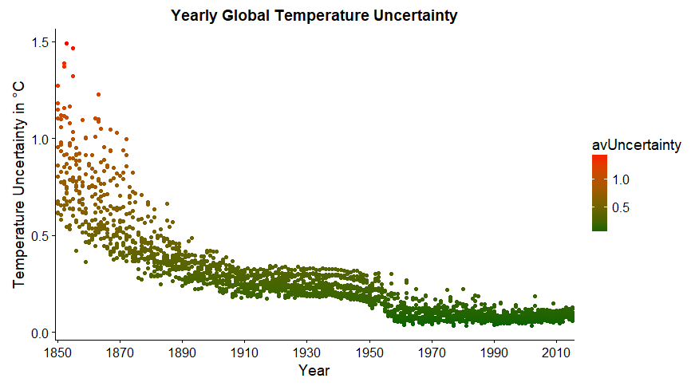
Global Temperature Uncertainty (1820-2013)

Slide 20
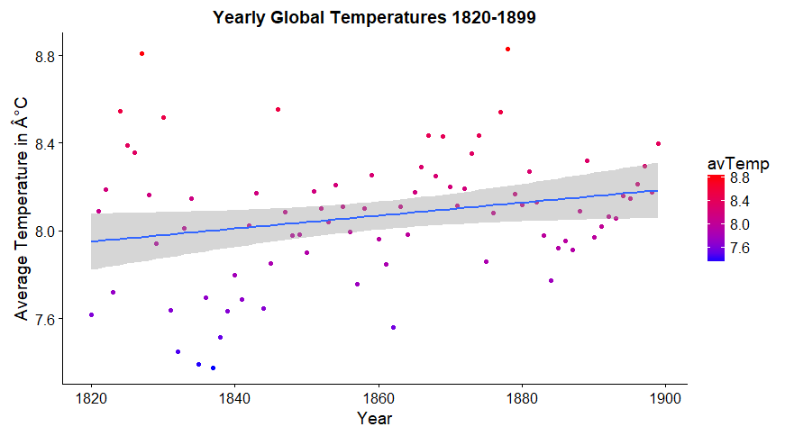
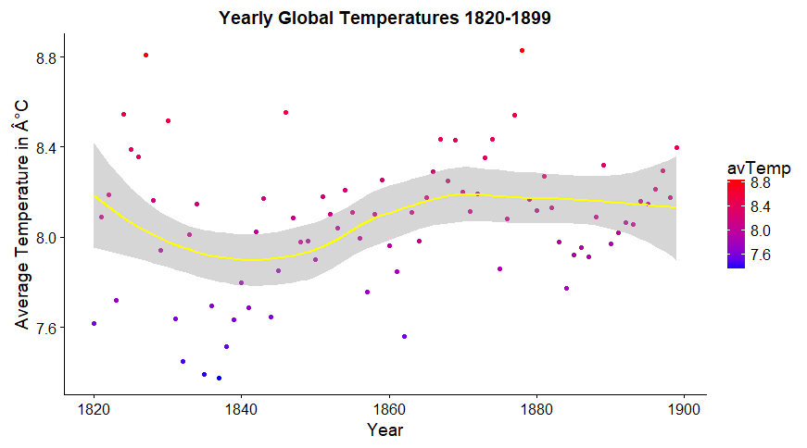
Global Temperature Analysis - Yearly Average (1820-1899)
Average Warming Rate: +0.296°C/100 years

Slide 21
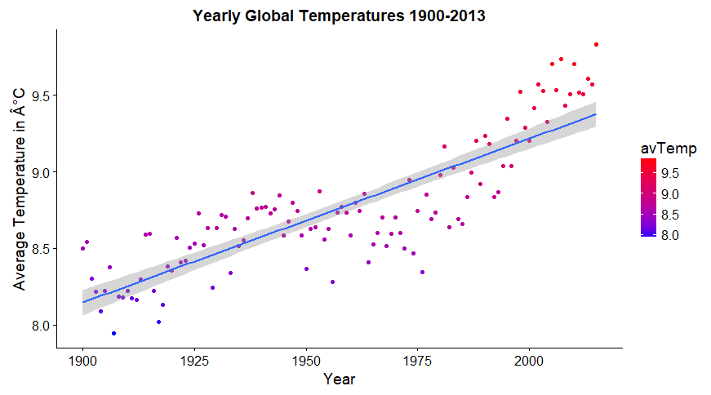
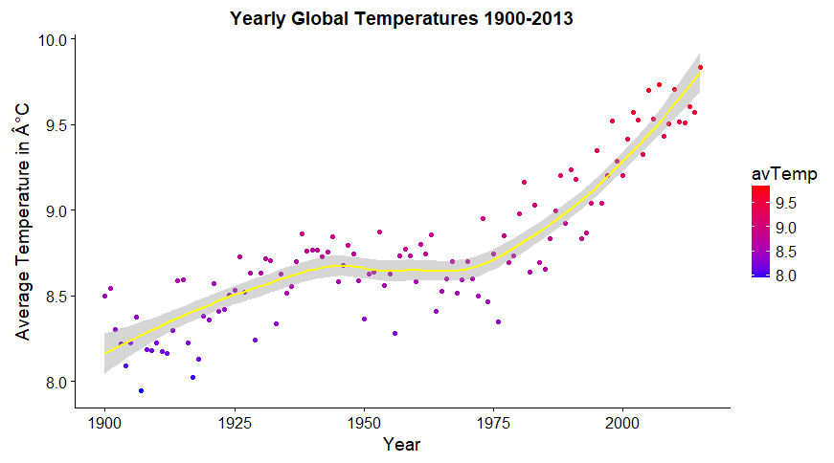
Global Temperature Analysis - Yearly Average (1900-2013)
Average Warming Rate: +1.06°C/100 years

Slide 22
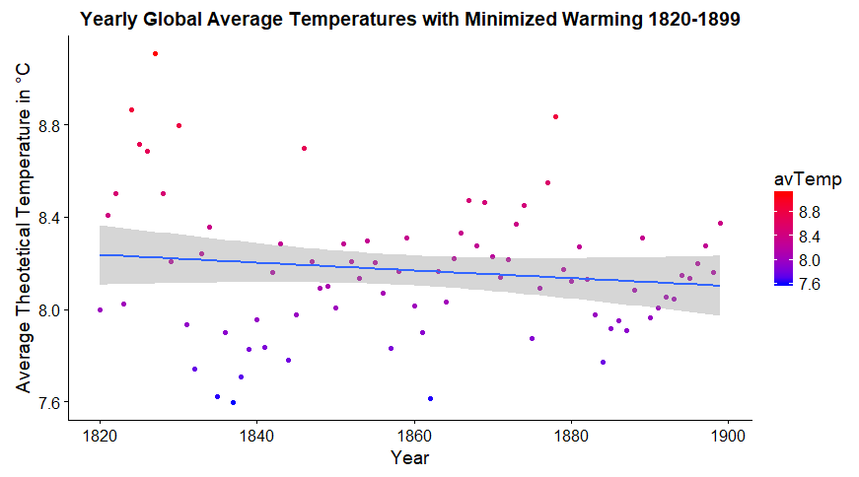
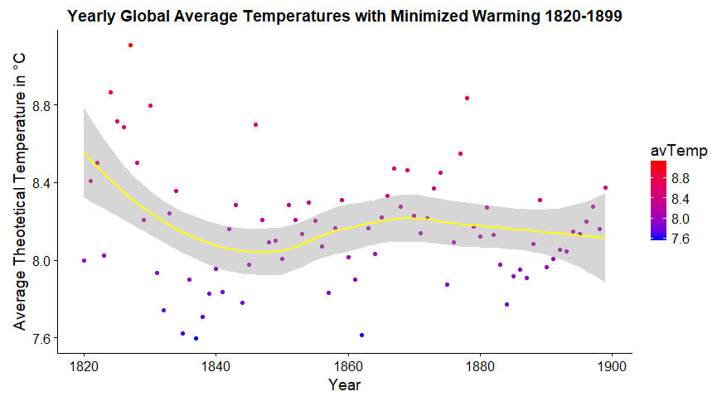
Global Temperature Analysis - Average with Minimized Warming (1820-1899)
Average Warming Rate: -0.17C/100 years

Slide 23
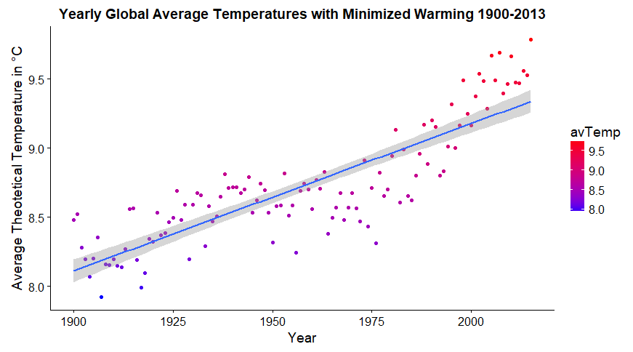
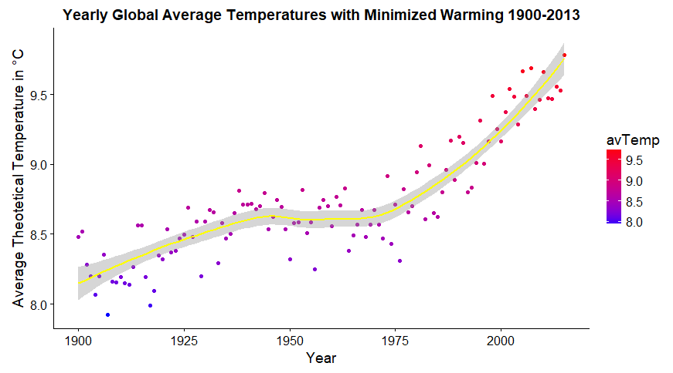
Global Temperature Analysis - Average with Minimized Warming (1900-2013)
Average Warming Rate: +1.06°C/100 years

Slide 24
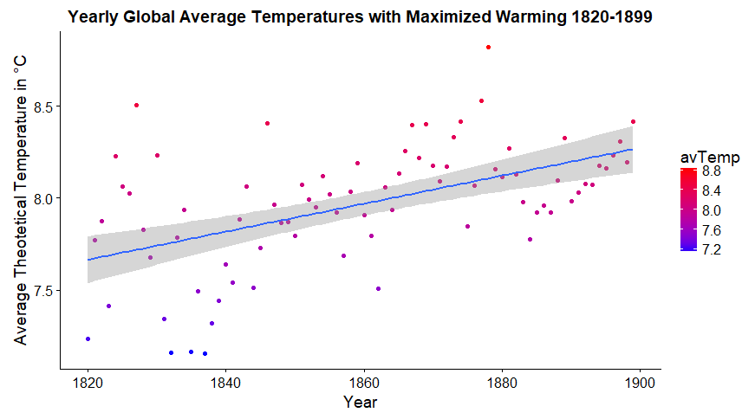
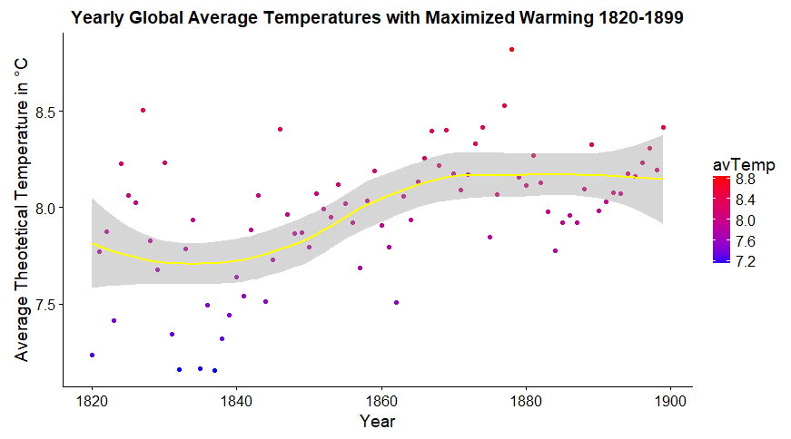
Global Temperature Analysis - Average with Maximized Warming (1820-1899)
Average Warming Rate: +0.76°C/100 years

Slide 25
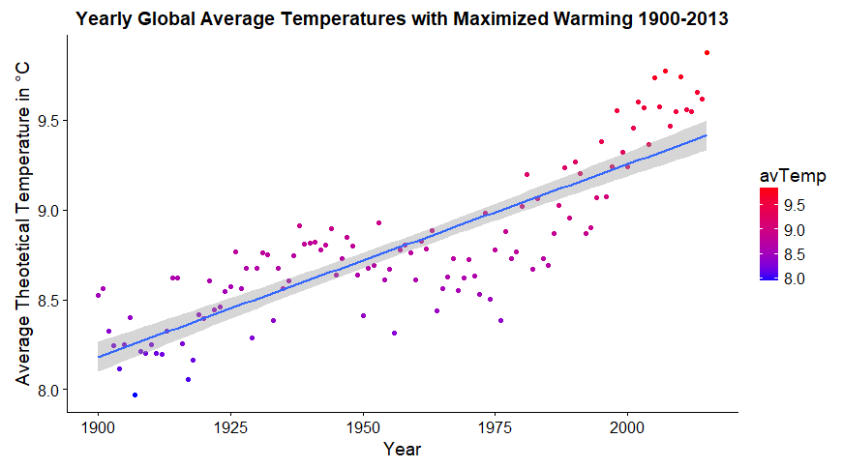
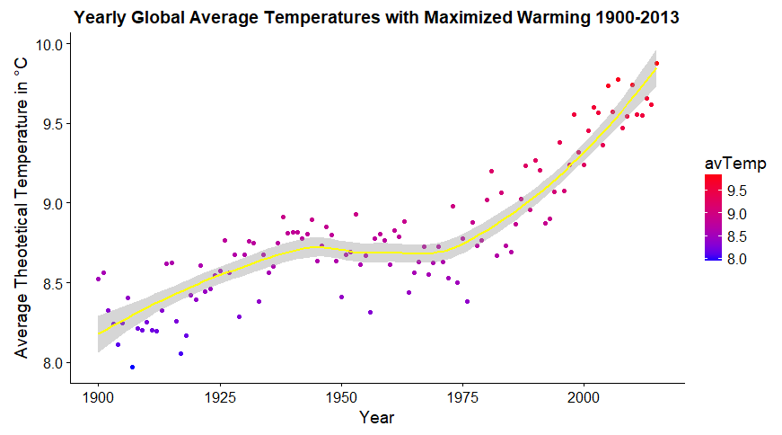
Global Temperature Analysis - Average with Maximized Warming (1900-2013)
Average Warming Rate: +1.07°C/100 years

Slide 26
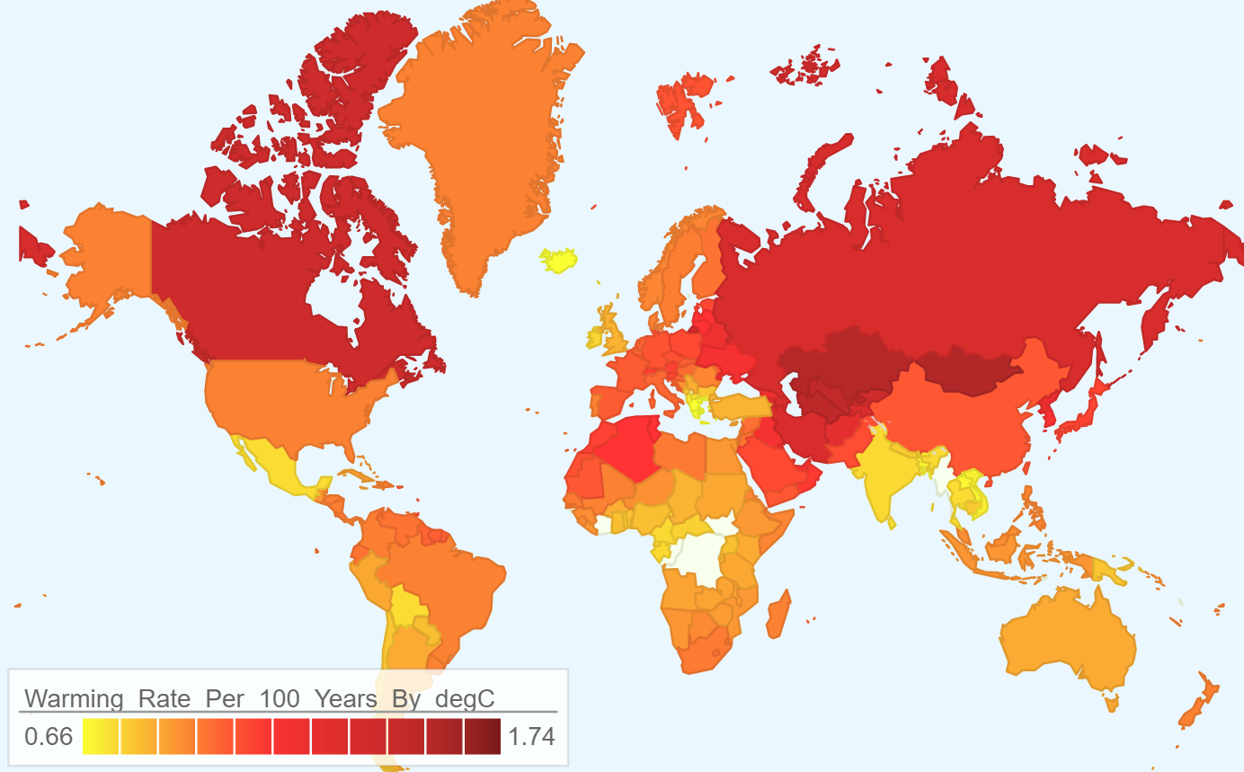
The Global Perspective Mean Heating Rate Per 100 Years by Country for 1900-2013
Created using googleVis package in R

Slide 27
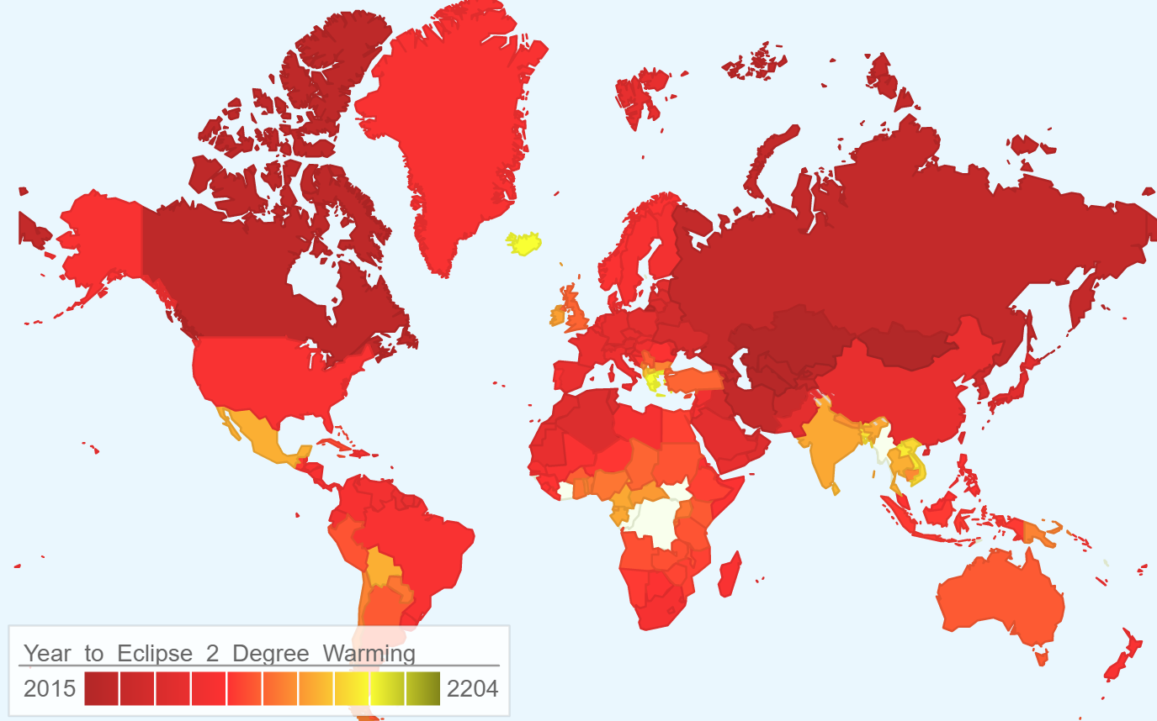
The Global Perspective Expected Year to Reach 2 Degrees Celsius Warming Using a Linear Rate of Warming from 1900
Average Year To Reach 2 Deg. Celsius Warming: 2104
Created using googleVis package in R

Slide 28
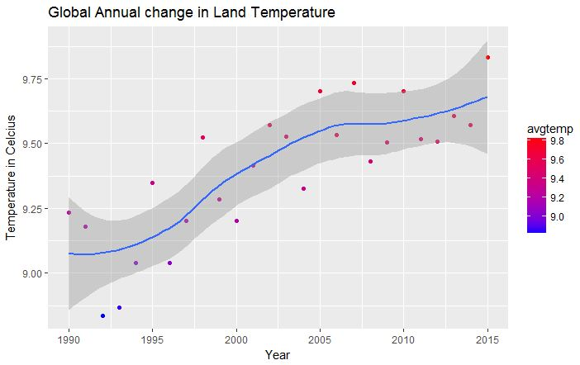
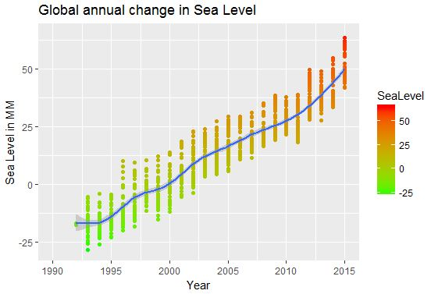
Correlated Trends In Global Warming Analyzing Sea-Level Change
Satellites Used: Topex, Jason #1, and Jason # 2
Sea level :
1993 -> (- 18mm)
2015 -> 45 mm

Slide 29
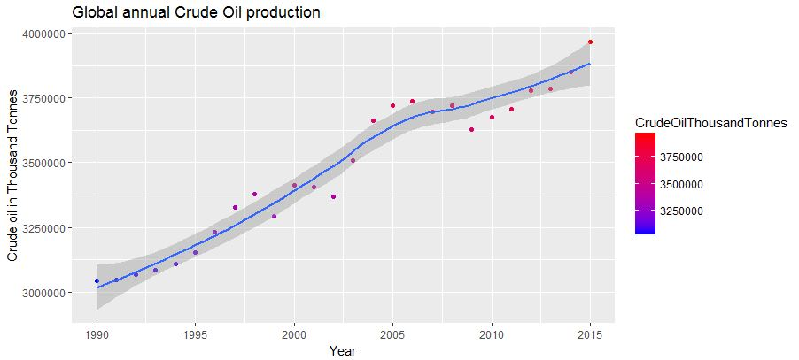
Correlated Trends In Global Warming Analyzing Crude Oil Production
Crude Oil Production :
1990 -> 3.04 M Thousand Tonne
2015 -> 3.90 M Thousand Tonne

Slide 30
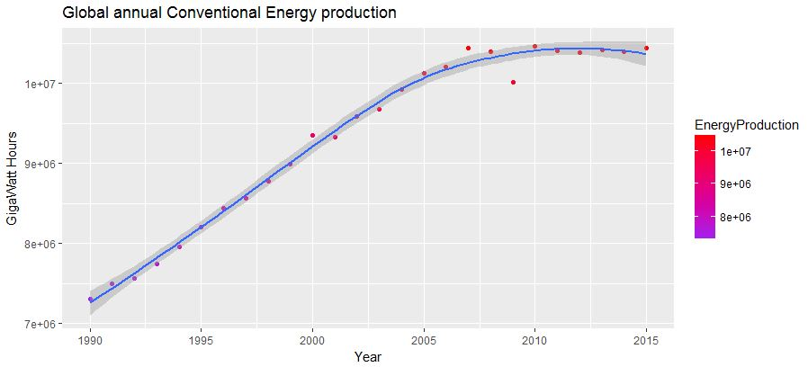
Correlated Trends In Global Warming Analyzing Conventional Energy Production
Conventional Energy Production :
1990 -> 7.30 M Giga Watts
2015 -> 10.44 M Giga Watts

Slide 31
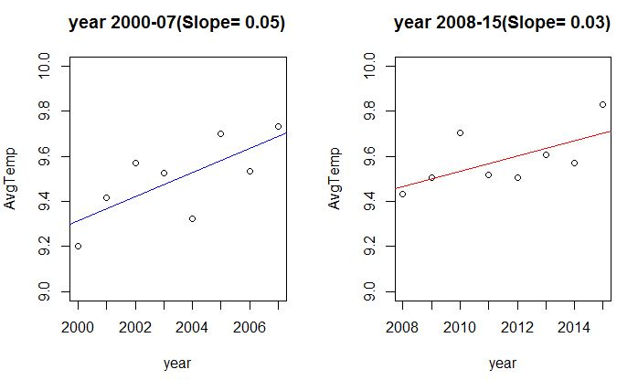
Correlated Trends In Global Warming Temperature Change rate

Slide 32
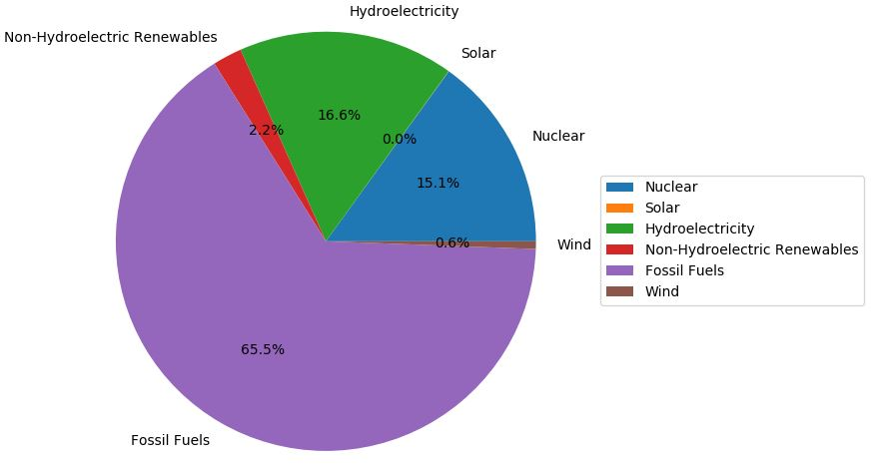
Correlated Trends In Global Warming Energy Sources 2005

Slide 33
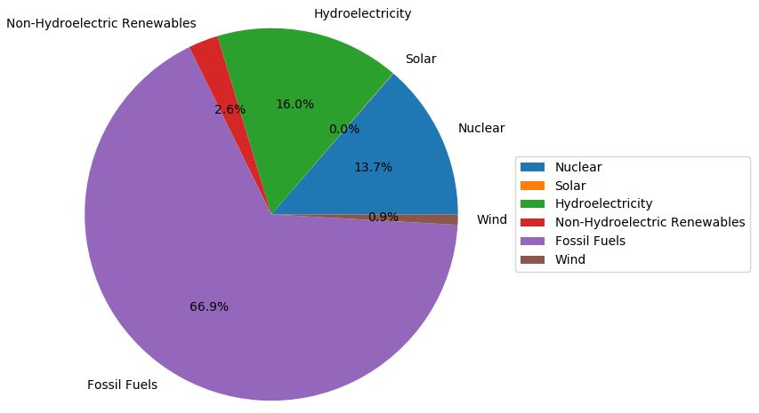
Correlated Trends In Global Warming Energy Sources 2007

Slide 34
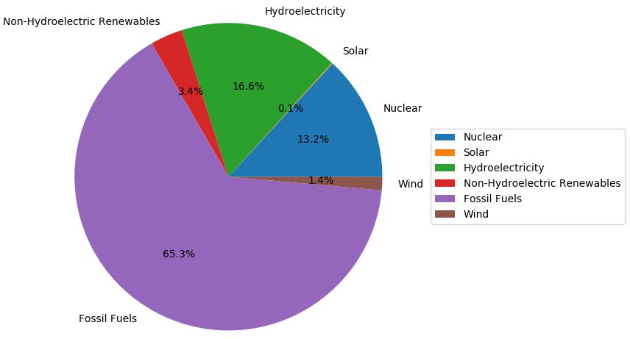
Correlated Trends In Global Warming Energy Sources 2009

Slide 35
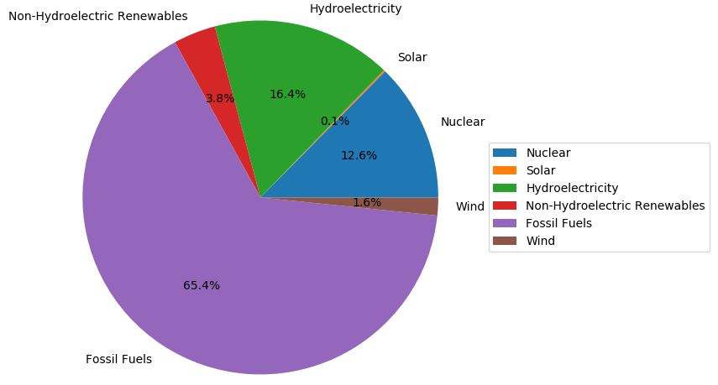
Correlated Trends In Global Warming Energy Sources 2010

Slide 36
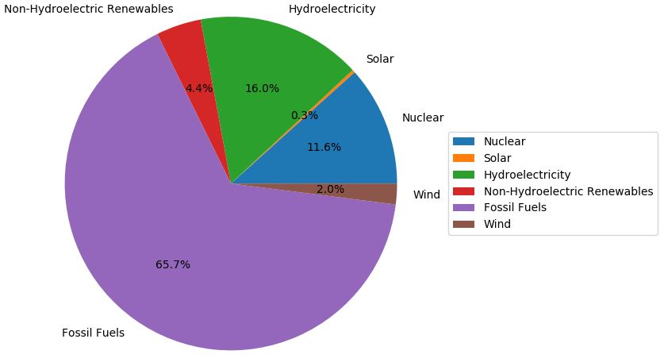
Correlated Trends In Global Warming Energy Sources 2011

Slide 37
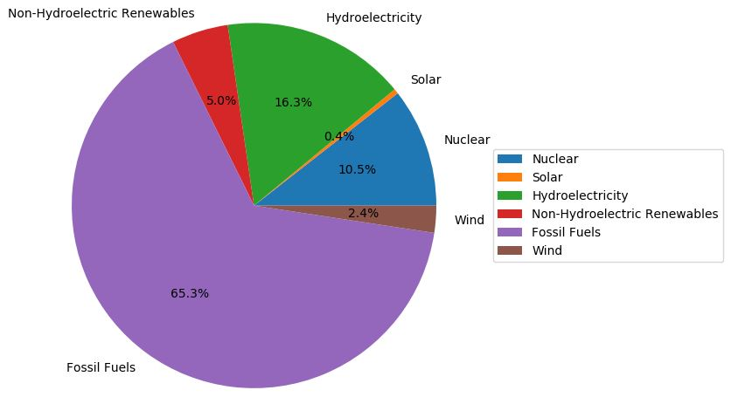
Correlated Trends In Global Warming Energy Sources 2012

Slide 38
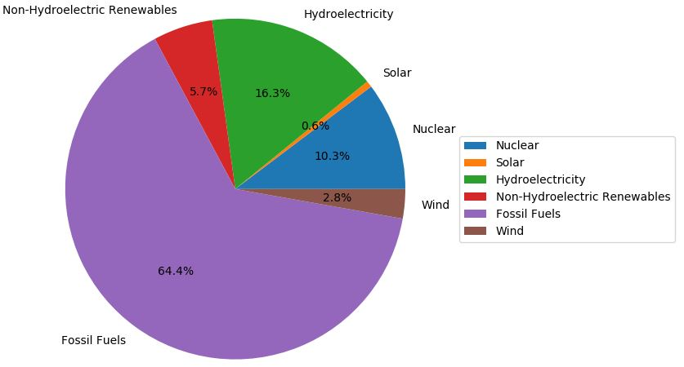
Correlated Trends In Global Warming Energy Sources 2013

Slide 39
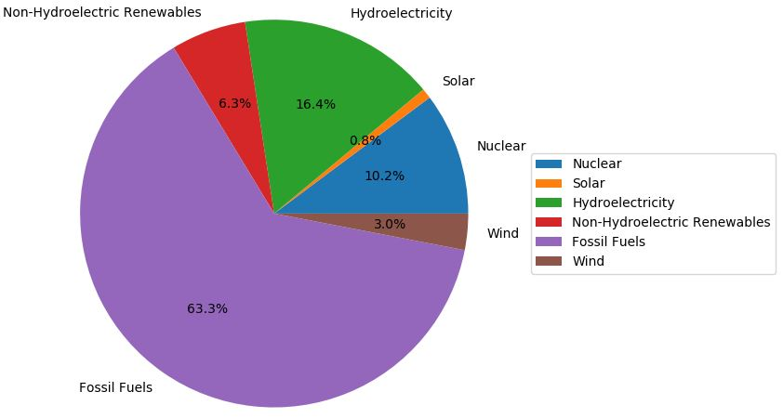
Correlated Trends In Global Warming Energy Sources 2014

Slide 40
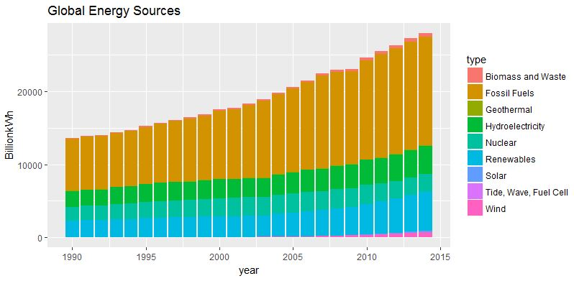
Correlated Trends In Global Warming Global Energy Sources

Slide 41
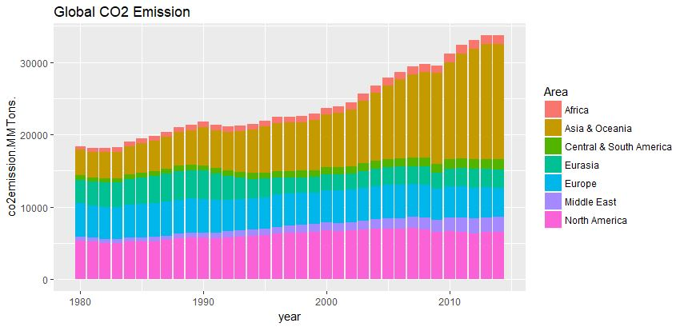
Correlated Trends In Global Warming Analyzing Global C02 Emission

Slide 42
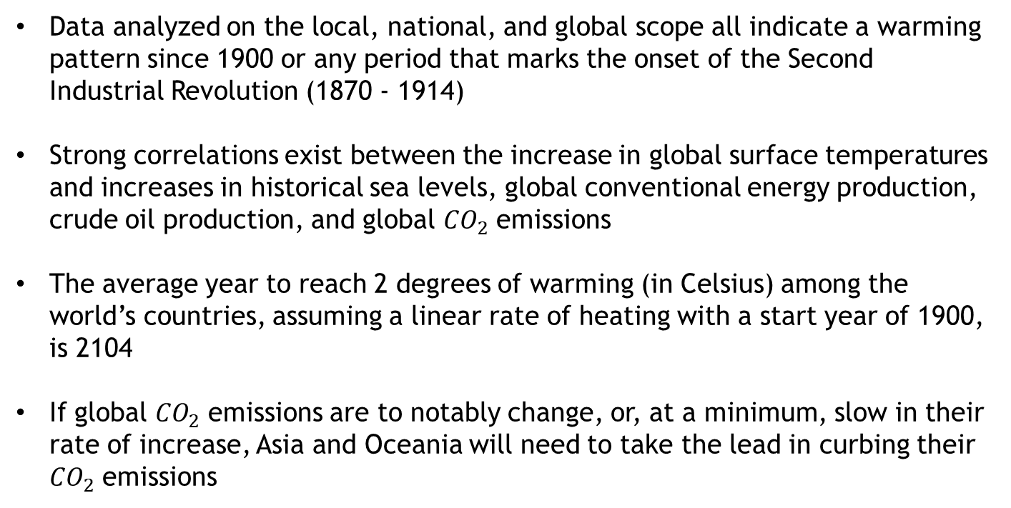
Conclusions
Data analyzed on the local, national, and global scope all indicate a warming pattern since 1900 or any period that marks the onset of the Second Industrial Revolution (1870 - 1914)
Strong correlations exist between the increase in global surface temperatures and increases in historical sea levels, global conventional energy production, crude oil production, and global ${CO}_{2}$ emissions
The average year to reach 2 degrees of warming (in Celsius) among the world’s countries, assuming a linear rate of heating with a start year of 1900, is 2104
If global ${CO}_{2}$ emissions are to notably change, or, at a minimum, slow in their rate of increase, Asia and Oceania will need to take the lead in curbing their ${CO}_{2}$ emissions

Slide 43
Prescriptive Measures
Support research initiatives that aim to determine the extent of warming in the coming century or more and probable consequences stemming from that warming so that efficient, actionable policy can be enacted with confidence
Support research initiatives that seek to find a cost-competitive, carbon-neutral alternative to conventional carbon-based fuels
Do your part, when feasible, to limit your activities that increase the amount of greenhouse gases (carbon dioxide included) that are emitted into the atmosphere as a result of those activities (also known as your carbon footprint)

Slide 44
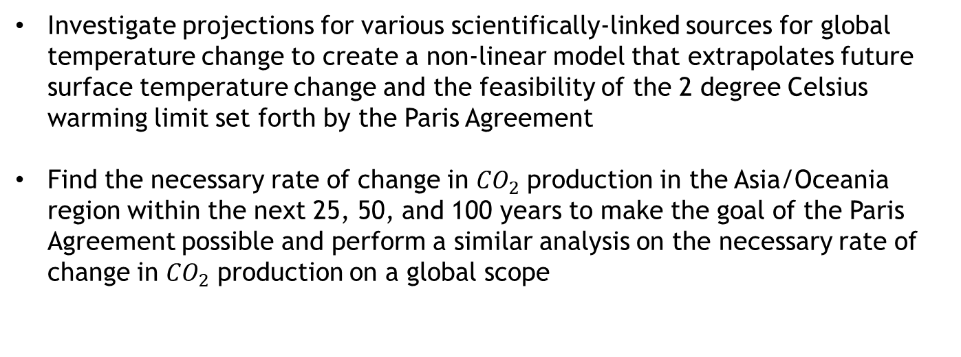
Further Research
Investigate projections for various scientifically-linked sources for global temperature change to create a non-linear model that extrapolates future surface temperature change and the feasibility of the 2 degree Celsius warming limit set forth by the Paris Agreement
Find the necessary rate of change in ${CO}_{2}$ production in the Asia/Oceania region within the next 25, 50, and 100 years to make the goal of the Paris Agreement possible and perform a similar analysis on the necessary rate of change in ${CO}_{2}$ production on a global scope

Slide 45
References
http://nca2014.globalchange.gov/report
https://climate.nasa.gov/scientific-consensus/
http://climatescience.oxfordre.com/view/10.1093/acrefore/ 9780190228620.001.0001/acrefore-9780190228620-e-367
https://www.kaggle.com/berkeleyearth/climate-change-earth-surface-temperature-data
https://www.star.nesdis.noaa.gov/sod/lsa/SeaLevelRise/index.php

